Slide 1


3D Structure from Jlab12 to EIC
Harut Avakian (JLab)
Transverse Momentum in Hadron Production
Non perturbative sea and k_{T}-distributions
Studies of TMD evolution from JLab12 to EIC
Accessing spin-orbit correlations in di-hadron production
Back to back production of hadrons in SIDIS
Summary

Slide 2
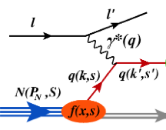

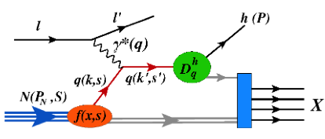
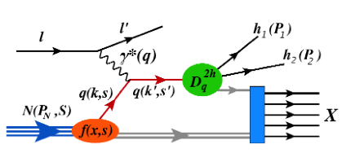
QCD: from testing to understanding
0h DIS
Testing stage:
pQCD predictions, observables in the kinematics where theory predictions are easier to get (higher energies, 1D picture, leading twist, current fragmentation, IMF)
parton distributions
hadronization
nucleon in 3D
strong interactions
&
quark gluon dynamics
evolution,
factorization
1h SIDIS/DVMP
quark-gluon correlations
Understanding stage:
non-perturbative QCD, strong interactions, observables in the kinematics where most of the data is available (all energies, quark-gluon correlations, orbital motion)
spectroscopy,
excited states
spin-orbit correlations
target fragmentationentanglement
2h SIDIS/DVMP
production in SIDIS provides access to correlations inaccessible in simple SIDIS (BEC,dihadron fragmentation , correlations of target and current regions, entanglement....)
Notes:
DIS proved to be a great tool in testing of the theory of strong interactions, which was a major focus in last decades. SIDIS, with detection of an additional hadron allowed first studies of of 3D structure, moving the main focus to understanding of strong interactions and quark gluon dynamics to address a number of puzzles accumulated in recent years. Detection of 2 hadrons, which is obviously more complicated provides access to even more details of quark gluon interactions Bose-Einstaein Correlations

Slide 3
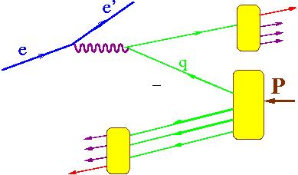
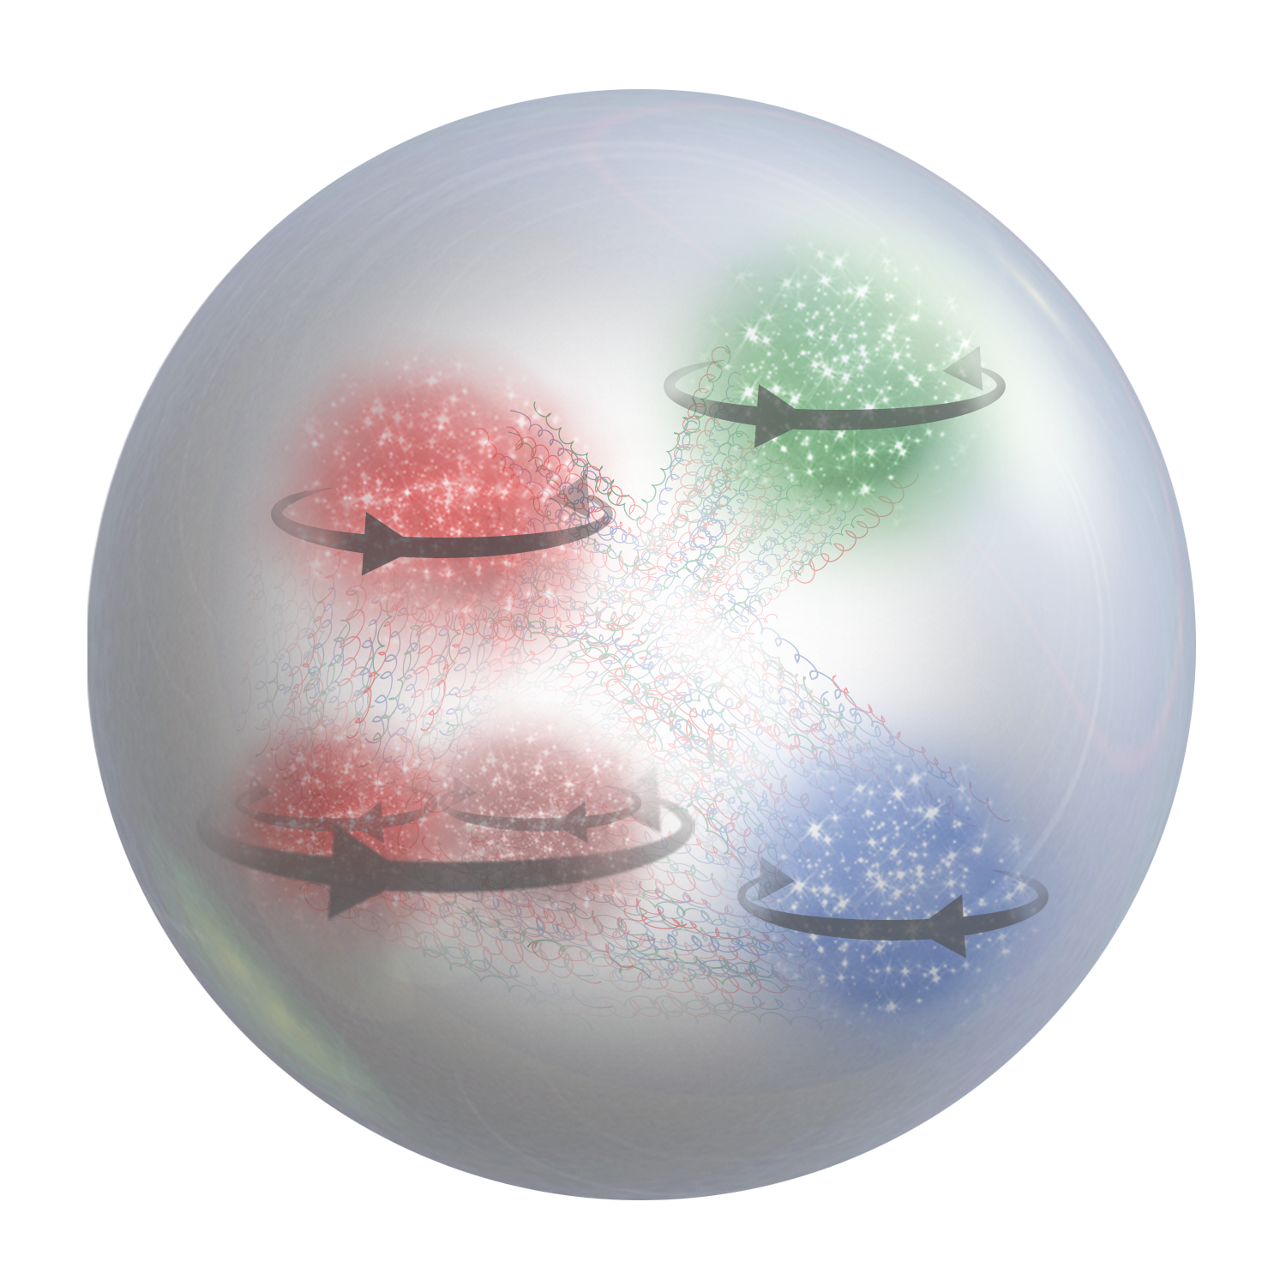
Hadron production in hard scattering
x_{F}>0 (current fragmentation)
X. Artru & Z. Belghobsi
h
L
FSI
x_{F}<0 (target fragmentation)
2-hadron correlations in CFR studied in EMC(1986) and COMPASS(2015)
Karliner, Kharzeev , Ellis & Kotzinian
Strikman,Weiss & Schweitzer
Anselmino, Barone, Kotzinian
x_{F} - momentum in the CM frame
L
Correlations of the spin of the target or/and the momentum and the spin of quarks, combined with final state interactions define the azimuthal distributions of produced particles

Slide 4
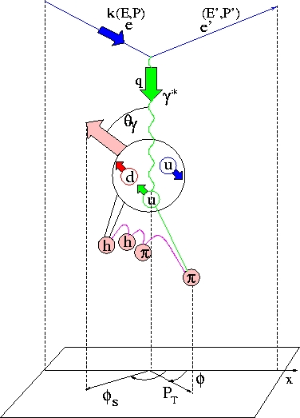
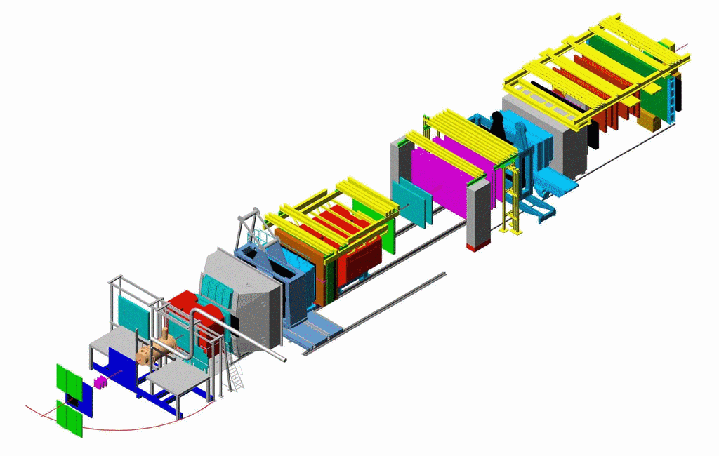



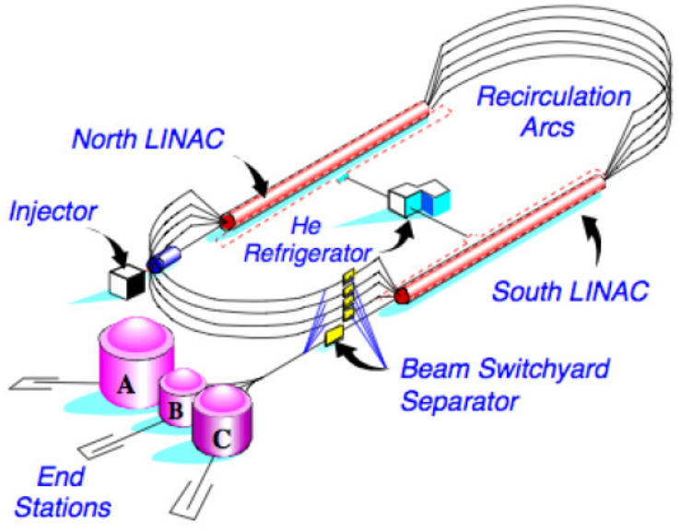



SIDIS kinematical plane and observables
Polarised Target
y
x
μ beam
z
z
EIC
corrections for the region of large kT~Q
beam polarization
target polarization

Slide 5
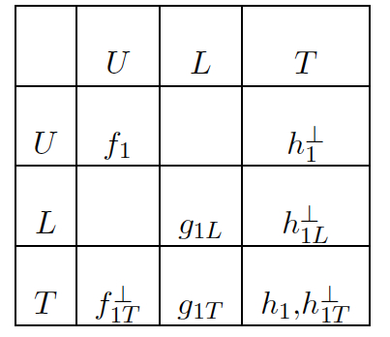
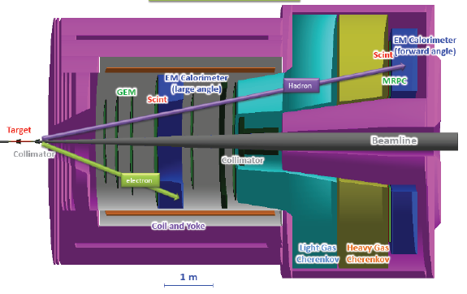
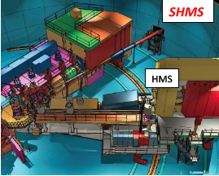
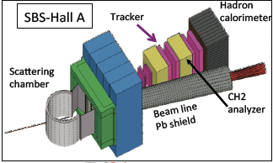
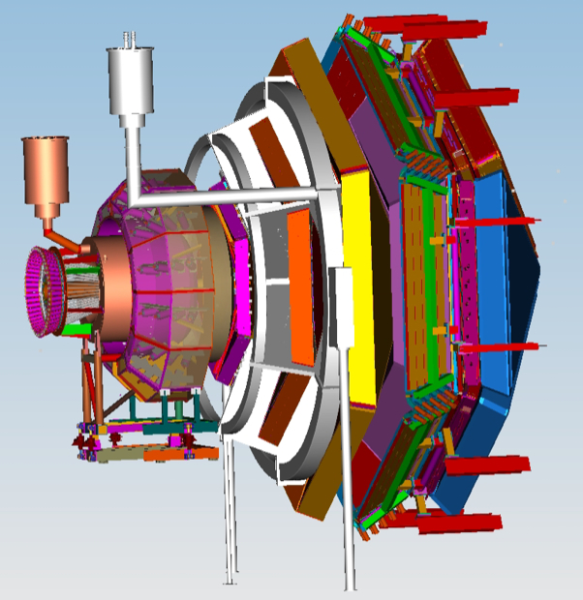
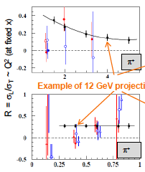
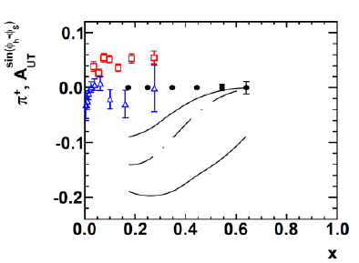
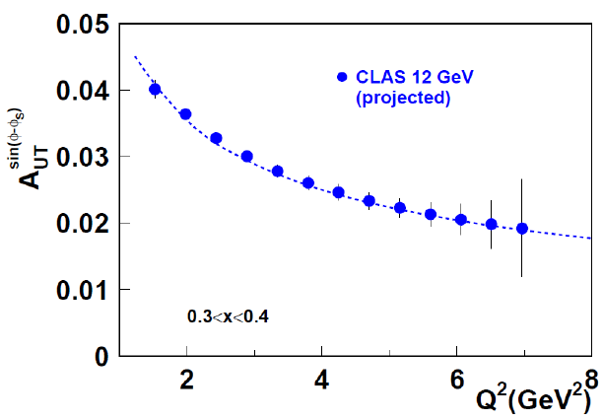
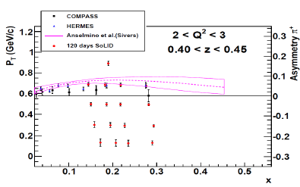
SIDIS at JLab12
π
Complementary measurements with different targets
CLAS12
SOLID
E12-09-018
Combination of high resolution measurements from spectrometers combined with large acceptance data from CLAS12 and SOLID would allow to pin down all TMDs in the valence region
Notes:
Hall C requires three superconducting quadrupole magnets (Q1, Q2, and Q3), an HB dipole and a superconducting dipole magnet for the Super High Momentum Spectrometer (SHMS) to be installed within its Continuous Electron Beam Accelerator Facility (CEBAF).

Slide 6
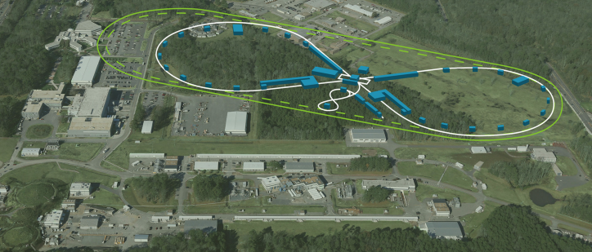
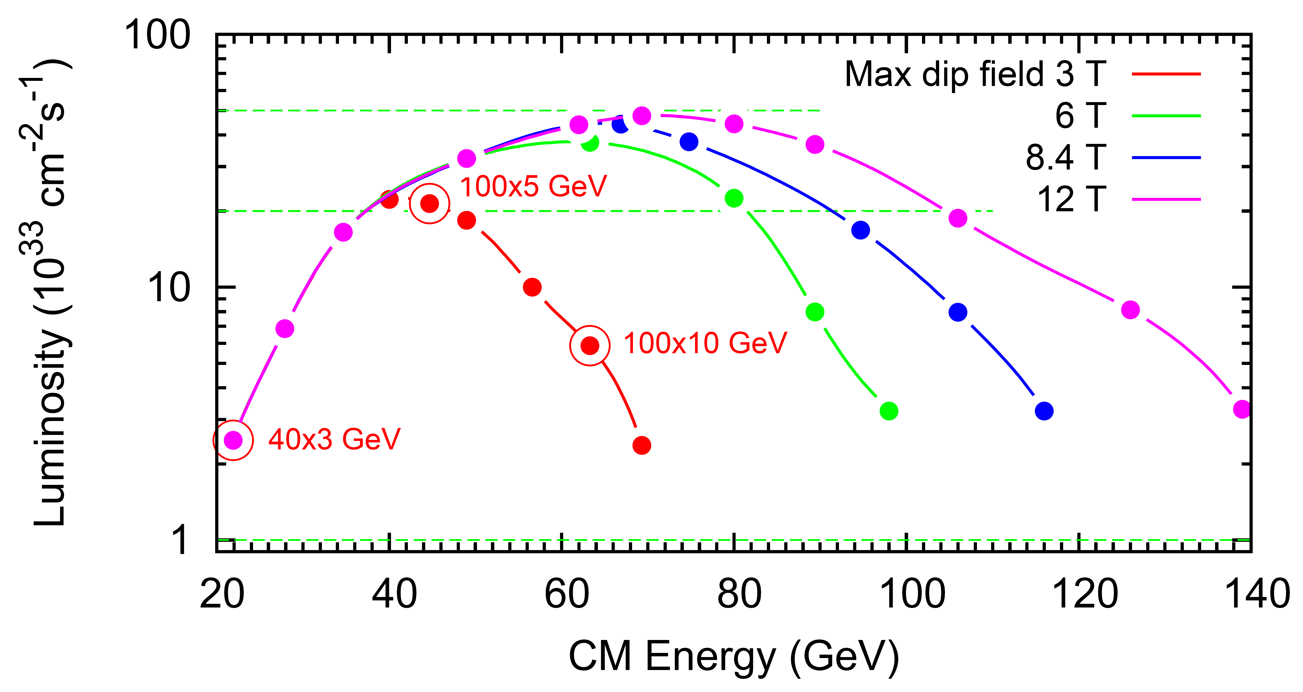
JLEIC energy reach and luminosity
10³⁵
LHC magnets →
energy range:
E_{e}: 3 to 12 GeV
E_{p}: 40 to 100 GeV
√s: 20 to 65 GeV
(upper limit depends on magnet tech. choice)
Luminosity (cm⁻²s⁻¹)
10³⁴
Electron complex
  CEBAF
  Electron collider ring
Ion complex
  Ion source
  SRF linac
  Booster
  Ion collider ring
10³³

Slide 7
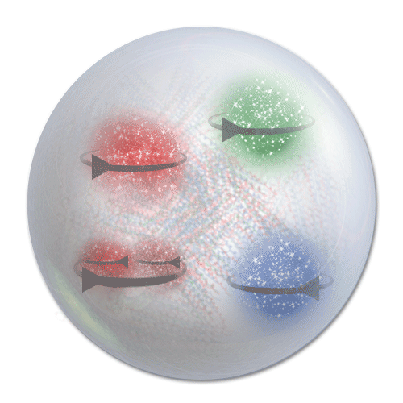
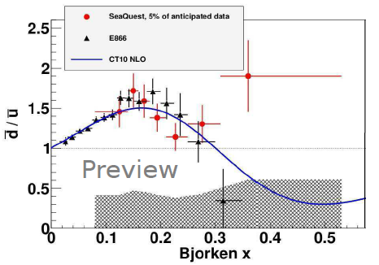
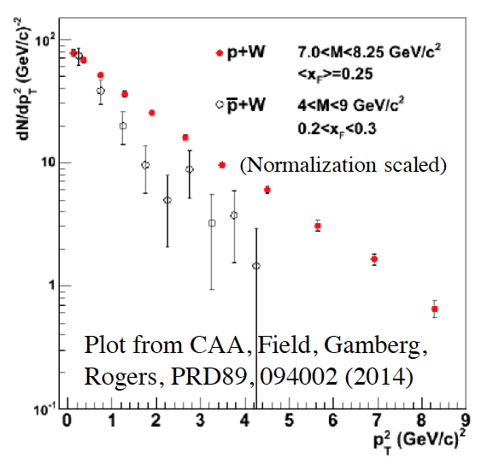
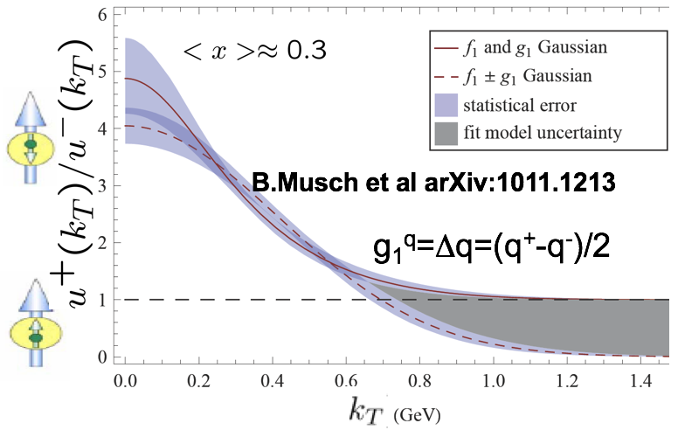
Non-perturbative distributions
L
Non-perturbative sea in nucleon is a key to understand the nucleon structure
-- Large flavor asymmetry as evidence
provides a hint for region where non-perturbative effects will be significant
Predictions from dynamical model of chiral symmetry breaking [Schweitzer, Strikman, Weiss JHEP 1301 (2013) 163]
-- k_{T} (sea) >> k_{T} (valence)
-- short-range correlations between partons (small-size q-qbar pairs)
-- directly observable in P_{T}-dependence of hadrons in SIDIS
spin and momentum of struck quarks are correlated with remnant
correlations of spins of q-q-bar with valence quark spin and transverse momentum will lead to observable effects

Slide 8
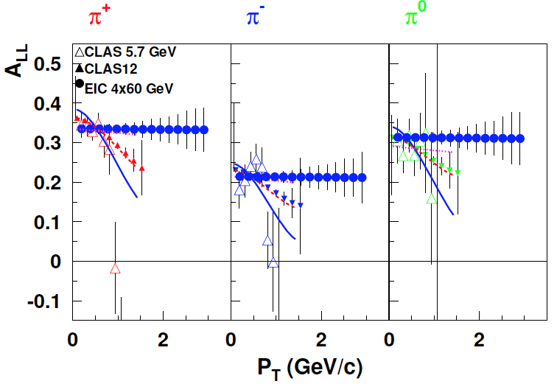
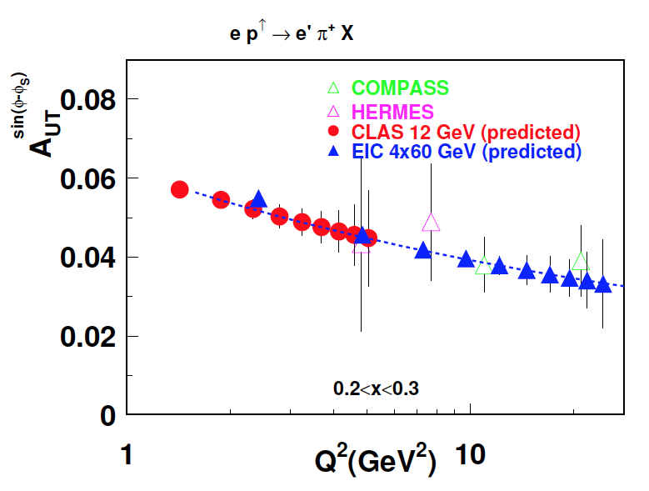
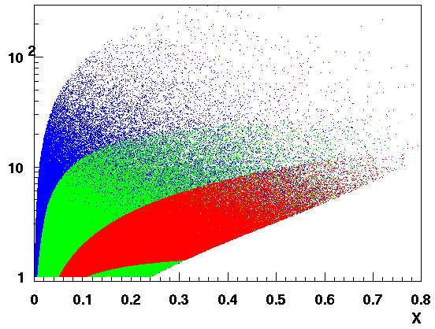
Evolution and k_{T}-dependence of TMDs
Q²
Aybat, Prokudin & Rogers
C12-11-111
C12-11-111
JLEIC 4x60
EIC@HIAF
Aybat, Prokudin & Rogers
JLab12
CLAS12/EIC kinematical coverage
k_{T}-dependence of
Q²-dependence of Sivers,
Large acceptance of CLAS12 allows studies of P_{T} and Q²-dependence of SSAs in a wide kinematic range
Comparison of JLab12 data with HERMES, COMPASS and EIC will pin down transverse momentum dependence and the non-trivial Q² evolution of TMD PDFs in general, and Sivers function in particular.

Slide 9
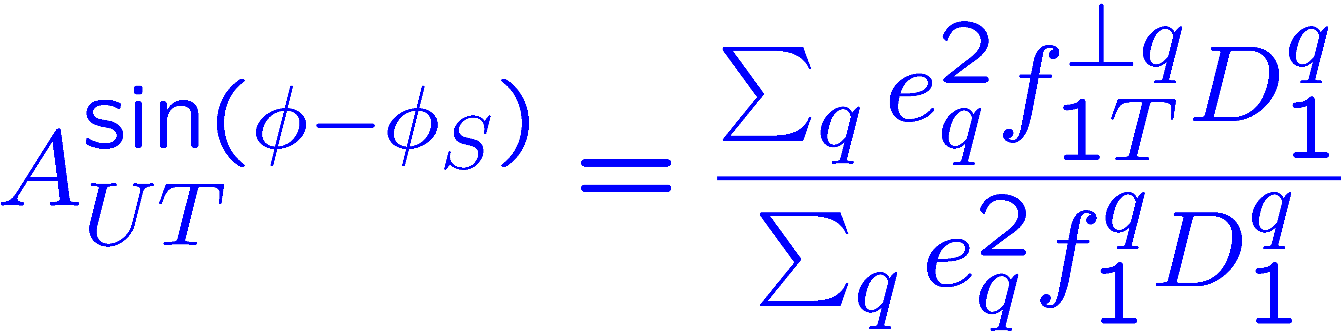
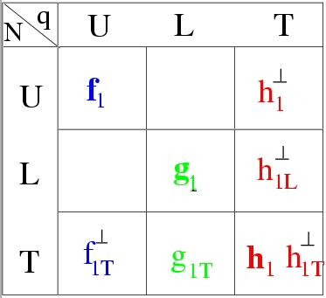

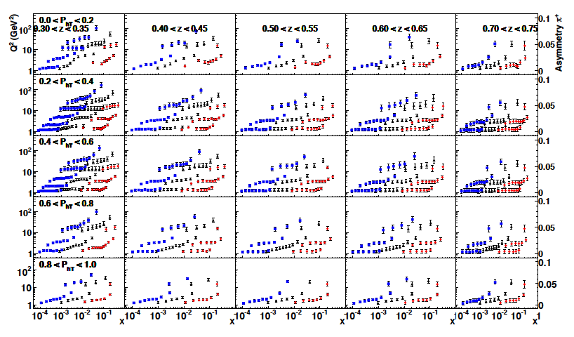
Sivers effect: π+ from EIC
√s = 140 GeV, √s = 50 GeV and √s = 15 GeV EIC configurations, respectively. Event counts correspond to an integrated luminosity of 30 fb−1
arXiv:1108.1713
Large acceptance and energy range of EIC makes it ideal place to study the contributions of sea quarks to Sivers asymmetry
Lower energies provide wider x-range for region where non-perturbative effects are significant, and overlap with JLab12
Notes:
X10 less will be fine, if Sivers and FUU behave as Prokudin’s parameterization and all systematics coming from unaccounted moments, radiative corrections and so on is smaller than statistical errors. But what if not?

Slide 10
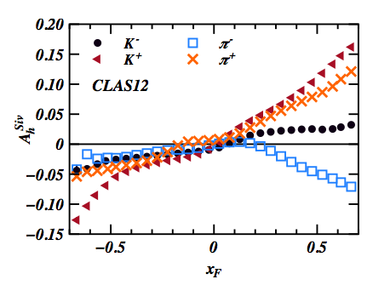
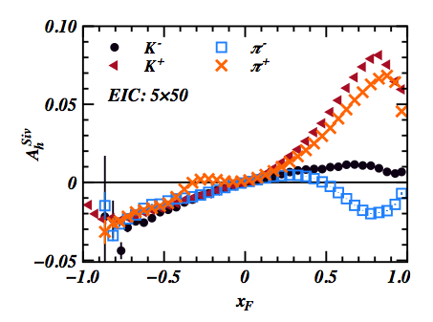
Sivers effect in Target fragmentation
P₁
H. Matevosyan et al.
arXiv:1502.02669
P₂
Wide coverage of CLAS12 and EIC will allow studies of kinematic dependences of the Sivers effect, both in current and target fragmentation regions

Slide 11
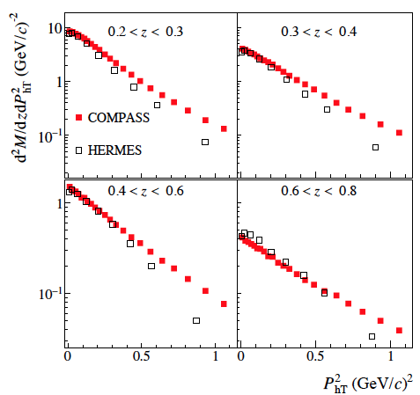
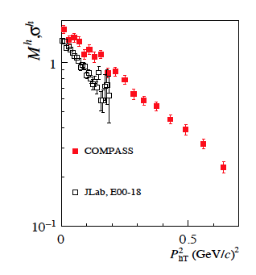
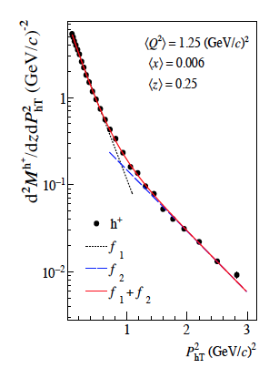
Multiplicities of hadrons in SIDIS
COMPASS:1709.07374
Lower the beam energy, less phase space for high P_{T}
P_{T}-weighting may be hard to control
What is the origin of the tail?
Is there a problem with the perturbative part (Sato) or with high P_{T}-part of TMD?

Slide 12
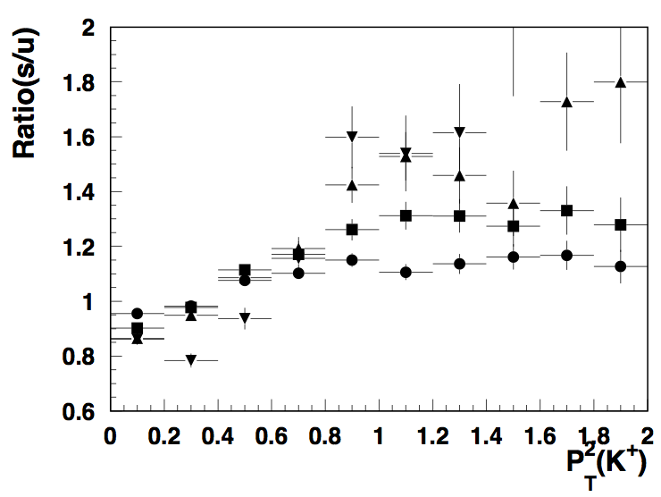
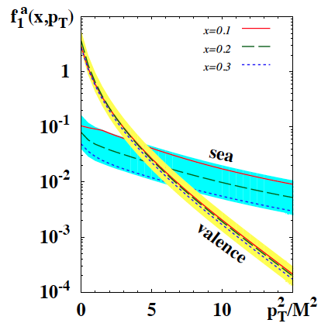
P_{T}-distributions of Kaons from s and u quarks
EIC 5x50: PYTHIA
z>0.5
P.Schweitzer et al. arXiv:1210.1267
z>0.1
0 0.5 1.0
Increase the <k_{T}> in PYTHIA (no orbital effects accounted)
At relatively large x (x>0.01), where non perturbative sea start to dominate significant fraction of Kaons may come from s-quarks
Additional control possible by detection of target fragments

Slide 13
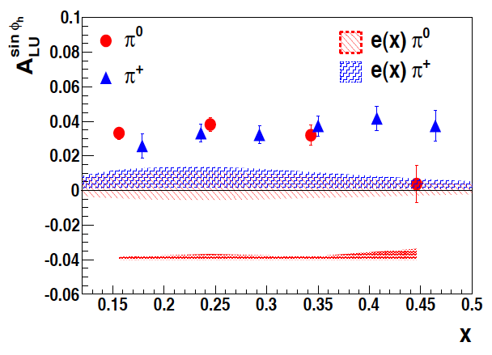
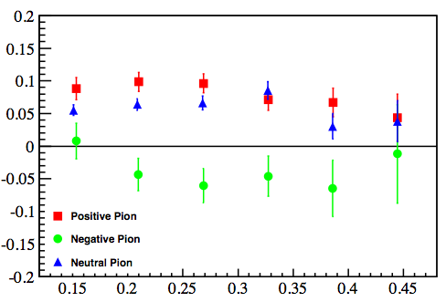
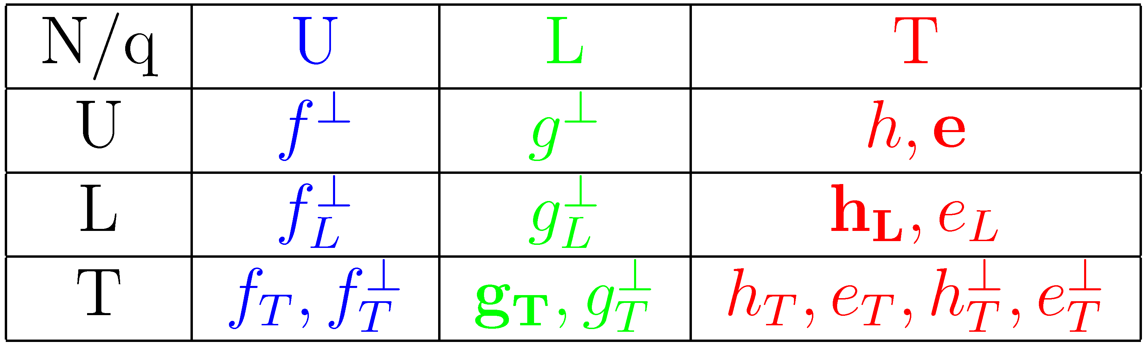
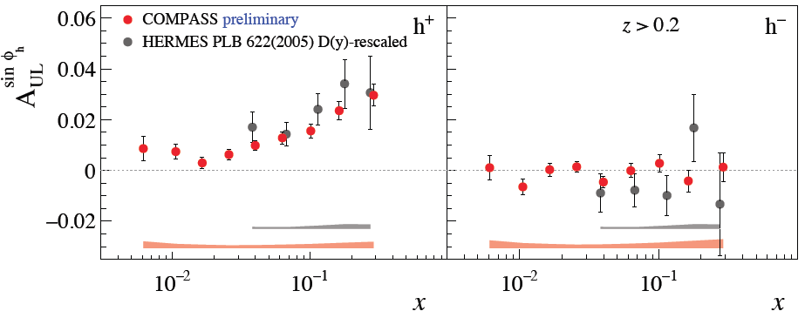
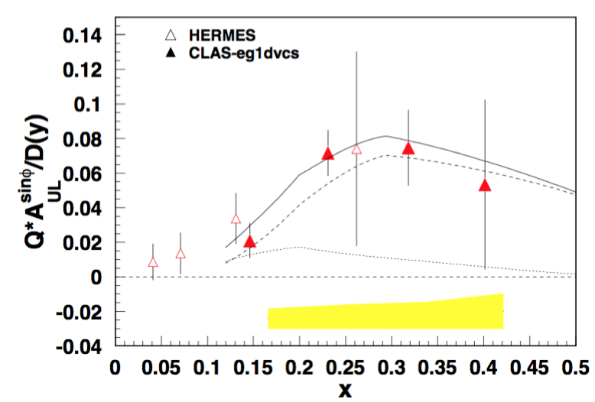
Quark-gluon correlations: flavor dependence
Higher Twist PDFs
roughly equal π⁺π⁰ SSA
π⁻ SSA much smaller, consistent with 0 or<0
CLAS/HERMES
arXiv:1709.10054
collins contribution
Significant longitudinal beam and target SSA measured at HERMES, JLab and COMPASS may be related to higher twist distribution functions
sinφ modulations for π⁺π⁰ consistent with dominance of Sivers mechanism
Subleading asymmetries comparable with leading ones (1/Q terms should be accounted)
Notes:
Lorenz invariant amplitudes

Slide 14
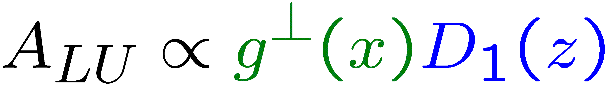
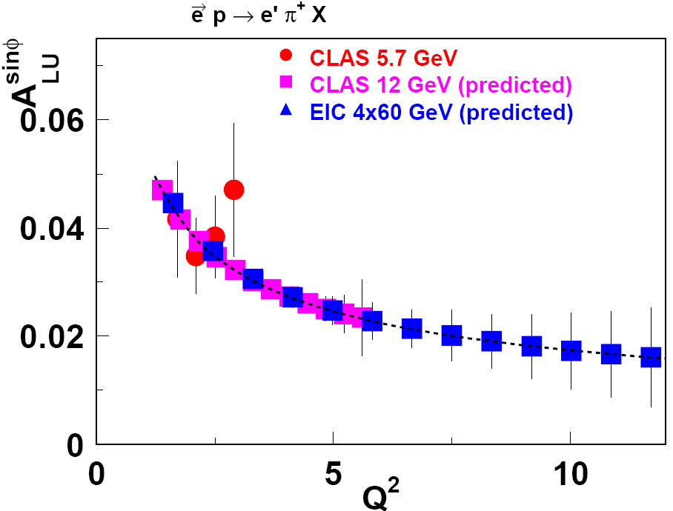
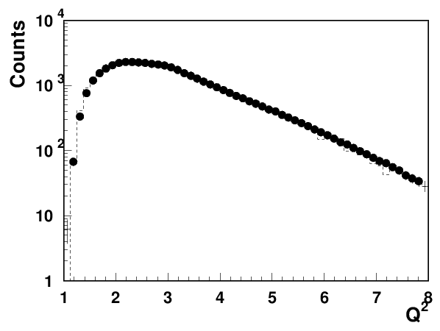
From JLab12 to EIC
JLab@12GeV (25/50/75)
0.1<x_{B}<0.7 : valence quarks
EIC √s = 140, 50, 15 GeV
10⁻⁴<x_{B}<0.3: gluons and quarks, higher P_{T} and Q².
CLAS12 (2018 Spring) vs MC
Understanding of quark-gluon correlations is crucial for precision studies of the structure of the nucleon.
At medium energies all experiments measure very significant HT contributions
Large HT effects may indicate the breakdown of the theory
Overlap of EIC and JLab12 in the valence region will be crucial for the TMD program

Slide 15
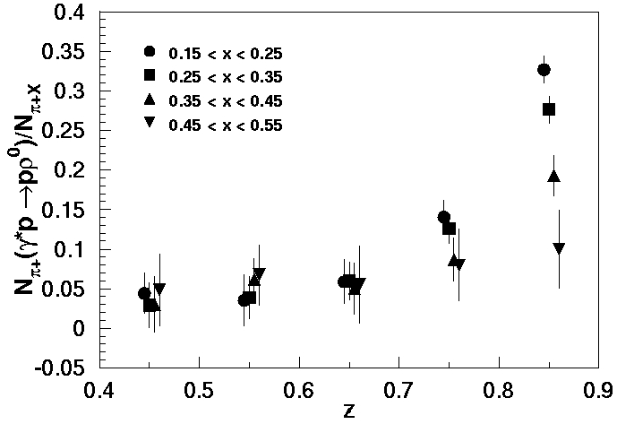
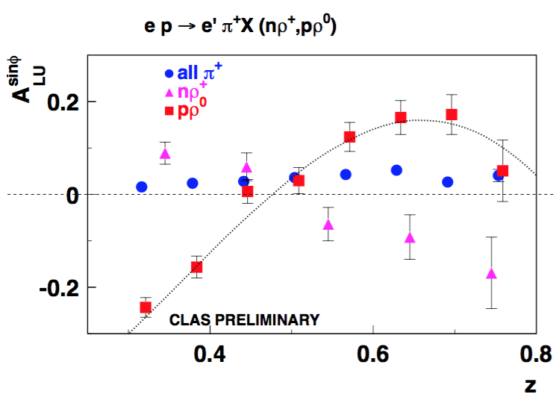
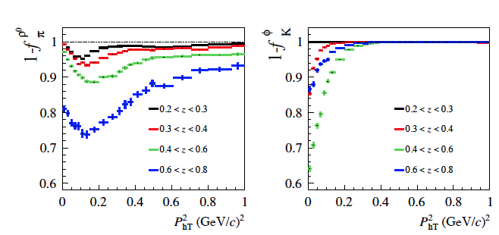
The role of vector mesons and dihadrons in SIDIS
Should we worry about pions/kaons coming from vector meson decays?
What about ρ+ and ρ-
What do we know about relevant observables for pions specifically coming from vector meson decays
What about SIDIS rhos (can we measure?)
What is radiative correction due to rho?
Vector meson as resonance in dihadron production?
COMPASS:1709.07374
π⁺π⁰
π⁺π⁻
Fraction of dihadrons should be significantly higher at EIC!

Slide 16
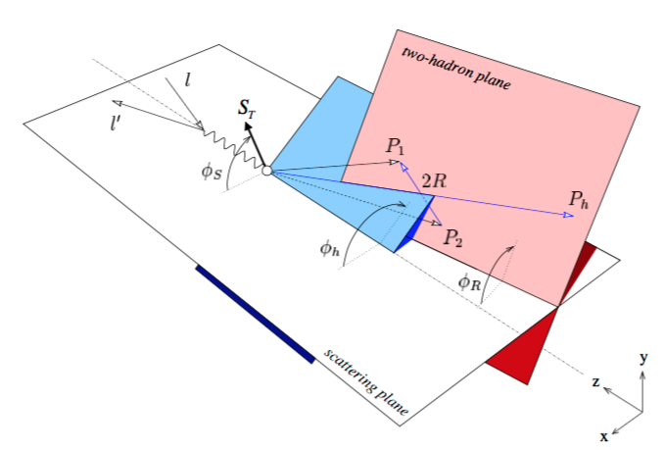
Correlated hadron production in hard scattering
2 hadrons in current fragmentation
hadrons in current & target fragmentation
With φ_{S}, φ₁, φ₂, φ_{R}, φ_{h} several observables have been identified to study correlations
φ_{R}−φ_{S}, φ_{R} -accessing transversity and quark-gluon correlations Radici & Bacchetta
φ_{R}−φ_{h} -accessing leading twist polarized fragmentation functions Matevosyan,Kotzinian,Thomas
φ₁−φ₂ -accessing correlations in current and target regions Anselmino, Barone, Kotzinian
Some dihadron proposals approved by Jlab PAC with high ratings, more to come
Notes:
{\cal{F}}_{LU}^{\sin(\phi_1-\phi_2)}=\frac{\mid\vec{P}_{1\perp}\vec{P}_{2\perp}\mid}{m_Nm_2} {\cal{C}}[w_5M_L^{\perp,h}D_1]

Slide 17
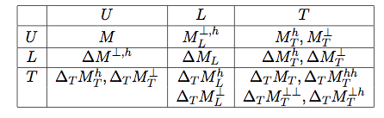
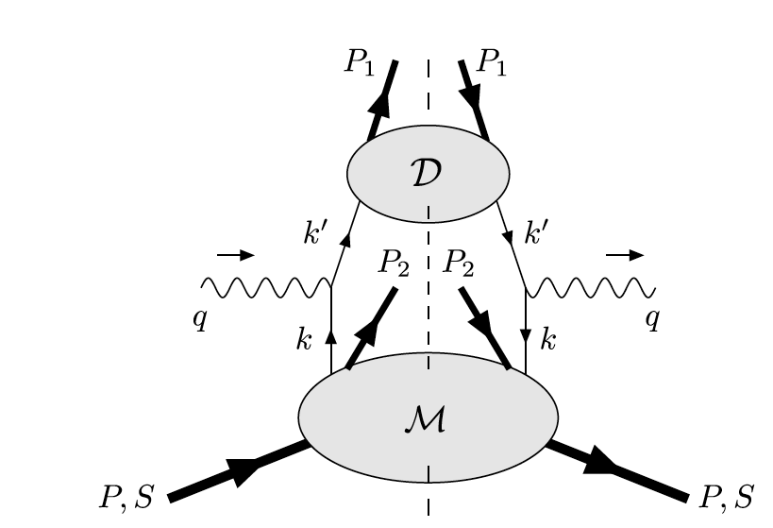
Back-to-back hadron (b2b) production in SIDIS
P₁
Leading Twist
M. Anselmino, V. Barone and A. Kotzinian, Physics Letters B 713 (2012)
P₂
The beam–spin asymmetry appears, at leading twist and low transverse momenta, in the deep inelastic inclusive lepto-production of two hadrons, one in the target fragmentation region and one in the current fragmentation region.
Back-to-back hadron production in SIDIS would allow:
study SSAs not accessible in SIDIS at leading twist
measure fracture functions
control the flavor content of the final state hadron in current fragmentation (detecting the target hadron)
study entanglement in correlations in target vs current
access quark short-range correlations and χSB (Schweitzer et al)
...
probability to produce the hadron h when a quark q is struck in a proton target
Notes:
{\cal{F}}_{LU}^{\sin(\phi_1-\phi_2)}=\frac{\mid\vec{P}_{1\perp}\vec{P}_{2\perp}\mid}{m_Nm_2} {\cal{C}}[w_5M_L^{\perp,h}D_1]

Slide 18




B2B hadron production in SIDIS: First measurements
M. Anselmino, V. Barone and A. Kotzinian, Physics Letters B 713 (2012)
CLAS PRELIMINARY
Single spin symmetries observed by CLAS at 6 GeV increase at large x and P_{T}
Notes:
{\cal{F}}_{LU}^{\sin(\phi_1-\phi_2)}=\frac{\mid\vec{P}_{1\perp}\vec{P}_{2\perp}\mid}{m_Nm_2} {\cal{C}}[w_5M_L^{\perp,h}D_1]

Slide 19





Target fragmentation region: Λ production
CLAS12
polarization transfer coefficient
EIC4x60
60 days of CLAS12
Large acceptance of CLAS12 and EIC provide a unique possibility to study the nucleon structure in target fragmentation region
First measurements already performed using the CLAS data at 6 GeV.

Slide 20







e
e’
X
Lambda production in EIC (5x50 GeV)
π
p
K
black e−
red K+
blue p (from Λ) magenta π-(from Λ)
black Λ
red p
green π-
most of the Λs in the target fragment
exclusive
Λ
At forward angles Lambdas are mainly from target fragments

Slide 21


b2b distributions: EIC 5x50 (proton-pion)

Slide 22
Summary
Understanding the dynamics of partons in general, and non perturbative sea, in particular, will be crucial for understanding of strong interactions
Studies of the nucleon structure beyond the traditional leading twist and current fragmentation, provides qualitatively new tools to study the nucleon structure.
Di-hadron production in SIDIS provides access to correlations inaccessible in simple SIDIS, opening a new avenue for QCD studies
Large acceptance of the EIC combined with clear separation of target and current fragmentation regions provide a unique possibility to study the nucleon structure in target fragmentation region and correlations of target and current fragmentation regions
Overlap in kinematics with JLab12 will be critical for interpretation of JLab12 data
Thanks !!!

Slide 23
Support slides

Slide 24




EIC 5x50 GeV: Kinematic distributions of Lambdas and Kaons
η_{p}
η_{p}
η_{π−}
η_{K+}
z>0.5
z>0.1

Slide 25







EIC 4x60 (Lumi 10³³,cm⁻²sec⁻¹ , ~1 hour)
<x>=0.1, <Q²>=4
σ(p) = 0.05 + 0.06*p [GeV] %
K*s can be studied with EIC
Notes:
The main goal is to observe…
There may be a significant contribution from perturbatively generated kT.
The idea of Schweitzer and Co is to isolate the non singlet sea…
Singlet grow faster at small x
Small x and large Q^2 the radiative contribution may be dominant..

Slide 26
Kaon production in SIDIS
FAST-MC
CLAS12
Λ
Σ
Σ∗
EIC4x60
detected
σ(p) = 0.05 + 0.06*p [GeV] %
Identification using the missing mass may be possible

Slide 27

Sivers effect: π+ from EIC
√s = 140 GeV, √s = 50 GeV and √s = 15 GeV EIC configurations, respectively. Event counts correspond to an integrated luminosity of 30 fb−1
arXiv:1108.1713
Large acceptance and energy range of EIC makes it ideal place to study the contributions of sea quarks to Sivers asymmetry
Lower energies provide wider x-range for region where non-perturbative effects are significant, and overlap with JLab12

Slide 28

CLAS12: Evolution and k_{T}-dependence of TMDs
Q²
Aybat, Prokudin & Rogers
C12-11-111
C12-11-111
JLEIC
Aybat, Prokudin & Rogers
JLab12
CLAS12 kinematical coverage
k_{T}-dependence of
Q²-dependence of Sivers,
Large acceptance of CLAS12 allows studies of P_{T} and Q²-dependence of SSAs in a wide kinematic range
Comparison of JLab12 data with HERMES, COMPASS and EIC will pin down transverse momentum dependence and the non-trivial Q² evolution of TMD PDFs in general, and Sivers function in particular.

Slide 29



Target Fragmentation
x_{F}>0 (current fragmentation)
h
h
M
x_{F}<0 (target fragmentation)
PDF
LEPTO: 11 GeV
Fracture Functions: probabilities to produce the hadron h when a quark q is struck in a proton target
Hadrons produced in target fragmentation may be correlated with hadrons in the current fragmentation and their studies will be important for precision studies in current fragmentation.

Slide 30

Is it related to non-perturbative sea?

Slide 31

Target fragmentation region: Λ production
polarization transfer coefficient
L
probability to produce the hadron h
when a quark q is struck in a proton target
Measurements of fracture functions opens a new avenue in studies of the structure of the nucleon in general and correlations between current and target fragmentation in particular
60 days of CLAS12
Large acceptance of CLAS12 and EIC provide a unique possibility to study the nucleon structure in target fragmentation region
First measurements already performed using the CLAS data at 6 GeV.

Slide 32





Dihadron asymmetries from CLAS
DVMP (GPDs)
SIDIS (TMDs)
S. Anefalos Pereira
Dihadron double spin asymmetry measured at 6 GeV consistent with DIS
CLAS Preliminary

Slide 33

JLEIC energy reach and luminosity
10³⁵
LHC magnets →
Luminosity (cm⁻²s⁻¹)
10³⁴
10³³

Slide 34



Dihadron production at JLAB12
Use the clasDIS (LUND based) generator + FASTMC
to study hh pairs
CLAS12
SoLID
x_{F} - momentum in the CM frame
π
Λ
Dihadron sample defined by SIDIS cuts + x_{F}>0 (CFR) and x_{F}<0 (TFR) for both hadrons
Wide angular coverage is important

Slide 35






Accessing transversity in dihadron production at JLab
Measurements with polarized protons
Measurements with polarized neutrons
CLAS12
SoLID
Bacchetta, Radici

Slide 36



Quark distributions at large k_{T}
bigger effect at large z
P_{T} = p┴ +z k_{T}
Higher probability to find a hadron at large P_{T} in nuclei
k_{T}-distributions may be wider in nuclei?
36

Slide 37



b2b SSAs

Slide 38


b2b distributions: EIC 5x50 (Lambda-pi)

Slide 39



b2b distributions: CLAS12(Lambda-pion)

