Slide 1
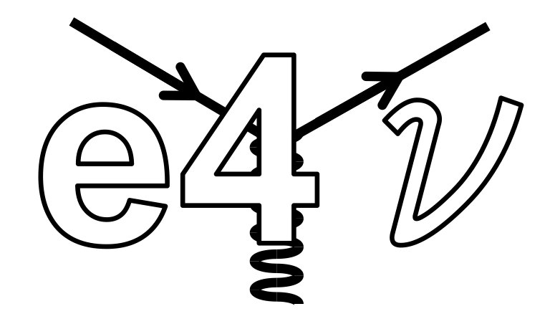
Electron-scattering constraints for neutrino-nucleus interactions
Lawrence Weinstein
Old Dominion University
NUSTEC 2019

Slide 2

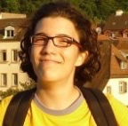


Collaboration
Old Dominion University
MIT
Jefferson Lab
Tel Aviv U
Michigan State
FermiLab
Pitt
York University, UK
Mariana Khachatryan
(ODU)
Afroditi Papdopolou (MIT)
Adi Ashkenazi (MIT)
Florian Hauenstein
(ODU)
+ Minerba Betancourt (FNAL)
+ Lucas Tracy (ODU)

Slide 3
Outline
Why electrons?
  Nuclear Physics
Current work
  Zero pion channel (updated)
  One pion channel (new)
Future plans

Slide 4
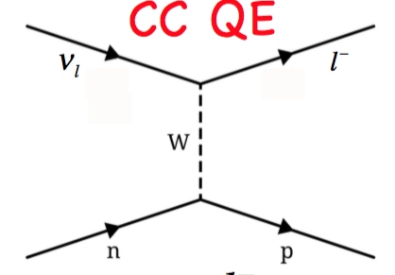
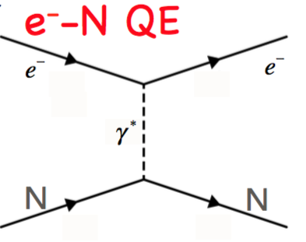


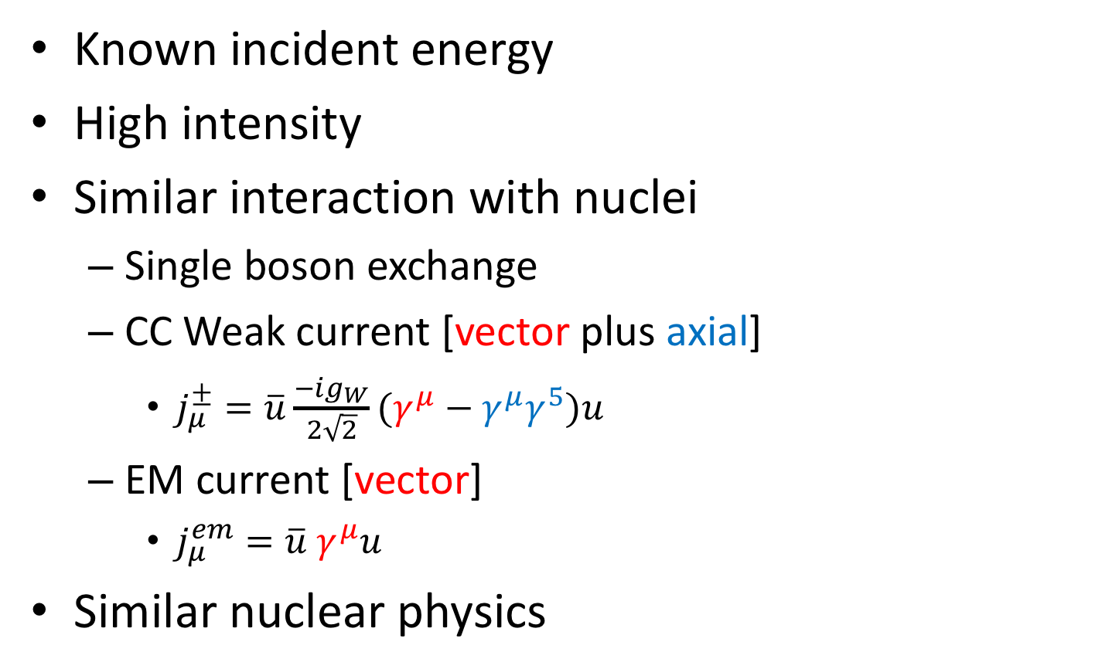


Why electrons?
Known incident energy
High intensity
Similar interaction with nuclei
  Single boson exchange
  CC Weak current [vector plus axial]
    $j_{μ}^{±}=\overline{u}\frac{−ig_{W}}{2\sqrt{2}}(γ^{μ}−γ^{μ}γ^{5})u$
  EM current [vector]
    $j_{μ}^{em}=\overline{u} γ^{μ}u$
Similar nuclear physics
$$ν_{l}$$
$$l^{−}$$
W⁺
n
p
$$e^{−}$$
$$e^{−}$$
p
p

Slide 5
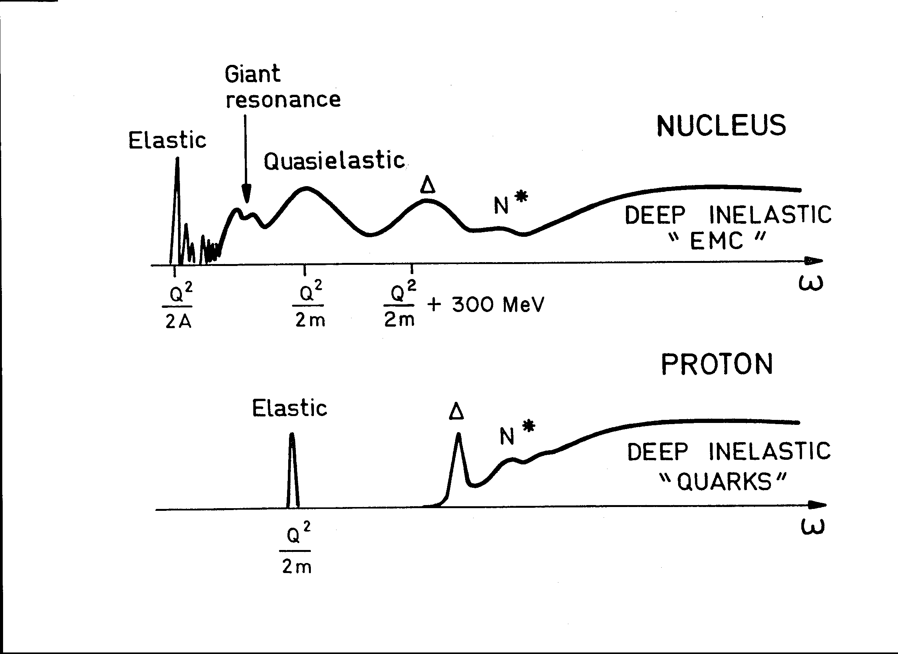
Nuclear Physics
Dip
or ν

Slide 6
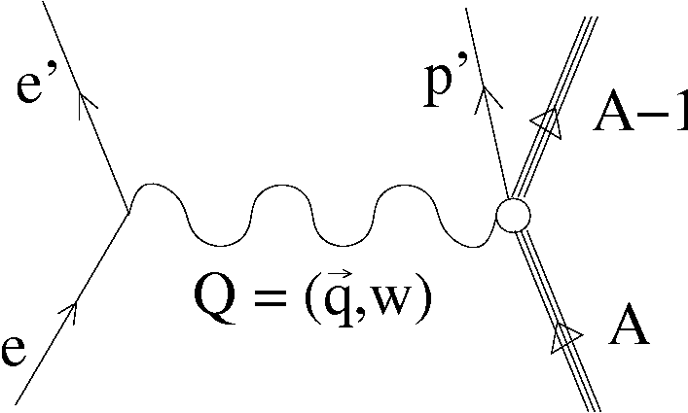
Nuclear Physics
Dip
or ν
What neutrino expts want

Slide 7
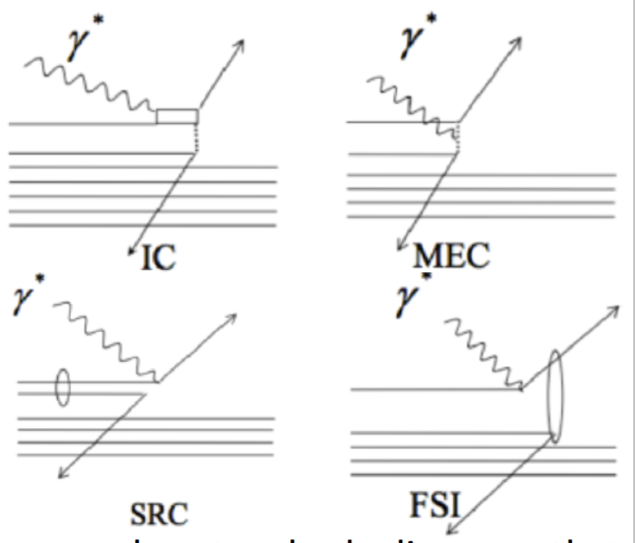
Nuclear Physics
Dip
or ν
What we get (even for 0pi)
Meson Exchange Currents
Final State Interactions
Resonance
Short Range Correlations

Slide 8
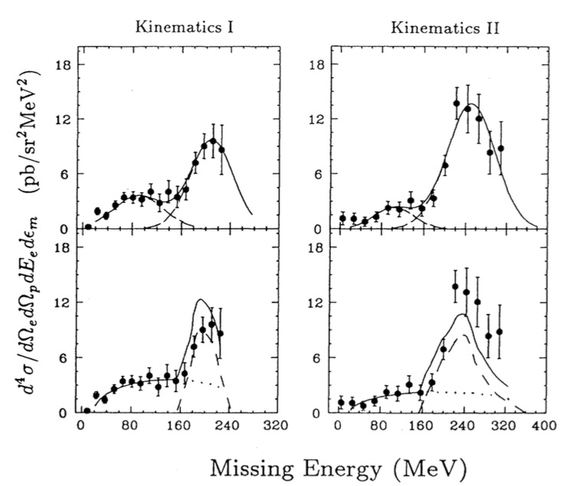
How do reaction mechanisms appear in A(e,e’p)?
??
Single nucleon knockout
Undetected pion
Undetected
2nd nucleon
Undetected
2nd nucleon
Missing energy (MeV)

Slide 9
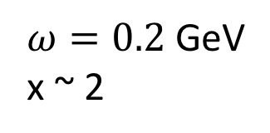


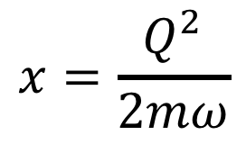
From QE to “dip”
C(e,e’p)
$$ω=0.2$$
$ω=0.2$ GeV
x ~ 2
0.6 GeV/c
x ~ 1
0.4 GeV/c
dip
$$ω=0.2$$
Missing energy [MeV]
Dip
$$x=\frac{Q^{2}}{2mω}$$
R. Lourie, PRL 56, 2364 (1986)
L. Weinstein, PRL 64, 1646 (1990)
S. Penn, PhD thesis, MIT

Slide 10
From Dip to Delta Region
C(e,e’p)
q = 400 MeV/c
ω = 275 MeV/c
q = 473 MeV/c
ω = 382 MeV/c
Δ➔πp
Δ➔πp
ΔN➔pN
or 2p2h
ΔN➔pN
Missing Energy (MeV)
Missing Energy (MeV)
Dip
Baghaei, PRC 39, 177 (1989)

Slide 11
What are correlations?
Average Two-Nucleon Properties in the Nuclear Ground State
Responsible for the high momentum part of of the Nuclear WF
Two-body currents are not Correlations
(but everything adds coherently)
in SRC
Notes:
Add FSI feynmann diagram here

Slide 12
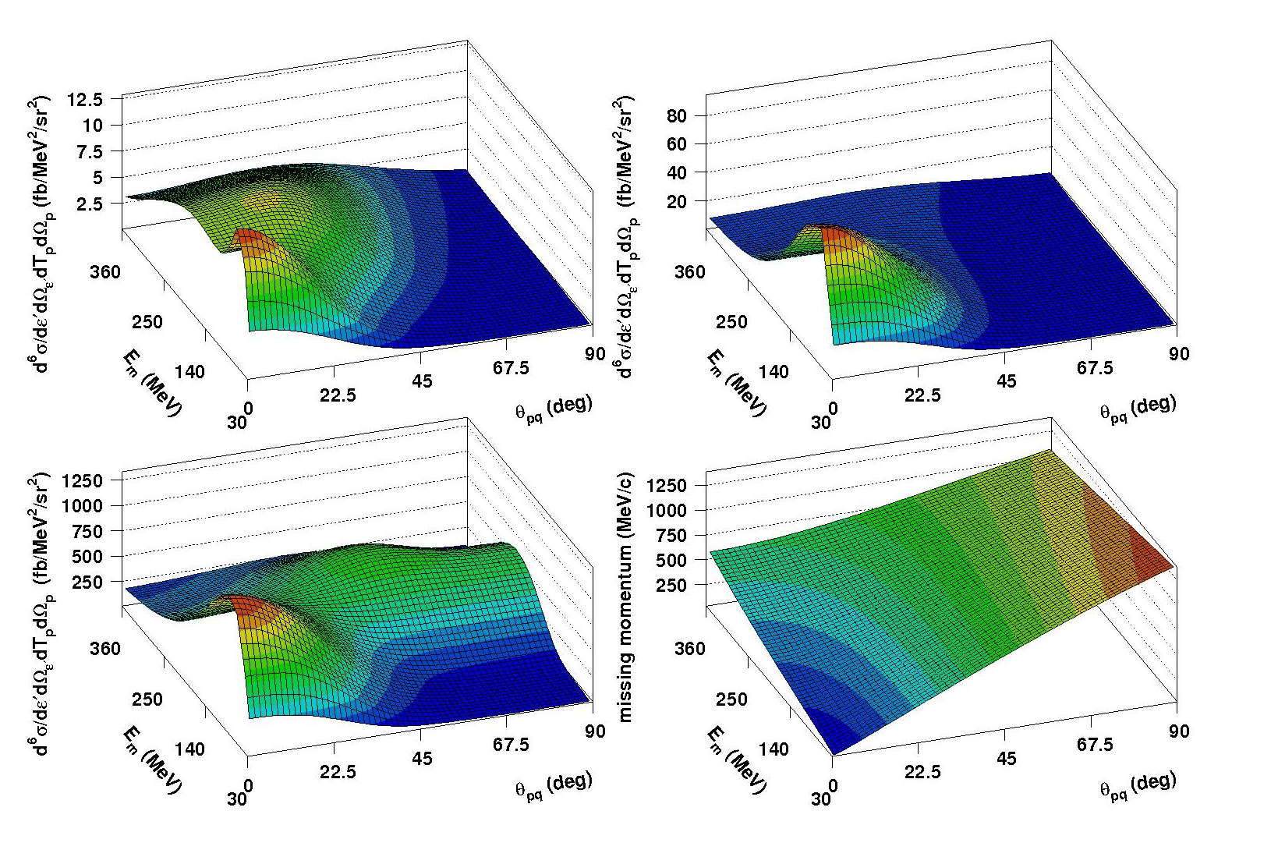
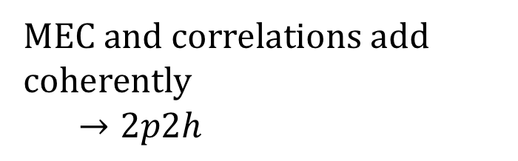
2N currents enhance correlations
Central correlations only
Central + tensor corr
12
80
σ
σ
1250
σ
MEC and correlations add coherently
$→2p2h$
360
E_{m}
90
30
0
θ_{pq}
Corr + MEC
O(e,e’p) Ryckebusch
NP A672 (2000) 285

Slide 13
Physics Summary
Electron scattering:
  Monochromatic beam
  Vector current only
  Can choose kinematics to minimize “uninteresting” reaction mechanisms
  Calculate cross sections after the fact
Neutrino interactions
  Continuous mixed beams
  Vector plus axial current
  Must include all reaction mechanisms
    MEC, IC, correlations, Delta, …
    FSI (not discussed here)
  Need good models in event generators

Slide 14
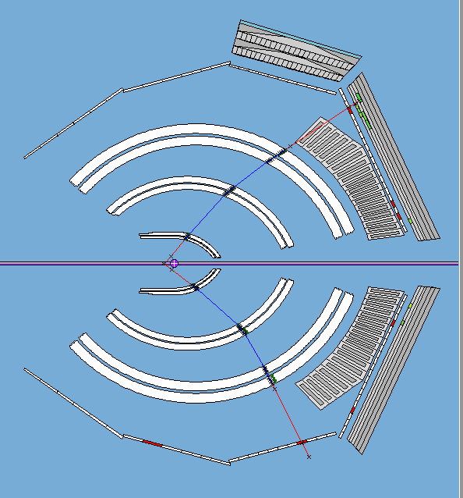
Jefferson Lab data
CLAS6: 1996-2015
TOF
CAL
CER
DC3
DC2
DC1

Slide 15
CLAS6 (e,e’p) Data (million events)
 | 1.1 GeV | 2.2 GeV | 4.4 GeV
3He | 4 | 9 | 1
4He | X | 17 | 3
12C | 3 | 11 | 2
56Fe | X | 0.5 | 0.1
E2a data only.
E2b has more 4.6 GeV 3He and 56Fe
Eg2 has 5 GeV d, C, Al, Fe, and Pb
𝜈_{𝜇} Flux [Arb.]
0 1 2 3 4 5 6
E_{𝜈} [GeV]

Slide 16
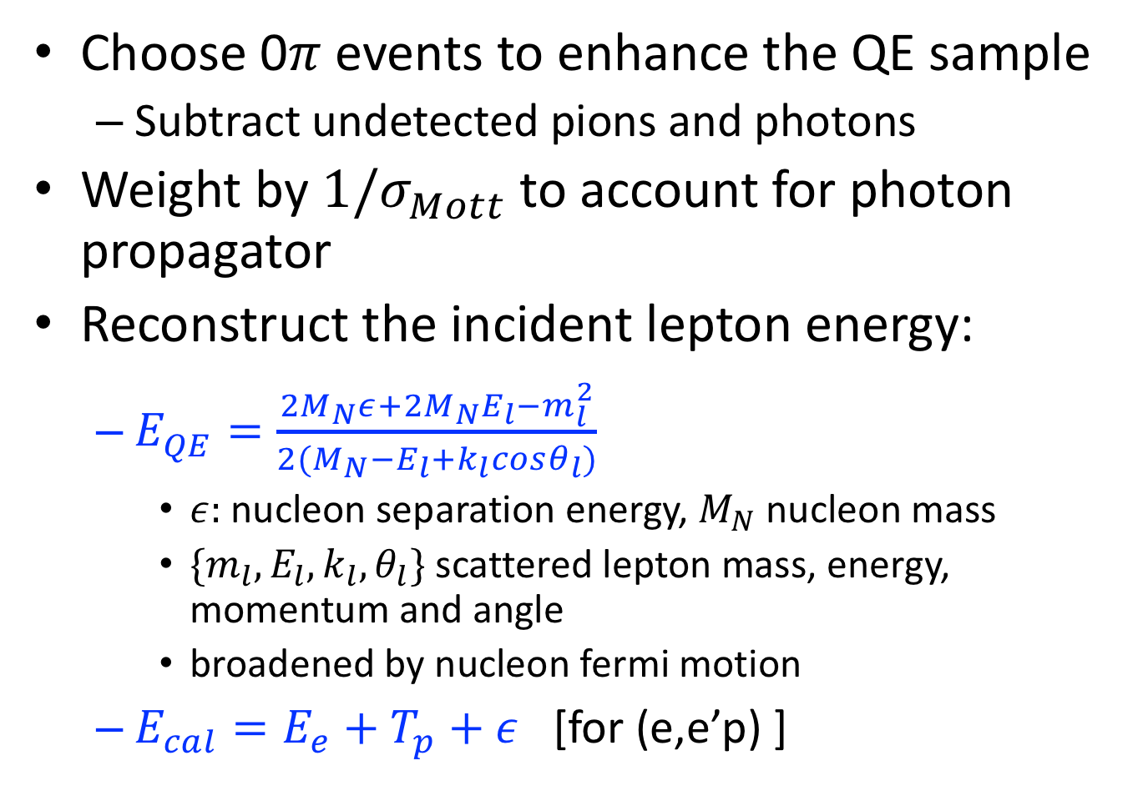
Reconstructing the initial energy
Choose 0$π$ events to enhance the QE sample
  Subtract undetected pions and photons
Weight by $1/σ_{Mott}$ to account for photon propagator
Reconstruct the incident lepton energy:
  $E_{QE}^{}=\frac{2M_{N}ε+2M_{N}E_{l}−m_{l}^{2}}{2(M_{N}−E_{l}+k_{l}cosθ_{l})}$
    $ε:$nucleon separation energy, $M_{N}$ nucleon mass
    ${\{m}_{l}, E_{l}, k_{l}, θ_{l}\}$ scattered lepton mass, energy, momentum and angle
    broadened by nucleon fermi motion
  $E_{cal}=E_{e}+T_{p}+ε$ [for (e,e’p) ]

Slide 17
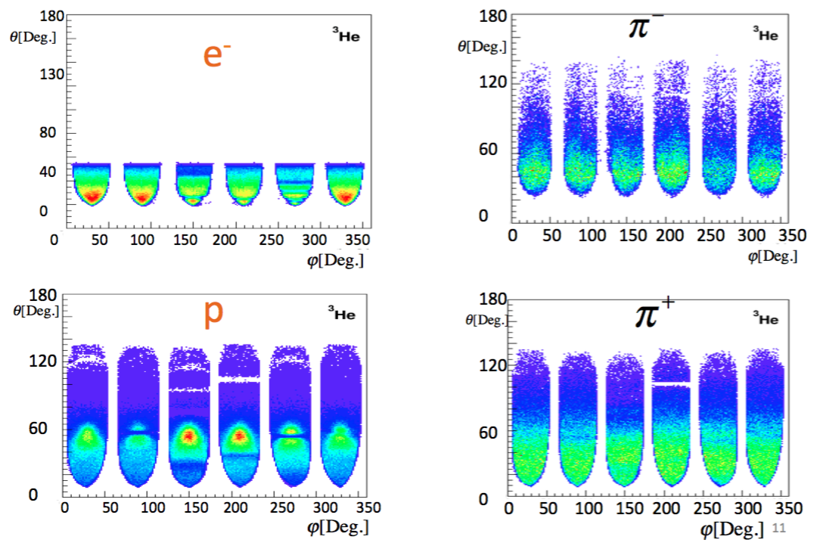


CLAS6 coverage
$p_{min}≈300$ MeV/c
$p_{min}≈150$ MeV/c

Slide 18
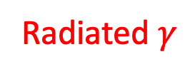

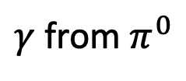
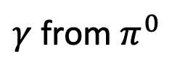
Exclude radiated photons
$γ$ from Batman
Radiated $γ$
$γ$ from $π^{0}$
$γ$ from $π^{0}$

Slide 19
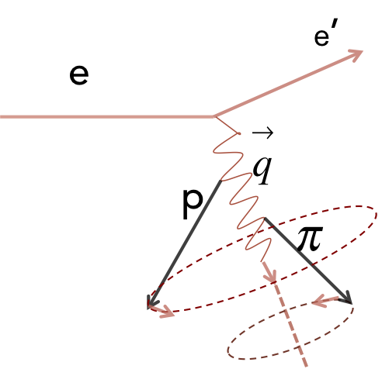
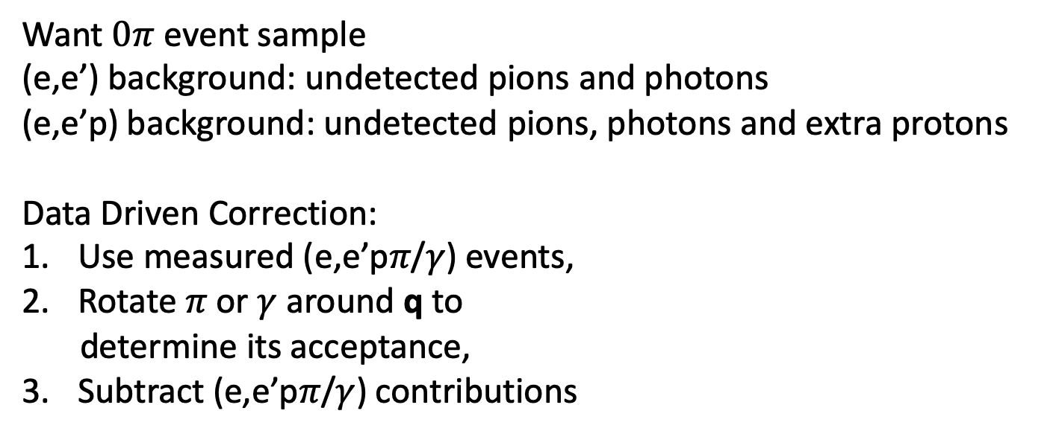
Background Subtraction
Want $0π$ event sample
(e,e’) background: undetected pions and photons
(e,e’p) background: undetected pions, photons and extra protons
Data Driven Correction:
Use measured (e,e’p𝜋/$γ$) events,
Rotate 𝜋 or $γ$ around q to
determine its acceptance,
Subtract (e,e’p𝜋/$γ$) contributions

Slide 20
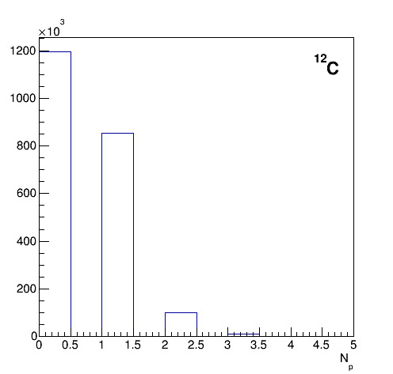
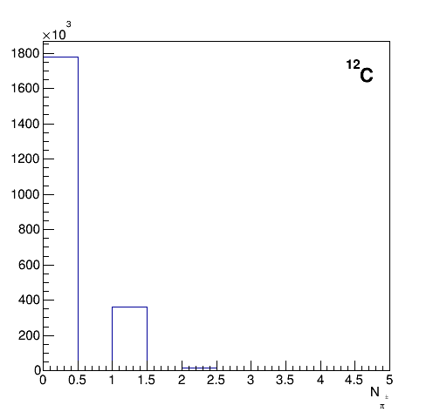
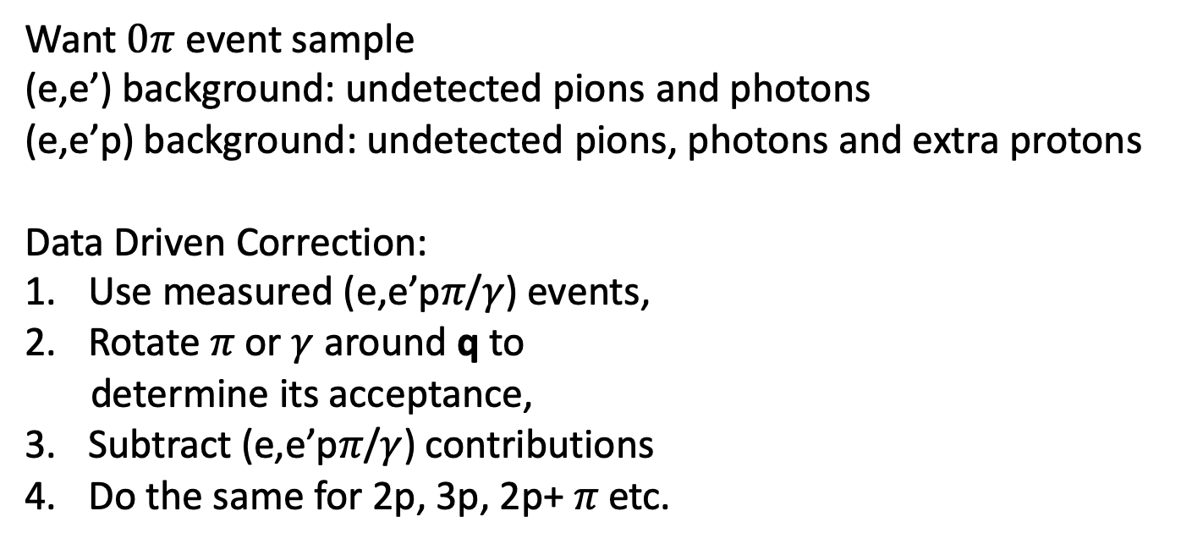
Background Subtraction
Want $0π$ event sample
(e,e’) background: undetected pions and photons
(e,e’p) background: undetected pions, photons and extra protons
Data Driven Correction:
Use measured (e,e’p𝜋/$γ$) events,
Rotate 𝜋 or $γ$ around q to
determine its acceptance,
Subtract (e,e’p𝜋/$γ$) contributions
Do the same for 2p, 3p, 2p+ 𝜋 etc.
Proton multiplicity
pion multiplicity
2.2 GeV ¹²C
2.2 GeV ¹²C
0 1 2 3
0 1 2 3

Slide 21
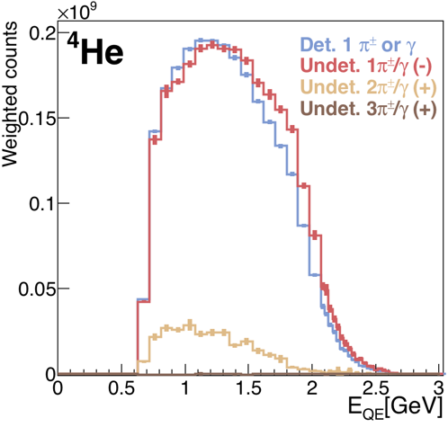


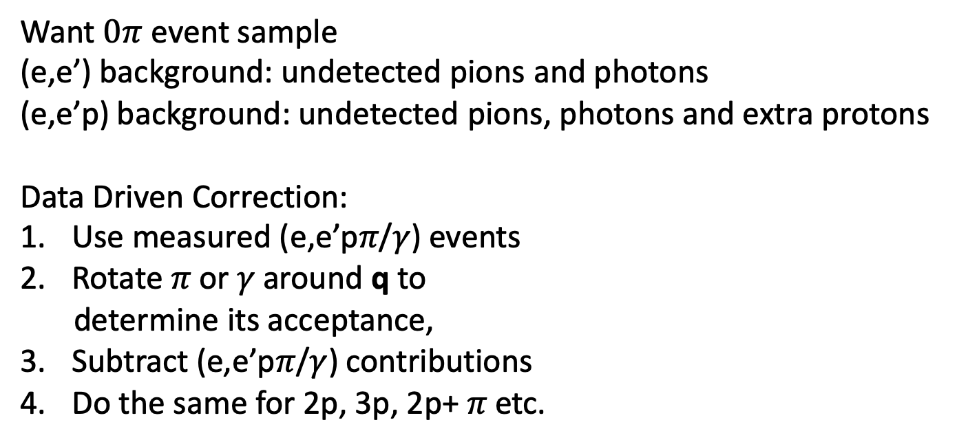

Scintillator based detector
Study:
Neutrino oscillations
nuclear effects
nuclear structure functions.
Background Subtraction
Want $0π$ event sample
(e,e’) background: undetected pions and photons
(e,e’p) background: undetected pions, photons and extra protons
Data Driven Correction:
Use measured (e,e’p𝜋/$γ$) events
Rotate 𝜋 or $γ$around q to
determine its acceptance,
Subtract (e,e’p𝜋/$γ$) contributions
Do the same for 2p, 3p, 2p+ 𝜋 etc.
Detected $1 π/γ$
Undetected $1 π/γ$
Undet 2$π/γ$
Proton multiplicity
pion multiplicity
2.2 GeV ¹²C
2.2 GeV ¹²C
0 1 2 3
0 1 2 3

Slide 22
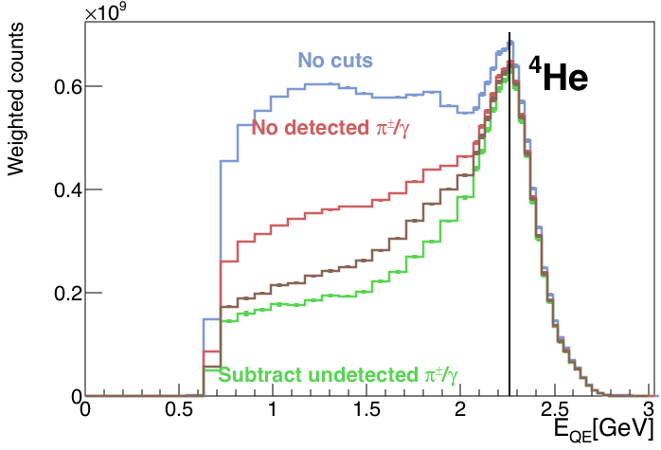




Scintillator based detector
Study:
Neutrino oscillations
nuclear effects
nuclear structure functions.
Background Subtraction
Want $0π$ event sample
(e,e’) background: undetected pions and photons
(e,e’p) background: undetected pions, photons and extra protons
Data Driven Correction:
Use measured (e,e’p𝜋/$γ$) events
Rotate 𝜋 or $γ$around q to
determine its acceptance,
Subtract (e,e’p𝜋/$γ$) contributions
Do the same for 2p, 3p, 2p+ 𝜋 etc.
No cuts
No det. $π/γ$
sub $π$
subtract $π/γ$
Proton multiplicity
pion multiplicity
2.2 GeV ¹²C
2.2 GeV ¹²C
0 1 2 3
0 1 2 3
True $0π$ event sample!

Slide 23
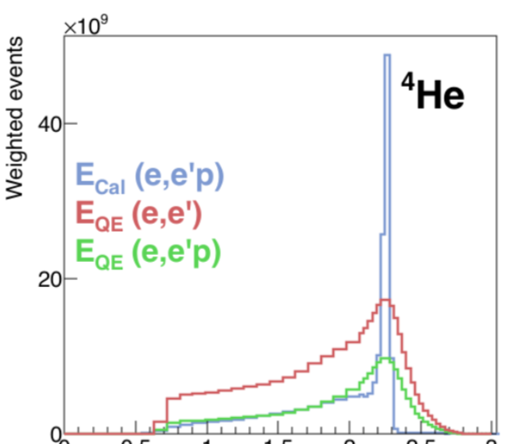
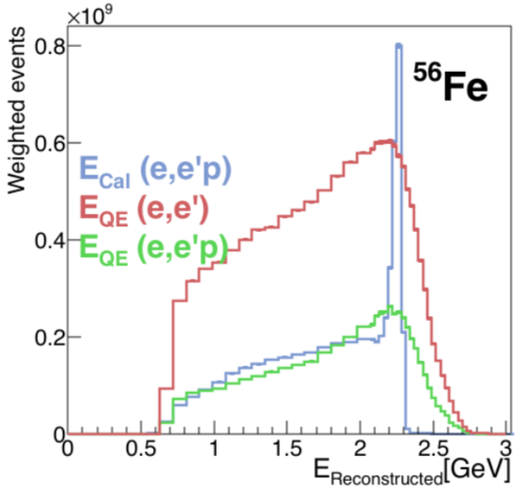
Energy Reconstruction: A dependence
2.26 GeV beam
Zero pion events
⁴He
⁵⁶Fe
E^{Cal} (e,e’p)
E^{Cal} (e,e’p)
Preliminary
E^{QE} (e,e’)
E^{QE} (e,e’)
E^{QE} (e,e’p)
E^{QE} (e,e’p)
0 0.5 1 1.5 2 2.5 3
0 0.5 1 1.5 2 2.5 3
E_{rec}[GeV]
E_{rec}[GeV]
Even 0pi events have a LOT of non-QE events
  Much bigger in Fe than ⁴He
Same long tail for E_{cal} and E_{QE}

Slide 24
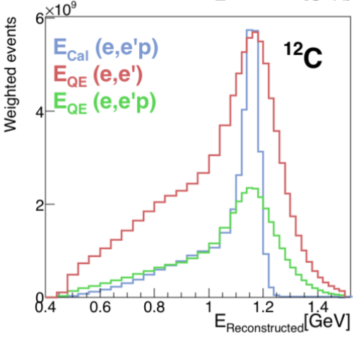
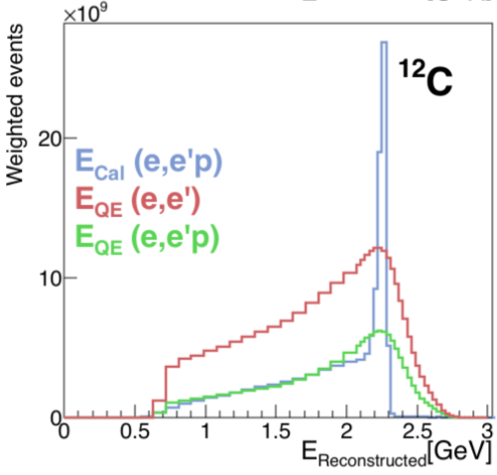
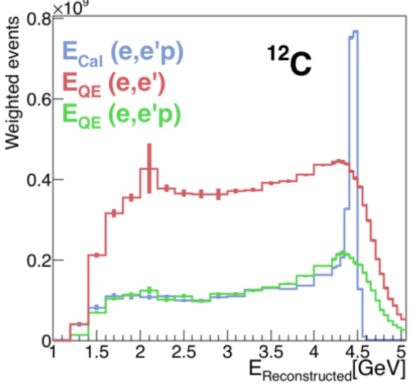
Energy Reconstruction: E dependence
¹²C
1.1 GeV
Non-QE events increase with E
Preliminary
2.2 GeV
4.4 GeV

Slide 25
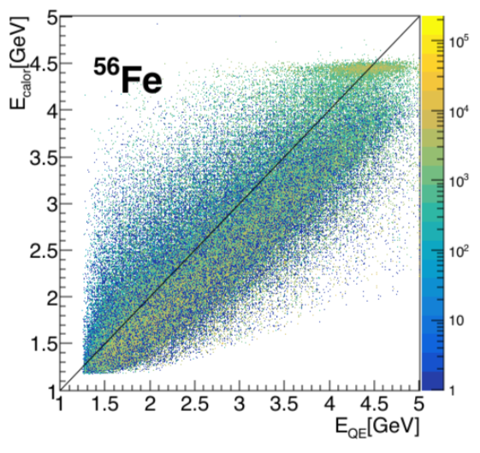
Agreement between methods does not guarantee correctness
Good reconstruction
Bad reconstruction
good agreement
Calorimetric method
QE (lepton only) method

Slide 26
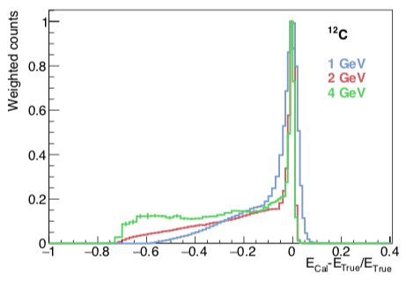
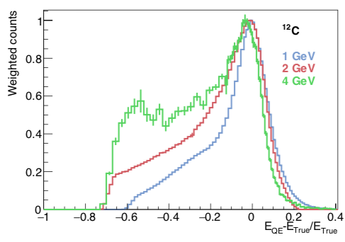
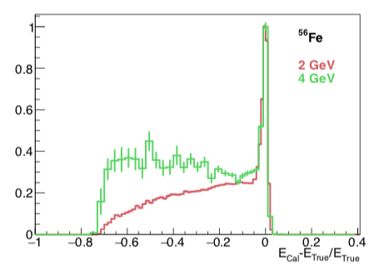
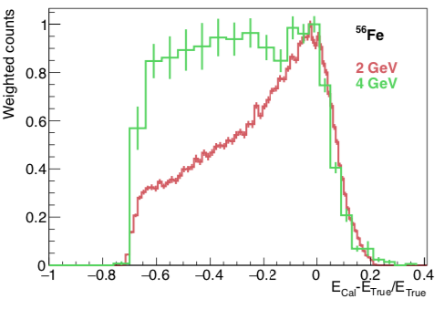
Fractional Energy Feeddown
calorimetric
¹²C
QE (e only)
4.4 GeV
2.2 GeV
1.1 GeV
Preliminary
⁵⁶Fe
4.4 GeV
2.2 GeV

Slide 27
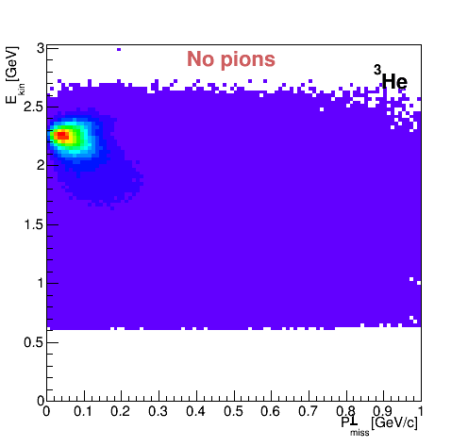


Can we select QE events?
2.2 GeV ⁵⁶Fe
2.5
2
1.5
1
0.5
0
E_{QE}[GeV]
$$e^{′}$$
$$p_{miss}^{⊥}$$
e
p
0 0.2 0.4 0.6 0.8 1

Slide 28
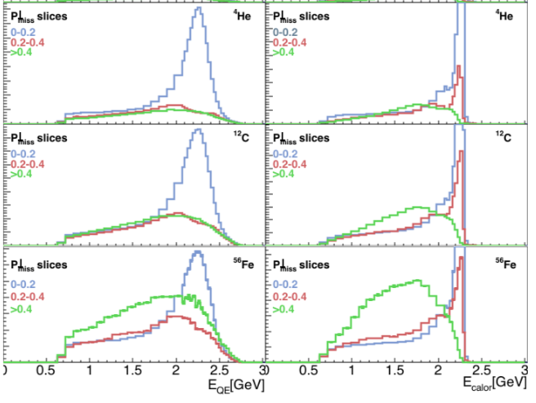
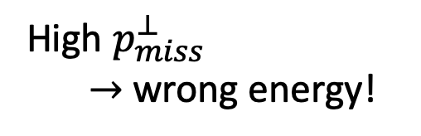
E_{QE}
E_{QE}
E_{Cal}
⁴He
0-0.2
>0.4
0.2-0.4
¹²C
Preliminary
0-0.2
⁵⁶Fe
>0.4
High $p_{miss}^{⊥}$
$→$ wrong energy!
0.2-0.4
E_{QE}[GeV]
E_{Calor}[GeV]
Notes:
for heavier

Slide 29
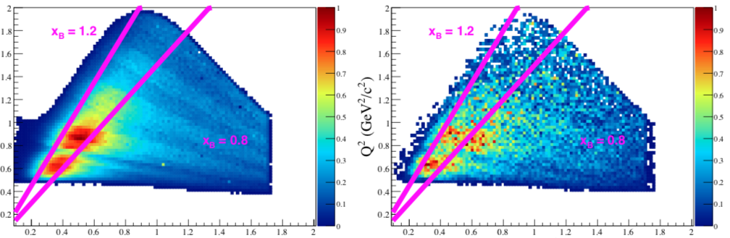
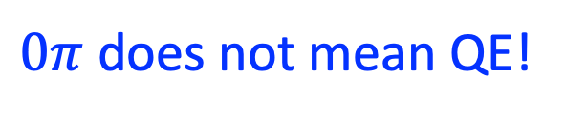

$0π$ Data vs Genie 2.2 GeV
C(e,e’p) 2.26 GeV
Data
GENIE
1.5
Q² (GeV²)
1.0
0.5
0.5
1.0
1.5
0.5
1.0
1.5
Energy Transfer
Preliminary
Energy Transfer
1.5
Q² (GeV²)
$0π$ does not mean QE!
1.0
GENIE
No resonance!
0.5
0.5
1.0
Energy Transfer

Slide 30
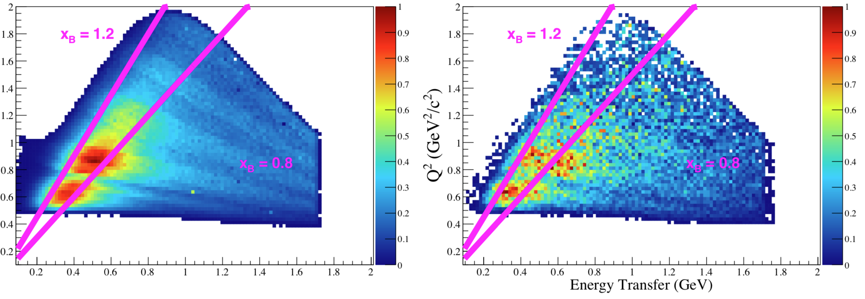
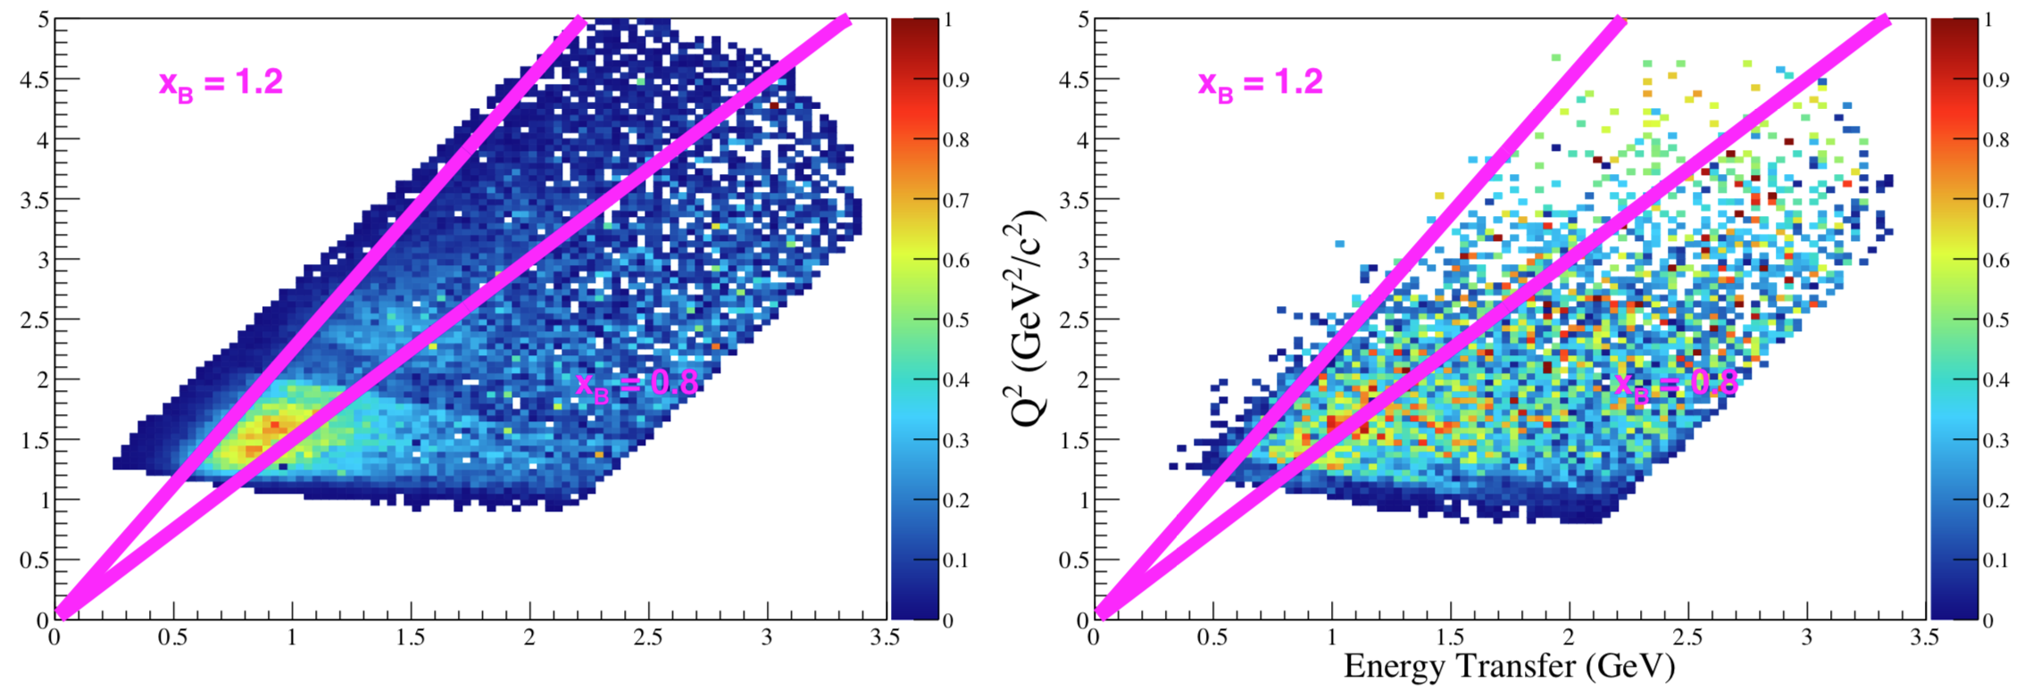

$0π$ Data Genie
2.0
2.2 GeV
2.2 GeV
Q² (GeV²)
1.0
1.0
Preliminary
2.0
1.0
2.0
4.4 GeV
4.4 GeV
4.4 GeV
4.0
Q² (GeV²)
2.0
1.0
3.0
1.0
3.0
Energy Transfer
Energy Transfer

Slide 31
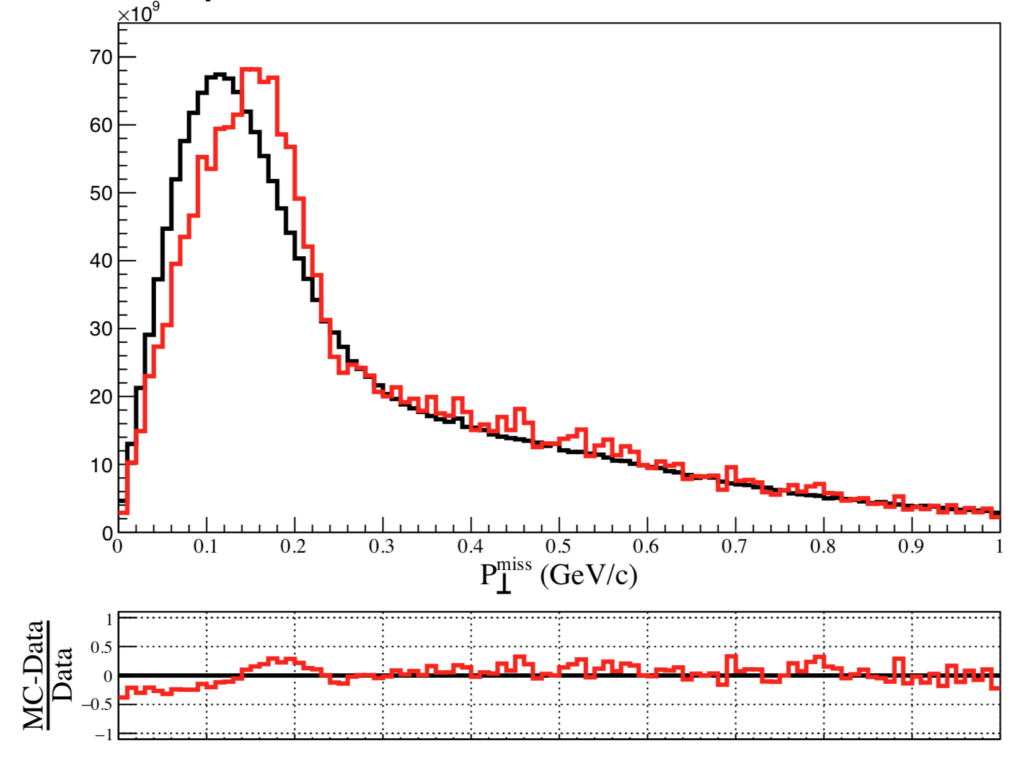
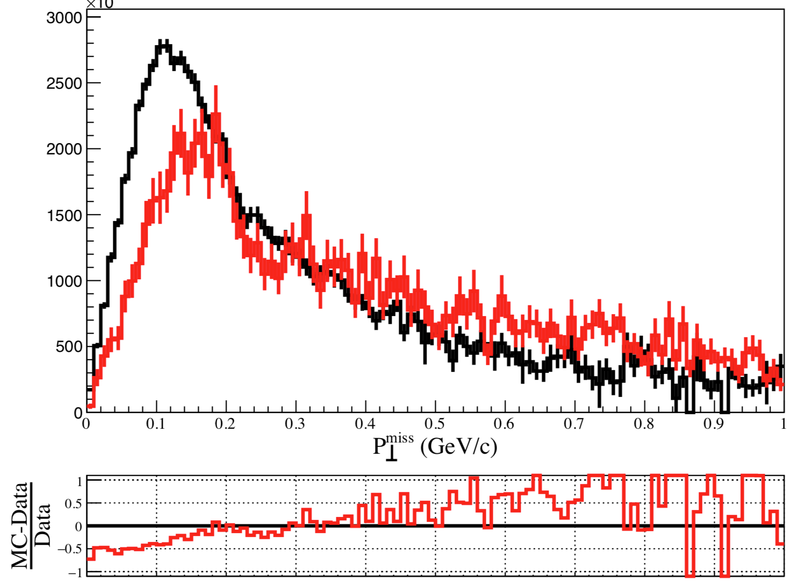

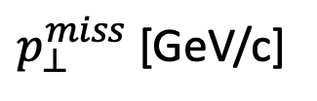
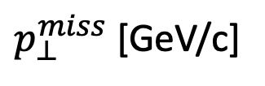
$0π$Data vs GENIE
C 2.2 GeV
C 4.4 GeV
Preliminary
Data
GENIE
Data
GENIE
0
0.5
1
0
0.5
1
$p_{⊥}^{miss}$ [GeV/c]
$p_{⊥}^{miss}$ [GeV/c]

Slide 32
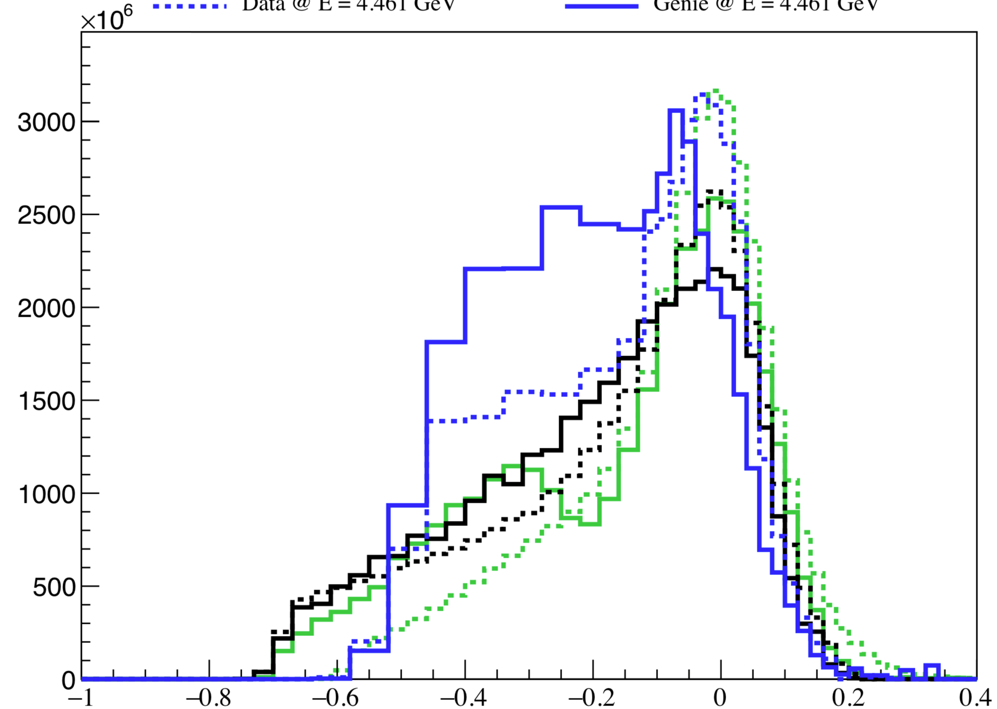

$0π$Data vs GENIE: Carbon
Data: dashed
GENIE: solid
Preliminary
4.4 GeV
2.2 GeV
1.1 GeV
Fractional energy feed down

Slide 33
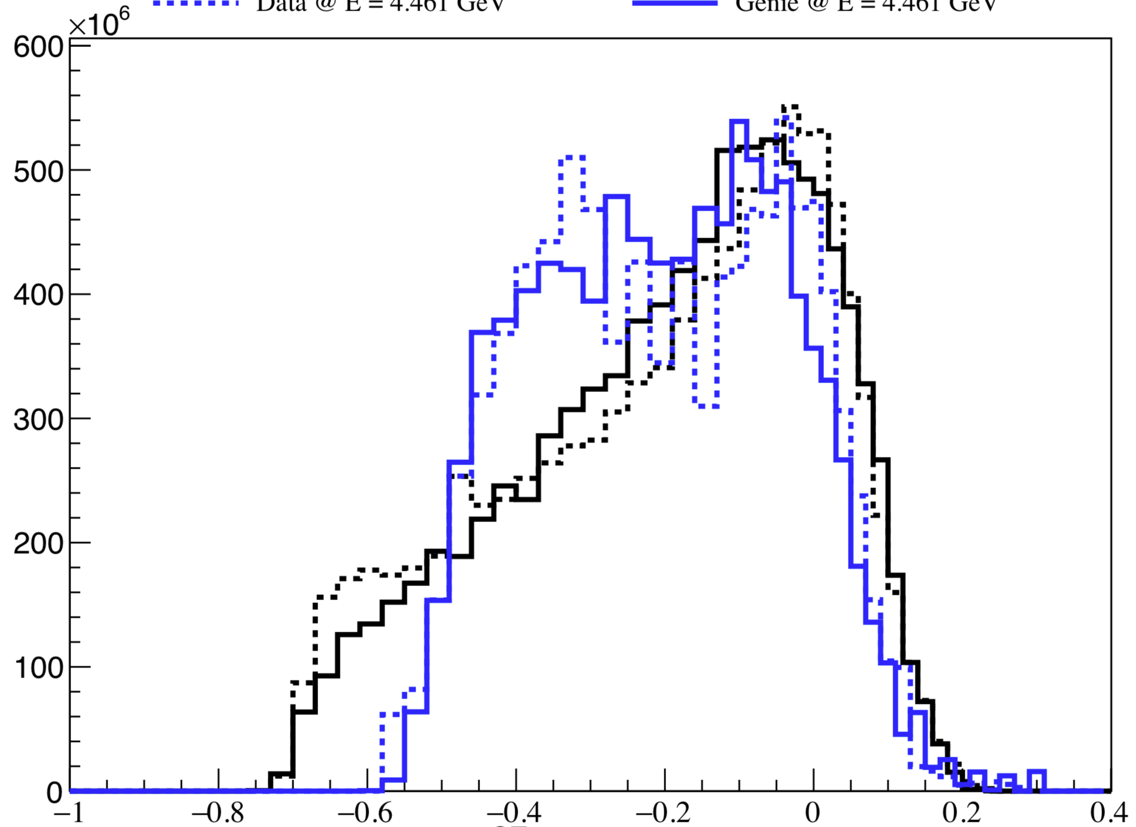

$0π$Data vs GENIE: Iron
Data: dashed
GENIE: solid
4.4 GeV
2.2 GeV
Preliminary
Fractional energy feed down

Slide 34


$0π$GENIE energy recon
¹²C(e,e’p) 2.2 GeV
The tail is entirely RES + DIS

Slide 35


1.1 GeV
2.2 GeV
GENIE
Data
1
1
2
Preliminary
¹²C E_{cal}
4.4 GeV
$p_{⊥}<200$ MeV/c
2
4

Slide 36



1.1 GeV
2.2 GeV
Data
GENIE
Preliminary
1
1
2
¹²C E_{cal}
4.4 GeV
${200<p}_{⊥}<400$ MeV/c
2
4

Slide 37


1.1 GeV
2.2 GeV
GENIE
GENIE
Data
Data
1
1
2
Preliminary
¹²C E_{cal}
4.4 GeV
$${400 MeV/c< p}_{⊥}$$
2
4

Slide 38

Data vs Genie: E_{beam} Reconstruction
Fe | e⁻ Data | $e$ GENIE
2.2 GeV | 26% | 29%
4.4 GeV | 16% | 21%
Fraction of Fe($e,e^{′}p$) events with E_{Cal} within 5% of E_{beam}

Slide 39





Apply QE CLAS data to DUNE Oscillation
$$Truth$$
DUNE Far Detector
$$νA GENIE$$
Preliminary
eA data
2
4
6
Reconstructed $Eν$ [GeV]
Threw events with $νA$Genie
  Reconstructed with $νA GENIE$ or eA data
Compared E_{rec} for eA to E_{rec} for $νA$

Slide 40


New analysis: one pion channel (e,e’p$π$)
Three energy reconstruction methods:
Kinematic (e only), assumes intermediate $Δ$
  $E=\frac{m_{Δ}^{2}−m^{′2}−2m^{′}E_{e}^{′}}{2(m^{′}−E_{e}^{′}+E_{e}^{′}cosθ_{e})}$ $m^{′}=m_{p}−ε$
Kinematic (e and $π$ only),
  assumes single missing proton
Calorimetric: $E=E_{e}^{′}+E_{π}+T_{p}+ε$
Comparisons to GENIE coming soon …

Slide 41





C(e,e’p$π$) 2.2 GeV
Prepreliminary
all $π$
$π$ plus
$π$ minus
Calorimetric energy: $E=E_{e}^{′}+E_{π}+T_{p}$

Slide 42









C(e,e’p$π$) 2.2 GeV
$$epπ$$
Prepreliminary
$$eπ$$
all $π$
Prepreliminary
$π$ plus
$e$ only
$π$ minus
all $π$
$π$ minus

Slide 43



More resonances?
3He (e,e’p$π$) 2.2 GeV
one pion channel
$e+π$ energy
Prepreliminary
all $π$
$π$ plus
$π$ minus
(Assumes single missing proton)

Slide 44

More resonances?
3He (e,e’p$π$) 2.2 GeV
one pion channel
$e+π$ energy
Prepreliminary
all $π$
Higher resonances?
$$Δ$$
$π$ plus
$π$ minus
(Assumes single missing proton)

Slide 45

CLAS12
CLAS12
forward detector (5 – 40º)
  Toroidal magnetic field
  $\frac{δp}{p}$~ 0.5—1%
  Neutrons:
    50% effi for p > 1 GeV/c
    $\frac{δp}{p}$ ~ 10-15% for 1 GeV/c
Hermetic central detector (40 – 135º)
  5 T solenoidal field
  Neutron effi ~ 10—15%
  Neutron $\frac{δp}{p}:$60 ps @ 0.3 m
45 beam days approved with an A rating for
  1.1, 2.2, 4.4, and 6.6 GeV beam energies
  d, He, C, O, Ar, Sn and SRC targets

Slide 46

Goals
We provide event yields and detector acceptance maps
  Many beam energies
  Many targets
  Many event topologies
Let experts use these to tune generators and understand energy reconstruction
What do you want from the data?

Slide 47



Preliminary
Nuclear physics is complicated!
Electron scattering can contribute dramatically to neutrino experiments
  Similar physics
  Lots of data available
  Lots more to come
Neutrino community input is welcome
Zero pion channel
Prepreliminary
all $π$
$π$ minus
$π$ plus
One pion channel

Slide 48
Backup slides

Slide 49

Mott weighting

Slide 50












Similarity of electron and neutrino GENIE
2.2 GeV Fe, zero-pion, QE
($e,e’p$)
($e,e’p$)
($ν,μ^{−}p$)
($ν,μ^{−}p$)
($e,e’p$)
($e,e’p$)
($ν,μ^{−}p$)
($ν,μ^{−}p$)

