Slide 1
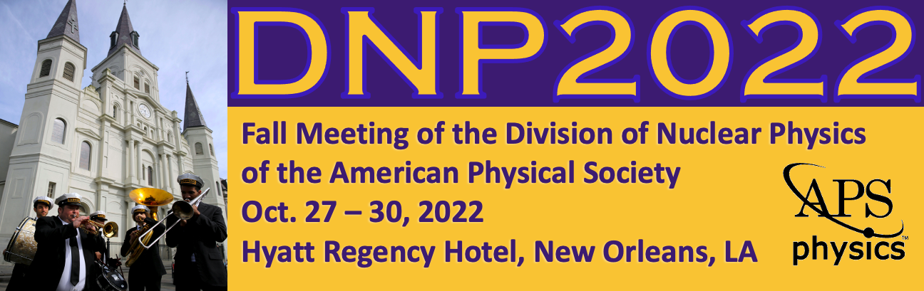

Inclusive electron scattering off the proton with CLAS12 at JLab
Valerii Klimenko,
University of Connecticut
APS + Picture
October 29, 2022

Slide 2

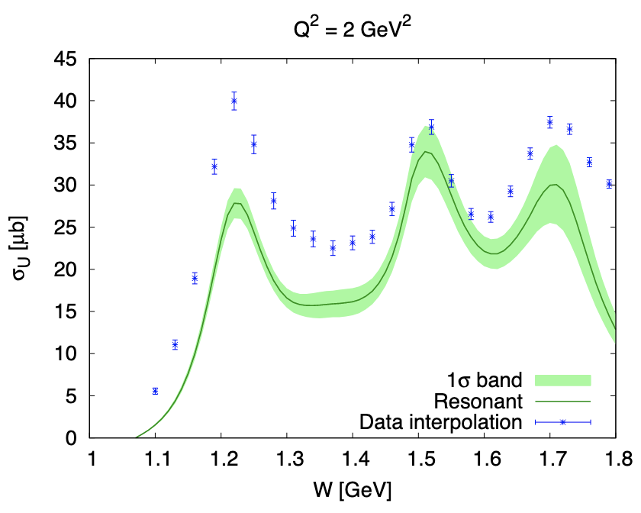
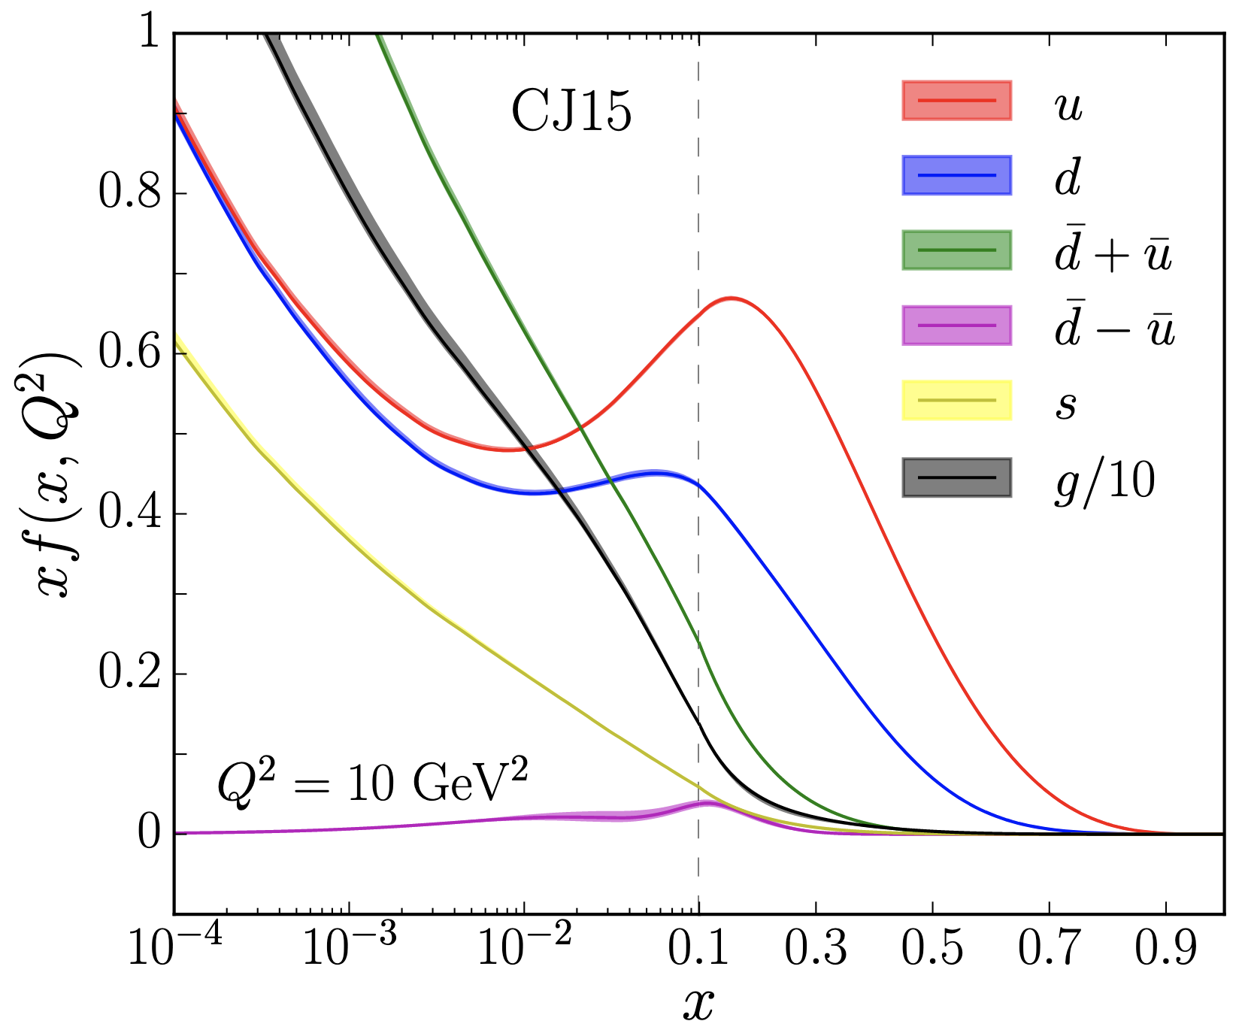


Extending Knowledge of the Nucleon PDF in the Resonance Region
Global QCD analyses have provided detailed information on the nucleon PDFs in a wide range of fractional longitudinal momentum, x, from 10⁻⁴ to 0.9.
At large x, in the nucleon resonance region W < 2.5 GeV, the PDFs are significantly less explored.
Extractions in this region require accounting for higher twist effects, target-mass corrections and evaluation from the nucleon resonance electroexcitations.
A. Accardi et al., Phys. Rev. D. 11, 114017 (2016), [hep-ph 1602.03154]
A. N. Hiller Blin et al., Phys. Rev. C 100 (2019) 3, 035201, [hep-ph 1904.08016]
note scale change

Slide 3
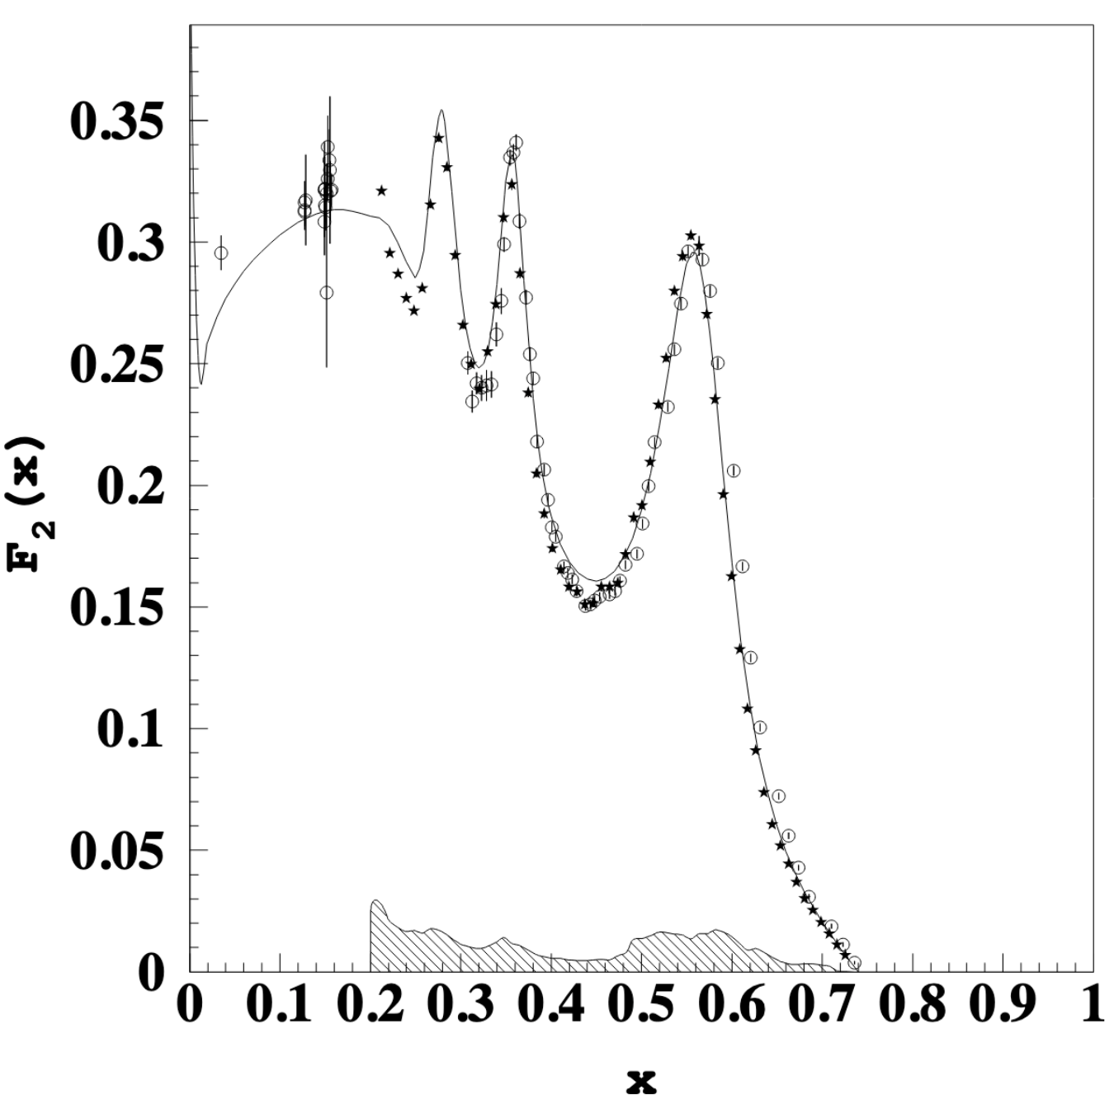
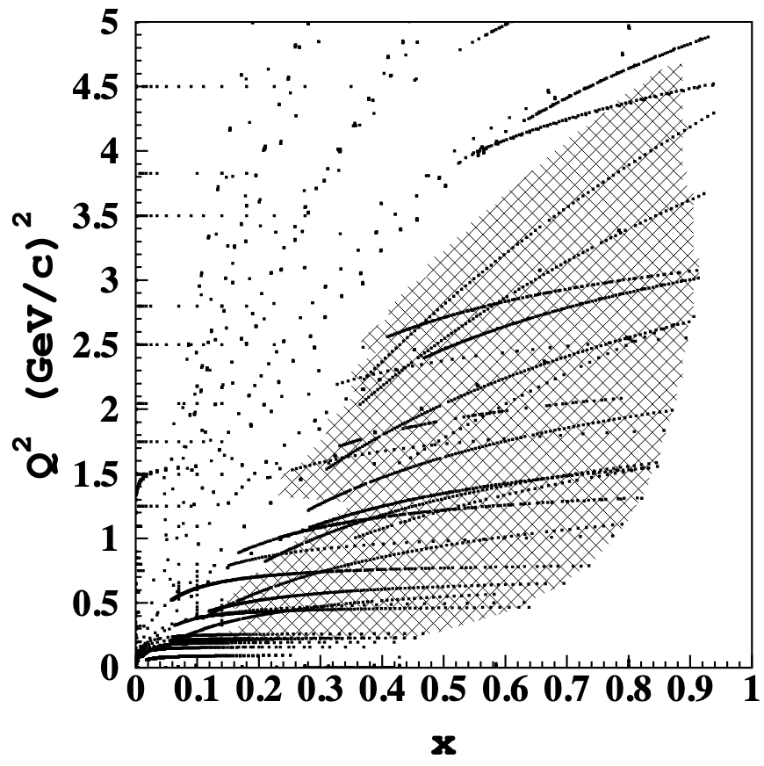

CLAS Results
CLAS measured the inclusive cross section up to x = 0.9 (W = 2.5 GeV) and Q² from 0.25 to 4.5 GeV².
Large acceptance of the CLAS detector allows for integration of the signal at a fixed Q² over a large range in x.
Stars: M. Osipenko et al., Phys. Rev. D 67 (2003), 092001, [hep-ph 0301204]
Other points: world data, see above paper
M. Osipenko et al., Phys. Rev. D 67 (2003), 092001, [hep-ph 0301204]
World data used for moment evaluations of F₂. Shaded area corresponds to CLAS.

Slide 4
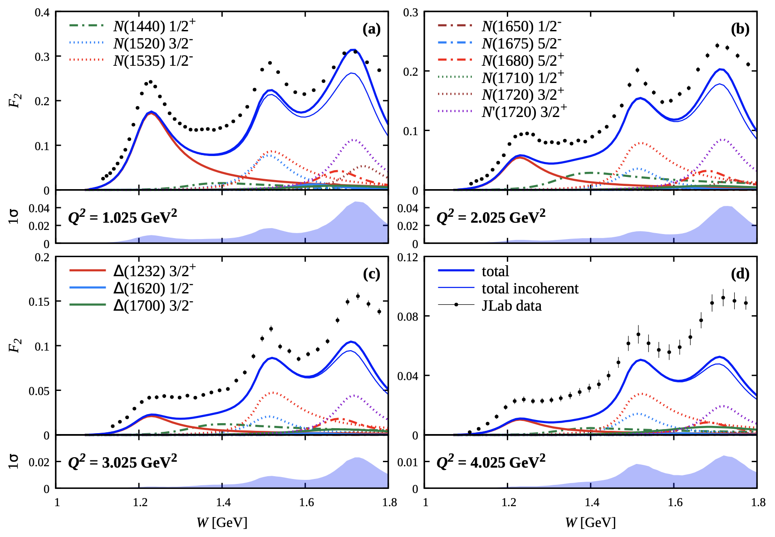
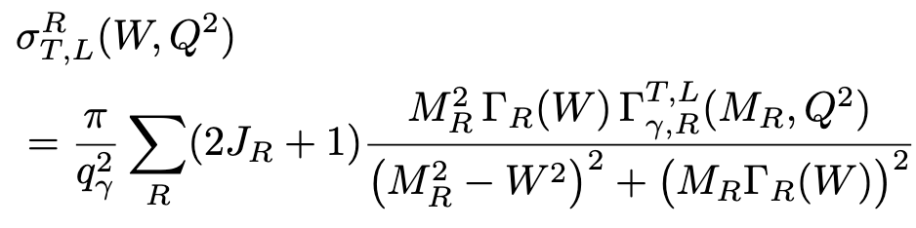
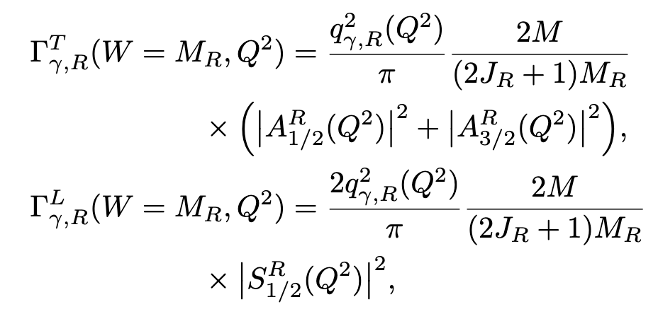
Resonant Contributions
Studies elucidate the contributions from excited nucleon states to the three resonance regions.
Extension of previous analysis to now include interference effects by adding the amplitudes coherently.
A. N. Hiller Blin et al., Phys. Rev. C 104 (2021) 2, 025201, [hep-ph 2105.05834]
Decay widths of resonance R to γ∗p related to electrocouplings from previous slide.
Notes:
Resonances with different quantum numbers do not interfere

Slide 5

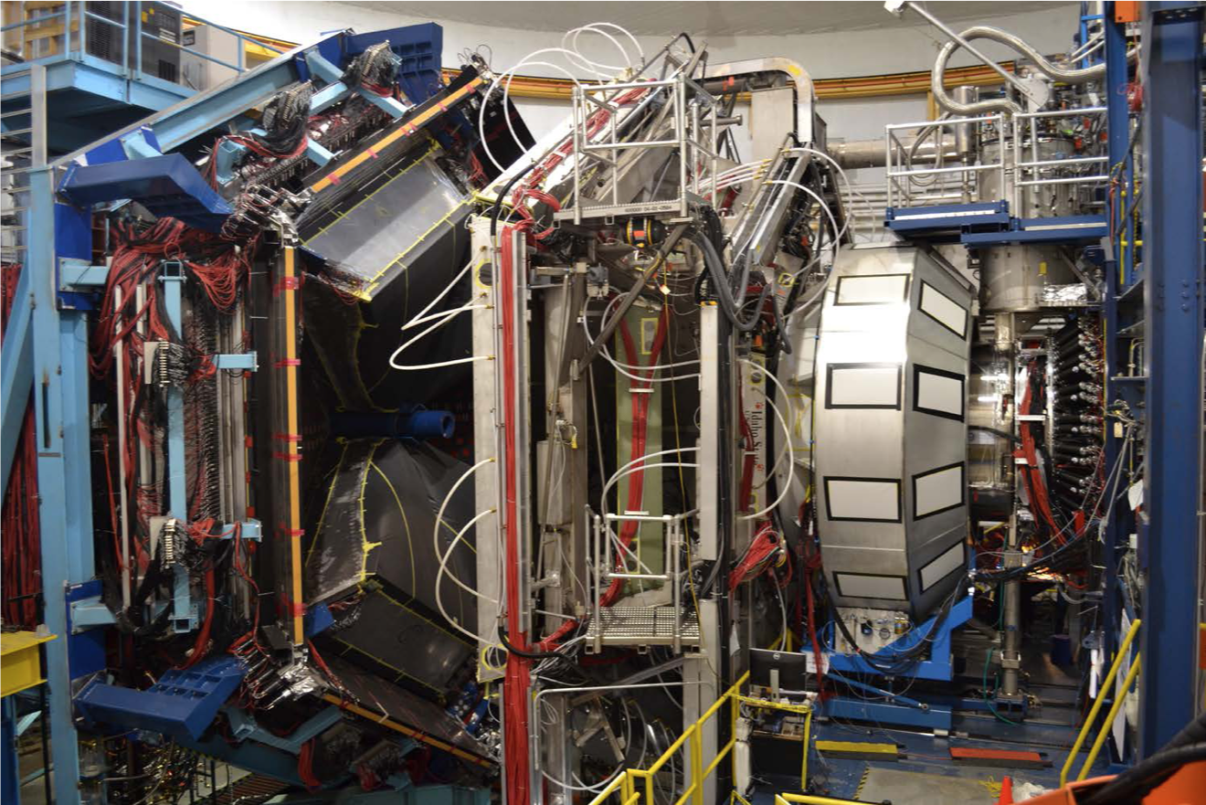
CLAS12 Spectrometer at JLab
DC
FTOF
HTCC
PCAL/EC
https://www.jlab.org/Hall-B/clas12-web/
V. Burkert et al., Nucl. Instrum. Meth. A 959 (2020) 163419
This is our first cross section measurement at 12 GeV; important to understand electron efficiency for other semi-inclusive and exclusive experiments.
CLAS12: very high luminosity, wide acceptance, low Q².
Began data taking in Spring 2018 – many “run periods” now available.
Data from Fall 2018 - 10.6 GeV electron beam, longitudinally polarized beam, liquid H₂ target.

Slide 6
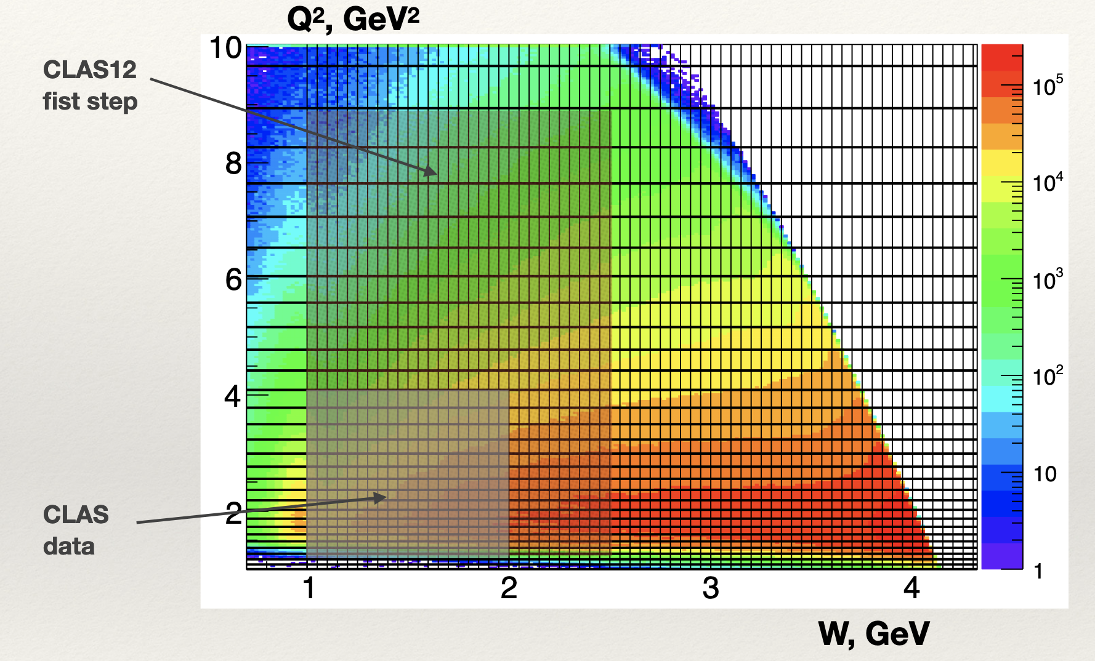
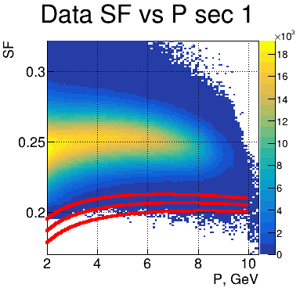
Electron Identification
Limited to Forward Detector (5 - 35° coverage in polar angle).
Negative track with a hit in Time-of-Flight, Electromagnetic Calorimeters and High Threshold Cherenkov Counter (HTCC).
>2.0 photoelectrons in HTCC.
3.5-σ cuts on a parameterized momentum-dependent sampling fraction.
PCAL and DC Fiducial cuts.
N* regime
DIS regime
First CLAS12 measurement
CLAS Data
Forward Calorimeter sampling fraction
for electrons: 3.5σ ± 0.5σ

Slide 7
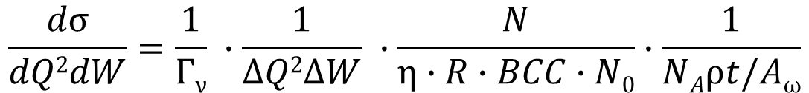
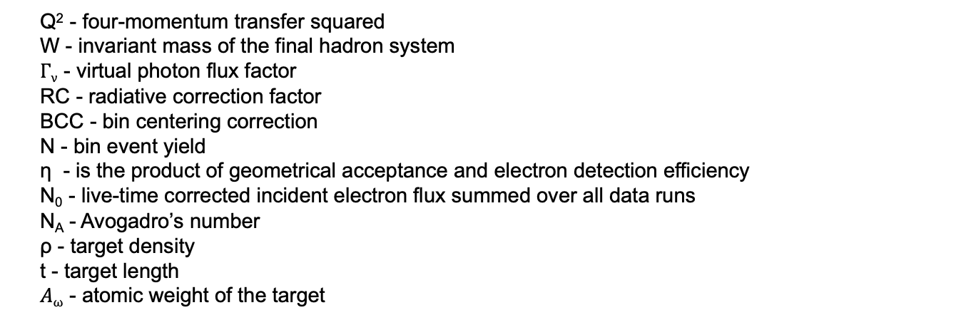
Cross Section Calculation
$$\frac{dσ}{dQ2dW}=\frac{1}{Γν} ∙\frac{1}{∆Q2∆W} ∙\frac{N}{η∙R∙BCC∙N0}∙\frac{1}{NAρt/Aω}$$
Q² - four-momentum transfer squared
W - invariant mass of the final hadron system
$Γν$ - virtual photon flux factor
RC - radiative correction factor
BCC - bin centering correction
N - bin event yield
η - is the product of geometrical acceptance and electron detection efficiency
N₀ - live-time corrected incident electron flux summed over all data runs
N_{A} - Avogadro’s number
ρ - target density
t - target length
$Aω$ - atomic weight of the target

Slide 8
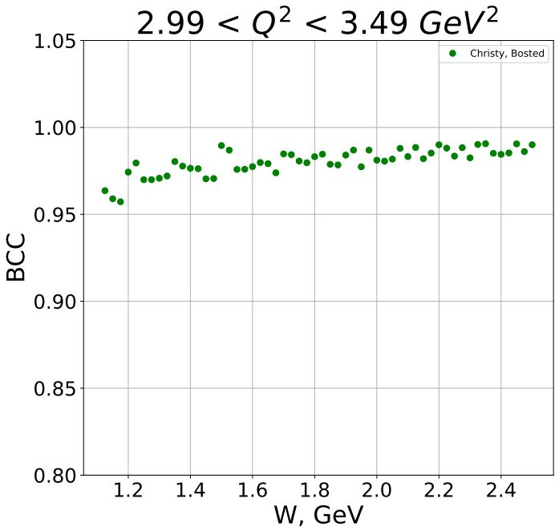
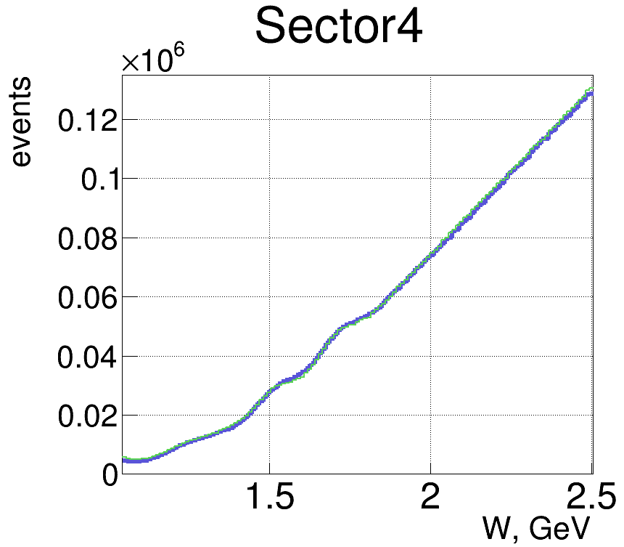
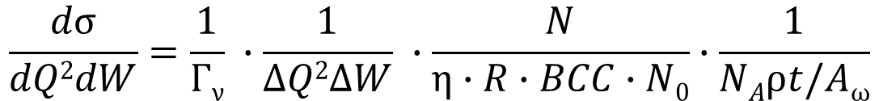

Bin Centering Corrections
$$\frac{dσ}{dQ2dW}=\frac{1}{Γν} ∙\frac{1}{∆Q2∆W} ∙\frac{N}{η∙R∙BCC∙N0}∙\frac{1}{NAρt/Aω}$$
Each (Q²,W) bin was divided into (the same) 21x11 bins
M.E. Christy & P.E. Bosted, Phys. Rev. C. 81, 055213 (2010), [hep-ph 0712.3731]
$$BC Corrections (BCC)= \frac{Mean Cross Section (No Rad)}{Cross Section (No Rad) in the central point}$$
Cross section generally increasing with W so BCC < 1.
PRELIMINARY

Slide 9
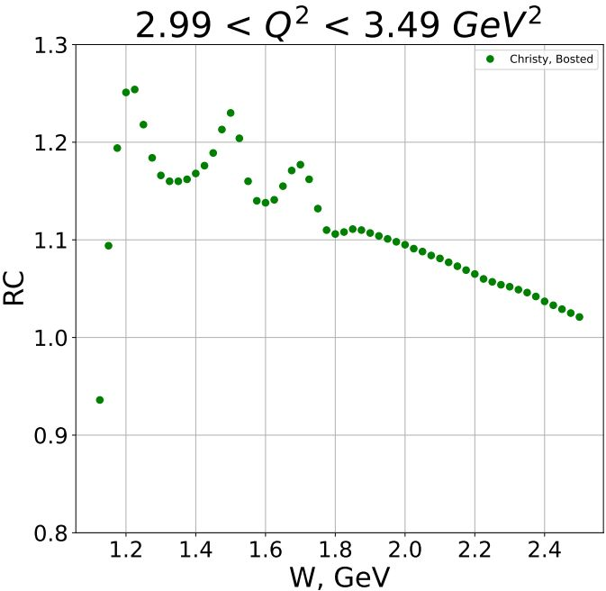
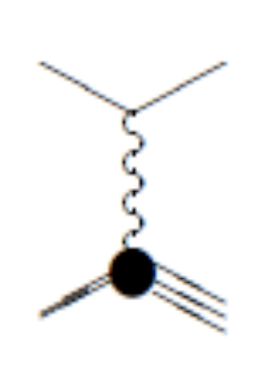
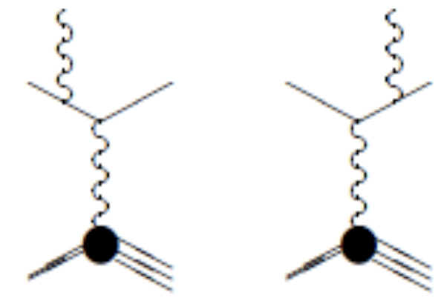
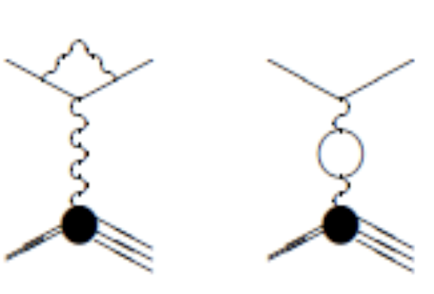
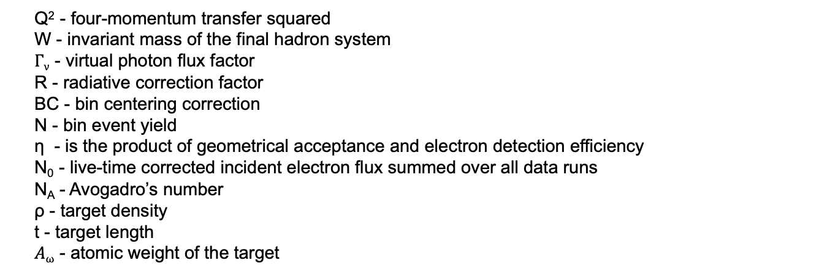

Radiative Corrections
$$\frac{dσ}{dQ2dW}=\frac{1}{Γν} ∙\frac{1}{∆Q2∆W} ∙\frac{N}{η∙R∙BCC∙N0}∙\frac{1}{NAρt/Aω}$$
Q² - four-momentum transfer squared
W - invariant mass of the final hadron system
$Γν$ - virtual photon flux factor
R - radiative correction factor
BC - bin centering correction
N - bin event yield
η - is the product of geometrical acceptance and electron detection efficiency
N₀ - live-time corrected incident electron flux summed over all data runs
N_{A} - Avogadro’s number
ρ - target density
t - target length
$Aω$ - atomic weight of the target
We measure the radiative cross section but want the unradiated cross section…
Christy & Bosted fit includes Hall C data with and without radiative corrections from L. W. Mo and Y. S. Tsai, Rev. Mod. Phys. 41 (1969)
M.E. Christy & P.E. Bosted, Phys. Rev. C. 81, 055213 (2010), [hep-ph 0712.3731]
Radiative Correction (RC) = $\frac{Mean Cross Section (Rad)}{Mean Cross Section (No Rad)}$
Effect decreases as you approach the DIS region.

Slide 10
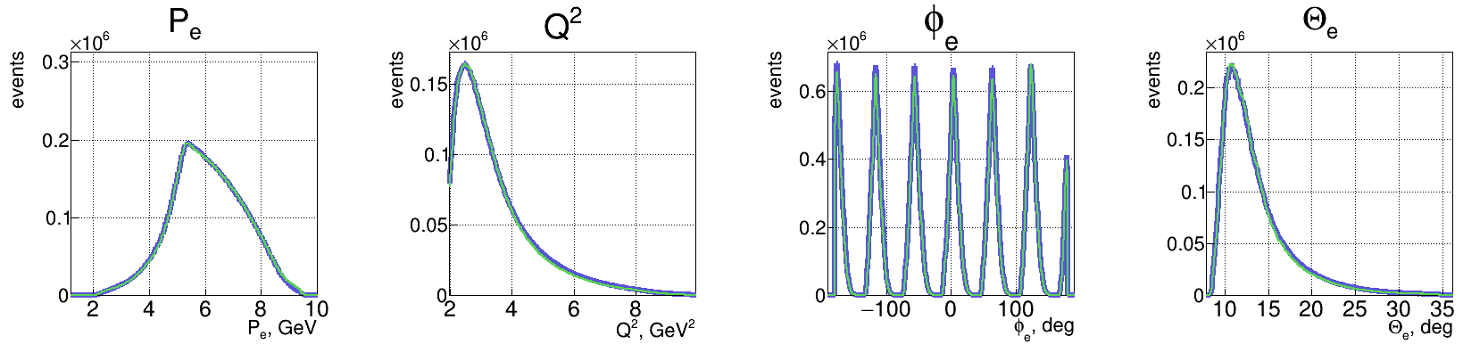
Simulation
Inclusive EG: M. Sargsyan, CLAS-NOTE 90-007 (1990).
Elastic tail + Inelastic radiated.
Kinematic range:
  Theta range 5 - 36°
  Scattered electron momentum 1.9 – 10 GeV
  Full Q² coverage.
  Additional kinematic smearing to match the resolution of reconstructed data.
PRELIMINARY
Green – Data
Blue – MC reconstructed
PRELIMINARY
PRELIMINARY
PRELIMINARY
PRELIMINARY

Slide 11
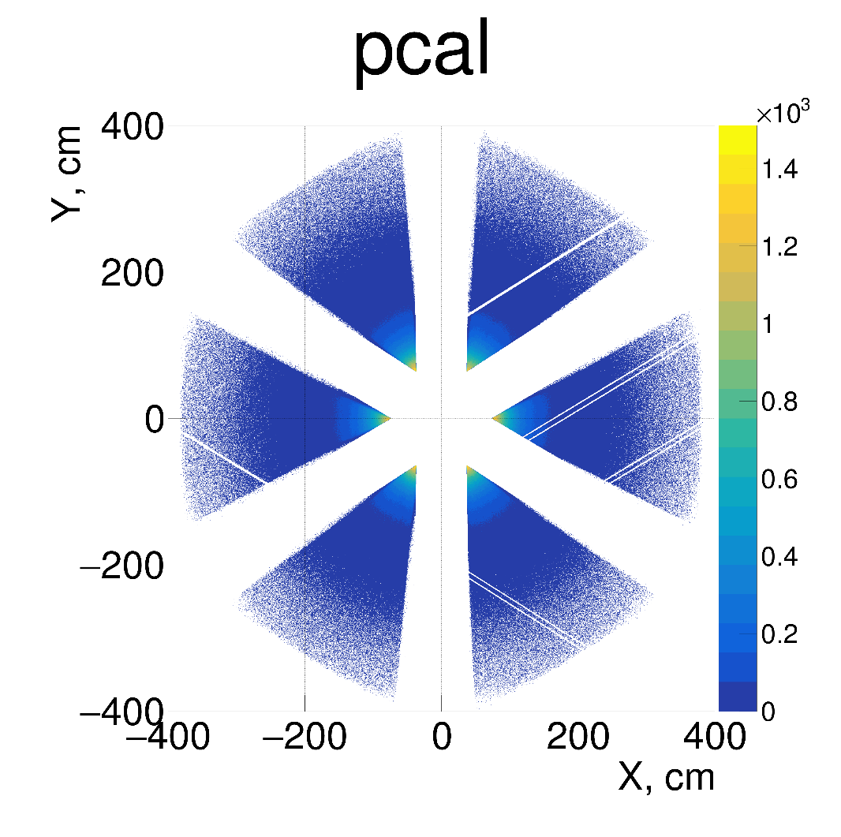
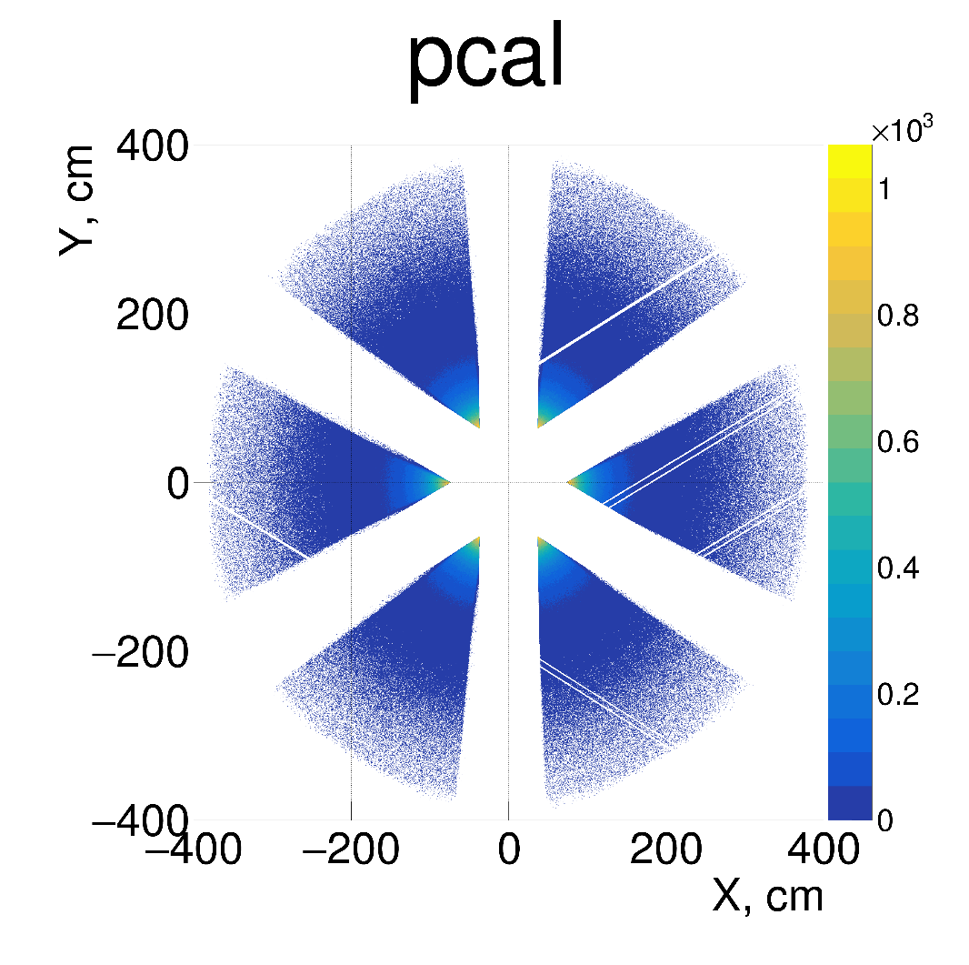
Simulation
Inclusive EG: M. Sargsyan, CLAS-NOTE 90-007 (1990).
Elastic tail + Inelastic radiated.
Kinematic range:
  Theta range 5 - 36°
  Scattered electron momentum 1.9 – 10 GeV
  Full Q² coverage.
  Additional kinematic smearing to match the resolution of reconstructed data.
Data Cuts
MC Cuts
Bad PMTs/swapped cables
Green – Data
Blue – MC reconstructed
PRELIMINARY
PRELIMINARY
PRELIMINARY
PRELIMINARY
PRELIMINARY
PRELIMINARY
PRELIMINARY
PRELIMINARY

Slide 12
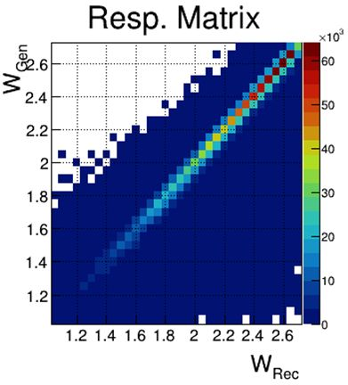
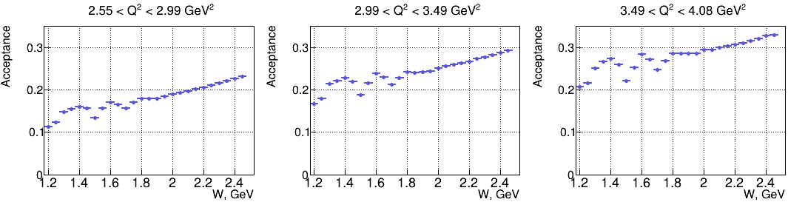
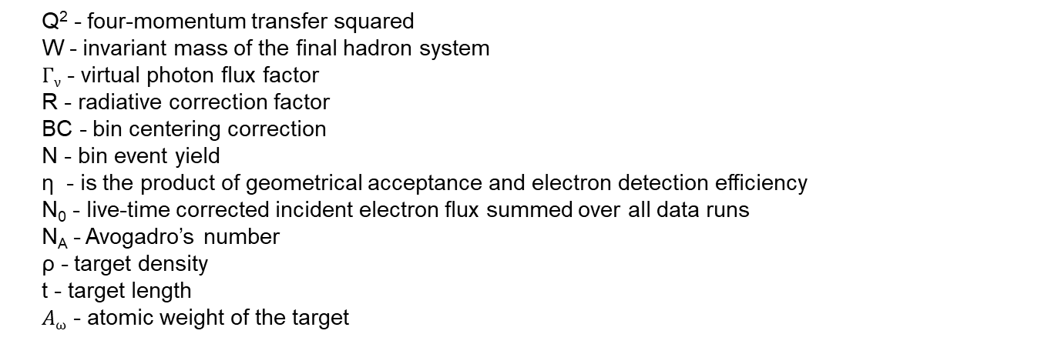
Acceptance and Efficiency
$$\frac{dσ}{dQ2dW}=\frac{1}{Γν} ∙\frac{1}{∆Q2∆W} ∙\frac{N}{η∙R∙BCC∙N0}∙\frac{1}{NAρt/Aω}$$
Q² - four-momentum transfer squared
W - invariant mass of the final hadron system
$Γν$ - virtual photon flux factor
R - radiative correction factor
BC - bin centering correction
N - bin event yield
η - is the product of geometrical acceptance and electron detection efficiency
N₀ - live-time corrected incident electron flux summed over all data runs
N_{A} - Avogadro’s number
ρ - target density
t - target length
$Aω$ - atomic weight of the target
CLAS12 detector system described in “GEMC^{”1,} a detailed GEANT4 simulation package.
SVD unfolding procedure was used Nucl.Instrum.Meth.A 372 (1996) 469-481
Same reconstruction algorithm used for simulation and data – ~10-40% acceptance depending on the bin.
M. Ungaro et al., “The CLAS12 Geant4 simulation,” Nucl. Instrum. Meth. A, vol. 959, p. 163422, 2020.

Slide 13
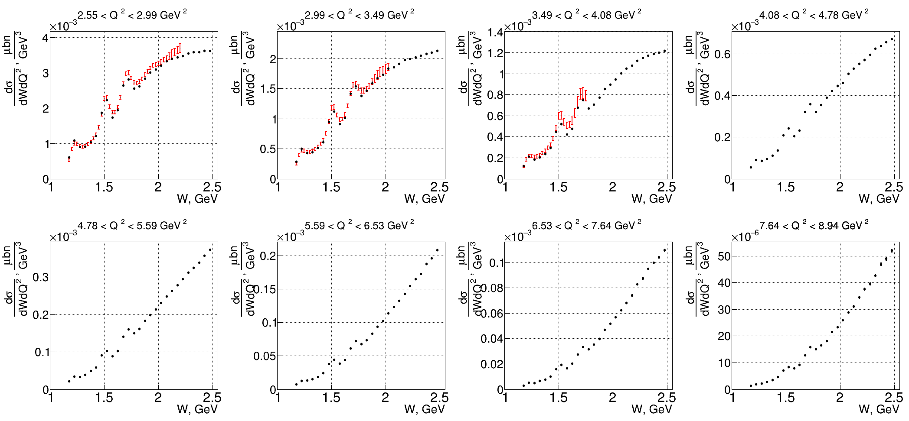
Preliminary Results
Preliminary CLAS12 measurements
CLAS data (after interpolation into the grid of our experiment), Phys. Rev. D67, 092001 (2003)
PRELIMINARY
PRELIMINARY
PRELIMINARY
PRELIMINARY
Only statistical errors.
PRELIMINARY
PRELIMINARY
PRELIMINARY
PRELIMINARY

Slide 14
Summary
Preliminary results on inclusive electron scattering cross sections are available from CLAS12 in the kinematic range of 1.18 < W < 2.50 GeV and 2.6 < Q² < 9.0 GeV² and show agreement with world data in overlapping Q² regions within 20%.
First data with broad coverage in W over the entire resonance region up to Q² = 9.0 GeV² where the transition from quark-gluon confinement toward pQCD is expected to take place.
Inclusive electron scattering data from CLAS12 and the evaluated resonant/non-resonant contributions will be important in order to gain insight into the ground state nucleon PDF at large values of x in the resonance region.

Slide 15
Back up

Slide 16
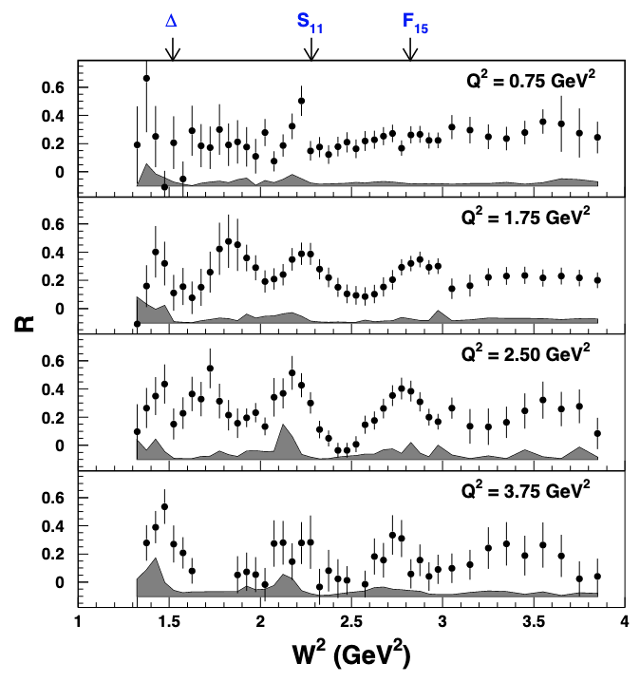
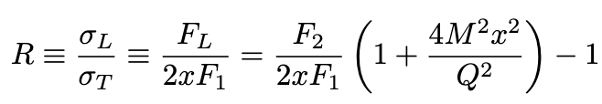
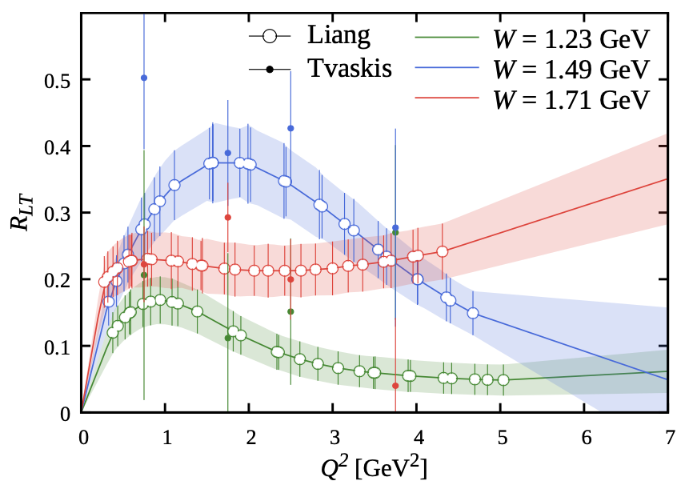
Updated R = σ_{L}/σ_{T}
Hall C data allows for Rosenbluth separation of 167 data points.
First separate values of F₁ and F_{L} in this kinematic regime.
A. N. Hiller Blin et al., Phys. Rev. C 104 (2021) 2, 025201, [hep-ph 2105.05834]
Predictions at higher Q² performed by fitting a second-degree polynomial to the grid of the Hall-C results.
Y. Liang et al. (Jefferson Lab E94-110 Collaboration), [nucl-ex 0410027]

Slide 17
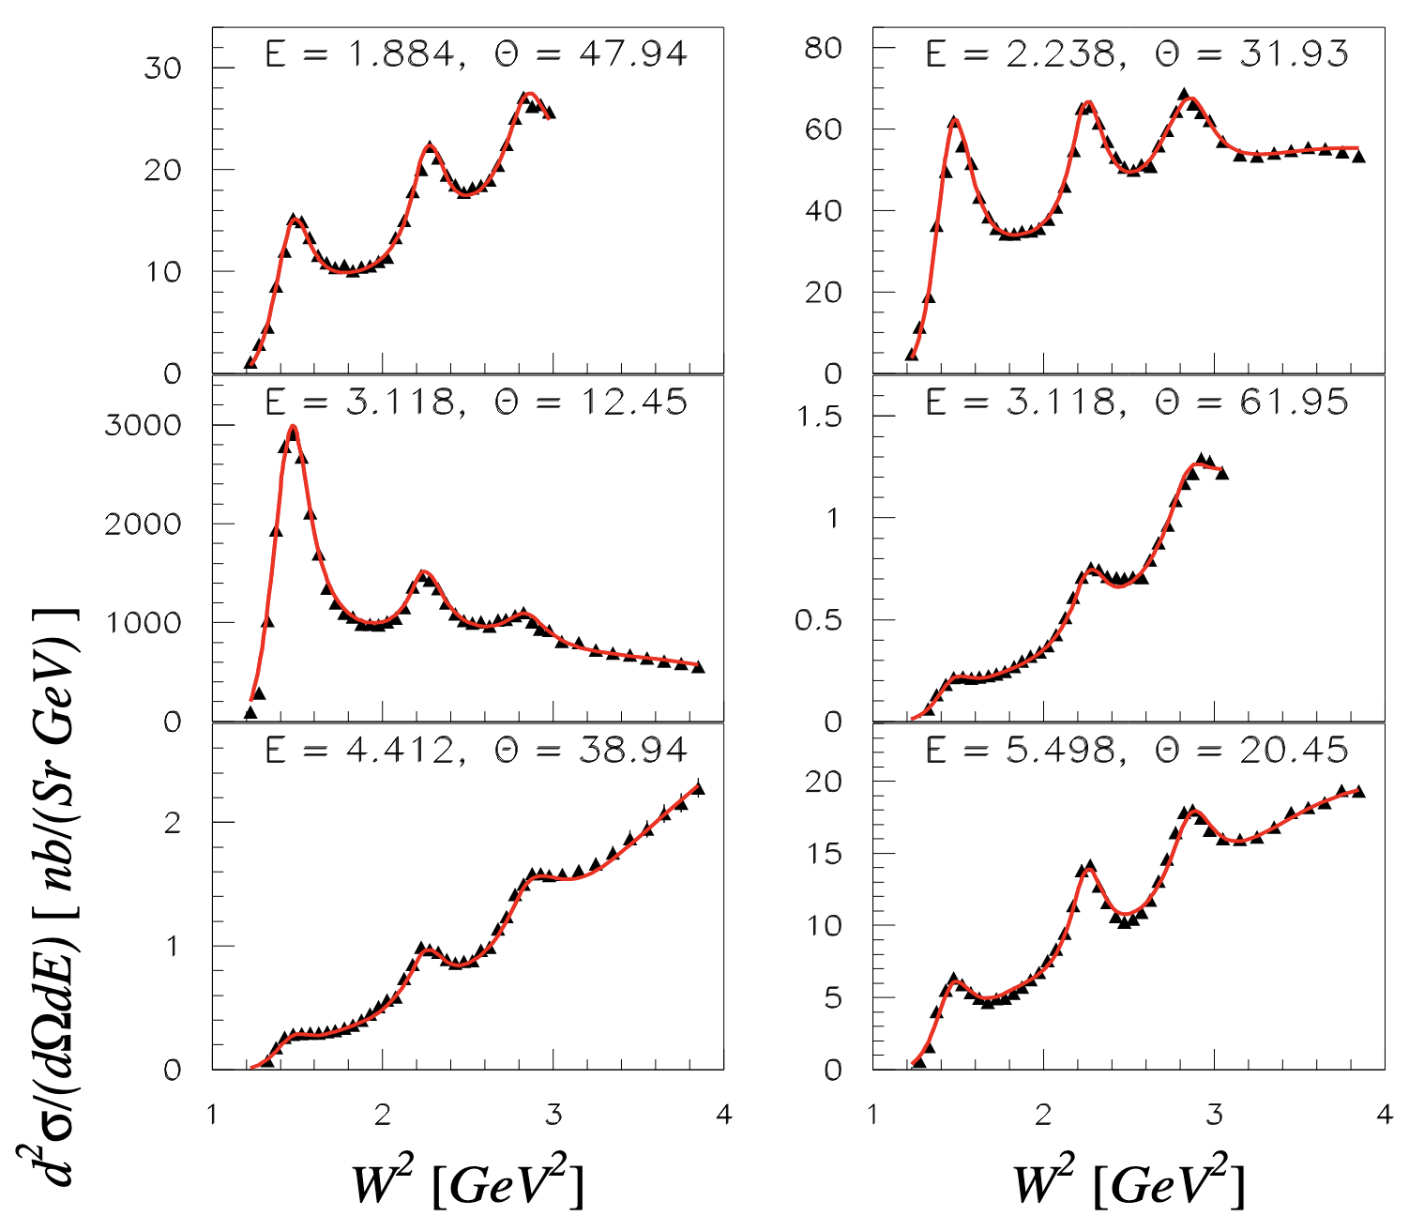
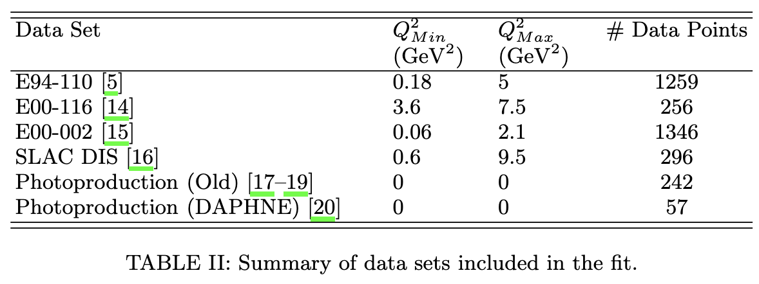

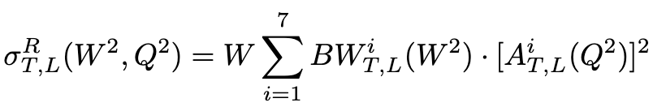
Empirical fit in the Resonance Region
Fit by Christy & Bosted (2010).
Constrained by L/T separated cross section measurements from Hall C.
Fit incorporates photoproduction data at Q² = 0.
Smooth transition from photoproduction all the way into the DIS region.
M.E. Christy & P.E. Bosted, Phys. Rev. C 81 (2010) 055213, [nucl-ex 0712.3731]
Cross section is the incoherent sum of contributions from resonance and non-resonance production.
Resonant cross section defined by threshold-dependent BW forms with Q² dependent amplitudes.
Non-resonant background varies smoothly with W.

Slide 18
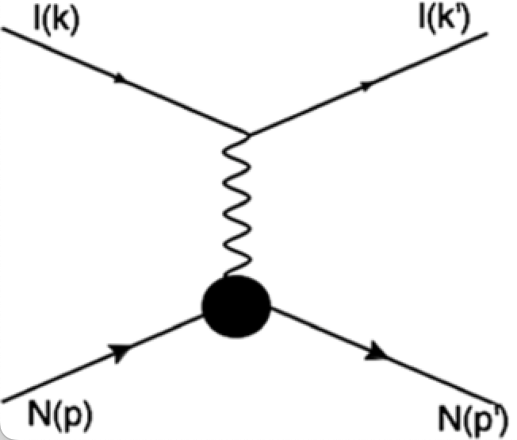
Structure Functions in Inclusive Scattering
Inclusive F₁ and F₂ structure functions are related to the total virtual photon-nucleon cross sections σ_{T} and σ_{L} for transversely and longitudinally polarized photons,
F₂ can be written in terms of the unpolarized cross section (measured here).
Convenient to define the longitudinal structure function F_{L} in terms of the longitudinal cross section (or F₁ and F₂).
R is the ratio of longitudinal to transverse cross sections.
Total inclusive cross sections have been measured extensively but the ratio R is known with much less accuracy.
c.f. A. N. Hiller Blin et al., Phys. Rev. C 104 (2021) 2, 025201, [hep-ph 2105.05834]

Slide 19
Systematics
Sector dependence
Pion misidentification as electrons
Model dependence (RC, BCC, etc.)
Momentum corrections

Slide 20
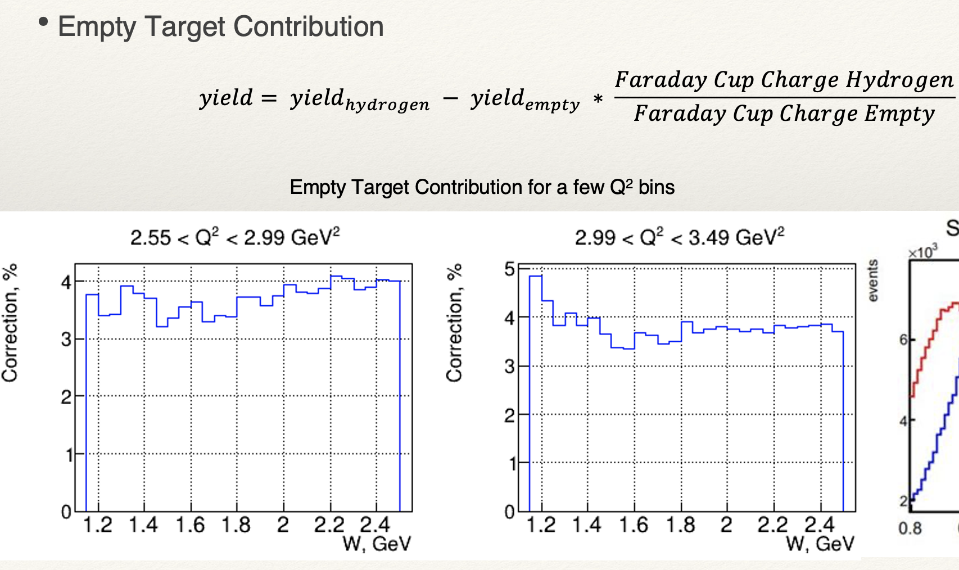
Empty Target

