Slide 1
Search for First Strange Hexaquark With CLAS12
Geraint Clash
University of York, UK

Slide 2
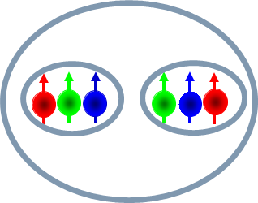
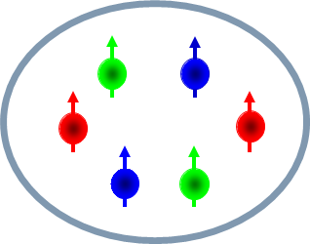
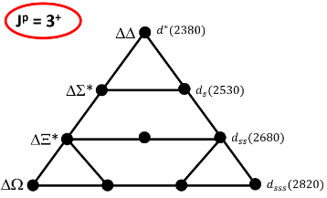
Motivation
What are Hexaquarks?
Mesons, Baryons and then exotic states (tetra, penta and hexa)
d* Antidecuplet
Hexaquark or Molecule?
Why are they important?
QCD many body effects
High density
Neutron stars
Early universe
Mihai Macanu - earlier talk
Dr. Mikhail Bashkanov – talk on Thursday
Me
Matthew Nicol – talk on Friday
M. Bashkanov et al., arXiv:2012.11449v1
1
Notes:
Why are they important?
Fantastic object to study many body effects

Slide 3
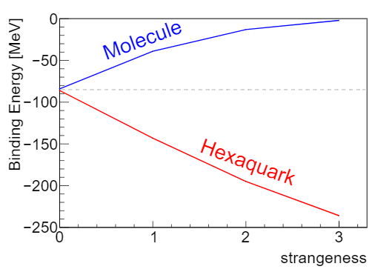
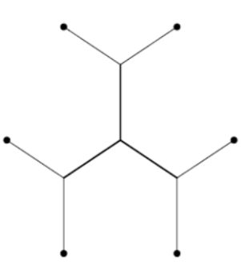
Motivation
$$d_{sss}$$
$$d^{∗}$$
$$d_{s}$$
$$d_{ss}$$
M. Bashkanov et al., arXiv:2012.11449v1
2
Notes:
We will keep the branching ratios in mind for how ive looked for the d_s

Slide 4
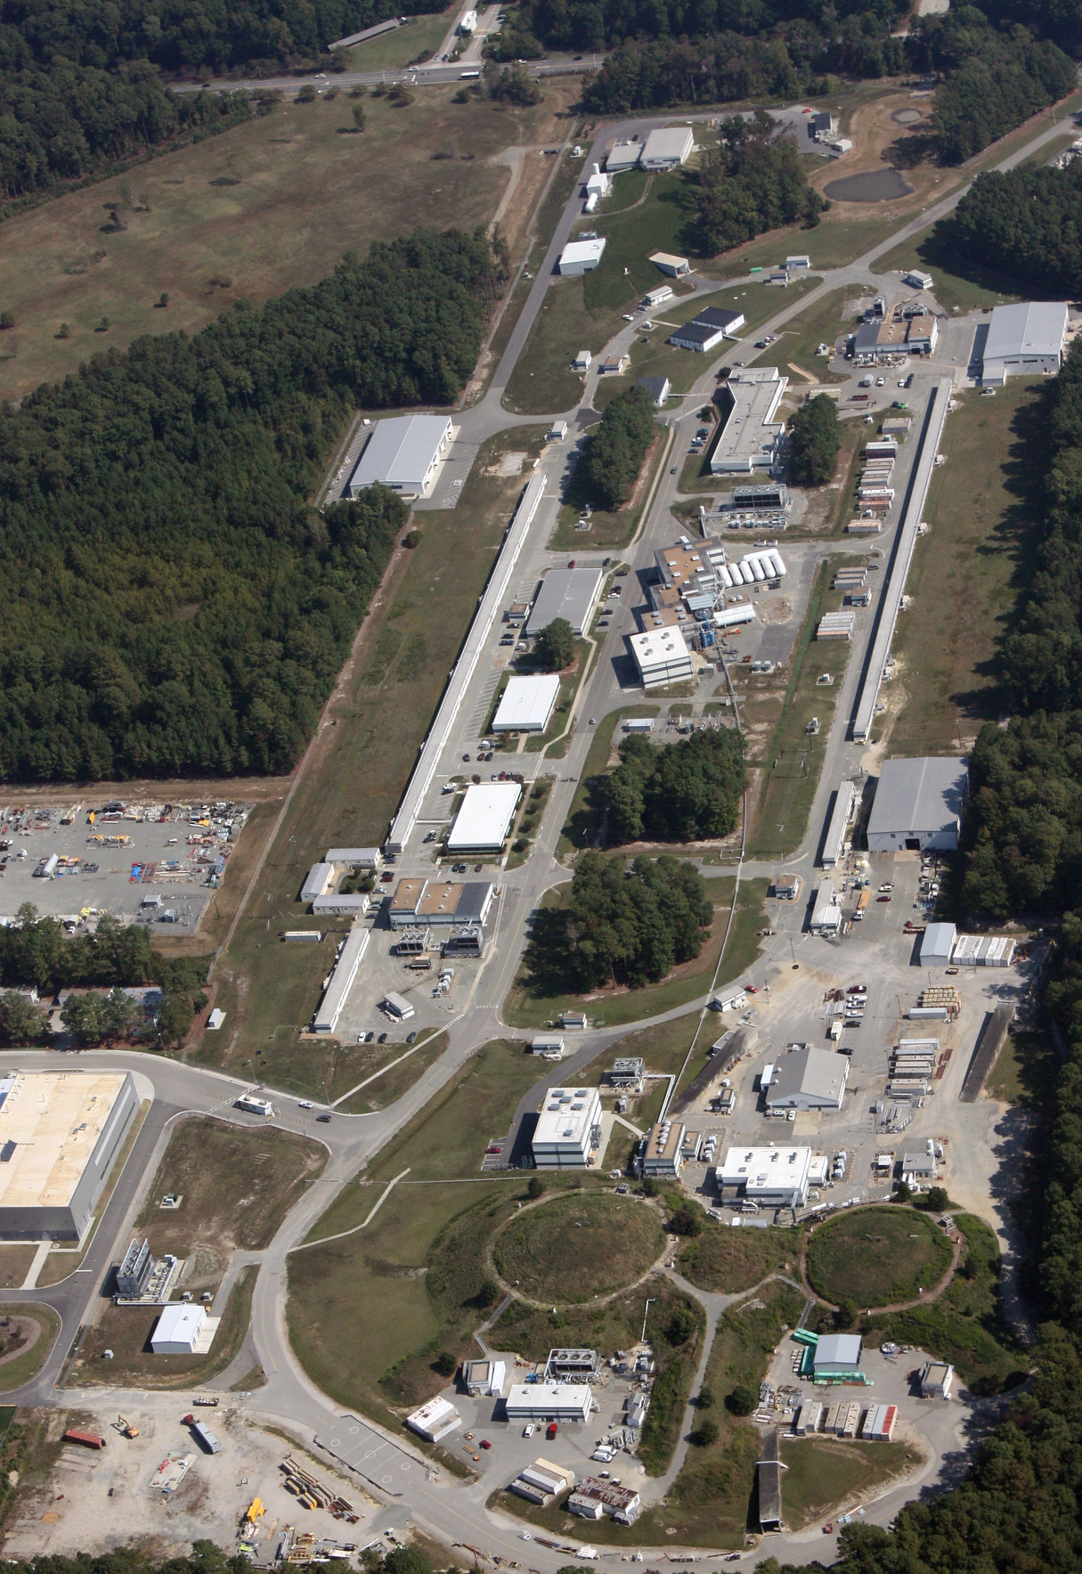
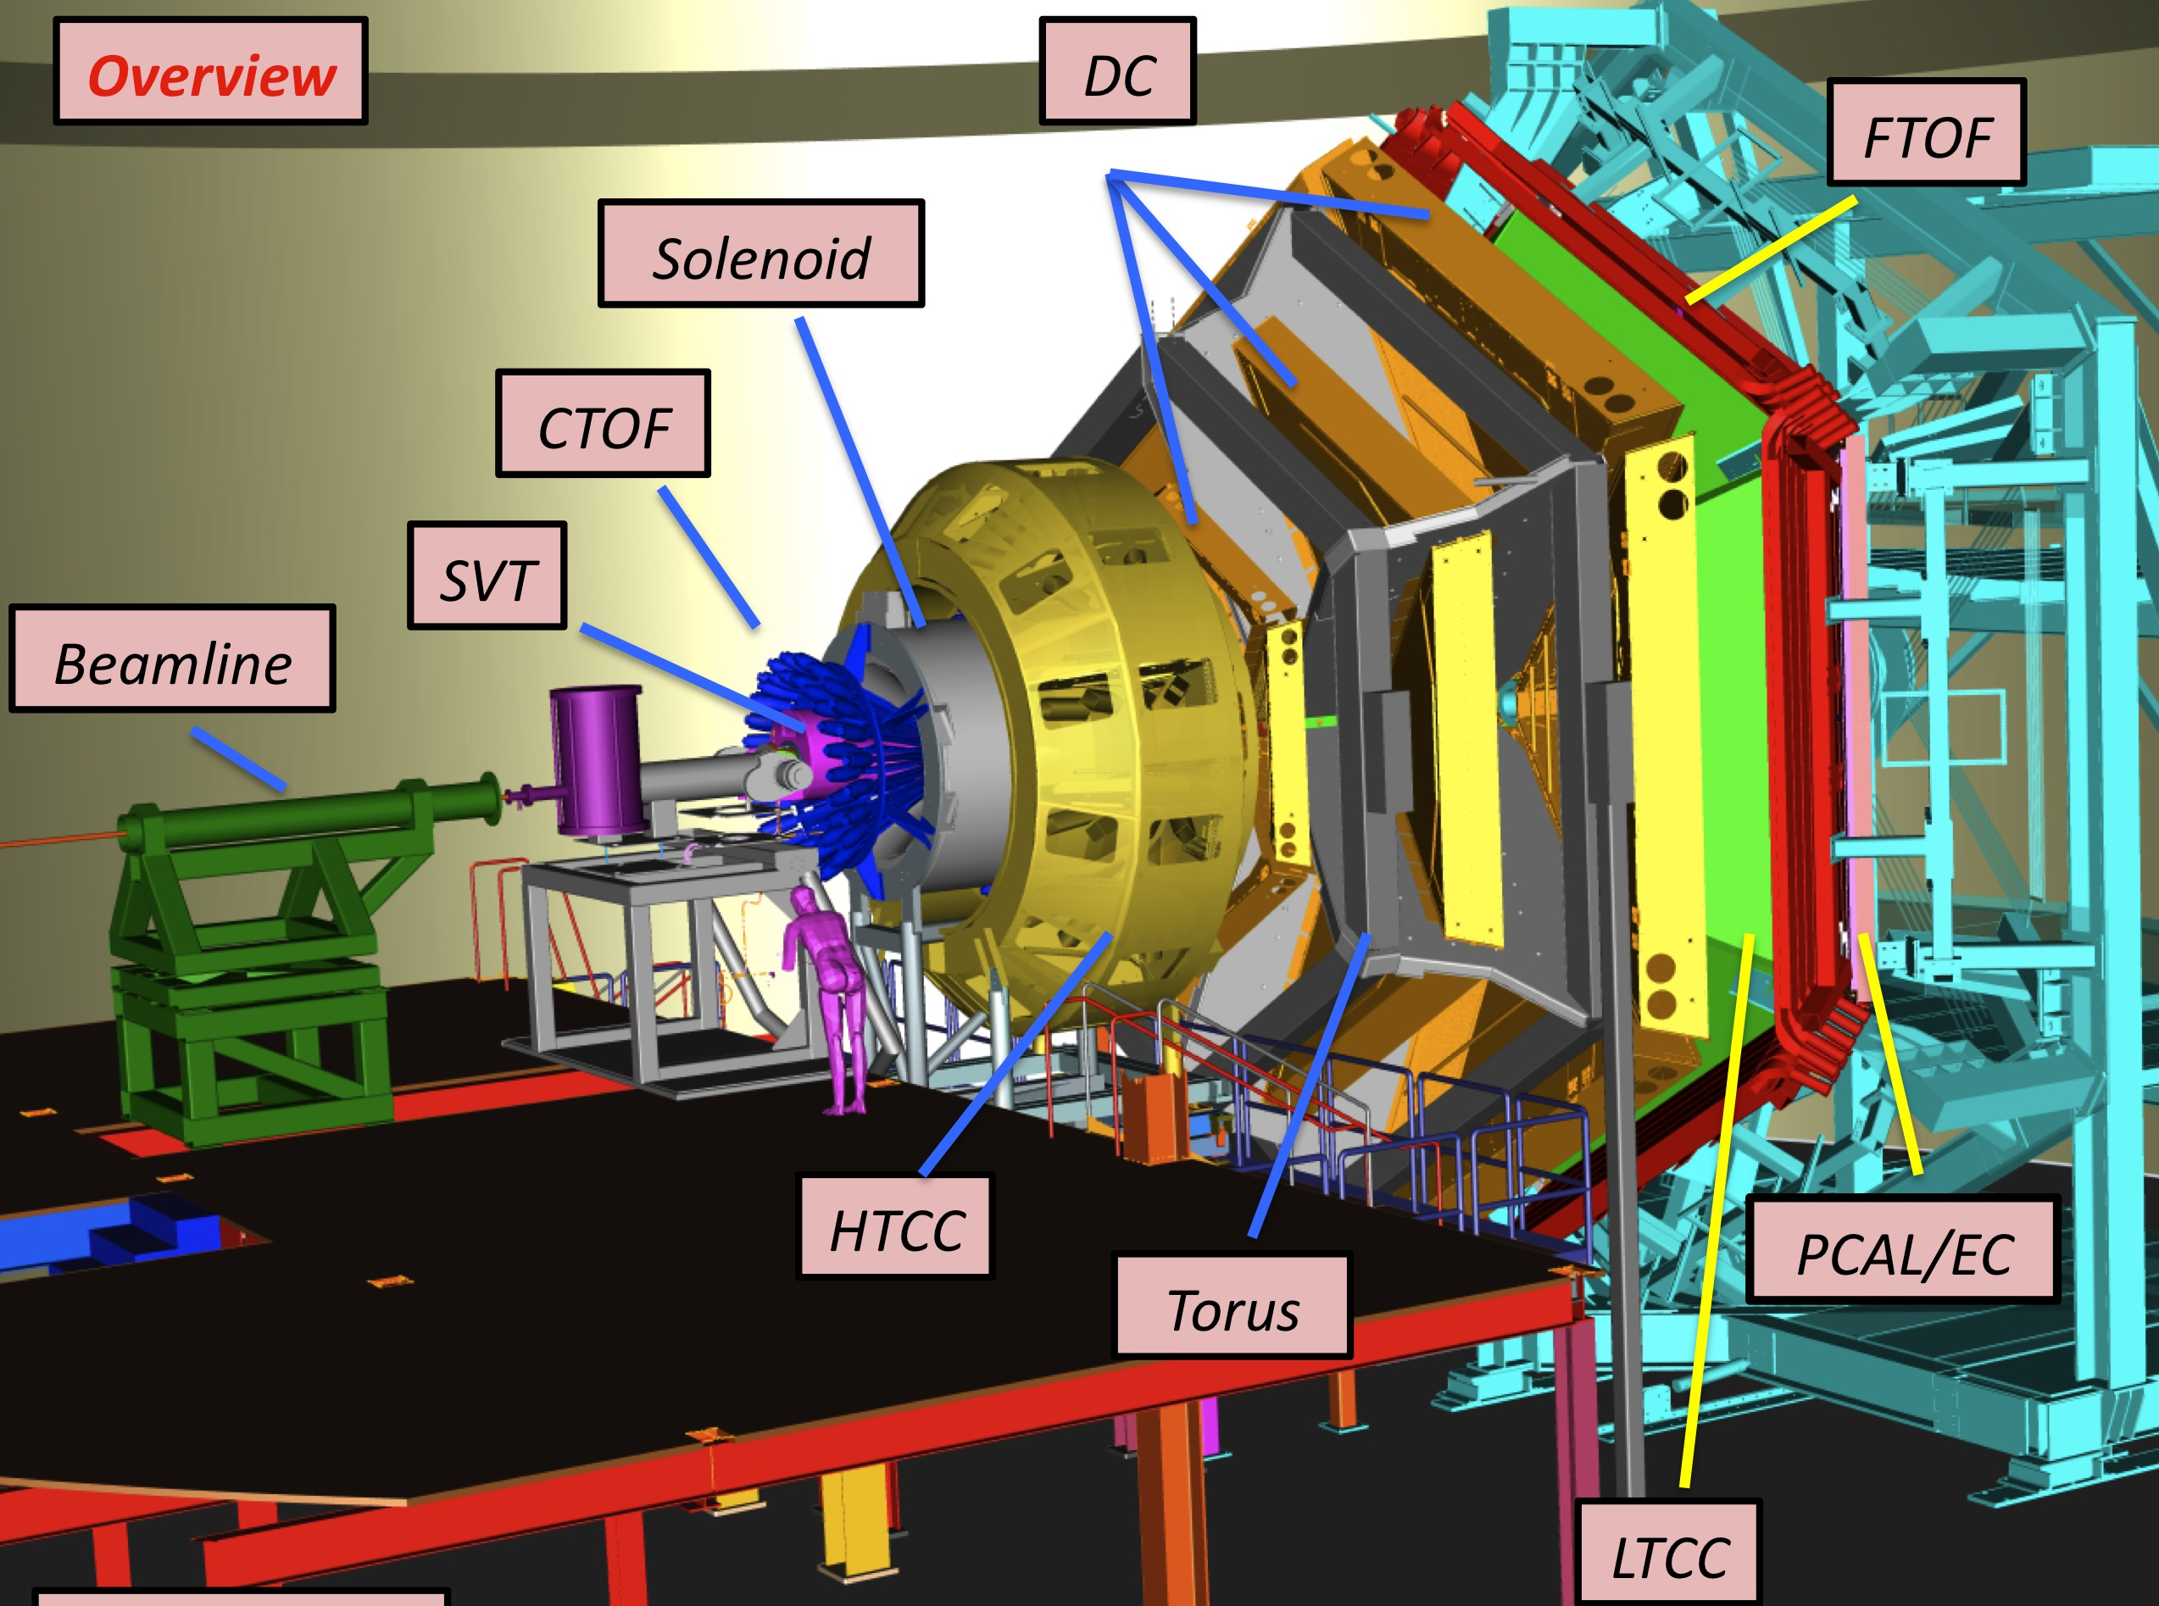
JLab
CEBAF gives electron beam
2 parallel linacs
At energy (10.2 – 10.6 GeV) beam enters halls
Hall b is where CLAS12 lives
3

Slide 5
What I am looking for
Reaction Channel:
$$e$$
$$e′$$
$$γ$$
$$K^{+}$$
$$n$$
$$K^{−}$$
$$p$$
$$Λ$$
$$d$$
$$d_{s}$$
$$π^{−}$$
4
Notes:
Pop feynman in here

Slide 6
Missing Mass
Reaction Channel:
$$e+d −e^{′}−K^{+}=d_{s}$$
5
Notes:
Pop feynman in here

Slide 7
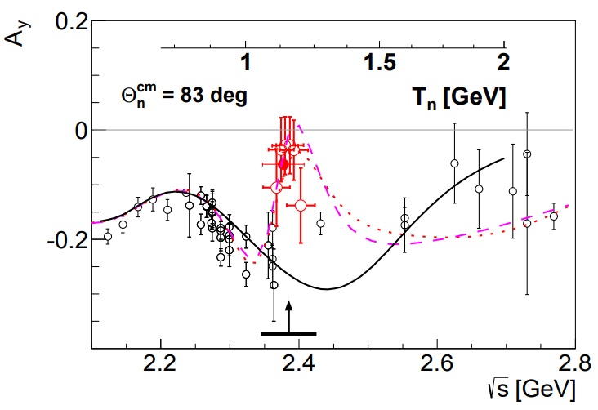
Main Goal
Why this channel
Polarization
Lambda self analysing
Lambda 100% polarized
$$d^{∗}$$
$$π^{−}$$
$$p$$
P. Adlarson et al., Phys. Rev. Lett. 112, 202301 (2014).
6
Notes:
Polarization known from theory argument with spins and experiment with d* to pn

Slide 8
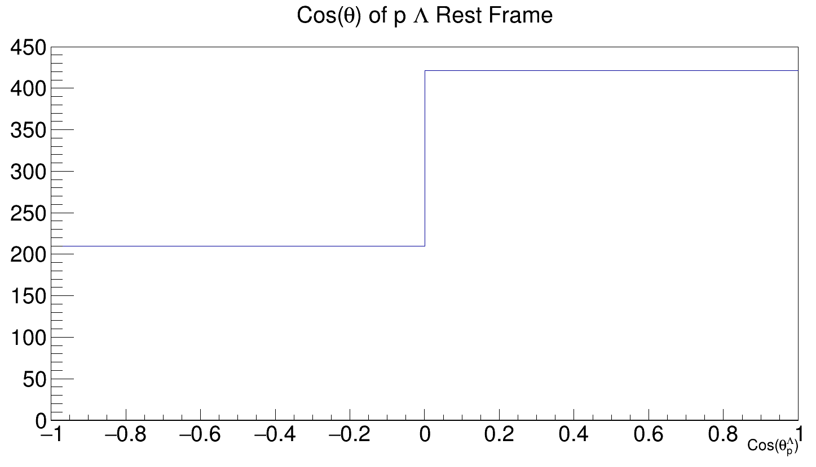
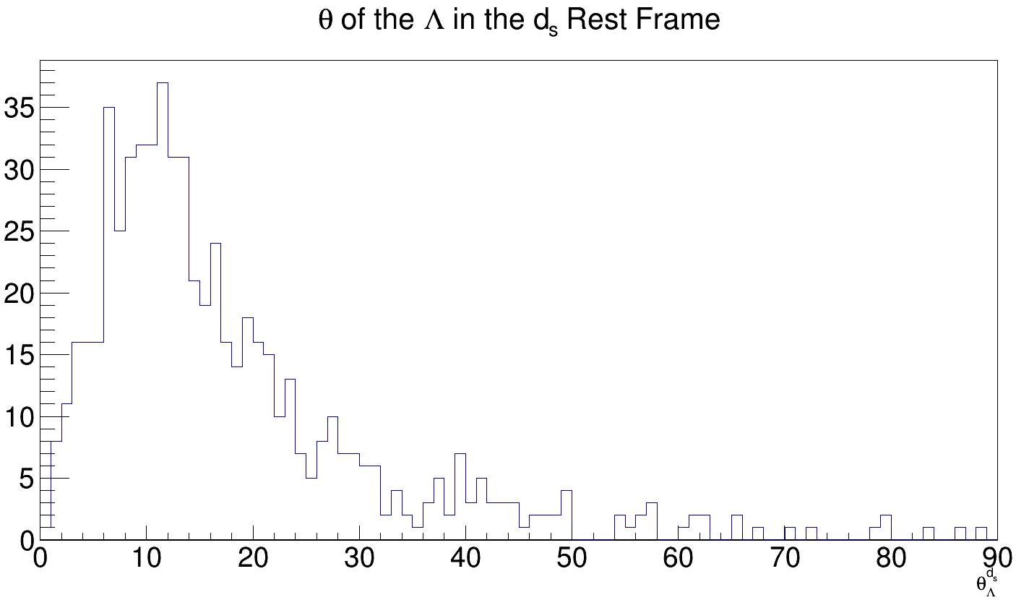
$θ_{b}^{a}$ theta of particle b in the rest frame of particle a
Preliminary
$$P_{y}=\frac{N_{+}−N_{−}}{\frac{α}{2}(N_{+}+N_{−})}$$
Preliminary
7

Slide 9
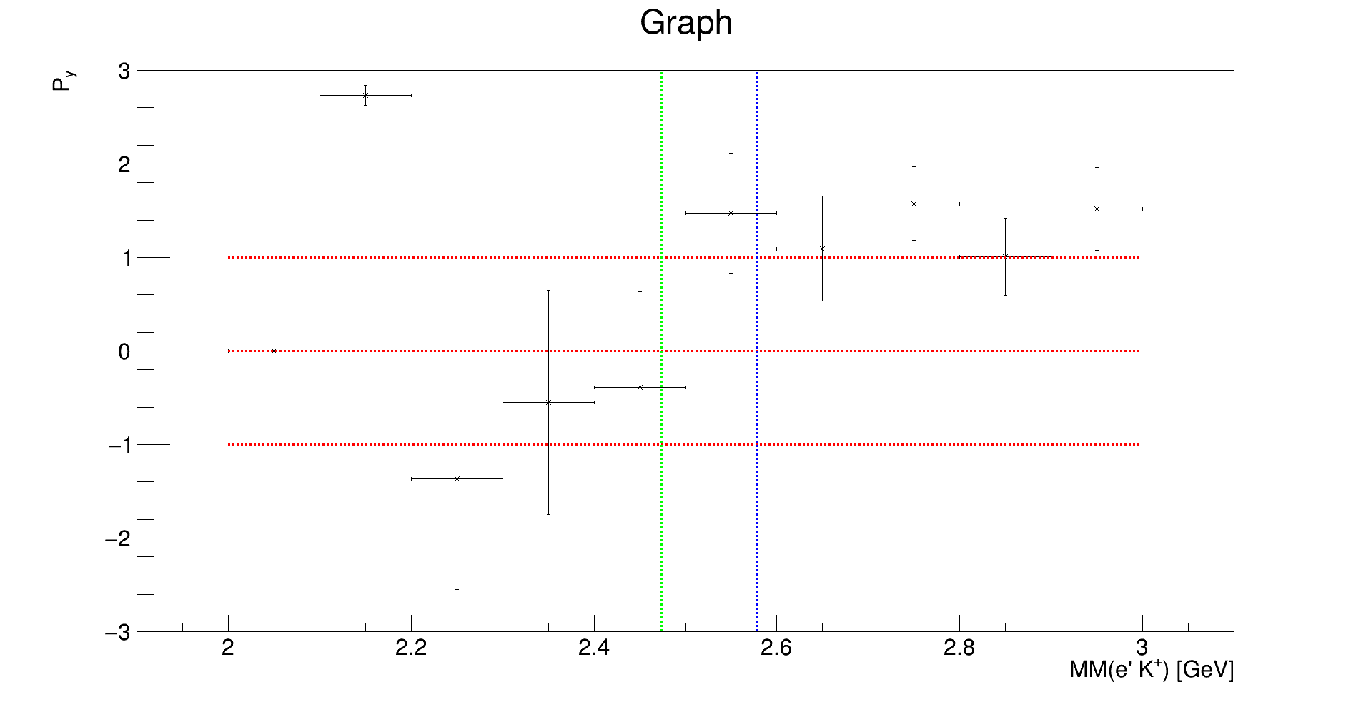
$${0<Q}^{2}<2.5$$
$$0<θ_{Λ}^{d_{s}}<20$$
Preliminary
8

Slide 10
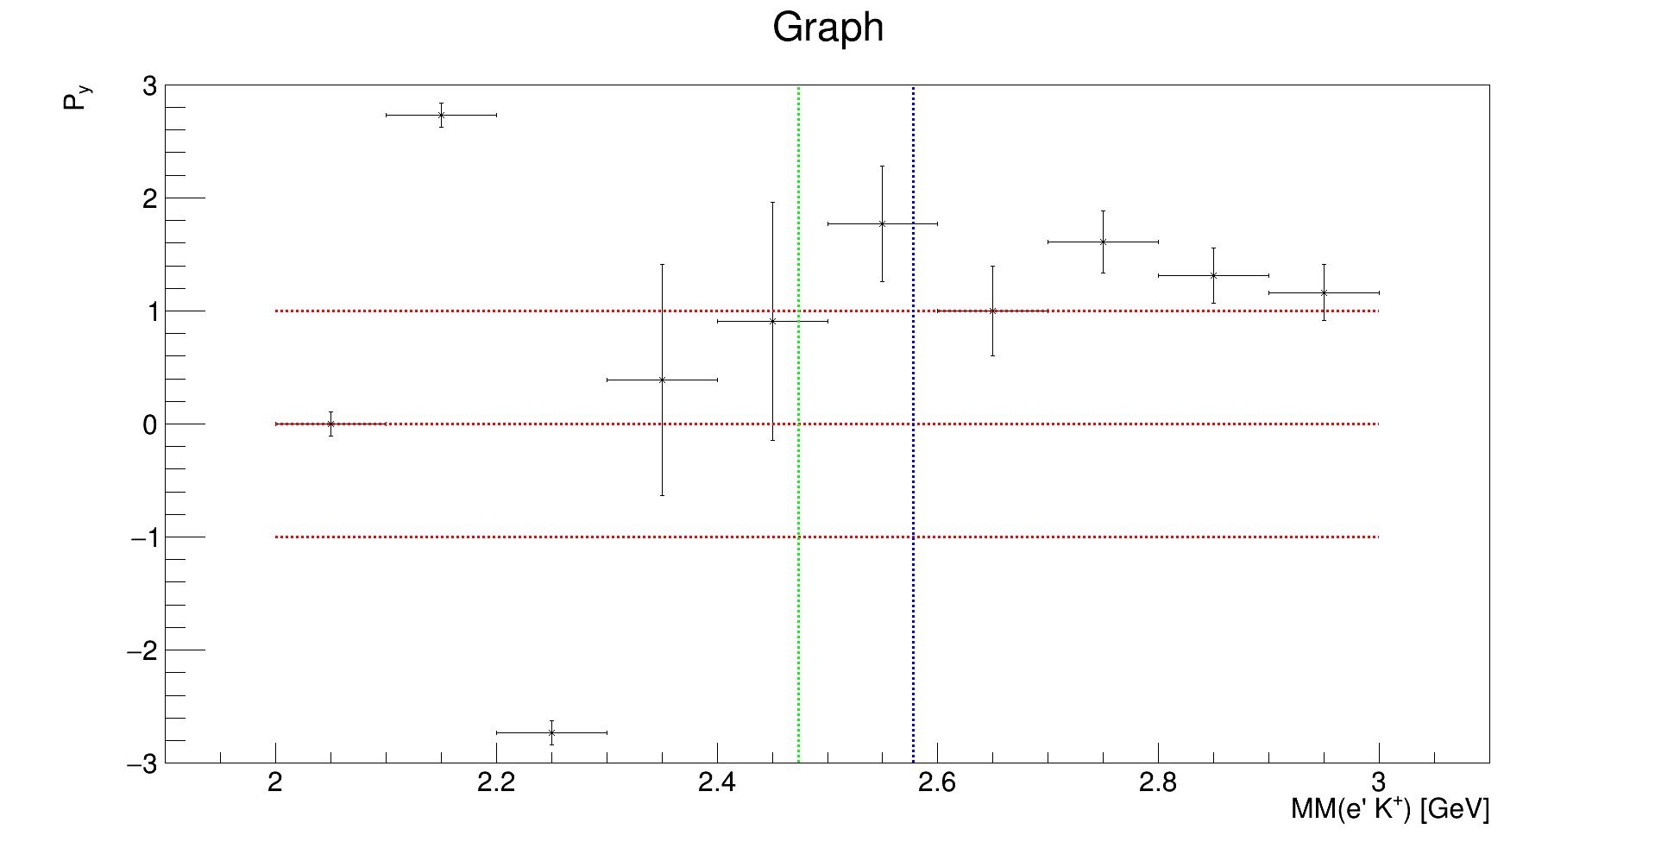
$${2.5<Q}^{2}<5$$
$$0<θ_{Λ}^{d_{s}}<20$$
Preliminary
9

Slide 11
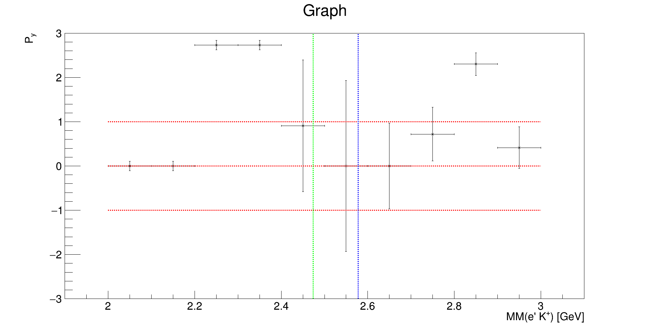
$$Q^{2}>5$$
$$0<θ_{Λ}^{d_{s}}<20$$
Preliminary
10

Slide 12
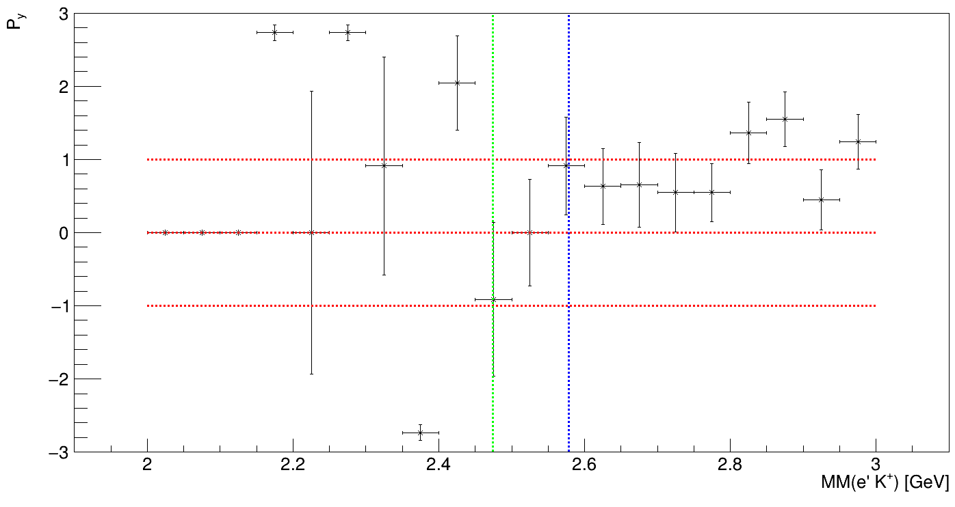
$$0<θ_{Λ}^{d_{s}}<40$$
Preliminary
11

Slide 13
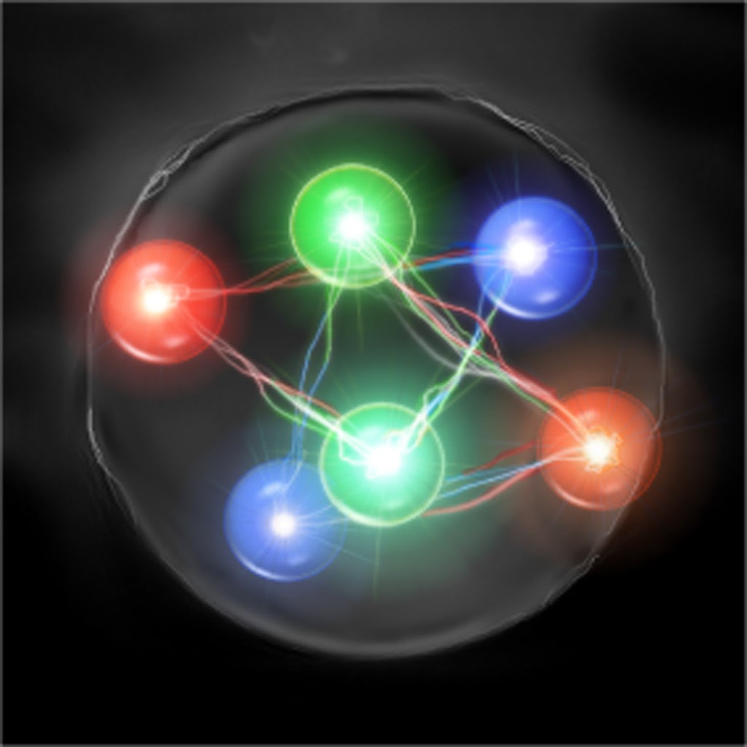
Summary
Not acceptance corrected (soon)
Continue to benchmark with $Λ$ off proton
Try multi bin method
Have not found ds yet
12
Notes:
Polarization known from theory argument with spins and experiment with d* to pn

Slide 14
Thank You Any Questions?

