Slide 1
Many Proton Knock-Out From Nuclear Targets Using Real Photon Beams
Rhidian Williams
June 16th , 2022
Rhidian Williams
June 16th , 2022 1/12
Notes:
Today I will talk about many proton knock-out from nuclear targets using real photon beams.

Slide 2
Preview
P₁
¹²C
P₂
ᵞ
¹⁰Be
Rhidian Williams
June 16th , 2022 2/12
Notes:
This is a quick depiction of what happens we have an incident beam on a nuclear target and then many protons are knocked-out and a residual target is produded.

Slide 3
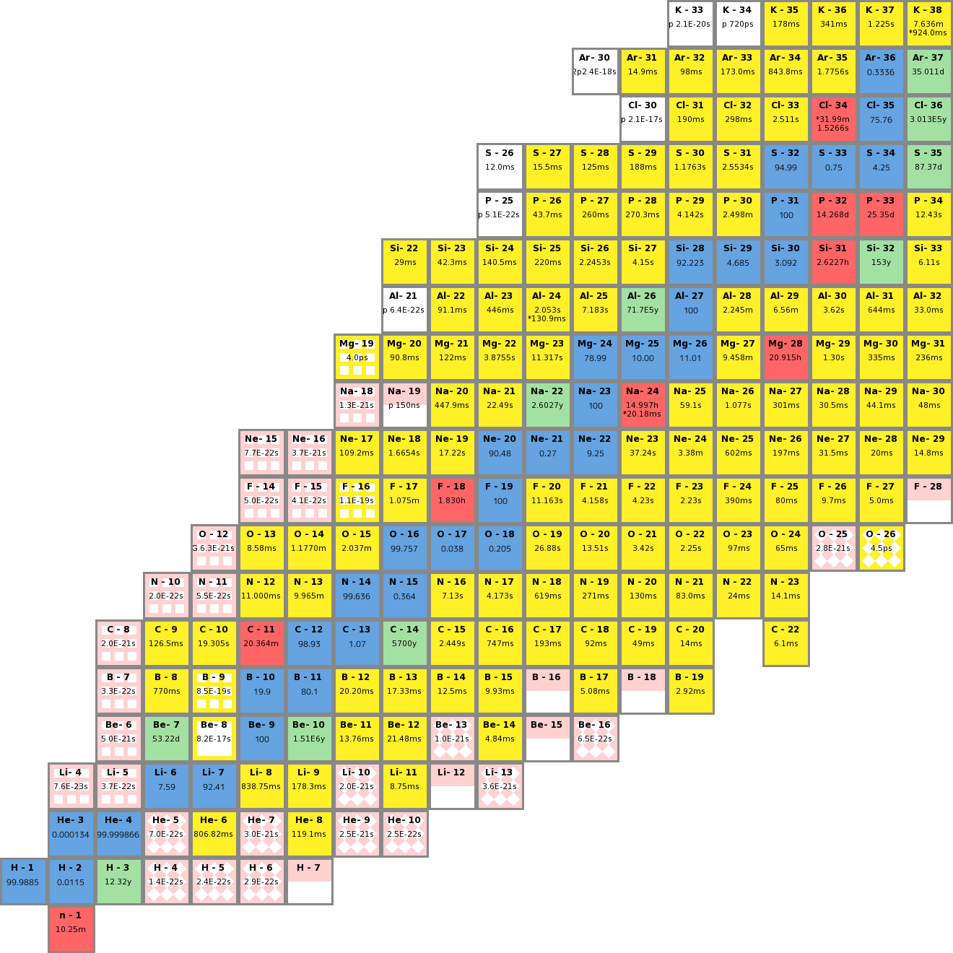
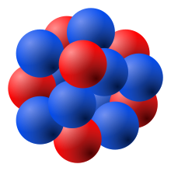
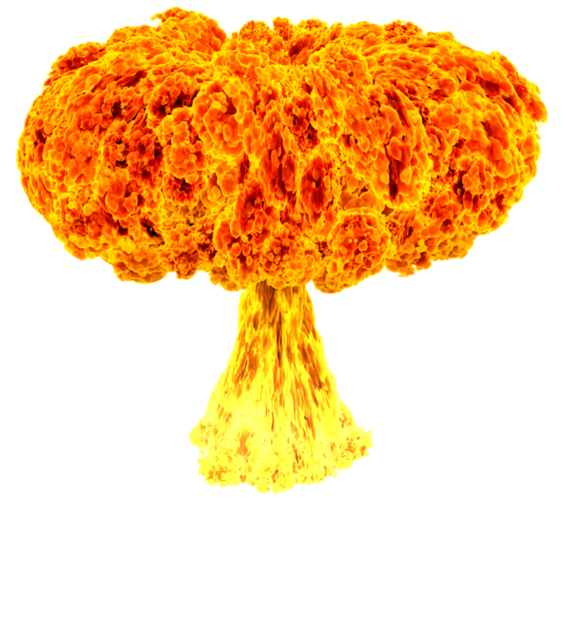
Motivation
Photon beams as a spallation source
Reach exotic nuclei
Comparison with simulation
Many body physics
Interpret dominant interactions
Number of protons
Number of protons
²⁰⁸Pb
Number of neutrons
Number of neutrons
Rhidian Williams
June 16th , 2022 3/12
Notes:
Let's start with some motivation for this study. The first would be to test the feasibility of photon beams as a spallation source, since photon beams have not been used for this kind of study before. In turn, this allows us to reach exotic nuclei within the nuclear chart. We will focus on the Carbon target and will study proton knock-outs which produced residuals along the line shown. We will compare our results with a theoretical model which will allow us to predict the nuclei we can possible create from heavier nuclei. Currently, the most feasible way to study heavier nuclei is to knock two slightly lighter atoms together to produce a larger one. The problem is that this produces proton rich nuclei. Using photon beams, we can take a lead target for example and knock-out many protons and reach neutron rich nuclei, important for studying the r-process. The r-process is a set of rapid neutron capture processes, responsible for the creation of about half of the atomic nuclei heavier than iron. Another important aspect of this study is its implications in further our understanding of many body physics, particularly given that many body calculations are difficult to model, but here we can fast track using phenomological model. We can also interpret dominant interactions, which is key to understanding the nuclear interactions that occur.
3

Slide 4
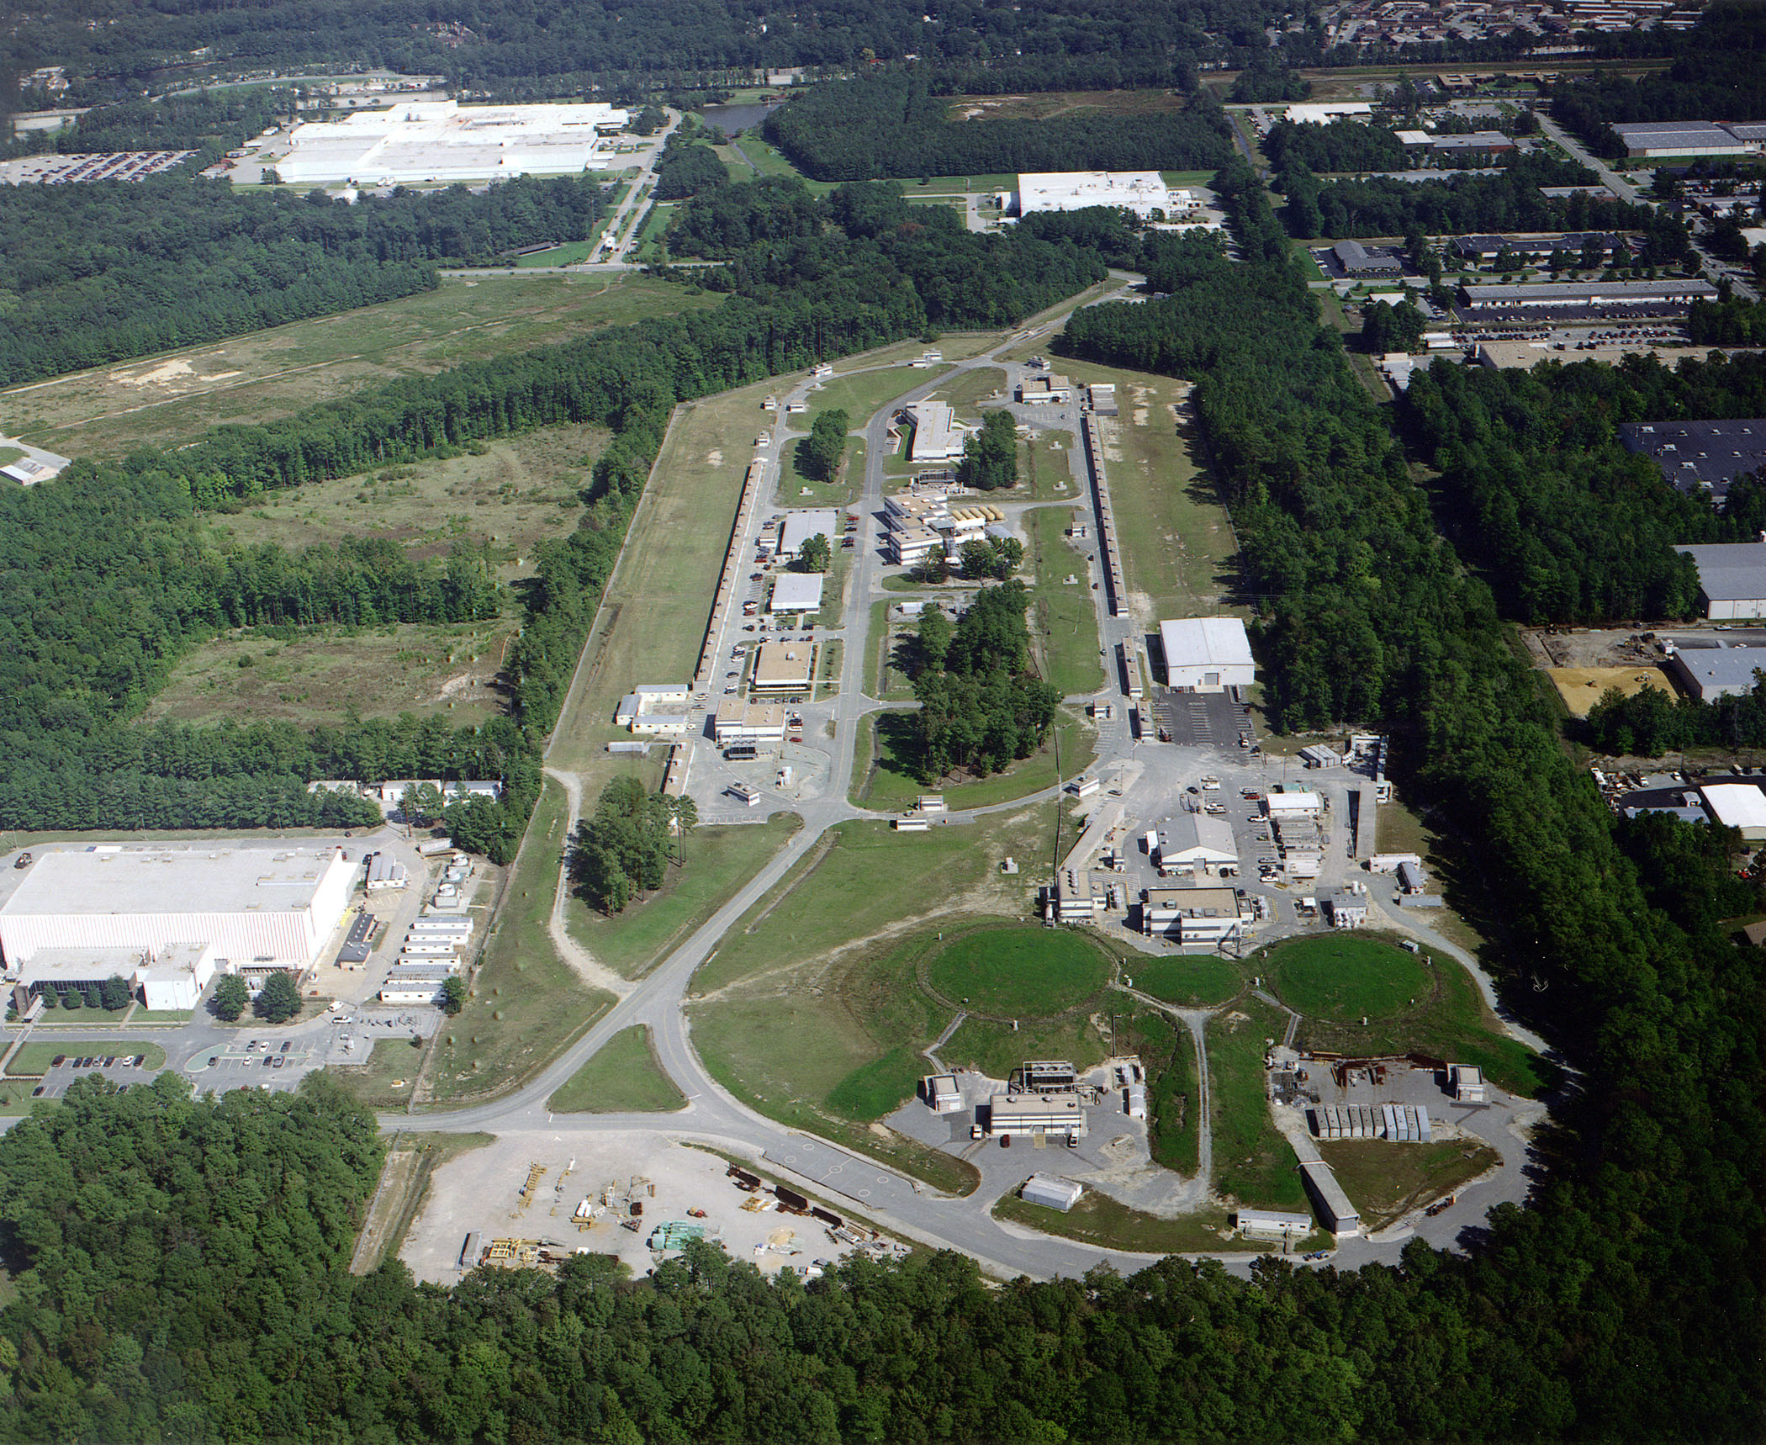
Thomas Jefferson National Laboratory
e⁻
A
B
C
Rhidian Williams
June 16th , 2022 4/12
Notes:
Some quick notes on the experimental aspects first. Jlab is a national particle accelerator where we have a continuous electron beam with energies up to 12GeV. The beam gets faster and faster and then is sent to one of the experimental halls where the particle experiments is conducted.

Slide 5
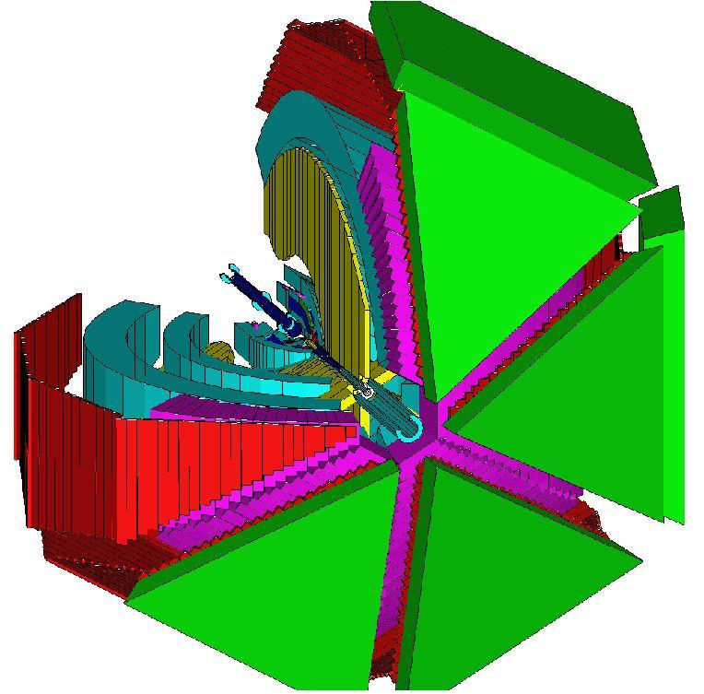
Experimental Details – FROST
Tagging Spectrometer
e⁻
ᵞ
Diamond Radiator
Tagged real photons
0.6 – 4.5 GeV beams
Nuclear targets
Rhidian Williams
June 16th , 2022 5/12
Notes:
Our experiment focuses on scattering an electron from a diamond radiator to produce real photon beams. These photons are tagged and their energy is determined by the tagging spectrometer, which allows us to study many interactions since we do not require the detection of the full final state. The photons then interact with the carbon targets and the particles are detected by the CLAS detector which has a nearly 4pi detection and excellent charged particle detection.
Show how big the detector is. Tagging spec allows for exclusive reactions without identifying all final state particles
5

Slide 6
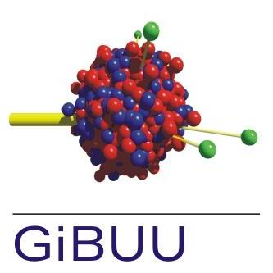
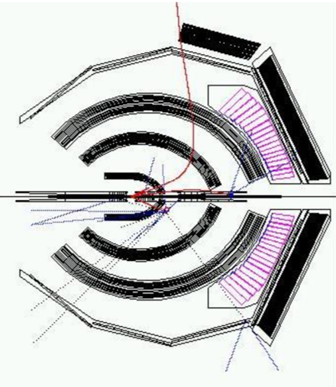
Simulation
Rhidian Williams
June 16th , 2022 6/12
Notes:
The simulation process begin with our theoretical model, GiBUU. It provides a complete dynamical description of particle interactions and has full knowledge of the final state. However, it is unhindered by detector acceptance and efficiency. We then process the events generated by GiBUU through a CLAS based simulation which models a virtual detector which mimics the real detector shown on the previous slide. The data is then processed in a manner similar to the experimental data where a fairer comparison can be made.
Virtual detector simulates the realistic detector shown previous slide
Process data through virtual detector, process them in manner identical to real data
Allows for fairer comparison
6

Slide 7
Particle Interactions
Some processes which could occur within the messy nucleus…
Pion Induced Chain Reaction
Proton-Proton Scattering
P₁
¹²C
P₂
ᵞ
¹⁰Be
Rhidian Williams
June 16th , 2022 7/12
Notes:
Next lets discuss some interactions that can occur in the nucleus. First we have a pion induced chain reaction, this is when the initial photon excites the proton to an excited state, called a resonance, and when the proton relaxes back to its ground state it is ejected from the nucleus and also ejects an additional particle, the pi zero. This pi zero then excites another proton and the cycle continues. The second example is proton-proton scattering where a proton is on its way out of the nucleus and bumps into a second proton in the nucleus, scattering from it and the two are ejected from the nucleus. These interactions occur over a small time of 10-24 and a small length of 3fm, so it is difficult to determine which interactions actually occurred, but what is important is the final satte, i.e. how many protons we have knocked-out.

Slide 8
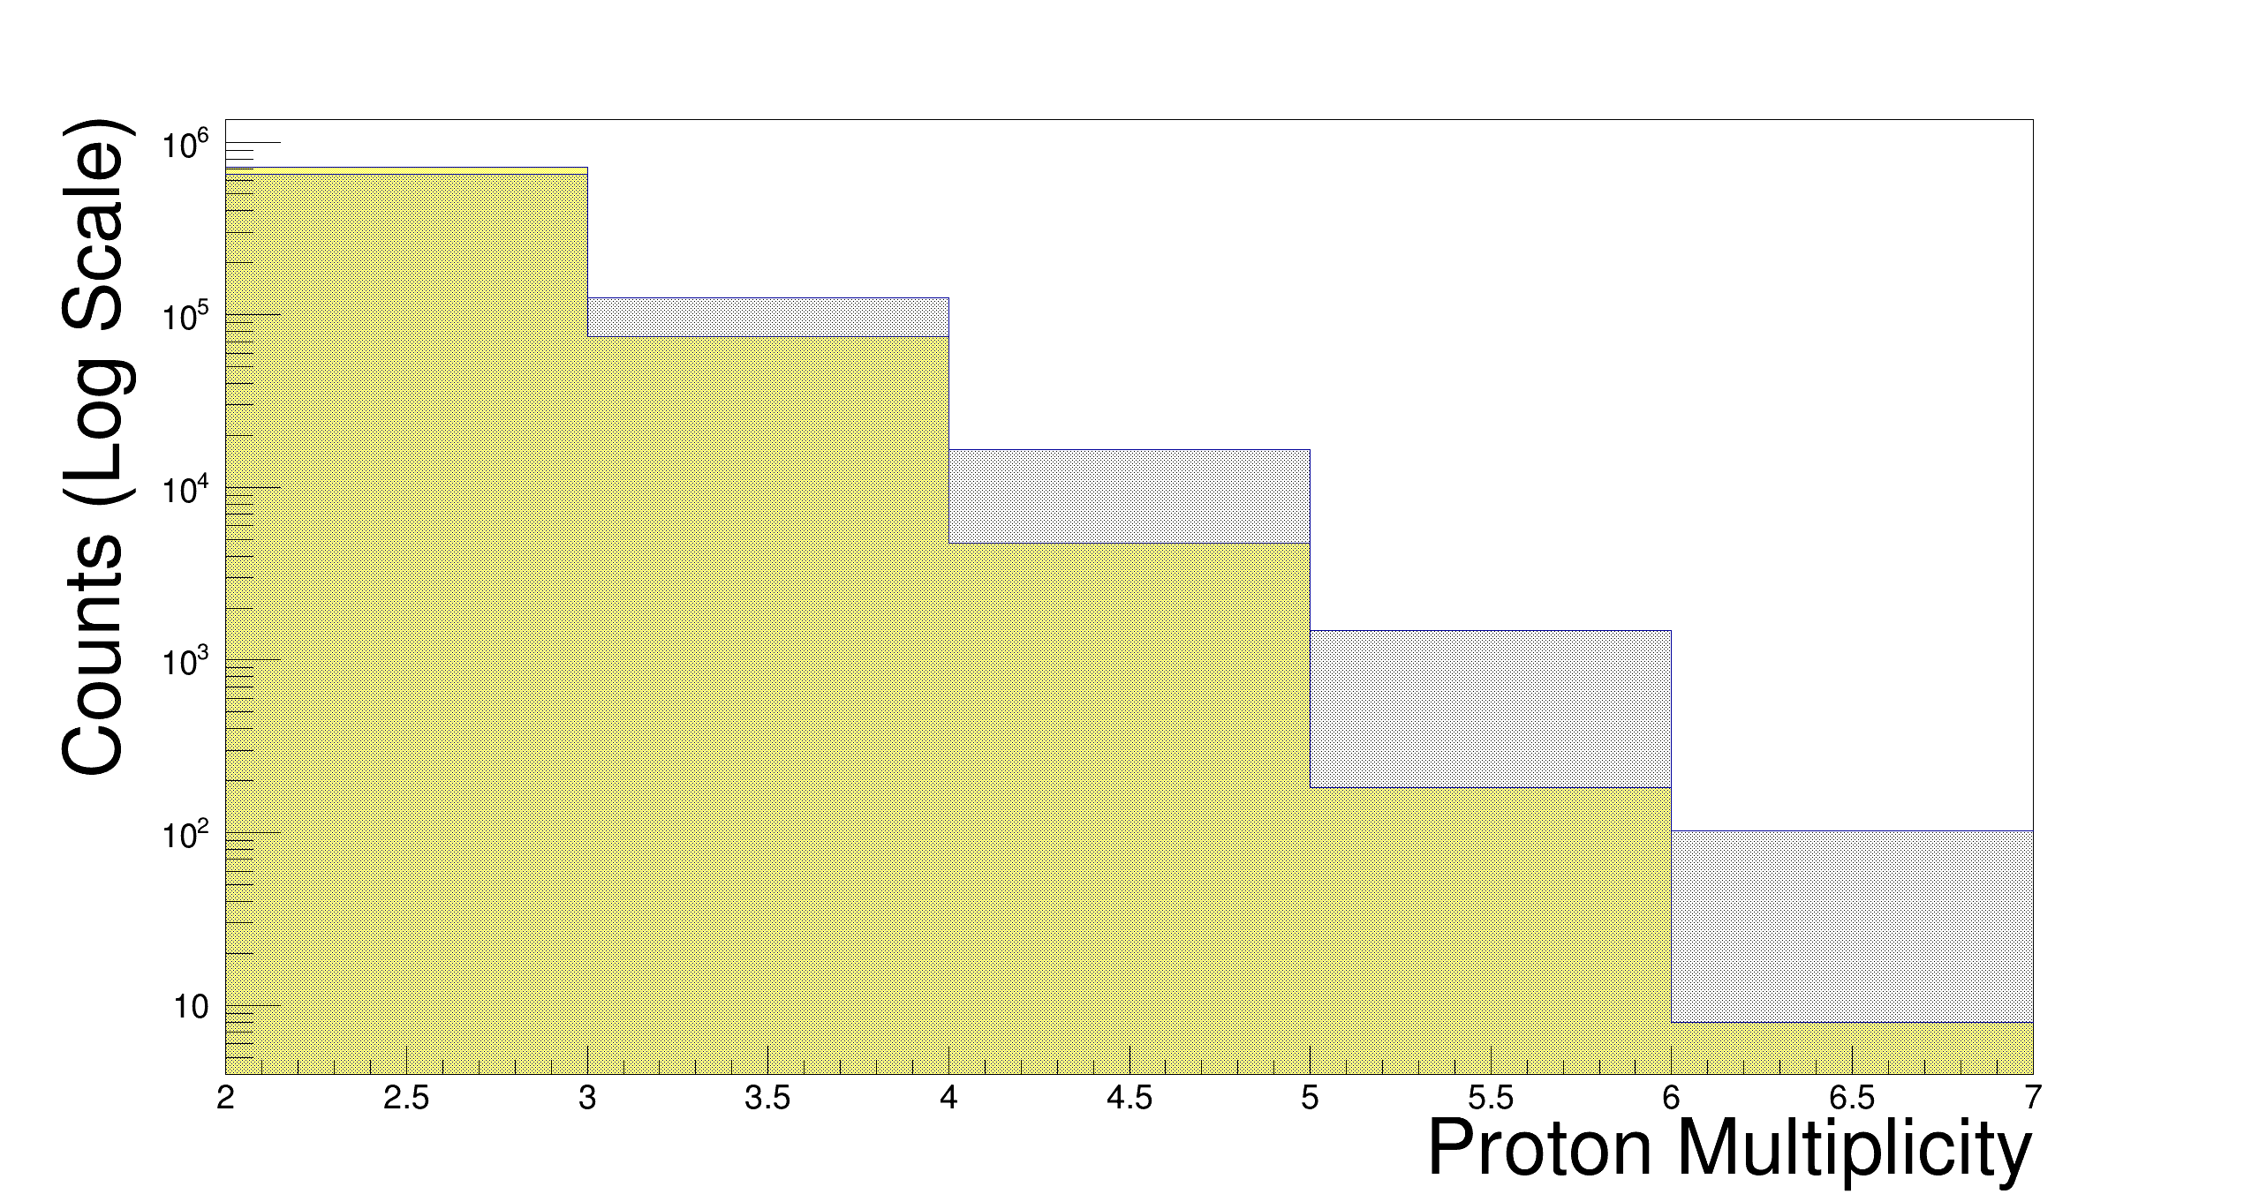
Proton Multiplicity
Theorists adapted model based on our results!
- Experimental Data
- Simulated Data
¹⁰Be
⁹Li
6 neutrons, ¹²C disintegrated
⁸He
⁷H
Rhidian Williams
June 16th , 2022 8/12
Notes:
After deducing the final states and finding the correct signatures of residual targets we can determine the proton multiplicities achieved. The yellow histogram is the experimental data and the black/shaded is the simulated data. Two key points to take from the plot are that we can knock-out 6 protons from the carbon nucleus so just imagine what we could do with lead. The model agrees well in predicating the multiplicities achieved in experiment, so can be used to simulate for heavier elements.

Slide 9
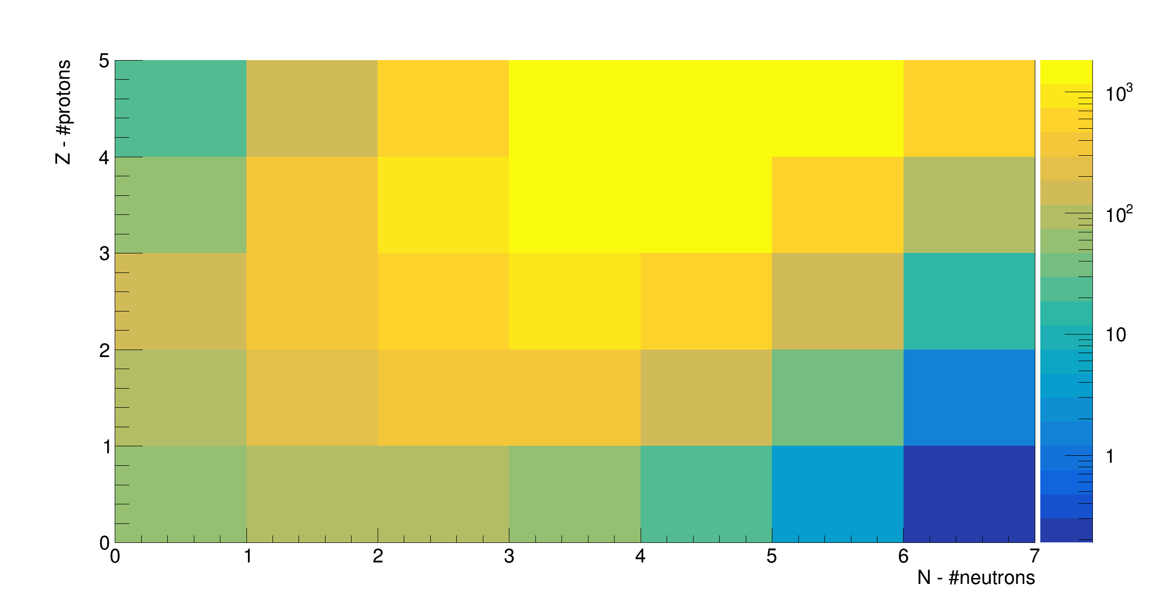
C₁₂ Nuclear Chart
¹⁰Be
⁷Li
⁹Li
⁸He
¹H
⁷H
Rhidian Williams
June 16th , 2022 9/12
Notes:
After deducing the final states and finding the correct signatures of residual targets we can determine the proton multiplicities achieved. The yellow histogram is the experimental data and the black/shaded is the simulated data. Two key points to take from the plot are that we can knock-out 6 protons from the carbon nucleus so just imagine what we could do with lead. The model agrees well in predicating the multiplicities achieved in experiment, so can be used to simulate for heavier elements.

Slide 10
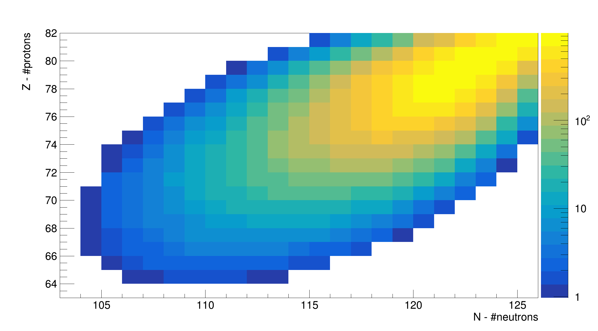
Pb₂₀₈ Nuclear Chart
Simulations show many neutron knock-out also possible!
Estimated Lifetime – Not measured
New Isotope
Exotic Nuclei
Rhidian Williams
June 16th , 2022 10/12
Notes:
After deducing the final states and finding the correct signatures of residual targets we can determine the proton multiplicities achieved. The yellow histogram is the experimental data and the black/shaded is the simulated data. Two key points to take from the plot are that we can knock-out 6 protons from the carbon nucleus so just imagine what we could do with lead. The model agrees well in predicating the multiplicities achieved in experiment, so can be used to simulate for heavier elements.

Slide 11
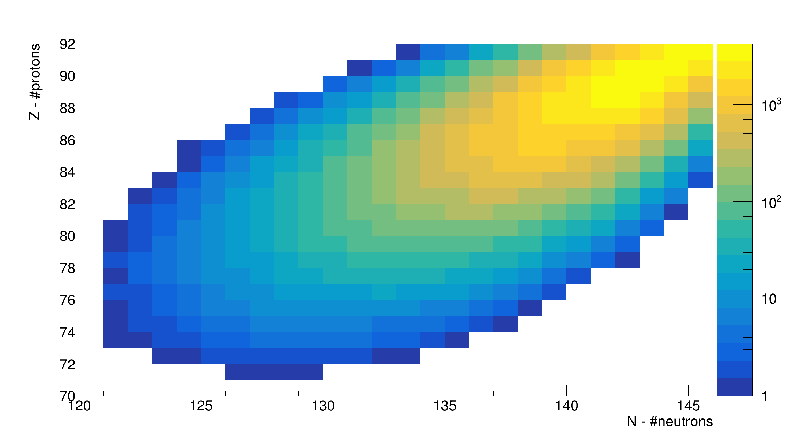
U₂₃₈ Nuclear Chart
Estimated Lifetime – Not measured
New Isotope
Exotic Nuclei
Rhidian Williams
June 16th , 2022 11/12
Notes:
After deducing the final states and finding the correct signatures of residual targets we can determine the proton multiplicities achieved. The yellow histogram is the experimental data and the black/shaded is the simulated data. Two key points to take from the plot are that we can knock-out 6 protons from the carbon nucleus so just imagine what we could do with lead. The model agrees well in predicating the multiplicities achieved in experiment, so can be used to simulate for heavier elements.

Slide 12
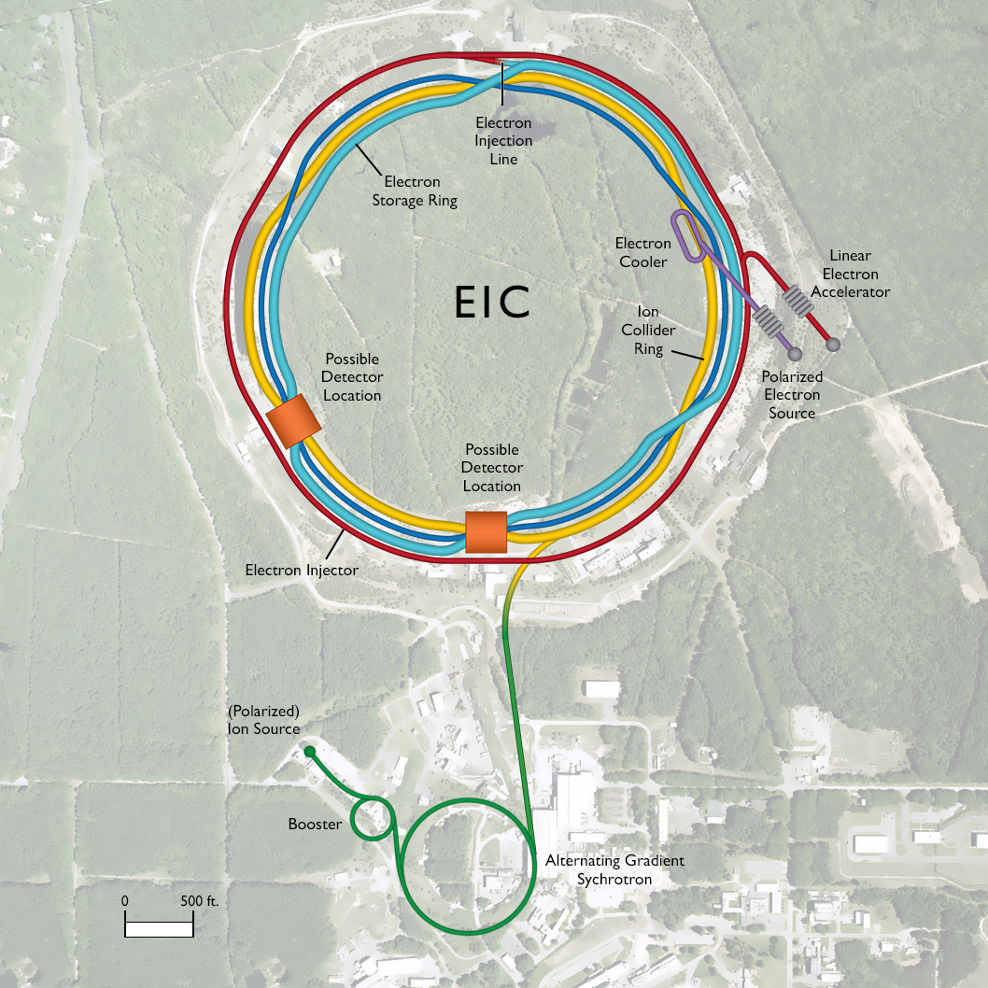
Future Work
Upcoming CLAS12 experiments
New institutions e.g. Electron Ion Collider
Theorists adapting model based on our results
Simulations show method applicable to neutrons
Comparison with other spallation sources
Expand physics learnt to other fields
Rhidian Williams
June 16th , 2022 12/12
Notes:
The result make for a promising future, particularly for the upcoming experiments art CLAS12 and new institutes like the Electron on Collider who are interested in the results obtained here. Comparisons with other spallation sources is possible, particularly for the RGM experiments upcoming this winter. We can also expand the physics learnt here to other fields, particularly neutrino physics where we can constrain the physics on nuclear processes. Neutrino oscillations make a big assumption in not regarding the nuclear interactions, so the work here is important to that field of study.

