Slide 1
Measurement of the
Proton Form Factor Ratio, G^{P}_{E}/G^{P}_{M}
from
Double Spin Asymmetries
Spin Asymmetries of the Nucleon Experiment
( E07-003)
Outline
Introduction
Physics Motivation
Detector Setup &
Polarized Target
Data Analysis
Conclusion
Anusha Liyanage
Advisor : Dr. Michael Kohl

Slide 2
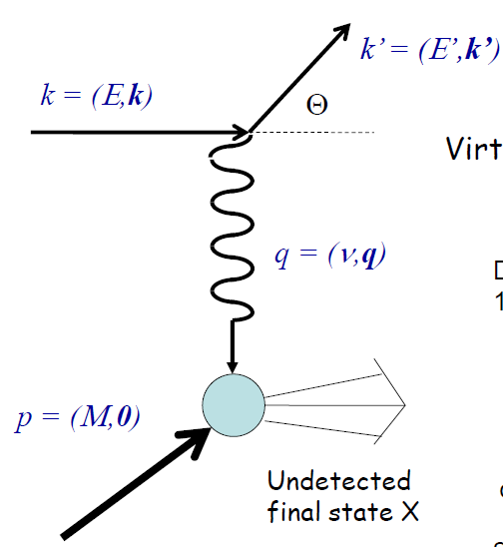
Introduction
From the elastic scattering of electron from the proton target,
and
Elastic, Electric and Magnetic Form Factors
(Sachs form factors)
Provide the information on the spatial distribution
of electric charge and magnetic moment within the
proton
Are functions of the four-momentum transfer
squared,
Fourier transforms of the charge,
and magnetic moment, distributions in Breit Frame
At low
The four-momentum transfer squared,
At
Notes:
At law q^2, G_E and G_M is normalized to the charge and magnetic moment distributions.

Slide 3
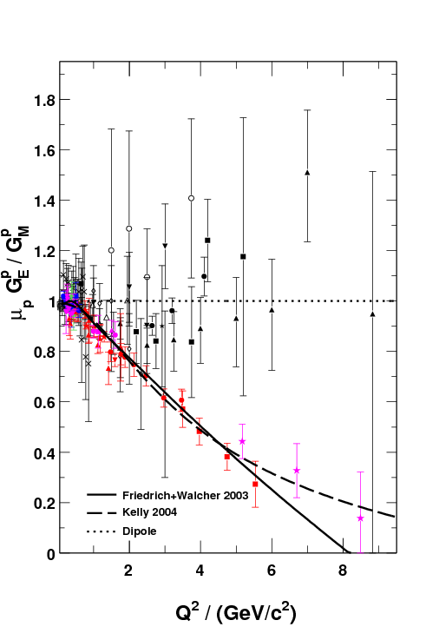
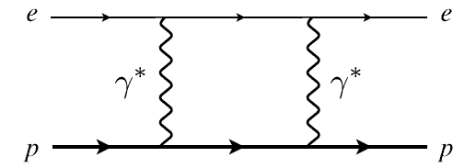
Physics Motivation
M. Jones et al., PRC74 (2006) 035201
Dramatic discrepancy between
Rosenbluth and recoil polarization
technique.
Multi-photon exchange considered
the best candidate for the
explanation
Double-Spin Asymmetry
is an Independent
Technique to verify
the discrepancy
RSS (Jlab)
Q² = 1.50 (GeV/c)²
Dramatic discrepancy !
A. Puckett , GeP-III
SANE
2.20
5.17
6.25
Q² / (GeV/c²)
Notes:
The measurement at law q^2 gives the motivation for the coin data. At law q^2, we don’t see a BIG discrepancy. If the ratio measurement verify the expectation at law q^2, It justifies the COIN measurements from the double spin asymmetry.

Slide 4
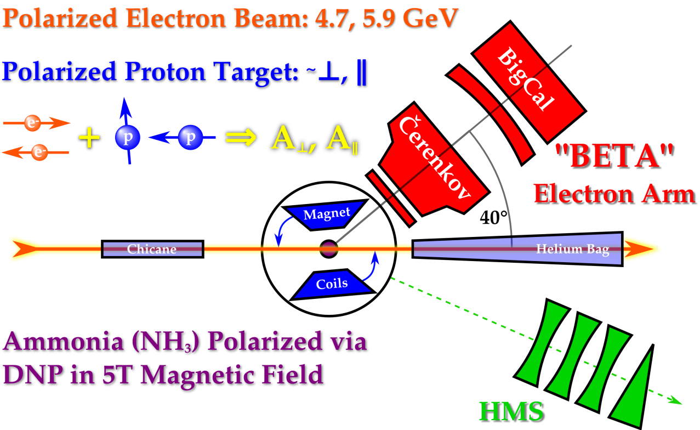
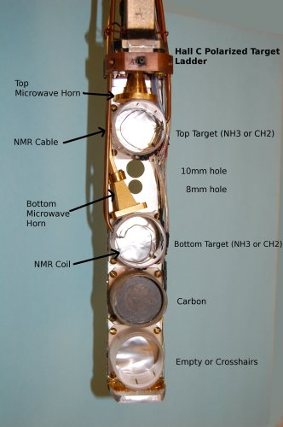
Detector Setup/Polarized Target
• C, CH₂ and NH₃
• Dynamic Nuclear Polarization (DNP)
polarized the protons in the NH₃
target up to 90% at
1 K Temperature
5 T Magnetic Field
Temperature is maintained by
immersing the entire target in the
liquid He bath
• Used microwaves to excite spin flip
transitions
(55 GHz - 165 GHz)
• Polarization measured
using NMR coils
Θ_{B} = 80°
Θ_{B} = 180°
( 80 and 180 deg )
Used only perpendicular magnetic
field configuration for the elastic data
Average target polarization is ~ 70 %
Average beam polarization is ~ 73 %

Slide 5
Run Dates | Beam Energy | Magnet Orientation | Run Hours/ Proposed PAC hours | Average Beam Polarization
Elastic Kinematics
( From HMS Spectrometer )
Spectrometer mode | Coincidence | Coincidence | Single Arm
HMS Detects | Proton | Proton | Electron
E Beam GeV | 4.72 | 5.89 | 5.89
P_{HMS} GeV/c | 3.58 | 4.17 | 4.40
Θ_{HMS} (Deg) | 22.30 | 22.00 | 15.40
Q² (GeV/c)² | 5.17 | 6.26 | 2.20
Total Hours (h) | ~40 (~44 runs) | ~155 (~135 runs) | ~12 (~15 runs)
e-p Events | ~113 | ~824 | -

Slide 6
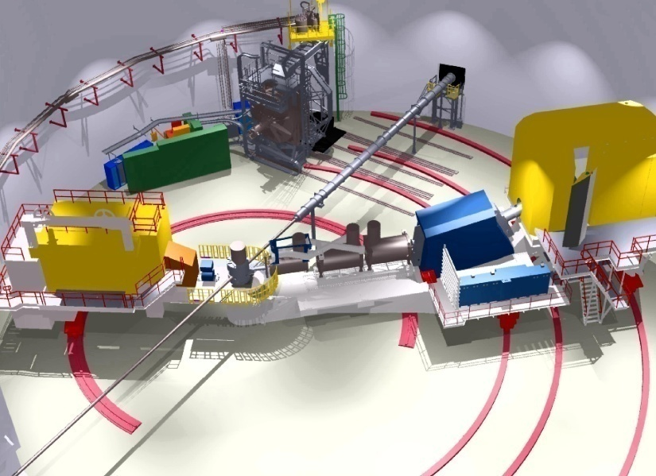
Data Analysis
Electrons in HMS
By knowing,
the incoming beam energy, ,
scattered electron energy,
and
the scattered electron angle,
Θ
E’
E
e⁻ p e⁻ p

Slide 7
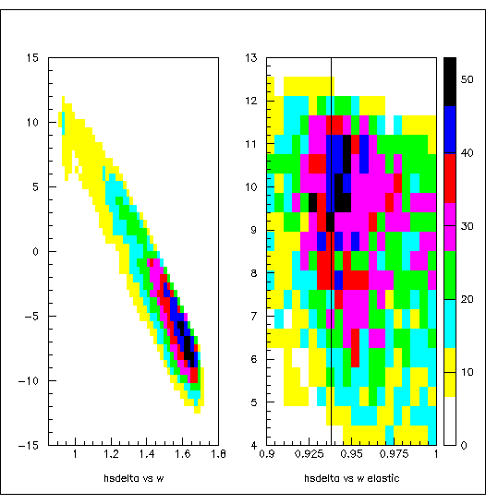
Momentum Acceptance
P -Measured momentum in HMS
P_{c}-HMS central momentum
The elastic data are outside of the usual delta cut +/- 8%
hsdelta (%)
Because HMS reconstruction
matrix elements
work fine up to 10
Invariant Mass, W
W - elastics
Use -8% < hsdelta <10%

Slide 8
Kinematics Offset
The W peak is shifted by ~12 MeV.
It could be a combination of a vertical beam offset and the offset in the HMS central momentum of more like
1x10-3 GeV.
W spectrum for single arm electron
1 mm of vertical offset is 0.8x10-3 GeV.
So, 4.400*(1.001)=4.4044 for the central momentum and change the vertical beam offset by 2 mm.
W spectrum for single arm electron
P_HMS = 4.4044 GeV
instead of 4.4000 GeV
Vertical beam offset = 0.2 cm

Slide 9
Find srast x/y offsets
Srast x – Horizontal beam position (pointing beam left)
Srast y – Verticle beam position (pointing up)
Used C run to find srast x/y offsets.
Adjust acceptance edges in
Ytar and y’ from adjusting srast x offset
x’ from adjusting srast y offset
Calibrate the EPICS Tx and Ty
Srast x offset=-0.2 cm
Srast y offset= 0.2 cm

Slide 10
MC with NH3
Generated N, H3 and He separately.
Calculated the MC scale factor using the data/MC luminosity
ratio for each target type.
Added all 3 targets together by weighting the above MC scale factors.
The srast x/y offsets were calculated using the EPICS calibration constants.
Srast x offset=-0.2 cm
Srast y offset= 0.2 cm

Slide 11
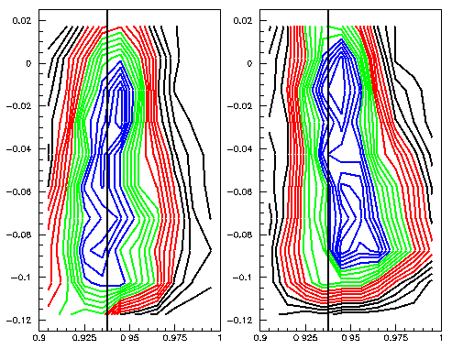
Check the srast x offsets with MC
Out-of-plain angle
W
Data
Srast x=0.2 cm
Data
Srast x=-0.2 cm
MC
Gen. Srast x=-0.2 cm
Rec. Srast x=-0.2cm
MC
Gen. Srast x=-0.2 cm
Rec. Srast x=0.2cm

Slide 12
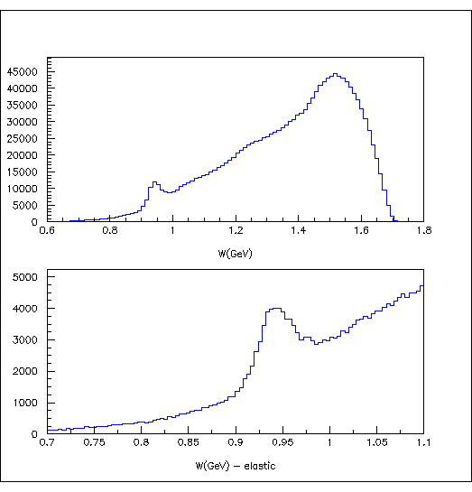
Extract the electrons
• Used only Electron selection cuts.
# of Cerenkov photoelectrons > 2 - Cerenkov cut
> 0.7 - Calorimeter cut
< 10 and > -8 - HMS Momentum Acceptance cut
Here,
- Detected electron momentum/
energy at HMS
P_{c} - Central momentum of HMS
- Total measured shower energy
of a chosen electron track by
HMS Calorimeter

Slide 13
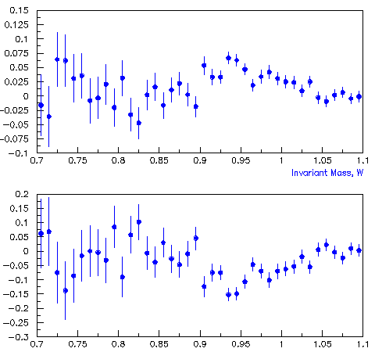
Calculated the Asymmetries …..
The raw asymmetry, A_{r}
N⁺ / N⁻ = Charge normalized counts for the +/-
helicity
∆A_{r} = Error on the raw asymmetry
P_{B}P_{T} = Beam and Target polarization
N_{c} = A correction term
The Asymmetries
Need
dilution factor, f
in order to determine the
physics asymmetry,
and G^{p}_{E}/G^{p}_{M}
(at Q²=2.2 (GeV/c)² )
The Raw Asymmetry, A_{r}
Preliminary !
Ar/P_{T/}P_{B}
Invariant Mass, W
Notes:
N_{c} is A correction term to eliminates the contribution from quasi-elastic ¹⁴N scattering under the elastic peak

Slide 14
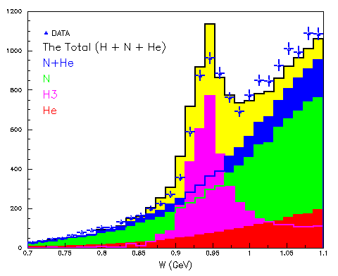
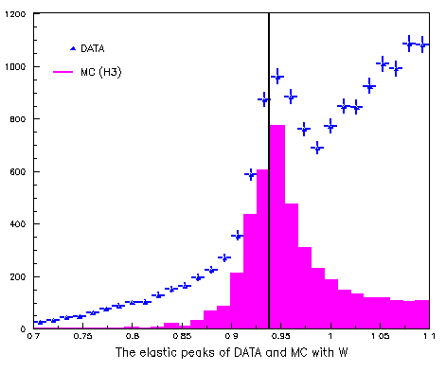
Determination of the Dilution Factor
What is the Dilution Factor ?
The dilution factor is the ratio of the yield from scattering off free protons(protons from H in NH₃) to that from the entire target (protons from N, H and He)
Dilution Factor,

Slide 15
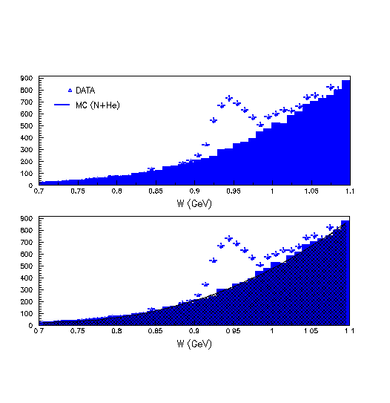
MC Background contributions (Only He+N)
Calculate the ratio of
Yield_{Data}/Yield_{MC} for the
W region 0.7 < W <0.85
and MC is normalized
with this new scaling factor.
Used the polynomial fit
to N+ He in MC
and
Subtract the fit function
from data
Invariant Mass, W (GeV)

Slide 16
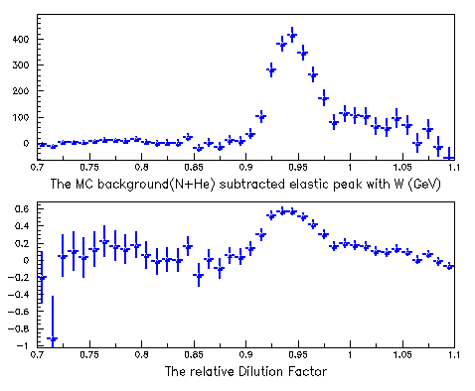
The relative Dilution Factor (Very Preliminary)
Dilution Factor,

Slide 17
The Physics Asymmetry (Very Preliminary)
Physics Asymmetry, A_{p}
A_{phy} | Error A_{phy}
-0.2156 | 0.0210
A_{p}=-0.216
Physics Asymmetry, A_{p}
Invariant Mass, W

Slide 18
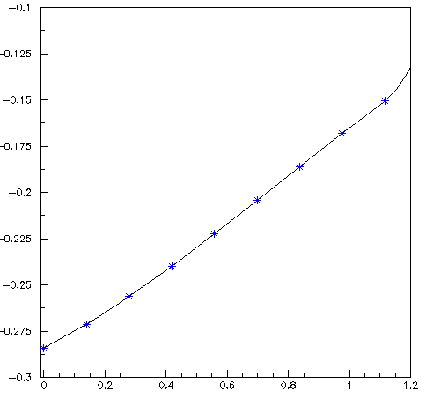
The beam - target asymmetry, A_{p}
Here,
r = G_{E} /G_{M}
a, b, c = kinematic factors
, = pol. and azi. Angles between and
The projected asymmetry vs μG_{E}/G_{M}
Using the exeperiment data at Q²=2.2 (GeV/c)²
and by knowing the Ap=-0.2156,
-0.100
At Q²=2.2 (GeV/c)²
and
≈ 34.55° and =180°
-0.125
-0.150
-0.175
Rosenbluth Tech.
1.2
Where , μ – Magnetic Moment of the
Proton=2.79
-0.200
Asymmetry
Pol. Tran. Tech
≈ 34.55° and = 180°
From the HMS kinematics, r² << c
-0.225
-0.250
-0.275
-0.300
0.0
0.2
0.4
0.6
0.8
1.0
1.2
μ G_{E}/G_{M} Ratio

Slide 19
Error propagation from the experiment
Preliminary …..
By knowing the ΔAp=0.0210,
This work
μG_{E}/G_{M} | Δ(μG_{E}/G_{M})
0.6105 | 0.24
Q² / (GeV/c²)

Slide 20
Conclusion
Measurement of the beam-target asymmetry in elastic electron-proton scattering offers an independent technique of determining G^{p}_{E}/G^{p}_{M} ratio.
Extraction of G^{p}_{E}/G^{p}_{M} ratio from single-arm electron data are shown.
The preliminary data point at 2.2 (GeV/c)² is very consistent with the recoil polarization data. (falls even slightly below it)
This is an ‘explorative’ measurement, as a by-product of the SANE experiment.

Slide 21
SANE Collaborators:
Argonne National Laboratory, Christopher Newport U., Florida International U., Hampton U., Thomas Jefferson National Accelerator Facility, Mississippi State U., North Carolina A&T State U., Norfolk S. U., Ohio U., Institute for High Energy Physics, U. of Regina, Rensselaer Polytechnic I., Rutgers U., Seoul National U., State University at New Orleans , Temple U., Tohoku U., U. of New Hampshire, U. of Virginia, College of William and Mary, Xavier University of Louisiana, Yerevan Physics Inst.
Spokespersons: S. Choi (Seoul), M. Jones (TJNAF), Z-E. Meziani (Temple),
O. A. Rondon (UVA)
Thank You

Slide 23
Backup Slides

Slide 24
Elastic Scattering
The four-momentum transfer squared,
For electron,

Slide 25
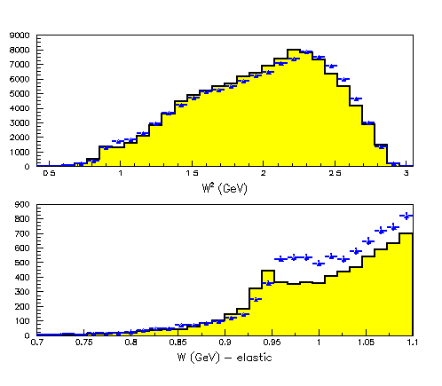
Comparing MC for NH3 target
In order to consider NH₃ target,
Used N, H and He separately
Invariant Mass, W (GeV)

