Slide 1
SHMS Kaon Aerogel Cherenkov Detector Update
Nathaniel Hlavin
Catholic University of America
Mentor: Tanja Horn
In collaboration with: CUA, FIU, SCU, MSU, JLab, and Yerevan
Jefferson Lab, Newport News, VA
Jamuary 15, 2011

Slide 2
Outline
Physics motivation
Detector requirements and project overview
Computer simulation: results and optimization
Design overview and outlook for detector

Slide 3
SHMS Detector System
SHMS base detector system provides particle identification for e, π, p over the full momentum range
Noble gas Cherenkov: e/π
Heavy gas Cherenkov: π/K
Lead glass: e/π
The π⁺/K⁺ separation is provided by the heavy gas Cerenkov
The lack of p/K⁺ separation does not allow a strange physics program in Hall C at 11 GeV with only the base equipment
Need to build kaon aerogel detector for the strangeness program in Hall C

Slide 4
SHMS (e,e’K⁺) Program in Hall C
To date four experiments have been approved for Hall C at 11 GeV
Range of kaon momenta that needs to be covered largely given by the Kaon factorization experiment
Experiment | Physics Motivation | SHMS Momenta (GeV/c) | Worst Fore/Bkd Rate Ratio
Color Transparency (E12-06-107) | vanishing of h-N interaction at high Q. exclusive π, K production from nuclei. | 5.1-9.6 | 1(K):10(p)
SIDIS p_{T} (E12-09-017) | extract mean k_{T} of u,d,s quarks in proton. SIDIS π±, K± production. | 1.5-5.0
SIDIS R (E12-06-104) | Measure the ratio R=σ_{L}/σ_{T} SIDIS, π±, K± production. | 1.5-5.0
Kaon Factorization (E12-09-011) | study of soft-hard factorization in exclusive K⁺ production. L/T separations vs. Q², t. | 2.6-7.1 | 1(K):3(p)
There is a strong kaon program proposed for Hall C. We need a kaon detector!

Slide 5
SHMS (e,e’K⁺) Program in Hall C
To date four experiments have been approved for Hall C at 11 GeV
Range of kaon momenta that needs to be covered largely given by the K factorization experiment
Experiment | Physics Motivation | SHMS Momenta (GeV/c) | Worst Fore/Bkd Rate Ratio
Color Transparency (E12-06-107) | vanishing of h-N interaction at high Q. exclusive π, K production from nuclei. | 5.1-9.6 | 1(K):10(p)
SIDIS p_{T} (E12-09-017) | extract mean k_{T} of u,d,s quarks in proton. SIDIS π±, K± production. | 1.5-5.0
SIDIS R (E12-06-104) | Measure the ratio R=σ_{L}/σ_{T} SIDIS, π±, K± production. | 1.5-5.0
Kaon Factorization (E12-09-011) | study of soft-hard factorization in exclusive K⁺ production. L/T separations vs. Q², t. | 2.6-7.1 | 1(K):3(p)
There is a strong kaon program proposed for Hall C. We need a kaon detector!

Slide 6
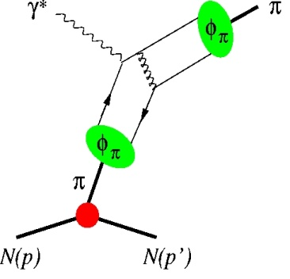
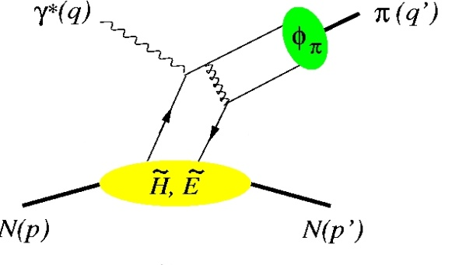
Meson Reaction Dynamics
Low Q²
We can learn about meson form factors and nucleon Generalized Parton Distributions (GPDs) from these two diagrams of the meson reaction process
F_{π,K}
Depending on Q², we probe either the meson form factors or the GPDs
High Q²
However, before one can learn about form factors and GPDs one has to investigate their prerequisites, e.g., factorization of hard and soft physics
Kaon factorization
Hard Scattering
GPD
Notes:
Picture behind the mechanism

Slide 7
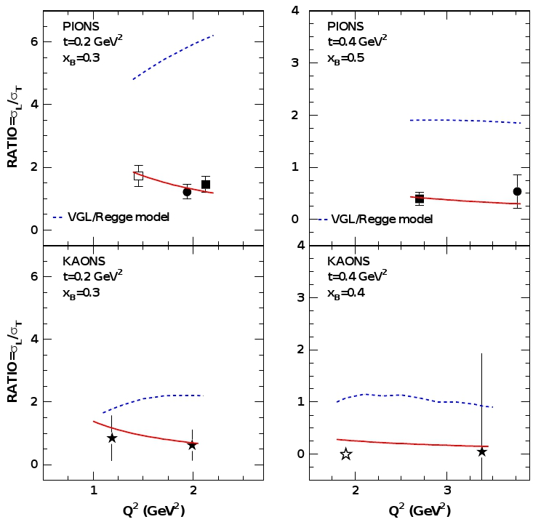
High Q²: Q^{-n} scaling of σ_{L} and σ_{T}
To access physics contained in GPDs, one is limited to the kinematic regime where hard-soft factorization applies
W<2GeV
t=0.2 GeV²
x_{B}=0.3
ep → e‘π⁺n
Q²=1.2-2.0 GeV²
R=σ_{L}/σ_{T}
Q²=2.7-3.9 GeV²
Q²=1.4-2.2 GeV²
A test is the Q² dependence of the cross section:
σ_{L} ~ Q⁻⁶ to leading order
σ_{T} ~Q⁻⁸
t=0.2
t=0.4
x=0.3
x=0.5
ep → e‘K⁺Λ
Q² (GeV²)
Q²=1.9-3.4 GeV²
t=0.2
t=0.4 GeV²
x_{B}=0.4
t=0.4
R=σ_{L}/σ_{T}
x=0.3
x=0.4
Q²=1.2-2.0 GeV²
Q²=1.9-3.4 GeV²
Difficult to draw a conclusion from current σ_{L}/σ_{T} ratios
Limited W (center of mass energy) and Q² coverage
Kaon data in resonance region (W<2 GeV)
Uncertainties from scaling in x, t
Q² (GeV²)
Q² (GeV²)
Q² (GeV²)
High quality σ_{L} and σ_{T} data for both kaon and pion would provide important information for understanding the meson reaction mechanism

Slide 8
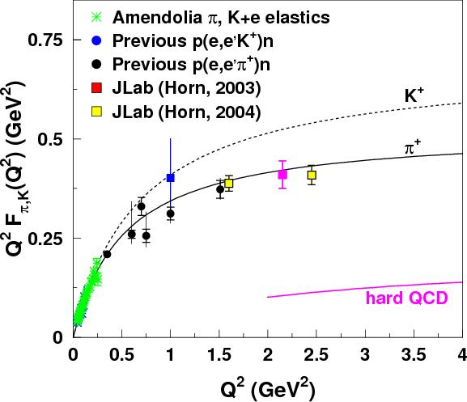
Problematic Pions
QCD scaling works for previous pion data, but the magnitude compared to the QCD prediction is suspicious.
Further kaon experiments could provide data that matches the QCD prediction.
The 12 GeV upgrade allows for kaon production above a Q² value of 1, and even higher into the hard QCD range.
T. Horn et al., Phys. Rev. Lett. 97 (2006) 192001.
T. Horn et al., arXiv:0707.1794 (2007).
A.P. Bakulev et al, Phys. Rev. D70 (2004)]

Slide 9
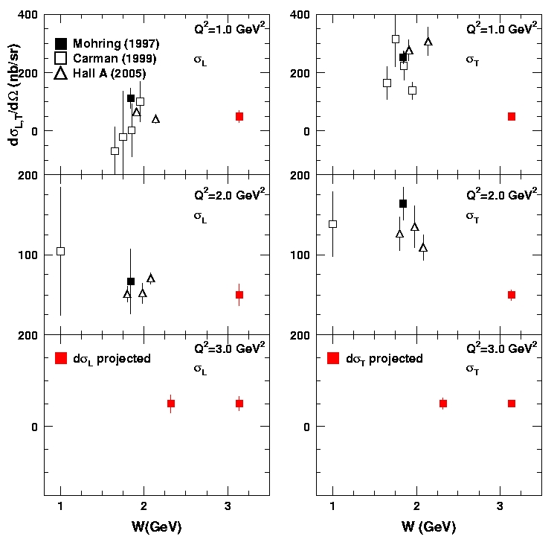
JLab 12 GeV: L/T separated kaon cross sections
σ_{L}
σ_{T}
Approved experiment E12-09-011 will provide first L/T separated kaon data above the resonance region (W>2.5 GeV)
Onset of factorization
Understanding of hard exclusive reactions
QCD model building
Coupling constants
E12-09-011: Precision data for W > 2.5 GeV
T. Horn et al.

Slide 10
Kaon Aerogel Project
NSF-MRI Consortium: Development of a Kaon Detection System
PI: The Catholic University of America (Tanja Horn)
co-PI: University of South Carolina (Yordanka Ilieva)
co-PI: Mississippi State University (Dipangkar Dutta)
co-PI: Catholic University of America (Franz Klein)
co-PI: Florida International University (Joerg Reinhold)
Current Status: MRI awarded by NSF October 2010 (NSF-PHY-1039446)
Detector design is well underway
PMTs expected to be procured early in 2011 and tested during summer
Drawings will be modified from HMS drawings and machining will begin at CUA
Aerogel negotiations underway

Slide 11
PID at higher momenta
N. Hlavin, S. Rowe
Up to about 4 GeV/c, the p/K⁺ separation can be achieved with a refractive index of n=1.030
Index: 1.03
Kaon
Up to about 6 GeV/c, n=1.015 can provide adequate p/K⁺ separation
Np.e.
Proton
p_{SHMS} | n | K_{pe} | p_{pe} | Discrimination (5 σ)
3.0 | 1.030 (1.015) | 27 (2) | <0.5 (<0.5) | >1000:1 (lower)
3.5 | 1.030 (1.015) | 34 (9) | <0.5 (<0.5) | >1000:1 (lower)
3.9 | 1.030 (1.015) | 36 (12) | 2 (<0.5) | >1000:1 (lower)
4.5 | 1.030 1.015 | 40 15 | 13 <0.5 | 1000:1 >1000:1
5.2 | (1.030) 1.015 | (42) 18 | (24) <0.5 | (30:1) >1000:1
5.5 | (1.030) 1.015 | (43) 19 | (26) 1 | (20:1) >1000:1
6.1 | (1.030) 1.015 | (44) 20 | (31) 6 | (10:1) 200:1
Momentum (GeV/c)
Index: 1.015
Np.e.
Kaon
Contribution of knock-on electrons is 2%
Proton
Momentum (GeV/c)
Notes:
11
11

Slide 12
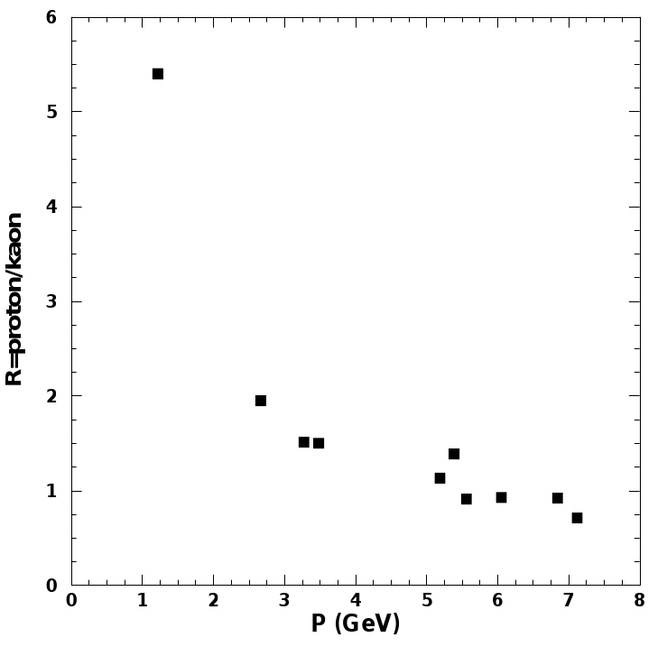
PID at higher momenta
For higher momenta, p/K⁺ separation is less of an issue
Kaon rate becomes larger than the proton rate
Easier to deal with non-peaked proton background
Prediction of rates for kaons and protons
Prediction coincides with Hall C kaon experiment (E93-108)
Advantage of using n=1.03, 1.015 is that they are the standard indices offered by Panasonic (successor of Matsushita)
Currently no option to manufacture and export aerogels with indices smaller than n=1.015 in large quantities
Future upgrade option for third index, e.g., n=1.0075 would give p/K⁺ 1000:1 at p=7.1 GeV/c (available from Novosibirsk)
For flexibility and to allow for future upgrades, design of detector will support use of aerogel with any index of refraction
Notes:
12
12

Slide 13
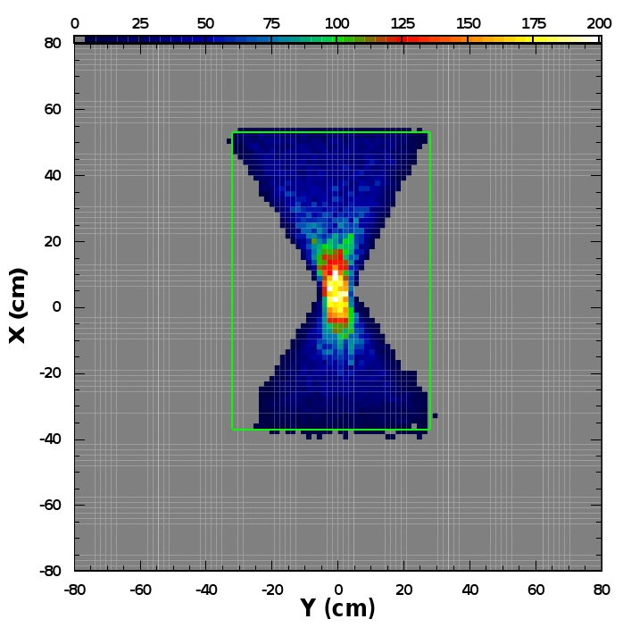
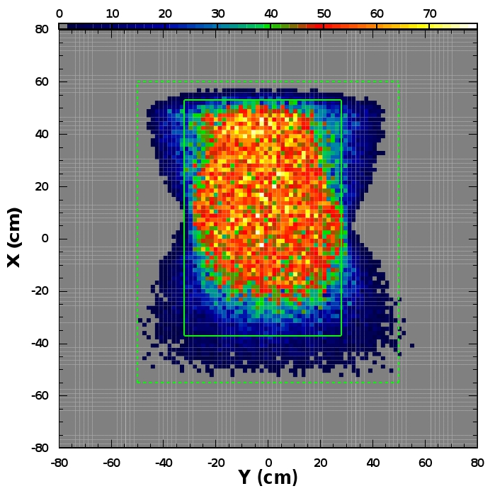
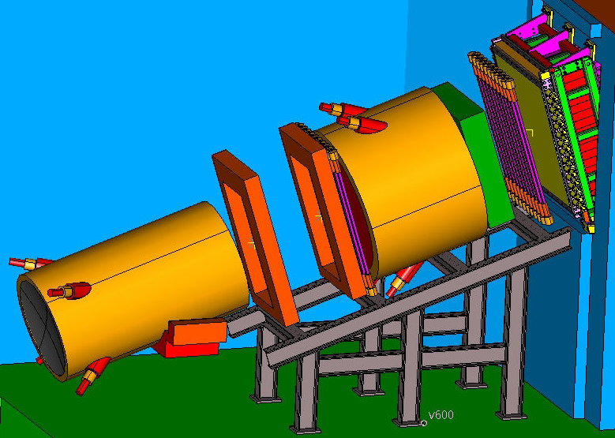
Transverse Detector Size
Simulation of event distribution at back of aerogel in SHMS detector stack
Approved experiments requiring kaon ID use 10 cm long targets and a relatively small fractional momentum region
Transverse aerogel size of 90x60 cm would be sufficient
Also covers the region of highest intensity for experiments using longer targets
10-cm target
40-cm target
Required aerogel volume per index (10 cm aerogel thickness) is 60 L
Quote (12/09) from Panasonic: $150,000 (per index)
Larger quantities are slightly discounted, e.g., $220k/100L - not much benefit
SHMS
Aerogel detector location
Notes:
13
13

Slide 14
Design studies: length and width of box
Simulation* of kaon signal
H. Mkrtchyan
Active area of 90x60 cm² covers the envelope of scattered particles from 10 cm targets
Box | PMTs | n | Npe
110x100x30 | 7+7 | 1.015 | 7.60
110x80x30 | 7+7 | 1.015 | 8.14
To leave the option to cover the tails from the 40 cm target, detector box will have area 110x100 cm²
Box | PMTs | n | Npe
110x100x30 | 7+7 | 1.030 | 14.99
110x80x30 | 7+7 | 1.030 | 16.07
Further reduction of box width by 20% (40%) only improves yield by 7% (15%) making further optimization unnecessary
With two-sided PMT readout, a summed Npe signal is uniform within 10% of the active area of the detector
Baseline configuration:
110x100x24.5 cm³ box
90x60 cm² aerogel active area
*D. Higinbotham, NIM A414, 332 (1998)

Slide 15
Design studies: aerogel thickness
n = 1.03
Monte Carlo Simulations of Kaon Signal
In this case a considerable gain in signal was achieved by thicker aerogel values
10 cm seems to by far to be the best choice.
10 cm thick
8 cm thick
Photoelectrons
5 cm thick
Baseline configuration:
90x60x10 cm³ aerogel active volume
Momentum (GeV)
N. Hlavin

Slide 16
Design studies: PMT selection
Minimum distance between 5” PMTs centers must be 5.875” (14.92 cm)
H. Mkrtchyan
For 110 cm detector height can fit seven 5” PMTs from each side
Box | PMTs | n | Npe
110x100x30 | 7+7 | 1.015 | 7.60
110x100x30 | 7+7 | 1.030 | 14.99
Gain for increasing height to fit eight 5” PMTs from each side is negligible
Box | PMTs | n | Npe
120x100x30 | 8+8 | 1.015 | 7.86
120x100x30 | 8+8 | 1.030 | 15.44
Effective coverage for 7 5” PMTs is 5.1%
With nine 4” PMTs this would be reduced to 4.2%

Slide 17
Design Studies: PMT placement
N
Top
n = 1.015
Top and bottom? Left and right?
Monte Carlo Simulations of Kaon Signal
90x60 (6x6x4)
W
Bottom
E
90x90 ; 110x100
PMTs on three walls
110x100
S
How many PMTs?
Photoelectrons
PMTs on two walls
110x100
PMTs on one wall
To optimize performance and facilitate access the PMTs will be mounted on the vertical sides of the box
N. Hlavin
Momentum (GeV)

Slide 18
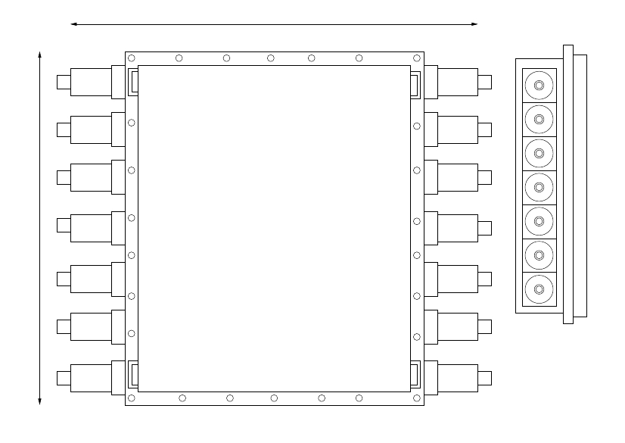
SHMS Aerogel Design Overview
Aerogel tray and diffusion lightbox with PMTs based on proven technology
Allows for simple detector assembly and easy replacement of the aerogel stack
Side View
Front View
Aerogel Panels
To cover momenta up to ~6 GeV/c aerogels with refractive indices, n=1.030 and n=1.015 will be purchased
Vendor: Panasonic*
Diffusion box will be built as single unit with fourteen 5” PMTs, 7 on each long side of the detector
Vendor: Hamamatsu, model R1250 (full assembly H6527)
PMTs
Active area will be 90x60cm² with box size 110x100cm² for future upgrades
Vendor: Hamamatsu, model R1250 (full assembly H6527)
Total depth ~ 30cm along the optical axis of the SHMS

Slide 19
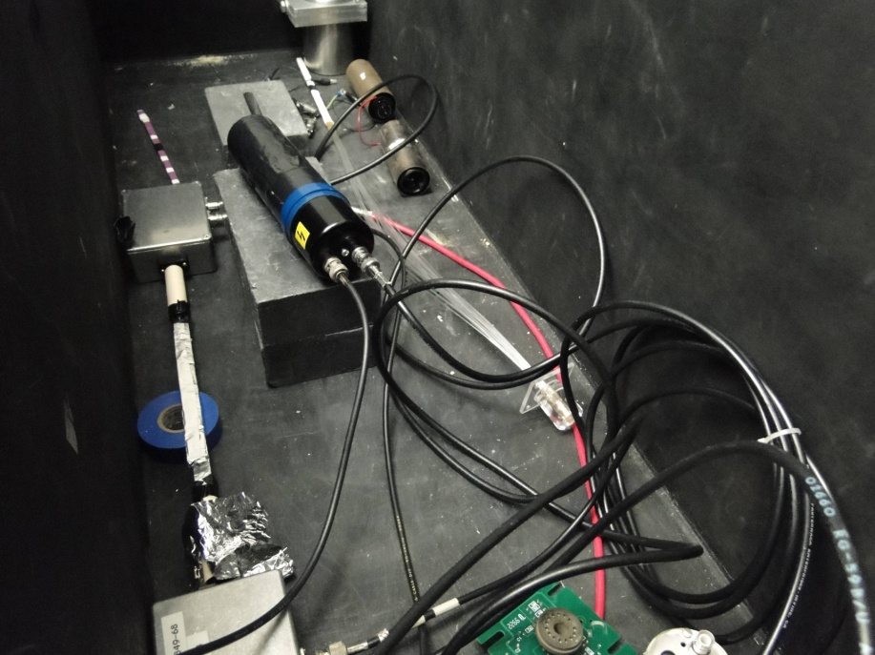
PMT Procurement
Constructed test setup and checked with cosmic rate
Currently developing testing procedures using PMTs from HKS experiment *
Negotiations with MIT/Bates about PMTs from ASU detectors from BLAST experiment
Together with Yerevan group we will evaluate the PMTs this spring
Procurement of PMTs will be completed this spring and extensive testing during the summer at JLab and CUA
Hamamatsu model R1250
Photonis XP4500B
*Thanks to Liguang Tang (HU), Joerg Reinhold (FIU), Tohuku University

Slide 20
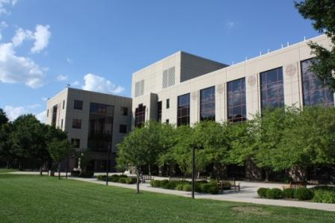
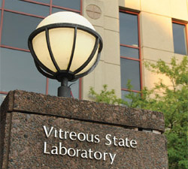
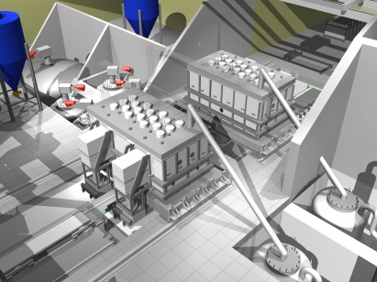
NP and Material Science Collaboration
Machining in-house with help from Vitreous State Laboratory
Machining of detector components can begin once the technical drawings are available
Broad involvement and support for our project in department

Slide 21
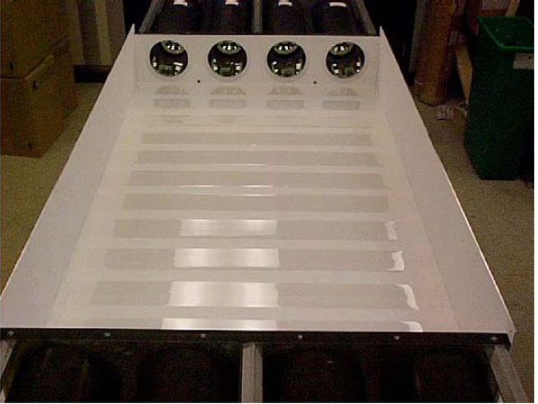
Collaboration with ASU
Panasonic is currently the only large scale aerogel supplier
Determines aerogel pricing
Collaboration with Ricardo Alarcon from Arizona State University to search for alternatives
Studies at Arizona State University to check other vendors* for:
Quality of aerogel compared to Panasonic
Capabilities for large scale production (>10L)
*Aspen Aerogel, Boston

Slide 22
Outlook
Technical drawings and machining of components starting in next few months
PMT procurement complete this spring
PMT testing and prototype this summer together with students from Catholic University of America, University of South Carolina, Florida International University, and Mississippi State University

