Slide 1



Proton polarization measurements in π° photo-production
--On behalf of the Jefferson Lab Hall C
GEp-III and GEp-2γ collaboration
Wei Luo
Lanzhou University
2011 Hall C User Meeting
January 14, 2011

Slide 2
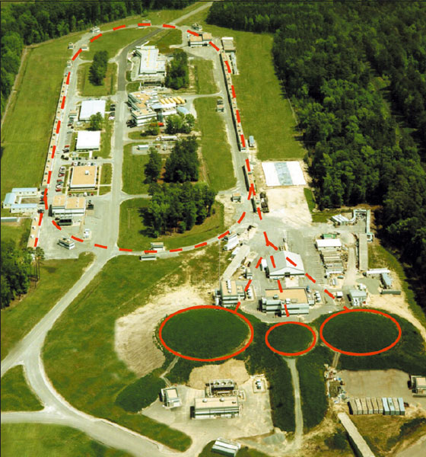
Outline
Introduction
    Physics motivation
    π° photo-production kinematics
π° events identification:
1 γ detected
2 γ detected
Preliminary results
Transferred Polarization components
Induced Polarization components
Conclusion
accelerator
Hall A
Hall C
Hall B

Slide 3
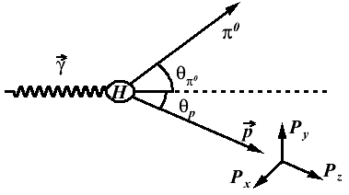
  Physics motivation
Polarization transfer components at target:
P_{x}, P_{z} (P_{T}, P_{L})
Induced polarization:
P_{y} (P_{N})
Helicity independent variable.
1. Evidence of baryon resonances:
The π° production is dominated by the baryon resonances at E_{γ} <2GeV. Tested by the measurement of the cross section* and the induced polarization observable Py.
One would expect the polarization components to behave smoothly above the baryon resonance regime.
2. Hadron Helicity Conservation(HHC) Rule**:
As a consequence of pQCD, the HHC predicts that transferred polarization Px and induced polarization Py both vanish and Pz should become independent of beam energy at high beam energy.
** S.J. Brodsky et. al., Phy. Rev. D 24, 2848(1981)
* D. Menze, et. al., Compilation of Pion Photoproduction Data (Physikalisches Institut der Universitat, bonn, 1977)

Slide 4
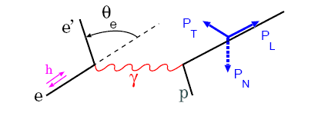
  π° photo-production in GEp-III & 2γ experiments
GEp experiment:
To get clean ep elastic data, at hardware level:
coincidence trigger of p and e’
threshold of electron arm ≈ half of elastic energy
EM calorimeter is sensitive to e, e+ and γ
What’s in the background?
π° photo-production:
the cross section is much larger than ep elastic at high Q², most of the background comes from this reaction.
Real Compton Scattering:
Cross section is much smaller than the π° production at high Q².
20cm liquid hydrogen target, equivalent to a 2.3% radiator.
The Bremsstrahlung photon is circularly polarized and carry 96.5% ~ 99.9% of the beam polarization
in the kinematics settings of the experiments.

Slide 5
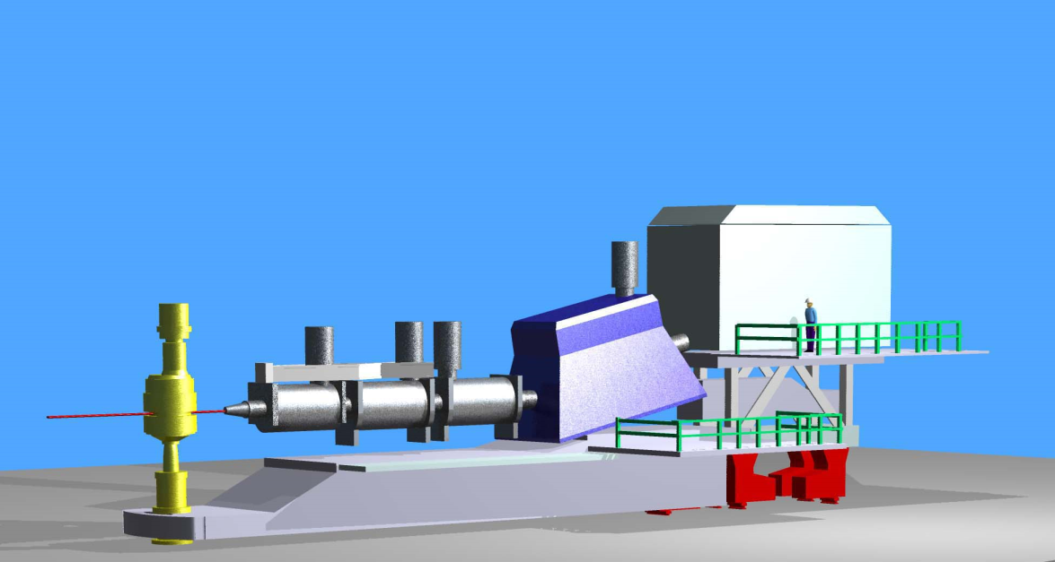
  Kinematics of π° photo-production
EM Calorimeter: BigCal
In some kinematics settings, BigCal can detect both γs(depends on θ₁₂ and distance from target to BigCal).
Polarization of proton are measured by Focal Plane Polarimeter inside HMS hut.
in the ideal dipole approximation:
BigCal
High Momentum Spectrometer (HMS)
γ
γ
θ₁₂
θ_{p}
P
Target chamber
Polarized electron beam
Where Χ is the precession angle around x axis
GEp-III & 2γ kinematics table*:
Experiment | E_{e} (GeV) | P_{HMS} (GeV/c) | Θ_{HMS} (°) | R_{BigCal} (cm) | Χ (°) | E_{γ} (GeV) | θ_{C.M,}^{π°} (°)
GEp-2γ | 1.867 | 2.068 | 14.49 | 493.2 | 109.1 | 1.60 - 1.86 | 135.-149.
GEp-III | 4.053 | 3.589 | 17.94 | 605.0 | 176.5 | 3.40 - 3.98 | 115.-129.
 | 5.714 | 4.464 | 19.10 | 608.2 | 219.2 | 5.00 - 5.70 | 100.-119.
 | 5.714 | 5.407 | 11.59 | 430.4 | 262.8 | 5.00- 5.70 | 129.-143.
*only the kinematics which can be used for π° analysis are shown.

Slide 6
π° event identification
HMS:
Acceptance cut
Timing cut
E_{p}
θ_{p}
E_{γ}
E_{π°}
θ_{π°}
π° photo-production
kinematics
Flow Chart of data analysis
BigCal:
Acceptance cut
Timing cut
one γ detected
high statistic
high background contamination
Cluster:
1
E₁
θ₁
π° decay kinematics
E₁’
θ₂’
E₂’
Red – calculated variables
white – measured variables

Slide 7
π° event identification
HMS:
Acceptance cut
Timing cut
E_{p}
θ_{p}
E_{γ}
E_{π°}
θ_{π°}
π° photo-production
kinematics
Flow Chart of data analysis
BigCal:
Acceptance cut
Timing cut
two γs detected
low statistic
low background contamination
Cluster:
1
E₁
θ₂
E₂
θ₁
π° decay kinematics
E₁’
θ₂’
E₂’
2
Red – calculated variables
white – measured variables

Slide 8
π° event identification: 1γ detected
π° event identification: one cluster found in BigCal
In case only one photon hit BigCal, to select π° event one can use the energy correlation between the energy measured by BigCal and photon energy predicted by proton measured in HMS.
Correlation of E₁ and E₁’ could be seen, but due to poor energy resolution of BigCal(10.7%), it is not used to estimate the background contamination.
Use SIMC to estimate background from ep elastic event.
Ratio_{ep} = 1.19%
Ratio_{random} = 1.47%
The discrepancy between data and SIMC come from random background and the π° model used in SIMC .

Slide 9
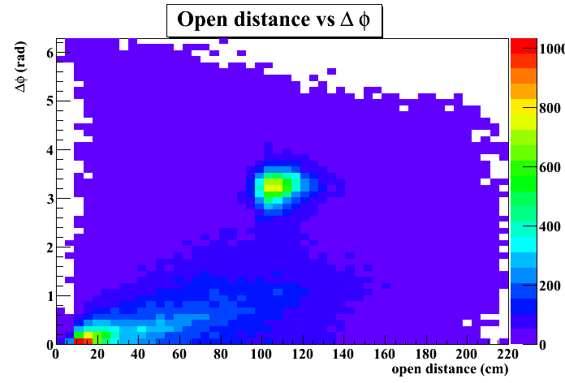
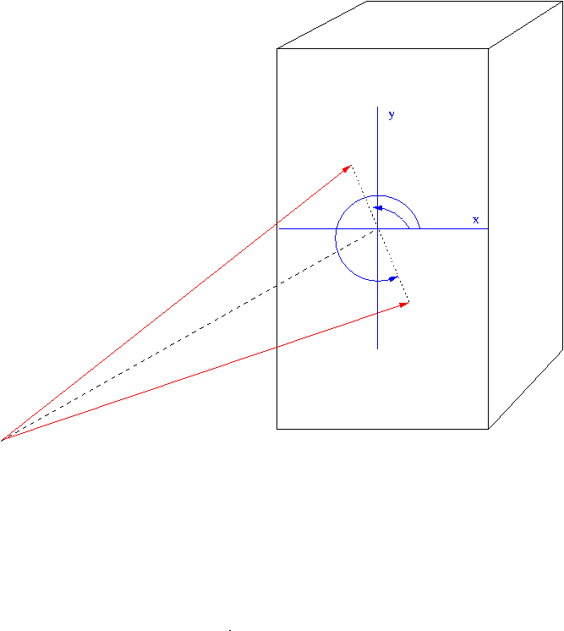
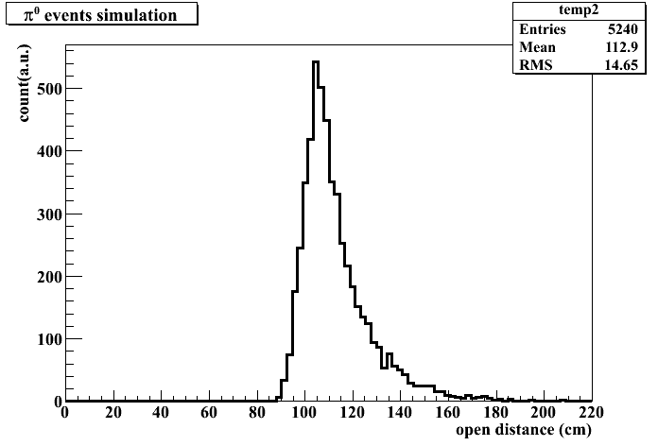
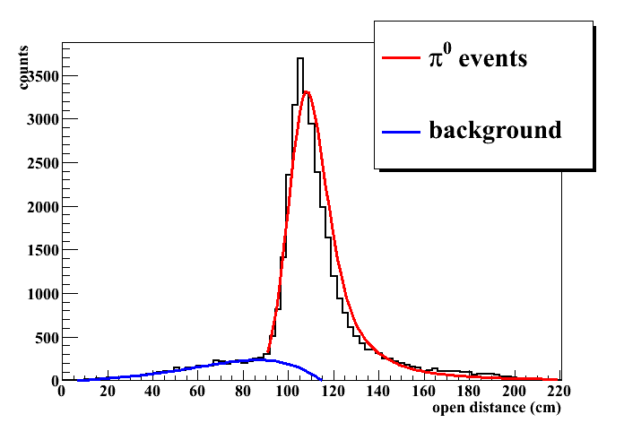
π° event identification: 2γ detected
GEp-III: Beam energy 5.71 GeV, BigCal at closest position to target, two photons decayed from π° could be detected.
γ₂
BigCal
φ₂
φ₁
Δφ cut
π°
γ₁
Target
Simulation
Data
Estimated background contamination: < 4.2%

Slide 10
  Analyzing power
Mean analyzing power vs proton momentum
Event by event correction for π° events has been applied to the data:
Analyzing power is parameterized by ep elastic events for each kinematics.

Slide 11
  Asymmetry at Focal Plane Polarimeter
ep elastic events
π° events
Within Born approximation, induced polarization should be 0 in ep elastic scattering.
All the asymmetry come from false(instrumental) asymmetry.
The peaks are due to mistracking in FPP chambers.

Slide 12
  Asymmetry at Focal Plane Polarimeter
After false asymmetry correction:
θ^{π°}_{c.m.} = 142 °, χ =109°
(1γ detected)
Ay Analyzing power of CH2
h Beam helicity
, Induced polarization components
, Transferred polarization components

Slide 13
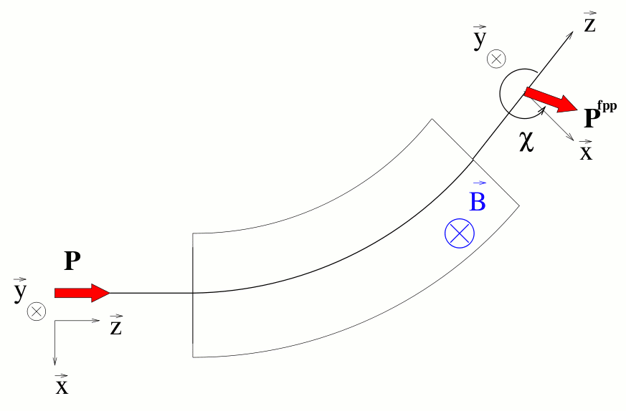
  Asymmetry at Focal Plane Polarimeter
Helicity-dependent distribution:
Spin procession:
In dipole approximation:
π° events
COSY model is used to calculate the
spin procession in HMS.
Θ^{π°}_{c.m.} = 142 °, χ =109° (1γ detected)

Slide 14
Background correction
3δ
With polarizations of ep elastic and random events, π° polarization could be extracted by:
Where x is the ratio of ep to all events
y is the ratio of random to all events

Slide 15
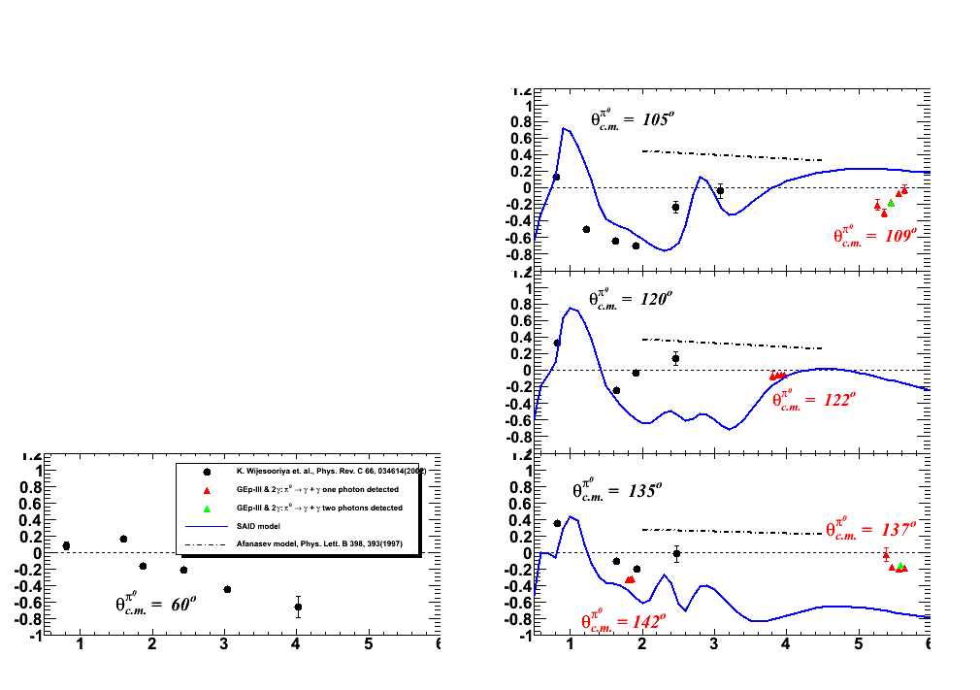
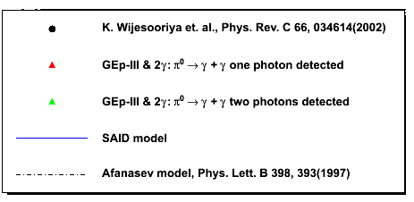
  Very close to final results
Transferred Polarization components:
P_{x}
maximum likelihood method to calculate the polarization at the target;
Background contamination corrected;
Statistics error dominate, maximum systematic error < 3.5% for each bin
PRELIMINARY
E_{γ} (GeV)

Slide 16
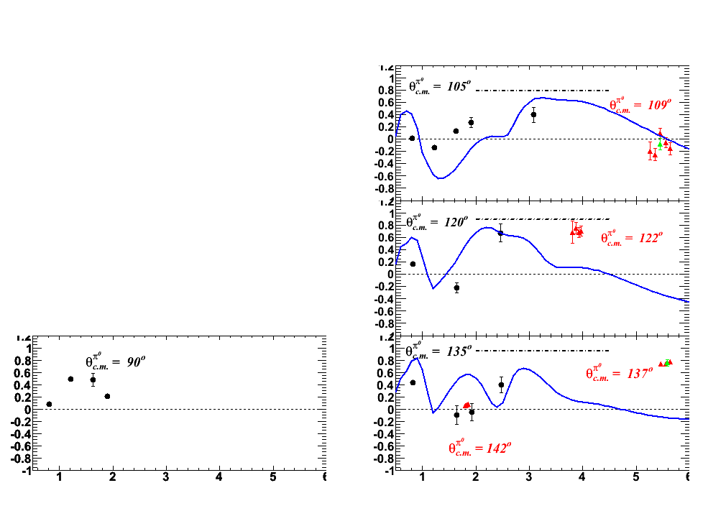
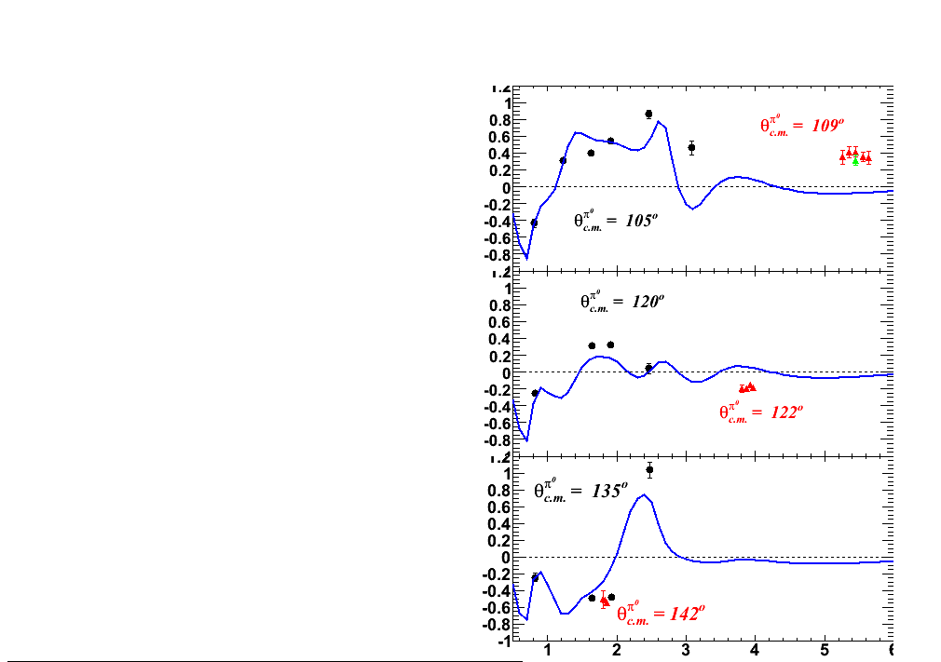
  Very close to final results
Transferred Polarization components:
Induced Polarization components:
P_{z}
P_{y}
PRELIMINARY
E_{γ} (GeV)
E_{γ} (GeV)

Slide 17
  Conclusion
Identifying π° with two different methods give consistent results.
First measurement of π° photo-production polarization components in range of E_{γ} > 4.0 GeV.
Preliminary results show:
consistency with the results of previous experiment at low Eγ
non-zero induced polarization at large Eγ
Transferred Polarization component P_{z} changes dramatically as a function of θ^{π°}_{cm} at E_{γ} ≈ 5.6 GeV
Very close to final result and preparing for the publication

Slide 19
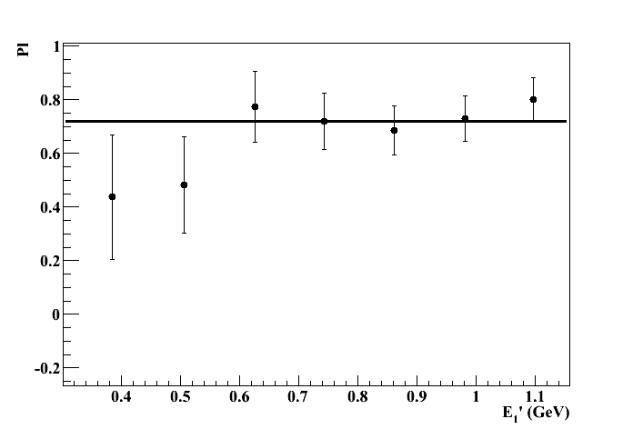
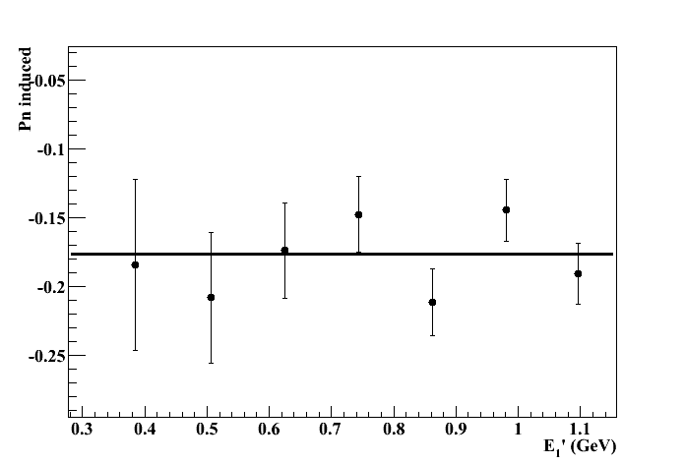
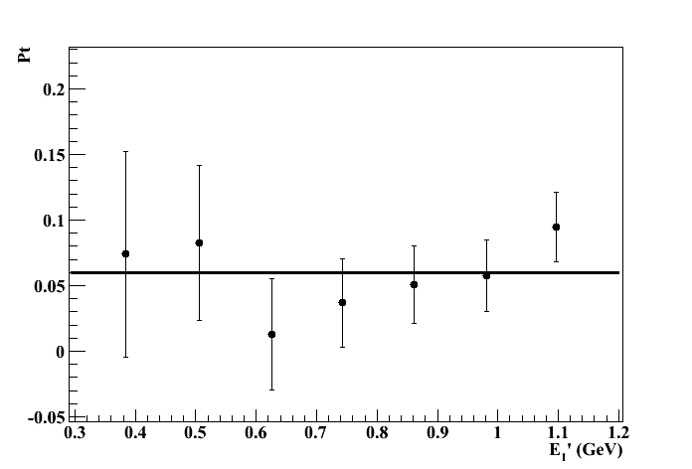
  Polarization components vs E₁’
Polarization components shows no difference for the events been cut off

Slide 20
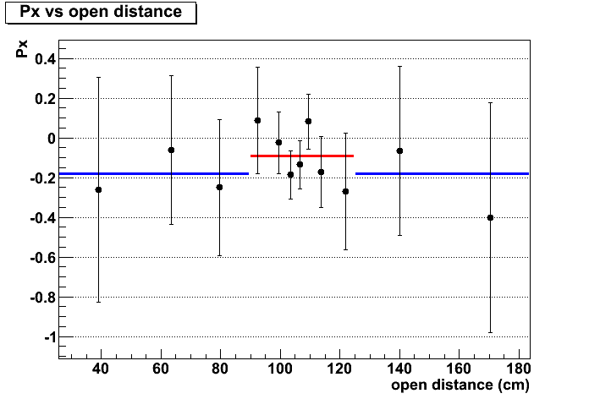
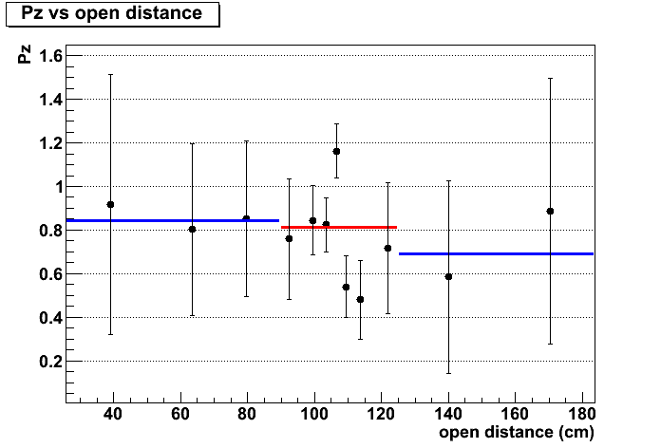
Q2 = 8.5 GeV² background correction
Two γs identified in BigCal
One γ identified in BigCal

Slide 21
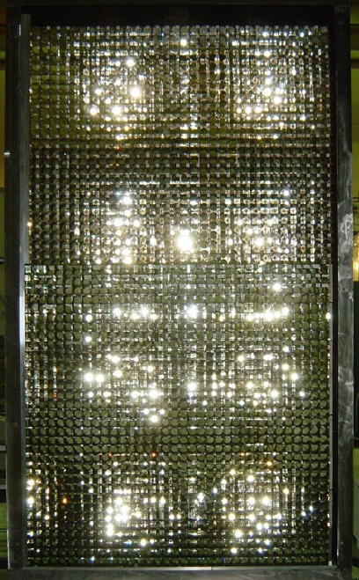
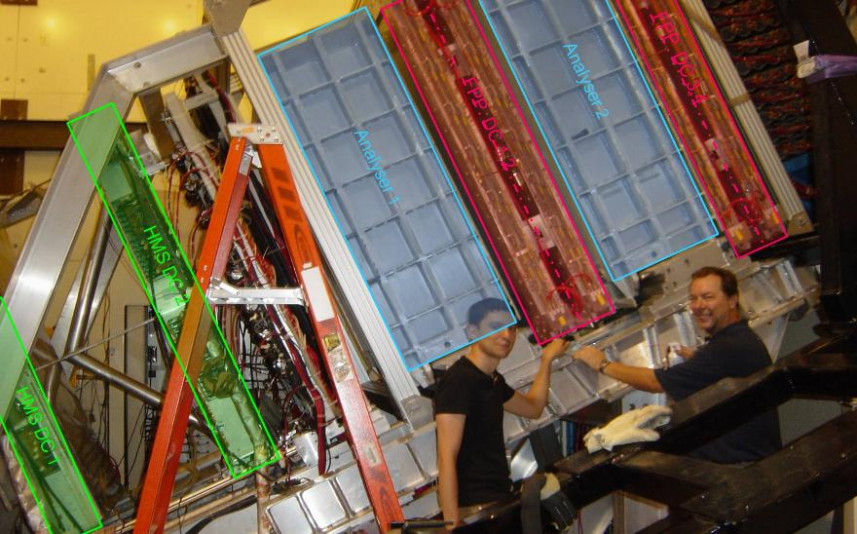
  Detectors
121.8cm
Calorimeter (BigCal)
Focal Plane Polarimeter (FPP)
217.6cm
Two sets of drift chamber pairs (12 planes of detection)‏ and CH₂ analyzer blocks.
The polarization of protons scattered in the analyzer blocks is revealed as an azimuthal angular distribution because of the strong interaction LS coupling.
EM calorimeter detects particles in coincidence with a proton in the HMS
Fine granularity (1744 blocks) for good angular resolution
Movable to match the angular acceptance of the HMS.

Slide 22
Background correction
3δ

Slide 23
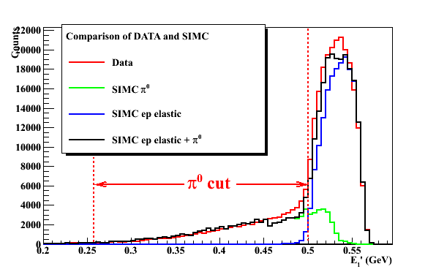
π° event identification: 1γ detected
π° event identification: one cluster found in BigCal
In case only one photon hit BigCal, to select π° event one can use the energy correlation between the energy measured by BigCal and photon energy predicted by proton measured in HMS.
Correlation of E₁ and E₁’ could be seen, but due to poor energy resolution of BigCal(11.7%), it is not used to estimate the background contamination.
Use SIMC to estimate background from ep elastic event.
Ratio_{ep} = 0.84%

