Slide 1
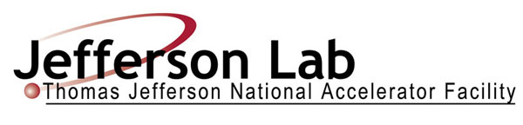


E07-002 Update: Wide-Angle Compton Scattering
Wei Luo
Lanzhou University
2011 Hall C User Meeting
January 14, 2011
Outline:
Brief overview of the physics of Wide-Angle Compton Scattering
Experimental technique
Data analysis update
Preliminary result

Slide 2
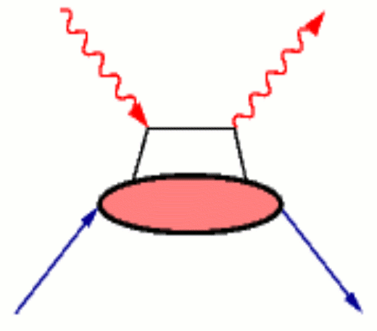
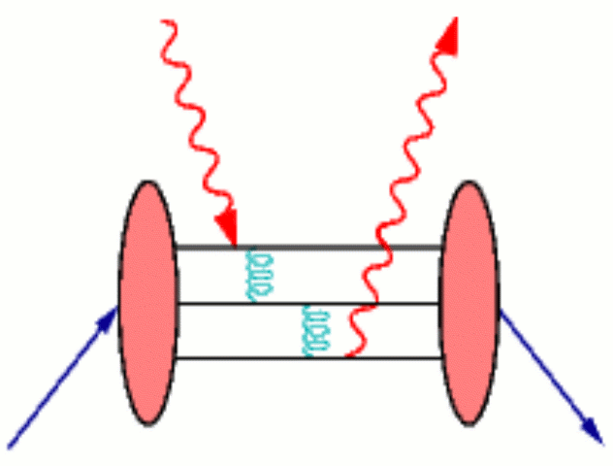
  Physics of Wide-Angle Compton Scattering
In the wide-angle regime(s, -t, u >>m_{p}²),
Proton Compton Scattering is a powerful probe of proton structure.
The physics is similar to that in ep elastic and DVCS.
It is one of the least understood fundamental reactions in the several GeV regime.
Which mechanism is dominate in a few GeV regime?
handbag
(one active quark )
pQCD
(two gluon exchange)

Slide 3
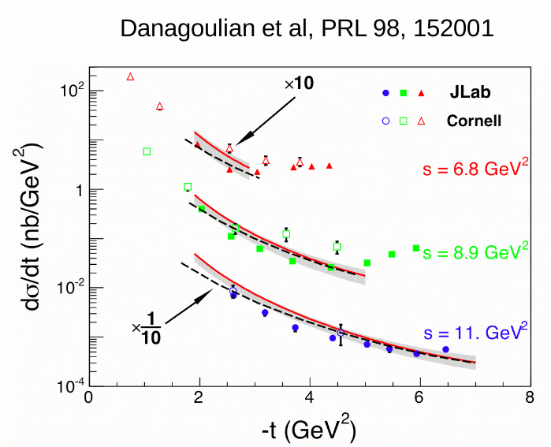
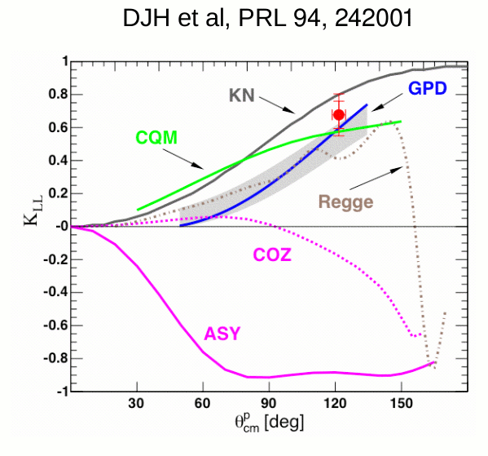
  Physics of Wide-Angle Compton Scattering
E99-114:
E07-002:
Disagreement with pQCD predictions
Modern GPD shows good agreement
s = 6.9 GeV²
-t = 4.0 GeV²
s = 8.0 GeV²
-t = 2.2 GeV²

Slide 4
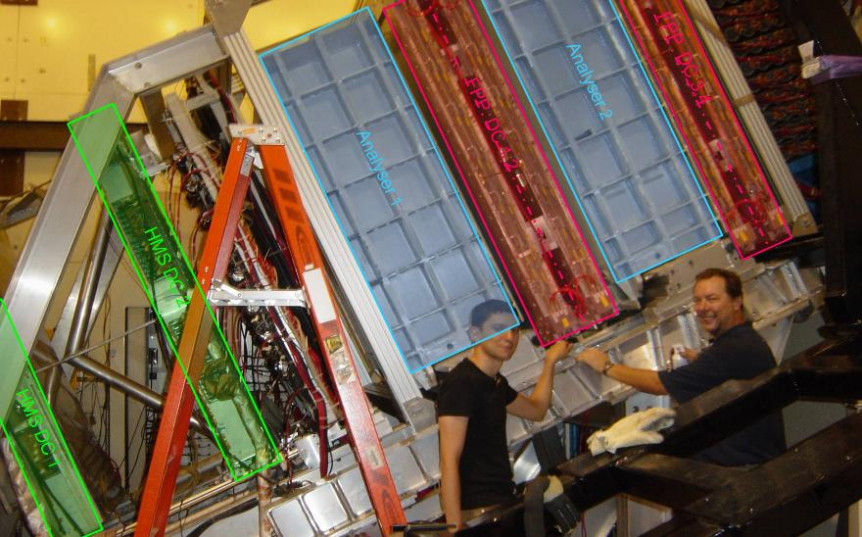
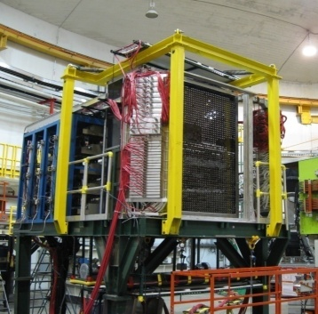
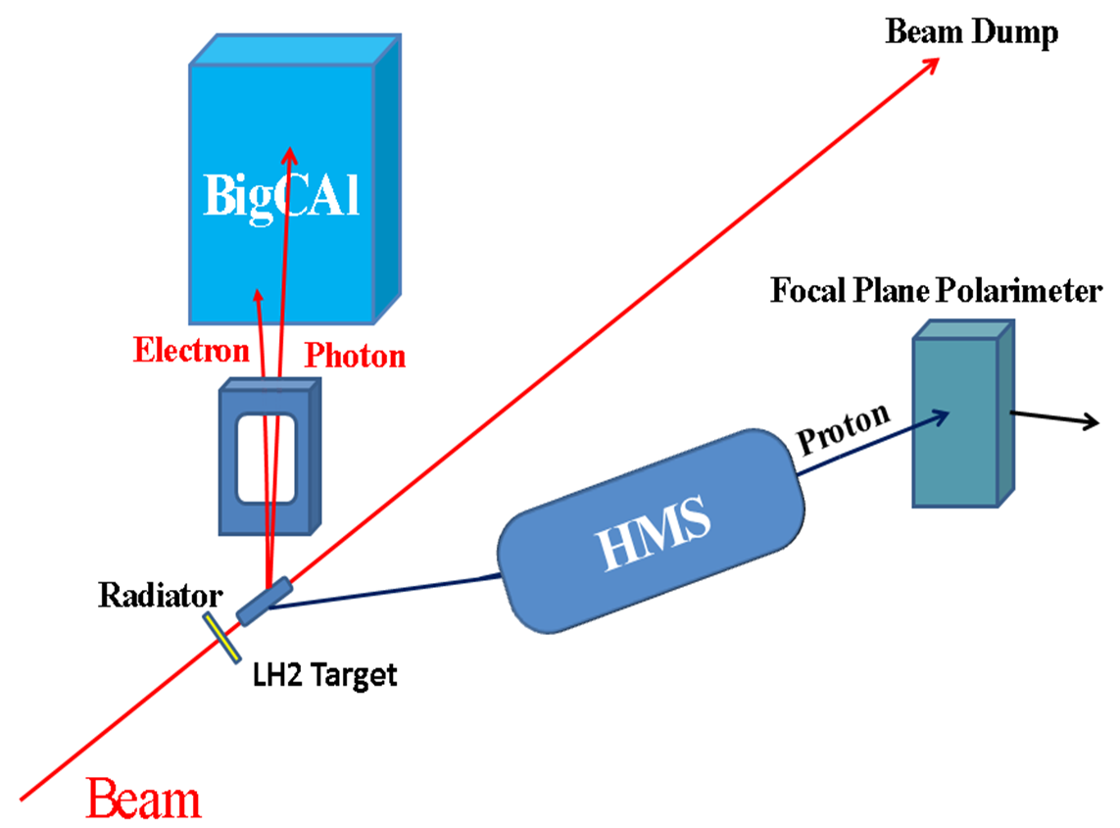
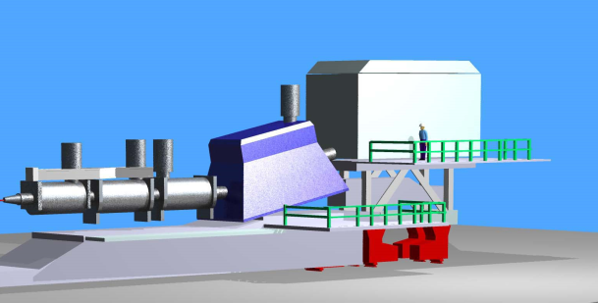
  Experimental Technique
BigCal detects the scattered electrons and photons.
Focal Plane Polarimeter measures the spin asymmetry of the proton.
Focal Plane Polarimeter
BigCal Calorimeter
High Momentum Spectrometer
(HMS)
detects recoiled proton
Magnet deflects electrons down
mixed photon/electron beam

Slide 5
  Data Analysis Update
Assuming two-body kinematic correlation to select WACS events.
Three main reaction channels:
WACS+π°
epγ
With ep elastic events:
BigCal timing and energy calibration
FPP analyzing power calibration
epγ polarization components
ep

Slide 7
  WACS events and background
Cut:
Coincidence timing
3.6 GeV<E_{beam} <3.98 GeV
|δ_{x}|<10 cm
|δ_{y}|<35 cm
Background mainly comes from:
π° photoproduction, polarization could be extracted simultaneously with WACS events
epγ background estimated by simulation: 10.6% of WACS events

Slide 8
  Analyzing power & polarization of epγ
Analyzing power:
0.151 +/- 0.001
Electromagnetic form factor ratio:
0.705 +/- 0.016
Transverse polarization:
P_{t} = - 0.143 +/- 0.003
Longitudinal polarization:
P_{l} = 0.471 +/- 0.003
Note: Momentum dependence of analyzing power have been corrected for WACS events.

Slide 9
  Preliminary results
COSY spin procession model used to in maximum-likelihood program instead of simple dipole approximation
Event by event background correction applied based on the π° contamination
epγ correction applied

Slide 10
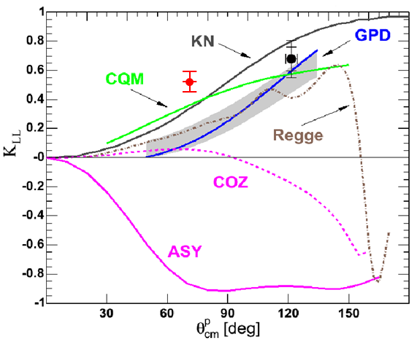
  Preliminary results
Transport result into c.m. frame:
K_{LL} = 0.525 +/- 0.070
K_{LT} = 0.125 +/- 0.067
Comparing to simple dipole results:
K_{LL} = 0.506 +/- 0.052
K_{LT} = 0.063 +/- 0.052
Systematic error not included
Further evidence that WACS proceeds through interaction of a photon and a single quark
PRELIMINARY
E07-002 Preliminary result
E99-114 result

Slide 11
  Summary
WACS is a powerful probe of proton structure
Preliminary result of E07-002 disagree with theoretical models, further investigation needs to be done.
Random background needs to be taking into account
Induced polarization component
Systematic errors

Slide 13
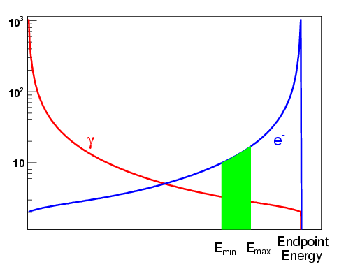
  Backup slide
Combined beam:
9% Cu radiator in front of 15 cm LH2 target.
The measured min and max beam energy are defined by HMS acceptance.
Distribution of expected and measured hit position in BigCal:
ep
WACS
π°

Slide 14
