Slide 1
Transverse Asymmetries
G0 Backward Angle
Juliette Mammei
University of Massachusetts, Amherst

Slide 2
Overview
G0 finished data-taking in 2007
Published forward and backward angle PV asymmetry results → strange quark contribution to the nucleon
Also measured parity-conserving asymmetry at both forward and backward angles
Forward angle - Physical Review Letters 99(9): 092301.
Backward angle – this work, preparing publication
Recent work by theorists at our kinematics

Slide 3
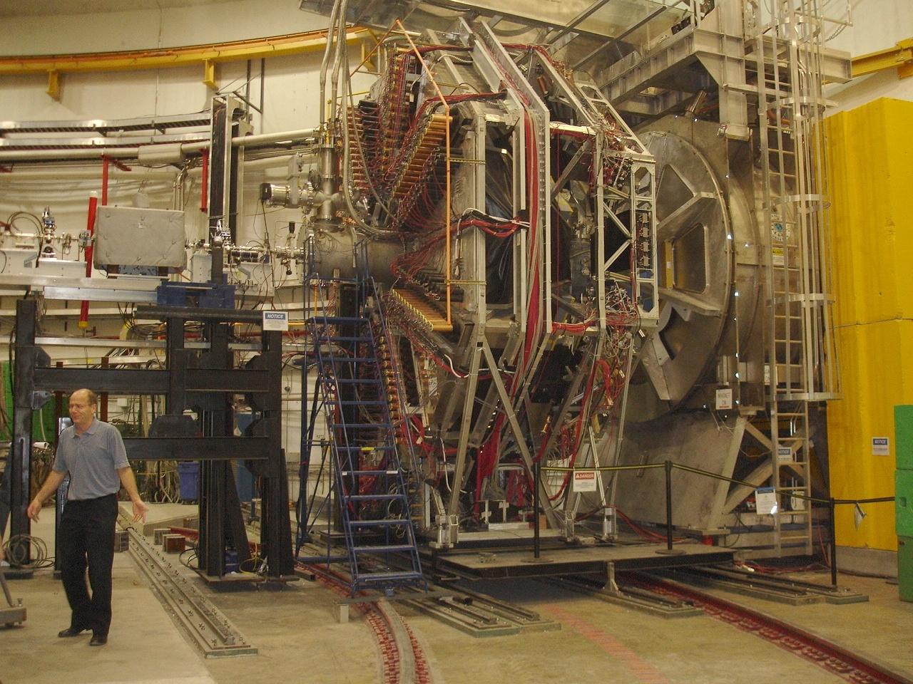
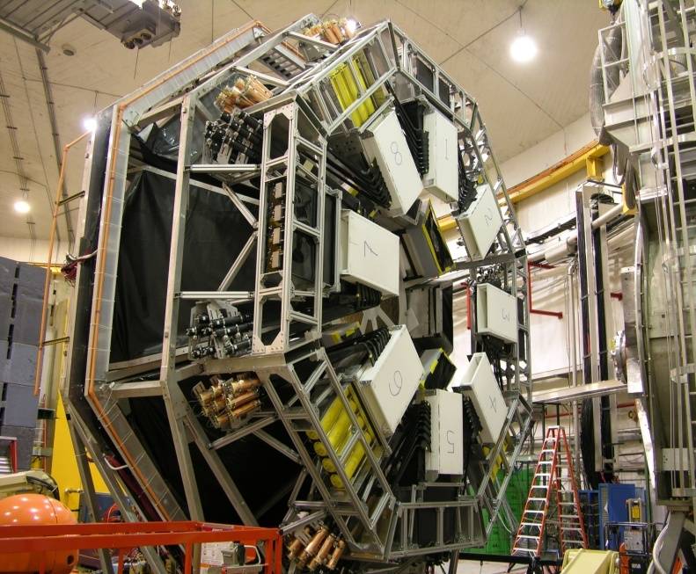
G0 Experiment
Super-conducting magnet (SMS)
Target service
module
G0 Beam monitors
LUMIs
Ferris wheel
FPD
Mini-ferris wheel
CED+ Cerenkov
View from ~upstream
View from downstream

Slide 4
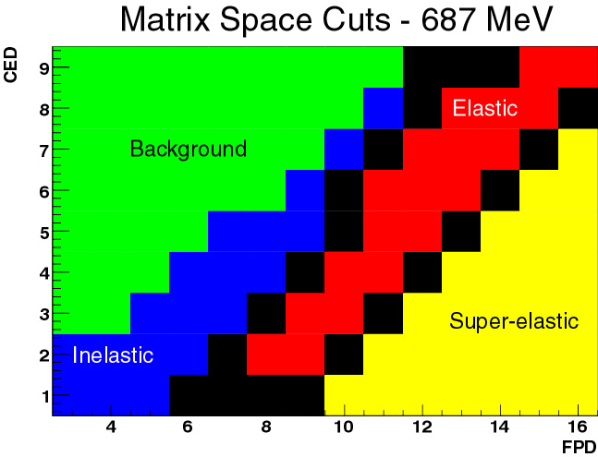
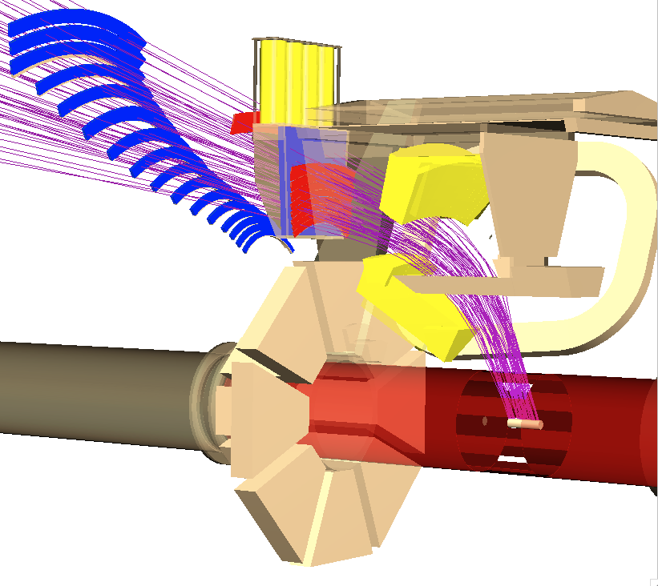
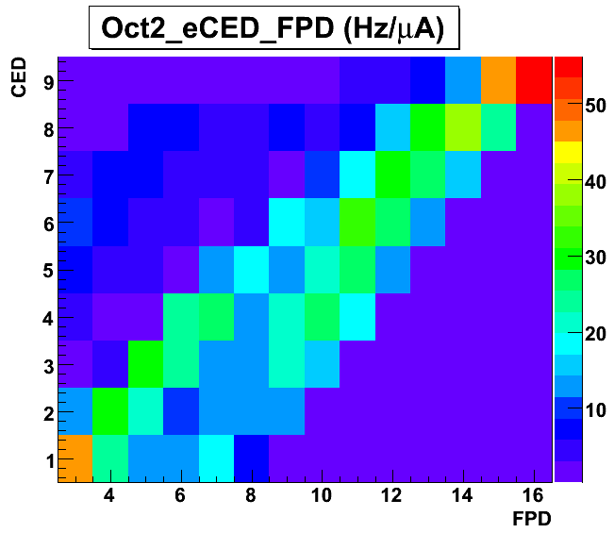
G0 Experiment
CED + Cerenkov
FPD
e⁻ beam
target
LUMIs
(not shown)

Slide 5
Motivation
Inclusion of the real part of the
2γ exchange in the cross section
may account for the difference
between measurements of G_{E}/G_{M}
from unpolarized cross section and polarization transfer measurements
without TPE contributions
Arrington, Melnitchouk, Tjon Phys. Rev. C 76, 035205 (2007)
Understanding the transverse asymmetries tests the theoretical framework that calculates the contribution of γZ and W⁺W⁻ box diagrams that are important corrections to precision electroweak measurements
with TPE contributions

Slide 6
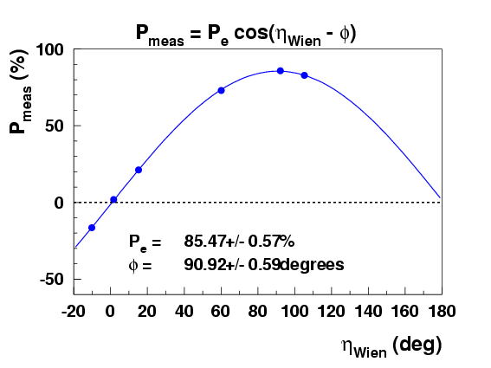
Polarized Beam
Moller polarimeter measurements give the longitudinal polarization in the hall as a function of wien angle
P_{meas}=0 means transversely polarized, in this case at ~0°
IHWP also reverses transverse P
velocity
spin

Slide 7
Transverse Asymmetry

Slide 8
Data Summary
G0 Backward, Transverse:
<θ_{lab}> ~ 108° for all
a total of
~50 hours of beam
Target | Energy (MeV) | Q² (GeV²/c²) | Amount of Data C IN / C OUT
H | 358.8 ± 0.5 | 0.222 ± 0.001 | 1.77 / 1.88
D | 359.5 ± 0.7 | 0.219 ± 0.001 | 1.00 / 1.10
H | 681.7 ± 0.9 | 0.626 ± 0.003 | 1.42 / 1.20
D | 685.9 ± 0.9 | 0.630 ± 0.003 | 0.08 / 0.06
Raw asymmetries
Notes:
Why H687 error bars so bad?

Slide 9
Analysis Overview
Blinding
Factors
(.75-1.25)
H, D Raw Asymmetries
A_{meas}
Corrections:
Scaler Counting Correction
Rate Corrections from Electronics
Helicity Correlated Corrections
Beam Polarization
Background Asymmetry
No radiative corrections
Unblind
Transverse Asymmetries
Sinusoidal fit

Slide 10
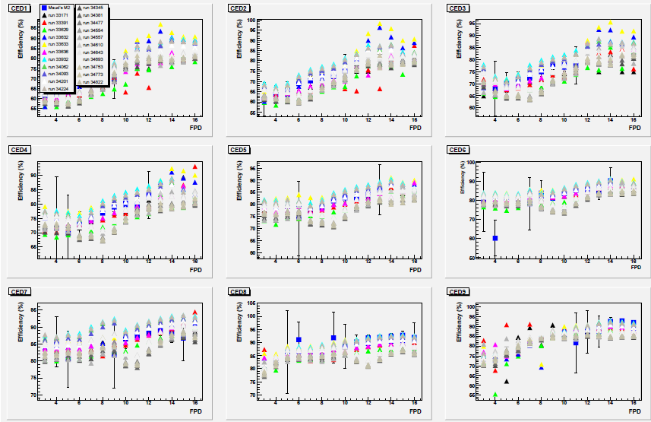
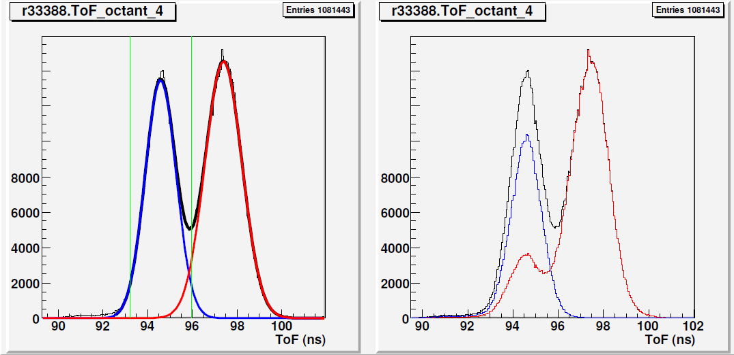
Cerenkov Efficiencies
TOF data (Maud)
ARS data (Alex)
Compare M2/M3 runs (Herbert)
Events identified as electrons or pions by the TOF analysis or the cerenkov
Notes:
Maud used TOF data with cerenkov trigger; Alex used “software trigger”, Herbert compared the ratio of the yields from M2/M3 runs and the calculated probabilities to get two or three hits based on a Poisson distribution, increasing the mean of the distribution,u, until the ratio of probabilities equaled the ratio of the yields and then got the effiency from the ratio of the measured yield to the calculated total yield.

Slide 11
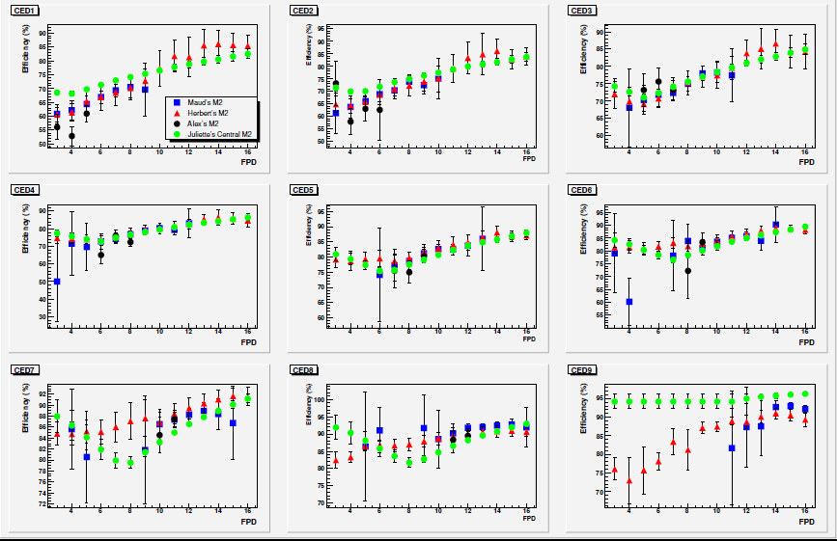
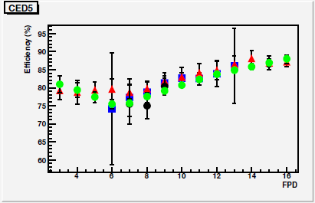
Cerenkov Efficiencies
Yields efficiencies
where X is the distance from the PMTs
and is the angle at the entrance to the
aerogel
Fit to Maud’s efficiencies (used ToF data)

Slide 12
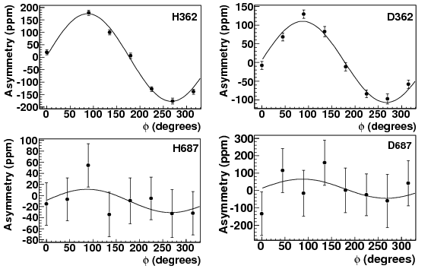
e⁻ Transverse Asymmetries
B_{n}=-176.2 ppm
B_{n} =-108.6 ppm
B_{n} =-21.0 ppm
B_{n} =-55.2 ppm

Slide 13
Summary of Results
Dataset | Transverse Asymmetry A_{n} ± σ_{stat} ± σ_{sys} ±σ_{global} _{(ppm)} | Change in asymmetry due to correction (%)
 |  | Scaler Counting | Rates from electronics | Linear Regression | Background Asymmetries
H362 | -176.2 ± 5.7 ± 6.0 ± 2.8 | <1% | 2.9% | 1.3% | 4%
D362 | -108.6 ± 6.7 ± 3.1 ± 1.7 | < 1% | 1.6% | < 1% | < 1%
H687 | -21.0 ± 18 ± 15 ± 0.4 | 4% | 4% | <1% | 9%
D687 | -55.2 ± 71 ± 32 ± 0.9 | < 1% | 28% | < 1% | 10%
Backward angle data from other experiments:
SAMPLE(H): E=192 MeV, Q²=.10 GeV², θ_{lab} =145º, A_{n} = -15.4+/- 5.4 ppm
Phys. Rev. C63 064001 (2001)
A4(H): E=315 MeV, Q²=.23 GeV², θ_{lab} =145º, A_{n} = -84.81+/- 4.28 ppm
Eur. Phys. J. A32 497 (2007) (preliminary)
more from A4 coming soon
Notes:
Why electronics changes D687 so much

Slide 14
Theory Summary
The predictions of the asymmetry are sensitive to the physics of the
intermediate hadronic state in the 2γ exchange amplitude
Threshold region: HBχPT
L. Diaconescu & M.J. Ramsey-Musolf, Phys. Rev. C70, 054003 (2004)
Resonance region: moderate energy
B. Pasquini & M. Vanderhaeghen, Phys. Rev. C70, 045206 (2004)
High energy forward scattering region: diffractive limit
Afanasev & Merenkov, Phys. Lett. B599, 48 (2004)
Gorchtein, Phys. Lett. B644, 322 (2007)
Hard scattering region: GPDs (Generalized Parton Distributions)
M. Gorchtein, P.A.M. Guichon, M. Vanderhaeghen, Nuc.Phys. A 741:234-248,2004

Slide 15
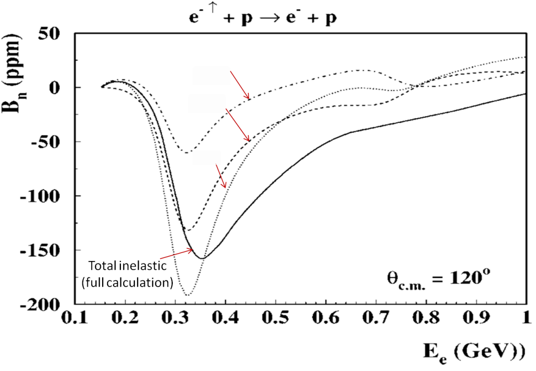
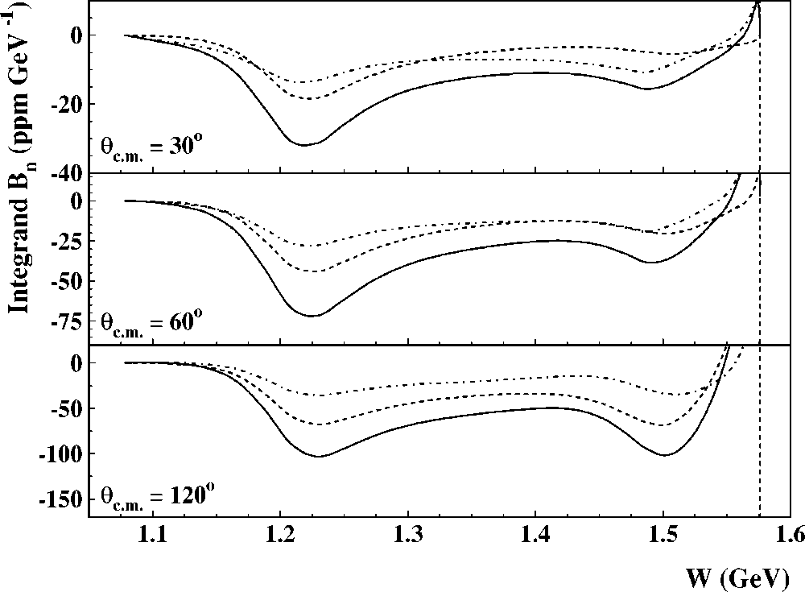
Theory Summary
The predictions of the asymmetry are sensitive to the physics of the
intermediate hadronic state in the 2γ exchange amplitude
Model the non-forward hadronic tensor for the elastic contribution (X=N) as well as the inelastic contribution in the resonance region (X=πN)
Use phenomenological πN electroproduction amplitudes (MAID) as input
Integrate over different photon virtualities
Resonance region: moderate energy
B. Pasquini & M. Vanderhaeghen, Phys. Rev. C70, 045206 (2004)
Sum
quasi-real Compton scattering,
Notes:
Quasi-real compton scattering at endpoint of integration; dominates up to energies of ~4 GeV explains some features of the theory.

Slide 16
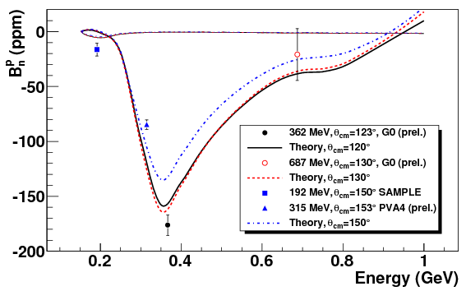
Comparison to Theory

Slide 17
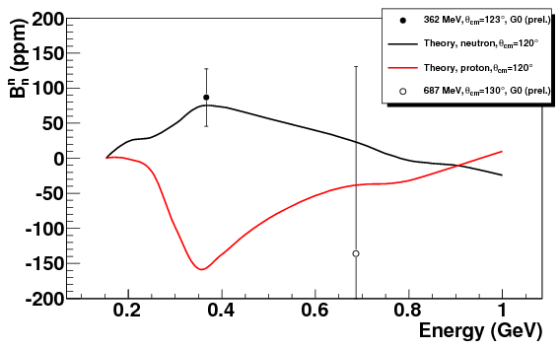
Transverse Asymmetries for the neutron
362 MeV:
= 23 µb/sr = 8 µb/sr
687 MeV: = 2.6 µb/sr = 1.1 µb/sr
In the quasi-static approximation:
Assume 5% error on cross section
For 362MeV:
For 687MeV:

Slide 18
Forward Angle Transverse
Q² (GeV²/c²) | Transverse Asymmetry A_{n} ± σ_{stat} ± σ_{sys} _{(ppm)}
0.15 | -4.06 ± 0.99 ± 0.63
0.25 | -4.82 ± 1.87 ± 0.98
Q²=0.15 GeV²/c²
θ_{cm}=20.2°
E_{beam} =3 GeV
Q²=0.25 GeV²/c²
θ_{cm}=25.9°

Slide 19
Conclusions
Backward angle transverse asymmetries consistent with a resonance region model that includes the inelastic intermediate hadronic states
G0 more than doubled the world dataset for the transverse asymmetries at backward angles on the proton
We provide the first measurement of the transverse asymmetry for the neutron

Slide 20
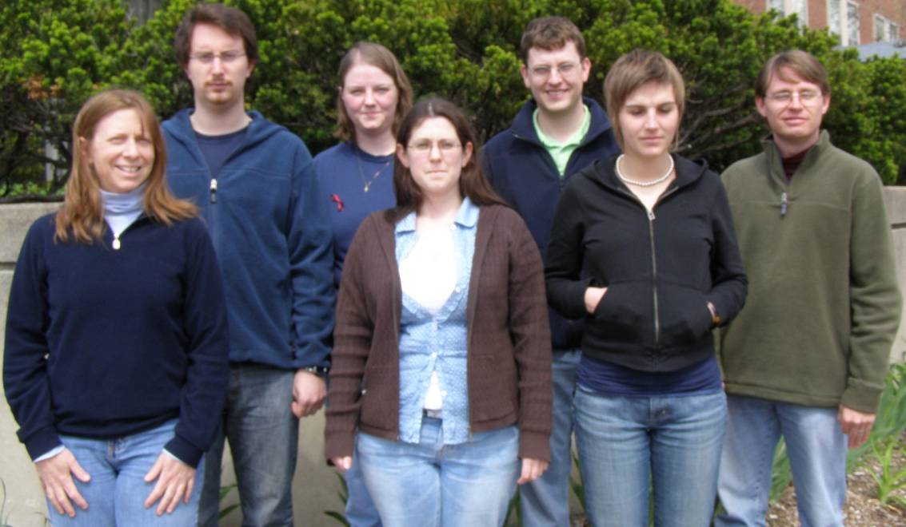
The G⁰ Collaboration
G⁰ Spokesperson: Doug Beck (UIUC)
California Institute of Technology, Carnegie-Mellon University, College of William and Mary, Hendrix College, IPN Orsay, JLab, LPSC Grenoble, Louisiana Tech, New Mexico State University, Ohio University, TRIUMF, University of Illinois, University of Kentucky, University of Manitoba, University of Maryland, University of Winnipeg, Virginia Tech, Yerevan Physics Institute, University of Zagreb
Analysis Coordinator: Fatiha Benmokhtar (Carnegie-Mellon,Maryland)
Thesis Students:
Stephanie Bailey (Ph.D. W&M, Jan ’07, not shown)
From left to right: Colleen Ellis (Maryland) , Alexandre Coppens (Manitoba),
Juliette Mammei (VA Tech), Carissa Capuano (W&M),
Mathew Muether (Illinois), Maud Versteegen (LPSC) , John Schaub (NMSU)

Slide 21
Backup Slides

Slide 22
Theory Summary
The predictions of the asymmetry are sensitive to the physics of the
intermediate hadronic state in the 2γ exchange amplitude
Resonance region: moderate energy
B. Pasquini & M. Vanderhaeghen, Phys. Rev. C70, 045206 (2004)
Model the non-forward hadronic tensor for the elastic contribution (X=N) as well as the inelastic contribution in the resonance region (X=πN)
Use phenomenological πN electroproduction amplitudes (MAID) as input
Integrate over different photon virtualities
Notes:
Quasi-real compton scattering

Slide 23
Theory Summary
Resonance region: moderate energy
B. Pasquini & M. Vanderhaeghen, Phys. Rev. C70, 045206 (2004)
Model the non-forward hadronic tensor for the elastic contribution (X=N) as well as the inelastic contribution in the resonance region (X=πN)
Use phenomenological πN electroproduction amplitudes (MAID) as input
Integrate over different photon virtualities
Sum
quasi-real Compton scattering,

Slide 24
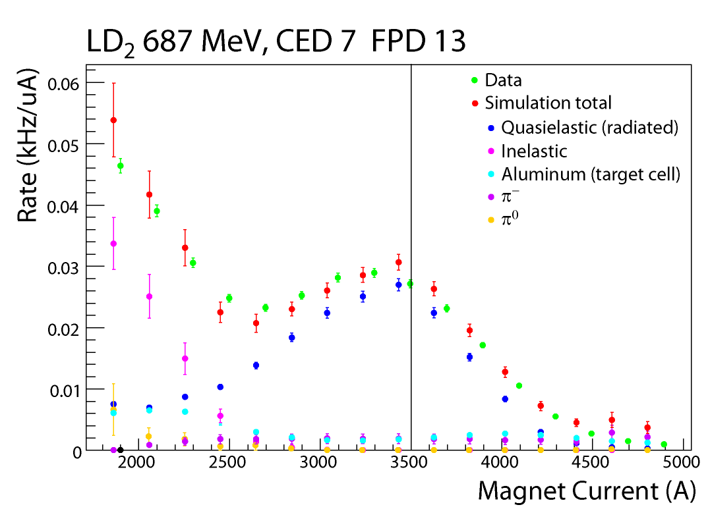
Background Corrections

Slide 25
Resonance Region Estimates
Different hadronic
intermediate states:
N
π N
Sum
“It will be interesting to check that for backward angles, the beam normal SSA indeed grows to the level of tens of ppm in the resonance region.”

Slide 26
Theory Summary
- contains intermediate hadronic state information

Slide 27
Luminosity Monitors/Phases
H362
LUMI Phases
Dataset | φ₀
H362 | -3.5° ± 1.7°
D362 | -3.1° ± 0.4°
H687 | -2.8° ± 0.8°
D687 | -1.1° ± 1.3°
D362
H687
Detector Phases
Dataset | φ₀
H362 | 2.6° ± 1.9°
D362 | 1.6 ° ± 3.4°
H687 | -10.9° ± 68°
D687 | -23.8 ° ± 63°
D687

Slide 28
Forward Angle Transverse
Q² (GeV²/c²) | Transverse Asymmetry A_{n} ± σ_{stat} ± σ_{sys} _{(ppm)}
0.15 | -4.06 ± 0.99 ± 0.63
0.25 | -4.82 ± 1.87 ± 0.98
Q²=0.15 GeV²/c²
θ_{cm}=20.2°
E_{beam} =3 GeV
Q²=0.25 GeV²/c²
θ_{cm}=25.9°

Slide 29
Transverse Uncertainty in Longitudinal Data
Dataset | Longitudinal Asymmetry A ± σ_{stat} ± σ_{sys} ±σ_{global} _{(ppm)} | σ_{transverse} _{(ppm)}
H362 | -11.0 ± 0.8 ± 0.3 ± 0.4 | 0.036 ± 0.002
D362 | -16.5 ± 0.8 ± 0.4 ± 0.2 | 0.024 ± 0.002
H687 | -44.8 ± 2.0 ± 0.8 ± 0.7 | 0.012 ± 0.014
D687 | -54.0 ± 3.2 ± 1.9 ± 0.6 | 0.008 ± 0.008
Upper estimate of detector asymmetry factor:
If you assign all octant variation in yields to variation in central scattering angle

Slide 30
Pion Asymmetries raw data
Dataset | Amplitude | φ₀
H362 | -112 ± 20 | -90° ± 2°
D362 | -184 ± 8 | -90° ± 2°
H687 | -144± 16 | -88° ± 7°
D687 | -67 ± 13 | -85° ± 11°
H362
D362
Note: there is no background asymmetry
correction here; there may be very
large electron contamination
errors are statistical
H687
Trying to determine the theoretical
implications – input is welcome!
D687

