Slide 1
HKS Analysis Status Report Liguang Tang (Hampton/JLAB) Hall C User Meeting, Jan. 15, 2011
HKS has data taken in 2005 (E01-011) and 2009 (E05-115)
Physics for 2005 data: ⁷_{Λ}He, ¹²_{Λ}B, and ²⁸_{Λ}Al
Physics for 2009 data: ⁷_{Λ}He, ⁹_{Λ}Li, ¹⁰_{Λ}Be, ¹²_{Λ}B, and ⁵²_{Λ}V
High precision mass spectroscopy is extremely challenging
Complicated magnetic spectrometer system
Extremely high particle rate
Hard work but great finding in 2010 from the 2009 data analysis
Hard and excellent work done by Ms Chunhua Chen (Hampton)
It may resolve all the puzzles we have so far in terms physics yield rates and precision/resolution
We have to recheck the “finalized” 2005 analysis, UNFORTUNATELY
We thank for the strong support given by the community and the JLAB management (especially Hall C). I apologize for the delay of 2005 data analysis and result.
Goal: High precision ↔ Experiments at JLAB (Please be patient with us)

Slide 2
Analysis for 2009 (E05-115) Data
HKS Tracking Code
We finally be able to run with very high luminosity but it also gave us trouble in tracking by high multiplicity plane (DC or other detectors)
Our 2005 tracking code converted from the Hall C SOS/HMS code gives large error in tracking due to many “Averaging Approaches” in handling multiple hits in terms of timings, locations, and so on…
Approach I: Modification of the existing code
It takes Ms Chunhua Chen (Hampton) almost 6 months effort
It is now approved work well up to certain limit, i.e. analysis can be done for data from sieve slit run and targets of CH₂, ⁷Li, ⁹Be, ¹⁰B, and ¹²C.
It still has problem with data from H₂O and ⁵²Cr targets
Approach II: New code with more pre-PID
Gogami from Tohoku group is working on it but not yet having progress report. Next collaboration meeting will be in mid-February, 2011
Additional KID Improvement (Efficiency and loss reduction)
A few students are doing on this

Slide 3
New Finding from 2009 (E05-115) Data Analysis
Strong asymmetry was found in the quadrupole field from Q1 and Q2 for both HKS and HES
It causes severe distortion of the kinematics space. If this asymmetry is not properly described in the optics which we use to reconstruct the kinematics parameters: p, θ, and φ.
Our calibration method developed in analyzing our 2005 (E01-011) data cannot achieve uniformed quality in the entire kinematics space if the initial assumed optics is far to reality, i.e. mathematical error in fitting with large number of degrees of freedom.
Finding the correct near “real” forward optics is a MUST. It was achieved by Ms Chunhua Chen in the 2nd half of 2010.
Such asymmetry was then also found in 2005 HKS system

Slide 4
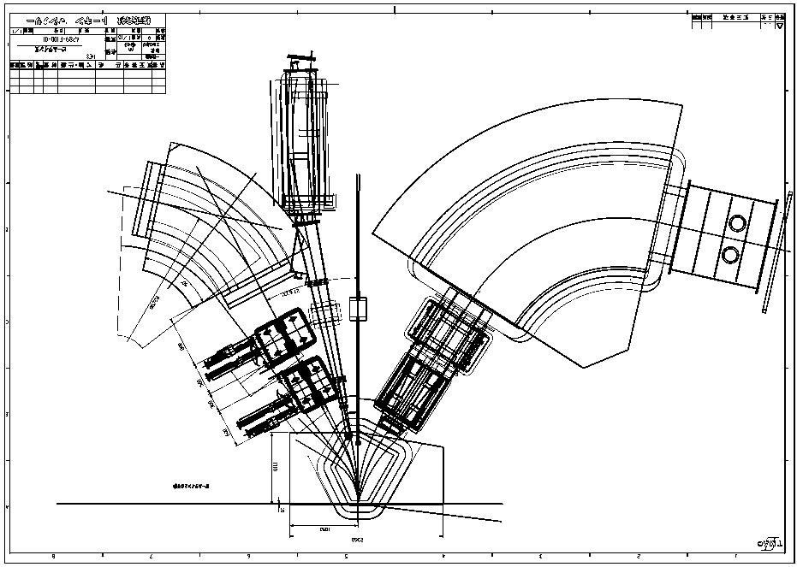
HKS-HES Layout and Source of Asymmetric Field
HKS
HES
Q2
Q2
Q1
Q1
New SPL

Slide 5
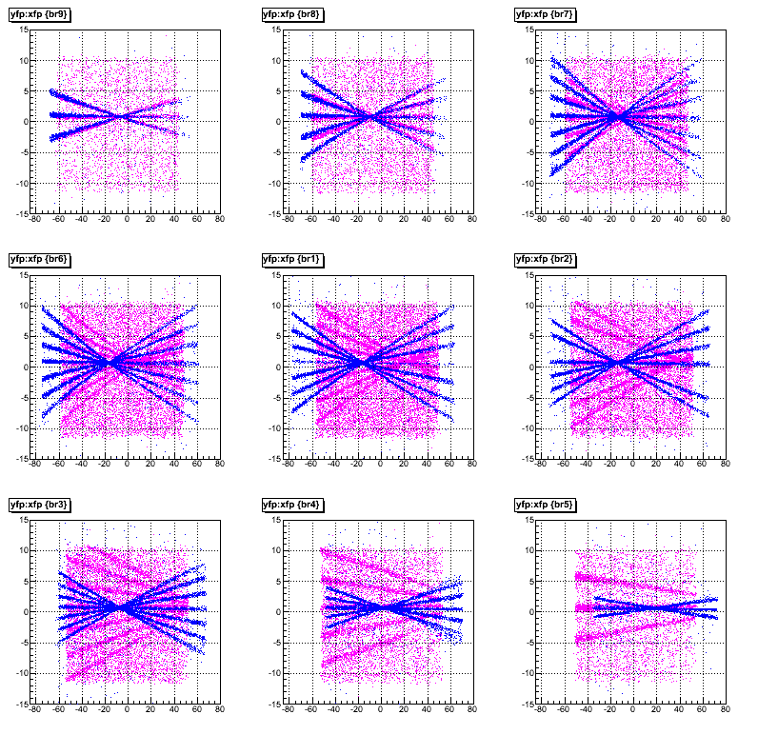
Effect of Asymmetric Field – X’ Dependence Focal Plane Y vs X Patterns from Different Column of S.S. Holes
Far Left
The same dependence or the effect to the correctness in the optics description appears in all correlations between focal plane x, x’, y, y’
Far Right
Blue: Simulated s.s. events with originally designed symmetric optics
Magenta: Real s.s. events taken in 2009 experiment

Slide 6
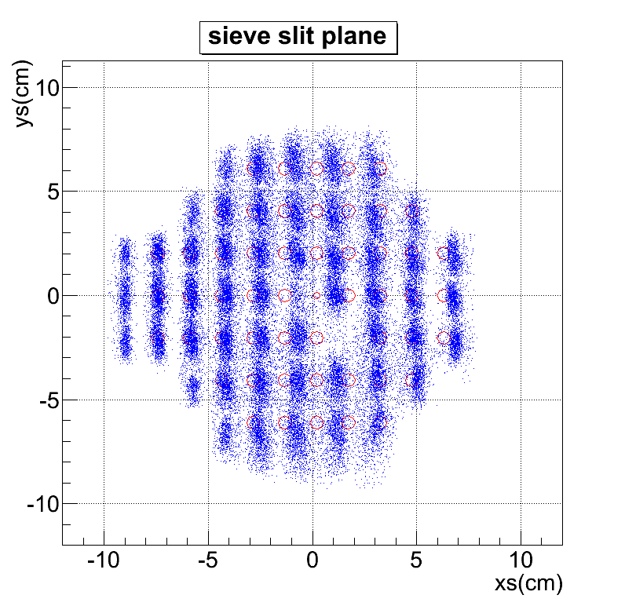
Effect of Asymmetric Field – X’ Dependence Reconstruction to the S.S. Plane
11 columns of holes
Only 10 bands appeared

Slide 7
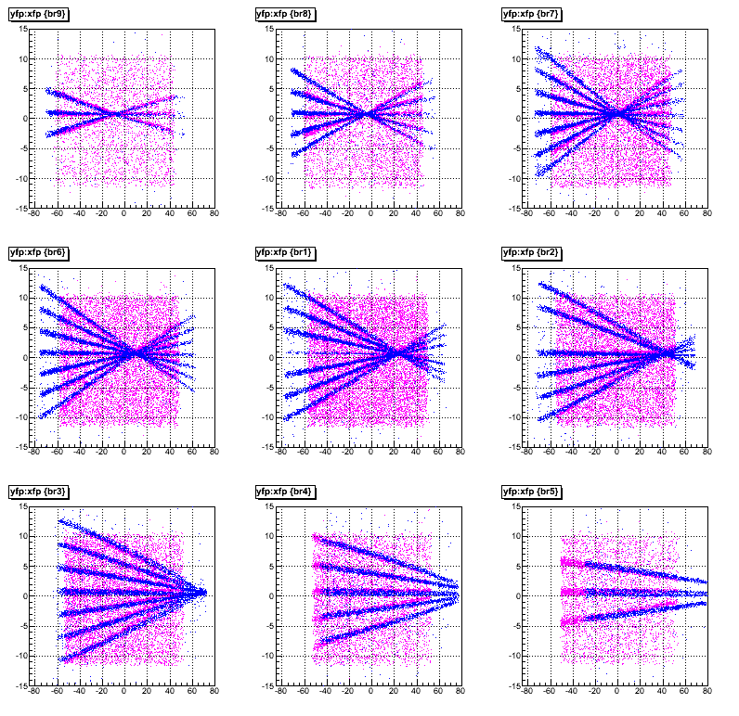
Effect of Introduction of Asymmetric Field in Optics Focal Plane Y vs X Patterns from Different Column of S.S. Holes
The same quality of agreement appears in all correlations between focal plane x, x’, y, y’
Blue: Simulated s.s. events with originally designed symmetric optics
Magenta: Real s.s. events taken in 2009 experiment

Slide 8
Comparison of Optics: Originally thought and Now
Before
After
Blue: Simulated s.s. events with originally designed symmetric optics
Magenta: Real s.s. events taken in 2009 experiment

Slide 9
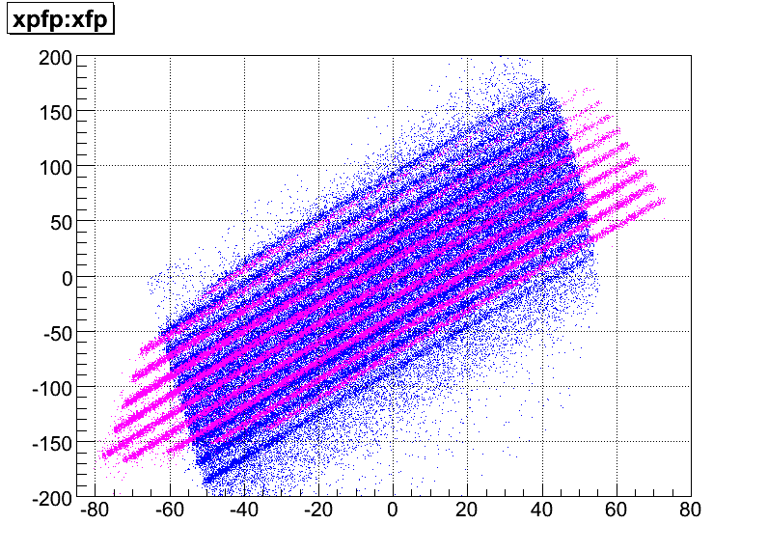
Comparison of Optics: Originally thought and Now
Before
After
Magenta: Simulated s.s. events with originally designed symmetric optics
Blue: Real s.s. events taken in 2009 experiment

Slide 10
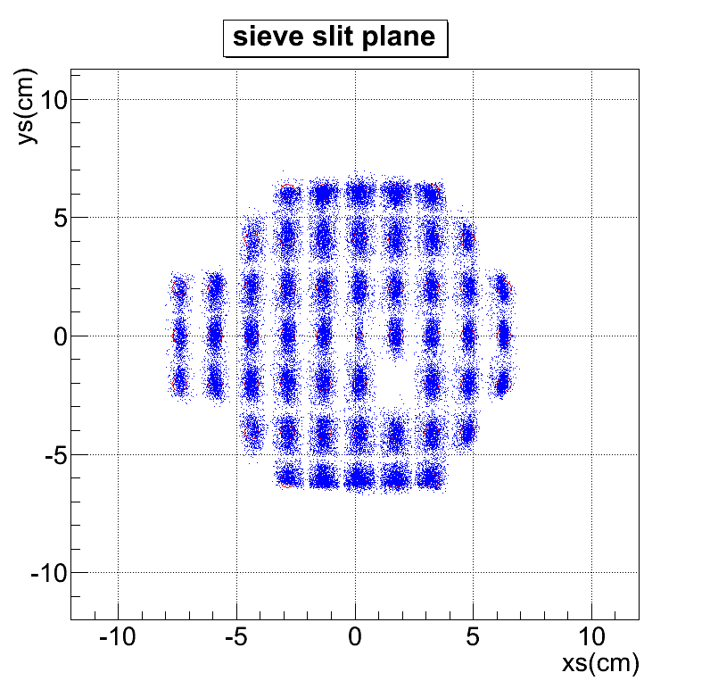
Comparison of Optics: Originally thought and Now
Before
After
11 columns of holes
Only 10 bands appeared
11 columns of holes
All 11 bands in agreement
Real HKS S.S. events reconstructed to the HKS S.S. plane

Slide 11
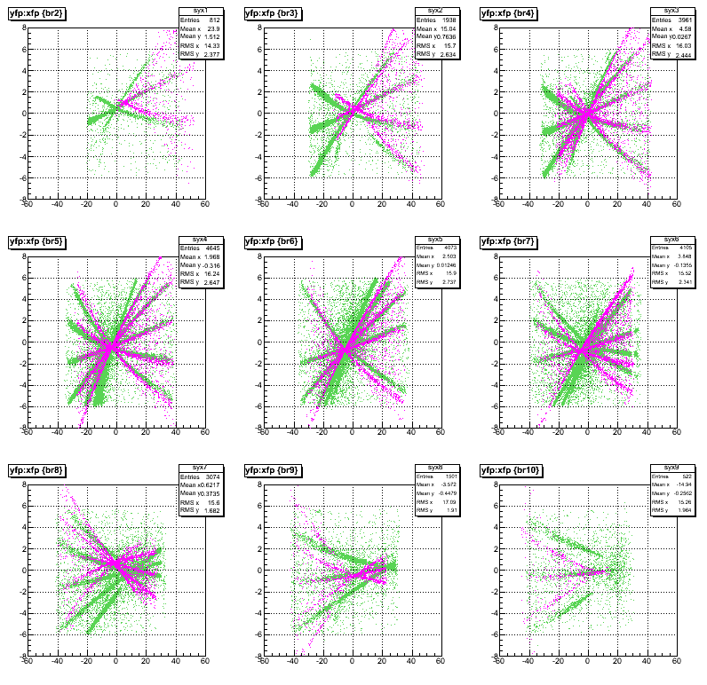
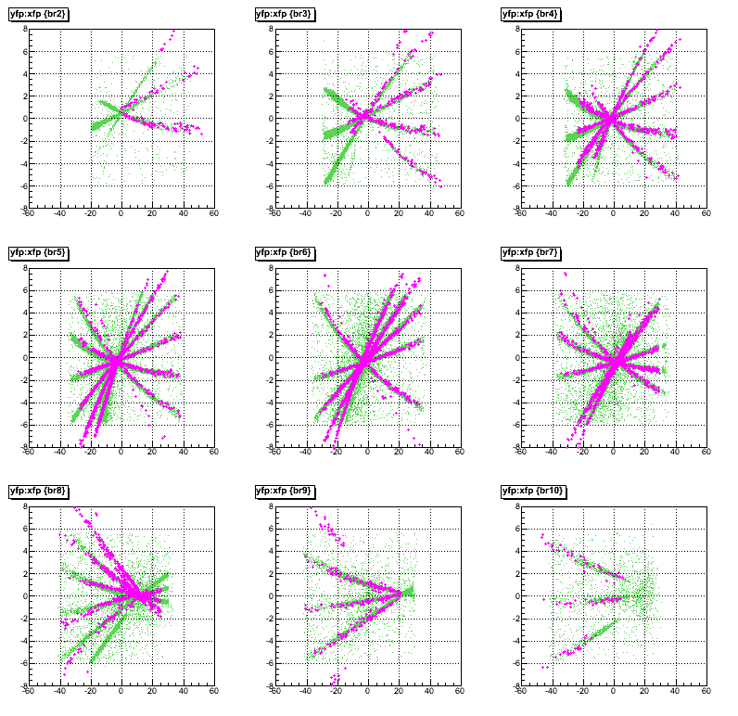
Same Comparison of Optics for HES
Before
After
Magenta: Simulated s.s. events with originally designed symmetric optics
Green: Real s.s. events taken in 2009 experiment

Slide 12
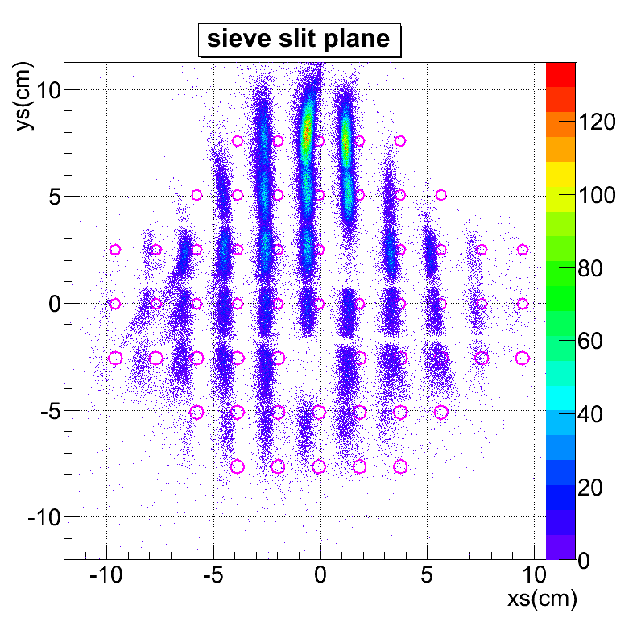
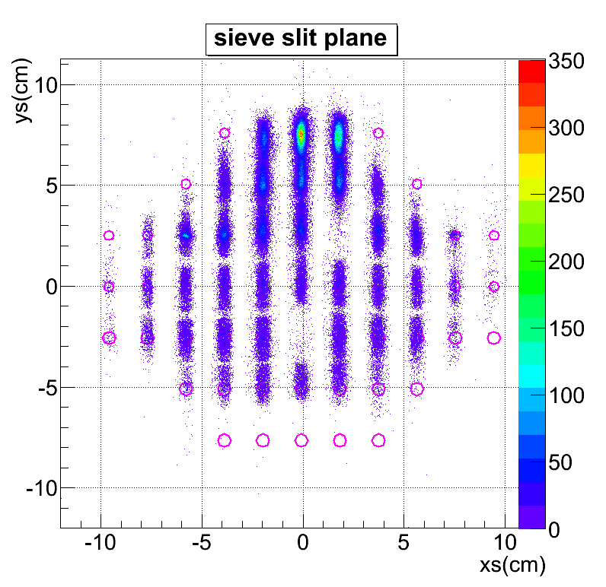
Comparison of Optics: Originally thought and Now
Before
After
Real HES S.S. events reconstructed to the HES S.S. plane

Slide 13
Analysis Plan for 2009 Data
Obtain the “close-to-Real” initial matrices (Done).
Study Λ (Σ⁰) spectrum as function of kinematic angle to verify the correctness of our understanding through quality uniformity and yield increase in the Λ (Σ⁰) peak. We hope to accomplish this by the next collaboration meeting in February.
Generate ¹²_{Λ}B: (1) verify and prove the yield rate; and (2) check the spectroscopy consistency. Study Λ (Σ⁰) spectrum from H₂O target. Overall, prepare data from CH₂, H₂O, and C targets to start kinematics calibration. We hope to accomplish this by April, 2011.
Kinematics calibration and optics optimization. Goal: to be able to finalize the spectroscopy for ⁷_{Λ}He, ⁹_{Λ}Li, ¹⁰_{Λ}Be, and ¹²_{Λ}B by the end of 2011.
Complete new tracking code in order to proceed the analysis on ⁵²_{Λ}V. This task may take a year to complete.
Focus on physics analysis, error/precision analysis, and publication in 2012.

Slide 14
Analysis Plan for 2005 Data
We need to do the same in finding the right starting optics for HKS and Enge.
Check and verify the spectroscopy of ⁷_{Λ}He, ¹²_{Λ}B, and ²⁸_{Λ}Al.
Redo calibration if needed.
Complete physics analysis.
Summary
I believe we have resolved the puzzles that bothered us since HNSS in 2000.
We have excellent students and postdocs worked and working hard and dedicatedly on various issues in the analyses.
We must ensure the correctness and precision in our physics results which may impact this field in great deal.
Please be patient with us.

