Slide 1
SHMS Progress Jan 15, 2015
Paul Brindza
Steve Lassiter, Eric Sun, Mike Fowler, Paulo Medeiros, Dan Young,
Bert Metzger, Gary Vettalana

Slide 2
SHMS Overview
SHMS Q1
SHMS HB
SHMS Dipole
SHMS Q2Q3

Slide 3
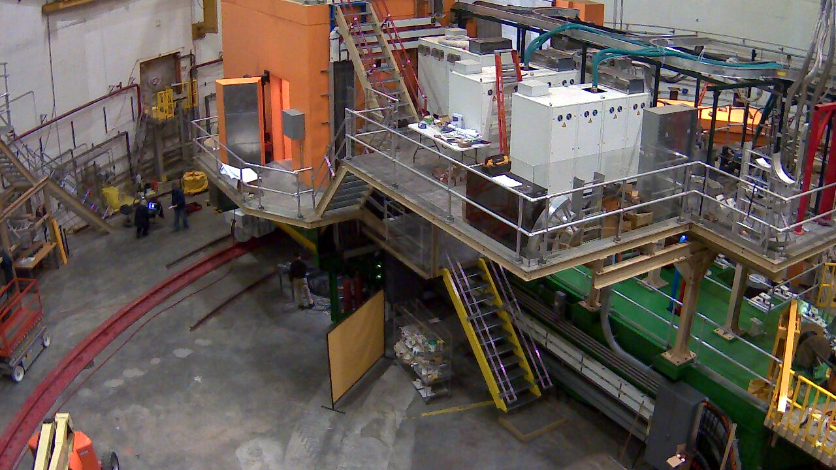
Hall C SHMS Jan 14, 2015

Slide 4
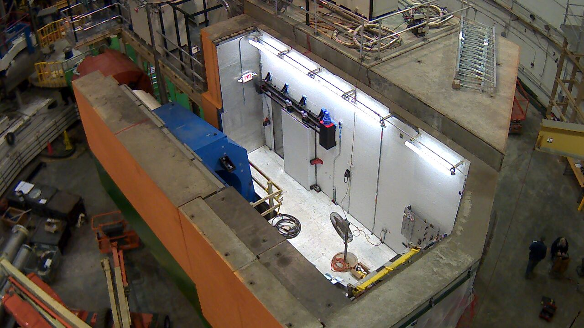
Hall C SHMS Jan 14, 2015

Slide 5
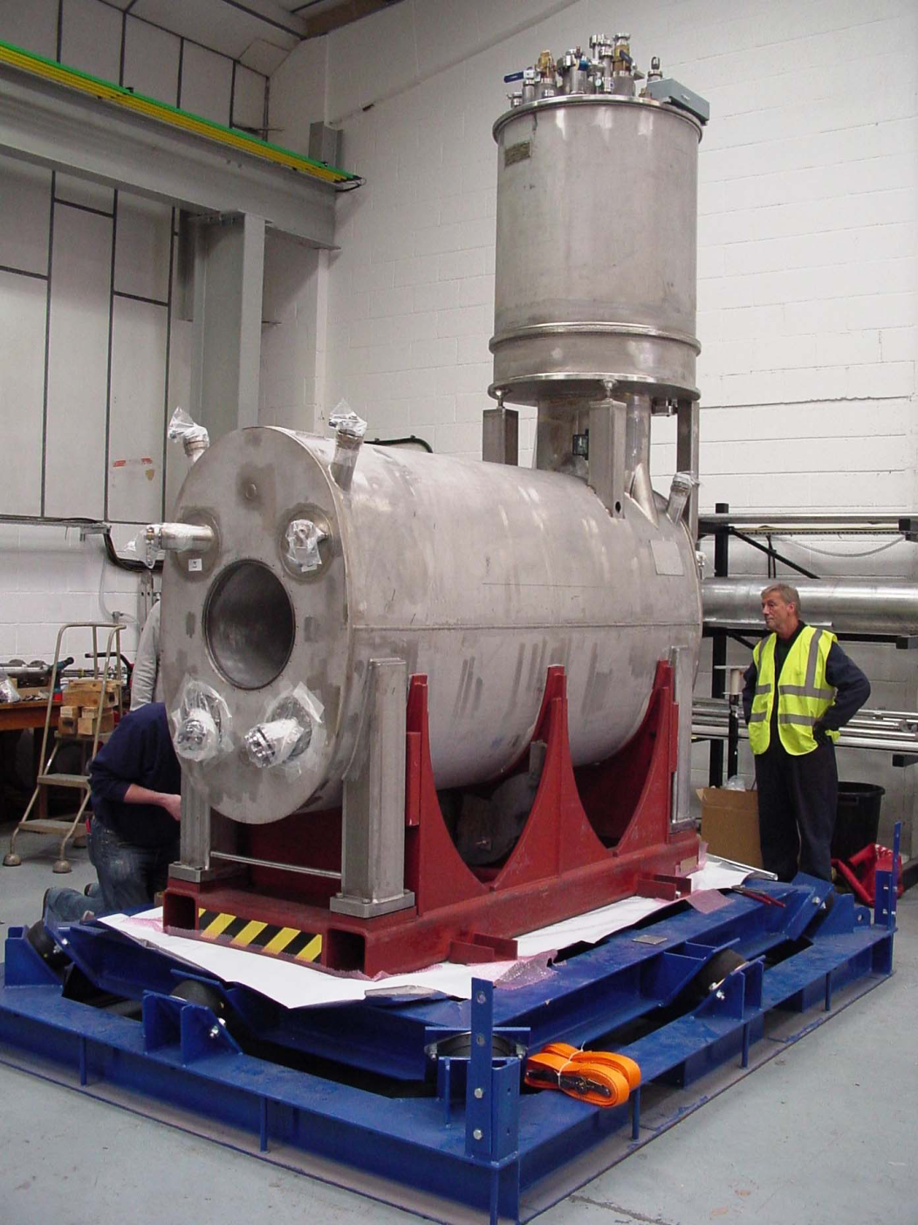
Q1 at SMI in the shipping Frame Dec 2014
Departed SMI Dec 12, 2014
In Norfolk Friday Jan 2, 2015
At JLAB Tuesday Jan 13, 2015
In Hall C Wed. Jan 14 , 2015

Slide 6
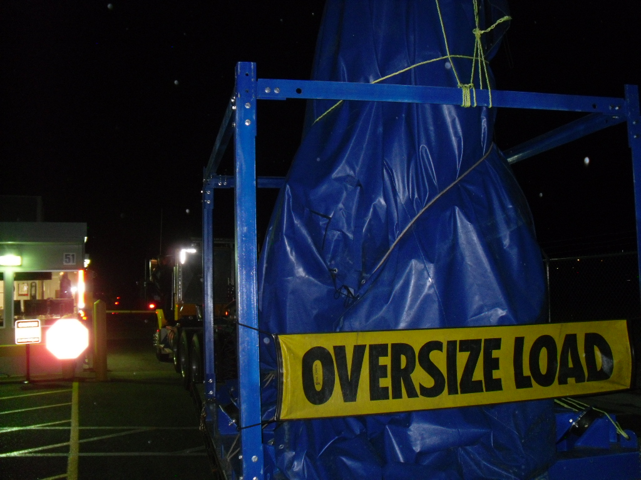
Q1 checking thru JLAB security @ 7 PM Jan 13, 2015

Slide 7
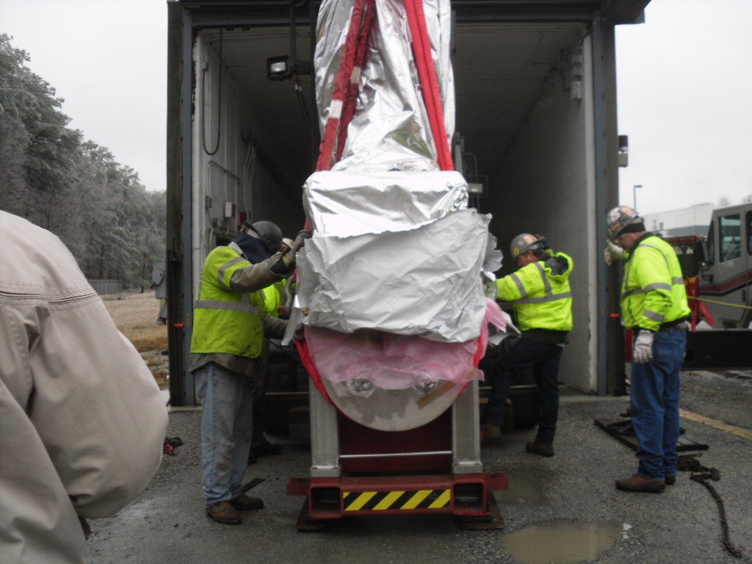
Into the Pit
Wed Jan 15, 2015

Slide 8
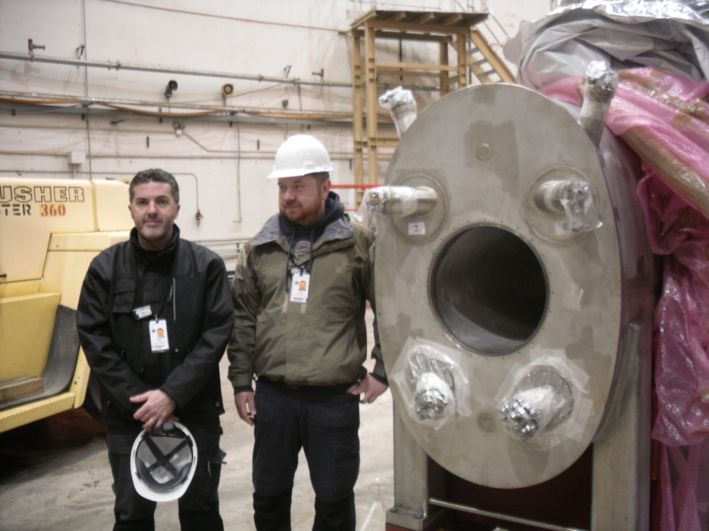
Q1 in Hall C with SMI Techs

Slide 9
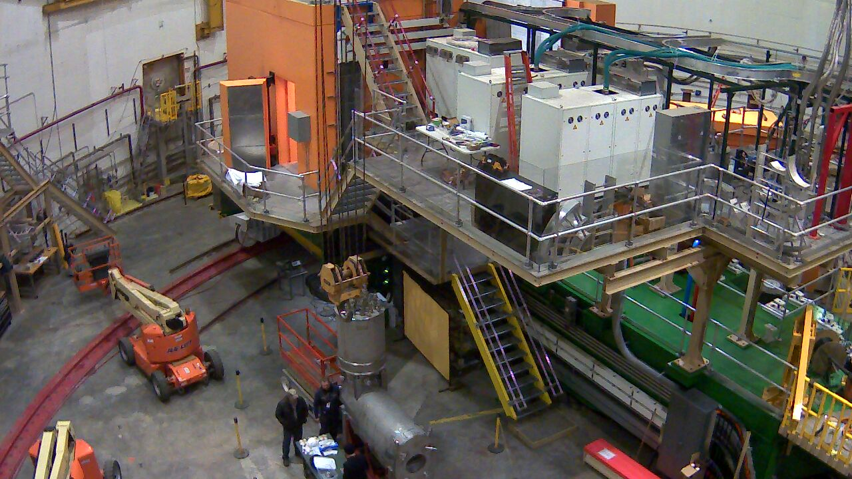
Q1 in Hall C Wednesday January 14, 2015

Slide 10
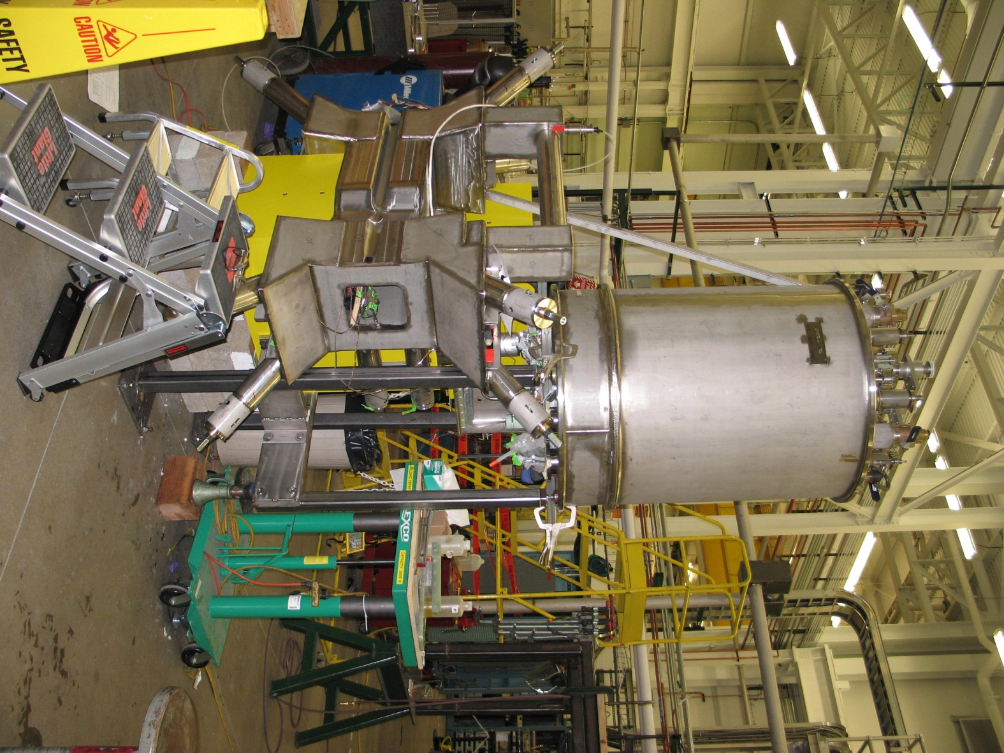
HB near complete @ MSU
On Jan 5, 2015
Ship date March 15, 2015

Slide 11
HB close up of SC bus connections Jan 5, 2015

Slide 12
Dipole Coils complete @ SigmaPhi Jan 15, 2015

Slide 13
Dipole Status at SigmaPhi
Dipole coils wound and Vacuum impregnated
Dipole coil A layer splices complete
Dipole coil assembly underway
Collars and collaring fixtures on order for Feb delivery
Dipole cryostat in Fab at SDMS, Lyon France
He vessel March 2015
Vacuum vessel & shield April 2015

Slide 14
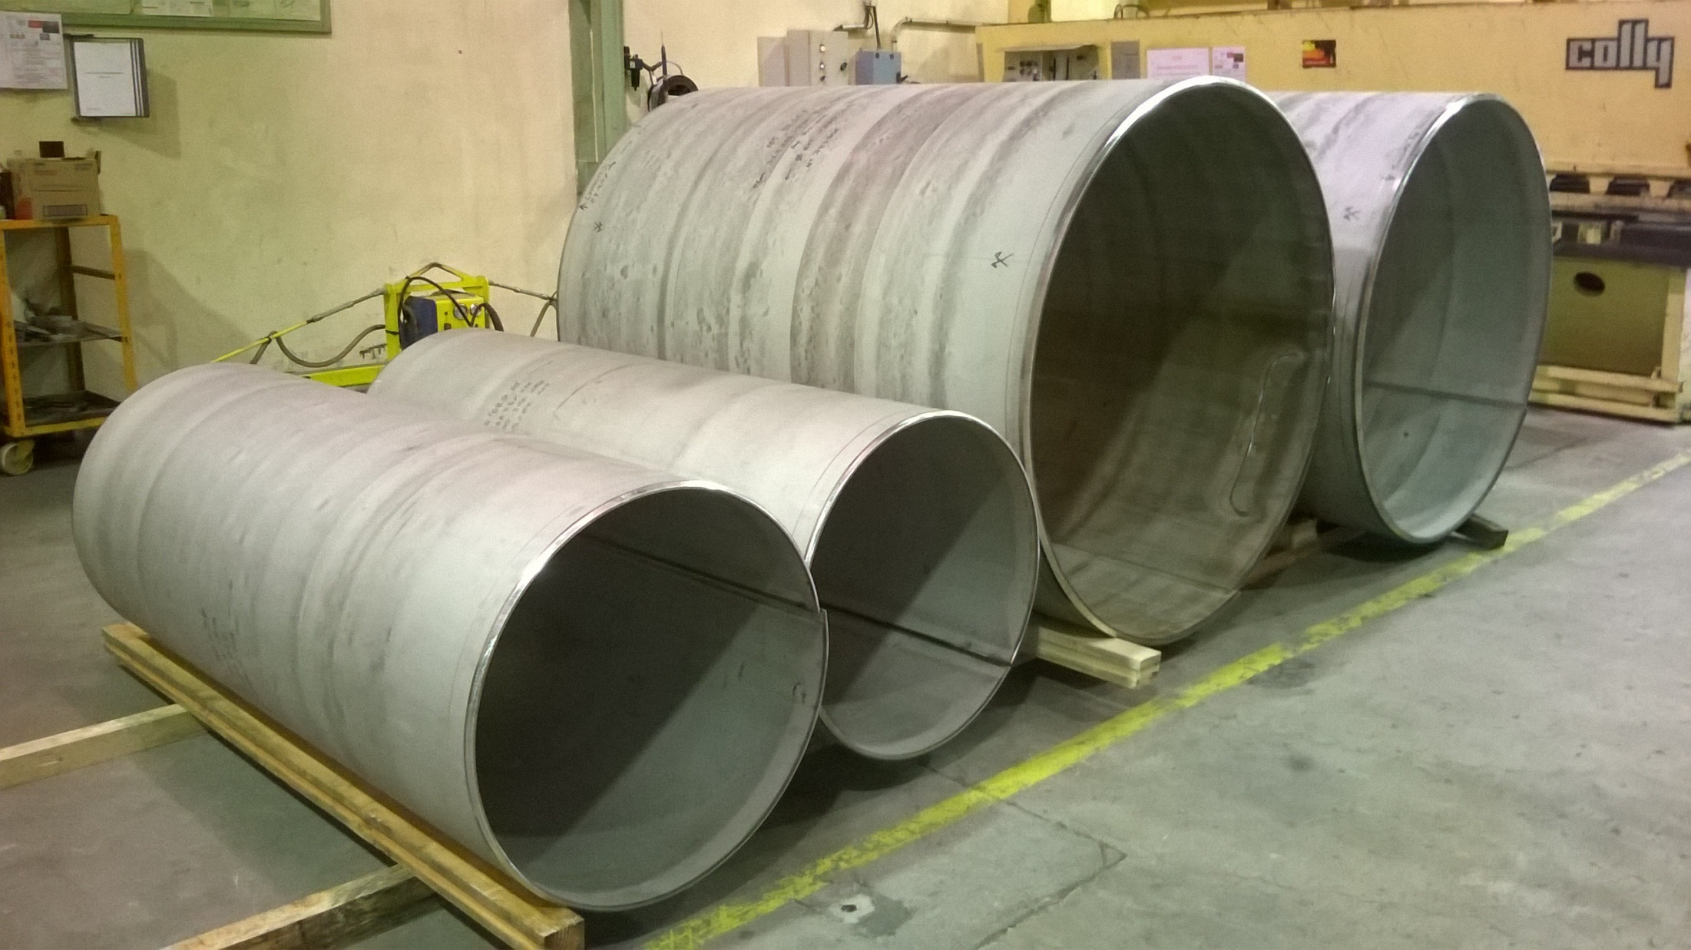
SHMS Dipole Cryostat Helium Vessel @ SDMS Jan 12, 2105

Slide 15
Dipole and Quad Cold Mass assembly
Dipole assembled
Dipole is wrapped in this fixture.
Dipole in the VPI Mold

Slide 16
Preparation for SHMS Dipole Collaring Jan 12, 2015

Slide 17
Dipole Coil Assembly Jan 14, 2014
Coil B preparing Leads
Coil A with assembly Jig

Slide 18
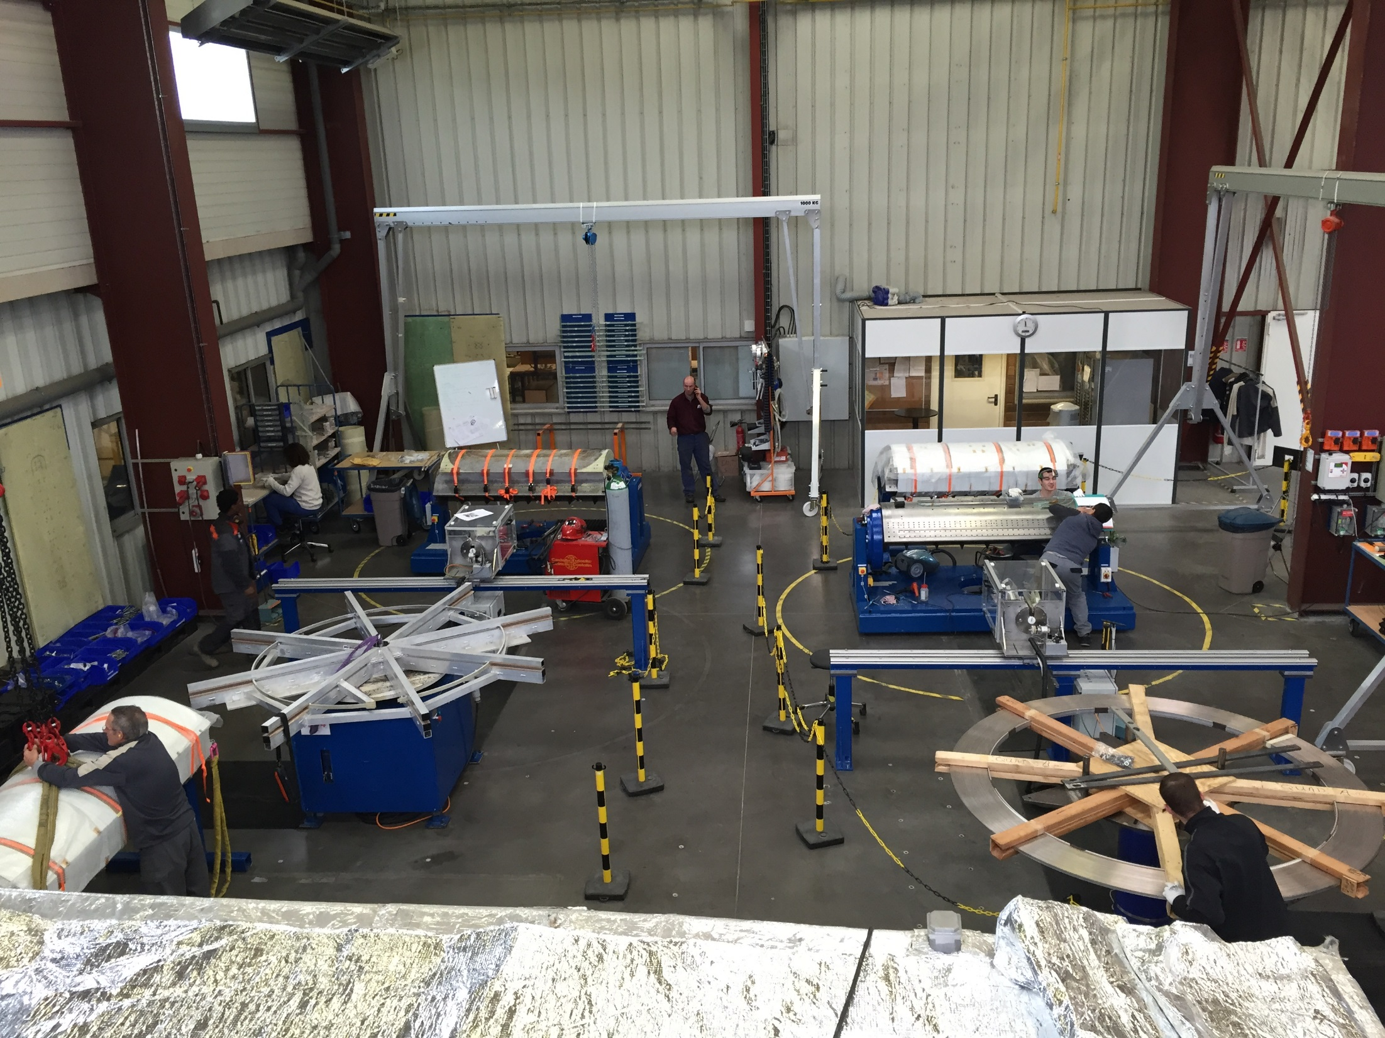
Q2 Coil A or D idle
Q2 Coil B ready for rotation and removal from mandrel
Mandrel being readied for Q3 winding
Conductor spools being readied for Q3 winding
Q2 Coil A or D being prepared for molding

Slide 19
Quad 2/3 status at SigmaPhi
Quad 2 coils wound- complete Nov 2014
Quad 2 coils B & C Vacuum Impregnated Dec 2014
Quad 2 coils A& D Vacuum Impregnation Jan 2015
Quad 3 winding start Jan 13 2015
Quad 2/3 cryostats in Fab at SDMS
Quad 2/3 assembly tooling same as dipole

Slide 20
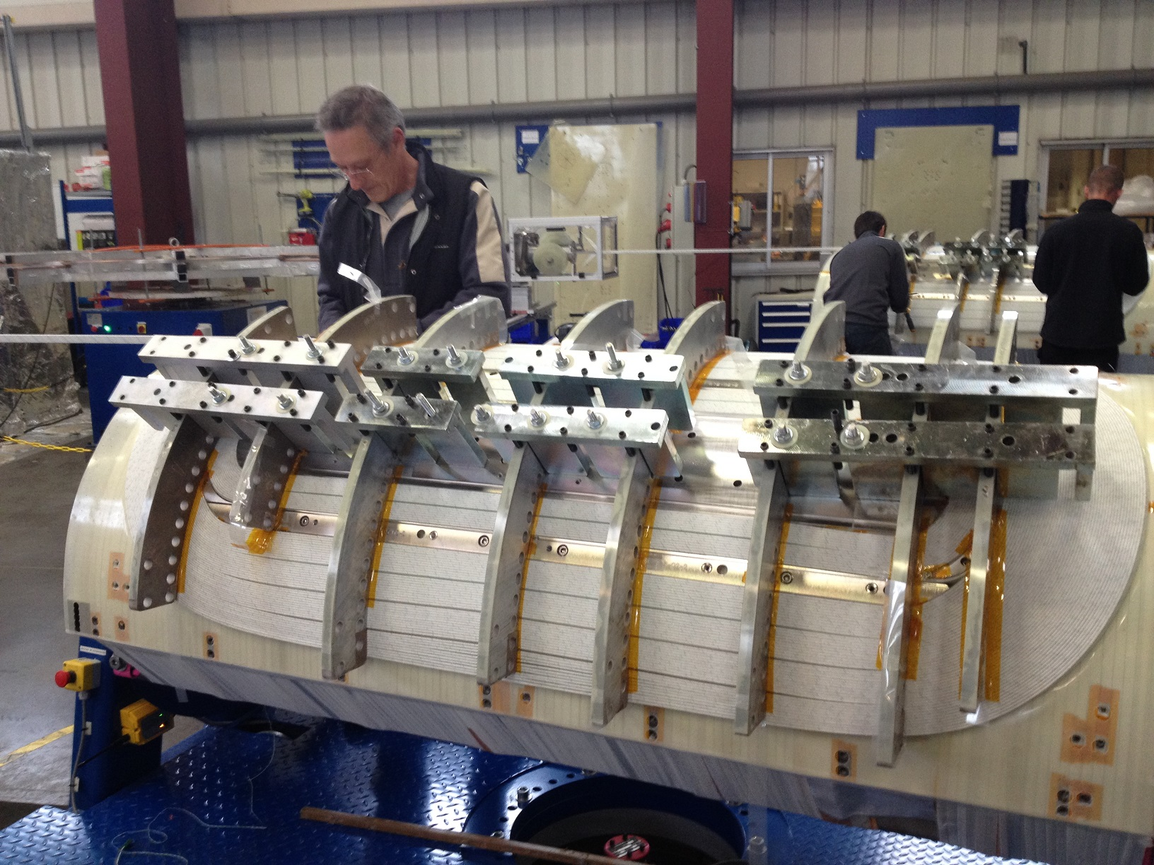
Quad 2 Winding Nov 2014

Slide 21
Quad 2 Coils Vacuum Impregnated Jan 9, 2015
Quad 2 Coil C
Quad 2 Coil B

Slide 22
Q3 wind start and clean up of Q2 coils Jan 14, 2015

Slide 23
Quad 3 coil Winding Jan 14, 2015
Progress on Quad 3 Coil F Layer 1
Start of Quad 3 Coil E

Slide 24
Quad 3 Winding Jan 15, 2015
Quad 3 Coil F complete
Quad 3 Coil E last turn

Slide 25
SHMS Infrastructure
AC power complete
LCW complete
SHMS Cryo system- complete & tested
DC power supplies – installed & tested
Controls & Instrumentation – complete & tested
I&C cabling installed & tested
DC bus installed
Yoke steel installed

Slide 26
SHMS Magnet Test Schedule
Arrival to Acceptance
SHMS Magnet Test and Commissioning | Quadrupoles | Dipole
Physics Div. Safety Review | Prior to arrival | Prior to Arrival
Arrival Tests | 1 week | 1 week
Cryostat & Yoke assembly | 1 week | 1 week
Dipole Only Assembly | NA | 8 weeks
Cryogenic Tests | 2 week | 2 week
Electrical Tests | 1 week | 1 week
Cool to 80 Kelvin | 2 weeks | 2 weeks
Cool to 4 Kelvin | 0.4 weeks ( 2 days) | 0.4 weeks ( 2 days)
Low Power Tests | 1 week | 1 week
High Power Tests | 2 weeks | 2 weeks
Acceptance Tests | 1 week | 1 week
Total | 11.4 weeks( ~ 3 months) | 19.4 weeks( ~ 5 months)

Slide 27
Conclusions
SHMS/Hall C is ready for first magnet
SHMS Q1 in Hall C Wed Jan 14, 2015!!! Yeah!!
SHMS HB due at JLAB March 2015
SHMS Magnets @Sigma Phi excellent progress
SHMS Dipole delivery est.- 10/12/15
SHMS Quad 2 delivery est.- 11/2/15
SHMS Q3 delivery est.-12/30/15

