Slide 1
Fast Electronics Group Activities
R. Chris Cuevas
Group Leader – Fast Electronics
Hall C Users/Collaboration Meeting
Jefferson Lab
15-January-2015

Slide 2
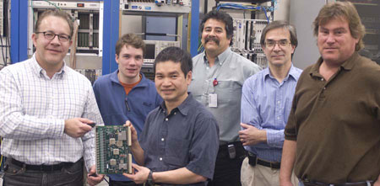
Group Members
  Group members:
    * Chris Cuevas – Group Leader
    * Fernando Barbosa – Sr. Engineer/Hall D Chief Electrical Engineer
      Cody Dickover – Staff Engineer
      Chris Stanislav – Electronics Technician
      Nicholas Sandoval – Electronics Technician
    * Hai Dong – Staff Engineer
    * Benjamin Raydo – Staff Engineer
    * Jeff Wilson – Designer/Associate Coordinator
    Mark Taylor – Designer/Associate Coordinator
    William Gunning- Sr. Electronics Technician
    Armen Stepanyan – Electronics Technician
* Shown in photo
Ed Jastrzembski shown but he is in the DAQ group

Slide 3
Services and Support Group
Significant design expertise and experience with high speed analog and digital circuitry for Nuclear Physics detectors, including custom firmware design for readout and triggering applications.
We work closely with the DAq group to provide new hardware and firmware designs as required for the detector systems in each experimental hall. CODA libraries and software support are provided for new readout electronics.
Services and support: (Include but not limited to)
AC power design
Circuit analysis/simulation
Fabrication and assembly
Installation expertise
Circuit repair/test/calibration
LabView test routines
EECAD documentation
Firmware development/simulation
Fiber optic design/installation
VME/VXS/NIM experts
FastBus (sigh) and anybody remember CAMAC?

Slide 4
OUTLINE
Brief Overview
  Pipeline DAQ – 12GeV era is here!
  Quick Hardware Acronym Definitions
  The Trigger information path
      Use extension of VME with high speed Gigabit Serial (VXS or VITA-41)
      Extensive use of multi-lane fiber optic transceivers and cable for Trigger system
  Trigger System Hardware, Methods and Examples
Hardware Status
  Instrument ‘Catalog’ →Production Boards
    Hall D fully instrumented with new readout electronics
    Hall B custom electronics
      Drift Chamber Readout Board (DCRB)
    Hall A custom electronics
      VETROC – VXS Electron Trigger & ReadOut control board
  New Applications
    New DAQ hardware successfully used for Heavy Photon Search beam test → December 2014
    Pipeline DAQ/Trigger for NPS at high e⁻ (Cluster finding)
    FPGA Readout Board - Will use for Hall B RICH detector and new applications
  Summary

Slide 5
Acronym Definitions
VXS => VME with Serial Extensions (VITA 41.0)
VITA => VME International Trade Association
FADC250 => Flash Analog to Digital Converter 250MHz
CTP => Crate Trigger Processor
TI => Trigger Interface
SD=> Signal Distribution
SSP=> Sub_System Processor
GTP=> Global Trigger Processor
TS=> Trigger Supervisor
TD=> Trigger Distribution

Slide 6
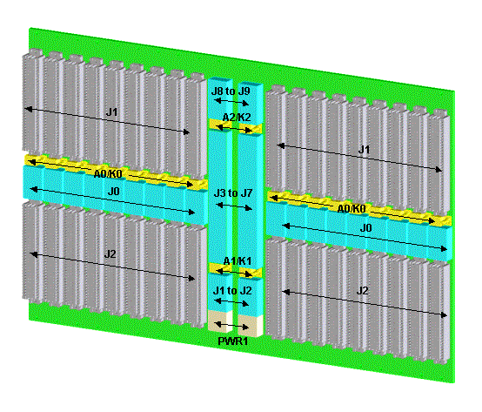
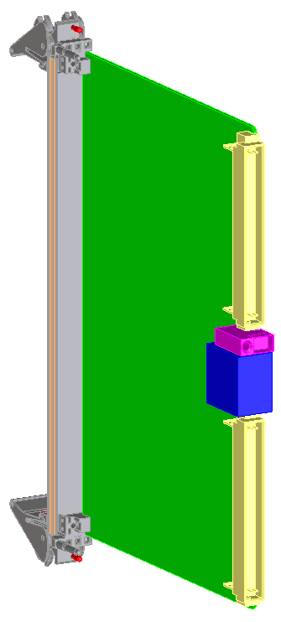
Quick VITA 41 *VXS Review
VXS “Payloads”
(JLAB FADC )
(*VME with Serial Extensions)
VXS Backplane
16 CH
16 CH
16 CH
16 CH
VME64
High Speed
Serial
Detector Signals
VME64
VXS “Switch” Card
Crate Trigger Processor
16 CH
16 CH
16 CH
16 CH
8Gb/s
Fiber
Energy Sum
to Trigger

Slide 7

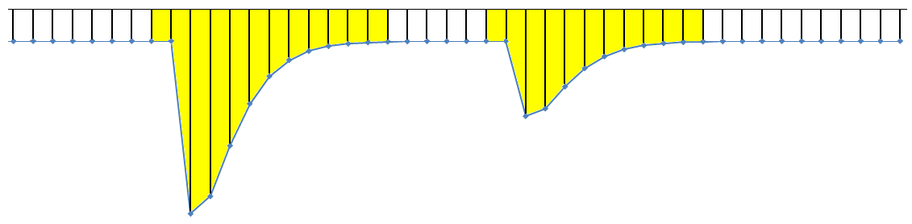

Pipeline Method of Signal Capture
Gigabit
Serial
Trigger
Data
VXS
Trigger Pulse
Pre-Processing
250MHz
Sample Clock
Capture Window
Energy & Time Algorithms
Event #1
Event #2
VME
2eSST
Readout
detector
signal
FADC
12-bit
ADC Sample Pipeline
Physics
‘Event’
Trigger Input
Trigger #1
Trigger #2
250MHz Flash ADC stores digitized signal in 8μs circular memory
“Event” trigger extracts a window of the ADC data for pulse sum and time algorithms
Trigger data contains detailed information useful for cluster finding, energy sum, etc.
Firmware algorithms provide a huge data reduction by reporting only time & energy
values for readout instead of raw samples

Slide 8
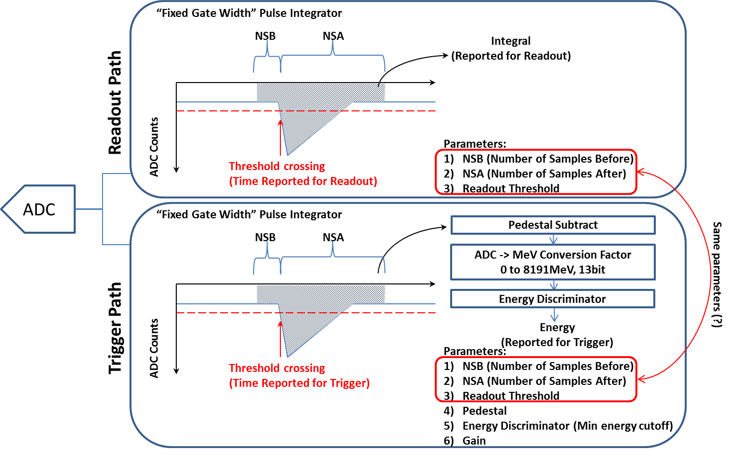
FADC Data Paths
B. Raydo

Slide 9
Present Flash ADC Implementation
Energy Sum Trigger (Present implementation for Hall D)
12 Bits
Energy Sum (BCAL, FCAL)
16 Channels/board
256 Channels/crate
CH-1
VXS Gigabit serial Transfer rate of 4Gb/s* per board
*(2 full duplex lanes @2.5Gb/s * 8/10b)
Transfer 16-bit Energy Sum every 4ns
To Crate
Trigger
Processor
(VXS Switch Card)
BCAL
Detector Inputs
Xilinx FPGA Trigger Function
Pre-Processing
+
12 Bits
CH-16
CH-16
CH-1
Global Trigger
Round Trip Latency <3us
8μs ADC Sample Pipeline
Energy & Time Algorithms
VME64x
2eSST Readout

Slide 10
Trigger Design Requirements
200kHz average (Hall D) Level 1 Trigger Rate, Pipelined with up to 8µs front end digitizer memory
    High Luminosity -> 10⁸γ/s creates high average trigger rate
    Initial commissioning at low beam current (~200nA). Luminosity - 10⁷γ/s
L1 trigger supports pipelined subsystem hit patterns and energy summing with low threshold suppression
Scalable trigger distribution scheme (Up to 128 crates)
  Hall D: 25 L1 Trigger crates, 52 total readout crates
  Hall B: 38 L1 Trigger crates, 56 total readout crates
  Hall A & C will have < 2 L1 Trigger crates
Low cost front-end & trigger electronics solution
Strong FIRMWARE Features –
  Hall B will use different programmable features than Hall D
  Strong Partnership between Detector Groups and Firmware experts
  Firmware “QA” control In Electronics/DAQ groups
  Firmware can be remotely loaded to FPGAs from VME
ALL Halls will benefit from new hardware design solutions

Slide 11
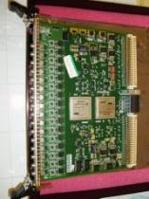
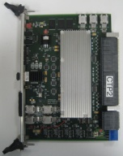
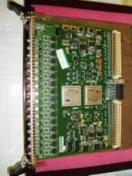
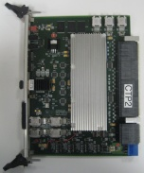
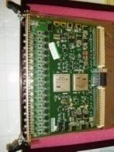
Board
Crate
Sub-System Processing
Global
Signal distribution to
Front End Crates
(Fiber Links)
Tagger
FADC
Hodoscope
Microscope
‘Track Counts’
SSP
(2 Crates)
-VXS-
GTP
Select
Trigger Equations
ST
BCAL Energy
TOF Hits
FCAL
Energy
-VXS-
-Fiber links
TRIGGER
SUPERVISOR
(Distribution)
-----------------
CLOCK
TRIGGER
SYNC
________
ReadOut
Crate
(ROC)
CONTROL
Start Counter
BCAL
FADC
-Fiber links
SSP
(12 Crates)
-VXS-
-VXS-
BCAL SUM
FADC
-VXS-
TOF
FCAL
-VXS-
TOF Hits
FCAL SUM
-Fiber links
SSP
(1 TOF)
(12 FCAL)
Drift Chamber
Boards/Crates not shown
Block Diagram Example:
Hall D Level 1 Trigger

Slide 12
Instrument Catalog
The following slides show each of the new 12GeV ‘pipeline’ DAq and Trigger boards including a brief specification listing.
Most of the boards have been designed on VXS format.
New Front-End DAq Electronics have adopted a much smaller custom FPGA board format. Will use the Sub-System Processor for readout and control.

Slide 13
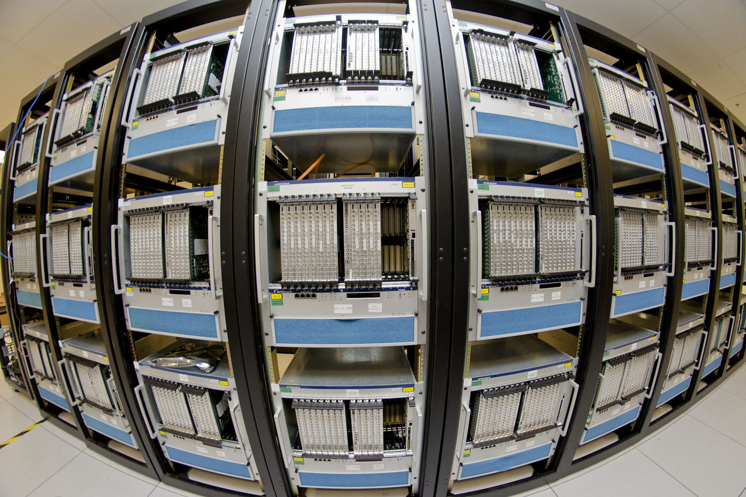
Flash ADC 250MHz
Fast Electronics
DAQ Groups

Slide 14
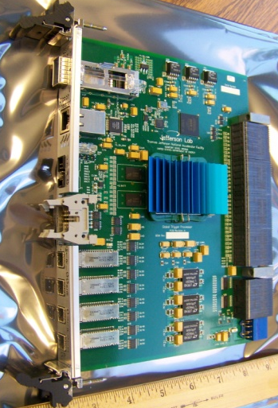
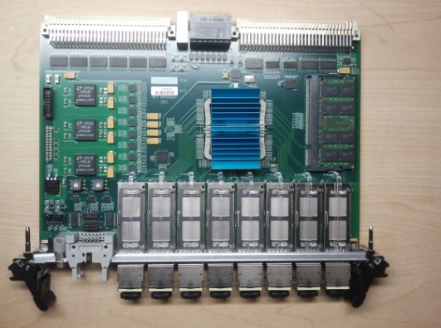
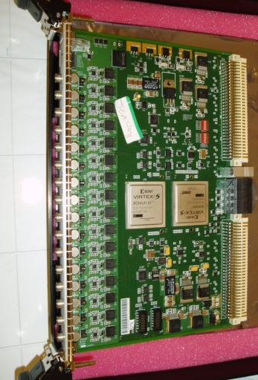
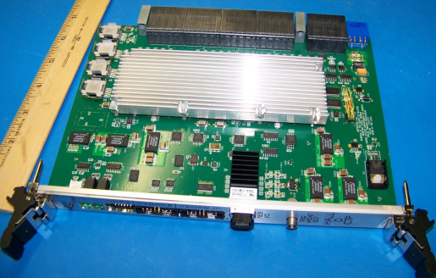
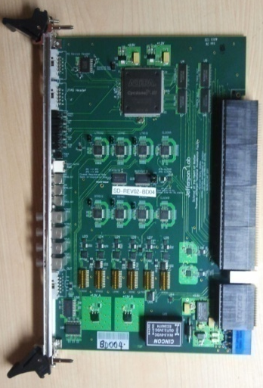
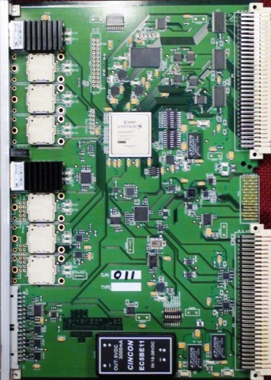
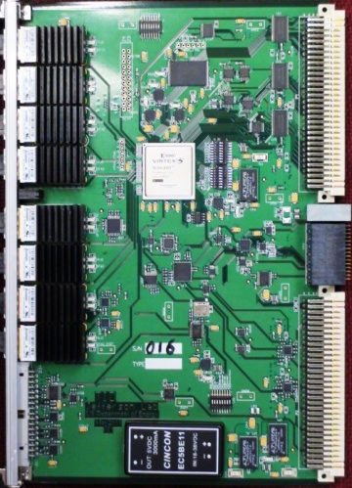
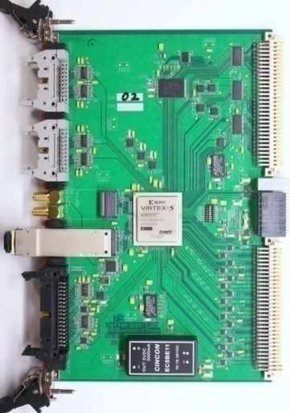
12GeV Pipeline Electronics
SSP
P
FADC250
CTP
GTP
L1 Trigger ‘Data’
MTP Ribbon Fiber
Global Trigger Crate
Sub-System Processor
Global Trigger Processor
SD
TI
TD
Trigger ‘Link” Control
Clock, Sync
MTP Ribbon Fiber
TS
Front End Crate
FADC250, (FADC125), (F1TDC)
Crate Trigger Processor
Signal Distribution
Trigger Interface
Trigger Control/Synchronization
Trigger Supervisor
Trigger Distribution

Slide 15
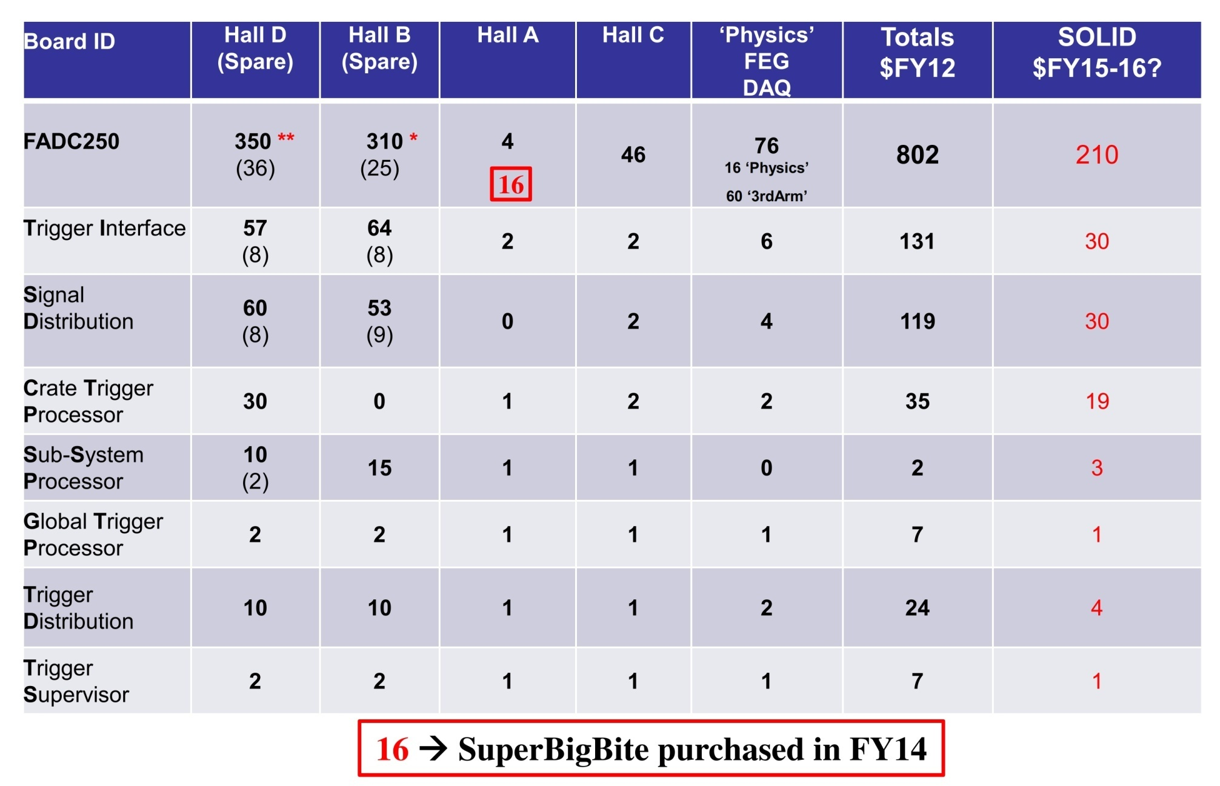
12GeV Production Board Quantities

Slide 16
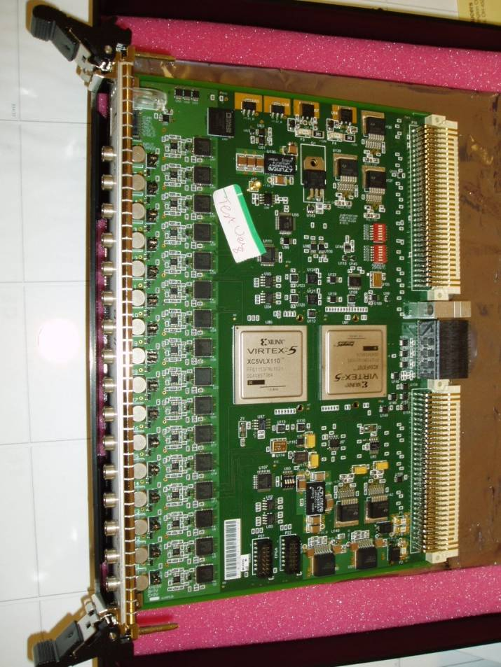
Flash ADC 250MHz
Fast Electronics
DAQ Groups
23-Sept-2011
16 Channel, 12-bit
  4ns continuous sampling
  Input Ranges: 0.5V, 1.0V, 2.0V
  (user selectable via jumpers)
  Bipolar input, Full Offset Adj.
  Intrinsic resolution – σ = 1.15 LSB.
  2eSST VME64x readout
  Several modes for readout data format
    Raw data
    Pulse sum mode (Charge)
    TDC algorithm for timing on LE
  Multi-Gigabit serial data transport of trigger information through VXS fabric
  Xilinx Virtex V technology
  On board trigger features
    Channel summing
    Channel coincidence
    Hit counters (Scalers)
  In use by ALL Hall groups
  802 boards on site

Slide 17

Crate Trigger Processor
Hai Dong
Jeff Wilson
Crate Trigger Processor ( CTP )
  Hall D production quantities (32) installed on schedule.
  A few assembly issues with spares and boards for Halls A & C, and progress is slow.
      Virtex V FPGA parts will support 5 Gbps transfer speed with FADC250 and provide additional FPGA resources for future L1 algorithms
  Successful commissioning in Hall D
    Energy Summing
    Hit based trigger
  Planning for an upgrade for Hall B CTP boards. Will use single Virtex 7 part.
New Front Panel I/O
MTP Parallel Optics
8 Gbps to SSP
VXS Connectors
Collect serial data from 16 FADC-250
(64Gbps)
2013 Production CTP

Slide 18
Trigger Hardware Status – TD/TI
W. Gu
DAQ Group
23-Sept-2011
‘Legacy’
Trigger
Supervisor
Interface
  Distributes from Trigger Supervisor crate to front end crates (TI)
  Distributes precision clock, triggers, and sync to crate TI modules
  Board design supports both TI and TD functions, plus can supervise up to eight front end crates.
  Manages crate triggers and ReadOut Controller events
TD Mode
Eight (8)
Optical Transceiver
HFBR-7924
Xilinx
VirtexV
LX30T-FG665
VXS P0
TD mode: from SD
TI/TS mode: to SD
External I/O
(trg, clk…)
Trigger Interface
“Payload Port 18”

Slide 19
Trigger Hardware Status - TS
W. Gu
DAQ Group
  Receives 32 trigger ‘Bits’ from GTP on P2 via RTM
  Global precision clock source connected to SD on VXS backplane
  Synchronization and Trigger Word distributed to crate Trigger Interface boards via parallel fiber.
  Manages global crate triggers and ReadOut Controller events
  VXS “Payload’ module
Xilinx
VirtexV
LX30T-FG665
Optional QSFP Fiber
VXS P0
Global Clock
SYNC
Trig1, Trig2
External I/O
(trg, clk…)

Slide 20
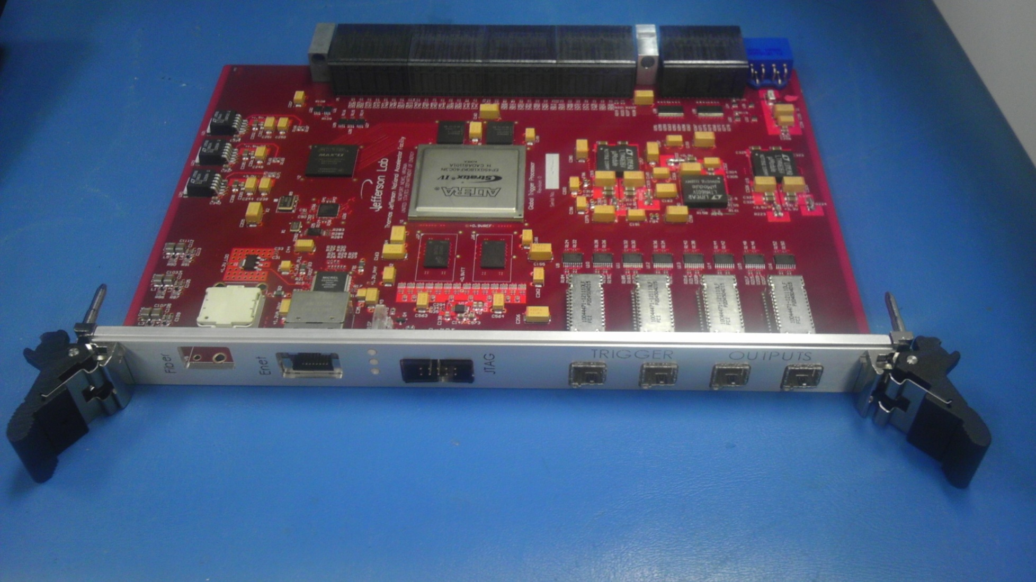
GLOBAL TRIGGER PROCESSOR
S. Kaneta
B. Raydo
Gigabit Links to SSP
VXS “Switch” card
DDR2 Memory
256 MB
4 Channel
Fiber
RJ45
Ethernet
Jack
Altera FPGA
Stratix IV GX
4x 8-Channel
LVPECL
Trigger Outputs to TS

Slide 21

Sub-System Processor
Ben Raydo
Production Status:
→ Commissioned in Hall D global crate
→ Single FPGA Virtex 5 TX150T
New Fiber Transceivers
  -- Support 10Gb/s (4 ‘Lanes’)
  -- QSFP format
8 optical links to 8 front end crates
  -- Aggregate link rate from CTP is
  4 x 2.5Gbps (10Gbps)
  -- Each optical link can be used as four independent Tx/Rx 5Gbps link
  -- Up to 32 fiber optic connections
  -- Will use this method to readout RICH and MicroMegas detectors in Hall B
→ Extremely versatile with ample logic space to manage multiple trigger streams from front end crates or custom trigger boards.
SSP Prototype – May 2010
ALL Production SSP Delivered and tested

Slide 22
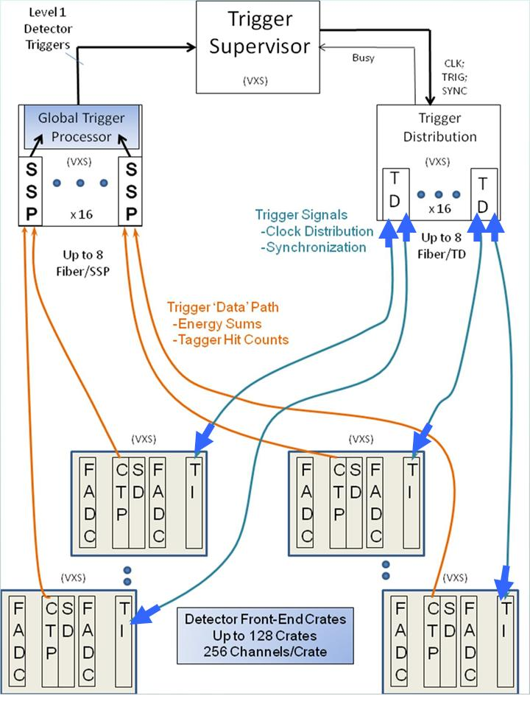
Trigger System Diagram
TS -> TD -> TI
Link
1.25Gb/s
Bi-Directional
BUSY
Trigger Sync
Trig_Comnd
CTP -> SSP -> GTP
L1 Trig_Data
Uni_Directional
Energy Sums
Trigger
Supervisor
(Distribution)
Global Trigger Processing
Sub-System Processing
(Multi-Crate)
Crate Trigger Processing
Flash ADC Modules
Detector Signals

Slide 23
Custom Applications & New Designs
Hall A - VETROC (VXS Electron Trigger ReadOut Card
  This board is a high density VXS single width module that allows digital signals to be captured and inserted into the Trigger Data path
  Mezzanine cards are compatible with the CAEN 1495 boards
  TDC function for up to 144 channels with ~10ps resolution
Hall B - DCRB (Drift Chamber Readout Board)
  This board is a very high density VXS single width module that receives differential analog signals from the CLAS12 Drift Chamber preamplifiers. The 96 channels are discriminated, and a TDC function allows for excellent 1ns resolution.
  Future tracking trigger algorithms are planned and will be used in conjunction with the suite of other 12GeV trigger boards for CLAS12.
  280 boards are in production
New FPGA Front-End DAq Electronics
  We have created a small custom FPGA board format that presently interfaces with high density ASICs. The Sub-System Processor will be used to control and readout these boards.

Slide 24
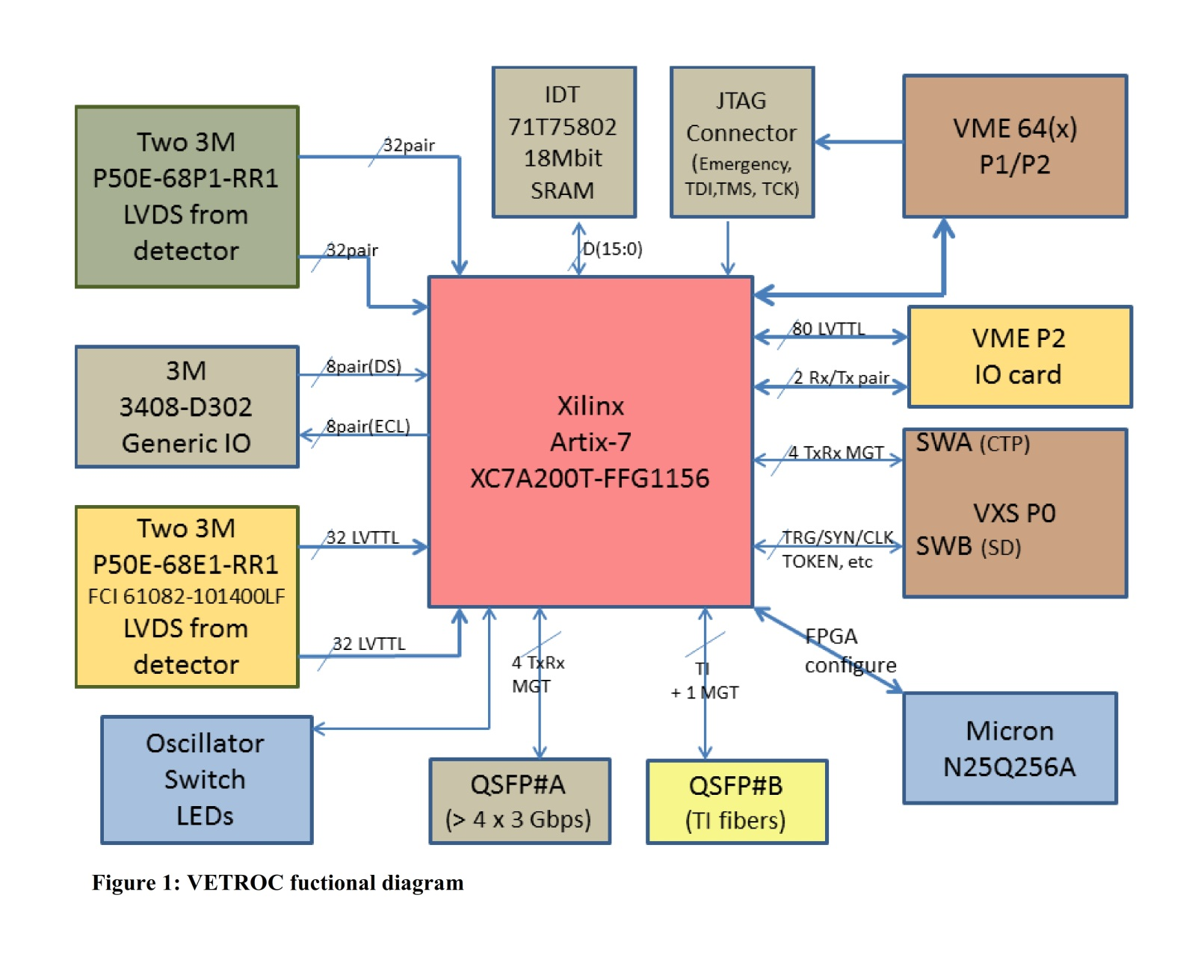
VETROC
William Gu
Ben Raydo

Slide 25
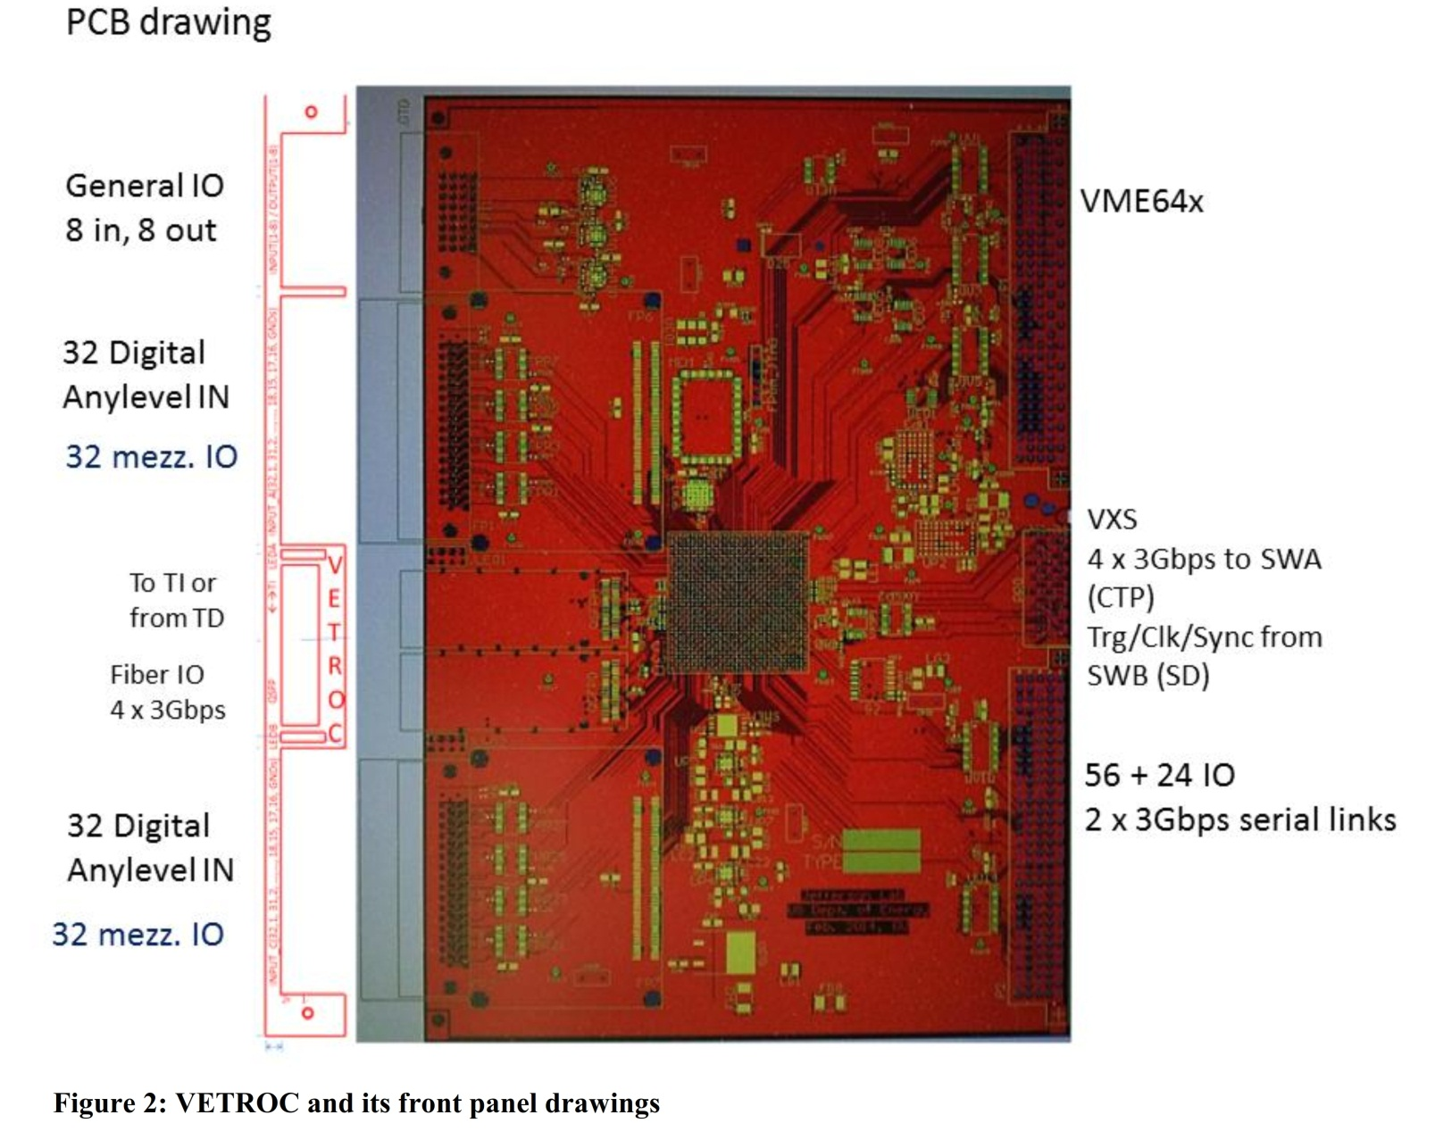
VETROC
William Gu
Ben Raydo
- Very high channel count
I/O can be configured as all input or combination.
P2 option allows for 80 additional I/O
VXS interface allows for custom digital ‘Hit’ Data to be used in the Level 1 Trigger decision.

Slide 26
Drift Chamber Readout Board
Ben Raydo
7 DCRB Units
1 Complete Superlayer
From CLAS12 Wire Chamber
1 full Region
1,344 anode wires
7 DCRB Units
1 Complete Superlayer
1 Crate contains a full region (2 superlayers) for 1 sector
Crate Trigger Processor (CTP) can see data from a complete region of 1 sector
Sub System Processor (SSP, not shown) receives data from 3 CTP units from 1 sector: so the SSP sees data from a complete sector

Slide 27
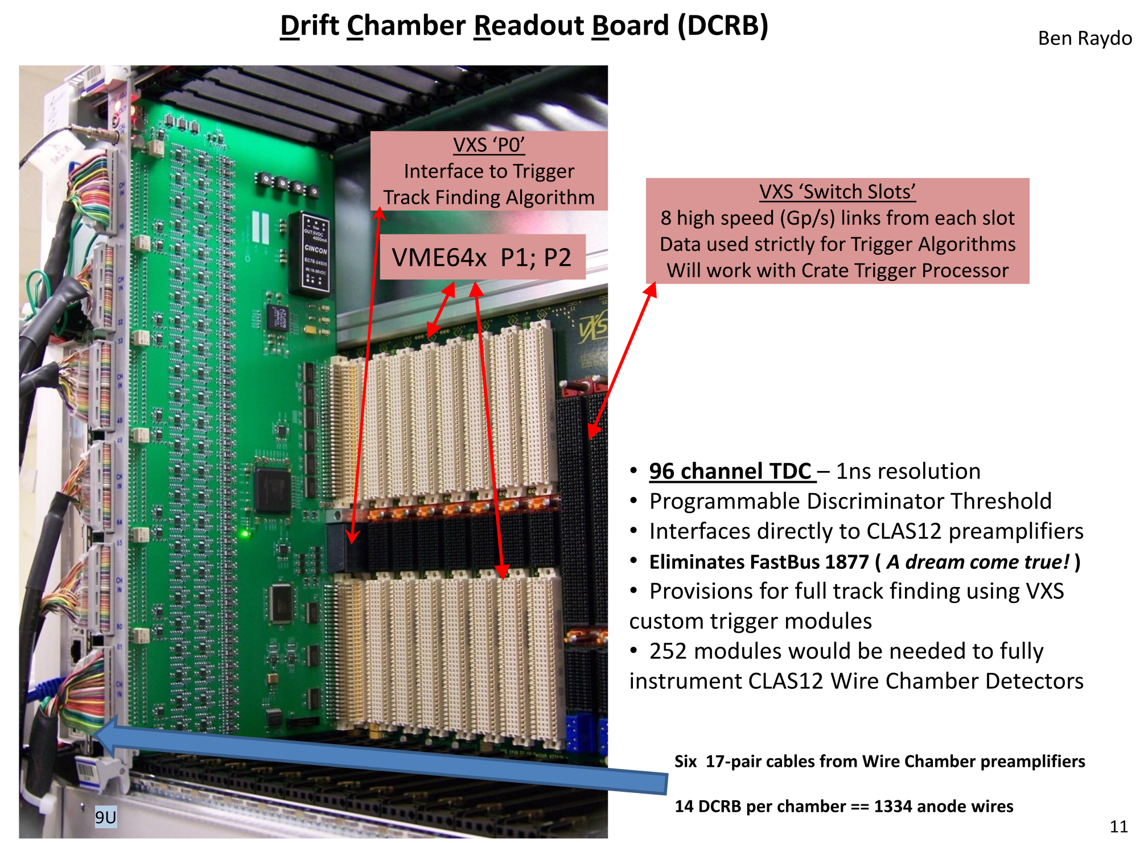
DCRB
Production version will
be 6U x 160mm board size

Slide 28
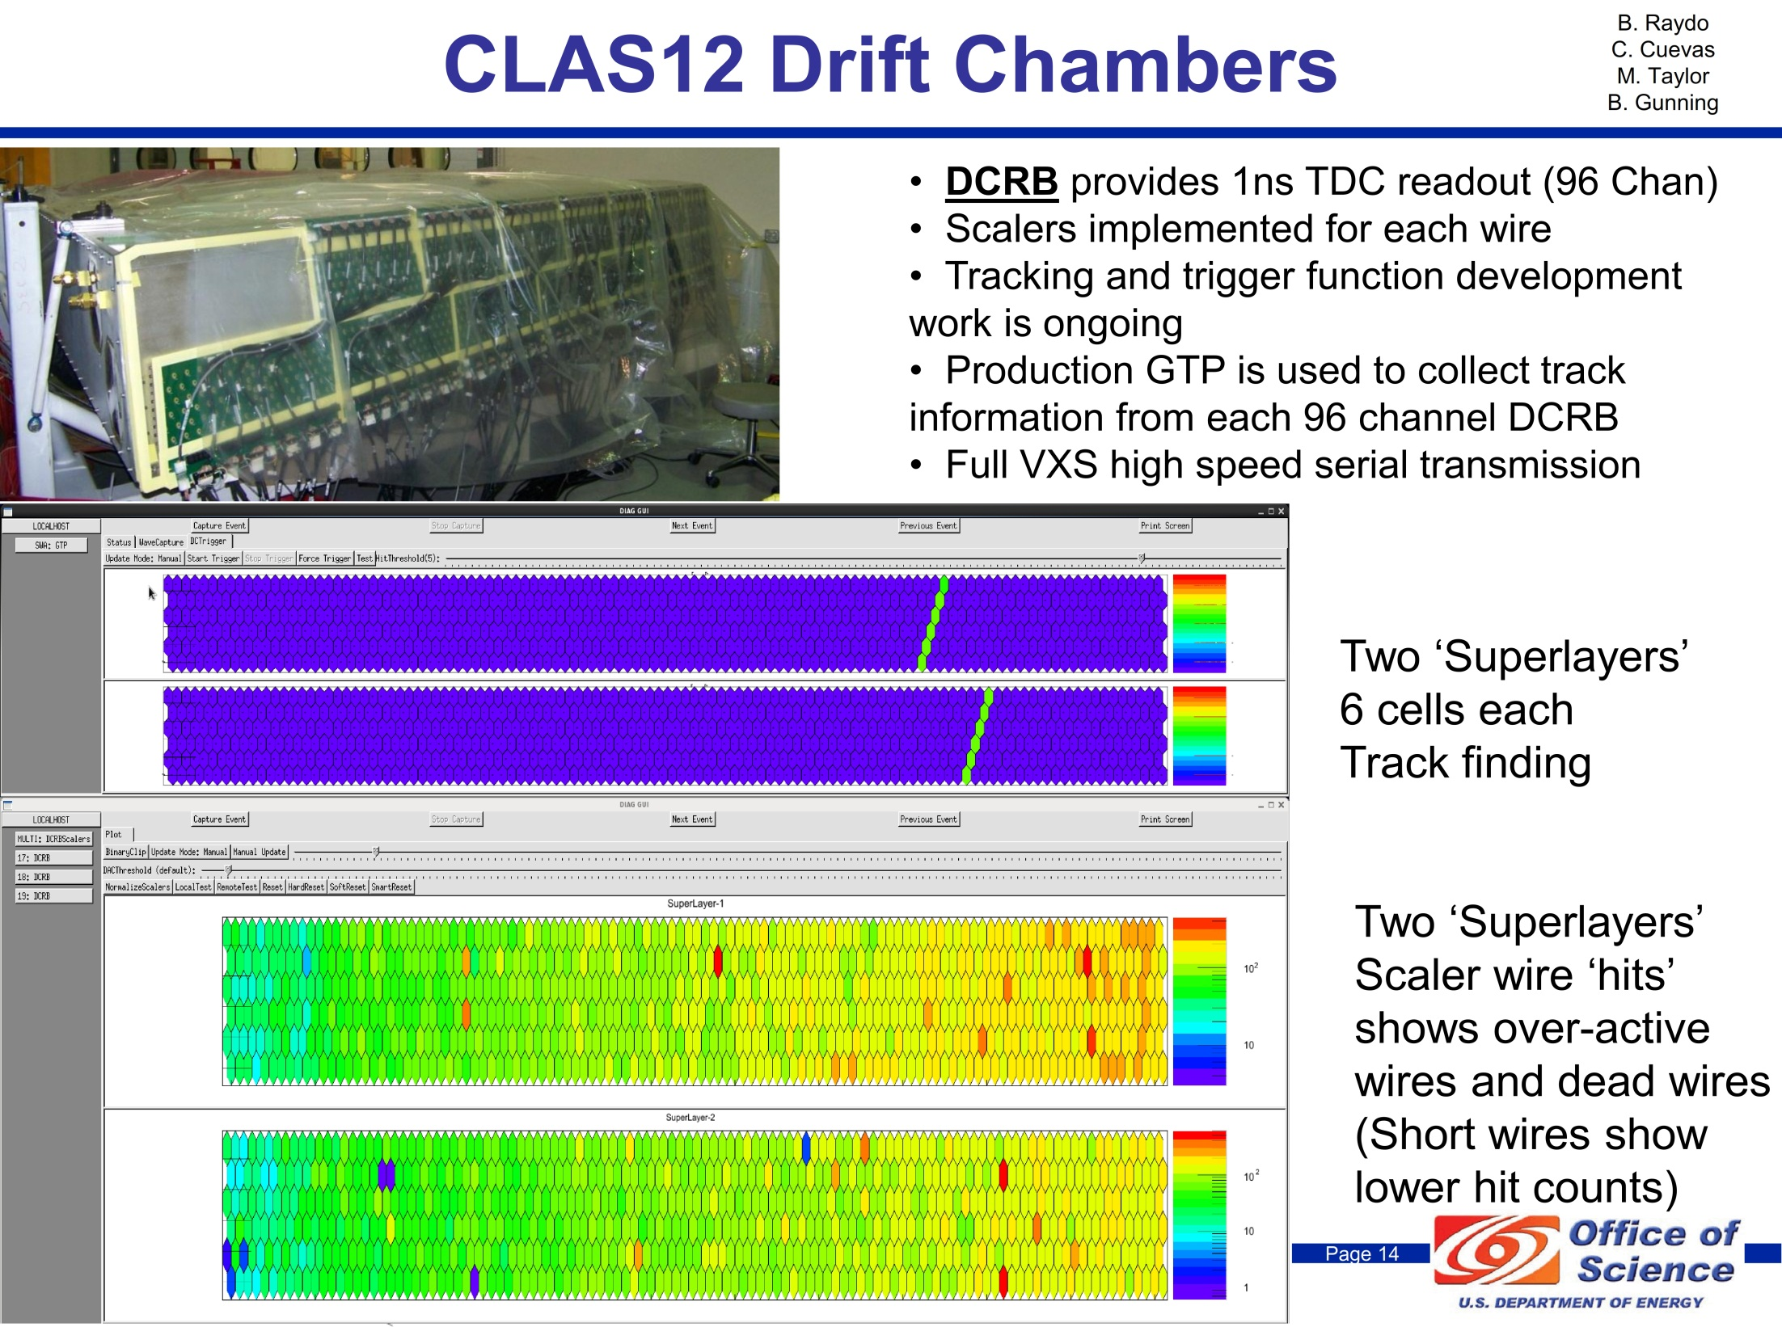
DCRB

Slide 29
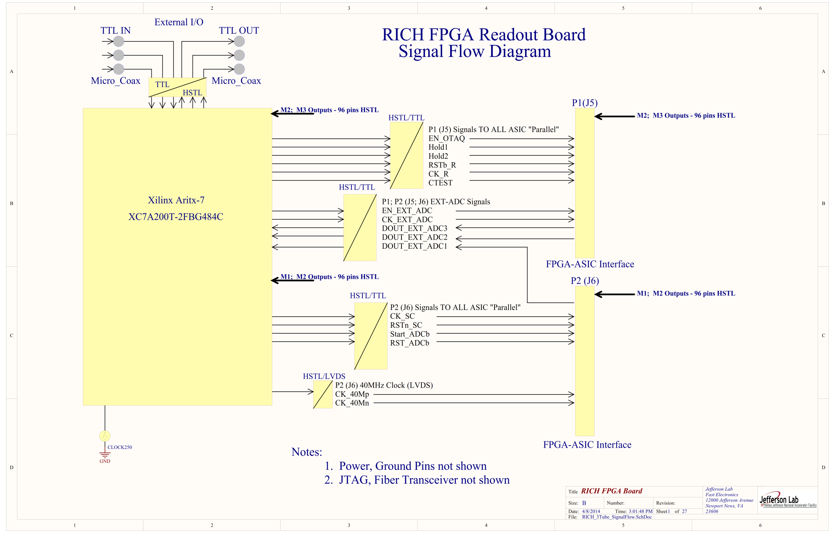
FPGA Readout Board
B. Raydo
J. Wilson
C. Cuevas
Up to three
MAROC3 ASIC
64 channel (maPMT)
ALL I/O is HSTL
Allowing for +1.8V
Power only for I/O
Banks. Saves regulator!

Slide 30
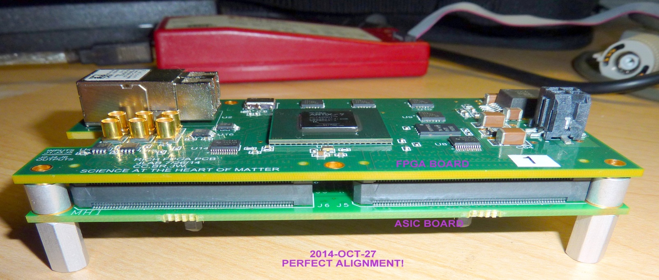
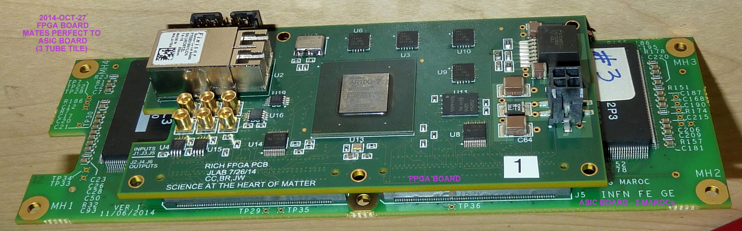
FPGA Readout Board
FPGA Readout Board
Use for 128 channels
(Two 64 pixel maPMT)
Or
Use for 192 channels
(Three 64 pixel maPMT)
Fiber optic interface

Slide 31
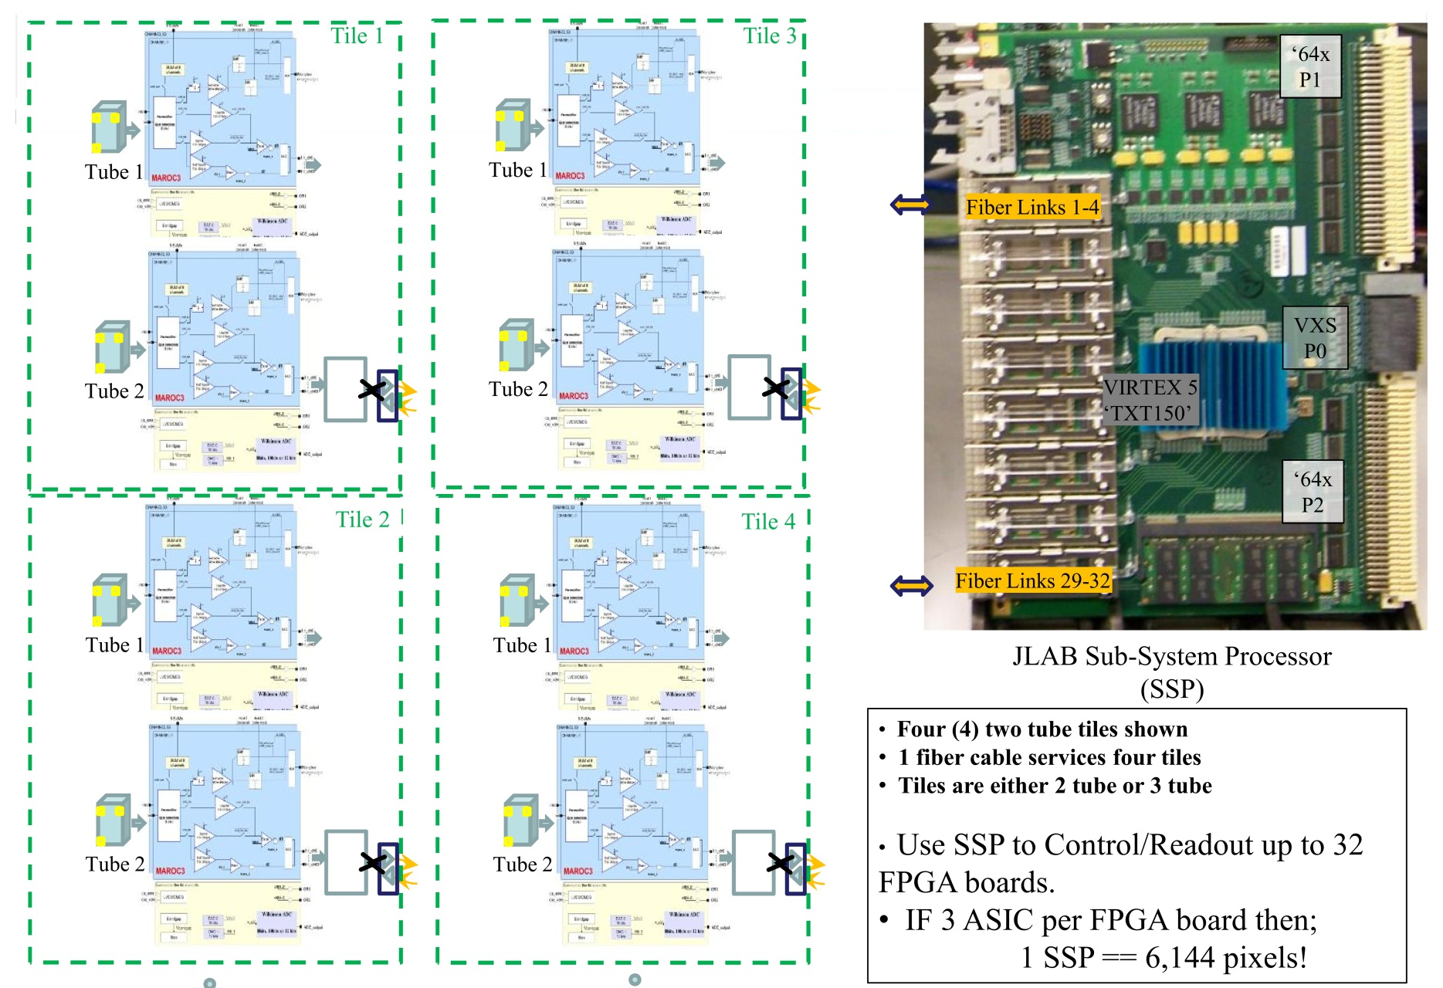
FPGA Readout Board

Slide 32

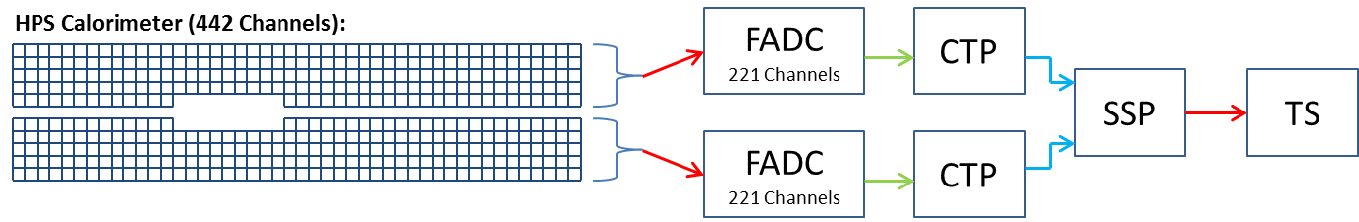
HPS ECAL Trigger Example
B. Raydo
S. Kaneta
FADC (Flash Analog-to-Digital Converter)
  250Msps, 12bit pulse digitizer for: Readout & Trigger (energy, timing)
  Sends pulse energy & times to CTP for trigger processing
CTP (Crate Trigger Processor)
  Collects pulse data from all FADC channels in crate
  Searches for clusters on half (top or bottom) of the ECAL
  Sends cluster energy, time, position to SSP for trigger processing
SSP (Sub-System Processor)
  Collects cluster data from top & bottom halves of ECAL from CTP
  Performs cuts on individual clusters: energy
  Performs cuts on paired clusters: energy sum/difference, coplanar, distance energy
  Delivers Yes/No trigger signal(s) to TS (Trigger Supervisor) for readout

Slide 33
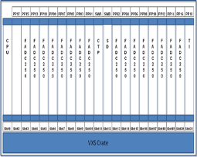
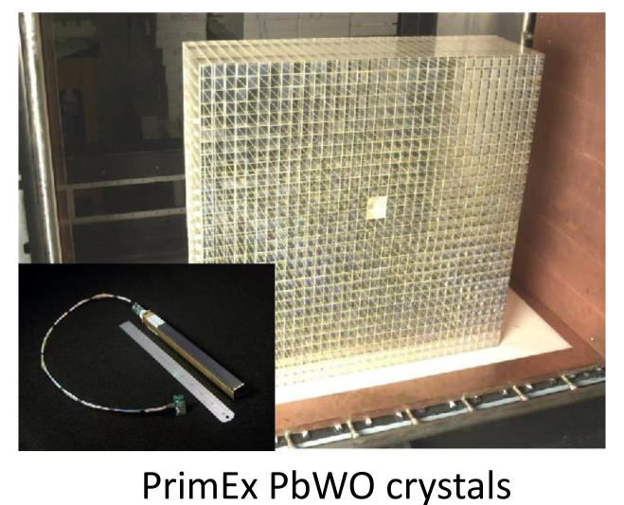
Pipeline DAQ/Trigger for NPS
(Low Q² )
256 channels/crate
5 VXS crates needed
Need Crate Trigger Processors
One VXS crate would need a SubSystem Processor
SSP will need to combine clusters across 256 channel boundaries for final trigger
Experiment trigger would be generated
from the SSP and distributed to the other detector DAQ crates.
Many details not shown but this type of Cluster finding trigger will require significant hardware cost commitment.
Good news is that a good deal of firmware effort has been completed for the HPS cluster functions, so in principle these firmware features can be reused for NPS.
31 x 36 2D Array
1116 - PMT Channels (R4125)
Coaxial output to FADC250
S
S
P
Trigger from Calorimeter
Distributed to other Detector DAQ crates

Slide 34
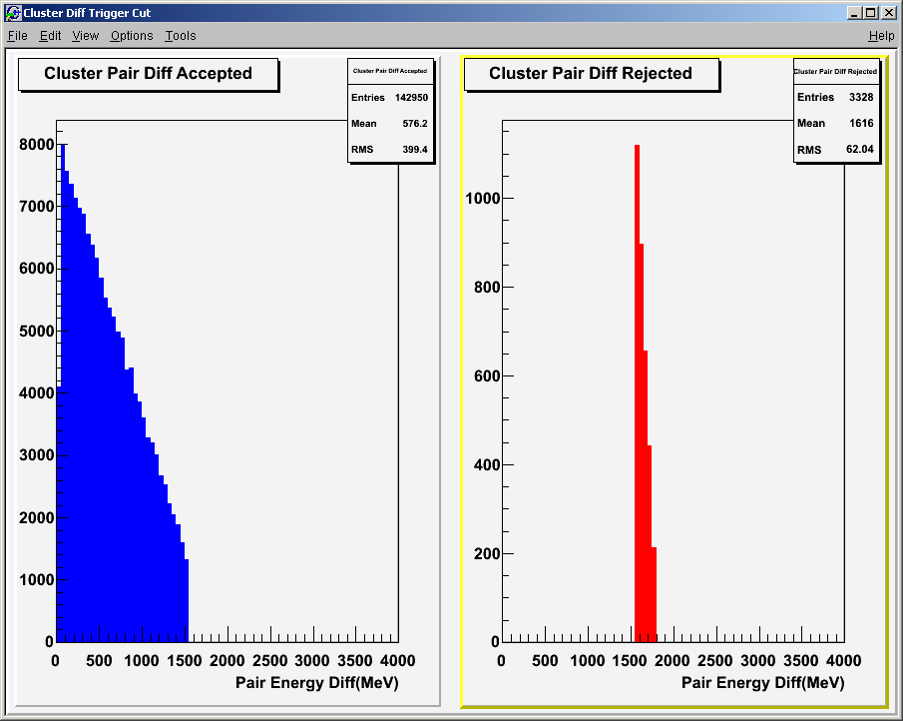
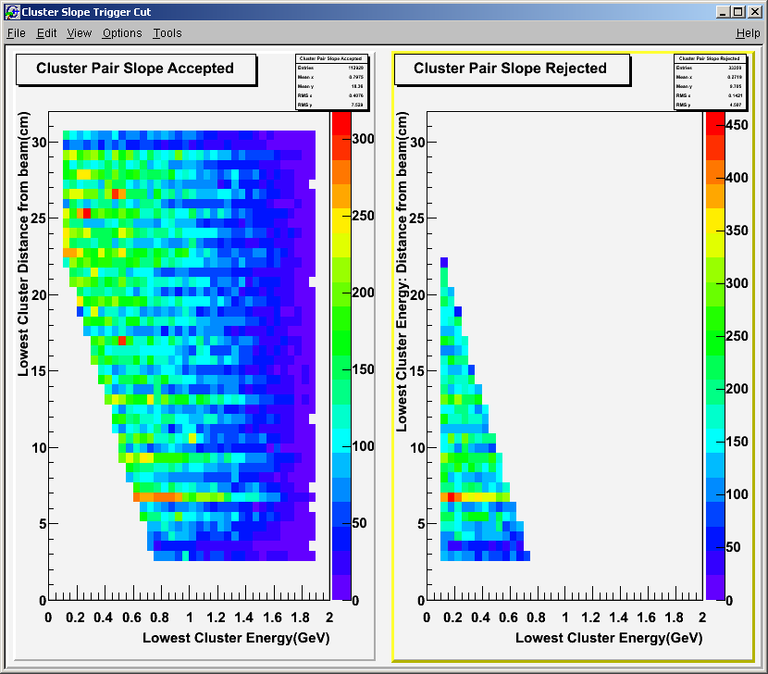
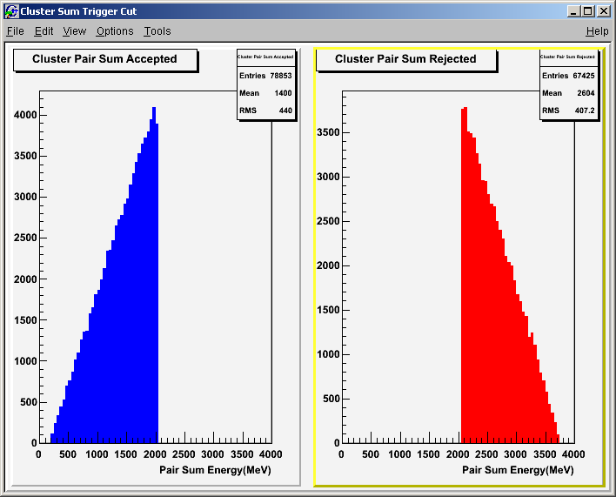
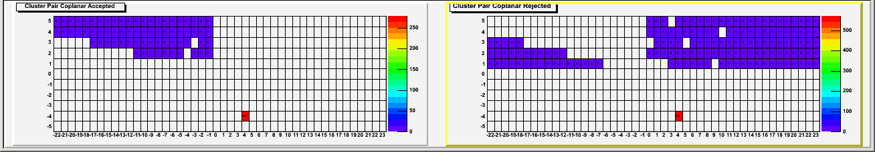
H/W Histograms
B. Raydo
FADC
  Scalers per channel (readout threshold based)
CTP (or FADC)
  Individual ADC channel pulse energy histograms
SSP
  Cluster Hits (Position)
  Cluster Hits (Position+Energy) - Depending on resources in SSP
  Trigger cut accept/reject:

Slide 35
Summary
Successful 12GeV implementation so far!
  Performance testing activities on track to verify system design goals
Many other board designs have been omitted for this presentation.
  Significant design work for detector ‘on-board’ electronics.
    -- Custom Preamplifiers, SiPM bias/amplifiers,,,
    -- Fan-out, Level Translators, Control Chassis,,, the list is large
Please follow the link below for the latest manuals and CODA drivers
https://coda.jlab.org/wiki/index.php/JLab_Module_Manuals
Please plan ahead for new ADC and/or Trigger algorithm requests. Significant development including software drivers need to be considered before implementation on an experiment.
Stop by EEL-109 anytime with repair questions, cable fabrication requests, or custom electronics chassis requests. We can assist with EECAD documentation, and panel fabrication for custom instruments.
Questions?

Slide 36
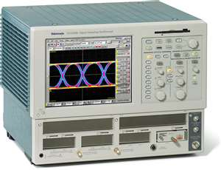
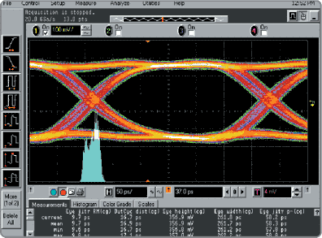
Backup slides

Slide 37
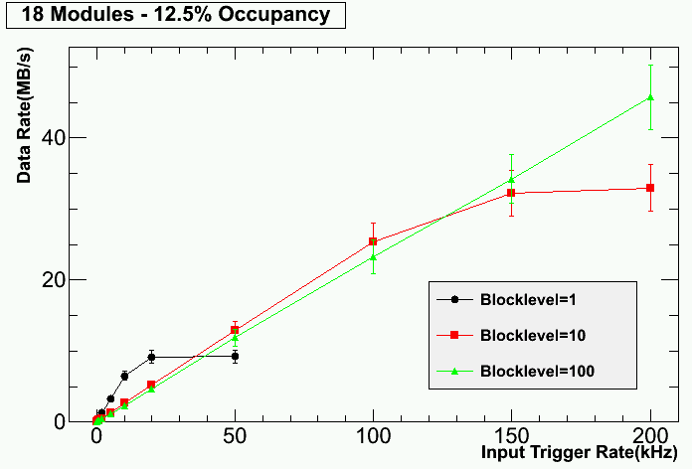
DAq Trigger & Readout Performance
Two Crate test
36 of 288 channels have signals (12.5%)
System testing includes:
  Gigabit serial data alignment
    4Gb/s from each slot
    64Gb/s to switch slot
    Crate sum to Global crate @8Gb/s
  Low jitter clock, synchronization
    ~1.5ps clock jitter at crate level
    4ns Synchronization
  Trigger rate testing
  Readout Data rate testing
  Overall Trigger Signal Latency
    ~2.3us (Without GTP and TS)
200KHz Trigger Rate!
Readout Controller Capable of 110MB/s
- Testing shows we are well within limits

Slide 38
FADC Charge Resolution
B. Raydo
FADC is: 12bit 250Msps, 50Ω Termination
Front-end input range: -0.5V, -1V, -2V
Set input range above maximum pulse height to ensure no signal clipping (-1V used in HPS test run)
Charge resolution is:
Noted that R4125 PMT with ‘Active’
Base has -4V (-80ma/50 Ohm) MAX
Need to verify signal range for NPS
Input Range | Nominal Charge Resolution
-0.5V | 9.76fC per ADC count
-1V | 19.53fC per ADC count
-2V | 39.06fC per ADC count

Slide 39
HPS Firmware Upgrade Notes
New FADC250 Firmware and New CTP Design
CH-1
12 Bits
VXS Gigabit serial fabric
Transfer rate of 8Gb/s* per board
*(2 full duplex lanes @5Gb/s
=10Gb/s * 8/10b encoding)
Use 32ns ‘frame’ to Transfer 16-bytes
Each channel is 16 bit word:
13 bit Sum + 3 bits for timing
To Crate
Trigger
Processor
(VXS Switch Card)
Xilinx FPGA Channel Sum
Processing
APD Signals
CH-16
12 Bits
CH-1
Existing CTP used close to 70% of FPGA resources
For HPS Test Run Trigger Application
CLAS12 will use CTP for three plane calorimeters
- PCAL, ECAL
- Possibility for more complex trigger algorithms
Proposal for CLAS12 wire chambers to use CTP
Output Fiber Transceiver will be upgraded
Requirements document complete
New hardware design
3 bit clock encoding
Allows 4ns clock recovery
in 32ns ‘frame’
32 ns
CH-16
32 Bytes in 32ns
Will require that the FADC250 transfer bandwidth doubles to 8Gb/s

Slide 40
Trigger Data Encoding Format
HPS Test Run – May 2012
12 Bits
CH-1
VXS Gigabit serial fabric
Transfer rate of 4Gb/s per board
(2 full duplex lanes @2.5Gb/s)
Use 32ns ‘frame’ to Transfer 16-bytes
Each channel is 1 byte:
5 bit Sum + 3 bits for timing
To Crate
Trigger
Processor
(VXS Switch Card)
Xilinx FPGA Channel Sum
Processing
Calorimeter
Detector Inputs
12 Bits
CH-16
CH-1
CE2 | CE1 | CE0 | 5 Bit Sum
16 Bytes in 32ns
Meets the 4Gb/s transfer bandwidth
Per board
3 bit clock encoding
Allows 4ns clock recovery
in 32ns ‘frame’
32 ns
CH-16
CE2 | CE1 | CE0 | 5 Bit Sum

Slide 41
Cluster Finding - CTP Data Path
B. Raydo
S. Kaneta
CTP Algorithm:
Add energy from hits together for every 3x3 square of channels in ECAL
Hits are added together if they occur (leading edge) within a programmable number of clock cycles (4ns ticks)
If 3x3 energy sum >= cluster energy threshold, report cluster to SSP (time, energy, position and 3x3 hit pattern )
Notes:
Reported cluster information has 4ns timing resolution based on when cluster condition is satisfied
Reported cluster position is not centroid – it is within +/-1 crystal index of centroid

Slide 42
The “Classical” method to capture detector signals
Expensive, bulky delay cable
dispersive & attenuates
6GeV Era DAQ/Trigger
Systems:
Non-pipelined electronics guarantee dead-time
(conversion time)
Gate
Delay line
detector
signal
to primitive
trigger logic
QDC
Splitter
Discriminator
TDC
CLAS TOF has >150,000ft delay line!
multiple modules for
time & energy
“Classic” DAQ Electronic examples:
FastBus 1881 QDC
FastBus 1887 TDC
Many NIM modules for Trigger Logic

Slide 43
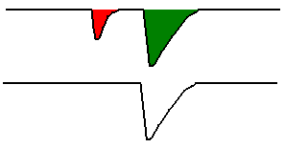
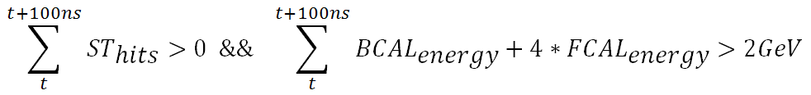
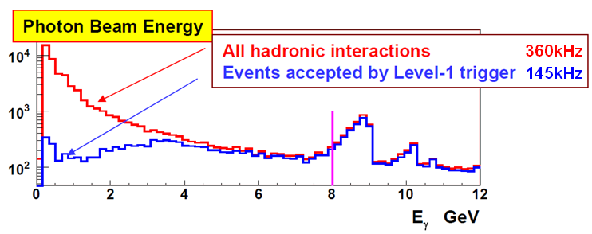
GlueX Example L1 Trigger
BCAL & FCAL <30MeV Channel Suppression (done at FADC250):
<30MeV – Rejected by FADC250
FADC Channel Input:
>30MeV – Accepted by FADC250
FADC L1 Sum Output:
At Luminosity of 10⁸γ/s use the following Trigger equation
GTP Trigger Equation:
Resulting L1 Acceptance Spectrum:
At Luminosity of 10⁷γ/s Tagger hit counts
& Start Counter will be used: L1 Rate ~10KHz
In Signal Region:
L1 Trigger Efficiency > 92%

Slide 44
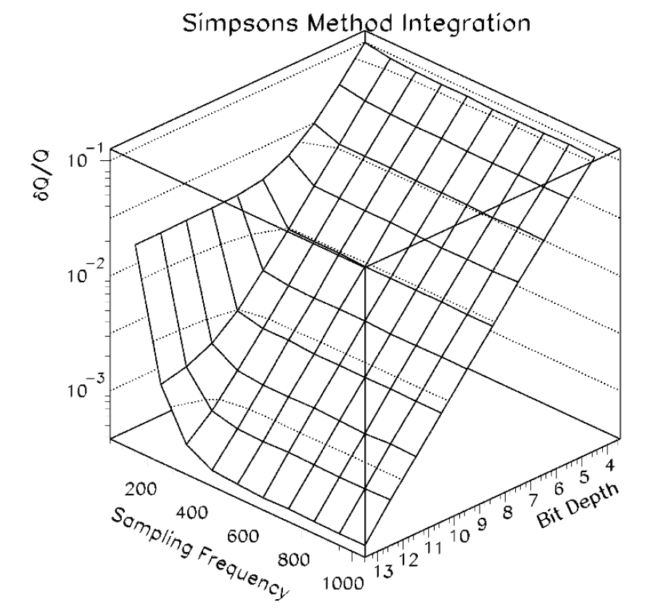
3.4 FADC Sampling – Charge Accuracy
Hall D FCAL PMT: FEU 84-3
10,000 Random height pulses 10-90% full scale of ADC range simulated
Sampling frequency makes little difference beyond 250MHz at 12bit, providing ~0.1% charge resolution
PMT pulse shape dominates sample frequency and bit depth of ADC
250MHz @ 12bit
From: 44 Doc# 425-v1

Slide 45
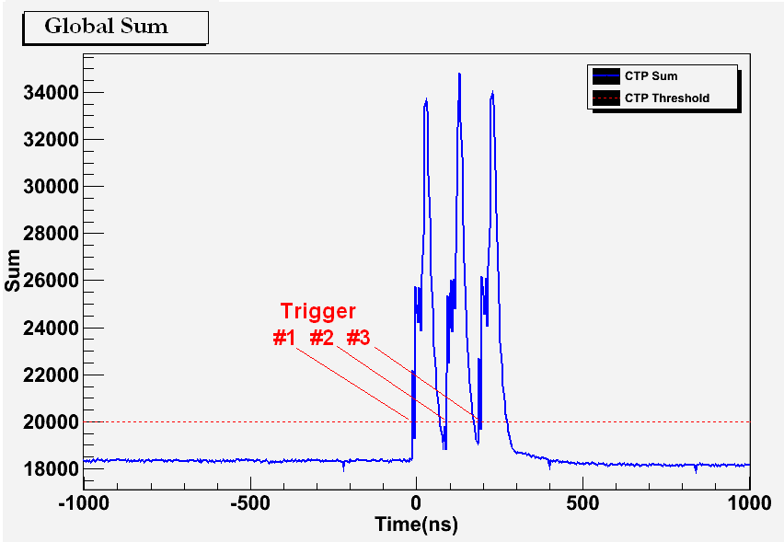
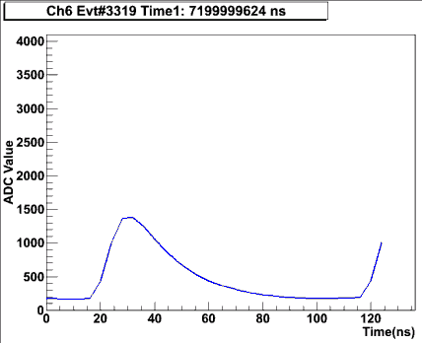
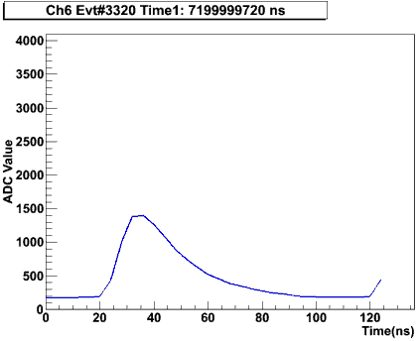
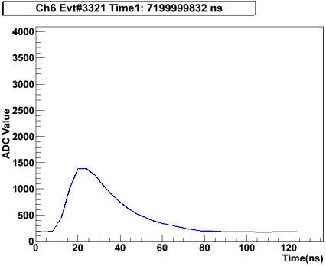
Synchronized Multi-Crate Readout
CTP #2 is also acting as an SSP (by summing the local crate + CTP#1 sum over fiber
A programmable threshold is set in CTP, which creates a trigger when the global sum (6 FADC boards => 96 channels) is over threshold.
Example test with a burst of 3 pulses into 16 channels across 2 crates/6 FADC modules
A 2μs global sum window is recorded around the trigger to see how the trigger was formed:
Example Raw Event Data for 1 FADC Channel:
B. Raydo

Slide 46
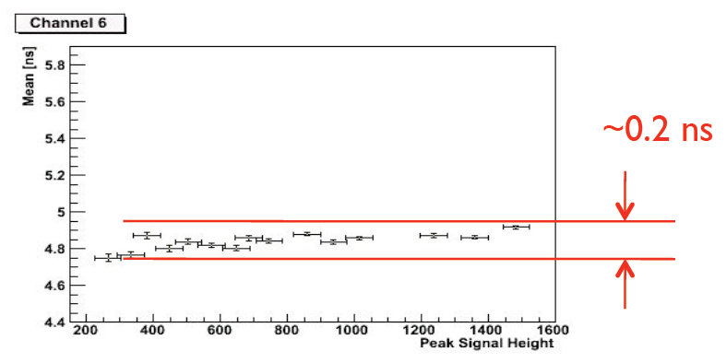
FADC Sampling – Timing Accuracy
Hall D FCAL PMT: FEU 84-3
Timing algorithm developed & tested by Indiana University for the Hall D forward calorimeter.
Implemented on the JLab FADC250 hardware achieving <300ps timing resolution on 50% pulse crossing time with varied signal heights.
- Resolution allow reliable information to link calorimeter with tagged electron bunch.
Typical timing resolution achieved ~1/10 the sample rate. The PMT shape will drive the ADC sample rate & depth requirements.
From: GlueX Doc# 1258-v1

Slide 47


POP4 Avago Transceivers and MTP parallel fiber cable
Fiber optic cable has been tested at 150m length
  Longest optic link is from Hall D to Hall D Tagger
  Is ~100m
Trunk lines will have 12 parallel ribbon fibers
  144 total fibers
  Multi-mode 50/125um
  MTP connectors to transceivers and patch panels
Specifications:
Min insertion loss <0.60db
Wavelength 850nm (Avago POP4 Transceiver 3.125Gb/s)
Attenuation (db/km) - 3.5/1.5
Temperature range: -40C- 80C
Low Smoke Zero Halogen jacket – Non-Plenum tray approved
Specifications include installation and testing requirements
Each Hall will require different quantities and specific lengths
Patch panel hardware has been specified and tested

