Slide 1
SHMS Detector Commissioning and Installation
Howard Fenker
Hall-C Users Meeting -- 15-Jan-2015

Slide 2
Status of Detectors for SHMS
Noble-Gas Cerenkov
Mount Optics in Box at Jlab ESB during UVa Spring Break.
Mirrors are at CERN being aluminized
Drift Chambers
Tested. See talk later today.
Move to JLab ESB in Feb. for Electronics & Cosmics
Hodoscopes
At NCA&T and JMU and JLab. Frames at W&M
All cosmic tested and Ready to install.
Heavy-Gas Cerenkov
At JLab ESB. Tested. Ready to install.
Aerogel Cerenkov
See talks later today
Pre-shower and Shower Counters
Installed and Tested!
See talk later today.
Active-Sieve GEM
Tested. Mounting hardware ready. Installation in Summer 2016.

Slide 3
System Status
High Voltage
Signal Cables
DAQ
Gas
Computing
Sieves & Collimators
Beamline
Vacuum System
Scattering Chamber

Slide 4
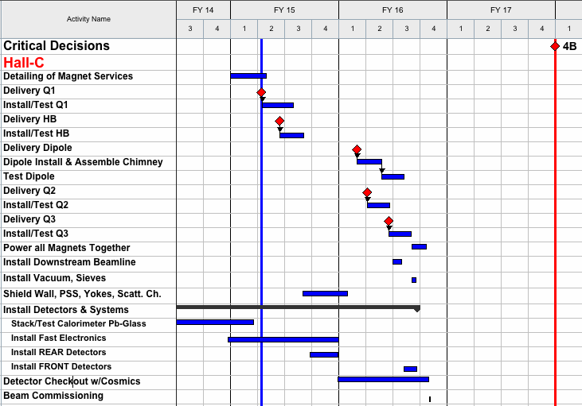
SHMS Schedule
DRAFT
NOT OFFICIAL 12GEV
DATELINE 1/12/15

Slide 5
Detector Installation Planning
DETECTOR | BENCH TEST | INSTALL | COSMIC | CONNECT
Shower | ✔ | ✔ | ✔ | Feb 2015
Preshower | ✔ | ✔ | ✔ | Feb 2015
S2X & Q2Y | ✔ | Spring & Summer 2015
Aerogel Č | ✓
Heavy Gas Č | ✔
S1X & S1Y | ✔
(Wait for Dipole Installation and Final Assembly – Tests Finish by 9-May-2016)
Drift Chambers | ✔ | May 2016 | Summer 2015 | May 2016
Noble Gas Č | April 2015 | June 2016 |  | June 2016

Slide 6
Commissioning-With-Beam Week’s Activities
CONCEPTUAL PLAN ONLY–
Establish beam into the Hall
Set Magnets to Nominal Currents / Fields
Rough timing of hodoscopes, etc.
Establish basic coincidence trigger
Reconstruct low-resolution tracks in Drift Ch.
Obtain calibration data for PID systems
Observe low-res. elastic peak
Exercise DAQ rate

Slide 7
Commissioning-Week Shifts
~August 2016 … One week … 21 Shifts
Will Need a Plan
Will Need a Run Coordinator
Need Staff: Hardware AND Software Experts
JLab Staff (Techs, Engineers, Scientists)
Users

Slide 8
The End
…but the Beginning is in sight!

