Slide 1
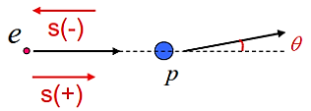
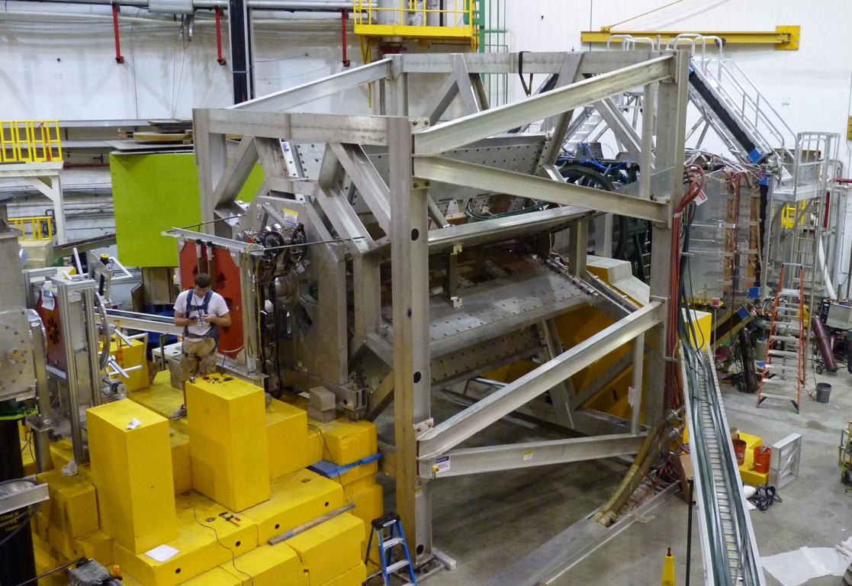



Qweak Instrumentation
Greg Smith
(for the Qweak Collaboration)
Hall C Users Meeting
January 16, 2015

Slide 2
Qweak Instrumentation Paper
Just accepted in NIM A
arXiv server:
  http://arxiv.org/abs/1409.7100
Jlab pubs JLAB-PHY-14-1959:
  https://misportal.jlab.org/ul/publications/downloadFile.cfm?pub_id=13340
Other instrumentation papers planned:
  LH₂ target
  Main quartz detectors
  Compton polarimeter

Slide 3
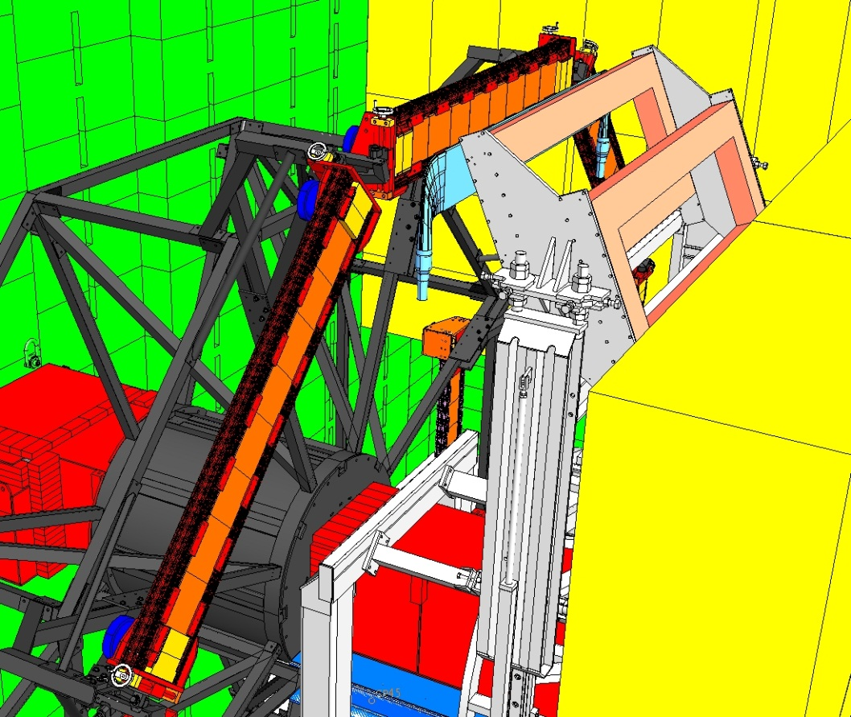
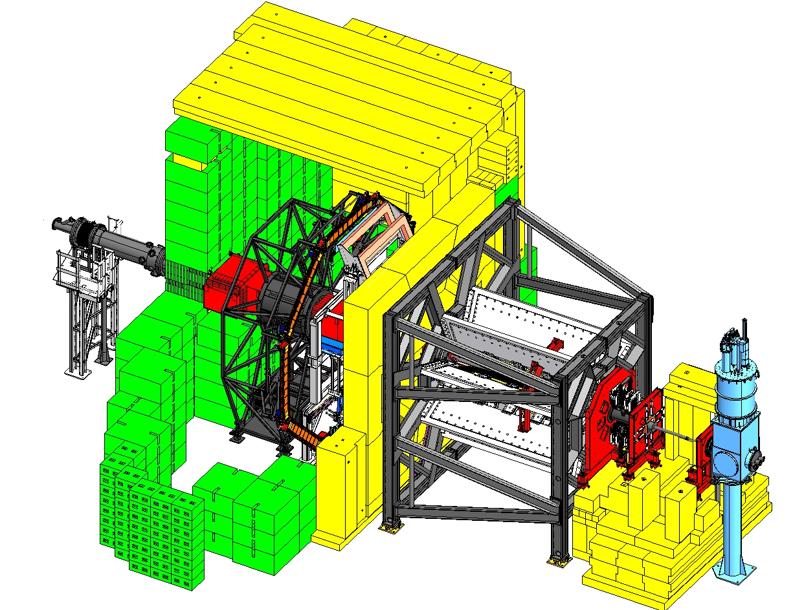
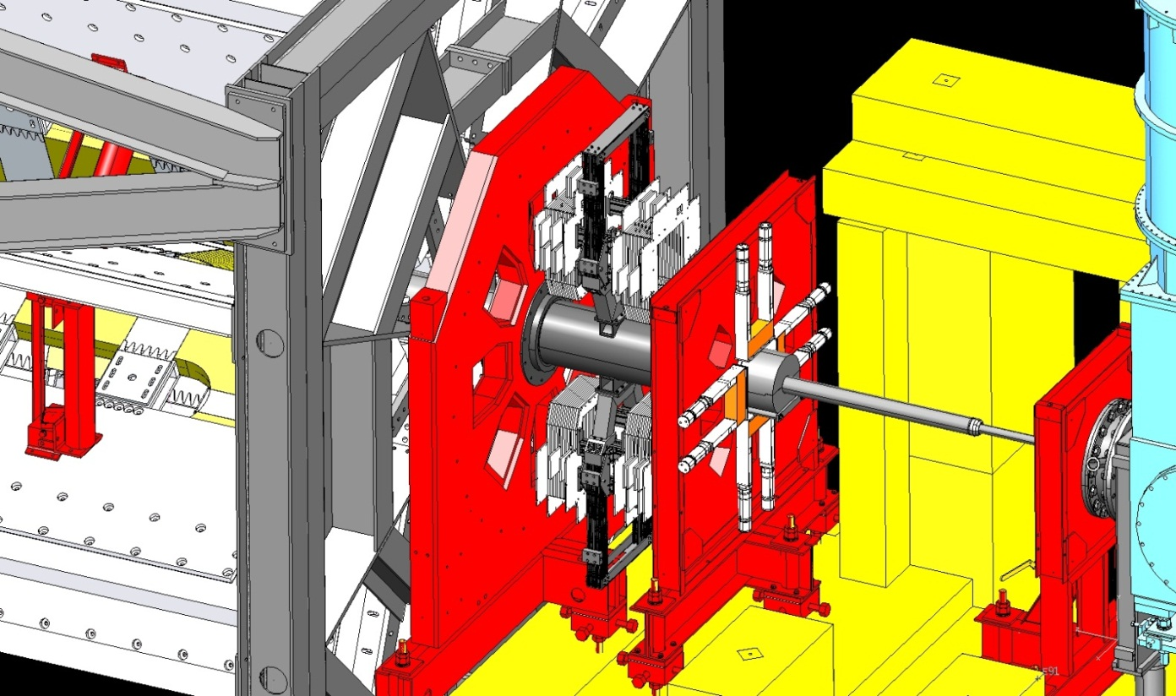
Experimental Apparatus
  Parameters:
  E_{beam}= 1.165 GeV
  <Q²> = 0.025 GeV²
  <θ> = 7.9° ± 3°
  φ coverage = 50% of 2π
  I_{beam} = 180 μA
  Integrated rate = 6.9 GHz
  Beam Polarization = 88%
  Target = 35 cm LH₂
  Cryopower = 3 kW
Shield Hut
Trigger Scintillators
Qweak Toroidal Magnetic Spectrometer (QTor)
Horizontal Drift Chambers
Luminosity Monitors
Downstream Luminosity Monitors
Beam
Vertical Drift Chambers
Quartz Cherenkov bars
LH2 target
Collimators
Used only during low current tracking mode operation

Slide 4
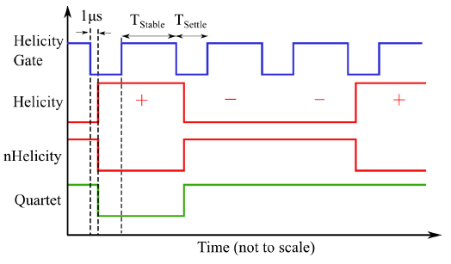
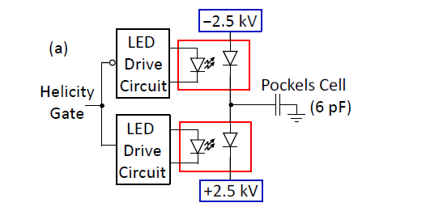
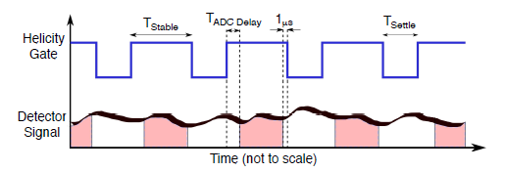
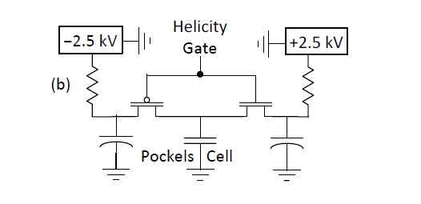
Helicity Timing & Fast Reversal
960 Hz
New
60 μs
Switching
@ 960 Hz
960 Hz helicity reversal
T_{settle}= 70 μs (6.7% DT)
T_{stable}= 971.65 μs
Opto-coupler
mounted directly to Pockels Cell
Integration
windows
Old
500 μs
Switching
@ 30 Hz
“Fast” HV transistor switches
18-bit ADCs sampled at 500 kHz →
464 samples/(Helicity Gate),
started T_{ADC Delay}= 42.5 μs (4.1% DT)
after start of T_{Stable}

Slide 5
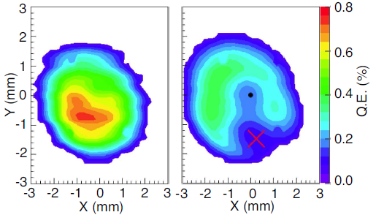
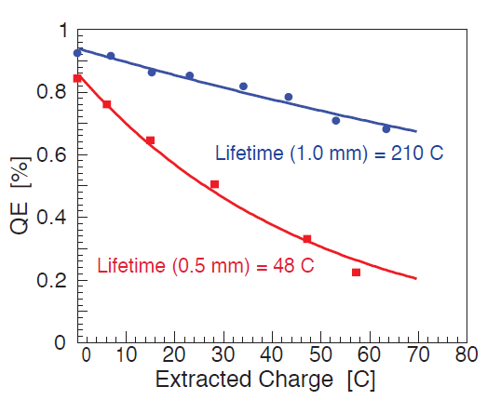
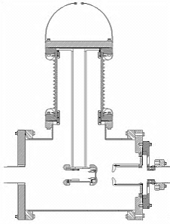
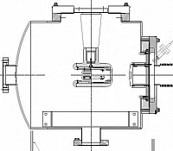
Photocathode Quantum Efficiency
1/e charge lifetimes with lens of 1.5 m focal length (0.55 mm spot)
and 2.0 m (1.0 mm spot)
QE Profiles before (left) & after (right) 4 weeks @ 180 μA.
1 mm φ laser spot indicated by X
Other improvements:
  New inverted e gun @ 130 kV
    Reduced loss on inj. apertures
100 kV
130 kV
Notes:
Laser spot was 1 mm diam., active area ~ 5 mm diameter.

Slide 6
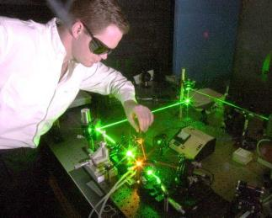
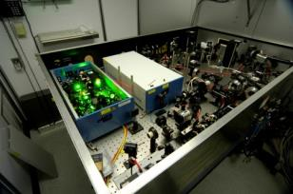
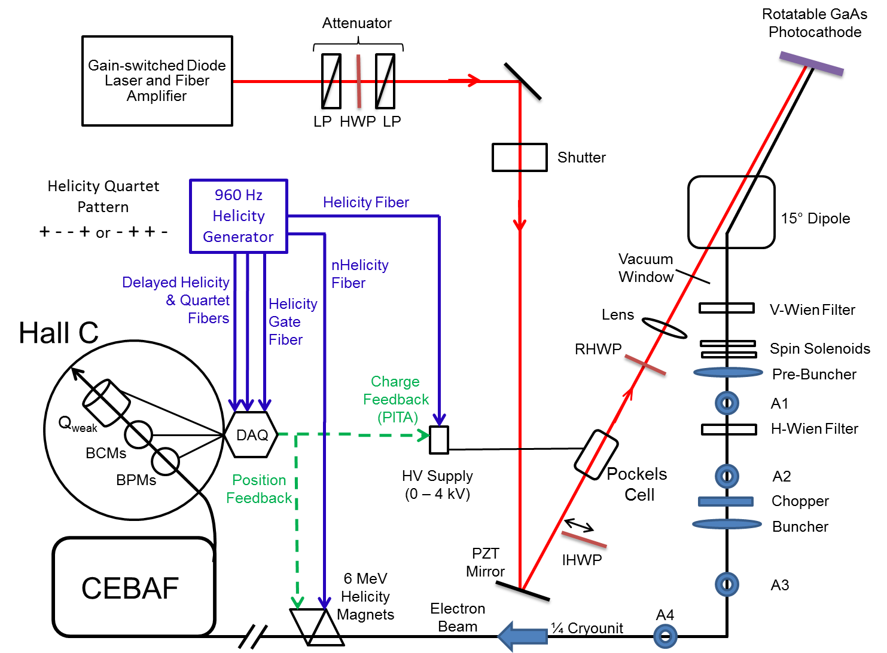
Polarized Source
monthly
reversal
960 Hz
reversal
± 2.5 kV
8 hour
reversal

Slide 7
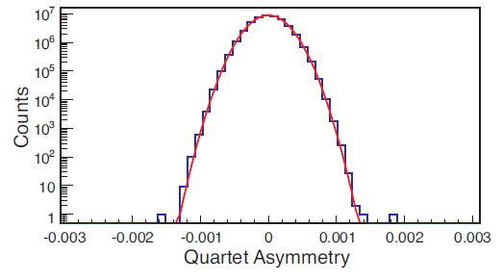

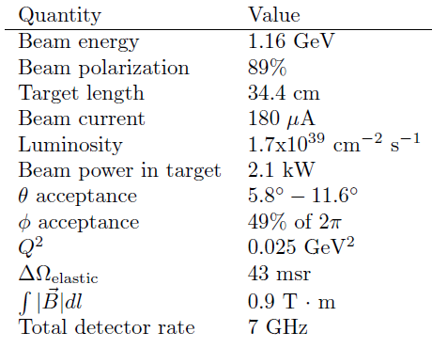
Parameters
σ_{A}
Gaussian Fit
(σ_{A} = 230 ppm)
ΔA ~ 1 ppm/d
Data
Msr P, Q², I_{B}, & Yield very well
960 Hz helicity flip (fast!)
MD PMT anode current integrated
for each helicity state
  normalized to beam charge
Quartet asymmetries calculated
every 4 ms (cancels linear drifts)
Asymmetry width σ_{A} ~ 230 ppm at 180 μA is dominated by counting statistics;
  target noise ~ 50 ppm
  beam charge msrmnt ~ 50 ppm
Also: collimation, shielding, control & msr bkgs & HCBAs, hi luminosity..

Slide 8
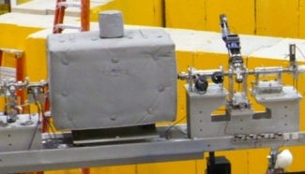

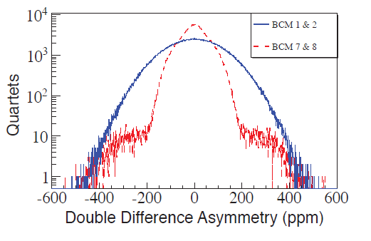
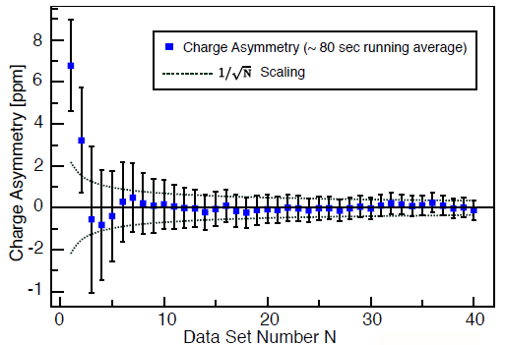
Beam Current Instrumentation
Six temp. stabilized, RF cavity BCMs:
  @1497 MHz, 100 kHz bandwidth
  Two with old analog receivers (1&2)
    Downconverted to 1 MHz
    Demodulated with RMS to DC converters
    DD resolution 100-140 ppm
  Four with new digital receivers (5-8)
    Downconverted to 45 MHz
    Digitally sampled & processed signals
    Rad damage → moved receivers to CR
    18 bit, 1 MHz DACs
    Air-core coax cables → Heliax
    DD resolution ~ 60 ppm
σ_{RMS}=57 ppm
σ_{RMS}=115 ppm
BCM linearity ~0.5% from 20-180 μA.
Below 1 μA used injector Faraday cup & DS lumis.
Kept IA < 100 ppb with active feedback, adjusting PITA offsets to Pockels Cell.
  Typical msrd IA only 40 ppb/month!

Slide 9
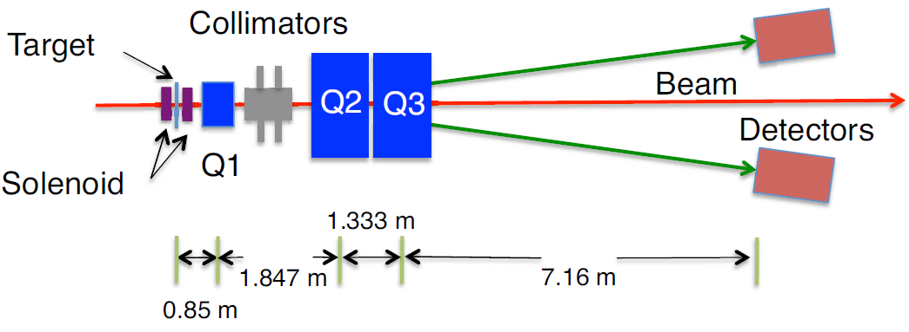
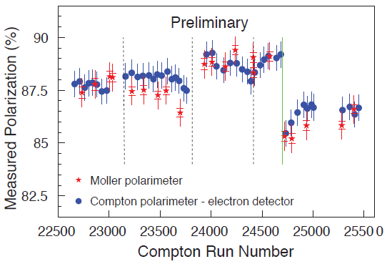
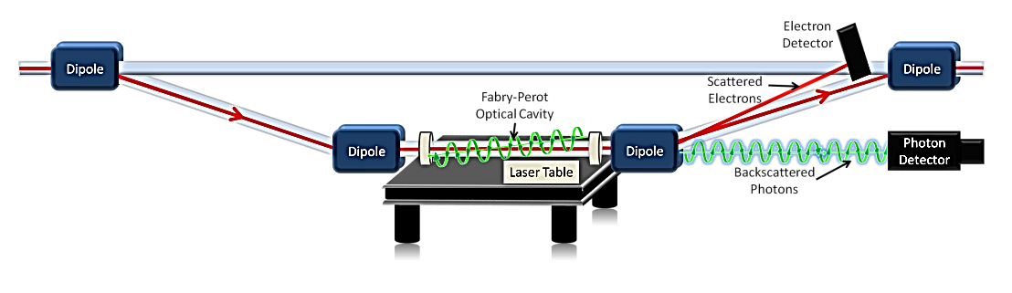
Precision Polarimetry
Møller Polarimeter
Qweak requires ΔP/P ≤ 1%
Strategy: use 2 independent polarimeters
Use existing <1% Hall C Møller polarimeter:
  Low beam currents, invasive
  Known analyzing power provided by polarized Fe foil in a 3.5 T field.
Use new Compton polarimeter (1%/h)
  High I_{beam}, non-invasive
  Known analyzing power provided by circularly-polarized laser
Compton Polarimeter
57 cm

Slide 10
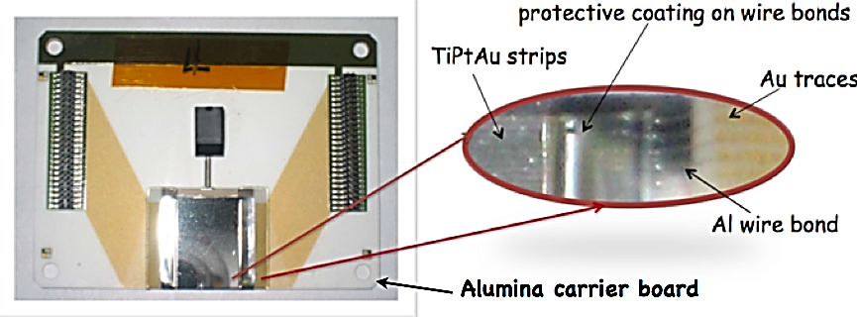
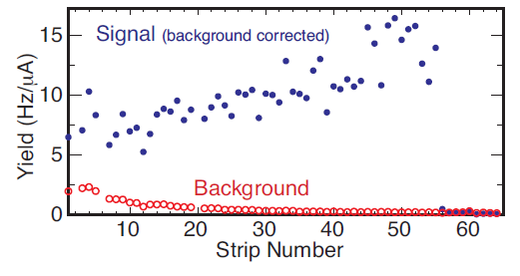
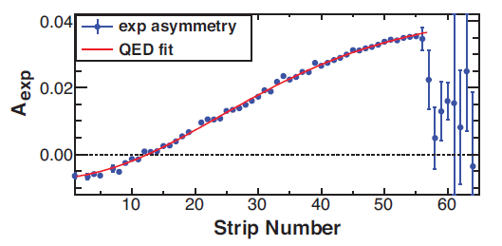
Compton Electron Detector
Missing strips (2, 6, & 20) have negligible impact on fit
Compton edge
Strip 1 closest (7 mm) to beam

Slide 11
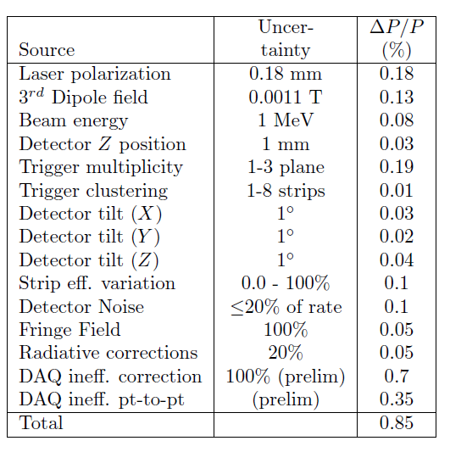
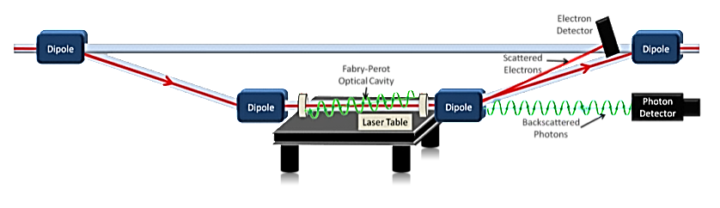
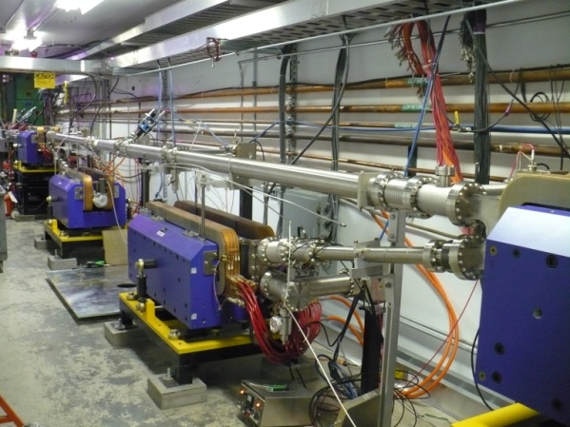
Compton Systematic Uncertainties
Note: Statistical uncertainties ~ 1%/hour @ 180 μA
0.3
0.3
Final
0.56
Note: DAQ errors could be made smaller still in a new implementation.
Note: No guarantee this can be reproduced in Hall A (different kinematics, detector, bkgs…)

Slide 12
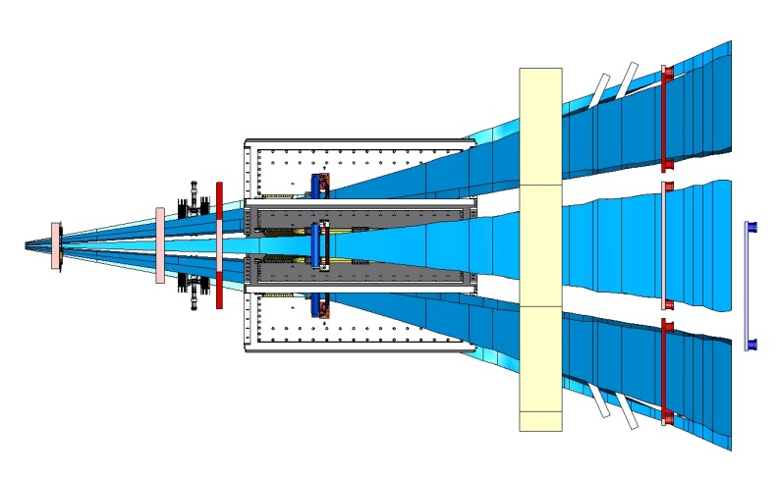
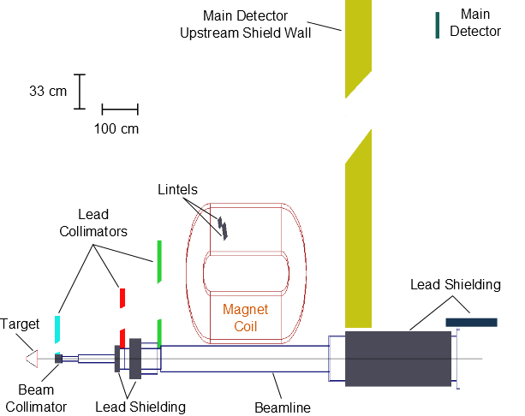

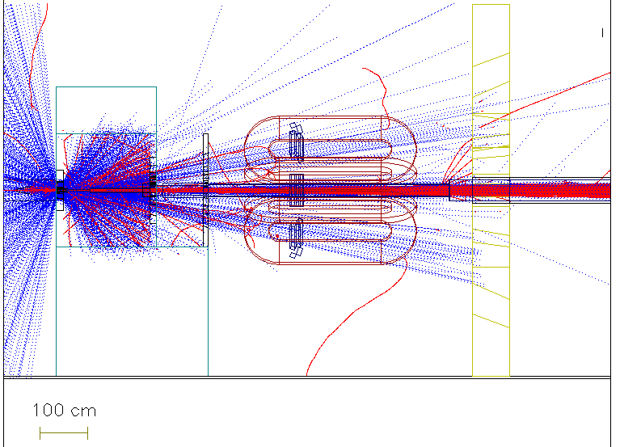
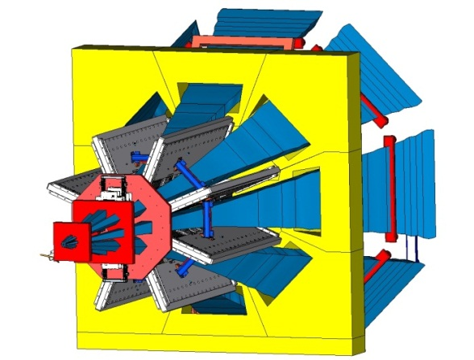

Neutral line-of-sight Collimation

Slide 13
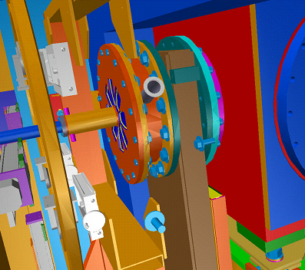
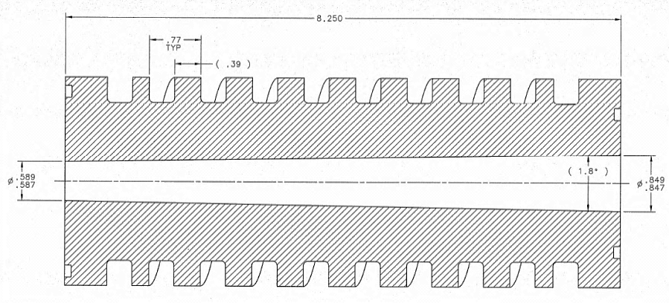
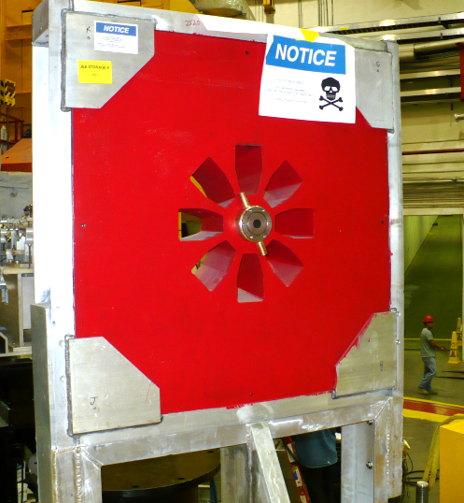
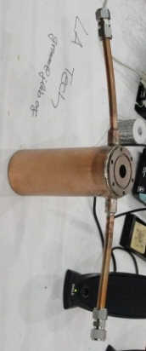
Beam Collimator
Water cooled W-Cu beam collimator
Beam Collimator
Target SC
16” GV
SC Window
Beam Collimator
(inside 1st collimator)
14.9 mm φ
47 cm ds of tgt
1.6 kW beam power

Slide 14
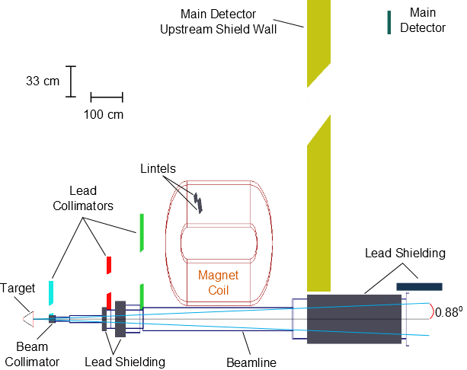
Beam Collimator
Water cooled W-Cu beam collimator
Beam Collimator
Target SC
16” GV
SC Window
Beam Collimator
(inside 1st collimator)
14.9 mm φ
47 cm ds of tgt
1.6 kW beam power

Slide 15

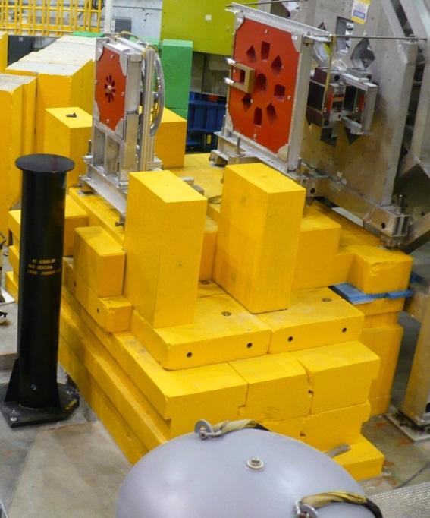
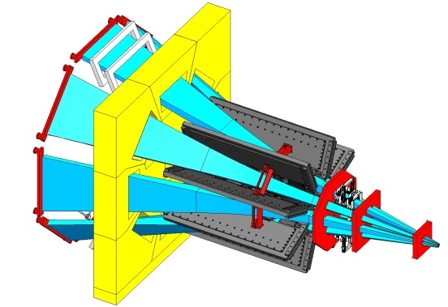
Maximum angle accepted by triple collimator system

Slide 16
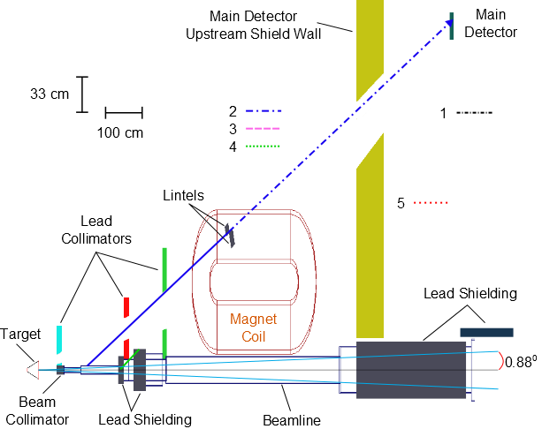

1st hot spot, shielded by lintels

Slide 17
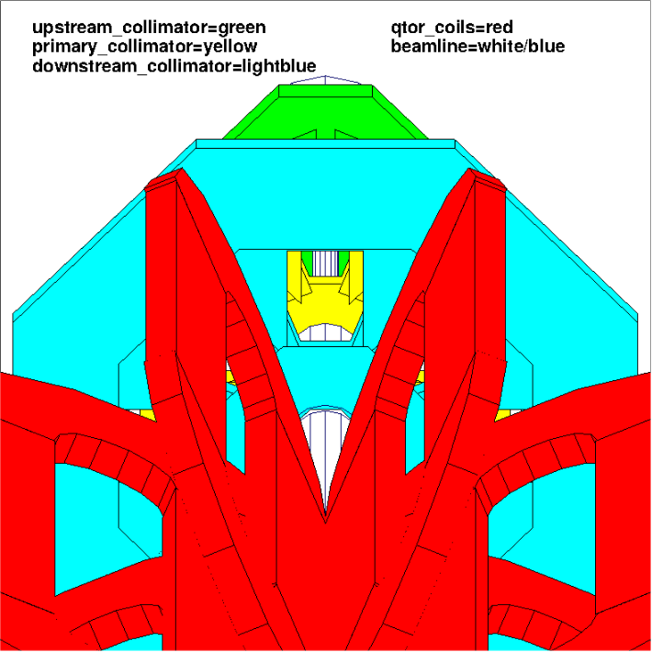
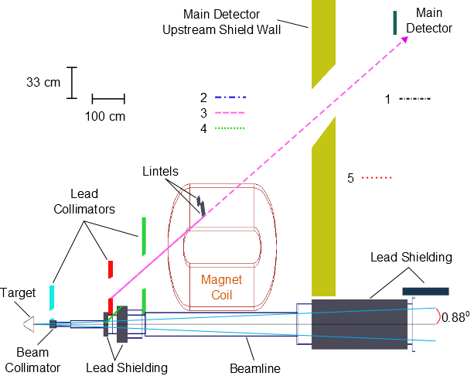
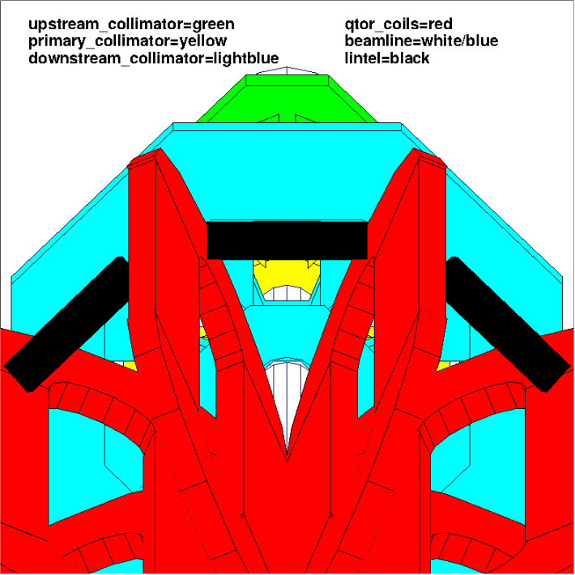
2nd hot spot, shielded by lintels
2nd collimator
Inner edge
hot spot
(looking upstream)

Slide 18
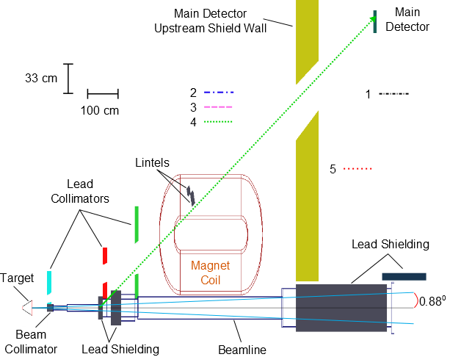
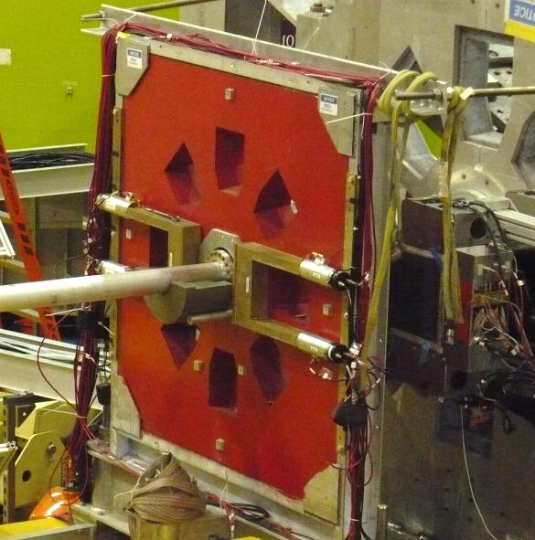
3rd hot spot, shielded by beamline Pb

Slide 19
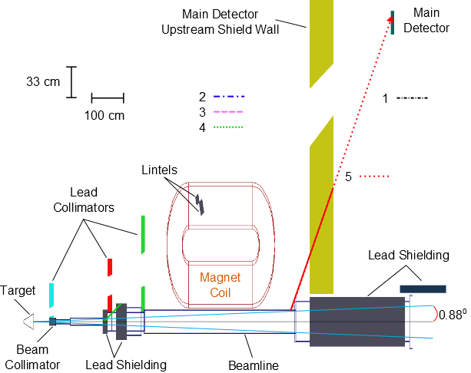
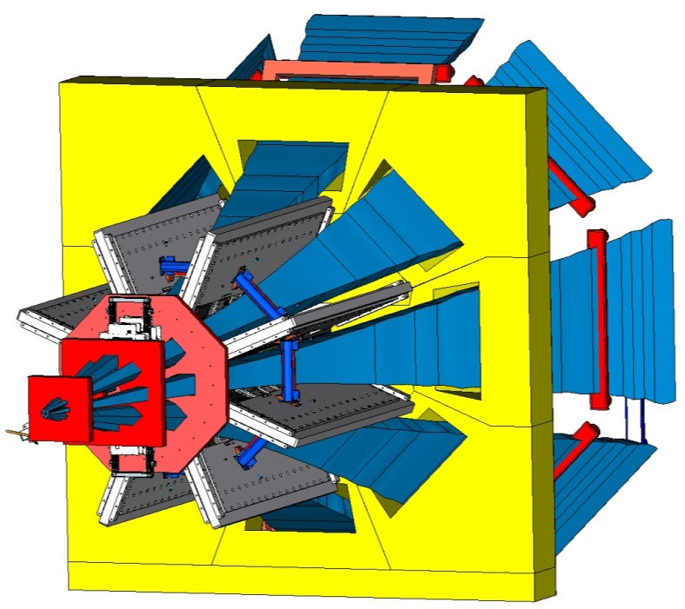
4th hot spot, shielded by hi density concrete

Slide 20
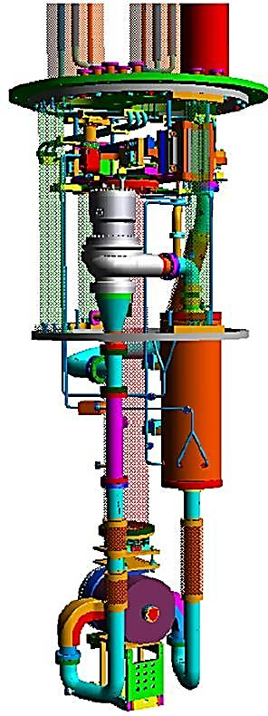




Target Design
I_{Beam} = 180 uA
L = 35 cm (4% X₀)
P_{beam} = 2.2 kW
A_{spot} = 4x4 mm²
V = 57 liters
T = 20.00 K
P ~ 220 kPa
World’s highest power and lowest noise cryogenic target ~3 kW
Centrifugal pump
(17 l/s, 7.6 kPa)
3 kW Heater
3 kW HX utilizing
4K & 14K He coolant
(m/s)
35 cm cell (beam interaction volume)
Fluid
velocity
Solid Tgts
beam
beam

Slide 21


Cell
Designed using Computational Fluid Dynamics
LH2 Transverse Flow:
1.1 kg/s
15 L/s
3-7 m/s
13.9°
13.9°
LH2 length: 35 cm
Al entrance window ~0.1 mm thick, 22.2 mm Φ
Al exit window ~0.125 mm thick over 15 mm Φ,
0.635 mm thick over 173.5 mm
Scattered electron acceptance ±13.9°
Electron Beam
180 μA, 4x4 mm²

Slide 22



Centering on extended tgt worked well
Dynamic 2 axis motion system (x,y).
Manual cell adjustment mechanism (pre-cooldown) allowed adjustment of z, roll, pitch & yaw.
2 mm
LH2 Exit window with thin central nipple (125 μm)
Aluminum background targets
15 mm

Slide 23






Target Performance
Measured helicity correlated target noise:
At 960 Hz reversal rate, the target noise (~50 ppm) is small compared to our measured helicity
quartet ( ) asymmetry width $∆A$_{qrt} (~230 ppm).
(statistical power ~ ${{∆A}_{qrt}}/{\sqrt{N_{qrts}}}$ ).
$$∆A_{qrt}=\sqrt{{\left(σ_{fixed}\right)}^{2}+{\left(σ_{tgt}\right)}^{2}}$$
±
±
±
±
Where ΔA_{qrt} is msrd main detector asymmetry width
(over each helicity quartet)
ΔA_{qrt} (ppm)
180 μA
4 x 4 mm²
T_{boil}=23.2 K
20 K
21 K
22 K
19 K
Pump speed = 28.5 Hz
(20 K)
σ_{tgt} (ppm)
Main Detector Yield (V/μA)
Time (sec)
22 K
21 K
20 K
19 K
Pump speed = 12 Hz
(20 K)
Time (sec)
Target Pump Speed (Hz)

Slide 24




QTOR Magnet
Double pancake coil
Manitoba / TRIUMF / MIT-Bates / JLab
Open geometry resistive toroid, for maximum solid angle acceptance
Eight water cooled, dble pancake coils
Separates elastics from inelastics at focus
Power Supply:
150 V, 9100 A
3-axis Mapper

Slide 25



Spectrometer Performance
Radial field distribution at magnet center along beamline, and 1/2-way between 2 coils azimuthally.
∫Bdl is calculated based on the actual coil positions determined from zero-crossing field mapping msrmnts.
<∫Bdl> is the 8-octant average.
θ is the polar angle, φ the azimuthal angle.
B_{φ}(r)
Octant to octant field uniformity
θ=
spec
3 axis mapper

Slide 26



Quartz Cerenkov Detectors
Quartz
Bars
Azimuthal symmetry maximizes rate and decreases sensitivity to HC beam motion, transverse asymmetry.
Spectrosil 2000: Eight bars, each 2 m long, 1.25 cm thick
  Rad-hard
  Non-scintillating, low-luminescence
Results over entire expt
  Simulation of MD face:
Yield 100 pe’s/track with 2cm Pb pre-radiators
Resolution limited by shower fluctuations.
Charge-normalized Yield
  Azimuthal direction
  Measured
Quartet Asymmetry width
f(tgt, BCMs, HCBA, stats, det. res.)
  Azimuthal direction
Scaled by sqrt(I_{B}/180)

Slide 27




More Quartz Detector Results
Main quartz detector pulse height spectrum.
50 pA, LH2, sum from both ends.
~6 min. main quartz detector yield
(mean subtracted)
Raw Yield
σ = 50 mV
Charge-normalized Yield
σ = 13 mV
measured
GEANT4
Shot
(stat. noise)

Slide 28




Determining the Kinematics
Required uncertainty on Q² is 0.5%
Combination of tracking and simulation
HDCs before magnet to msr θ
  Q² = 2E² (1-cosθ) / [1 + E/M(1-cosθ)]
VDCs & trigger scintillators after magnet to msr light weighted Q² across quartz bars
azimuthal
radial

Slide 29





Tracking System
VDC
rotator
VDC
VDCs
HDC
rotator
HDCs

Slide 30




Tracking Chambers
HDC: e’s drift || to plane.
6 planes/chmbr (xuvxʹuʹvʹ) of 32 wires.
5.85 mm pitch. 28x38 cm.
50 pA
LH2
~ 100 kHz
HDC residual
1 of 12 planes (2 chmbrs)
σ_{fit}=178 μm
2 chmbrs/octant in 2 octants.
Rotation systems to access the other octants. Overlap in 1 octant.
Separate electronics, MD bases & DAQ.
Chambers retracted out of acceptance for main (180 μA) measurement.
VDC: e’s drift ┴ to plane.
2 planes/chmbr (uv) of 279 wires.
4.97 mm pitch. 205x53 cm.
50 pA
LH2
~ 300 Hz
VDC residual
1 of ~24 wires
(2 chmbrs)
σfit=264 μm
1 cm³ quartz profile scanner
VDC projection

Slide 31

The Qweak Collaboration
95 collaborators
23 grad students
10 post docs
23 institutions:
  JLab, W&M, UConn, TRIUMF, MIT, UMan., Winnipeg, VPI, LaTech, Yerevan, MSU, OU, UVa, GWU, Zagreb, CNU, HU, UNBC, Hendrix, SUNO, ISU, UNH, Adelaide
D.S. Armstrong, A. Asaturyan, T. Averett, J. Balewski, J. Beaufait, R.S. Beminiwattha, J. Benesch,
F. Benmokhtar, J. Birchall, R.D. Carlini¹, J.C. Cornejo, S. Covrig, M.M. Dalton, C.A. Davis,
W. Deconinck, J. Diefenbach, K. Dow, J.F. Dowd, J.A. Dunne, D. Dutta, W.S. Duvall, M. Elaasar,
W.R. Falk, J.M. Finn¹, T. Forest, D. Gaskell, M.T.W. Gericke, J. Grames, V.M. Gray, K. Grimm, F. Guo, J.R. Hoskins, K. Johnston, D. Jones, M. Jones, R. Jones, M. Kargiantoulakis, P.M. King, E. Korkmaz,
S. Kowalski¹, J. Leacock, J. Leckey, A.R. Lee, J.H. Lee, L. Lee, S. MacEwan, D. Mack, J.A. Magee,
R. Mahurin, J. Mammei, J. Martin, M.J. McHugh, J. Mei, R. Michaels, A. Micherdzinska, K.E. Myers,
A. Mkrtchyan, H. Mkrtchyan, A. Narayan, L.Z. Ndukum, V. Nelyubin, Nuruzzaman, W.T.H van Oers,
A.K. Opper, S.A. Page¹, J. Pan, K. Paschke, S.K. Phillips, M.L. Pitt, M. Poelker, J.F. Rajotte,
W.D. Ramsay, J. Roche, B. Sawatzky,T. Seva, M.H. Shabestari, R. Silwal, N. Simicevic, G.R. Smith²,
P. Solvignon, D.T. Spayde, A. Subedi, R. Subedi, R. Suleiman, V. Tadevosyan, W.A. Tobias, V. Tvaskis, B. Waidyawansa, P. Wang, S.P. Wells, S.A. Wood, S. Yang, R.D. Young, S. Zhamkochyan
¹Spokespersons ²Project Manager Grad Students
Notes:
Only using lh2 statistics
Black line – day 27 cut-off
Note: our 2.1% goal isn’t here

Slide 32


Beam Position Instrumentation
Stripline monitors: 2 +/− pairs of antennas
  Readout multiplexed (SEE) every 4.2 μs to eliminate gain drifts in electronics
  Readout every helicity state (960 Hz) into custom-built 18-bit ADCs (TRIUMF)
  24 BPMs in injector beamline
  23 BPMs in Hall C beamline
    5 used for position & angle at LH2 tgt
    Offsets stable to 25 μm
    Position resolution at tgt 1 μm with 5 tgt BPMs
    Angle resolution at tgt 150 nrad
  Slow (1 s) position lock on tgt employed
Notes:
SEE = switched electrode electronics

