Slide 1
SHMS Status HallA/C users meeting
Paul Brindza
Jan 20,2017

Slide 2
Hall C SHMS

Slide 3
Overall SHMS Status
All SC magnets are at JLAB and installed
HB, Q1 tested and accepted
Q2 accepted this week
Q3,D TBD
Experiment Readiness Review was a success
All detectors have been installed.
Noble gas Cerenkov removed to permit other work
Beamline installation
DS more than 50%
US 98%
Dump upgrade 98%

Slide 4
Noble Gas Cerenkov Installed Nov 2016

Slide 5
SC magnets
HB Accepted 2016
Q1 Accepted 2015
Q2 Acceptance status
Acceptance tests complete
Reached 3866 Amps > 3660 Amps 11GeV/c after training
Ramp to 3660 Amps in 30 minutes, hold 1 hour and ramp down
Cool down in 8 days < 10 days
Heat leak is ~ 60 watts > 40 watts

Slide 6
SHMS Q1 and HB Status
Q1:
Installed on SHMS
Cooled down
Power test to 3000 Amps or 110% of operational current
Accepted 2015
HB:
Installed on SHMS
Cooled down
Power test to 4000 Amps or 102% of operational current
Accepted 2016

Slide 7
Q2 entering Hall C Oct 6, 2016

Slide 8
Q2 Has arrived Oct 6, 2016

Slide 9
Q2 installation Oct 7, 2017

Slide 10
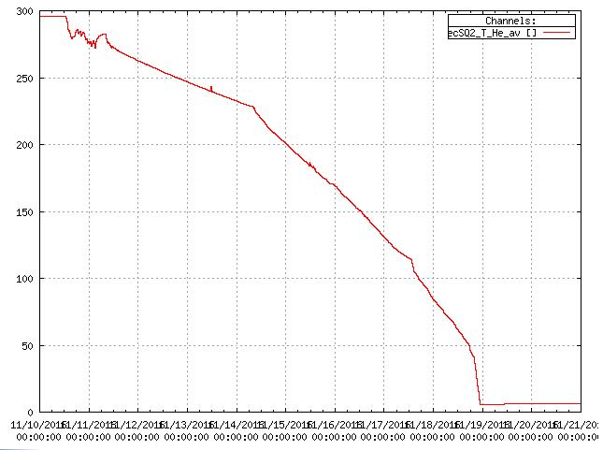
Q2 cool down Nov 11, 2016

Slide 11
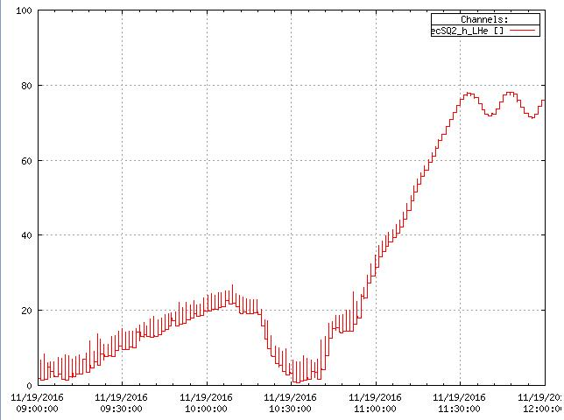
Q2 first helium fill Nov 19 , 2106

Slide 12
Q2 training curve

Slide 13
Q2 beam side Jan 19, 2017

Slide 14
SC magnet part 2
Q3
installed and assembled
Connections underway to cryo, power and controls
Passed leak and pressure and hipot tests
JT valves, pressure sensors and thermometers calibrated
Set up of voltage taps and quench detector TBD
I&C checkout TBD
Purification and cooldown TBD
Power tests TBD

Slide 15
Q3 in Hall C Dec 7, 2016

Slide 16
Q3 Installed Dec 9, 2016

Slide 17
Q3 CCR Jan 18, 2017

Slide 18
Q3 CCR Jan 19, 2017

Slide 19
Q3 from beam side Jan 19,2017

Slide 20
SC magnets part III
Dipole
installed
Chimney assembly underway
Connections to cryo, power and controls underway
Hipot test passed
Pressure sensors and thermometers calibration done
Leak and pressure tests done
JT valves calibration underway
Set up of voltage taps and quench detector TBD
I&C checkout TBD
Purification and cooldown TBD
Power tests TBD

Slide 21
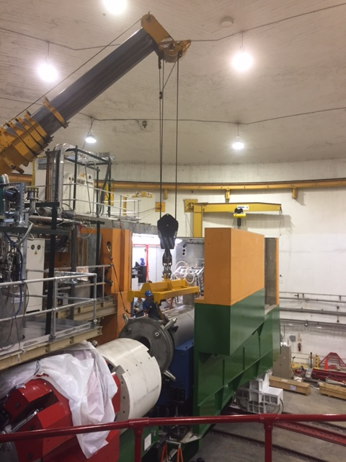
Dipole installation on SHMS Dec 2016

Slide 22
Dipole CCR work Jan 18,2917

Slide 23
Dipole CCR Jan 19, 2017

Slide 24
Dipole beam side Jan 19, 2017

Slide 25
What’s left besides magnets?
SHMS rotation
SHMS can be rotated under power by an operator
Mount and wire angle limit sensors
Test rotation in full automatic mode
Assemble SHMS vacuum system
Align magnets to a common center
Magnet to magnet bellows
Shutter and vacuum window
Install pumps and test under vacuum

Slide 26
What’s left besides magnets II
Down stream beamline
Complete tube installation ~ 50% now
Install pump and test under vacuum
Up stream beam line
One short piece to install between scattering chamber and existing beam line

Slide 27
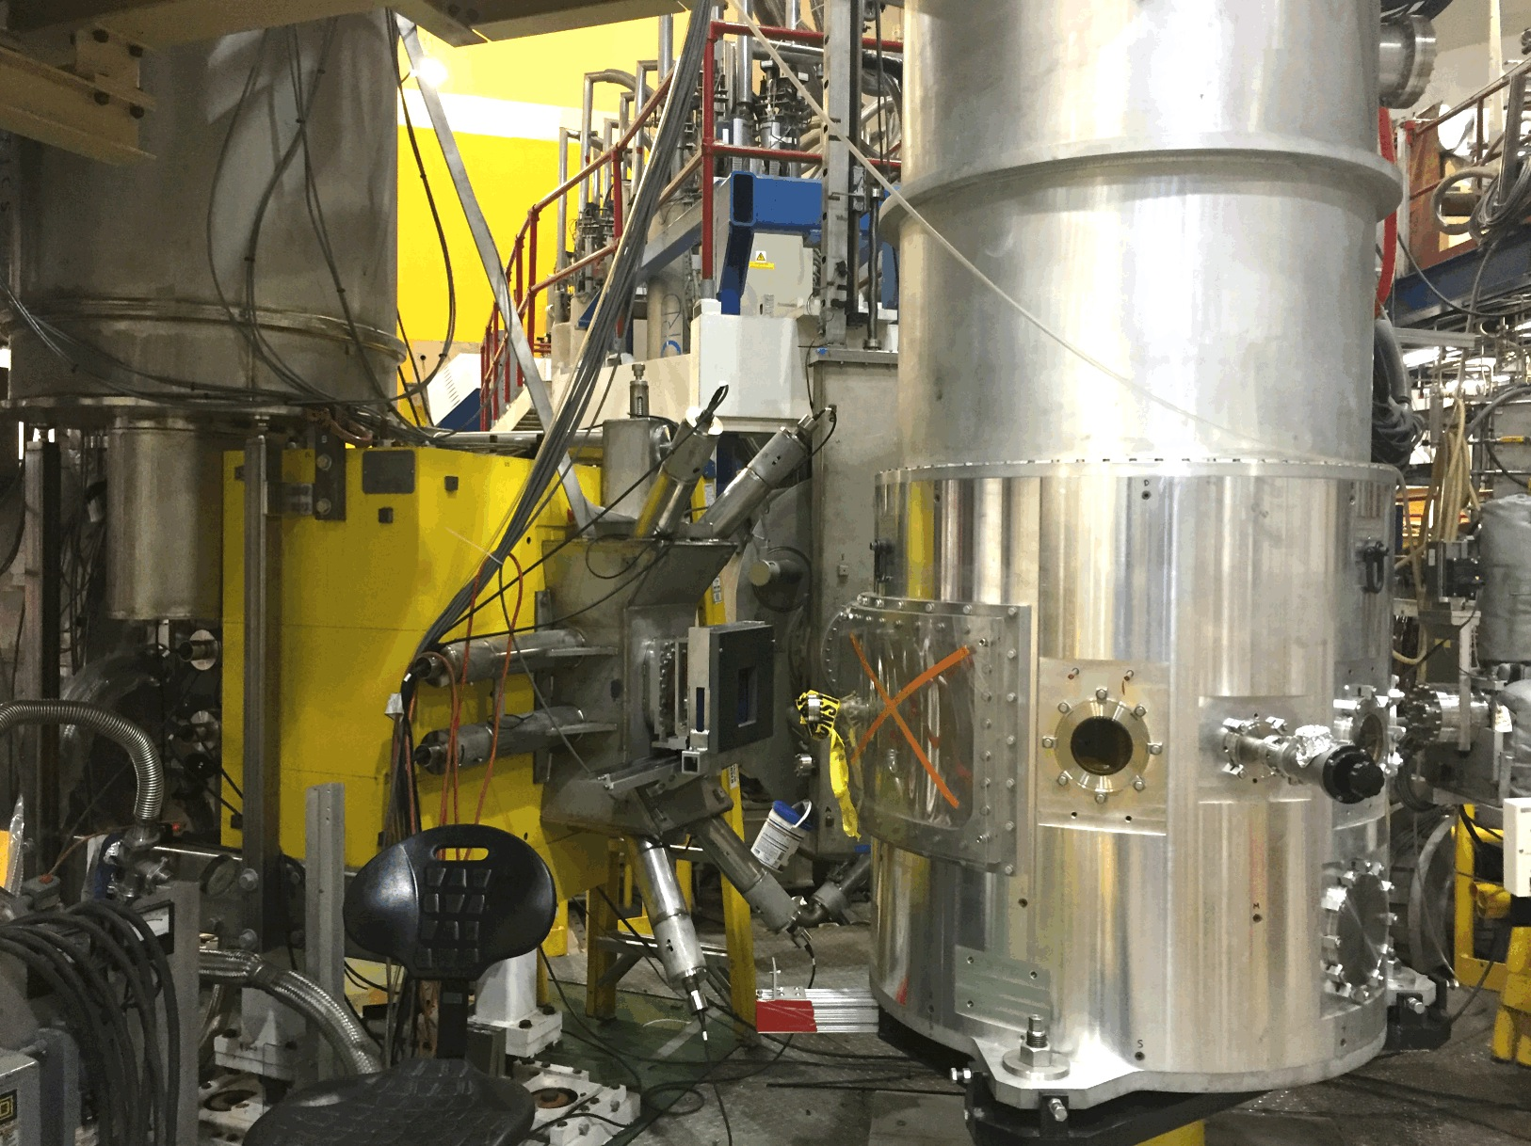
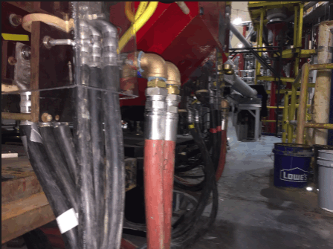
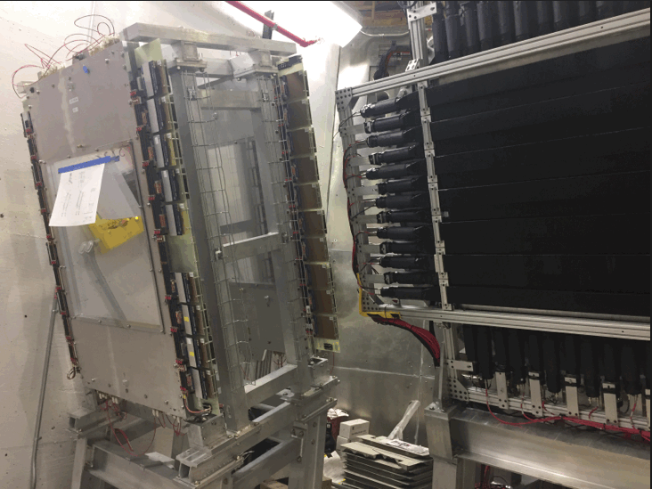
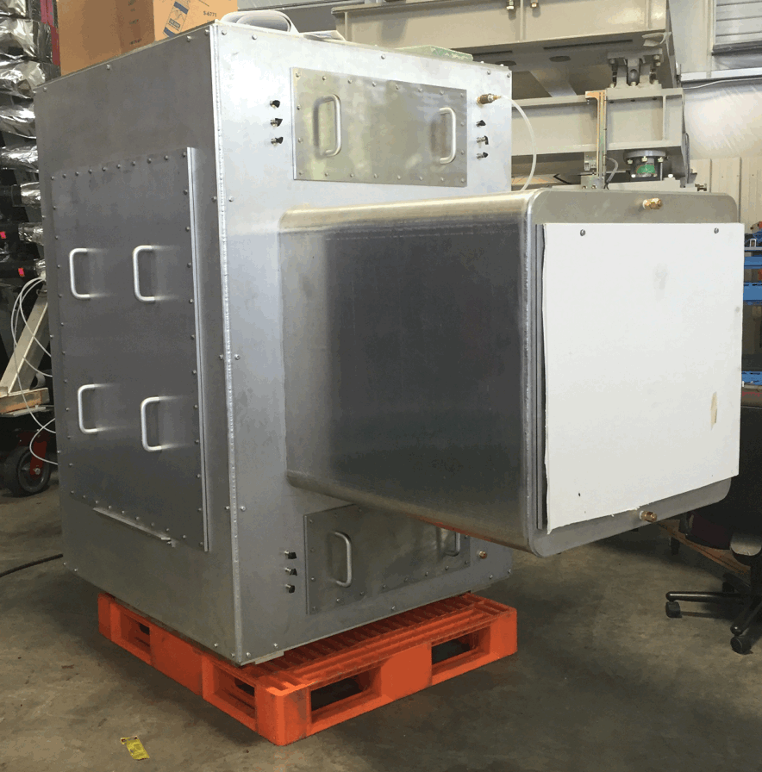
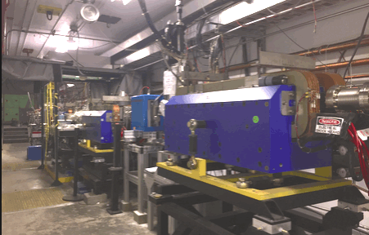
Hall-C Project Status
Moller Quad Power Connections
Drift Chambers
Installed In SHMS
HB Magnet, Sieve Slits, Scattering Chamber
Beamline Vacuum Pipe Sections
Compton
Polarimeter
Noble Gas Cerenkov

Slide 28
Conclusions
Q3 and Dipole are in a race to cool down first
Both should be cold by end of February
Magnet operations for the key Performance Parameter validation should not be difficult due to 6.3 Gev/c electron beam
Magnet 6 GeV/c (11 GeV/c))
Dipole 1854 Amps (3400 A)
Q2 1996 Amps (3660 A)
Q3 1362 Amps (2500 A)
Q1 1636 Amps (3000 A)
HB 2181 Amps (4000 A)

Slide 29
Old friend HMS 25 years old! Now at 7.4 GeV/c

Slide 31
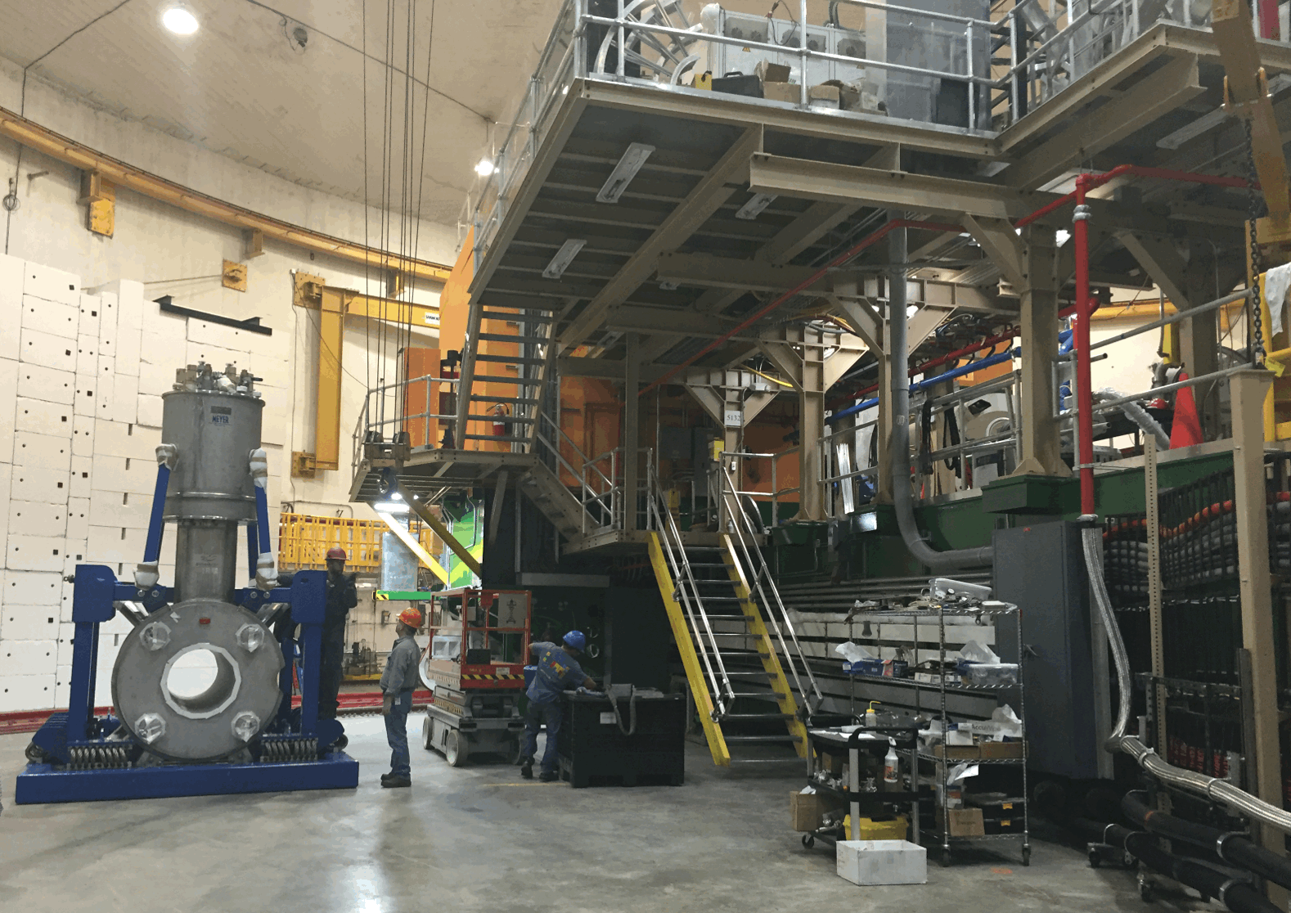
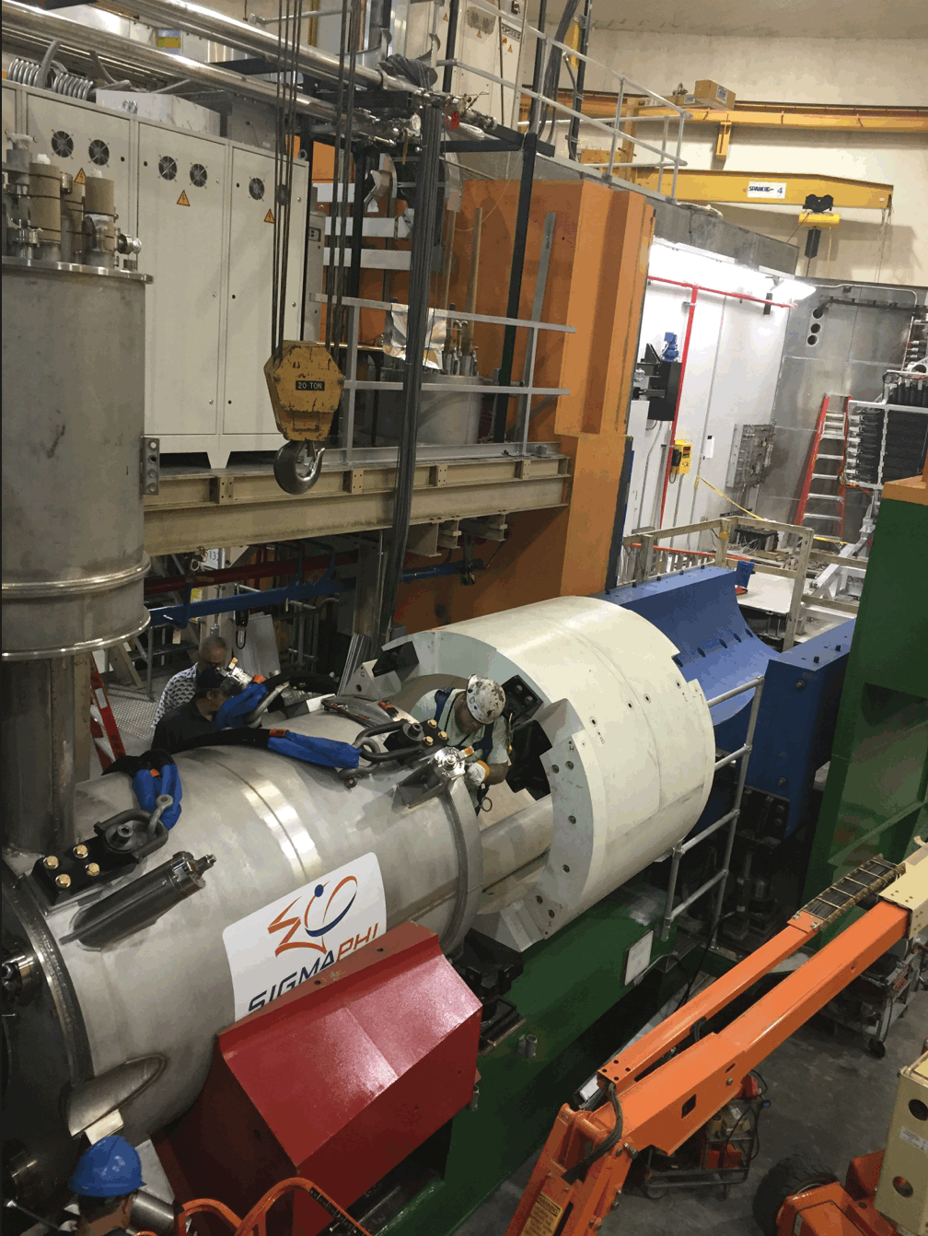
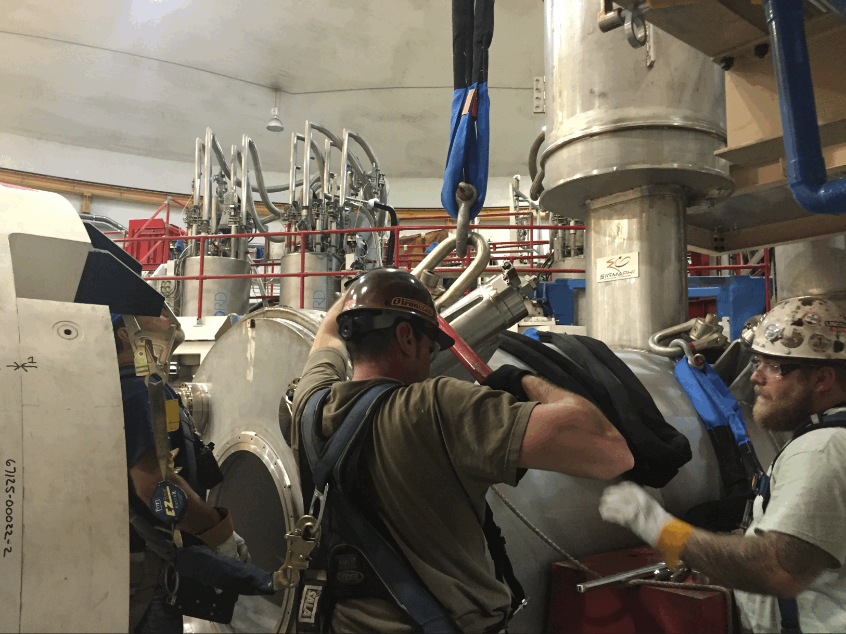
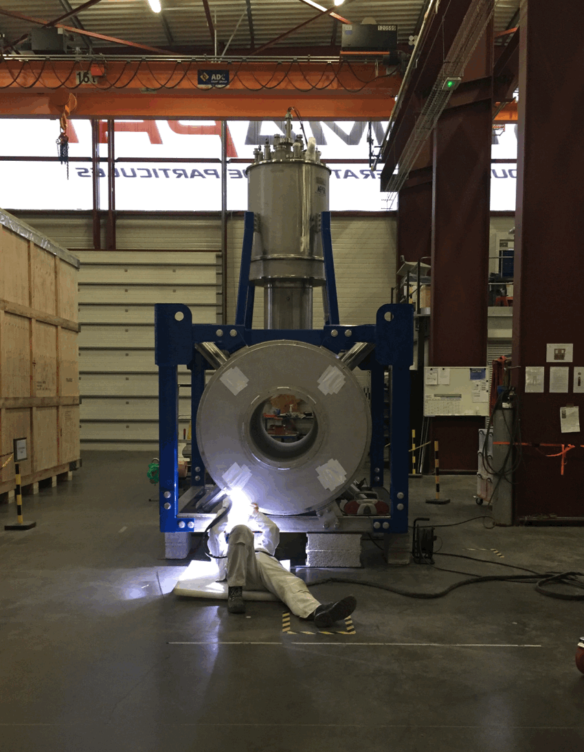
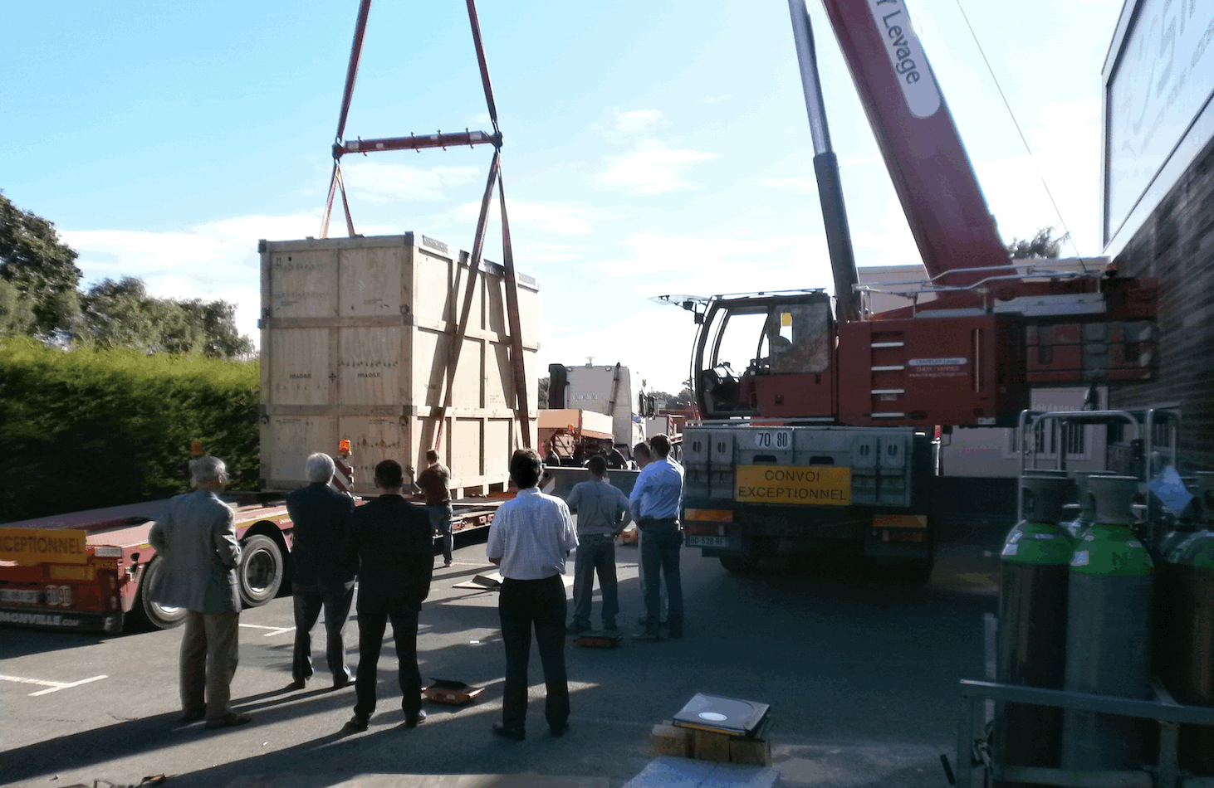
Hall-C Project Status
Q2 in Hall C and On the SHMS
Dipole Left Sigmaphi
23-SEP
Final Welding of Q3

