Slide 1
Precision measurements of the F₂ structure function at large x in the resonance region and beyond
S.P. Malace*, M. Paolone, S. Strauch, I. Niculescu, G. Niculescu, A. Accardi, A. Albayrak,
O. Ates, M.E. Christy, C. Jackson, C.E. Keppel, M. Kohl, Y. Li, P. Monaghan, A. Pushkapumari,
J. Taylor, T. Walton, L. Zhu, R. Ent, H. Fenker, D. Gaskell, M.K. Jones, D. Meekins,
P. Solvignon, G. Smith, L. Tang, A. Asaturyan, A. Mkrtchyan, H. Mkrtchyan, V. Tadevosyan,
S. Zhamkochyan, G. Huber, S. Danagoulian, P. Markowitz, A. Daniel, T. Horn
University of South Carolina , James Madison University, Hampton University, Jlab,
Yerevan Physics Institute, University of Regina, North Carolina A&T State University,
Florida International University, Ohio University, Catholic University of America
Spokespersons
*Contact Person
Outline
Motivation
Experimental details
Summary
S. Malace, PAC35 January 2010, Jefferson Lab

Slide 2
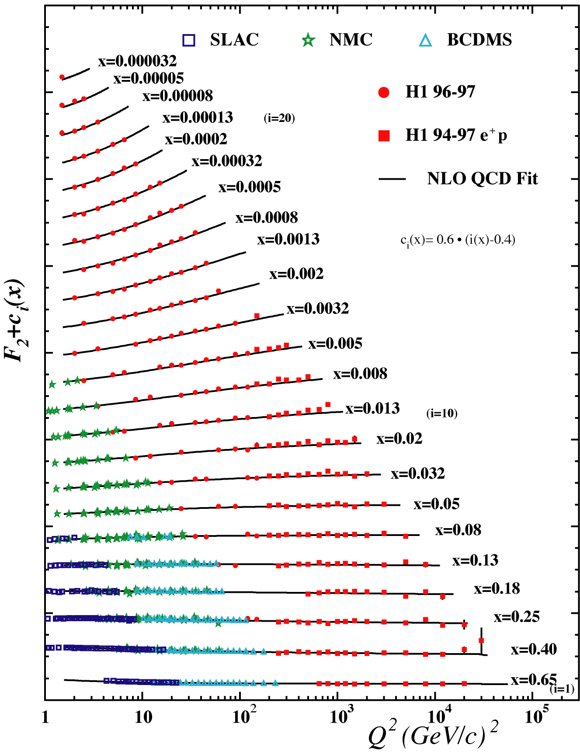
The structure of the Nucleon in QCD
Motivation
Distribution of quarks and gluons (PDFs) inside the nucleon: fundamental characterization of its structure in QCD
PDF
PDFs
connect hadron processes with parton subprocesses
universal: many processes can be calculated with same set of PDFs
important information as to the underlying structure of hadrons
Decades of accumulated data + sophisticated QCD analyses => mapping of PDFs over a large kinematic range
S. Malace, PAC35 January 2010, Jefferson Lab

Slide 3
Standard Extraction of PDFs in QCD
Motivation
Two ideas of QCD + data:
perturbative
x dependence obtained from fits to data
Factorization:
+
input (PDF)
NLO
LO
Evolution:
+
perturbative
Data: DIS ( ), neutrino DIS dimuon production, vector boson production, hadronic jet production,…
Knowledge of the x-dependence of PDFs depends on data coverage across x
S. Malace, PAC35 January 2010, Jefferson Lab

Slide 4
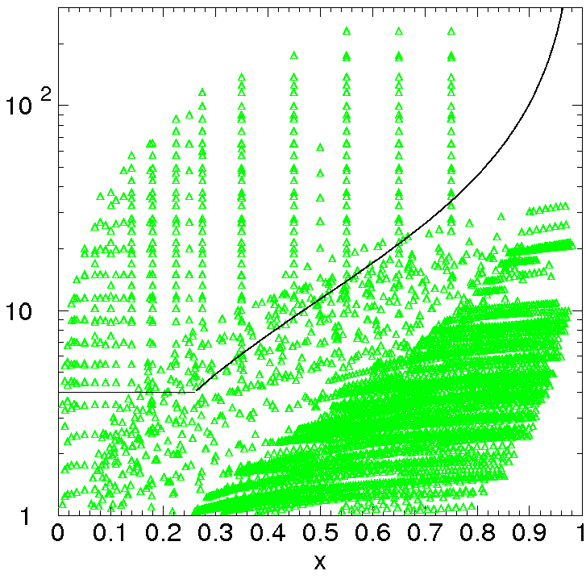
Standard Extraction of PDFs in QCD: Uncertainties
Motivation
pQCD => leading-twist calculation, applicable where nonperturbative corrections negligible
Kinematic cuts reject data from regions where nonperturbative corrections not negligible (large x, low Q²): CTEQ
example 1: CTEQ6
W² > 12.25
PDFs: large errors at large x
Q² > 4
data not used
S. Malace, PAC35 January 2010, Jefferson Lab

Slide 5
Standard Extraction of PDFs in QCD: Uncertainties
Motivation
pQCD => leading-twist calculation, applicable where nonperturbative corrections negligible
Kinematic cuts reject data from regions where nonperturbative corrections not negligible (large x, low Q²): MSTW
example 2: MSTW
W² > 15
PDFs: large errors at large x
Q² > 2
data not used
S. Malace, PAC35 January 2010, Jefferson Lab

Slide 6
Pushing QCD applicability to large x and low Q²
Motivation
S. Alekhin, JETP Lett. 82, 628 (2005); S. Alekhin et al., arXiv:0908.2766 [hep-ph]
CTEQx: A. Accardi et al., arXiv:0911.2254 [hep-ph], accepted to PRD
Relax kinematic cuts to include large x, low Q² data in PDF fits => include nonperturbative effects in the QCD calculation
(Hall C E00-116)
leading twist (pQCD) + kinematical higher twist
(target mass corrections)
residual power corrections
NLO global PDF fit to proton and deuteron data with Q² > 1.69 GeV² and W² > 3 GeV² including now: DIS from SLAC, JLab, FNAL Drell-Yan, W asymmetry data at higher x
cut 0: Q² > 4 GeV², W² > 12.25 GeV² (standard)
cut 1: Q² > 3 GeV², W² > 8 GeV²
cut 2: Q² > 2 GeV², W² > 4 GeV²
cut 3: Q² > 1.69 GeV², W² > 3 GeV²
S. Malace, PAC35 January 2010, Jefferson Lab

Slide 7
Results from CTEQx Fit
Motivation
Compared to previous analyses:
stronger suppression of d-quark PDF at large x (sensitive to the treatment of nuclear corrections)
greatly reduced experimental errors: 10-20% for x < 0.6 and up to 40-60% at larger x
no direct constraints from data
u and d PDFs stable with respect to choice of target mass correction if flexible enough parametrization of higher twist is used
S. Malace, PAC35 January 2010, Jefferson Lab

Slide 8
Quark-Hadron Duality: Extension of PDFs to Larger x
Motivation
Extending to larger x at finite Q² => encounter the resonance region
can be treated using the concept of Quark-Hadron Duality
established in F₂^{p} from Q² ~ 1 to Q² ~ 7 GeV²
recently acknowledged in F₂^{n} extracted from proton and deuteron data
S.P. Malace et al., Phys. Rev. C 80 035207 (2009)
proton
S.P. Malace et al., arXiv:0910.4920 [hep-ph]
neutron
Confirmation of duality in both proton and neutron => phenomenon not accidental but a general property of nucleon structure functions
S. Malace, PAC35 January 2010, Jefferson Lab

Slide 9
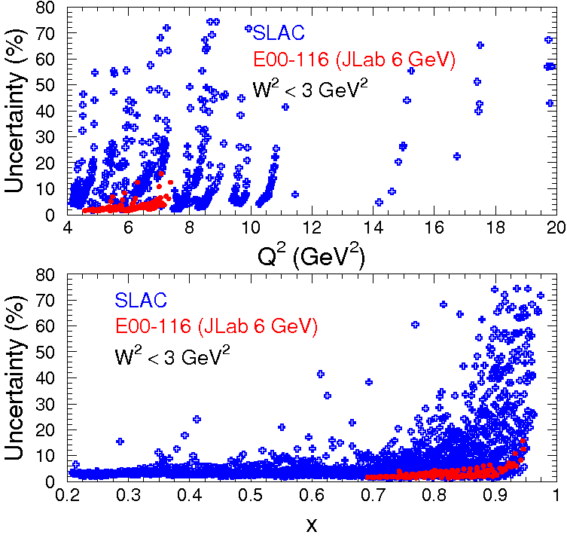
Data at Large x: Current Status
Motivation
W² > 3 GeV²
W² < 3 GeV²
proton
deuteron
very limited Q² coverage between 10 and 20 GeV²
data scarce for x > 0.8
S. Malace, PAC35 January 2010, Jefferson Lab

Slide 10
Motivation: Summary
Motivation
Need precision data on proton and deuteron F₂ at large x to:
constrain PDFs at large x
behavior of PDFs with x of interest e.g. to verify the Drell-Yan-West relation postulate
relates the large x-behavior of F₂ with the Q² behavior of form factors …
distinguish different mechanisms of spin-flavor symmetry breaking (d/u at large x)
BONUS/Hall B (E12-06-113) → F₂^{n}/F₂^{d}
Hall C PR-10-002 → precision F₂^{p}/F₂^{d} in same kinematic region
essential for determining high-energy cross sections at collider energies in search for physics beyond Standard Model etc.
JLab New Milestone HP13 by 2018
“Extract accurate information on spin-dependent and spin-averaged valence quark distributions to momentum fractions x above 60% of the full nucleon momentum”
can use global quark-hadron duality to push to x > 0.8
and extend studies of local quark-hadron duality in proton and neutron F₂
S. Malace, PAC35 January 2010, Jefferson Lab

Slide 11
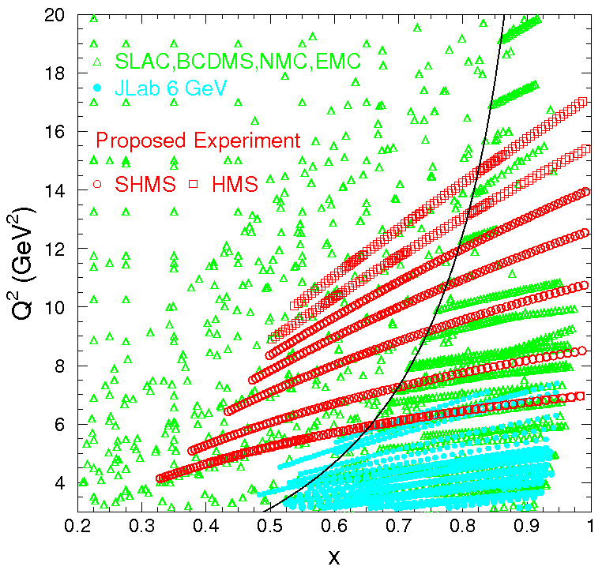
PR-10-002 @ 11 GeV in Hall C
Experimental details
Extend proton and deuteron F₂ structure function precision measurements to larger x and Q² by measuring H(e,e’) and D(e,e’) cross sections in the resonance region and beyond up to Q² ~ 17 GeV² and x~0.99
Straightforward extension of E00-116:
S.P. Malace et al., Phys. Rev. C 80 035207 (2009)
S.P. Malace et al., arXiv:0910.4920 [hep-ph]
For PR-10-002 we need:
11 GeV beam (+ 6.6 GeV for systematic measurements)
10 cm Hydrogen and Deuterium cryogenic targets (+ Al for background measurements)
SHMS and HMS in Hall C
HMS
SHMS
HMS
+
SHMS
S. Malace, PAC35 January 2010, Jefferson Lab

Slide 12
Kinematics of PR-10-002
Experimental details
SHMS:
intermediate angle measurements: 17 - 35 deg
central momentum range: 2.3 - 6 GeV (spectrometer low limit 2 GeV)
HMS:
large angle measurements: 42 & 55 deg
central momentum range: 1.2 – 6.7 GeV (spectrometer high limit 7.3 GeV)
17 deg scan: taken with both HMS and SHMS for crosschecks; hydrogen elastic data
HMS
SHMS
HMS
+
SHMS
S. Malace, PAC35 January 2010, Jefferson Lab

Slide 13
Expected Backgrounds
Experimental details
Electrons scattered on the Al walls of cryogenic target cell => take data for each setting on empty Al (dummy) target
Pion contamination of the electron distribution
E00-116: main limitation was the pion rejection in the calorimeter at low momentum
E00-116: < 0.5% at E’ ~ 0.8 GeV
E00-116: < 1.8% at E’ ~ 0.8 GeV
hydrogen
deuterium
PR-10-002: lowest momentum 1.2 GeV in HMS and 2.3 GeV in SHMS => pion rejection should be sufficient for the proposed kinematics
S. Malace, PAC35 January 2010, Jefferson Lab

Slide 14
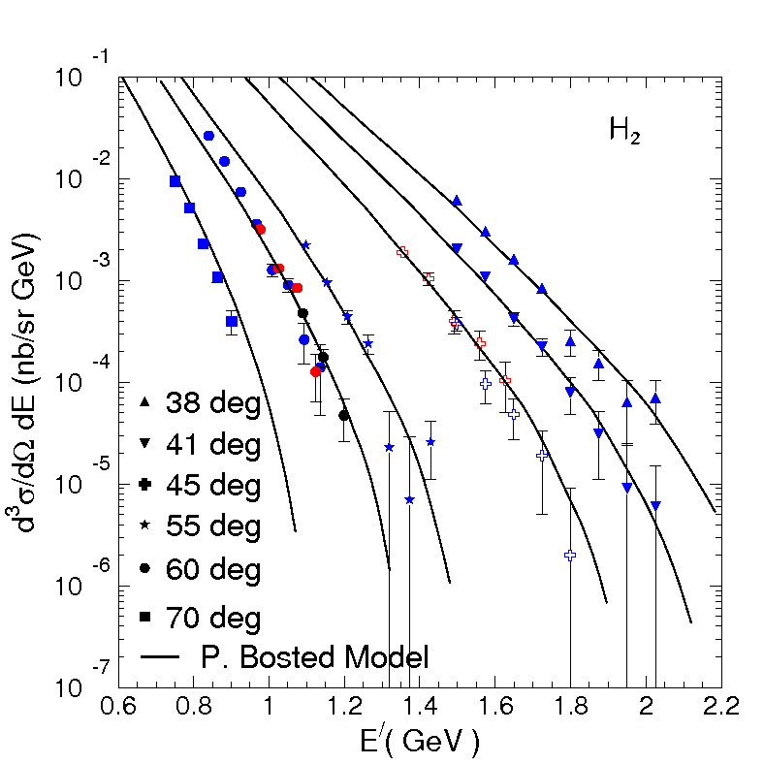
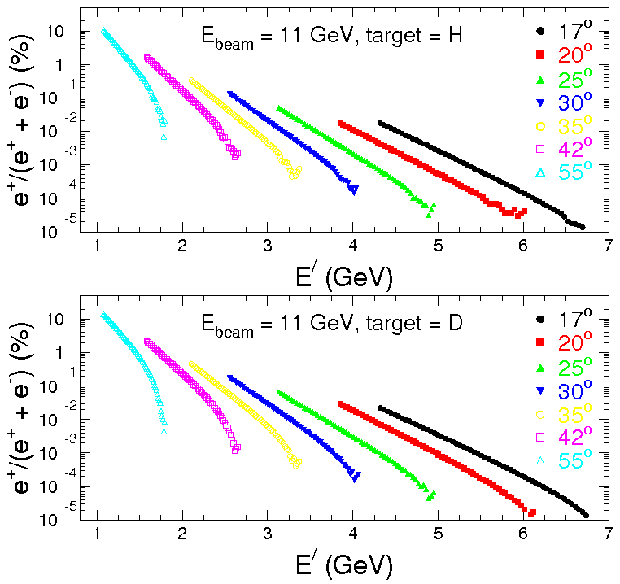
Expected Backgrounds
Experimental details
Charge-symmetric background: secondary electrons from neutral pion production in the target and its subsequent decays
E00-116: measured and extensively studied
E00-116: positron cross section
PR-10-002
hydrogen
PR-19-002: expected to be at most 11% for H and 15% for D at 55 deg, lowest momentum => measure background at 55, 42, 35, 30 deg
S. Malace, PAC35 January 2010, Jefferson Lab

Slide 15
Uncertainties
Experimental details
Statistical
PR-10-002: shoot for 2% in a W² bin of 0.1 GeV², with a 10 cm target and a 40 μA and 11 GeV beam
significant improvement over scarce existing measurements from SLAC
Systematic
PR-10-002: expect reduction, e⁺ and e⁻ measured at same kinematics with same spectrometer
Quantity Uncertainty δ_{σ}(%)
Charge-symmetric background 6% - 20% < 2%
Model dependence 0.2% - 5% 0.2% - 5%
Radiative corrections 0.5% - 3.6% 0.5% - 3.6%
E00-116: for W² > 2 GeV² within 1%
Systematic uncertainties from E00-116 exceeding 1%
PR-10-002: expect reduction, for our kinematics elastic/quasielastic contribution small to negligible
S. Malace, PAC35 January 2010, Jefferson Lab

Slide 16
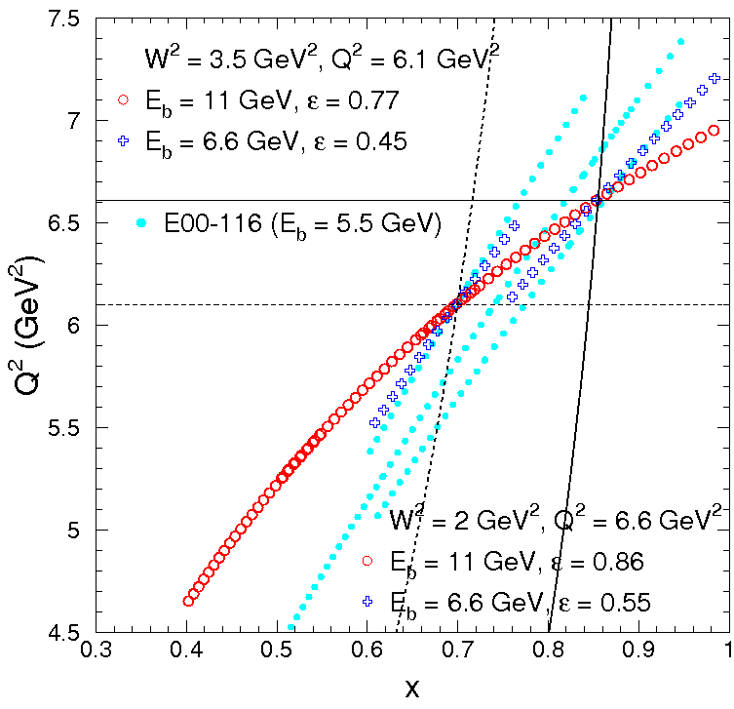
Uncertainties
Experimental details
Systematic: need R to construct F₂
E00-116: 2% uncertainty on F₂ from R
PR-10-002: R expected to be < 0.15
R-related fractional uncertainty on F₂:
Assuming 100% uncertainty on R =>
can be cut in half by a modest 50% determination of R with a lower beam energy (6.6 GeV)
S. Malace, PAC35 January 2010, Jefferson Lab

Slide 17
PR-10-002: Request to Laboratory
Experimental details
PR-10-002 beam time is driven by the large angle measurements: 42 & 55 deg
SHMS
HMS
Beam time accounting
some overlap in kinematics with PR-10-008 (20 – 35 deg) but small overlap in beam time: < 1 day
PR-10-002: we need 13 days to complete the proposed experiment
PR-10-002: excellent candidate as a commissioning experiment
S. Malace, PAC35 January 2010, Jefferson Lab

Slide 18
Summary
PR-10-002: extend proton and deuteron F₂ structure function precision measurements to larger x and Q² by measuring H(e,e’) and D(e,e’) cross sections in the resonance region and beyond up to Q² ~ 17 GeV² and x ~ 0.99
Data would be used to:
constrain PDFs at large x
use global quark-hadron duality to push to largest x (x > 0.8)
and extend studies of local quark-hadron duality in proton and neutron F₂
We need:
11 GeV beam (+ 6.6 GeV for systematic measurements)
Hydrogen and Deuterium cryogenic targets (+ Al for background measurements)
SHMS and HMS in Hall C
13 days of beam time
S. Malace, PAC35 January 2010, Jefferson Lab

Slide 19
Backup Slides

