Slide 1
Teaching at an undergraduate institution
Working
Gabriel Niculescu (for M.I.N., K.G….)
Associate Professor of Physics
Department of Physics and Astronomy
James Madison University
THE “problem”
Working toward a solution…
Working @ and undergraduate institution
Improving your chances 4 an interview…

Slide 2
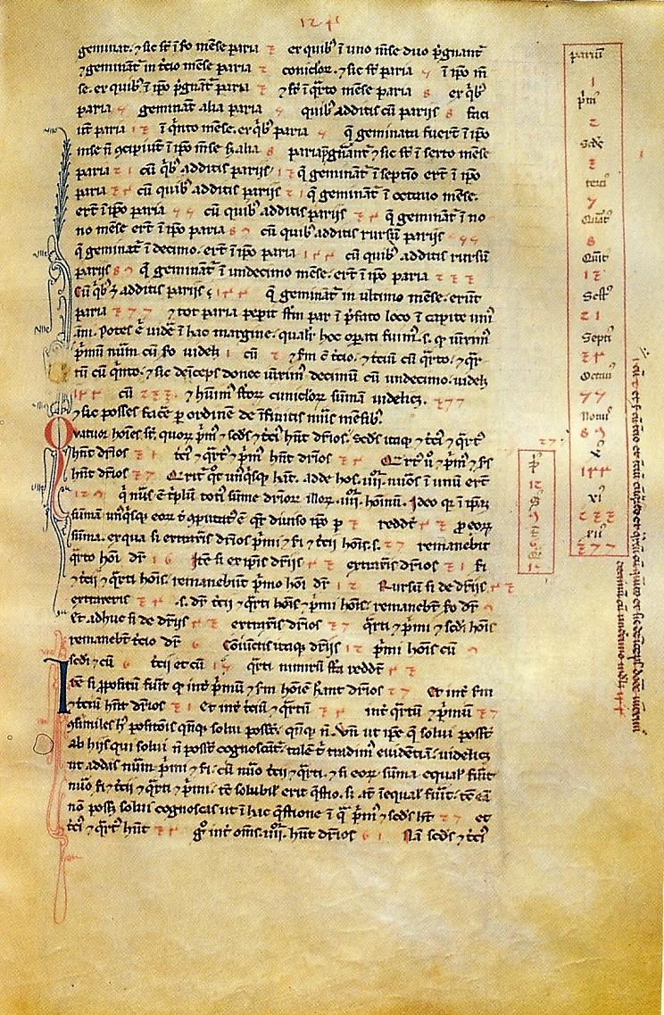
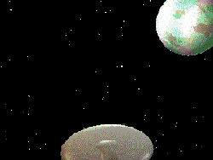

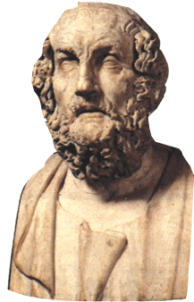
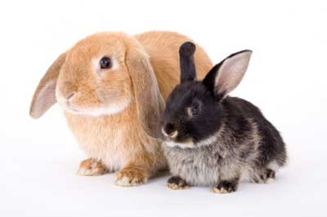
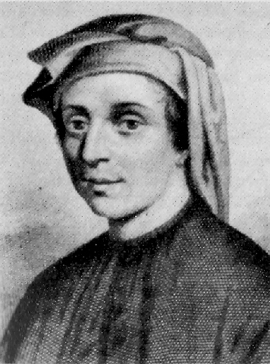
Problem Solution Working Improving
1
1
2
3
5
8
Leonardo di Pisa - Liber Abaci (1202)

Slide 3

Problem Solution Working Improving
Lots of PhD-granting institutions (here and abroad!)
Based on APS 2011 data (latest available):
  there are ~200 M./PhD level Univ. in the US
  produced 1578 PhDs (692 Master)
Assuming 30 faculty/R1 dept. ~6000 faculty*
so every 4 years…
The “lifetime” of an University prof. is 25++!!!
did not even mention foreign institutions
or “competing” fields astro*, materials, eng.

Slide 4
Problem Solution Working Improving
Clearly not realistic that all the newly minted
PhDs will be absorbed into R1s!
Some have started arguing that the production
of degrees is too large
The reality is of course different…RAGS-RAC5
My $0.02: less plug-and-play PhDs - more employable PhDs

Slide 5
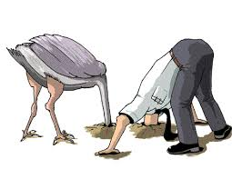
Problem Solution Working Improving
Working towards a solution:
1. Acknowledging that there is a problem

Slide 6
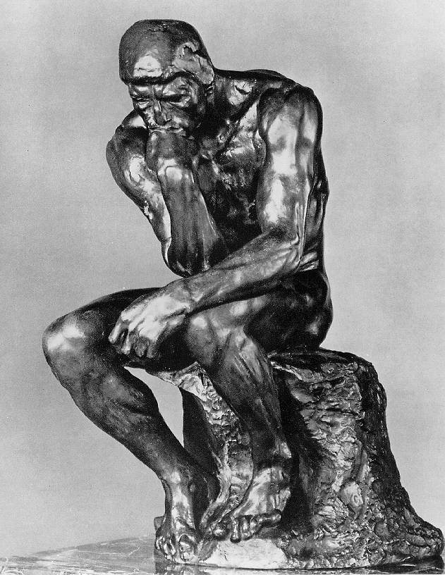
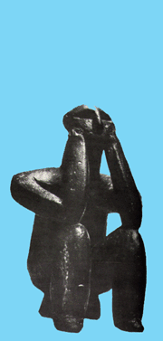
Problem Solution Working Improving
Working towards a solution:
1. Acknowledging that there is a problem

Slide 7
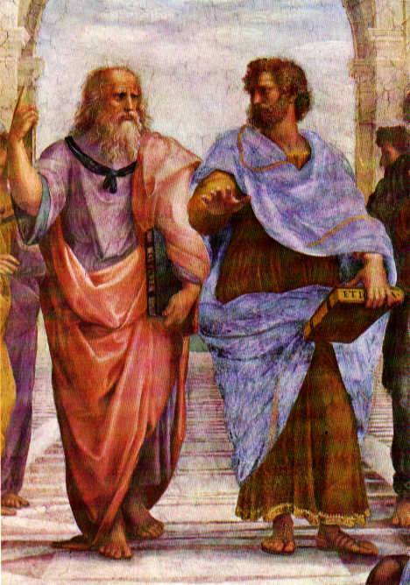


Problem Solution Working Improving
Working towards a solution:
Acknowledging that there is a problem
More openness (as far as “THE” problem)
in the adviser-student relationship
students
adviser
adviser
student

Slide 8
Problem Solution Working Improving
adviser
student
Acknowledging that there is a problem
More openness (as far as “THE” problem)
in the adviser-student relationship
3. More preparation/emphasis toward
possible “alternative” careers
- skill set
- application writing
- interview preparation

Slide 9
Problem Solution Working Improving
Working at an undergrad institution
First, the #s:
APS 2011 level data:
540 Bachelor level Universities
Assume an avg. of 8 faculty per ~ 4000*
That’s 2/3 of the # of positions @ R1s!
It will not solve the overall problem but
it might be part of the solution!

Slide 10
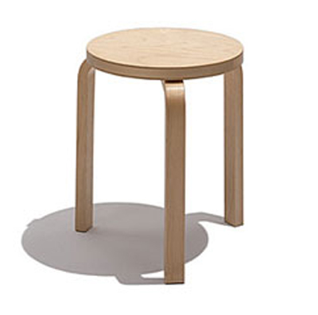
Problem Solution Working Improving
Working at an UG Institution
Like @R1s, “work” is a three-legged stool:
  Teaching
  Research
  Service
The balance between
these is different between R1s & Undergrad. Inst.
It also varies between UGs as well
@JMU is (roughly)
40/40/20*
T
S
R

Slide 11


Problem Solution Working Improving
Workload
Expect a heavy(er) teaching load @UGs vs R1s
How heavy depends on several factors:
Size of the UG, size of the dept., grants
I’ve seen up to 5 classes*/week
I will show you my schedule 4 the year – it is not typical!

Slide 12
Problem Solution Working Improving
My Teaching Workload:
GN’s Fall 2013 Schedule - click here ;P
GN’s Spring 2013 Schedule - see above

Slide 13
Problem Solution Working Improving
Balancing Teaching & Research
By far the hardest act U need 2 master
Recalibrate: id. your long-term research goals.
Take on projects you reasonably hope to
complete (timely). Think hardware!
Help (MOU) from Lab(s)
Help from other UG, R1s*
Limited (if any) help from your UG - gets better later!
Expect envy (and some resentment) from
fellow faculty…
Beware of the diff. btw. REU and RUI!!!

Slide 14
Problem Solution Working Improving
Balancing Teaching & Research
H8 to toot my own horn but:
the Particle and Nuclear Physics @ JMU (KG, MIN, GN) has been reasonably successful in the past 10 years:
  50+ students
  1e6+ $$ in grants (NSF, SCHEV)
  Publications (100+), Awards (3)
  Print, radio, TV coverage, interviews, etc.
  Finished/ongoing projects @ FNAL, PSI, JLAB
  Lots of students (~60) that went on into promising careers

Slide 15
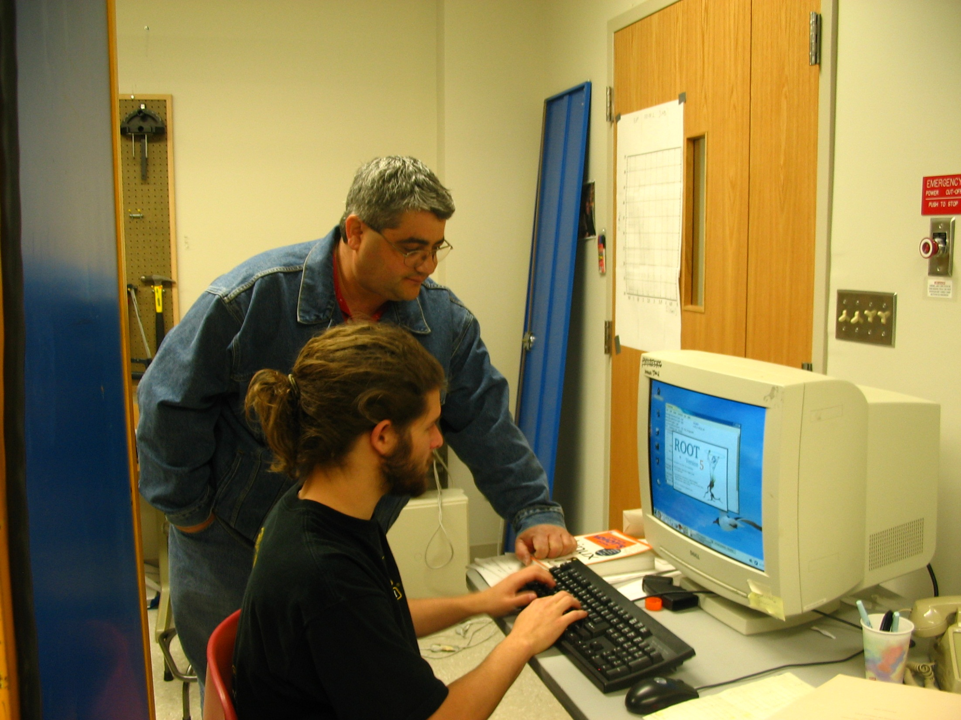
int rabbitGraphs() {
// Voltages to look at:
char *fname="RabbitTest_08_17_06_HV_800_LED_08_onechannel.root";
char *fname2="RabbitTest_08_17_06_HV_800_LED_08_onechannel.root";
char *fname3="RabbitTest_08_17_06_HV_750_LED_09)onechannel.root";
char *chan="1";
int bns = 200;
int xmax= 20000;
int xmin= -100;
char *txt = " ";
int c = 1;
//First Graph
TFile *f = new TFile(fname);
TText *t1 = new TText(6550,4000,fname);
//Display canvas according to golden ratio
TCanvas *c1 = new TCanvas("c1","RABBIT",900,556);
TH1F *h10 = new TH1F("h10",fname,bns,xmin,xmax);
h10->SetLineColor(2);
c1->Clear();
ntped->Draw("ped>>h10",chan);
h10->SetFillColor(3);
h10->Draw();
//Second Graph
TH1F *h11 = new TH1F("h11",fname2,bns,xmin,xmax);
TFile *f = new TFile(fname2);
ntped->Draw("ped>>h11","chan==1","same");
//Third Graph
TFile *f = new TFile(fname3);
ntped->Draw("ped>>h11","chan==4","same");
return 1;
}

Slide 16
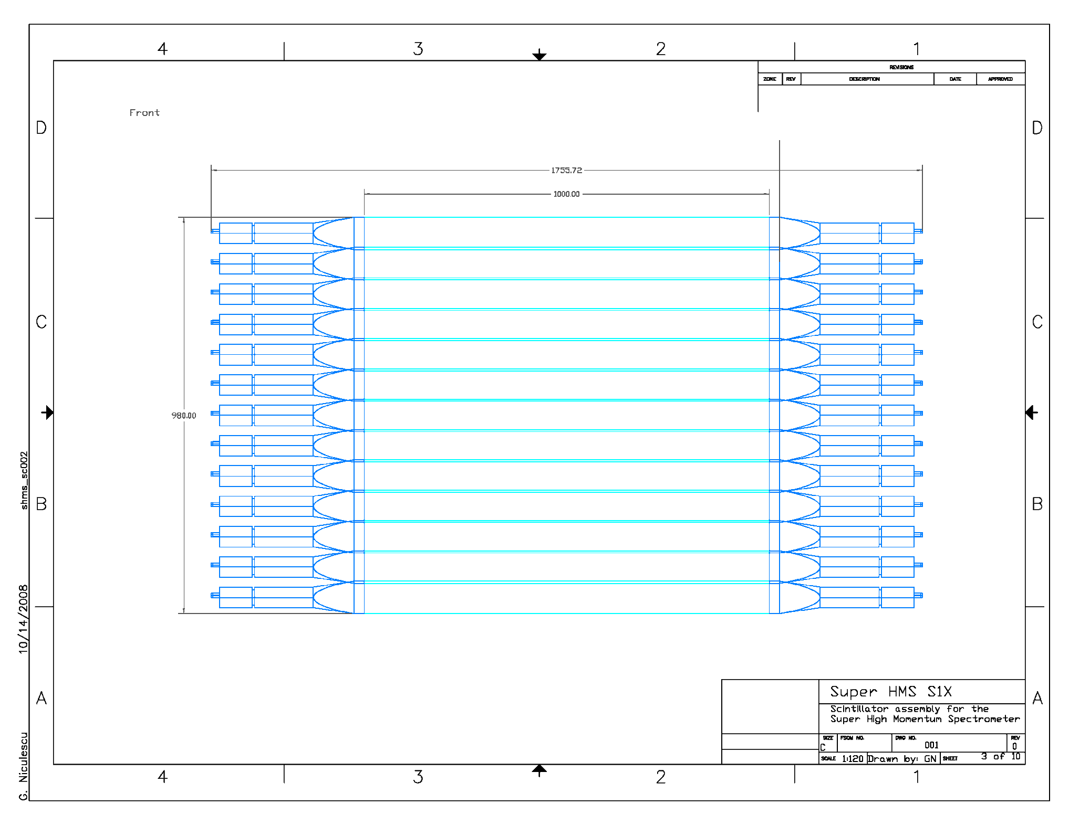
S1 design

Slide 17
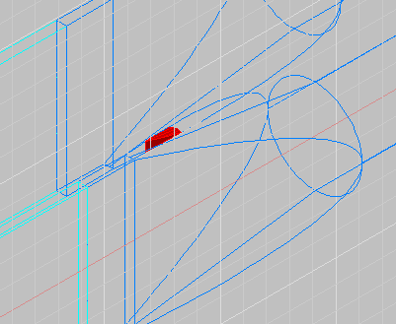
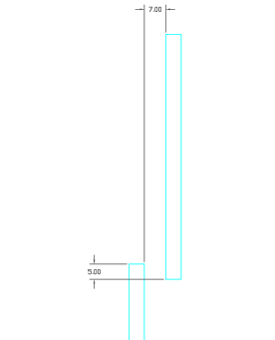
Careful here…
Need this to avoid problems like that.

Slide 18
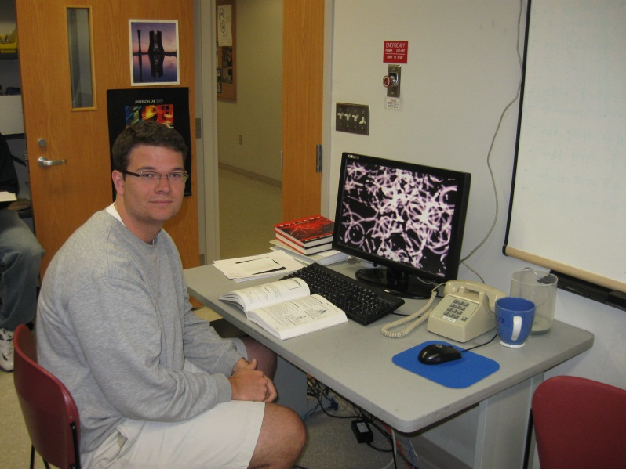
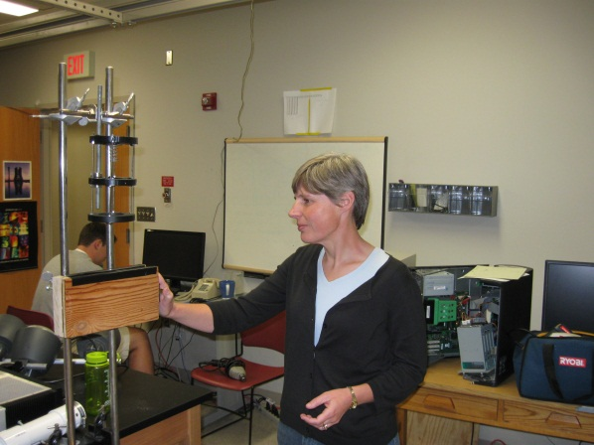
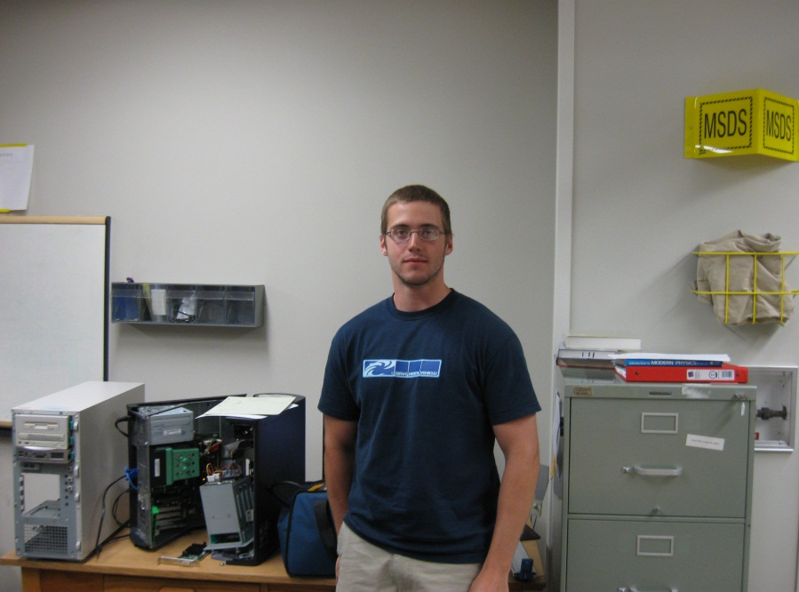
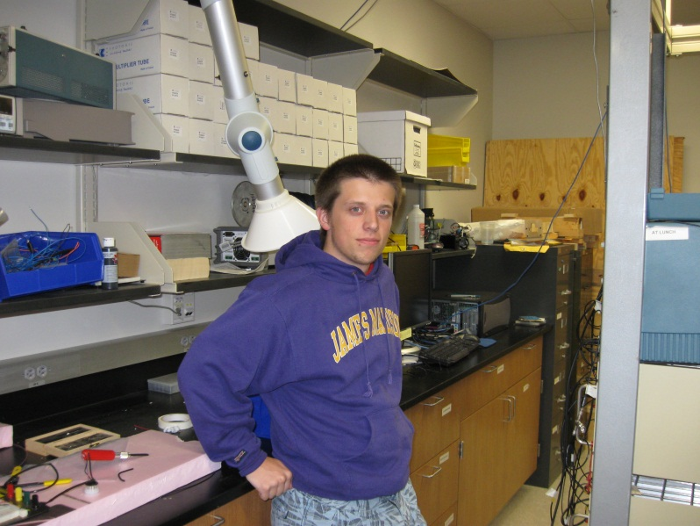
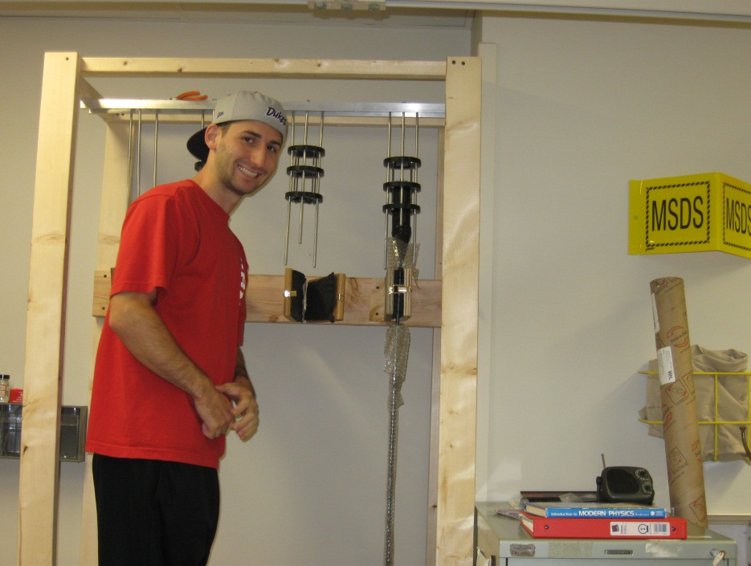
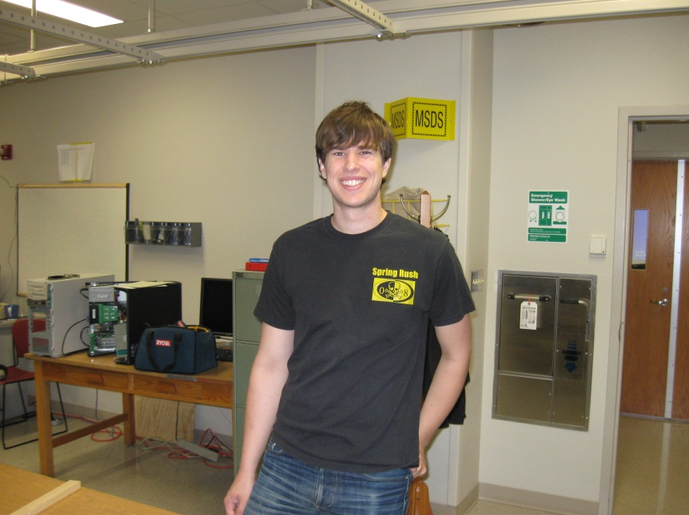
the team (2011)…
I.N.
Matt Burton
Taylor Jarrell
Brandon Lewis
Bob Michaels
Anthony Speziale

Slide 19
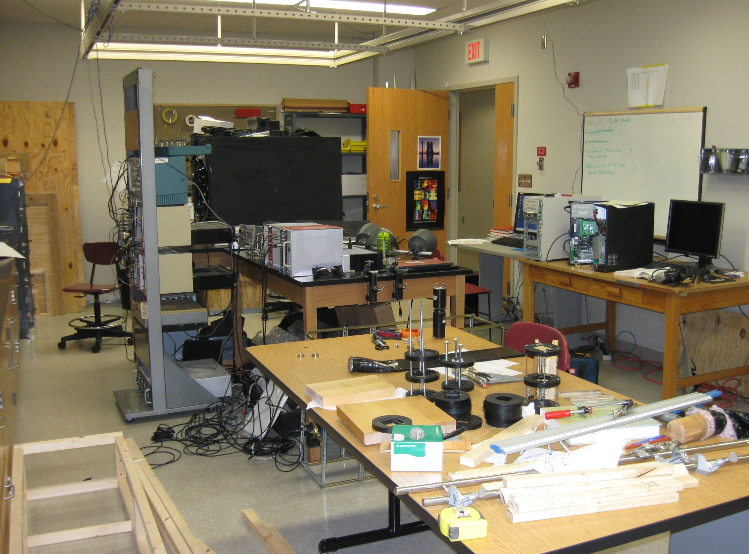
The INGN lab @JMU…

Slide 20
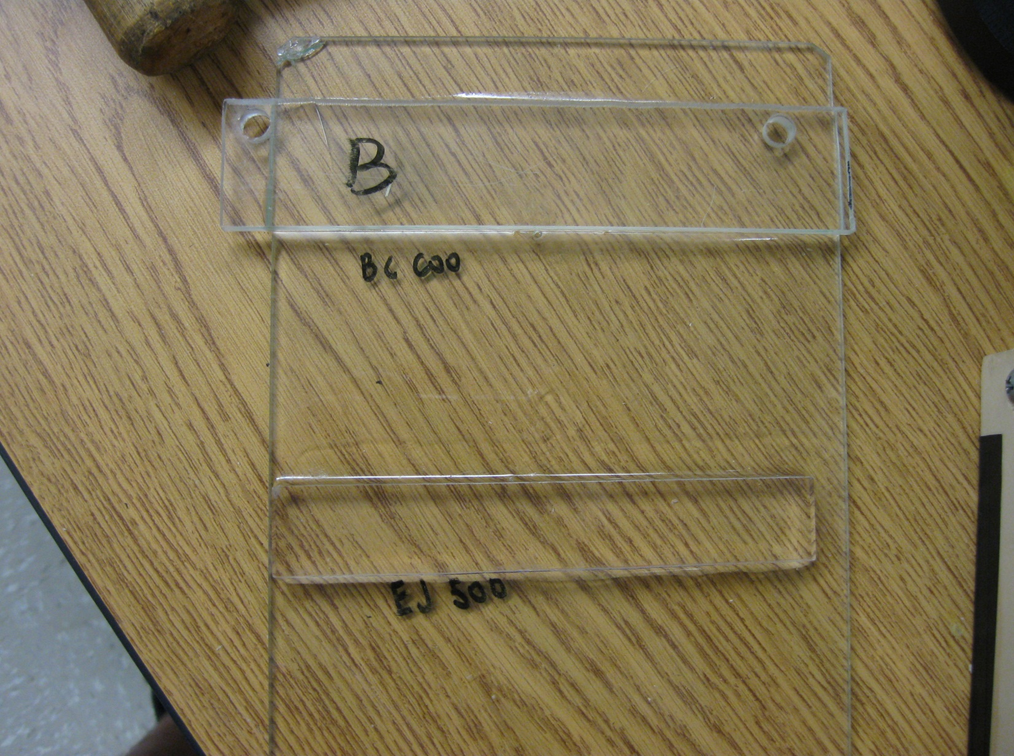
Optical glue test…
BC600
EJ500

Slide 21
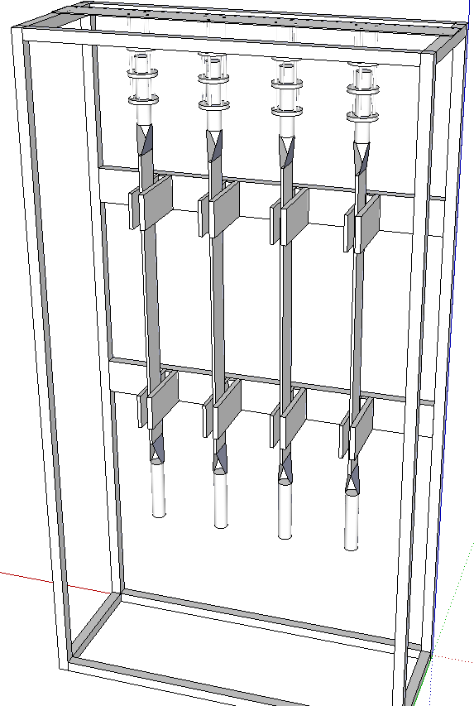
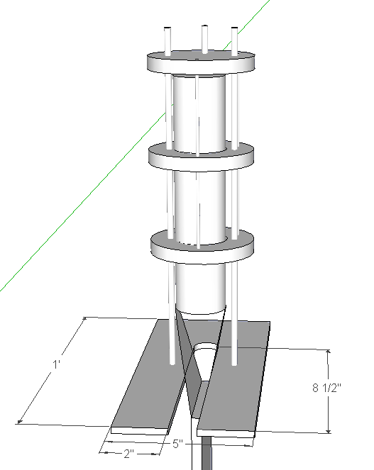
Gluing jig…
glue takes ~16hours to set properly
Quad-core gluing jig
all drawings done in Google Sketchup by Bob Michaels

Slide 22
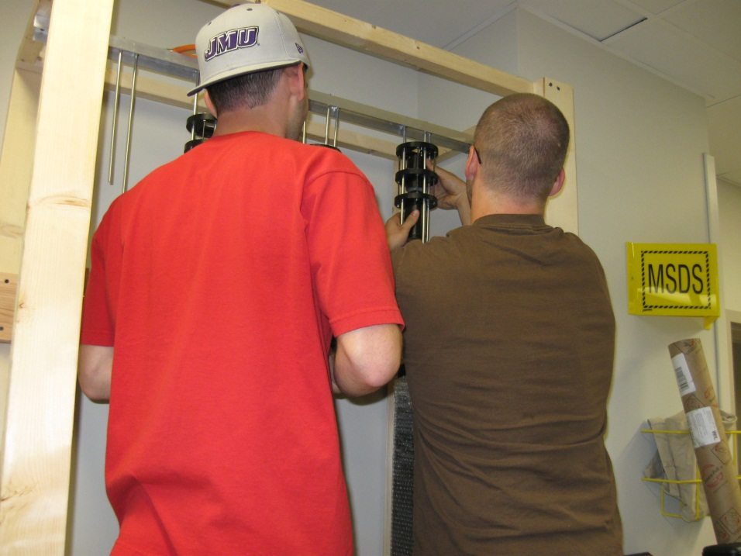
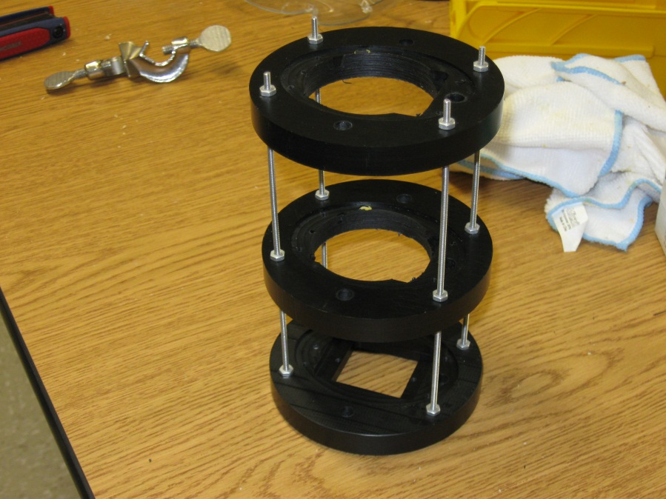
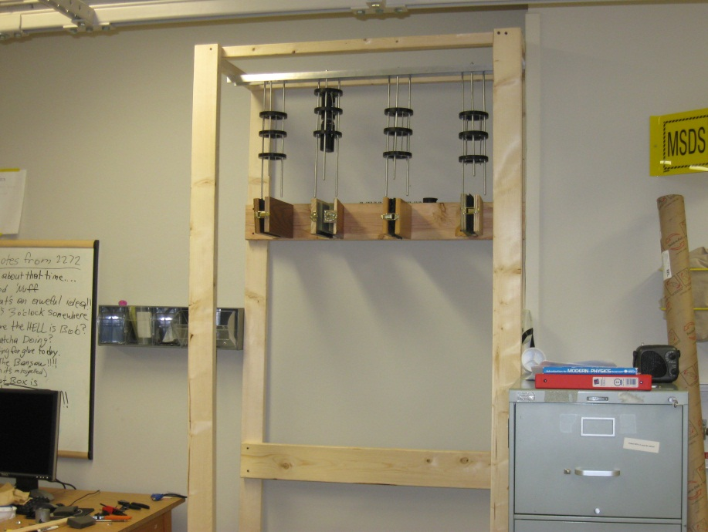
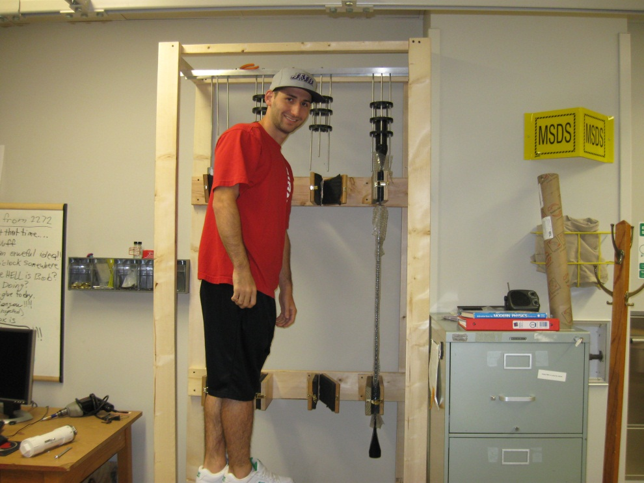
Gluing jig construction…

Slide 23
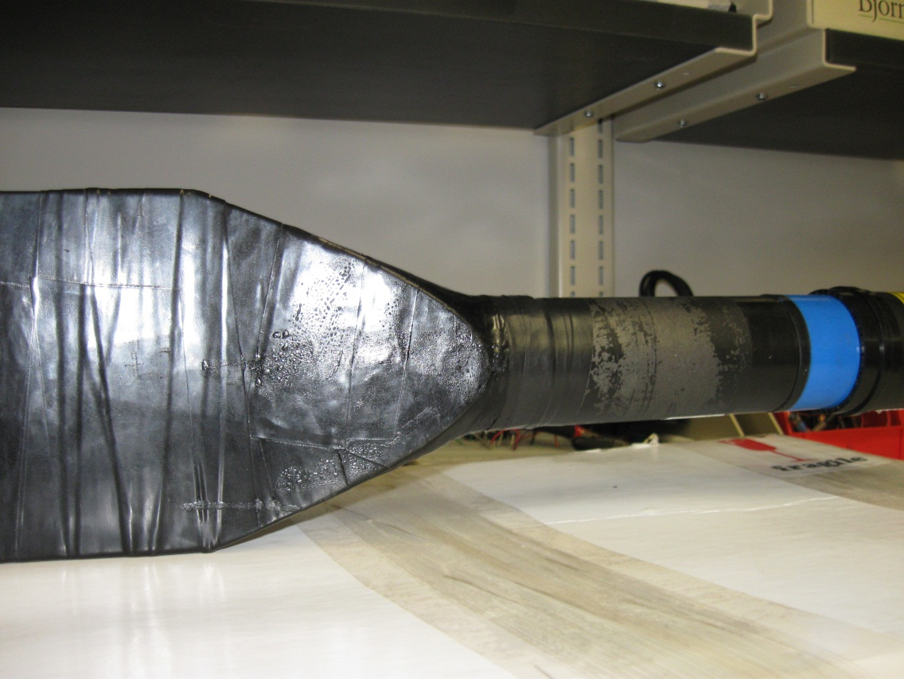
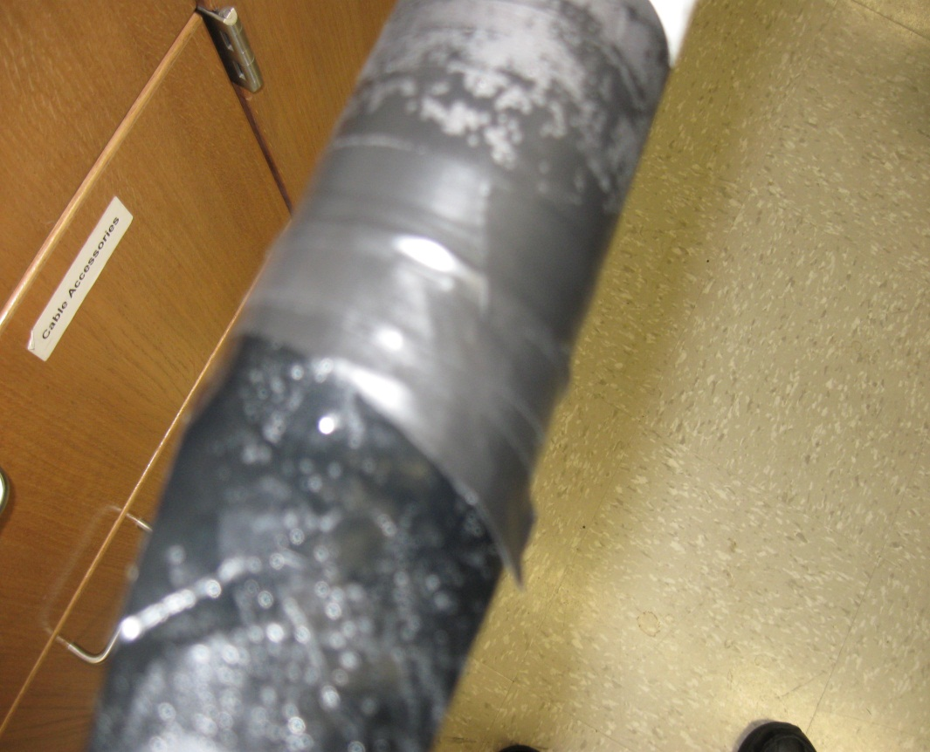
Gluing PMTs…
Success!
First PMT is glued (only 79 2go!).
Needs tape @ the PMT-fishtail interface

Slide 24
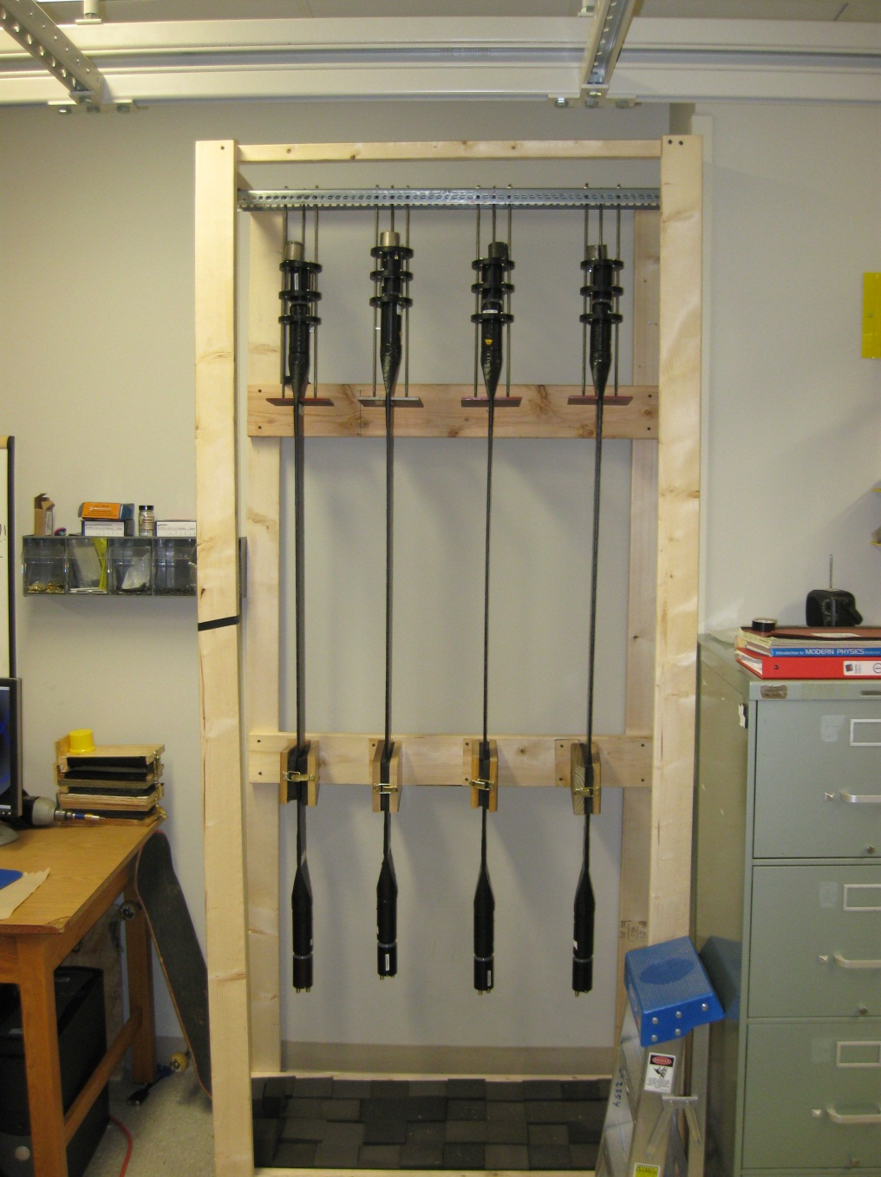
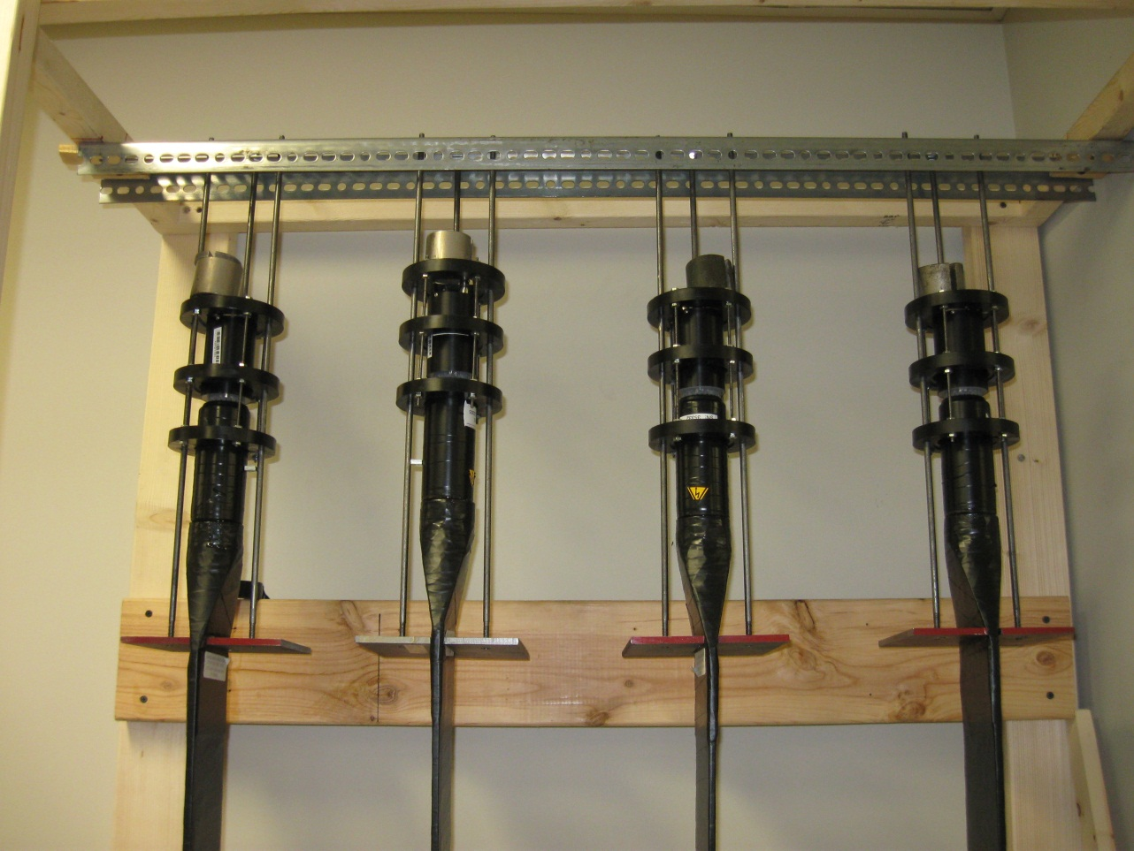
Gluing PMTs x4…

Slide 25
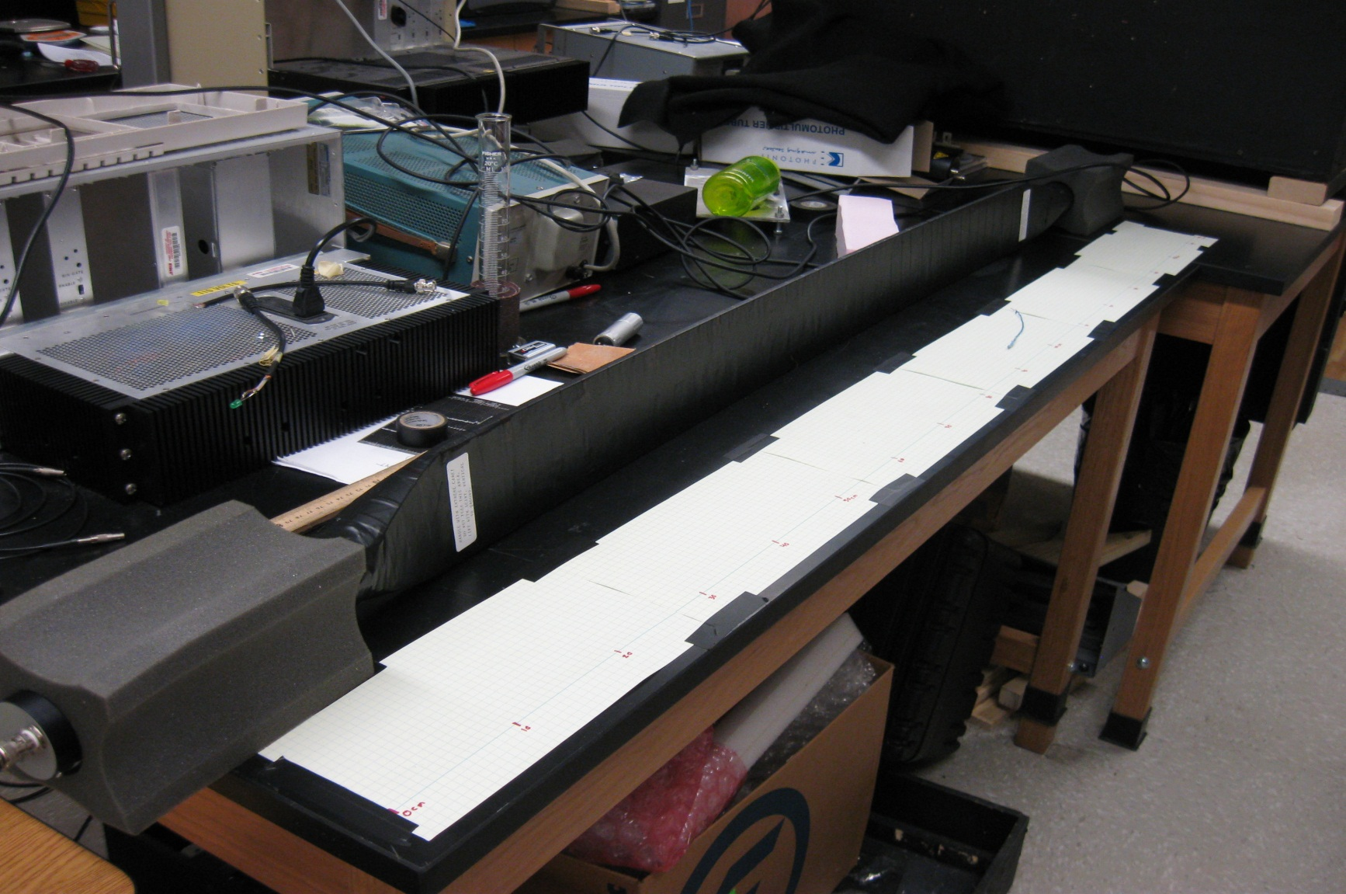
Testing SHMS Hodo paddles
Light leak tests
  Ambient light
  Flashlight
Radioactive Source

Slide 26
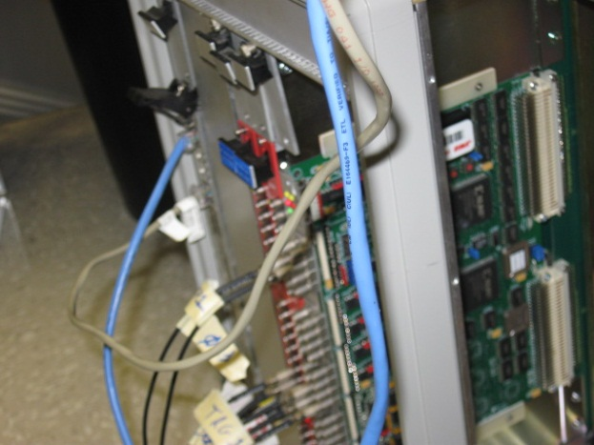
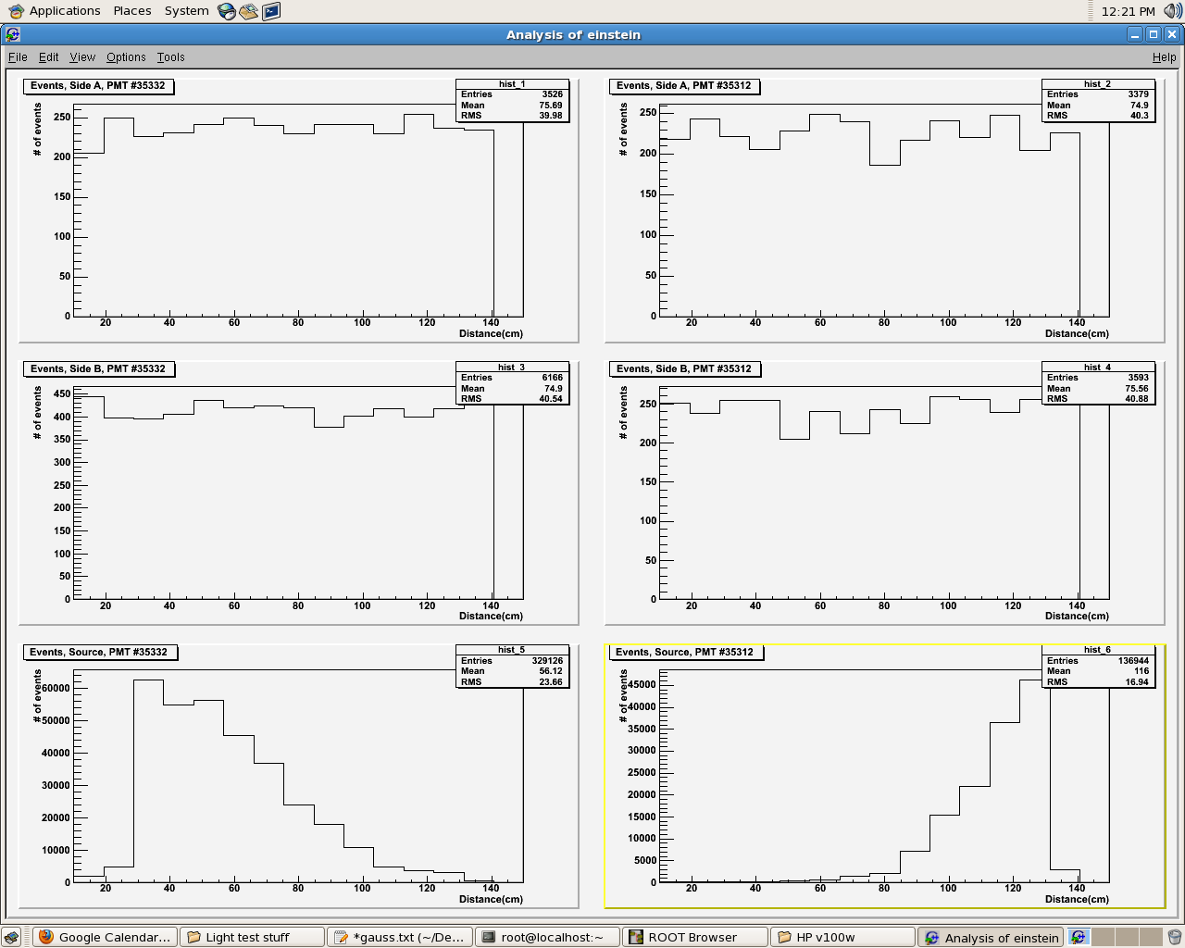
Testing SHMS Hodo paddles
Counts
Distance

Slide 27
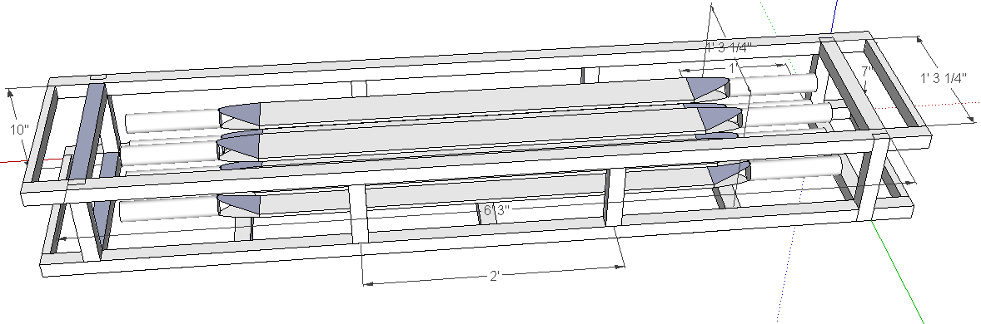
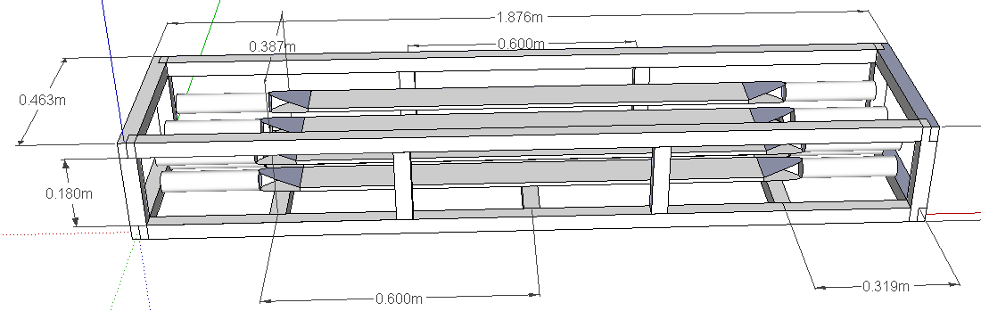
Storing finished paddles
Need reliable means for storing/transporting the HODO paddles

Slide 28
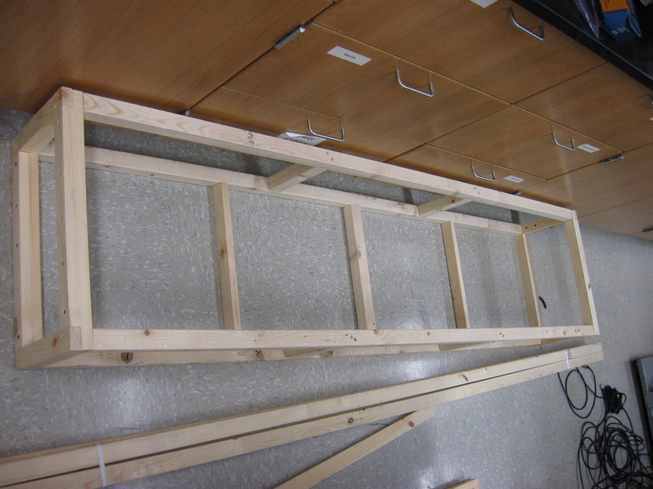
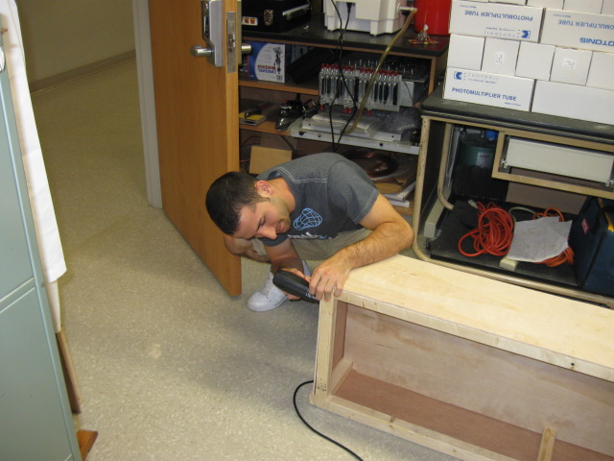
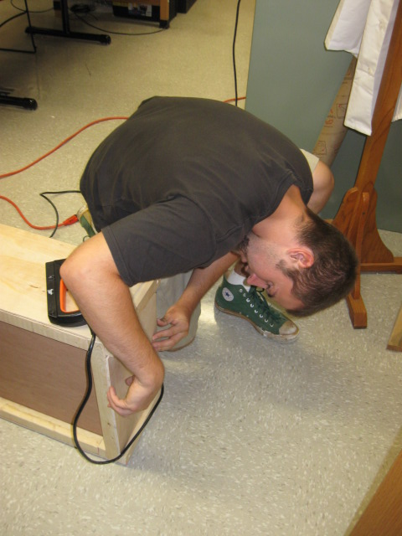
Implementing storage…
Need reliable means for storing/transporting the HODO paddles

Slide 29
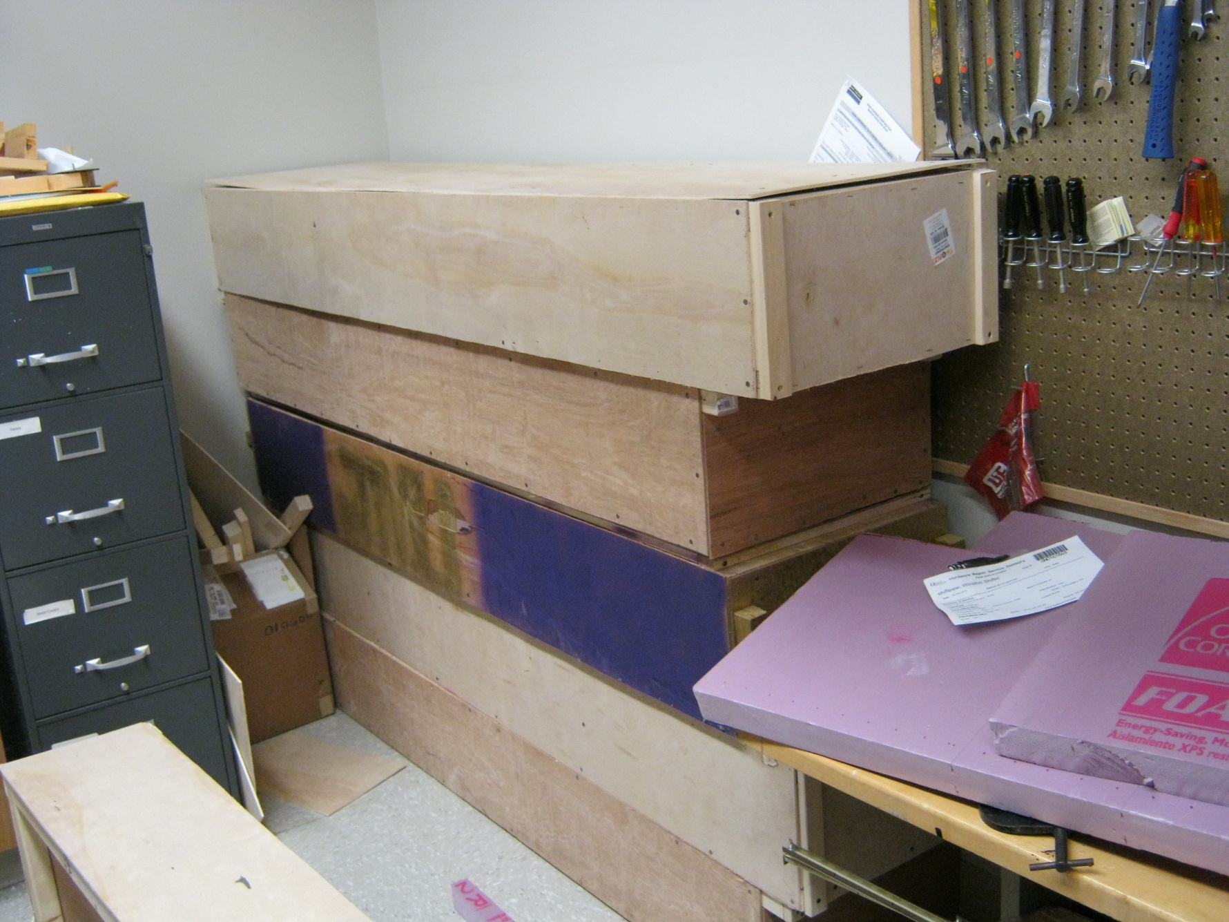
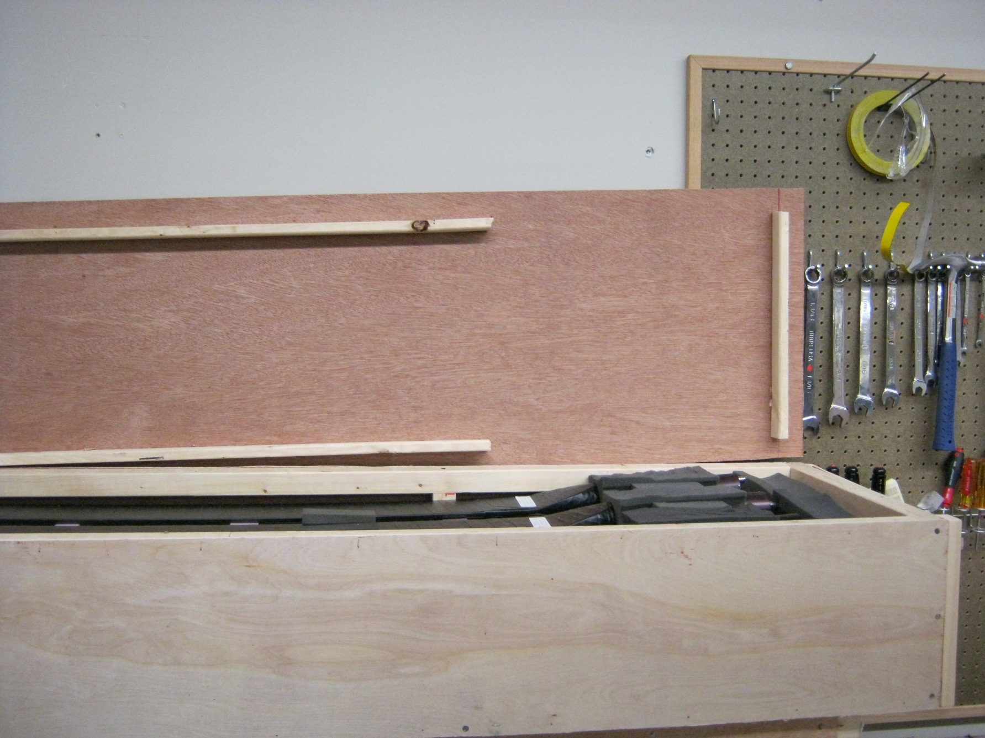
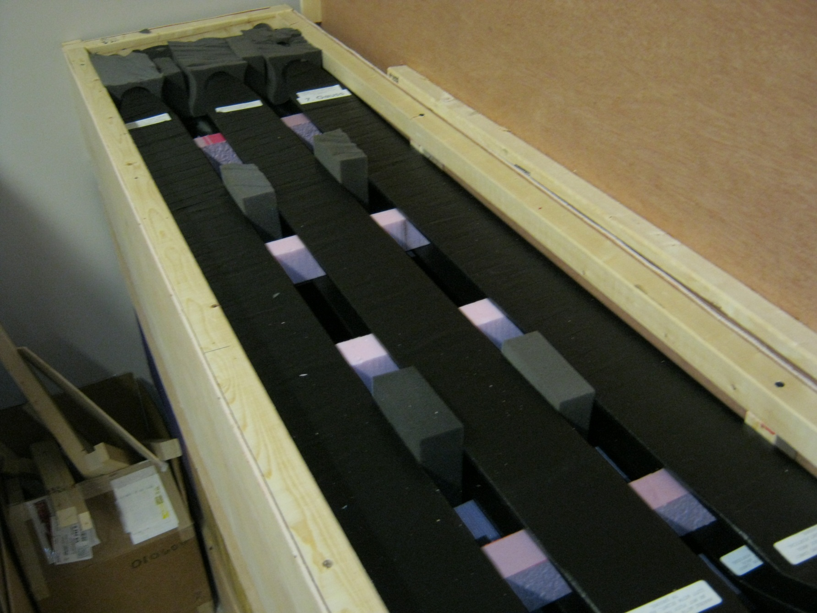
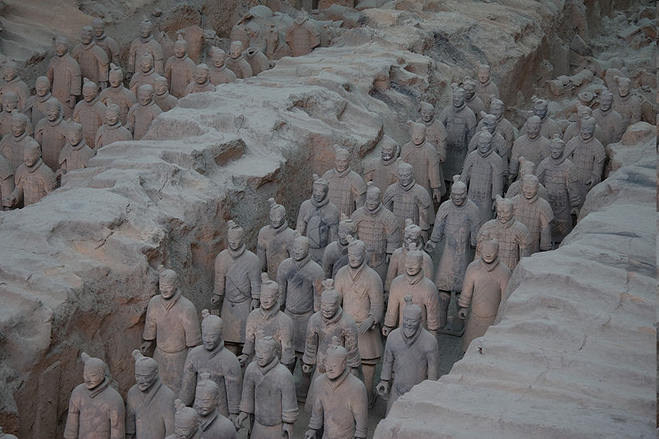
Scintillator paddle vault

Slide 30
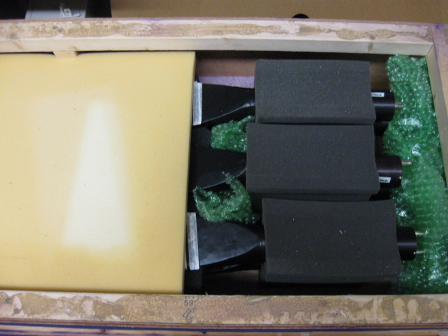
Scintillators to W&M
W&M needed some paddles to see if the support stand they build fits
Packed a crate with 9 paddles (only partially tested, need to come back to JMU).
8/15/2013

Slide 31
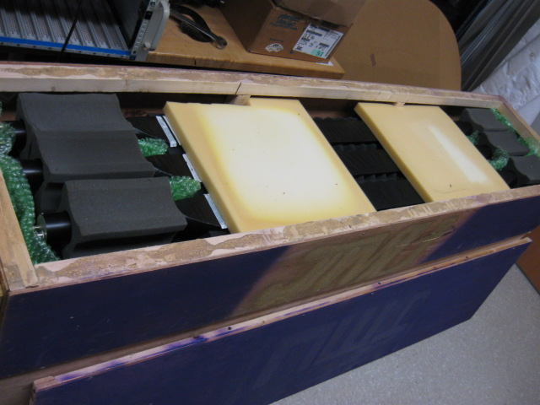
Scintillators to W&M
Delivered on 08/05/2011 b4 noon, with no apparent damage.
8/15/2013

Slide 32
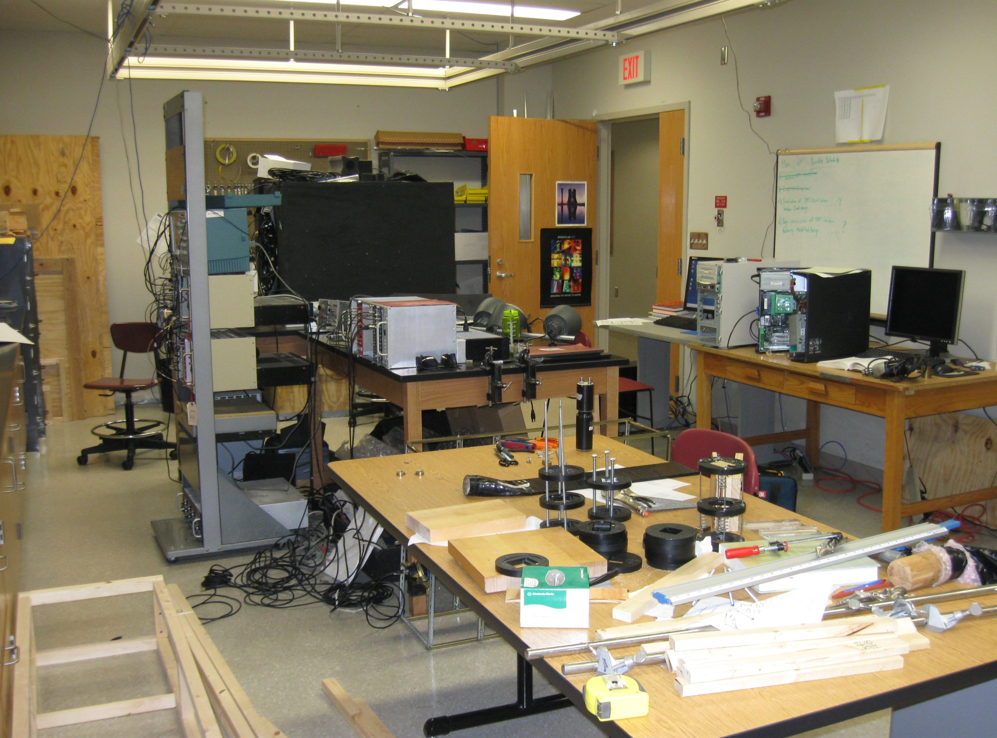
Meanwhile in the INGN lab @JMU…
8/15/2013

Slide 33
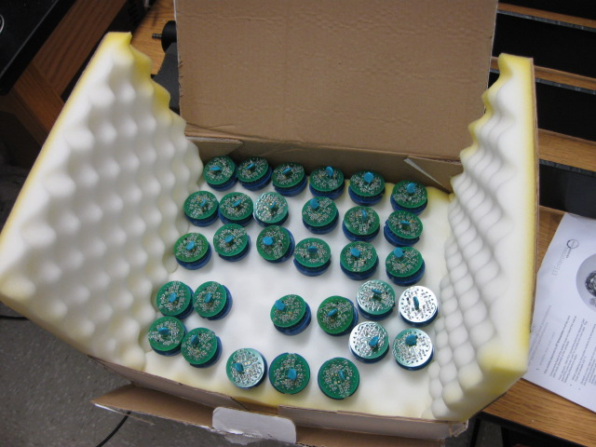
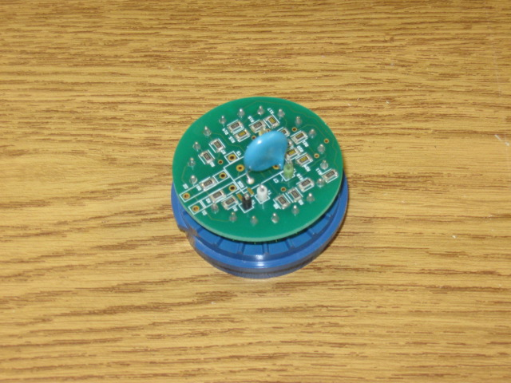
ET PMTs bases
“We” managed to turn these…
NOTE: There was no looting, this is what ET Enterprises sells as “base”

Slide 34
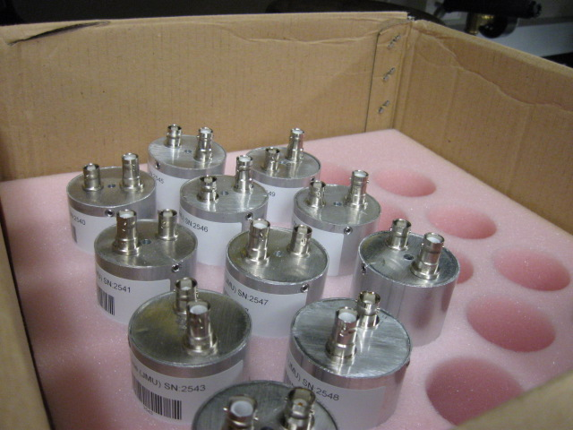
ET PMTs bases
Into these…
Manufactured housing
Labeled bases
Tested PMT+base assemblies – in progress
8/15/2013

Slide 35




Building the ET bases
8/15/2013

Slide 36



Thermal build-up testing…
test PMTs under high voltage to ensure they do not overheat
8/15/2013

Slide 37
Temperature test Results
8/15/2013

Slide 38
ET PMTs Gains
Measure Gain vs HV for the ET PMTs:
f – measured (final); 1 – 1pe; 0 – ped.
\sigma – width; \mu - mean
8/15/2013

Slide 39


ET PMTs Gains
And here is one of our results
PLEASE NOTE HV RANGE!!
8/15/2013

Slide 40



Cosmic Ray Test Stand
8/15/2013

Slide 41


Cosmic Ray Test Stand
A
B
pmtB
pmtA
C
8/15/2013

Slide 42

Cosmic Ray Test Stand
A
B
pmtA
pmtB
C
Lots of flexibility
Lots of redundancy
Little possibility for error
Slow*
8/15/2013

Slide 43
Problem Solution Working Improving
Service
Both R1s and UGs want faculty 2d “service”
Outreach (community, prospective students*)
Recruiting
Seminar
…
Serving in committees, commissions, panels

Slide 44
Problem Solution Working Improving
Improving your chances for an
UG interview…
If you think you can apply with same material/skill set emphasis @ a R1 & @ an UG – THINK AGAIN!
Here is what not to do: applic_gabriel_template.pdf
“that” landed me exactly 0 (zero) interviews

Slide 45

Problem Solution Working Improving
So what can a person do?
Go and teach (as an adjoint) at one of the local schools
  If teaching is something that you do not
  enjoy/stand then why bother applying?
  Pay especial attention to low-
  level/introductory classes – these will be the bulk of your assignment at an UG
  Make sure that this experience is
  prominently featured in your application AND in your phone & in-person interview

Slide 46
Problem Solution Working Improving
So what can a person do?
Educate yourself about current trends in
teaching (techniques, hardware, lingo)
  Know what clickers are, what is “active learning”, FCI, “flipped classroom”, “think-pair-share”…
  … or whatever is “trendy” in physics education when you apply
  don’t “talk down” any of them*
  Try (really hard) to take a liking to one or two of these…

Slide 47
Problem Solution Working Improving
So what can a person do?
Be aware of UGs biases against our field – be prepared to counteract them (best defense…)
  Most faculty (including deans and the like) @ UG think that N-P physics ONLY happens @ big, national labs.
  Explain how you will involve the UGs students in your research ON CAMPUS, what good/useful experience they will get…
  Explain how your relationship with a nat.lab. will benefit the UG
  Most UGs will want to see their students involved in some research
  Think especially hard b4 offering the students to do “data analysis”

Slide 48
Problem Solution Working Improving
So what can a person do?
Taylor your presentation to the audience:
  Make your presentation appeal to both the faculty and the students in the audience
  Enough high level stuff to have the faculty impressed
  … but not too much so that you lose the students*
  Spend a good time (at the beginning)
  painting the “big picture” and then
  introducing how your particular interests fit into that picture.

Slide 49
Problem Solution Working Improving
(Instead of) Conclusion
Teaching at an Undergraduate Institution might be a good/rewarding career choice
You might continue pursuing your research…
Competition could be substantial – so prepare yourself
You are the smartest, most qualified person in that applicant pool!
You just need to convince the Search
Committee of that!

Slide 50

Problem Solution Working Improving
(Instead of) Conclusion
GOOD LUCK!
Teaching at an Undergraduate Institution might be a good/rewarding career choice
You might continue pursuing your research…
Competition could be substantial – so prepare yourself
You are the smartest, most qualified person in that applicant pool!
You just need to convince the Search
Committee of that!

Slide 51
Extras from here on!

Slide 52


A question of scale…

Slide 53


Another sense of scale…

Slide 54

Another sense of scale…

Slide 55




Hall B

Slide 56

Hall C
Used for detection of electrons
Shielded Detector Hut
Superconducting Dipole
Target Scattering Chamber
HMS
SOS
Used for detections of positrons
Superconducting Quads
Electron Beam

Slide 57




Hall C

Slide 58




Slide 59




JLab Computing

Slide 60

Jlab Experiment E00-002
Preliminary
Not very conclusive…
Can one do better?

Slide 61

also part of the team…

Slide 62





Slide 63


“I was like a boy playing on the sea-shore, and diverting myself now and then finding a smoother pebble or a prettier shell than ordinary, whilst the great ocean of truth lay all undiscovered before me.”
Isaac Newton
A great while ago the world begun,
With hey, ho, the wind and the rain,
But that's all one, our play is done,
And we'll strive to please you every day.
Feste’s Song- TWELFTH NIGHT, W. Shakespeare

Slide 64

Thank You!

Slide 65
…
What to do?
What to do?
They don’t make
Thinkers as they
Used to…
…need a projectile
e-
…and a target
n
p
...and…Eureka!
e-
Hamangia culture, about 5k years b4 Rodin
We’ve got it!!!
?
p

Slide 66



What does this mean?

Slide 67





Hall A

Slide 68

The human factor…
int rabbitGraphs() {
// Voltages to look at:
char *fname="RabbitTest_08_17_06_HV_800_LED_08_onechannel.root";
char *fname2="RabbitTest_08_17_06_HV_800_LED_08_onechannel.root";
char *fname3="RabbitTest_08_17_06_HV_750_LED_09)onechannel.root";
char *chan="1";
int bns = 200;
int xmax= 20000;
int xmin= -100;
char *txt = " ";
int c = 1;
//First Graph
TFile *f = new TFile(fname);
TText *t1 = new TText(6550,4000,fname);
//Display canvas according to golden ratio
TCanvas *c1 = new TCanvas("c1","RABBIT",900,556);
TH1F *h10 = new TH1F("h10",fname,bns,xmin,xmax);
h10->SetLineColor(2);
c1->Clear();
ntped->Draw("ped>>h10",chan);
h10->SetFillColor(3);
h10->Draw();
//Second Graph
TH1F *h11 = new TH1F("h11",fname2,bns,xmin,xmax);
TFile *f = new TFile(fname2);
ntped->Draw("ped>>h11","chan==1","same");
//Third Graph
TFile *f = new TFile(fname3);
ntped->Draw("ped>>h11","chan==4","same");
return 1;
}

Slide 69



The human factor…

Slide 70

The human factor…

Slide 71




0.056<Q²<0.36
0.61<Q²<1.37
0.32<Q²<0.92
0.56<Q²<1.00

Slide 72

Instead of “the end”…
Particle physics is FUNdamental
It is the bleeding edge of physics
It’s good for you (from as early as you can start)

Slide 73



SHMS Hodoscope S1

Slide 74


JMU Test Stand
(work by Dillon Trelawny, Physics, JMU)
/pulsed LED/Laser
Dark box (“six pack”)
VME-based DAQ
Running Coda(lite)
ROOT/C++ Analysis code
It all works right now!
PC

Slide 75




JMU Test Stand pictorial

Slide 76



More JMU SHMS hodoscope HODO- Testing
As it says…
XP2262B+
BC408
(50x13cm)+
Cs137

Slide 77

F₂^{n} / F₂^{p} (d/u) Ratio at Large x
F_{2n}/F_{2p} = F_{2d}/F_{2p} -1
???

Slide 78

Parton Distribution Functions
u(x)
d(x)
PDF’s by far least well known at large x!!

