Slide 1
Tests of CAEN 1190 Multi-hit TDCs
Simona Malace
Brad Sawatzky and Brian Moffit
JLab
Hall C Summer Workshop Aug. 15-16 2013, JLab

Slide 2
Scope
→ CAEN 1190 multi-hit TDCs will be implemented in Hall C for the 12 GeV running in both HMS and SHMS
→ In an initial bench test we studied the high rate behavior/capabilities of TDC1190
Outline
→ General remarks on TDC1190
→ Experimental setup
→ Data Structure/ Data Decoding/ Data Analysis
→ Results: resolution, hit maps, measurement histograms
→ Still to do…

Slide 3
General Remarks on TDC1190
CAEN 1190 multi-hit TDC: 128 independent multi-hit/multi-event
time-to-digital conversion channels organized in 4 High Performance TDC (HPTDC) chips (32 channels each)
The data acquisition can be programmed in “EVENTS” (“TRIGGER MATCHING MODE” with a programmable time window) or in “CONTINOUS STORAGE MODE”
It can be enabled to the detection of the rising and/or falling edges of the pulse width
The board houses a 32 kwords deep output buffer that can be readout via VME as single data, block transfer or chained block transfer in an independent way of the acquisition itself

Slide 4
General Remarks on TDC1190
TDC chip architecture
40 MHz input clock but 100 ps resolution can be achieved with PLL multiplication
Each channel can store up to 4 hit measurements before being written into a 256 words deep L1 buffer shared by 8 channels
In trigger matching mode a function will match hits with triggers based on trigger information stored in the Trigger Fifo (bunch id and event id) and a programmable matching window
→ The read-out FIFO is 256 words deep and enables data to be read out while others are being processed

Slide 5
General Remarks on TDC1190
Power ON: Default
For our test:
Trigger matching: enabled
Matching window width: 900 ns
Matching window offset: -1200 ns
Subtraction trigger time: enabled → time measurements are referred to the beginning of the match window
We read the TDC1190 via Block Transfer, Direct Memory Access (BLT DMA)
Notes:
Lock Transfer

Slide 6
Experimental Setup
match window width = 900 ns
Common stop
-1200 ns
-960 ns
-560 ns
-300 ns
Beginning of match window
This 1 kHz reference pulse is OR-ed with a variable rate pulse (mimics noise) and goes in all channels
This 1 kHz reference pulse goes in select channels:
0, 15, 16, 31 in TDC1
32, 47, 48, 63 in TDC2
64, 79, 80, 95 in TDC3
96, 111, 112, 127 in TDC4
Ref. pulses: delayed copies common stop

Slide 7
Data Structure/Data Decoding/Data Analysis
Global header
TDC1
header
dummy
filler
TDC1
data
TDC1
trailer
Global trailer

Slide 8
Data Structure/Data Decoding/Data Analysis
We use the Hall A analyzer; the THaCodaDecoder has been modified to extract information from: global/chip headers and trailers and form measurement words
Number of hits
Measurement for each hit

Slide 9
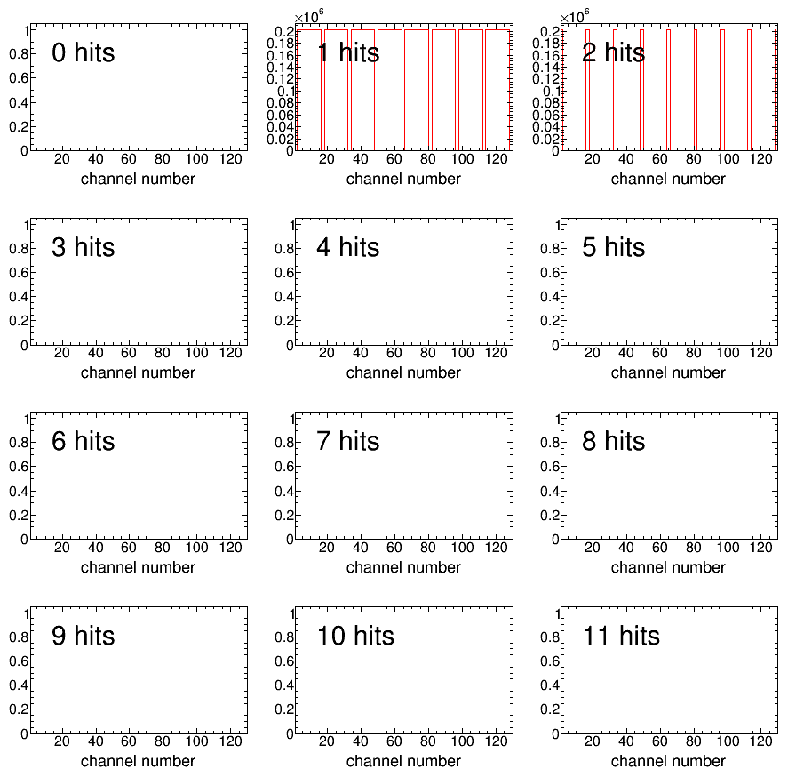
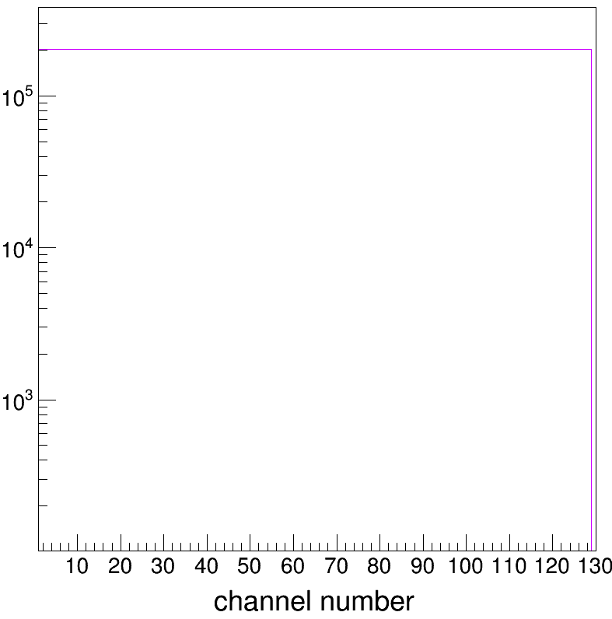
Results: Hit Maps
Rate per channel: 1 kHz, 2kHz in select channels (noise = 1mHz)
At very low noise rate by construction we expect 2 hits in select channels 0, 15, 16, 31, 32, 47, 48, 63, 64, 79, 80, 95, 96, 111, 112, 127 and 1 hit only in all the rest

Slide 10
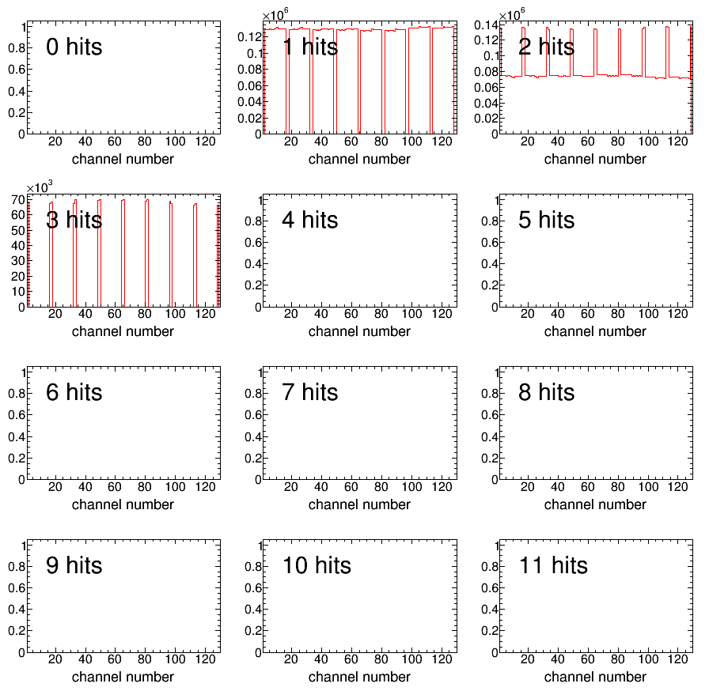
Results: Hit Maps
Rate per channel: 501 kHz, 502 kHz in select channels (noise = 500 kHz)
At 500 kHz noise rate there is a large probability (~45%) to have 3 hits in select channels 0, 15, 16, 31, 32, 47, 48, 63, 64, 79, 80, 95, 96, 111, 112, 127

Slide 11
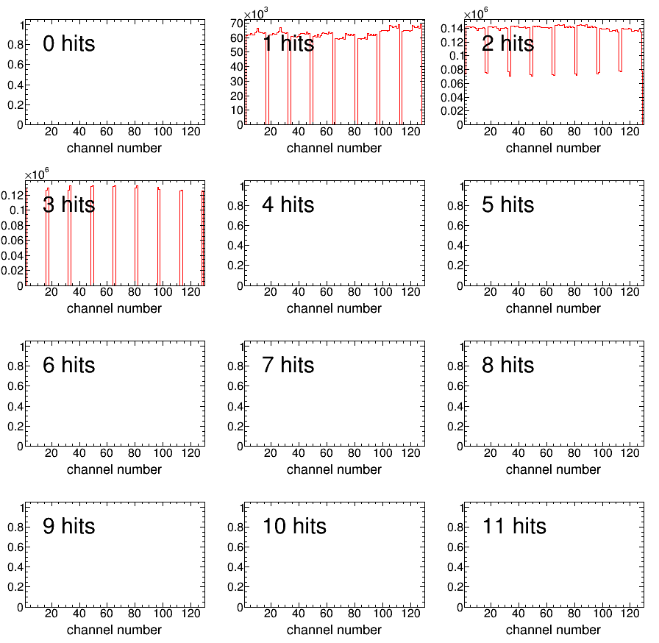
Results: Hit Maps
Rate per channel: 1.1 MHz, 1.2 MHz in select channels (noise = 1 MHz)
At 1 MHz noise rate there is an even larger probability (~90%) to have 3 hits in select channels 0, 15, 16, 31, 32, 47, 48, 63, 64, 79, 80, 95, 96, 111, 112, 127

Slide 12
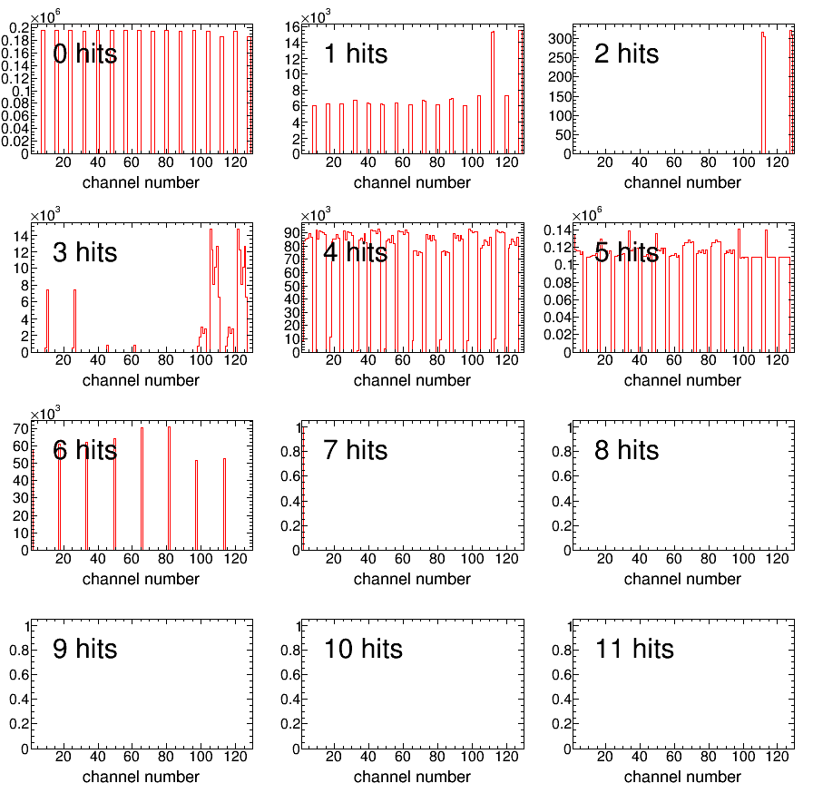
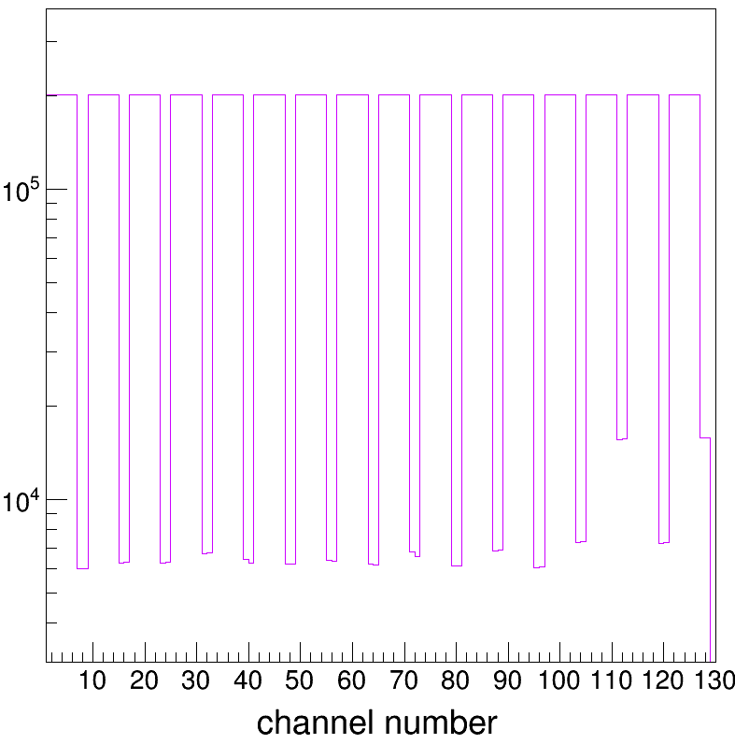
Results: Hit Maps
Rate per channel: 5.1 MHz, 5.2 MHz in select channels (noise = 5 MHz)
At 5 MHz noise rate it fails; there should never be events with 0 hits

Slide 13
Results: Raw Measurements
Rate per channel: 1 kHz, 2kHz in select channels (noise = 1mHz)
2 reference pulses at 1 kHz rate
I picked this one for subtraction
Measurements are reported w.r.t. the start of the match window
this
farther away from common stop than
this

Slide 14
Reference Pulse Subtracted Measurements
Rate per channel: 1 kHz, 2kHz in select channels (noise = 1mHz)
Resolution
0.127 – 0.14 ns

Slide 15
Reference Pulse Subtracted Measurements
Rate per channel: 1 kHz, 2kHz in select channels (noise = 1mHz)
Here the chosen reference pulse has been subtracted from all other measurements (ref_pulse - measurement)
Chosen reference pulse
The other reference pulse

Slide 16
Reference Pulse Subtracted Measurements
Rate per channel: 501 kHz, 502 kHz in select channels (noise = 500 kHz)
Here the chosen reference pulse has been subtracted from all other measurements (ref_pulse - measurement)
The gap is probably generated by the noise and reference pulse “walking” on each other:
the leading edge of the noise pulse comes first and there is overlap with the ref. pulse →a gap on the + side
the leading edge of the ref. pulse comes first and there is overlap with the noise pulse →a gap on the - side
Chosen reference pulse
The other reference pulse

Slide 17
Reference Pulse Subtracted Measurements
Rate per channel: 1.1 MHz, 1.2 MHz in select channels (noise = 1 MHz)
Here the chosen reference pulse has been subtracted from all other measurements (ref_pulse - measurement)
Chosen reference pulse
At ~ 1MHz per channel, ~128 MHz integrated rate still looks O.K.
The other reference pulse

Slide 18
Reference Pulse Subtracted Measurements
Rate per channel: 2.1 MHz, 2.2 MHz in select channels (noise = 2 MHz)
Here the chosen reference pulse has been subtracted from all other measurements (ref_pulse - measurement)
Chosen reference pulse
At ~ 2MHz per channel, ~256 MHz integrated rate it appears to fail
The other reference pulse

Slide 19
Summary
→ We tested the high-rate behavior of CAEN 1190 multi-hit TDCs:
→ it appears to function properly up to ~ 1 MHz per channel, 128 MHz integrated rate
→ we programmed the TDC for 100 ps resolution; the measured resolution is 120 -140 ps
→ Still to do:
→ sanity checks …. Again!
→ simulate a “hot wire” input and verify if it fails in a similar fashion as shown here

Slide 20
Unrelated: the maPMT H8500C-03 test results I presented at the last Hall C meeting have been organized into a paper that was accepted this week for publication in the Journal of Instrumentation

