Slide 1
Hall C Commissioning: The Past (1996)
First Exp: “by consensus”
What ANL wanted
What Hampton Univ. wanted

Slide 2
Hall C 12 GeV Commissioning: Future
Lab management will be increasingly discussing 12 GeV startup plans over
the next year.
The PAC will likely be asked to review startup/commissioning plans at
the next summer PAC. (August 2012).
Hall C needs to develop a tentative / working plan for the first two years of
operations.
It would be good to select as early experiments those that can be
analyzed relatively quickly so that a "payoff" of the upgrade can be seen.
The purpose of today's discussion is information gathering and to share
and hear opinions about what should run early. See if some kind of
“consensus” or broad support for any particular experiment ordering.
There are already at least 5-6 years of experiments approved. Users
should be realistic and understand that some experiments will run towards
the end of the decade.
Steve has asked Arne for a rough estimate of how much beam Hall C
could get in the first couple of years. Will show this draft next.

Slide 3
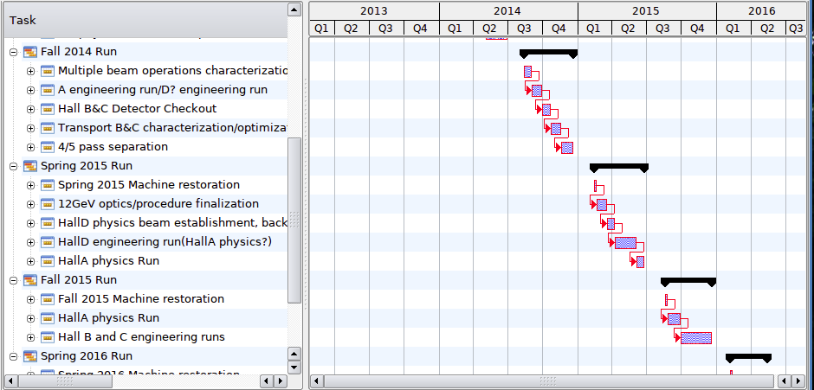
“12 GeV” Schedule: “Speculative and Conservative”
Disclaimer: “This is all still very speculative and conservative, but the first beam to Hall C will be in the Fall of 2014 for beam transport and detector test. (Oct 2014 to Dec 2014). This will be followed by an engineering run in B & C the Fall of 2015, Oct to Dec. I haven't had a chance to work on this schedule, the one thing I need to increase the multiplicity earlier, this might allow for more beam to C or B, right now I more or toggle between A&D (which come on line first, and run during the spring) and B&C (which run in the Fall).” Arne Freyberger 8/17/11

Slide 4
12 GeV Hall C Experiments
All experiments listed shown are approved, but four have not been graded, so they have
not actually been awarded time. But the times they had requested are included and what the PAC awards next week are likely to be similar. The yellow rows are those experiments that require something non-standard. (Polarized He3, Polarimeter, GeN.)

Slide 5
Hall C 12 GeV Commissioning
Please limit your presentations to ~10 minutes (including questions) so that there is time for discussion after the presentations. We hope people will follow the format suggested in the earlier email.
To Review:
Present an overview of the experiment. As we have a PAC that assigns grades, don't try to sell the importance of the physics.
But do point out if the physics result is a prerequisite to other Jlab experiments that may run early in the 12 GeV era.
Clearly indicate if the experiment should be considered as a possible:
"commissioning” experiment (first two),
or
"early" experiment (roughly first five, including the two commissioning).
Note the contributions that your experiment's collaboration is making toward
the construction/commissioning of the SHMS and the restart of Hall C.

Slide 6
Hall C 12 GeV Commissioning
3. Because of the additional manpower and expertise likely needed for for
commissioning experiments, discuss your collaboration's openness to
inviting additional hall users and staff to participate in the experiment.
Discuss the collaboration's readiness (manpower, hardware, software,
commitment to a tight schedule, past experience/track record, ...) to
run the experiment early.
5. Discuss the features of your experiment that make it conducive to running
with a new not yet well understood spectrometer and new accelerator.
Conversely, list special unusual/difficult requirements, such as unusual
target demands, tight resolution and efficiency requirements, tight
tolerances on absolute quantities such as beam energy, angles, momenta, etc.
Describe the benefits to Hall C and subsequent experiments from running your experiment early.
7. Summarize, discussing the pros and cons of running your experiment early.

