Slide 1
Exclusive Vector Meson Electroproduction
at 12 GeV
Paul Stoler
Rensselaer Polytechnic Institute

Slide 2
What do we want to do at 12 GeV?
Approach to the small–size regime
Learn about short–range nucleon and meson structure
Is 12 GeV the right energy?

Slide 3
From gluon dressed to bare quarks.
(Craig Roberts et al.)
From valence quarks to
sea quarks and gluons
high x_{B}
valence
quarks
low x_{B}
sea
quarks

Slide 4
GPD’s

Slide 5
Example of world data
VGG
GK
VGG+D
JML

Slide 6
Example of CLAS 6 GeV date
σ
σ
GPD: n=3

Slide 7
φ - dσ/dt’
Jlab 6 GeV
Jlab 12 GeV
Q²=1-3 GeV², W=2-3

Slide 9
Backward angle (high -t) electroproduction
u =(p_{i} − p_{π} )² small
t =(p_{i} − p_{p} )² large
J.P Landsberg, B. Pire, L. Szymanowski
Elastic scattering from proton core in a dressed nucleon.

Slide 10
CLAS12 Proposal
Exclusive Vector Meson Electroproduction with CLAS12
Kinematic covered.
W ~ 2 ➞ 4.5 GeV
Q² ~ 1 ➞ 13 GeV²
−t’ ~ 0 to > 15 GeV²
Explore the transition from soft physics
to the dominance of QCD quarks and gluons

Slide 11
Meson Decay Modes

Slide 12
Goals of the experiment
Structure Functions:
Goal-obtain information about all 5 structure functions available
with polarized beam and unpolarized target
obtained from cos(φ) and cos(2φ) with h = 0
–angular distribution of meson decay products.
beam spin asymmetries
Beam spin cross section differences

Slide 13
L/T separation
H
Helicity Frame

Slide 14
Simulations
Extensive simulations were carried out
for all 4 mesons channels.
In general, statistics are quite good due to
large acceptance, high luminosity and efficient PID
Compared with previously successful CLAS 6 GeV
ρ⁰ ρ⁺ φ and ω experiments, statistics will increase by factor ~10²

Slide 15
ρ⁰ channel simulations

Slide 16
13 GeV²
Q²
1 GeV²
0.1
0.8
x_{B}

Slide 17
dσ/dt ( μb/GeV²)
0
10
20
-t (GeV²)

Slide 18
φ simulations

Slide 20
Acceptance - e p K⁺

Slide 21
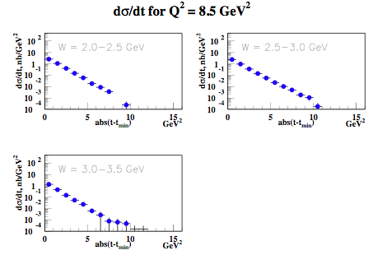
6 backup slides follow

Slide 22
Errors on cross sections
Statistics
Average acceptance ≃ 10 to 50%.
(depending on kinematics)
Systematics
Background subtraction~ few % (sharp state)
Acceptance ~5-10 %
Net: σ ~7-12%
Statistics
⇒Statistics: very high
Average acceptance ≃ 10 to 30%.
(depending on kinematics)
Systematics
Background subtraction: systematics 10%
Net: σ ~15%

