Slide 1
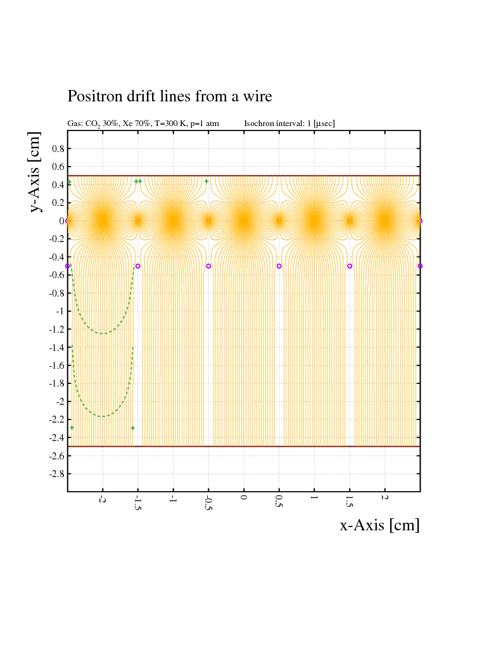
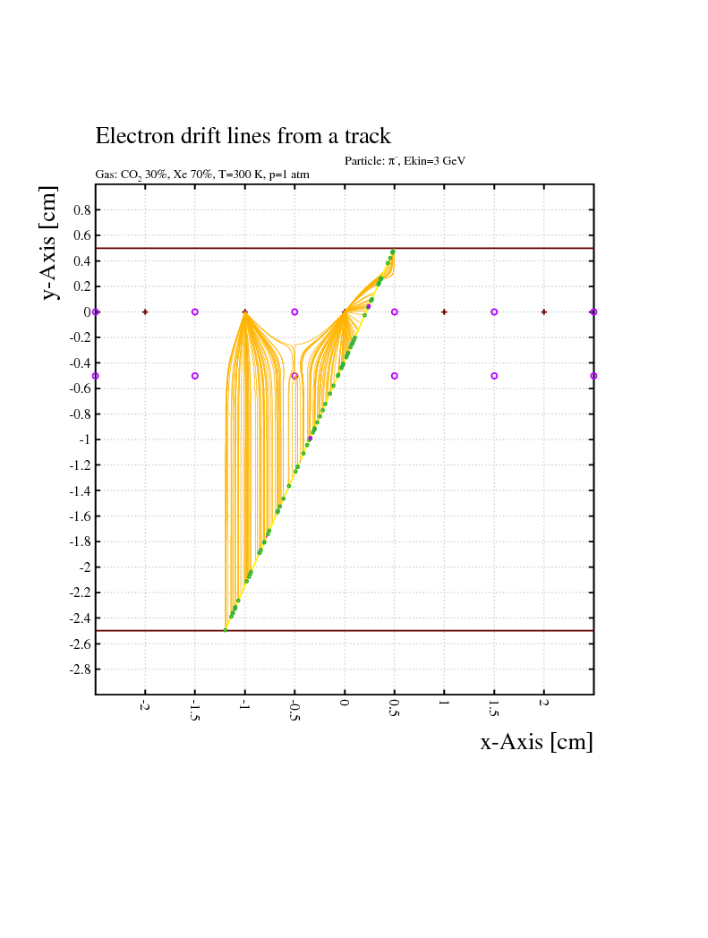
Transition Radiation Detector – Drift Chamber Prototype
0 V
+1950V
0 V
-2000V
1
Notes:
1
1

Slide 2
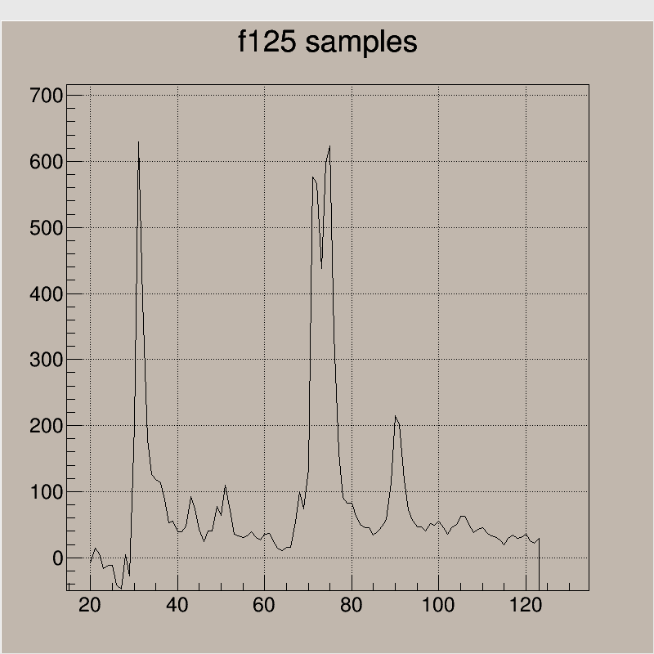
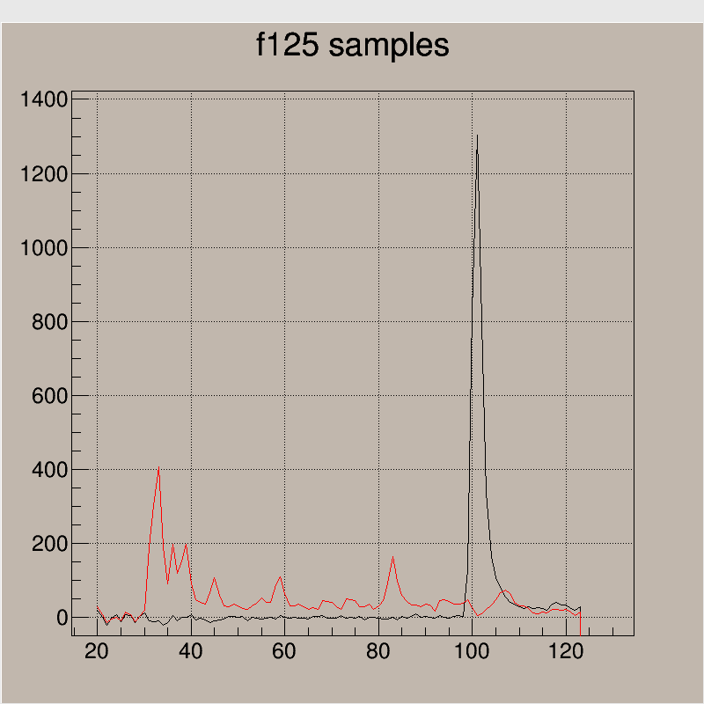
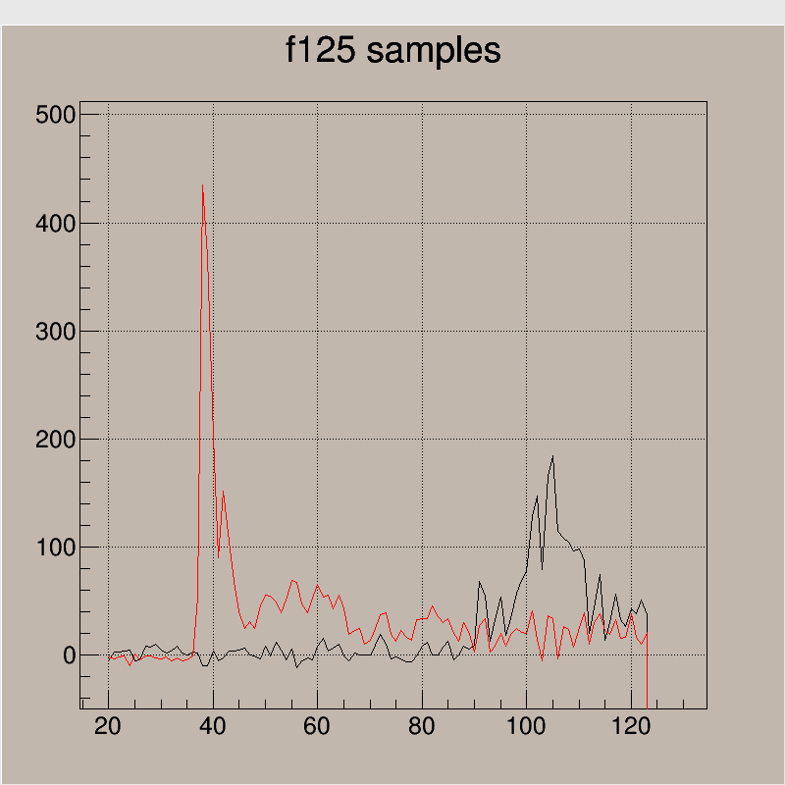
TRD – single event examples
f125 samples of 32ns – colors correspond to different wires
2
Notes:
2
2

Slide 3
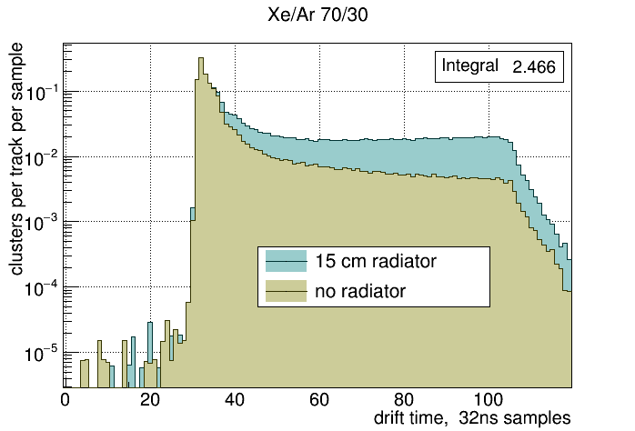
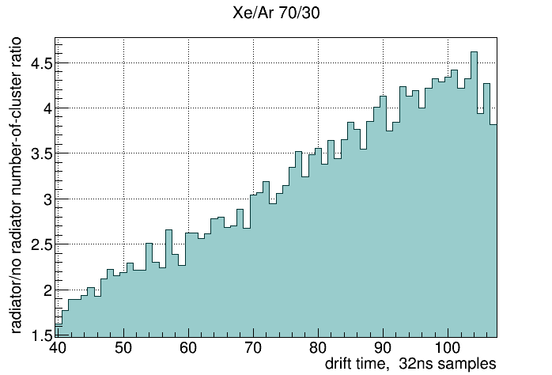
TRD – first results
Threshold for cluster counting = 300 fADC units
3
Notes:
3
3

Slide 4
TRD Drift Chamber Prototype – with Ar and Xe
4
Notes:
4
4

Slide 5
Transition Radiation Detector - Prototype
5
Notes:
5
5

