Slide 1
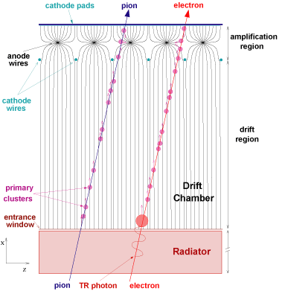
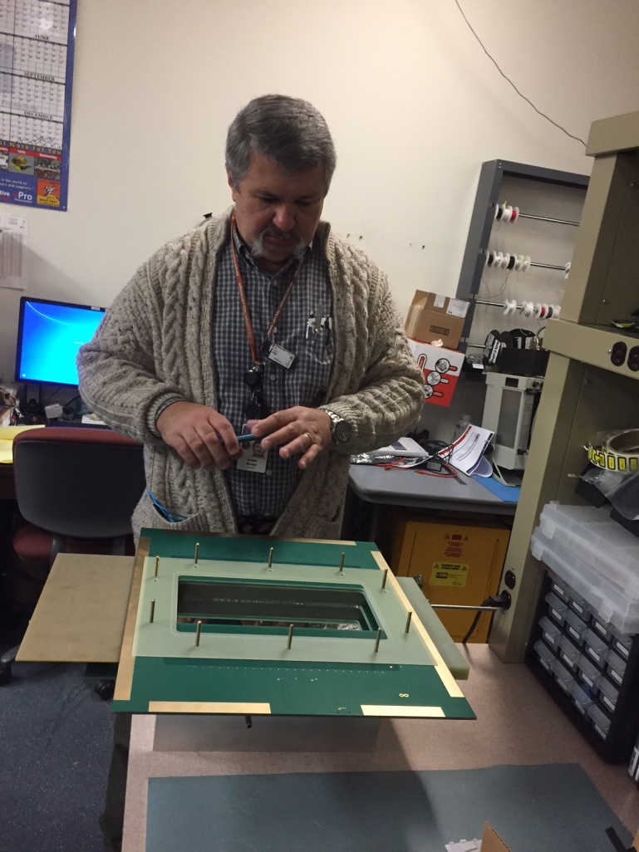
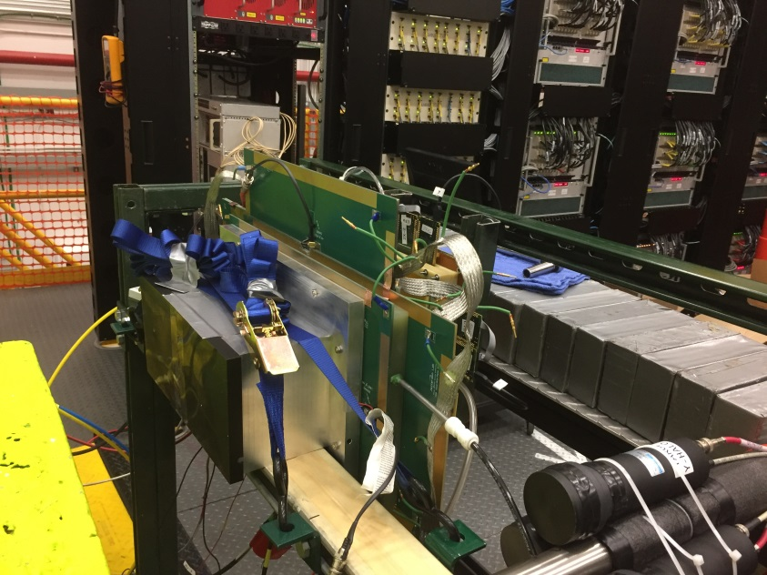
Transition Radiation Detector – Prototype Studies
TRD has the unique feature of identifying particles by their gamma factor, making it ideal for e/π separation
TR keV-photons created by the electron in the radiator deposit all its energy preferably close to the entrance, while the ionization from the pions is uniformly distributed along the path in the drift volume of the chamber
TRD prototype built by Detector Group: Brian Cross, Seung Joon Lee, and tested in HallD
1
Notes:
1
1

Slide 2
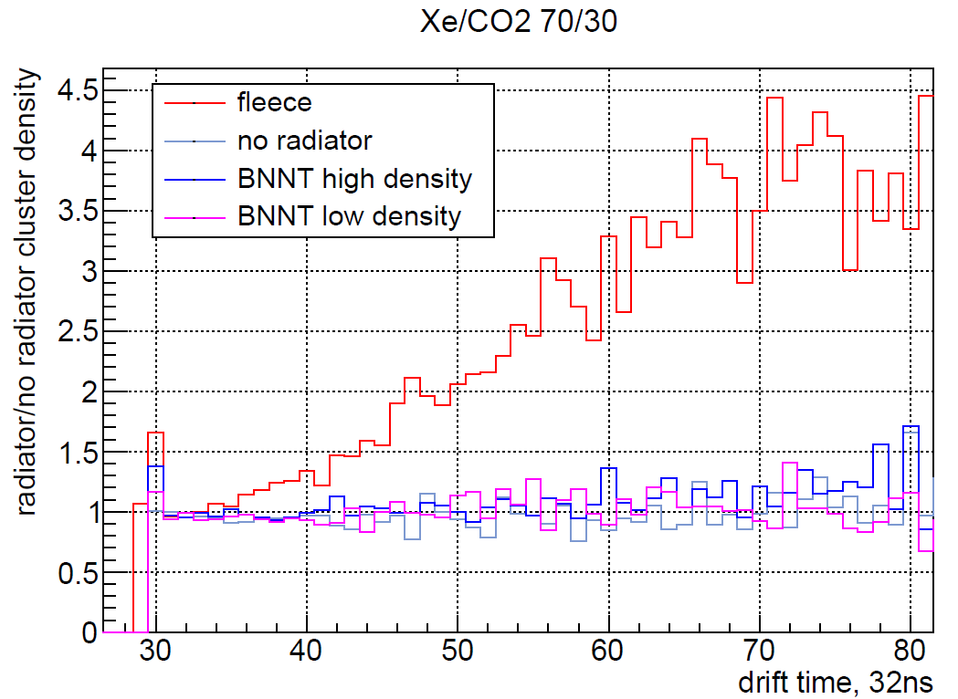
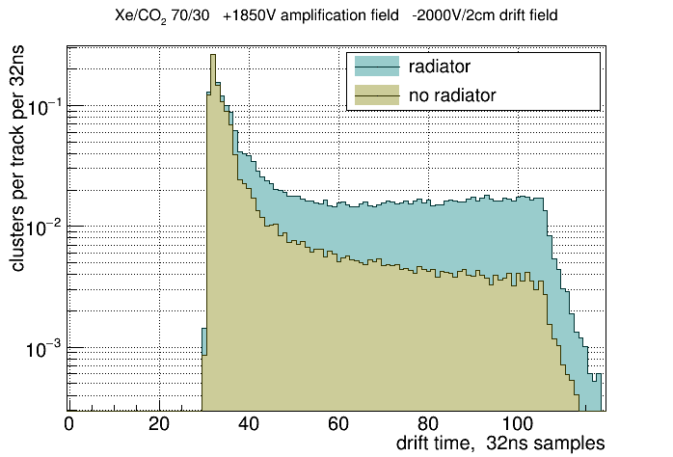
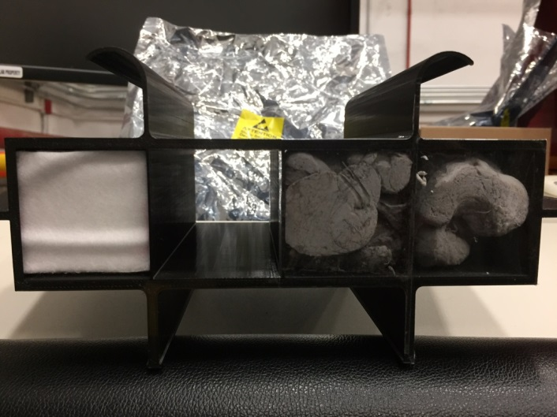
Results from test in Hall D
Electrons from the pair spectrometer were registered in the detector using Xe gas mixture with and without radiator.
Cluster density plotted vs drift time demonstrates the effect of the TR for different radiators
Electron direction
2
Notes:
2
2

