Slide 1
Summer ‘09 SAD
Same good photocathode PREP and LOAD chambers
Spin Flipper: Stage 1
Remove unbaked girder region between valve & chopper
Install new “normal” Wien for Physics program, with quad correction
Thoroughly test & transfer functionality for setting pol.
No need to move laser room.
Install “Inverted” HV chamber with capabilities for higher voltage, anticipating better transmission & photocathode lifetime
Preserve baked region, continue R&D/BS during Fall
H-Wien + Quads
Harp/MFA0I03 “match point”

Slide 2
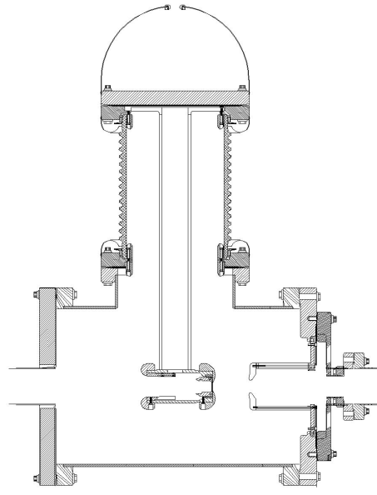
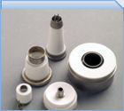
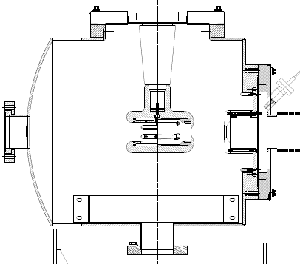
Gun Status
Present Ceramic
Exposed to field emission
Large area
Expensive (~$50k)
Medical x-ray technology
e⁻
New Ceramic
Compact
~$5k
New design
neg modules
Want to move away from “conventional” insulator used on all GaAs photoguns today – expensive, months to build, prone to damage from field emission.

Slide 3
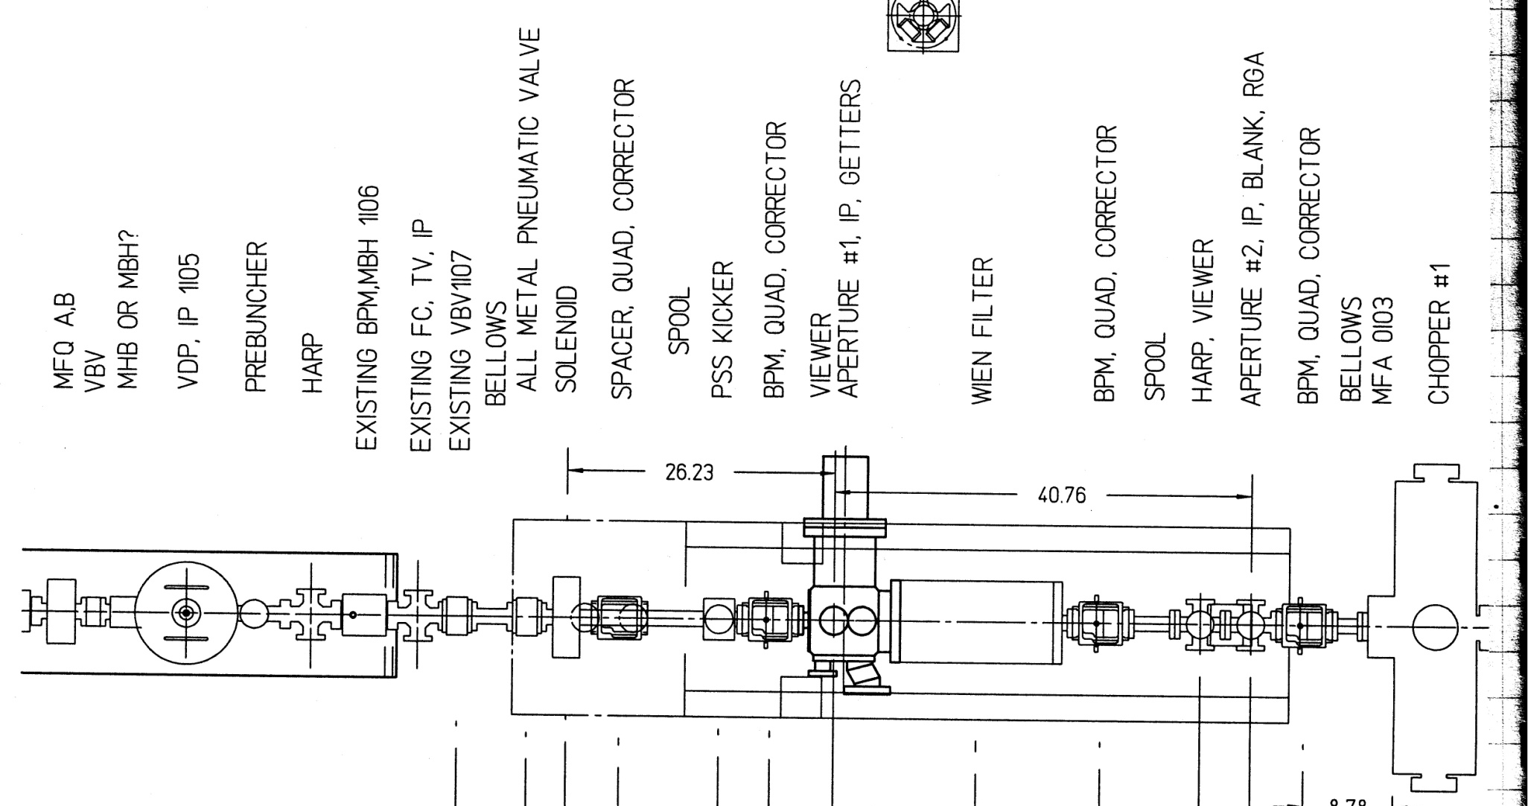
Mechanical Layout

Slide 4
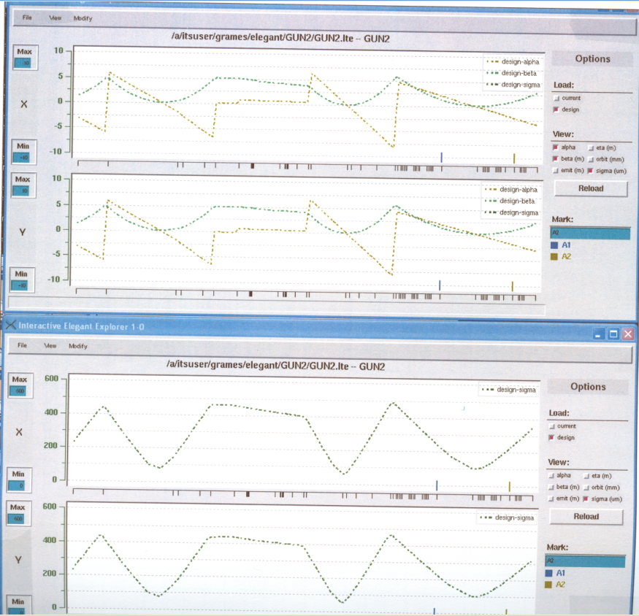
Optical Layout (Wien=0)

Slide 5
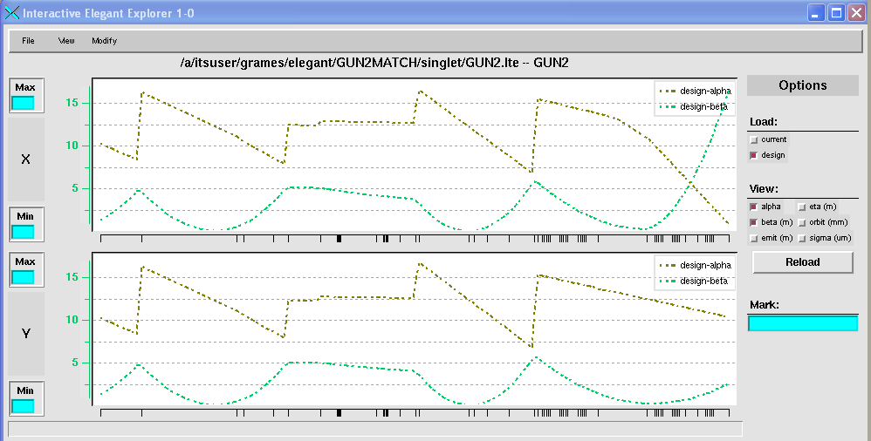
Optical Layout (Wien=90, Quads=OFF)

Slide 6
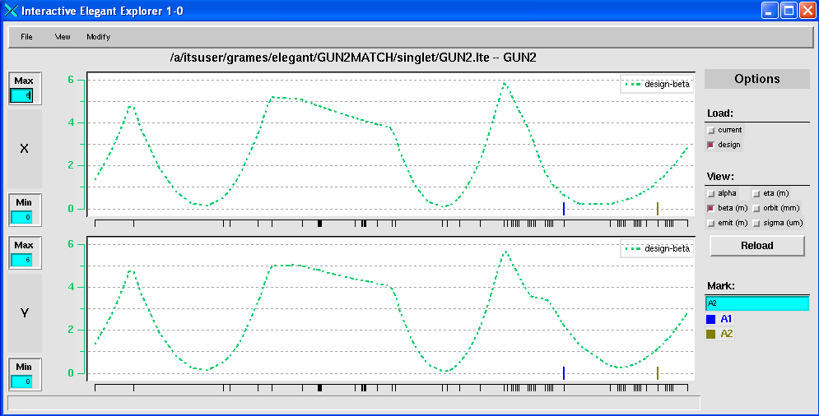
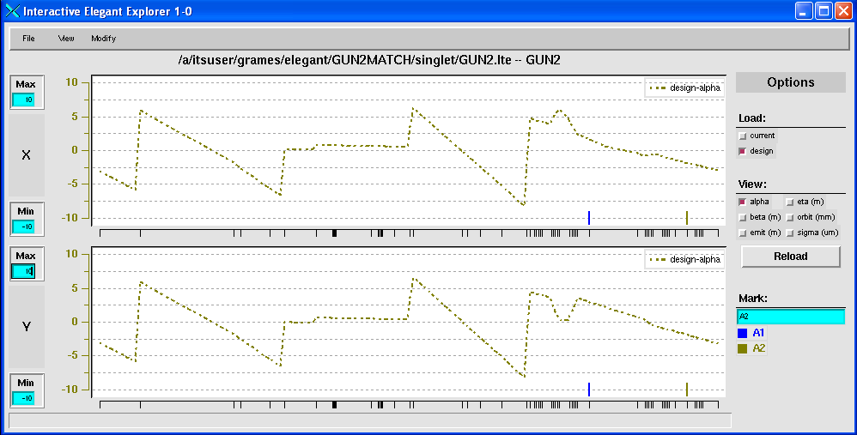
Optical Layout (Wien=90, Quads=ON)

Slide 7
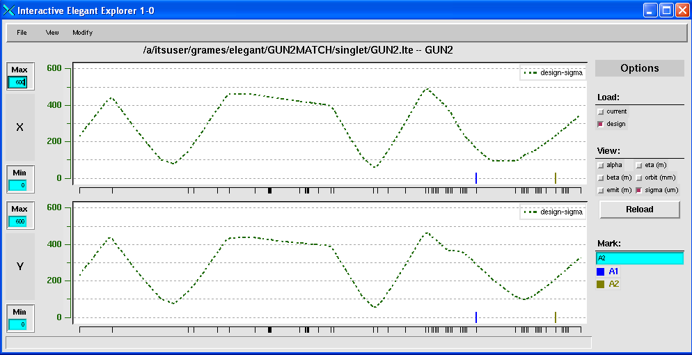
Optical Layout (Wien=90, Quads=ON)
Max. B’L ~23 G
Will use QS (B’L ~ 13G/Amp)
200keV increase is 50% (OK)

