Slide 1
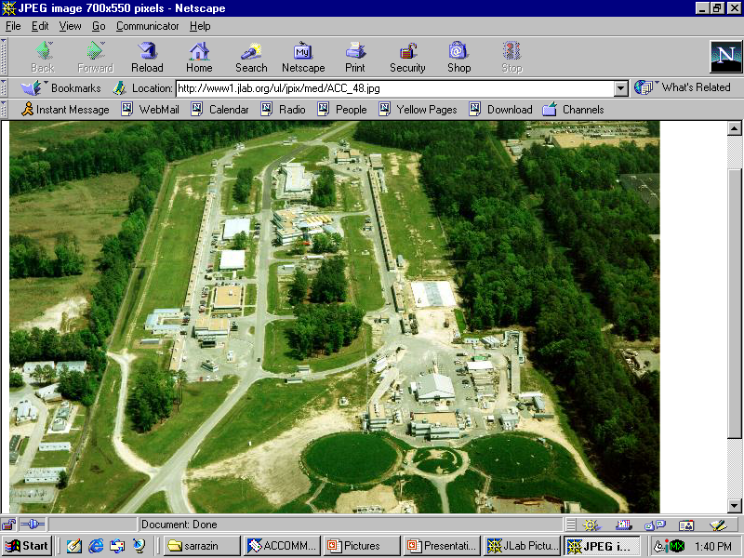
Positron
Polarized Electron Footprint at JLab
P. Adderley, J. Clark, J. Dumas^{ǂ}, A. Freyberger, J. Hansknecht, J. Grames, M. Poelker, K. Surles-Law, M. Stutzman, R. Suleiman, E. Voutier^{ǂ}
Thomas Jefferson National Accelerator Facility
Newport News, Virginia, USA
^{ǂ} Laboratoire de Physique Subatomique et de Cosmologie
Grenoble, France

Slide 2



Continuous Electron Beam Accelerator Facility
Recirculating SRF LINACs
Three Halls; 3x the physics
Two SRF 600 MeV linacs
(1497 MHz)
67 MeV injector
(1497 MHz)
RF Lasers
(499 MHz)
A
B
C
RF deflectors
A
B
C
Double-sided septum
Pockels cell
Wien filter
Spin Precession
Degrees of Freedom
P
100 keV DC
Electron Gun

Slide 3
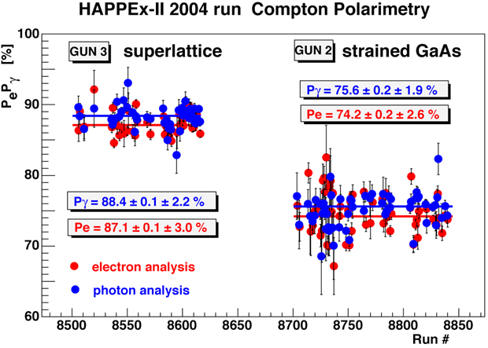
Everyone Gets Polarized Electrons !
CEBAF’s first polarized e-beam experiment 1995
Now polarized beam experiments comprise ~ 80% of our physics program, in fact, we only deliver polarized electrons
All beam originates via photoemission from a strained superlattice GaAs crystal inside a 100kV DC photogun
Three experimental areas may simultaneously receive:
  high polarization (~85%)
  continuous wave (499 MHz)
  independent intensity (50 pA to 200 μA)
  energy selection (6 GeV now, 12 GeV 2012)
What about positron physics ?
  Lepton charge degree of freedom
  But, costly endeavor…
  But, rich e- program keeps us busy…

Slide 4








JPOS’09
Recent workshop to discuss e+ @ Jlab … identified “old” & new physics motivations…
Generalized Parton Distributions
Investigation of 2g exchange in elastic scattering
Study of Coulomb distortion in the inelastic regime
Search for a light dark matter gauge U-boson
Measurement of the C_{3q} neutral weak coupling
Positron Annihilation Spectroscopy
e⁺ beam current > 100 nA in CW mode
As large as possible e⁺ beam polarization
New interest from the source & accelerator community working at JLab …

Slide 5
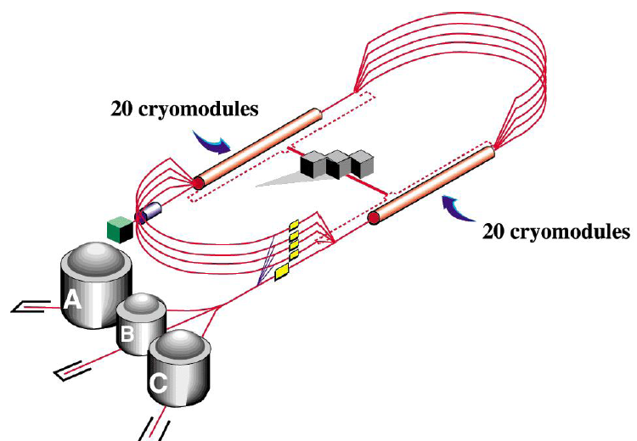
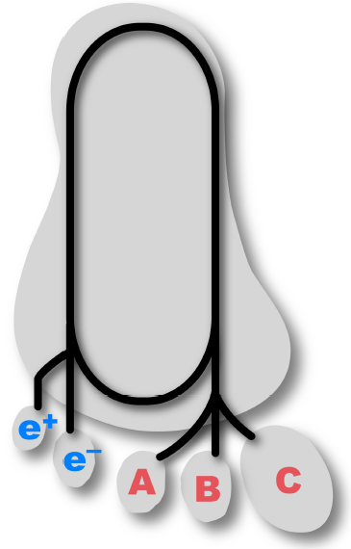
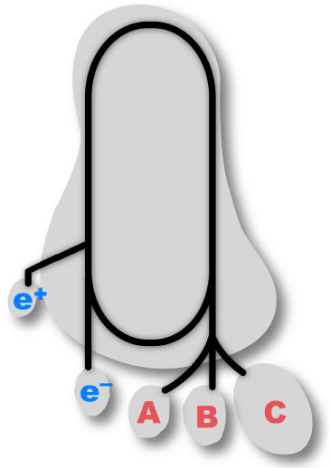
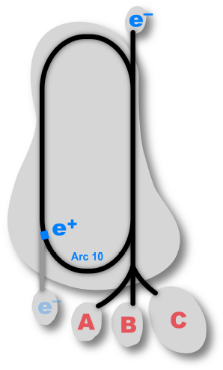
If the shoe fits …
…then wear it !
10 MeV/10 mA
Power loss/scattering
Compact, low rad
100 MeV/10 mA
Better divergence
Worse energy spread
1000 MeV/1 mA
Easier source
Bigger “driver”
A. Freyberger, Proc. of the International Workshop on Positrons at Jefferson Lab, Newport News (VA, USA), March 25-27, 2009

Slide 6
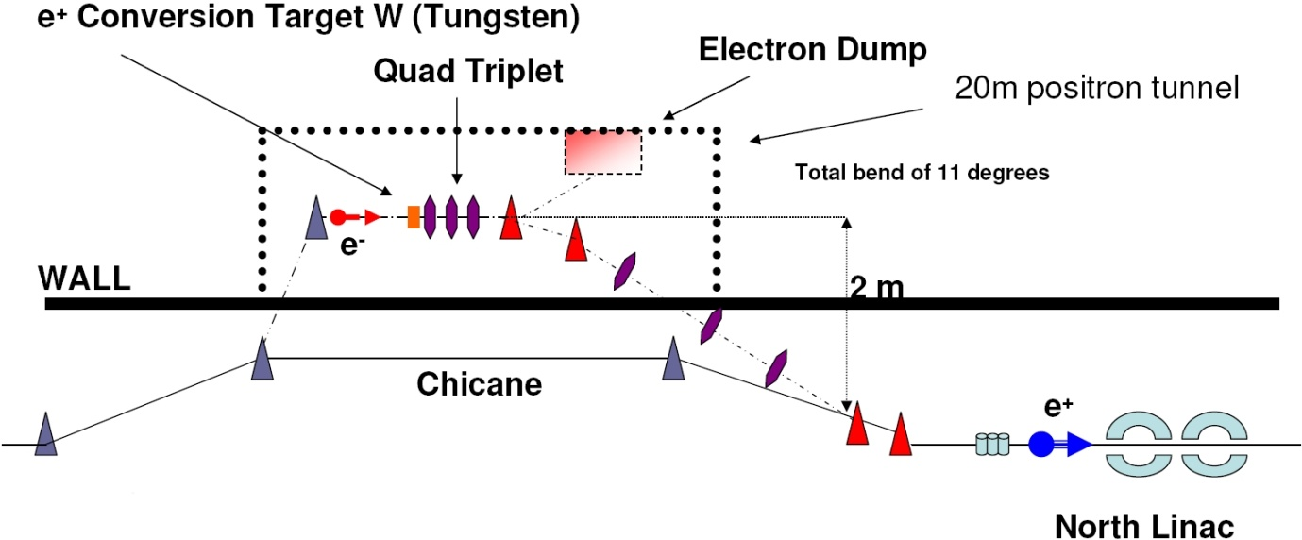
R&D Effort for a continuous wave [polarized] positron source
at JLab for fixed target experiments to take place in the 12 GeV era.
J. Dumas, C. Hyde, T. Forest, A. Freyberger, S. Golge, J. Grames, R. Kazimi, E. Voutier
S. Golge et al., Proc. of the International Workshop on Positrons at Jefferson Lab, Newport News (VA, USA), March 25-27, 2009
A possible concept involves the construction of a dedicated e⁺ tunnel at the end of the injector and parallel to the north linac.
Positrons would be produced with 120 MeV e⁻ (JLab 12 GeV) incident on a tungsten target.
e⁺’s are selected with a quadrupole triplet and transported to the accelerator section.
G4beamline simulations indicate a global efficiency of 10⁻⁵ e⁺/e⁻ for 120 MeV e⁻ off a 3 mm W target.
10 mA e⁻ → 100 nA e⁺

Slide 7
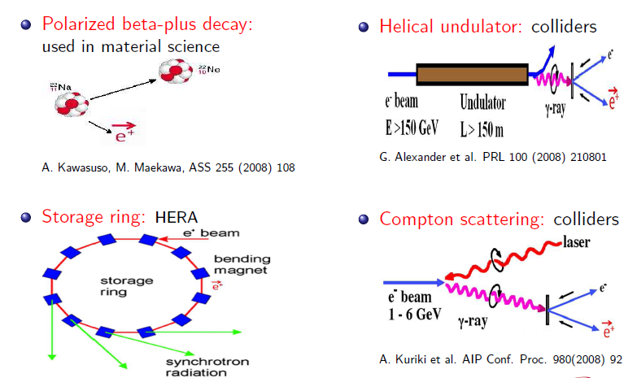
What about polarized e+ ?

Slide 8
Polarized Bremsstrahlung/Pair Creation
E.G. Bessonov, A.A. Mikhailichenko, EPAC (1996) A.P. Potylitsin, NIM A398 (1997) 395
e⁻
γ
e⁺
Brem
Pair
e⁻
Within a high Z target, longitudinally polarized e⁻’s radiate circularly polarized γ’s.
Within the same/different target, circularly polarized γ’s create longitudinally polarized e⁺’s.
So, why not pursued so far … ?
bulk GaAs
Strained GaAs
Superlattice GaAs
P_{e-}
35%
35%
75%
75%
85%
85%
85%
1995
1998
1999
2000
2004
2007
2010
I_{e-}
30 μA
100 μA
50 μA
100 μA
150 μA
1 mA
180 μA
All operating with suitable photocathode lifetime to sustain weeks of operation
Evolution of CEBAF
polarized electron source

Slide 9
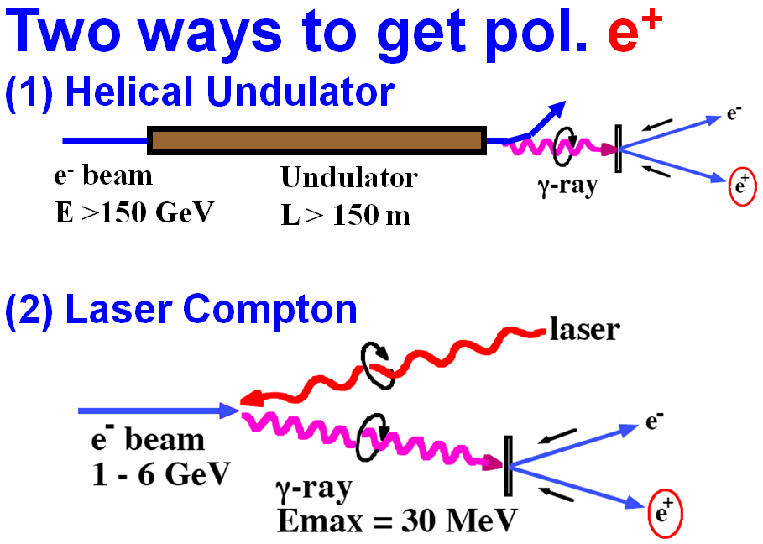
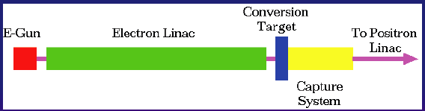
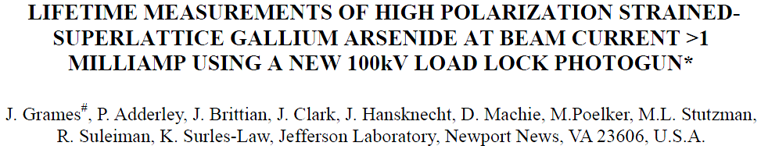
PhD Thesis: Polarized Positrons for JLab, Jonathan DUMAS
Advisors: Eric Voutier, LPSC and Joe Grames, JLab
ILC Polarized e+ Schemes/Demos
(synchrotron/Compton polarized photon)
Conventional un-polarized e+ Scheme
(bremsstrahlung photon)
E = 50 GeV L = 1m E-166 Experiment
OR
High Polarization, High Current e- Gun
(polarized bremsstrahlung photon)
T. Omori, Spin 2006
Positron Yield scales with Beam Power
Replace GeV-pulsed with MeV-CW
Reduce radiation budget
Remain below photo-neutron threshold
Bunch/Capture to SRF linac
Compact source vs. Damping Ring
Unique capabilities
First CW source with helicity reversal
Source Property | E-166 Experiment PRL 100, 210801 (2008) | J. Dumas et al. Proc. Spin 2008
Electron beam energy | 50 GeV - Undulator | 10 MeV - Conversion
Electron beam polarization | Unpolarized | 85%
Photo Production | Synchrotron | Bremsstrahlung
Converter Target | Tungsten Foil | Tungsten Foil
Positron Polarization | 80% (measured) | 40% (Simulation)

Slide 10
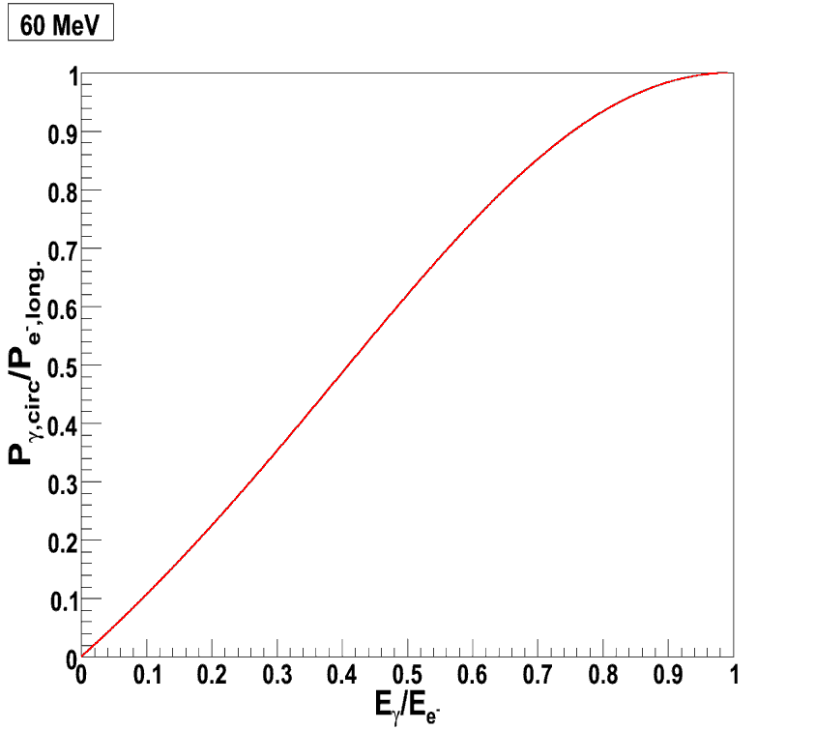

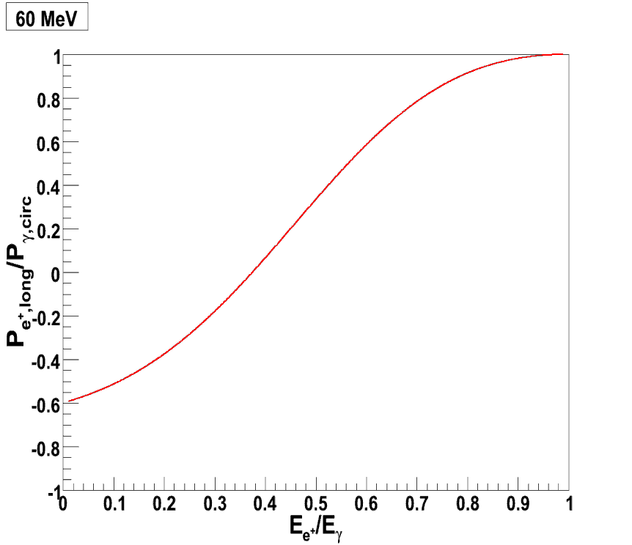
e⁺ Source Polarization
Simulation are performed within the GEANT4 framework, taking advantage of the polarization capabilities developed by the E166 Collaboration.
The source files are modified to select complete screening (where T~0 or T~60 MeV)
R. Dollan, K. Laihem. A. Schälicke, NIM A559 (2006) 185
Polarized
Bremsstrahlung
Polarized
Pair Creation
H.A. Olsen, L.C. Maximon, Phys. Rev. 114 (1959) 887.

Slide 11

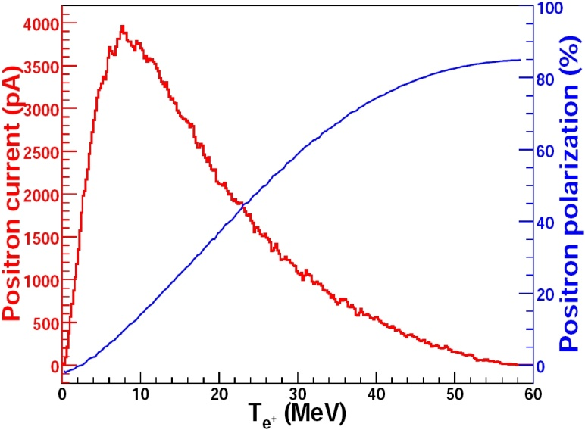
e⁺ Figure of Merit (FOM)
The Figure of Merit is the quantity of interest for the accuracy of a measurement which combines
the incident flux of particles and its polarization.
Optimum
FoM
Optimum energy

Slide 12
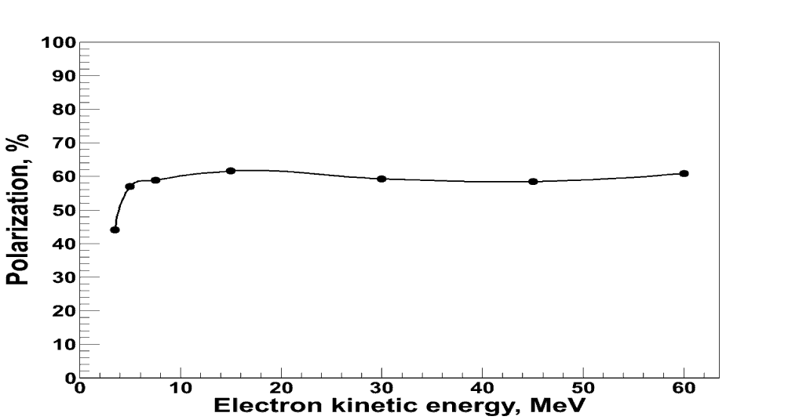
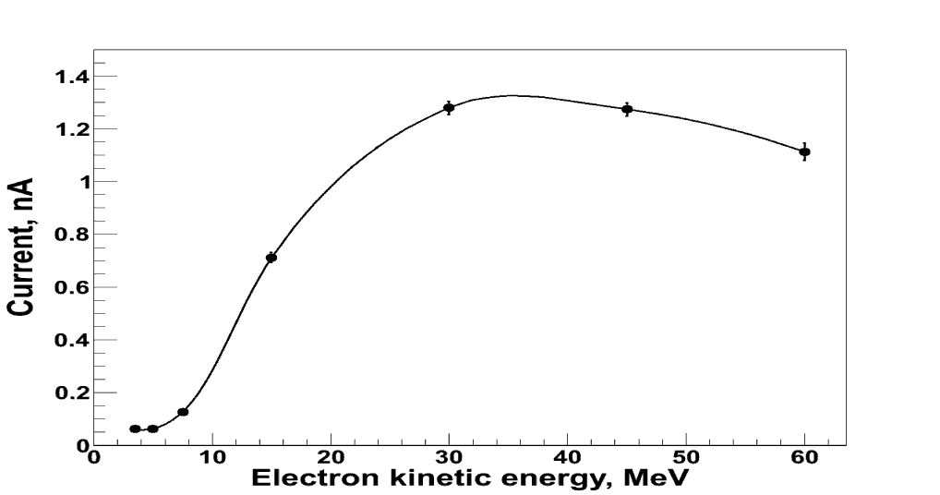
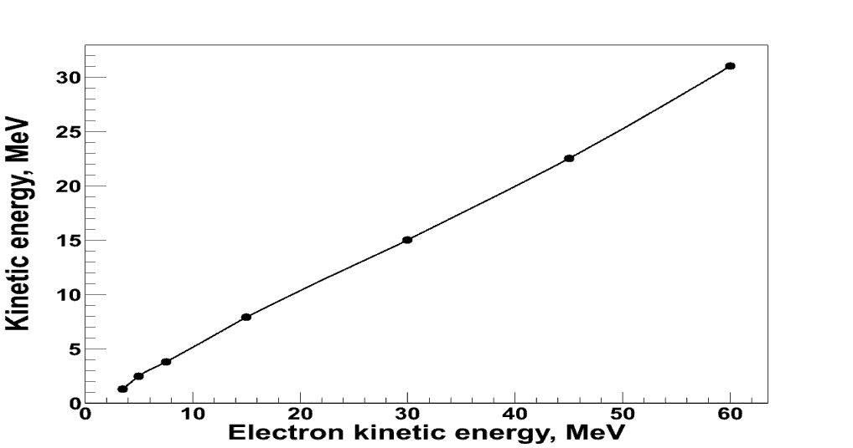
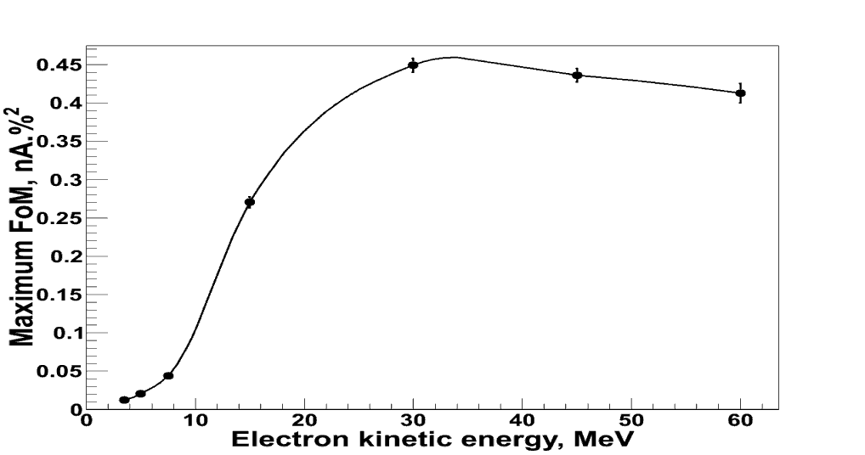
FOM Evolution vs. e- Energy (0 to 60 MeV)
Simplistic cuts are applied to mimic a capture system and the accelerator acceptance.
Thickness sensitivity is under study…

Slide 13
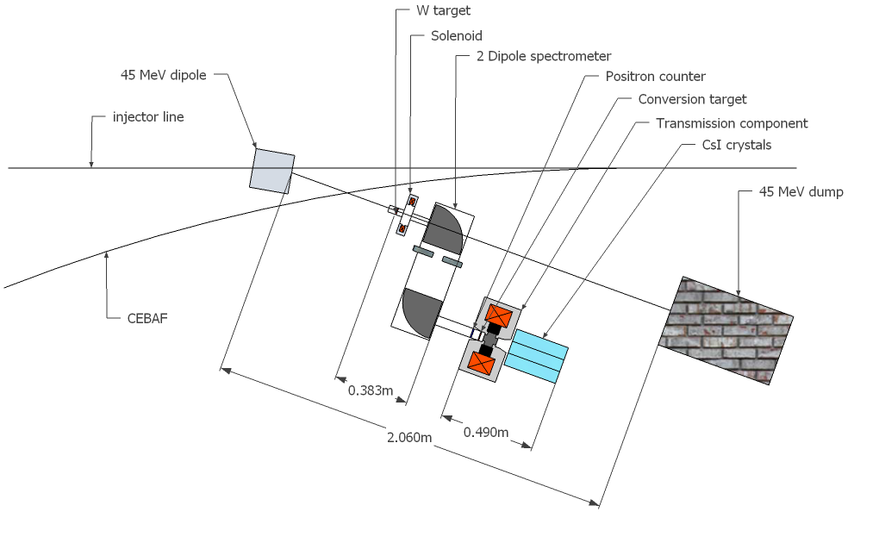
Demonstration Experiment
An experiment to test the production of polarized positrons is currently designed.
The goals are to measure the yield and polarization distributrions as a function of the beam energy.
The ATF/KEK & E166 successful set-up serves as a conceptual guidance towards the final design.
Polarimetry would consist of a Compton transmission polarimeter.
Calibration and check of the analyzing power can be performed with the polarized electron beam.
The Compton asymmetry would be measured by reversing the beam (up to 1 kHz frequency of random change) and/or the target polarization.
G. Alexander et al, PRL 100 (2008) 210801
G. Alexander et al, physics.ins-det:0905.3066
ATF/KEK: M. Fukuda et al. PRL 91 (2003) 164801 T. Omori et al. PRL 96 (2006) 114801

Slide 14
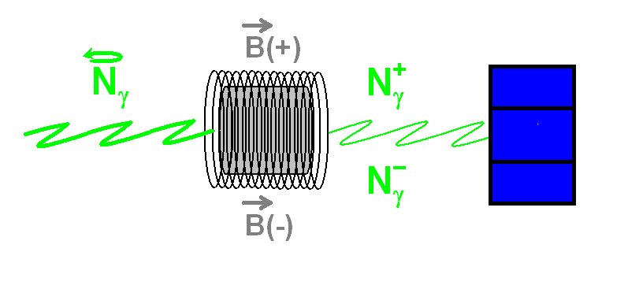
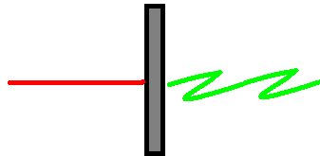
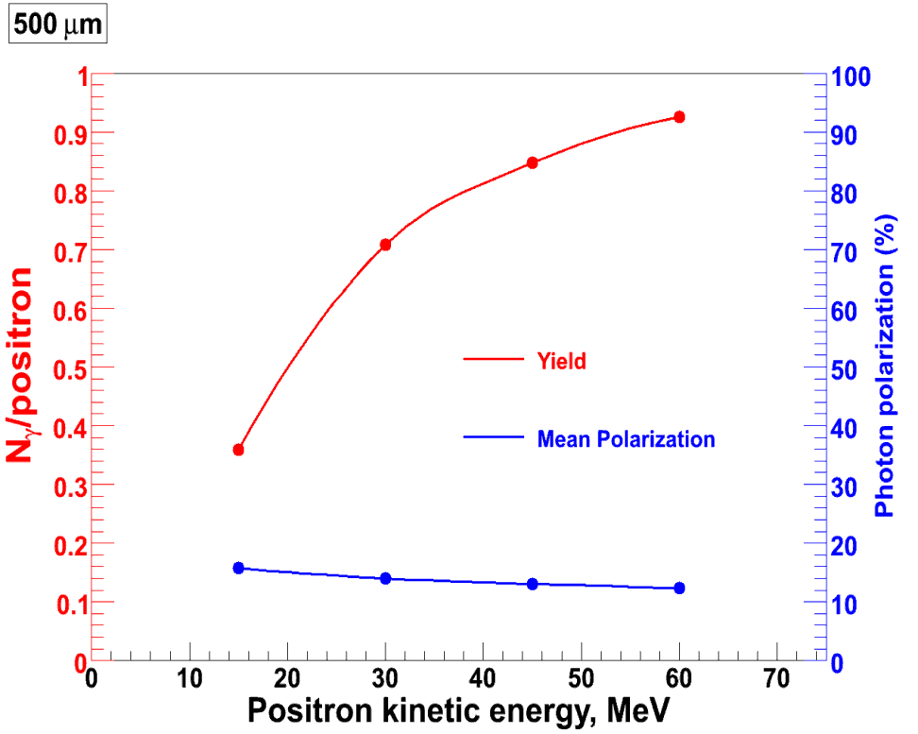
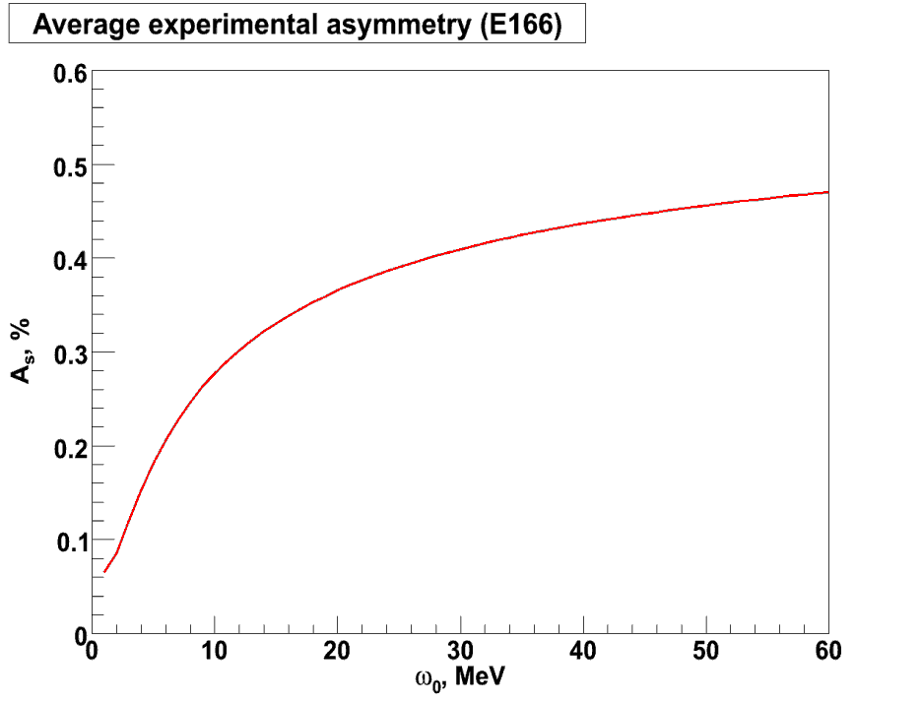
Compton Transmission Polarimeter
W
e⁺
photons
P_{γ}, _{circ}=100%
Detector solid angle = +/- 8°
Average asymmetry for P_{γ},_{circ}=10%

Slide 15
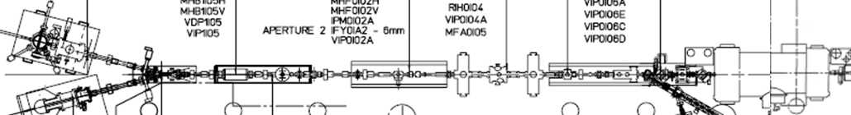
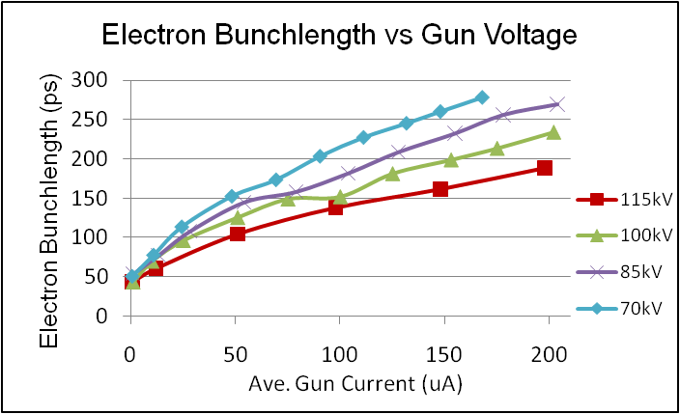
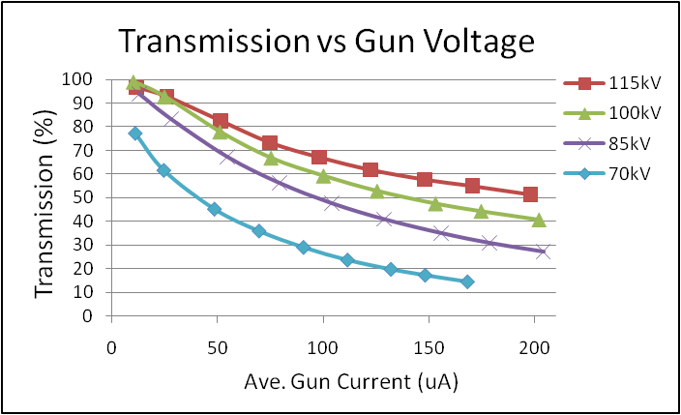
What about CEBAF 10 MeV injector at milliamps?
100kV Gun
ε_{x,y} filter
ε_{z} filter
SRF
Condition | Repetition Rate | Bunch Charge | Current
Typical | 499 MHz | 0.2 pC | 100 uA
G0 (2003) | 31 MHz | 1.25 pC | 40 uA
G0-like | 1497 MHz | 1.25 pC | 1900 uA
Operating at higher gun voltage…
Improves transmission (stiffer beam)
May improve photocathode lifetime
For high bunch charge guns (like ILC/CLIC)
Essential to overcome photoemission limit

Slide 16
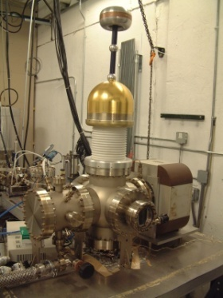
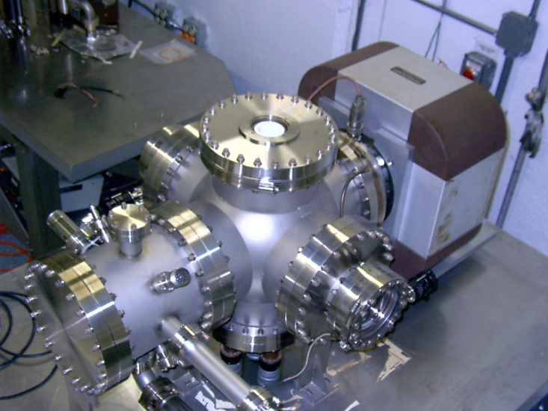
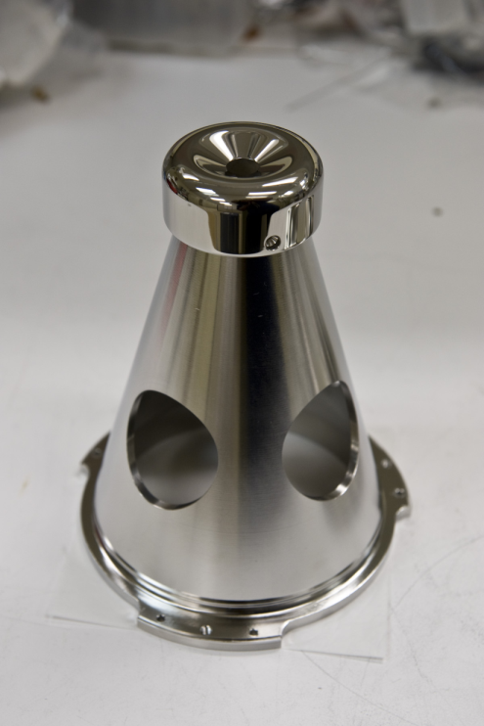
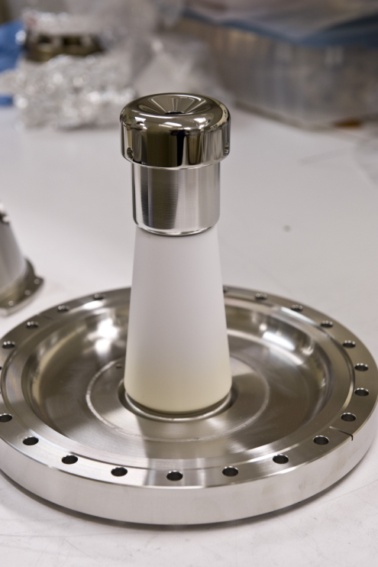
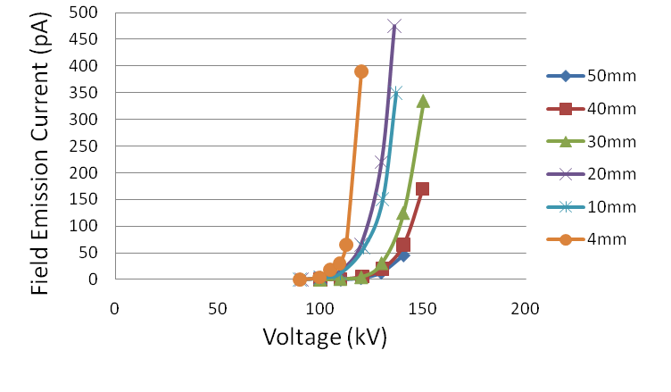
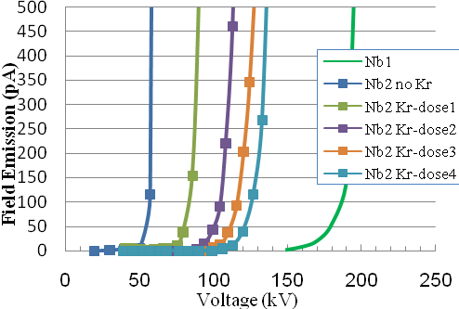
Field Emission – Critical Issue for Higher Voltage
“Conventional”
cathode electrode mounted on metal support structure
“Inverted”
no SF6 and no HV breakdown outside chamber
Stainless Steel (vs. gap)
Niobium (50 mm gap)
5 MV/m
Work of Ken Surles-Law, Jefferson Lab
Thanks to P. Kneisel, L. Turlington, G. Myneni

Slide 17

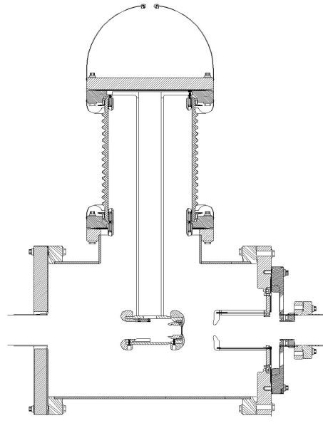
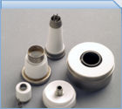
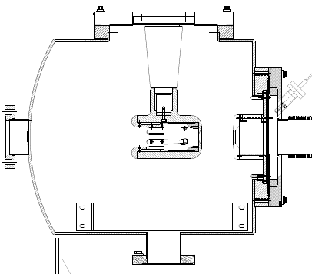
“Inverted” Gun
Conventional Ceramic
Exposed to field emission
Large area
Expensive (~$50k)
Medical x-ray technology
e⁻
New Ceramic
Compact
~$5k
New design
NEG modules too close
Want to move away from “conventional” insulator used on all GaAs photoguns today – expensive, months to build, prone to damage from field emission.

Slide 18
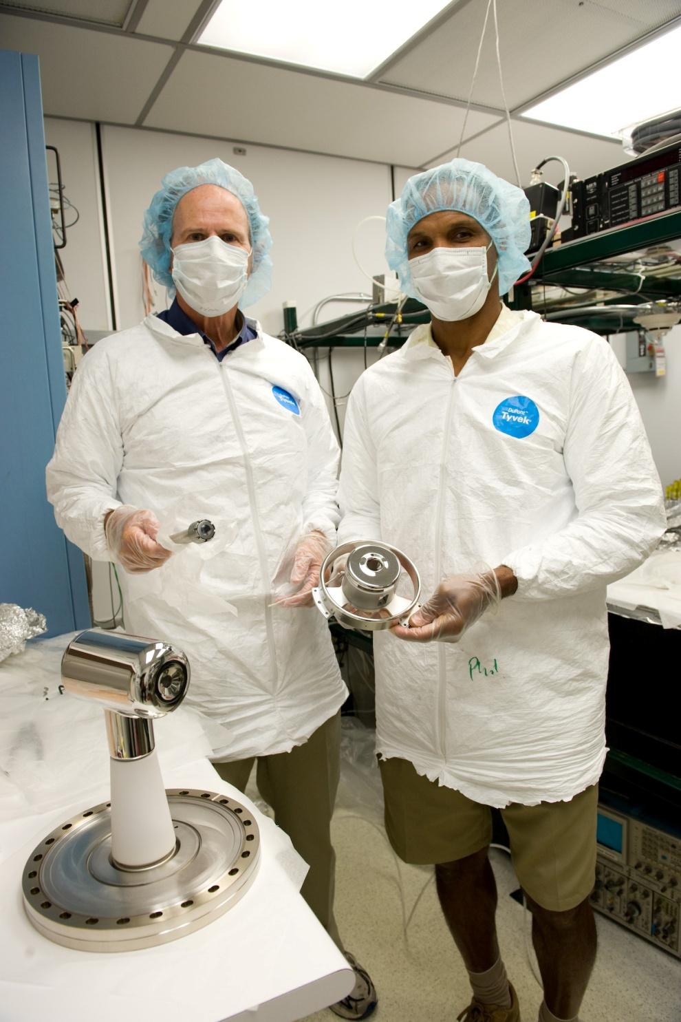
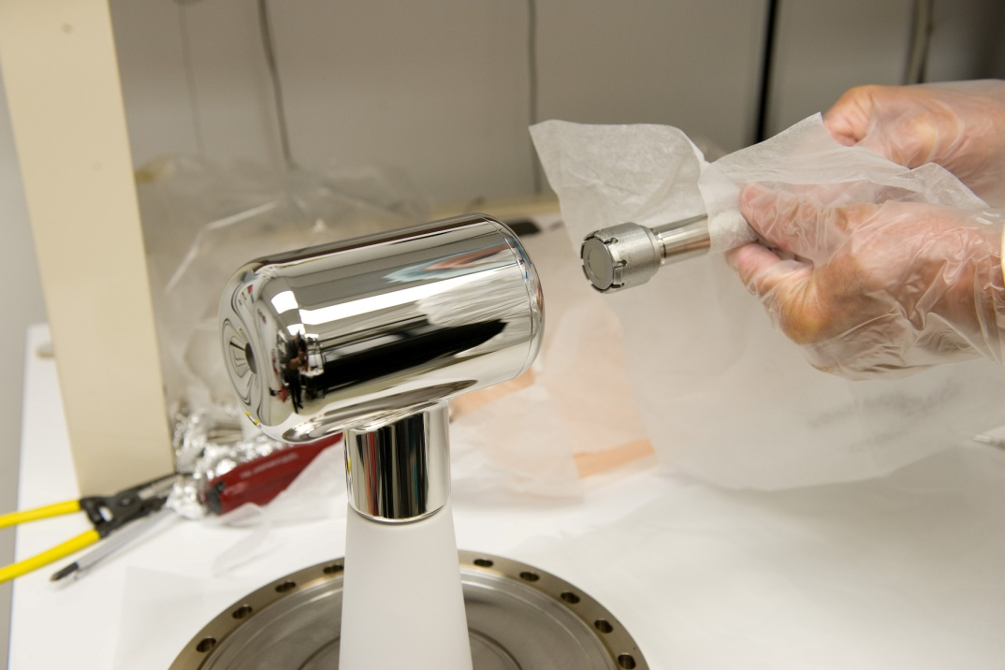
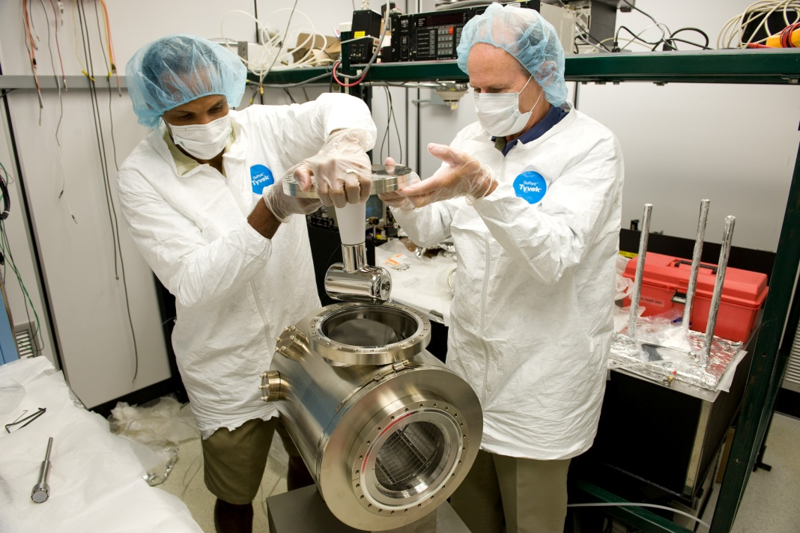
July 2009 – Assembling the inverted gun chamber

Slide 19
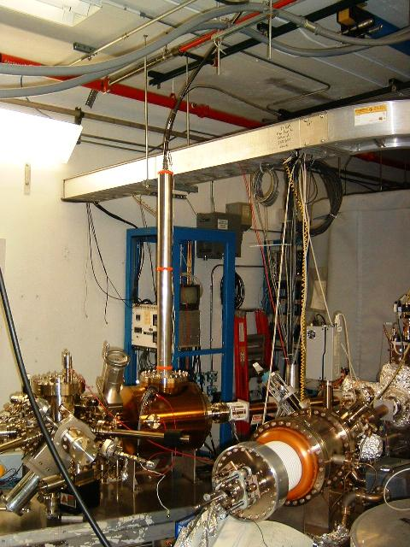
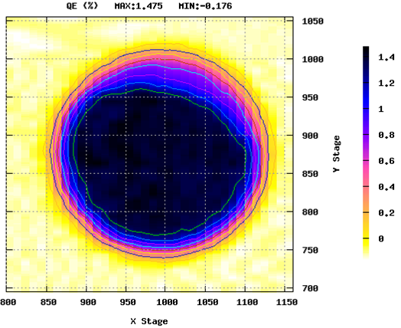
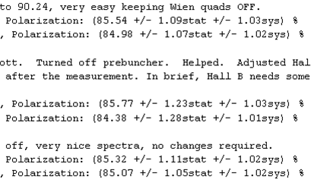
New CEBAF “Inverted” Polarized e- Gun
Installed July-August:
Vacuum => extractor ~3E-12 Torr, IP ~20pA
HV Process to 110kV => no FE or VAC activity
New HVPS => Increased to 150kV supply
New Photocathode => QE>1% and P~85%
Just began running about a week ago.
We’ll begin characterizing lifetime & photocathode…

