Slide 1
Homework - Clarification
4.5K Cold Box Controls Software Review
Ritendra Bhattacharya
March 3-4, 2020

Slide 2
Homework # 1
Example of one hazard in HAZOP, trace back to PFD, P&ID, Controls Philosophy, Specifications, Code, Validation (check-out documentation of bench tests)

Slide 3
Interface HAZOP
Interface HAZOP study was performed referring to document # C1303 NT 701 (0)
Action following HAZOP is to add a PID pressure controller to control the pressure using PV-22390 or PV22393.

Slide 4
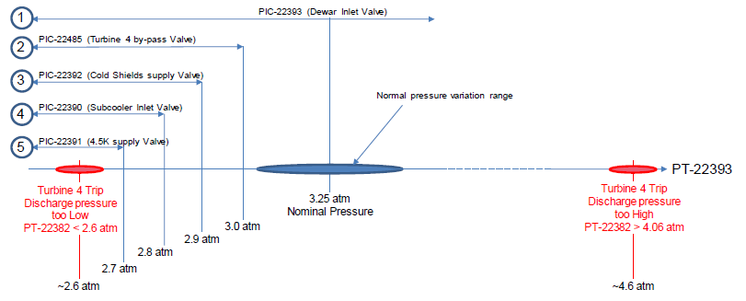
Control Philosophy

Slide 5
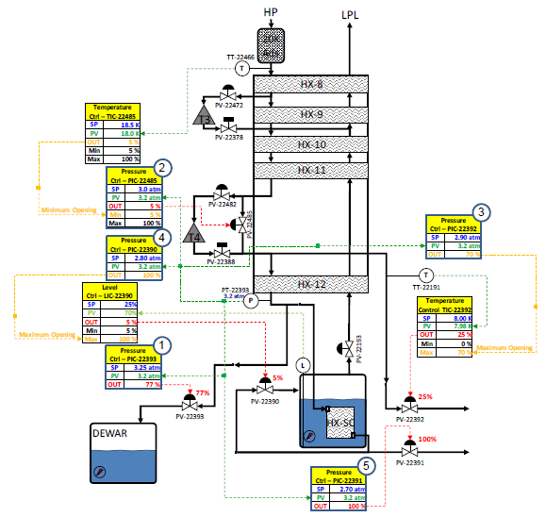
Control Philosophy with PFD

Slide 6
PLC Code
PV22939 PID Controller PV22390 PID Controller

Slide 7
Check Out - Results

Slide 8
Homework # 4
Information on R2A2s and assignments for plan forward, specifically on Ritendra’s Integration (Slide 14).

Slide 9
Slide # 14
No. | Description | Days | JLAB | ALATUS | SLAC
100 | Initial Check of Installation: Equipment, Tools & Utilities - Wiring checks | 5.0 1.0 | EE | POC + LEAD | EE
210 | Final Loop Checks Electrical synchronization of signals (from HMI to sensor/actuator) Check good working of actuators: heater, valves (+ calibration), etc. Check good working of sensor and calibrate if needed Check emergency stop action | 5.0 | EE | POC + LEAD | EE + ET
250 | Final Software check – Alarms, Trips and Interlocks - Check all the thresholds and simulate if possible | 3.0 | EE | POC + LEAD | EE
310 | Final Software check – Sequences Preliminary test of controller & sequences (turbine, cool down, thermal shield etc.) Check of system interlocks and alarms (if some could not be tested at #250) | 5.0 | EE | POC + LEAD | EE
340 | Cold box start: Test & tune sequences Cool Down Adsorber Regeneration Warm and Cold Shields Primary 4.5 K supply Calibration checks Shutdown checks | 24.0 | EE + SME | POC + LEAD | OPS + EE
350 | Performance Tests - Testing of 6 operating modes | 20.0 | SME | POC + LEAD | OPS + SME

Slide 10
JLAB Team: R. Bhattacharya, R. Norton, A. Rangharajan, N. Sandoval
ALATUS Team: A. PERFECT, G. MAS
SLAC Team: D. Fairley, A. De Lira, S. Shrishrimal, D. Robinson

Slide 11
THANK YOU FOR KIND ATTENTION

