Slide 1
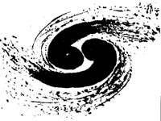
Highlights from BESIII
Shuangshi Fang
(for the BESIII Collaboration )
Institute of High Energy Physics
The 7th International Chiral Dynamics Workshop,
August 6-10, 2012, Jefferson Lab, USA

Slide 2
Outline
Status of BEPCII/BESIII
Charmonium transitions
Charmonium decays
Light hadron spectroscopy
Charm physics
Summary

Slide 3
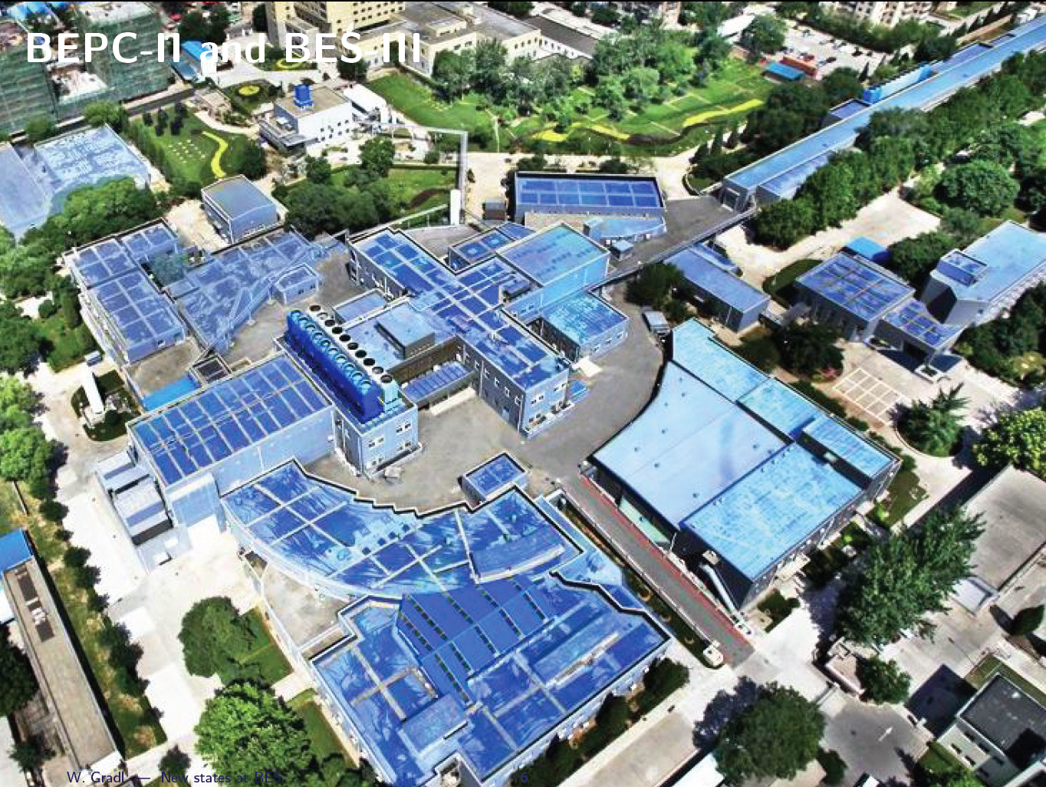
Satellite view of BEPCII /BESIII
LINAC
South
2004: start BEPCII construction
2008: test run of BEPCII
2009-now: BECPII/BESIII
data taking
BESIII detector

Slide 4
BEPCII storage rings
Beam energy:
1.0-2.3 GeV
Design Luminosity:
1×10³³ cm⁻²s⁻¹
Optimum energy:
1.89 GeV
Energy spread:
5.16 ×10⁻⁴
No. of bunches:
93
Bunch length:
1.5 cm
Total current:
0.91 A
Circumference：
237m

Slide 5
NIM A614, 345 (2010)
The BESIII Detector
Drift Chamber (MDC)
σP/P (⁰/₀) = 0.5%(1GeV）
σ_{dE/dx} (⁰/₀) = 6%
Super-conducting magnet (1.0 tesla)
Time Of Flight (TOF)
σ_{T} : 90 ps Barrel
110 ps endcap
μCounter
8- 9 layers RPC
δRΦ=1.4 cm~1.7 cm
EMC： σE/√E(⁰/₀) = 2.5 % (1 GeV)
(CsI) σ_{z,φ}(cm) = 0.5 - 0.7 cm/√E
Comparable capabilities to CLEO-c, plus muon ID
The big advantage: BEPCII is a double-ring machine designed for charm
  Design (achieved) luminosity at ψ(3770): 1 (0.65) x 10³³

Slide 6
BESIII Collaboration
(12)
(2)
300> physicists
52 institutes from 11 countries

Slide 7
BESIII – physics using “charm”
Charmonium physics:
- Spectroscopy
- transitions and decays
Light hadron physics:
- meson & baryon spectroscopy
- glueball & hybrid
- two-photon physics
- e.m. form factors of nucleon
Charm physics:
- (semi)leptonic + hadronic decays
- decay constant, form factors
- CKM matrix: Vcd, Vcs
- D⁰-D⁰bar mixing and CP violation
- rare/forbidden decays
Tau physics:
- Tau decays near threshold
- tau mass scan
…and many more.

Slide 8
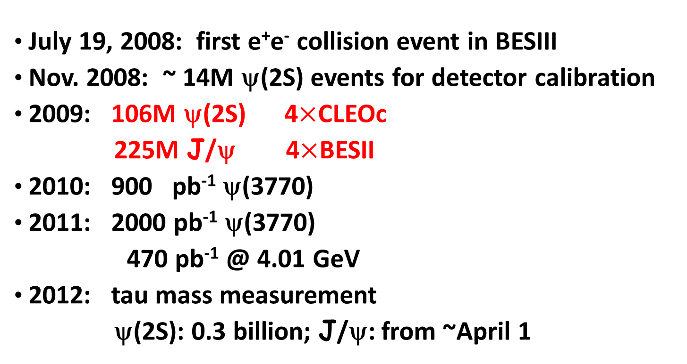

BESIII data set and future plans
World’s largest sample of
J/ψ,ψ(2S) and ψ(3770)
(and still growing)
0.4
1 billion
Tentative future running plans:
  2013 E_{CM}=4260 and 4360 MeV for “XYZ” studies (0.5 fb⁻¹ each)
  2014 E_{CM}=4170 MeV for Ds (~2.4 fb-1)
  TBD Additional ψ(3770) data

Slide 9
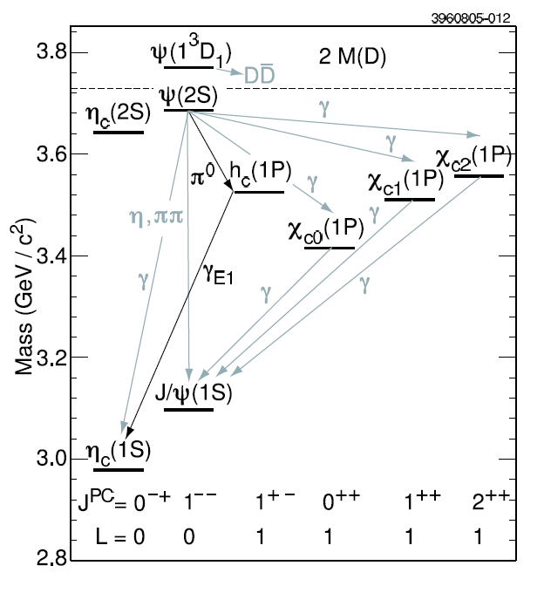
Below Threshold Charmonium
Properties not
well known
Problems with mass
measurements

Slide 10
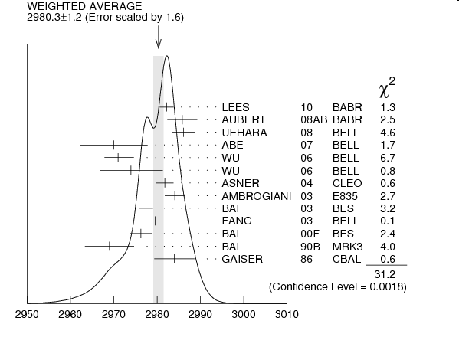
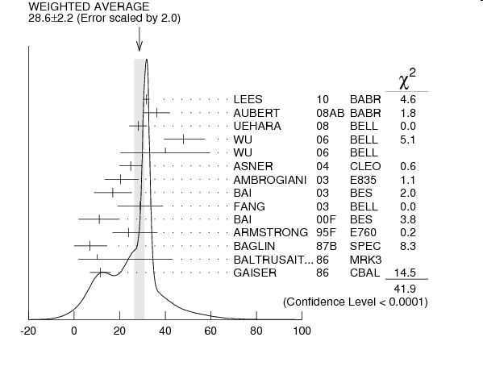

Mass and width of η_{c}(1S)
Ground state of $c\overline{c}$ system, but its properties are not well known:
J/ψradiative transition:M $\sim$ 2978.0MeV/c², Γ $\sim$ 10MeV
γγ process: M = 2983.1±1.0 MeV/c², Γ = 31.3±1.9 MeV
CLEOcfound the distortion of the η_{c}lineshape in ψ’ decays
$c\overline{c}$ hyperfine splitting: M($\text{J}/ψ$)- M(η_{c}) is important experimental input
to test the lattice QCD, but is dominated by error on M(η_{c})
width
mass

Slide 11
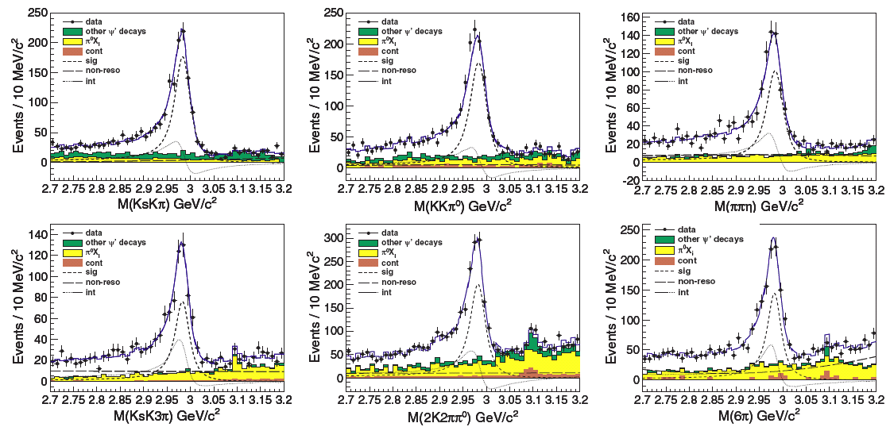
η_{C} resonance parameters from ψ′→γη_{C}
KsK
η
KK⁰
KsK3
2K2⁰
3()
The interference between η_{c} and non-η_{c} decays:
mass: 2984.30.6_{stat}0.6_{sys} MeV/c²
width: 32.01.2_{stat}1.0_{sys} MeV
: 2.400.07_{stat}0.08_{sys} rad (constructive)
or 4.190.03_{stat}0.09_{sys} rad (desconstruct)
Relative phase φ values from each
mode are consistent within 3,
➔ use a common phase value
in the simultaneous fit.
Phys.Rev.Lett. 108 (2012) 222002

Slide 12
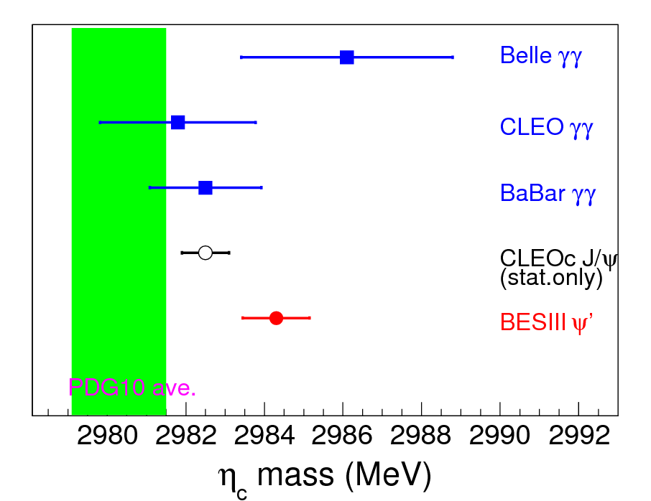
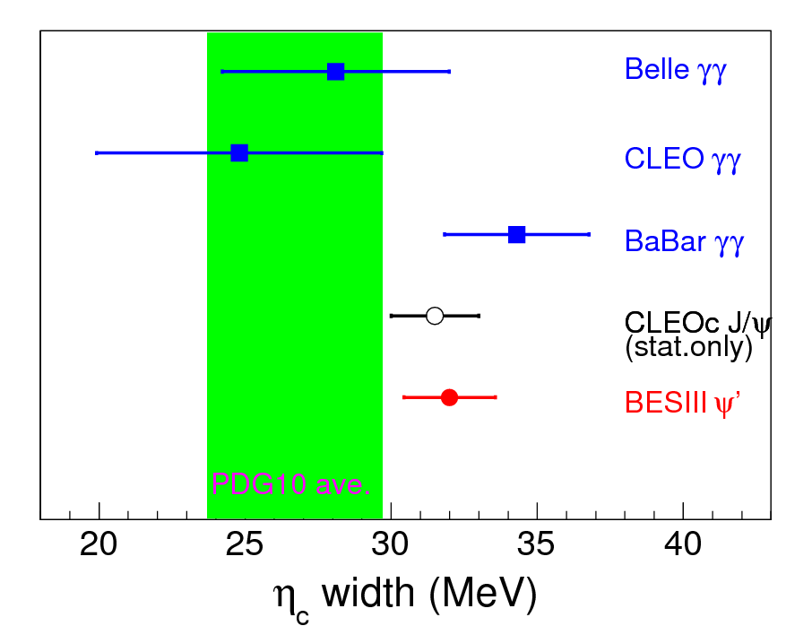
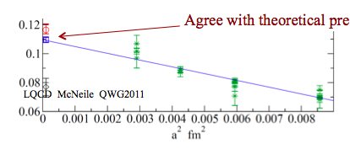
Comparison of the mass and width for η_{c}
Hyperfine splitting: ΔM(1S) = 112.6 ± 0.8 MeV
Better agreement with LQCD calculations

Slide 13
Property of h_{c} (1p1)

Slide 14
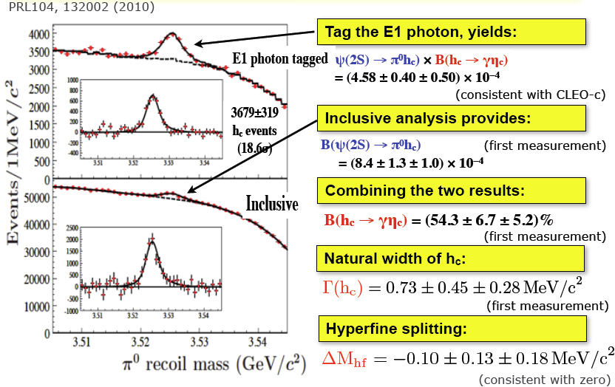
Observation of h_{c} in inclusive reaction

Slide 15
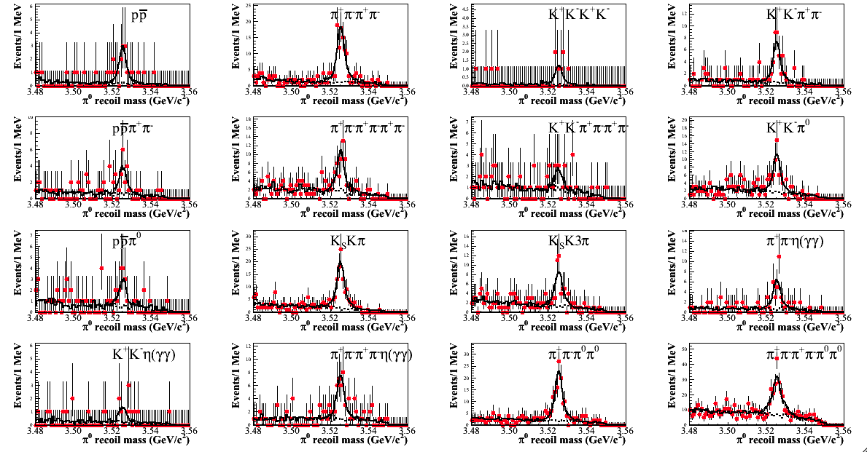
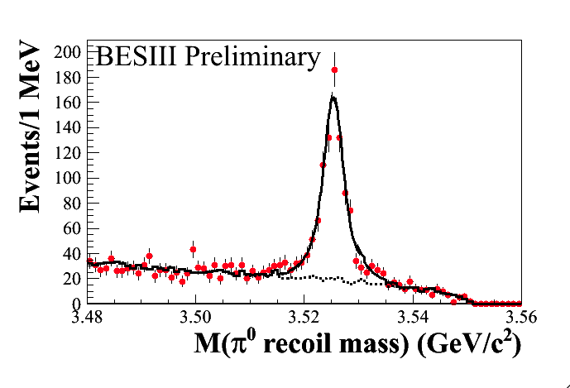
h_{c}(1P1) in ψ′→⁰h_{c}, h_{c}→γη_{c,} η_{c}→X_{i} (exclusive)
BESIII preliminary
ψ′→⁰h_{C}, h_{C}→γη_{C},
η_{C} is reconstructed
exclusively with
16 decay modes
Summed π⁰ recoil mass
Simultaneous fit to π⁰ recoiling mass:
M(h_{c}) = 3525.31±0.11±0.15 MeV
Γ(h_{c}) = 0.70±0.28±0.25 MeV
N = 832±35
²/d.o.f. = 32/46
Consistent with BESIII inclusive
results PRL104,132002(2010)
CLEOc exlusive results
M(h_{c})=3525.21±0.27±0.14 MeV/c²
N = 136±14
PRL101, 182003(2008)
BESIII preliminary

Slide 16
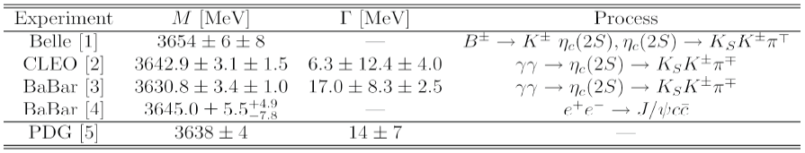
  Observation of ψ’→ γη_{c}(2S)
First “observation” by Crystal Ball in 1982 (M=3.592, B=0.2%-1.3% from ψ′→γX, never confirmed by other experiments.)
Published results about η_{c}(2S) observation:
Combined with the results based on two-photon processes from BaBar and Belle reported at ICHEP 2010, the world average Γ(η_{c}(2S))=12±3 MeV
The M1 transition ψ′→γη_{c}(2S) has not been observed.
(experimental challenge : search for real photons ~50MeV, )
Better chance to observe η_{c}(2S) in ψ′ radiative transition with ~106M ψ′ data at BESIII.
Decay mode studied: ψ′→γη_{c}(2S)→γKsKπ ,Κ⁺Κ⁻π⁰

Slide 17
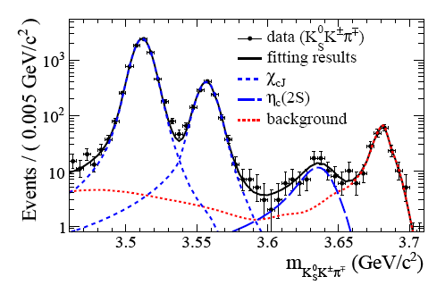
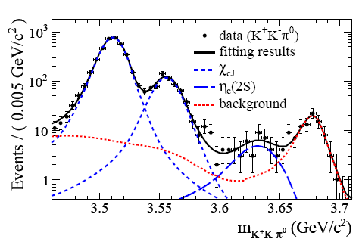
Observation of η_{c}(2S) in ψ′→γη_{c}(2S), η_{c}(2S)→K_{s}K, K⁺K⁻⁰
With 106M ψ′ events:
simultaneous fit results:
M(η_{c}(2S)) = (3637.6±2.91.6) MeV/c²
G(η_{c}(2S)) = 16.9±6.4±4.8
Statistical significance larger than 10.2σ!
Br(ψ′→γη_{c}(2S)→γKKπ)
=(1.30±0.20_{stat}±0.30_{sys}) ×10⁻⁵
+
Br(η_{c}(2S)→KKπ)=(1.9±0.4±1.1)%
From BABAR(PRD78,012006)
Br(ψ′→ γη_{c}(2S))
=(6.8±1.1_{stat}±4.5_{sys}) ×10⁻⁴
CLEO-c: <7.610^{4} PRD81,052002(2010)
Potential model: (0.16.2)10^{4}
PRL89,162002(2002)
Phys. Rev. Lett. 109, 042003 (2012)

Slide 18
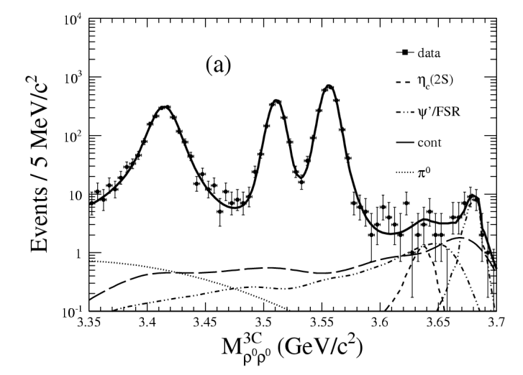
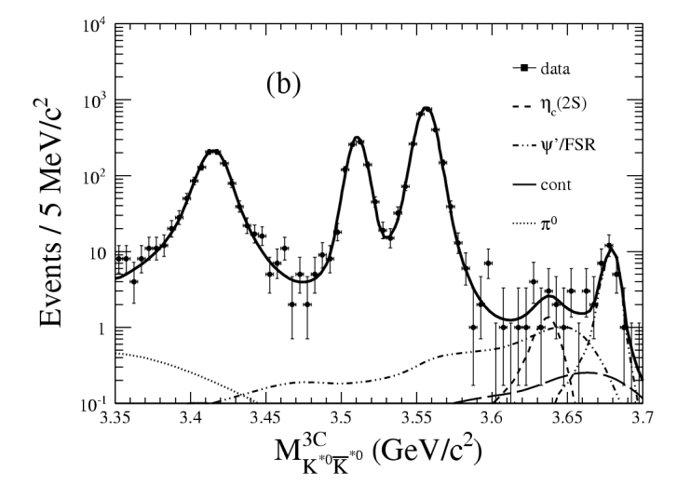
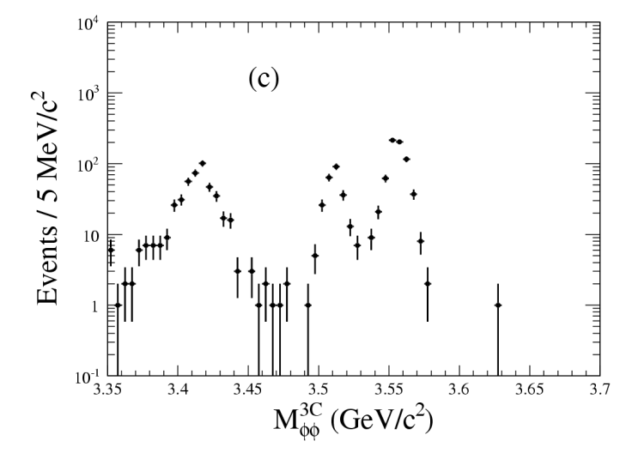
Search for η_{c}(2S)→VV
PRD84, 091102R (2011)
Test for the ‘intermediate charmed meson loops’:
η_{c}(2S)→VV is highly suppressed by the helicity selection rule.
‘intermediate charmed meson loops’ can increase the production rate of η_{c}(2S)→VV.
(PRD81, 014017 (2010))
ρ⁰ρ⁰
K*⁰K*⁰
φφ
 | Br(ψ′→γη_{c}(2S)→γVV) (10⁻⁷) | Br(η_{c}’→VV) (10⁻³) (using BESIII BF(ψ′→γη_{c}(2S)) | Br(η_{c}’→VV) (10⁻³) Theory: (arXiv:1010.1343)
ρ⁰ρ⁰ | <12.7 | <3.1 | 6.4 ~ 28.9
K*⁰K*⁰ | <19.6 | <5.4 | 7.9 ~ 35.8
φφ | < 7.8 | <2.0 | 2.1 ~ 9.8
No signals observed in η_{c}(2S)→ ρρ, K*⁰K*⁰, φφ; more stringent UL’s are set.

Slide 19
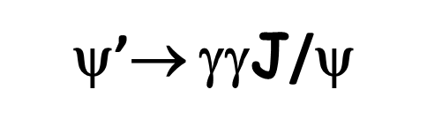
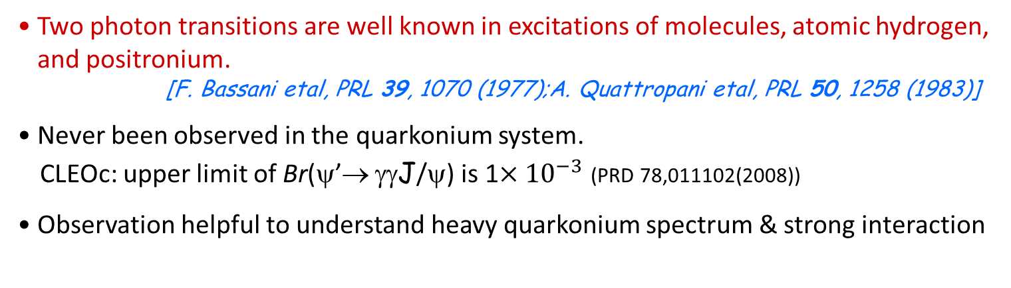
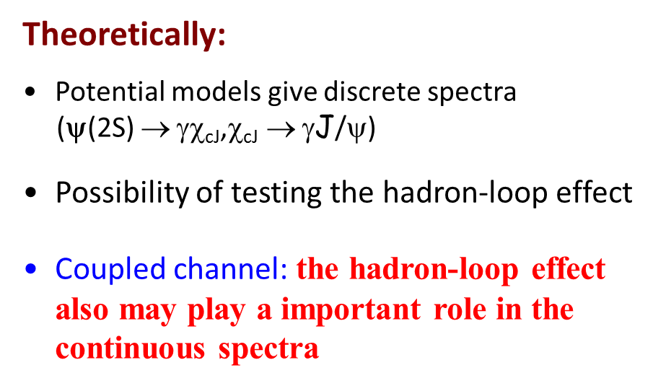
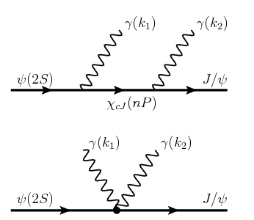
Coupled channel: the hadron-loop effect
also may play an important in the continuous
spectra

Slide 20

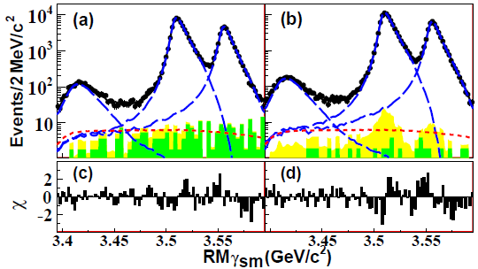
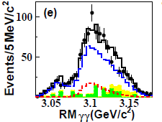
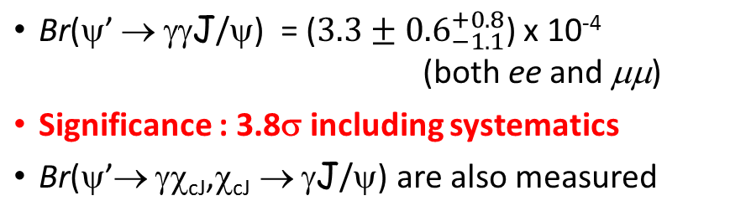
arXiv: 1112.0942 Submit to PRL
Select ψ(2S) → γγJ/ψ, J/ψ → e⁺e⁻ and μ⁺μ⁻ events
γ_{sm} - low energy gamma
the χ_{cJ} components: double E1 scaling
yields of the two-photon events
continuum(green)+ ψ’-decay BG(yellow)
ee
μμ
Global fit of the two-photon process and cascade χ_{cJ} processes
See clear excess over BG + continuum
3.44<RM(γ_{sm} )<3.48GeV

Slide 21
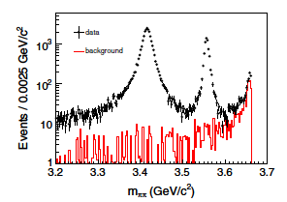
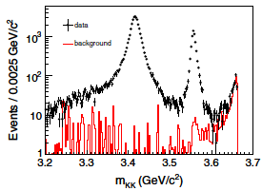
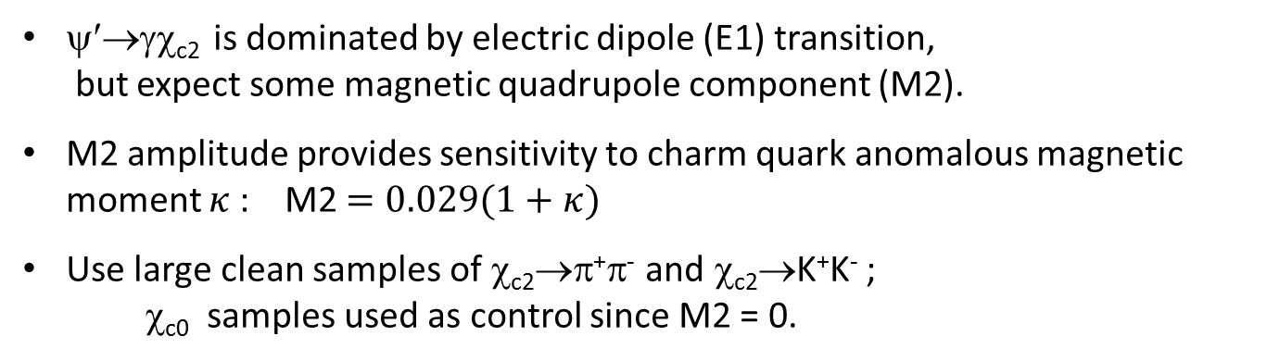
Higher-order Multipole in ψ′→γχ_{c2}, χ_{c2}→π⁺π⁻,K⁺K⁻
PRD84, 092006 (2011)
Investigate the contribution from high-order multipole amplitudes
ψ′→γχ_{c2} is dominated by electric dipole (E1) transition,
but expect some magnetic quadrupole component (M2).
M2 amplitude provides sensitivity to charm quark anomalous magnetic moment $κ$: M2$=0.029(1+κ)$
Use large clean samples of χ_{c2}→π⁺π⁻ and χ_{c2}→K⁺K⁻ ;
χ_{c0} samples used as control since M2 = 0.
χ_{c0}
χ_{c2}
χ_{c0}
χ_{c2}
ψ′→γπ⁺π⁻
ψ′→γK⁺K⁻

Slide 22
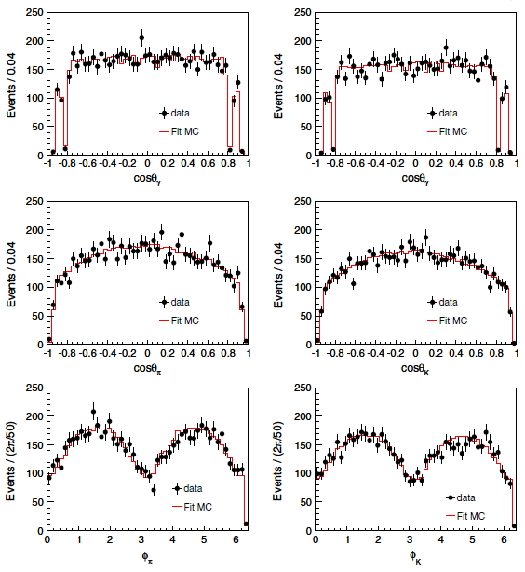

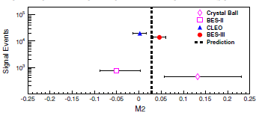


Higher-order Multipole in ψ′→γχ_{c2}, χ_{c2}→π⁺π⁻,K⁺K⁻
PRD84, 092006 (2011)
Extract M2 using fit to
full angular distribution
Evidence of M2 contribution:
4.4σ
Significant signal for M2 amplitude
that is consistent with $κ$ =0
M(c) = 1.5 GeV and $κ$ = 0
χ_{c2}→π⁺π⁻,
χ_{c2}→K⁺K⁻

Slide 23
Evidence for ψ′ decays into γ and γη
PRL105, 261801(2010)
We are measuring
BRs at 10⁻⁶

Slide 24
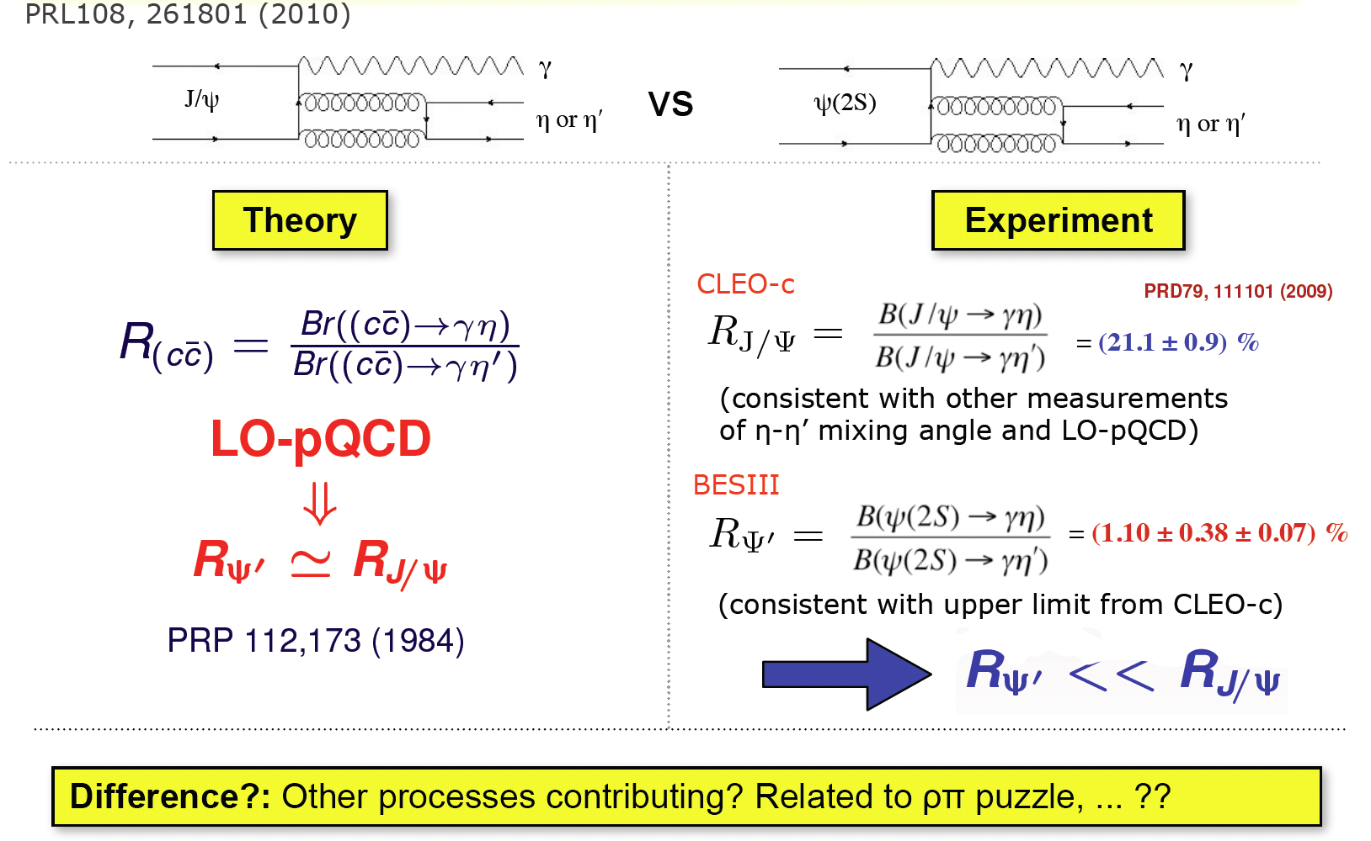
Some surprises
PRL105, 261801(2010)
Q. Zhao, PLB697(2011)52

Slide 25
χ_{cJ}→VV
PRL107, 091803 (2011)
φφ(KK)
φφ(3π)
ωω
ωφ
Evidence
First observation
PRD81 014017 (2010) , PRD81 074006 (2010)

Slide 26
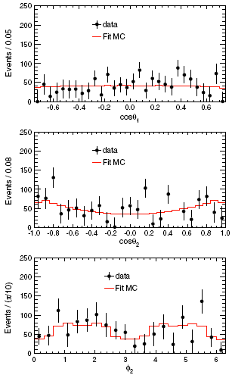
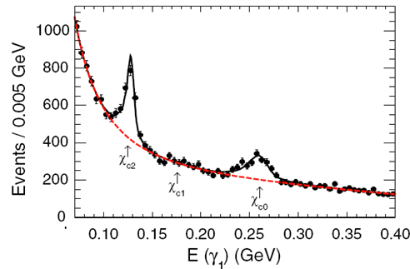
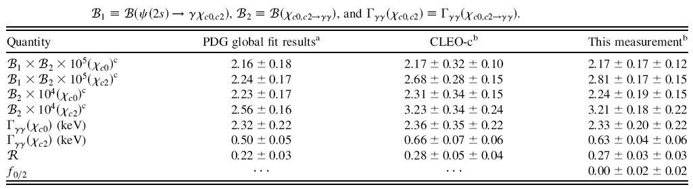

χ_{c0/2}→γγ
PRD85, 112008, (2012)
γ(λ1)
Helicity configuration
χ_{c2}
γ(λ2)
f₀
f₂

Slide 27
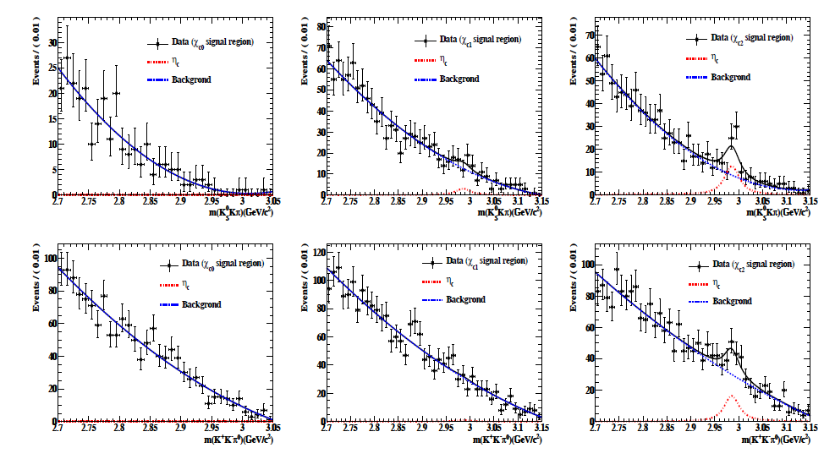

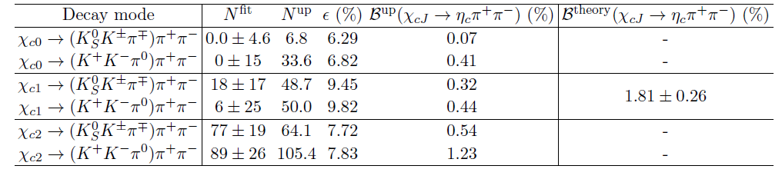
Search for χ_{cJ}→π+π+η_{c} (η_{c}→KKπ)
(Preliminary results)
χ_{c0}
χ_{c1}
χ_{c2}
M(K_{S}Kπ)
M(KKπ⁰)
@ 90% C.L.

Slide 28
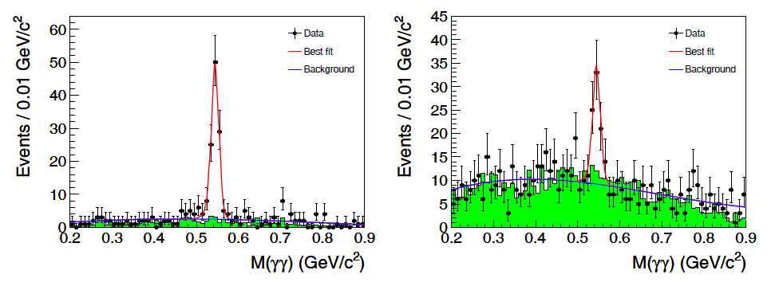
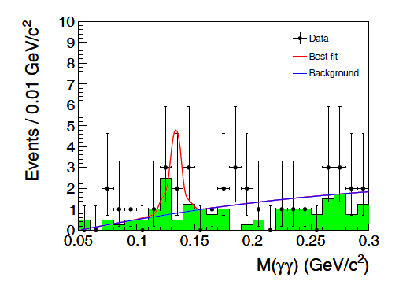



Observation of e⁺e⁻→η J/Ψ @4.009 GeV
(Preliminary results)
J/ψ → μ⁺μ⁻
J/ψ → e⁺e⁻
J/ψ → μ⁺μ⁻
Data: 477pb⁻¹ @ 4.009 GeV
First observation of e+e-→ ηJ/Ψ
Assumption of ηJ/Ψ signal is from Ψ(4040)
@90% C.L.

Slide 29
Charm as a tool to study light hadron spectroscopy

Slide 30
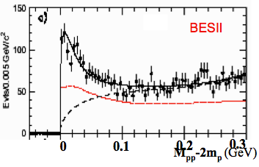
Observation of X(ppbar) @ BESII
Theoretical interpretation:
conventional meson?
ppbar bound state/multiquark
glueball
Final state interaction (FSI)
…
+3 +5
−10 −25
M=1859 MeV/c²
Γ < 30 MeV/c² (90% CL)
PRL 91 (2003) 022001

Slide 31
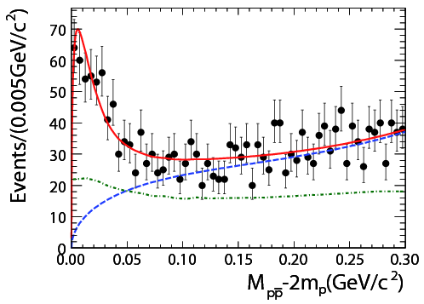

Confirmation @ BESIII and CLEOc
Fit with one resonance at BESII did:
BESIII
CLEOc
M=1861 ⁺⁶ ₋₁₃⁺⁷₋₂₆ MeV/c²
Γ < 38 MeV/c² (90% CL)
Chinese Physics C 34, 421 (2010)
PRD 82, 092002(2010)

Slide 32
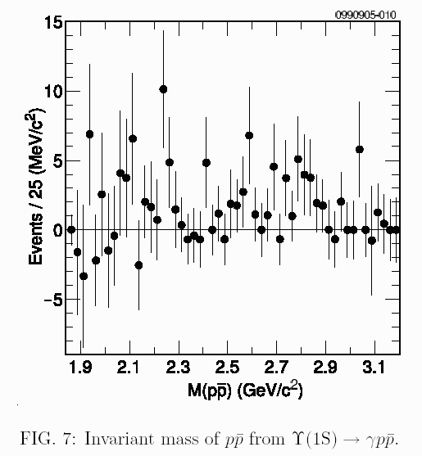
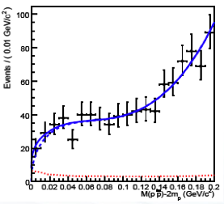
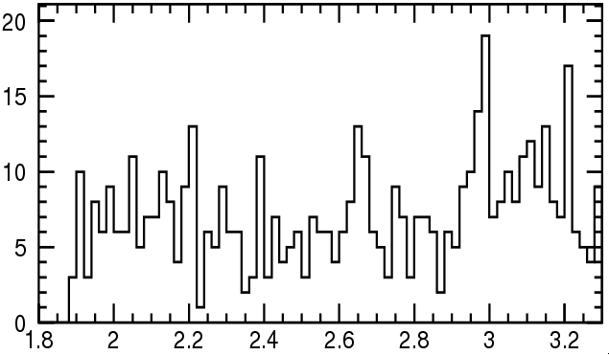
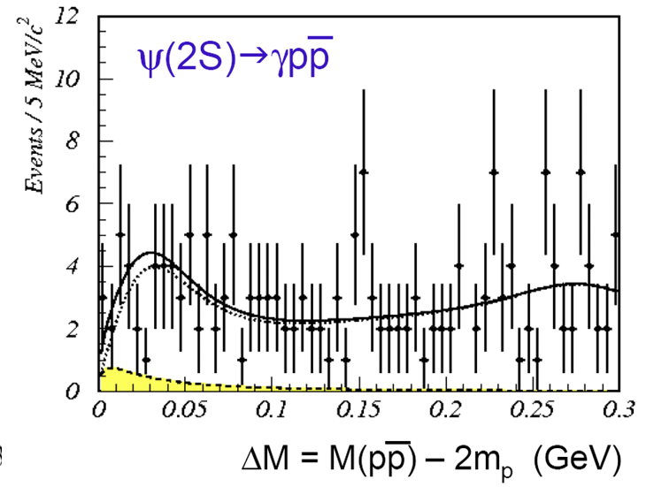



Several non-observations
$Υ(1S)→γp\overline{p}$@CLEO
$J/ψ→ωp\overline{p}$@BESII
PRD 73 (2006) 032001
EPJC 53 (2008) 15
@CLEOc
$ψ′→γp\overline{p}$@BESII
PRD 82 (2010) 092002
PRL 99 (2007) 011802
Pure FSI interpretation is disfavored

Slide 33
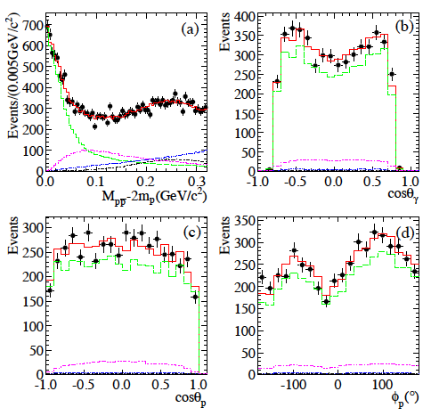
PWA of @BESIII
PWA of J/ψ→γppbar was first performed
The fit with a BW and S-wave FSI(I=0) factor can well describe ppb mass threshold structure.
It is much better than that without FSI effect, and Δ2lnL=51 (7.1σ)
Different FSI models→Model dependent uncertainty
PRL 108,112003(2012)
Spin-parity, mass, width and B.R. of X(ppbar):
>6.8σ better than other J^{pc} assignments

Slide 34
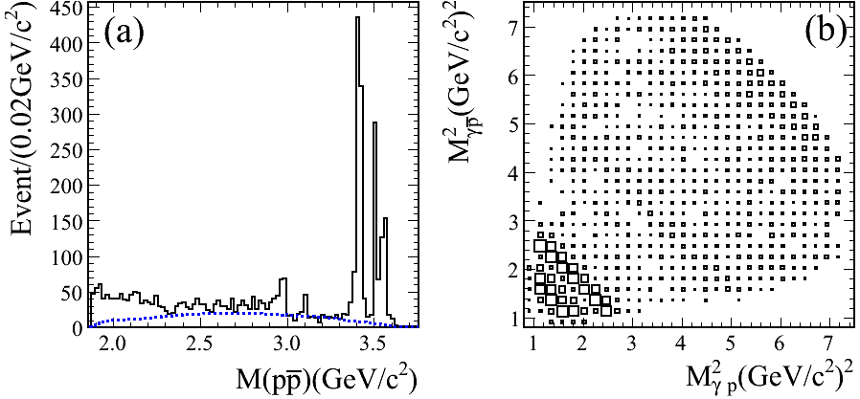
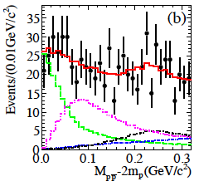
M_{ppbar} threshold structure of @BESIII
Obviously different line shape of ppbar mass spectrum near threshold from that in J/ψ decays
PWA results:
PWA Projection:
Significance of X(ppbar) is > 6.9σ.
The production ratio R:
It is suppressed compared with “12% rule”.
first measurement
PRL 108,112003(2012)
34

Slide 35
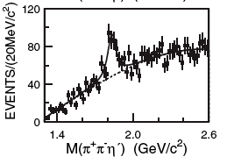
Confirmation of X(1835) and two new structures
PRL 95,262001(2005)
PRL 106, 072002(2011)
two news!
BESII
J/ψ→γη′⁺
η′→η+
η′→γ
f1(1510)
BESIII: 225M
J/ψ events,
new structures!
BESIII fit results:
Resonance | M( MeV/c²) | Γ( MeV/c²) | Stat.Sig.
X(1835) | 1836.5±3.0^{+5.6}_{-2.1} | 190.1±9.0⁺³⁸₋₃₆ | >20σ
X(2120) | 2122.4±6.7^{+4.7}_{-2.7} | 83±16⁺³¹₋₁₁ | 7.2σ
X(2370) | 2376.3±8.7^{+3.2}_{-4.3} | 83±17⁺⁴⁴₋₆ | 6.4σ
An amplitude analysis could help with
interpretation for the additional new structures!
X(1835) consistent with
0^{+}, but the others are
not excluded

Slide 36
What’s the nature of new structures?
PRD73,014516(2006) Y.Chen et al
It is the first time resonant structures
are observed in the 2.3 GeV/c2 region,
it is interesting since:
LQCD predicts that the lowest lying
pseudoscalar glueball: around 2.3 GeV/c².
J/ψ-->γη' decay is a good channel
for finding 0⁻⁺ glueballs.
Nature of X(2120)/X(2370)
pseudoscalar glueball ?
η/η′ excited states?
0^{+}: 2560(35)(120)
2⁺⁺: 2390(30)(120)
PRD82,074026,2010
J.F. Liu, G.J. Ding and M.L.Yan
PRD83:114007,2011
(J.S. Yu, Z.-F. Sun, X. Liu, Q. zhao),
and more…
For detail see Light meson session:
Hongwei Liu’s talk on June 17

Slide 37

X(1870) in J/ψ→X, X→a₀(980)
a₀(980)
J/ψ→η⁺,
a₀(980) reconstructed in η
X(1870):
7.2σ
η(1405)
f₁(1285)
M(η⁺)
M(η)
PRL 107, 182001(2011)
M(a₀(980))
M(η⁺) non-a₀(980)
BR(J/ψ→X, X→ )
Identification
of X(1870):
0^{+}(?)
It is X(1835)?
Need PWA!

Slide 38





Anomalous line shape of f₀(980) in J/ψ→γ3π
f₀(980)→π⁺π⁻
f₀(980)→π⁰π⁰
PRL 108, 182001 (2012)

Slide 39


η(1405) in J/ψ→γf₀(980)π⁰, f₀(980)→2π
f₀(980)→π⁺π⁻
f₀(980)→π⁰π⁰
f₁/η
3.7σ
f₁/η
1.2σ
First observed: η(1405)→f₀(980)π⁰ (Large isospin breaking):
∨
PRL 108, 182001 (2012)
PRD, 83(2100)032003
a₀-f₀ mixing alone can not explain the branching ratio of η(1405)

Slide 40
Large isospin violation in η(1405) decay
In general, magnitude of isospin violation in strong decay should be less
than 1% or at 0.1% level. For example:
However:
K*K pair in TS is almost
on-shell, together with
mixing explain the narrow
f₀(980), and large
isospin violation.
a₀—f₀ mixing
Triangle Singularity (TS)
J.J.Wu et al, PRL 108, 081803(2012)

Slide 41


Study of ηη system
First observed f₀(1710) from J/ψ radiative decays to ηη by Crystal Ball in 1982.
LQCD predicts:
Crystal Barrel Collaboration (2002) analyzed the three final states π⁰π⁰π⁰, ηπ⁰π⁰ and π⁰ηη with K matrix formalism. Found a 2⁺⁺ (~1870MeV), but no f₀(1710).
E835 (2006): ppbar → π⁰ηη , found f₀(1500) and f₀(1710).
WA102 and GAMS all identified f₀(1710) in ηη .

Slide 42


Preliminary PWA results of J/ψ→γηη @BESIII
Preliminary
f₀(1710) and f₀(2100) are dominant scalars.
f₀(1500) exists (8.2σ).
f₂’(1525) is the dominant tensor.

Slide 43



M_{ωΦ} threshold enhancement in J/ψ→γωφ
BESII
PRL 96(2006) 162002
For X(1810):
J^{pc} favors 0⁺⁺ over 0⁻⁺ and 2⁺⁺

Slide 44


Preliminary PWA results of J/ψ→γωφ @BESIII
Is X(1810) the f0(1710)/f0(1790) or new state?

Slide 45

Observation of two N* baryons in ψ′→π⁰p‾p decay
arXiv:1207.0223
Non-relativistic quark model is successful in interpreting of the excited baryons
Predicted more excited stated (“missing resonance problem”)
J/ψ (ψ’) decays offers an window to search for the missing resonance
1
2
3
4
5
5

Slide 46



PWA results on N* baryons in ψ′→π⁰p‾p
Two new baryonic excited states are observed !

Slide 47




Preliminary results on N* baryon in ψ′→ηp ‾p decay
BESIII Preliminary
Dalitz plot
data
Dalitz plot
MC fit
A full PWA is
performed.
Background
clean!
N(1535) is 1/2
N(1535)
Mass:
GeV/C²
Width:
GeV
M(pη)
M(pp)
Br(ψ'→ppη)=(6.6±0.2±0.6)×10^{5}
Br(ψ'→N(1535)p)×Br(N(1535)→pη+c.c.)
=
PDG2010: (6.0±1.2)×10^{5}

Slide 48
Charm physics at BESIII
e⁺e Colliders@threshold:
Good for charm flavor physics:
Threshold production: clean
Known initial energy and quantum numbers
Both D and ‾D fully reconstructed (double tag)
Absolute measurements

Slide 49

D⁺→μ⁺ν
D⁺ leptonic decays play an important role in
understanding of the SM
Test LQCD calculation of f_{D}
Precise measurement of |V_{cd}|
Theoretical uncertainty will be
reduced in determination of |V_{ud}|
If FF calculations can be validated
with charm
Reduced width of band in triangle would lead to precisely test the SM, and search for new physics beyond the SM

Slide 50



  In the system recoiling against the singly tagged D⁻, BES-III selected the purely leptonic decay events for D⁰→μ⁺ ν
BESIII preliminary

Slide 51


Slide 52




  D⁰→K⁻/π⁻ e⁺ ν
BESIII, ~2.93 fb-1 data taken at ψ(3770), ~923 pb-1 analyzed
signal side: missing neutrino inferred
D⁰ tag
K⁻/π⁻
e⁺
ν
  D⁰→K⁻ e⁺ ν
  D⁰→π⁻ e⁺ ν
U_{k} (GeV)
U _{π}(GeV)

Slide 53


  D⁰→γγ
Theoretical predictions: SM (short distance)~ 10⁻¹¹
Long distance ~10⁻⁸
B(D⁰→γγ)
B(D⁰→γγ)/B(D⁰→π⁰π⁰)<5.8×10⁻³ @90% CL, with PDG value: B(D⁰→π⁰π⁰)=8×10⁻⁴ ,
BESIII: B(D⁰→γγ))<4.6×10⁻⁶ @90% CL.
BaBar: B(D⁰→γγ)<2.2×10⁻⁶ @90% CL.

Slide 54

Summary
BESIII is successfully operating since 2008：
World largest data samples at J/ψ, ψ′,ψ(3770), ψ(4040) already collected, more data in future ($D_{S}^{∗+}D_{S}^{−}$ at 4170 MeV coming soon).
Charmoniumdecays
first observation of η_{c}(2S) in ψ′→γη_{c}(2S) decay.
Precision measurements of h_{C}andη_{C}(1S) and η_{C}(2S) properties
  First evidenceofψ’→γγJ/ψ
  First measurement of χ_{c1}→ ωφ , ωω, φφ and h_{c}(2S)→VV , χ_{c0/2}→γγ
Light hadron spectroscopy
Confirmation of ppbar threshold enhancement
Confirmation of X(1835) and observation of two new strucutures
Observation of a new structure X(1870)
First observation of η(1405)→f₀(980)π⁰
Observation of two new excited baryonic states
Charm decays：
precision open-charm D physics to come soon.
Expect many more results from BESIII in the future!

Slide 55
Thank you !

Slide 56



η_{C} lineshape from ψ′→⁰h_{C}, h_{C}→γη_{C}
Sum of 16 of
η_{C} decay modes
Background
subtracted
The η_{C} lineshape is not distorted in the h_{C}→γη_{C}
Detail analysis of η_{c} parameters is ongoing!
Symmetric
lineshape
in γγ production
Asymmetric
lineshape
in ψ decay

