Slide 1
Intense Super-radiant X-rays from a Compact Source
W.S. Graves
MIT
March, 2012
Presented at the ICFA Future Light Sources Workshop

Slide 2
Acknowledgements
This work is the result of collaboration with
K. Berggren, F. Kaertner, D. Moncton, P. Piot, and L. Velasquez-Garcia
Funding has been provided by
DARPA AXis, DOE-BES, and NSF-DMR

Slide 3
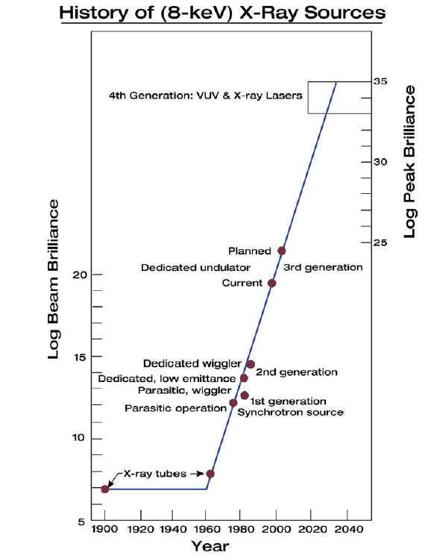
Generations of Hard X-ray Sources
X-ray Lasers
Coherent
Emission
Super-radiant ICS
Synchrotron
Radiation
ICS
Relativity
X-ray Tubes

Slide 4
Super-radiant X-rays via ICS
ICS (or undulator) emission is not a coherent process, scales as N
Super-radiant emission is in-phase spontaneous emission, scales as N²
N electrons
Steps
Emit array of electron beamlets from cathode 2D array of nanotips.
Accelerate and focus beamlet array.
Perform emittance exchange (EEX) to swap transverse beamlet spacing into longitudinal dimension. Arrange dynamics to give desired period.
Modulated electron beam backscatters laser to emit ICS x-rays in phase.
“Intense Super-radiant X-rays from a Compact Source using a Nanocathode Array and Emittance Exchange”
W.S. Graves, F.X. Kaertner, D.E. Moncton, P. Piot
submitted to PRL, published on arXiv:1202.0318v2

Slide 5
Super-radiant ICS Example at 13 nm
FEA gun focus & matching emittance-exchange ICS
Acceleration & matching
Emittance exchange (EEX)
Nanocathode
Quadrupoles
Dipoles
IR laser
Gun
RF cavity
Super-radiant ICS
RF deflecting cavity
75 cm
150 cm

Slide 6
Nano-Fabrication of Field Emission Tips
Electron micrographs of silica pillars fabricated with electron-beam lithography
MIT Nanostructures Lab
(Berggren group)

Slide 7
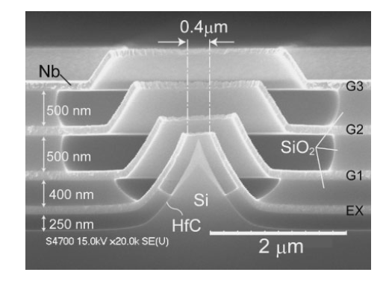
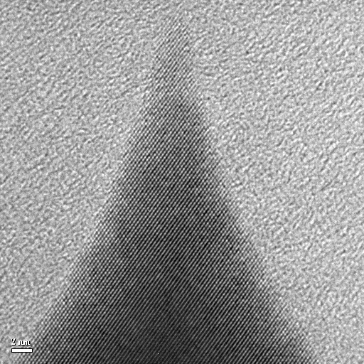
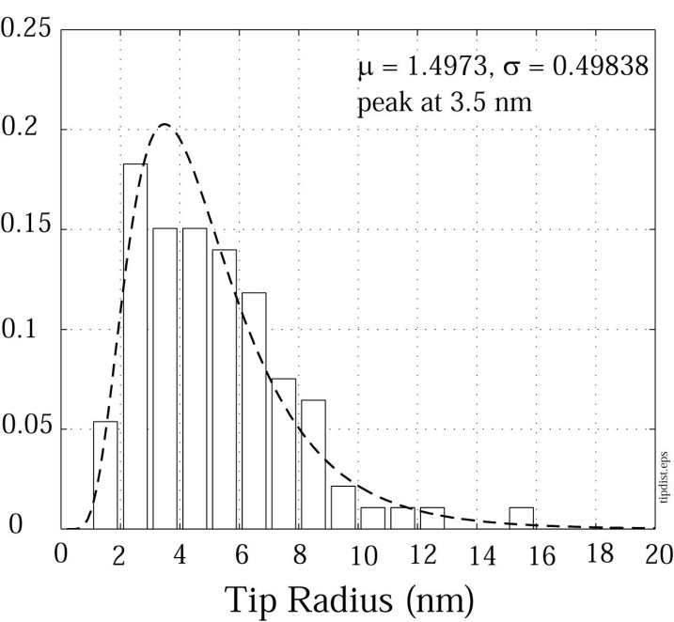
Multi-gate Structures
Multi-gate structure, Nagao et al, Jpn J. Appl Phys 48 (2009) 06FK02
≈1.6 nm radius circle
T. Akinwande & L. Velasquez-Garcia, MIT MTL
K. Berggren, MIT Nanostructures Lab
Notes:
Tunneling of Electrons through a potential barrier (workfunction), due to high electric fields
Field Emission: High fields are achieved with high aspect-ratio structure, best structures are whisker-like structures
Two ways of modulation: control of the transmission through the barrier, or control of the flux of electrons to the surface
Barrier transmission is described by Fowler Nordheim model.
Time fluctuations: Absorption / Desorption of gas molecules by tip
Spatial fluctuations: statistical variations in emitter tip

Slide 8
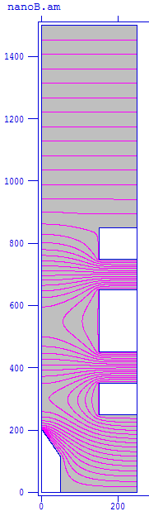
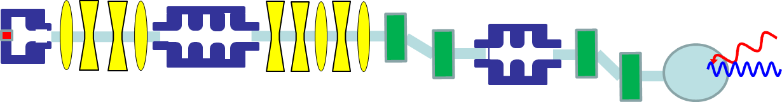
Model of Nanotip Electric Field
+100V
Exploring geometries and voltages.
Modeling at nm scale requires care.
V ~ 10-50 V on gates
E-field at tip ~ 6 X 10⁹ V/m
Dimensions and voltages are consistent with arrays produced in the lab
Gate voltages = +55, +3, +55V
Tip radius = 3 nm
+55V
Einzel lens surrounding each tip focuses individual beamlets
+3V
+55V
Conical tip is rotationally symmetric
You are here
0V

Slide 9
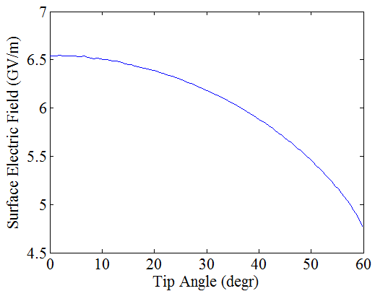
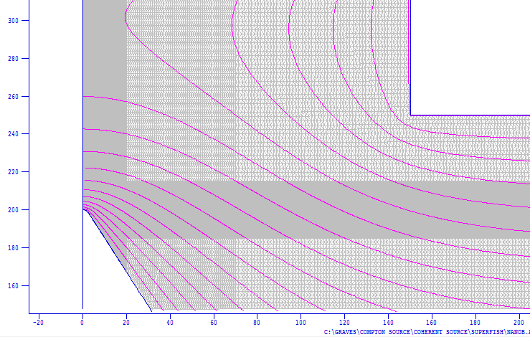
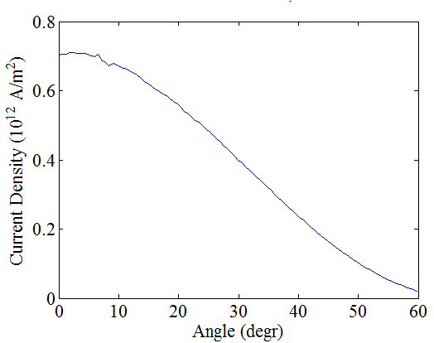
Surface Fields and Current Density
Gate
Tip
Fowler-Nordheim emission using numerical surface fields
Current per tip = 10 uA for 1 ps
Charge = 65 electrons/shot/tip
Can make 400 X 400 array or larger
Total charge ~1 pC
You are here

Slide 10
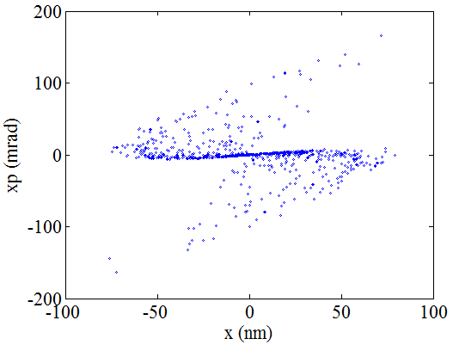
Phase space at cathode exit (~100 eV)
Tails due to electrostatic lens aberrations surround dense core
~30% of electrons lost on gates
ε_{n} = 2 X 10⁻¹¹ m-rad after gates
Thermal emittance studies typically 10⁻⁶ m-rad per mm spot size
Emittance of each tip is very small. RMS emission width ~1 nm.
=> Initial emittance = 10⁻¹² m-rad
Uncertainty Principle requires ε_{n} >= 2 X 10⁻¹³ m-rad

Slide 11
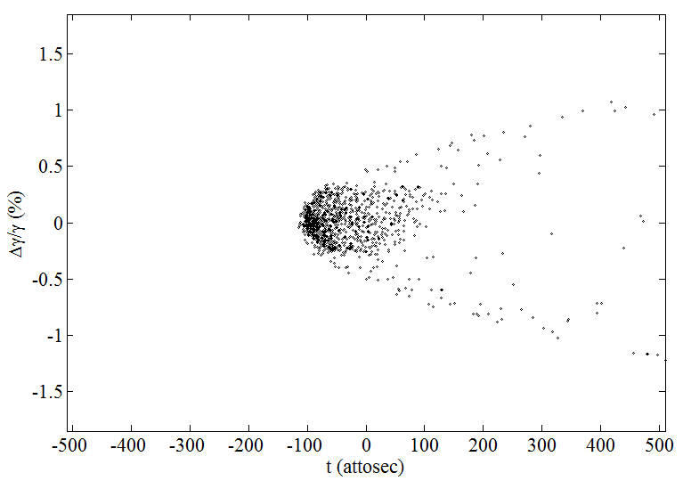
EEX Beamlet Transformation
The x-x’ phase space at the cathode is exchanged into the time-dE/E phase space by the EEX line, generating a bunched beam. The bunching and energy spread depend on the small tip emittance.
Transverse distribution at cathode
Longitudinal distribution at ICS IP

Slide 12
Beamlet Phase Space Requirements
P. Piot simulation results of ELEGANT tracking from PARMELA output
Requirements for super-radiant emission
Need pulse short relative to wavelength.
Energy spread small enough to prevent debunching during ICS
δγ/γ
Need
σ_{t}
Implies
m-rad at 13.5 nm wavelength
You are here

Slide 13
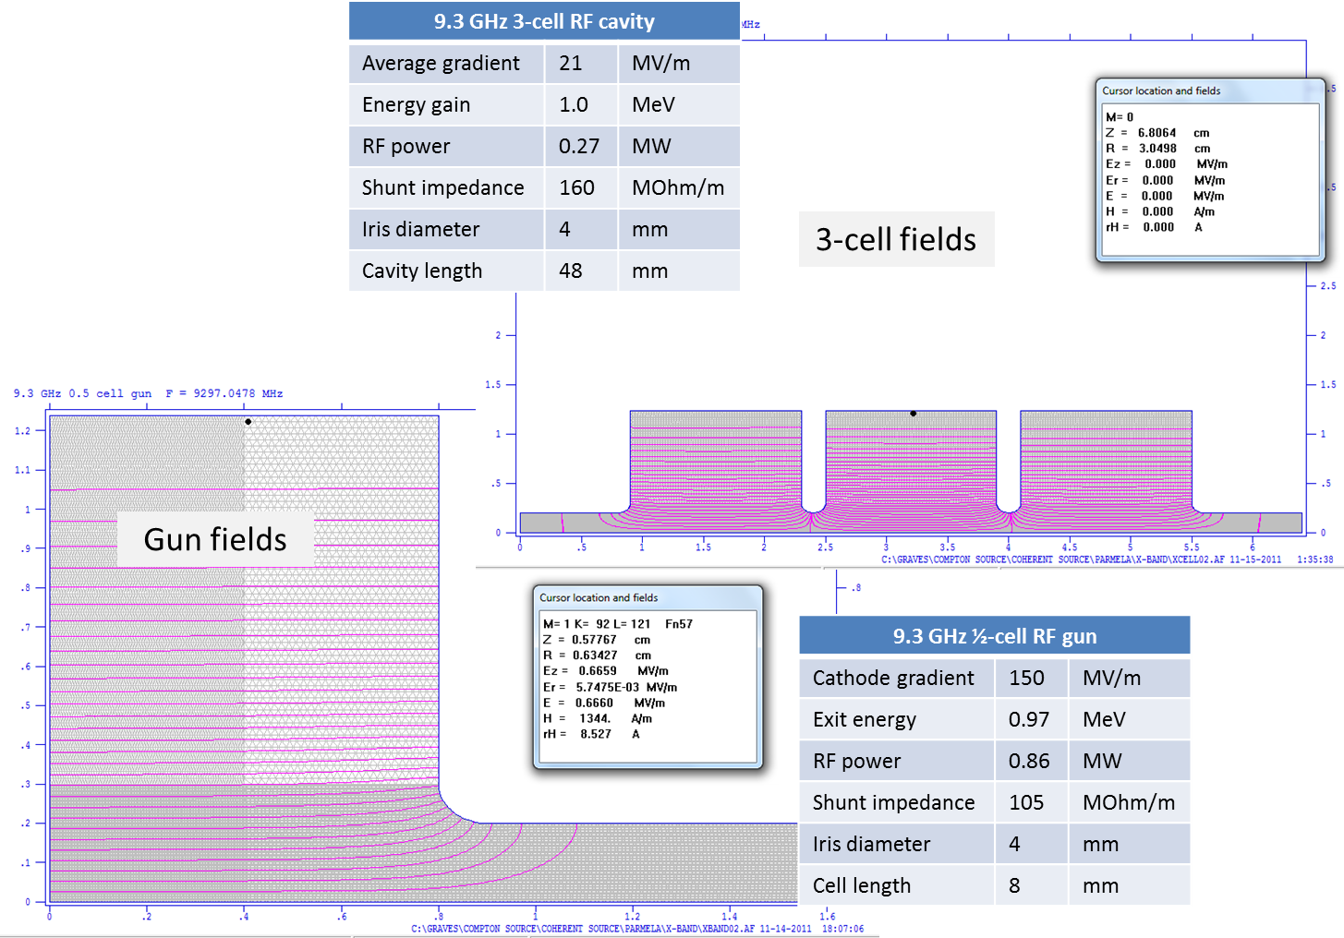
Use ½-cell gun and 3-cell linac to reach 1.5 MeV
Total accelerator length ~10 cm
Low-cost 9.3 GHz copper structures
These 2 components

Slide 14
Emittance Exchange (EEX)
Sigma matrix contains second moments.
where
See P. Piot talk in Compact Working Group this afternoon
Unusual transport matrix completely exchanges transverse and longitudinal phase space.
Result of matching and EEX is a beam with periodic current modulation at x-ray wavelength.
EEX components
M. Cornacchia and P. Emma, Phys. Rev. ST-AB 5, 084001
P. Emma, Z. Huang, K.-J. Kim, and P. Piot, Phys Rev ST-AB 9, 100702
B.E. Carlsten, K.A. Bishofberger, S.J. Russell, N.A.Yampolsky, to appear in Phys. Rev. ST-AB
Y.-E Sun, P. Piot, et al, Phys. Rev. Lett. 105, 234801
A. Zholents and M. Zolotorev, report ANL/APS/LS-327

Slide 15
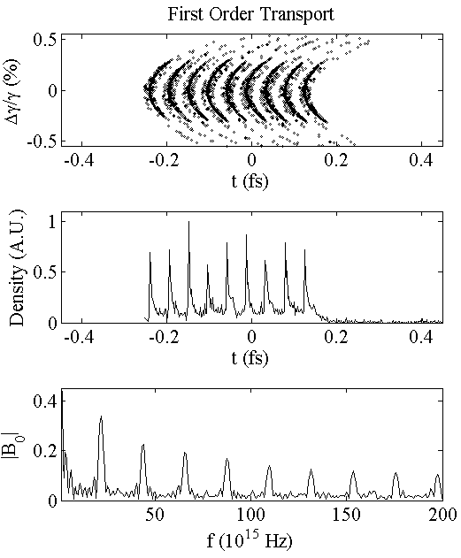
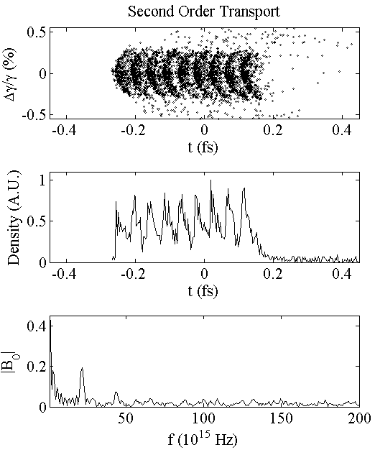
9X9 Array Bunching after EEX
13 nm
6.5 nm
13 nm
P. Piot simulation results of ELEGANT 1st and 2nd order tracking from PARMELA output
You are here

Slide 16
Single Electron X-ray Emission
See K.-J. Kim, “Characteristics of Synchrotron Radiation”, AIP Conf. Proc. 184, 565 (AIP 1989)
Resonant x-ray wavelength
Laser strength parameter
Energy emitted on-axis per unit frequency & solid angle
N_{L} = laser periods, α = fine struct const
Bandwidth for single electron.
Opening angle of central cone with narrow bandwidth
You are here

Slide 17
Incoherent ICS X-ray Scaling
On-axis emission from N_{e} electrons
Single electron
ICS
Super-radiant term
Bandwidth
Bunching factor
Opening angle
Standard incoherent ICS emission scales linearly with N_{e} (~10⁷)
Phases usually add randomly at x-ray frequencies
You are here

Slide 18
Super-radiant ICS X-ray Scaling
Super-radiant spectral density
For N_{B} beamlets emitting in phase, bandwidth becomes
And opening angle is
Super-radiant emission narrows bandwidth and angle, and increases flux
Nanocathode + emittance exchange produces bunches at x-ray period
You are here

Slide 19
Estimated Super-radiant EUV Performance
Parameter | Value
Photon energy [eV] | 93
Pulse length [fs] | 26
Flux per shot [photons] | 10⁸
FWHM bandwidth [%] | 0.2
Source RMS divergence [mrad] | 12
Source RMS size [mm] | 0.003
Peak brightness [photons/(sec mm² mrad² 0.1%bw)] | 10²⁴
Coherent fraction [%] | 4
Avg flux at 1 kHz (0.1% BW) | 10¹¹
Avg flux at 100 MHz (0.1% BW) | 5 X 10¹⁵
Avg brightness at 1 kHz | 2 X 10¹³
Avg brightness at 100 MHz | 10¹⁸

Slide 20
Summary
Compact sources using mildly relativistic beams will be 10⁶ brighter than existing lab sources
Cost & size are attractive for science not easily done at major facilities
Super-radiant emission may enable compact performance similar to a major facility undulator
Pulses are <100 fs, special modes may reach sub-fs
Scaling to hard x-rays to be explored

