Slide 1
THE WISCONSIN SUPERCONDUCTING RF ELECTRON GUN UPDATE
R.Legg (JLab); J. Bisognano, R. Bosch, D. Eisert, M. Fisher, M. Green, K. Jacobs, K. Kleman, J. Kulpin, G. Rogers (UW-Madison/SRC); J. Lawler, D. Yavuz (UW-Madison Physics); T. Miller (UIUC)
March 6, 2012
DOE Award # DE-SC0005264

Slide 2
Starting Point:
Next Generation VUV/Soft X-ray Source
Probe physical, chemical, and biological systems on their critical temporal, spatial, and energy scales—femtoseconds, nanometers, and millivolts
Performance goals
  Full 6D coherence
  Short pulses
  High repetition rates into megahertz
  High peak and average flux
  Tunability and polarization control
  Many beamlines operating independently and simultaneously to spread costs
Superconducting-linac-driven FEL “farm” is an ideal solution
  CW
  Naturally a coherent process
  Seeding ensures temporal as well as transverse coherence

Slide 3
Key Gun Parameters
Electric field at cathode – up to 45 MV/m
Peak surface magnetic field – 93 mT
Dynamic power loss into He – 39 W at 4K
Q – 2.5E9
Frequency – 199.6 MHz
Key Bunch Parameters
RMS bunch length at gun exit – 0.18 mm
Cathode spot ~1 mm for 0.85 mm-mrad thermal emittance (Cs2Te)
At gun exit, δp/p ~ 2.5%, divergence – 7 mrad
Q – 200 pC
Kinetic energy – 4.0 MeV
With smaller spot, can be operated in lower charge modes with lowered emittance

Slide 4
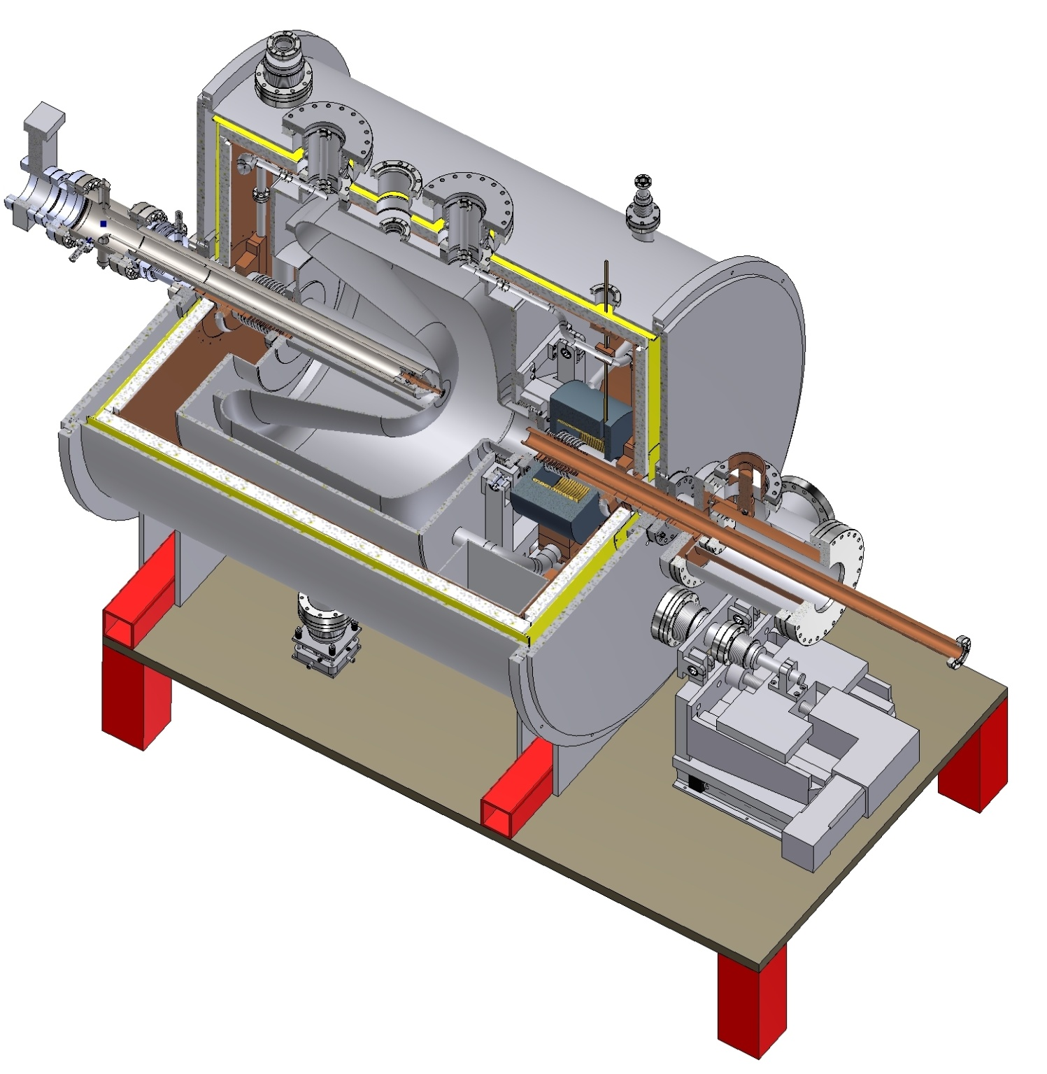
CW Electron Gun is Critical Component
Wisconsin SRF e-gun

Slide 5
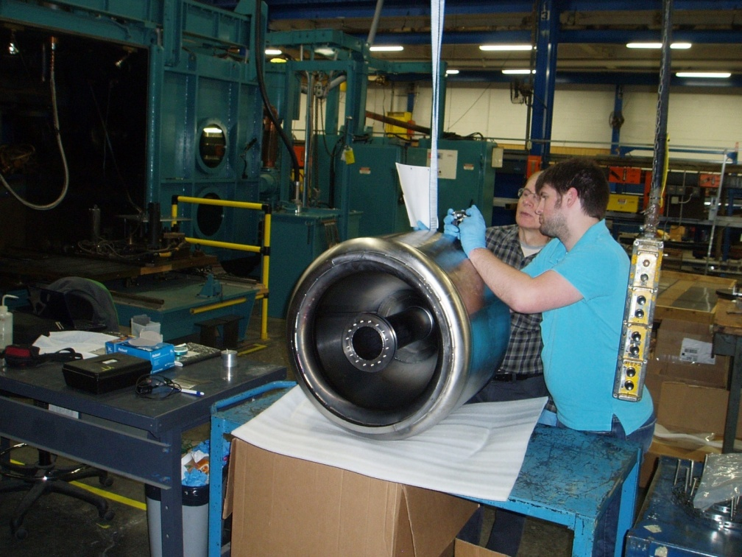
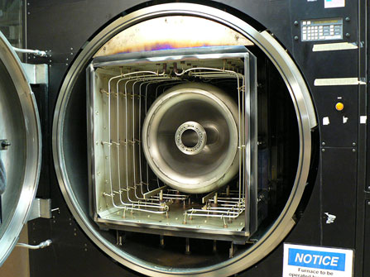
Wisconsin SRF Electron Gun Progress
Preparations for final e-beam weld
Bake at JLab to prevent Q-disease

Slide 6
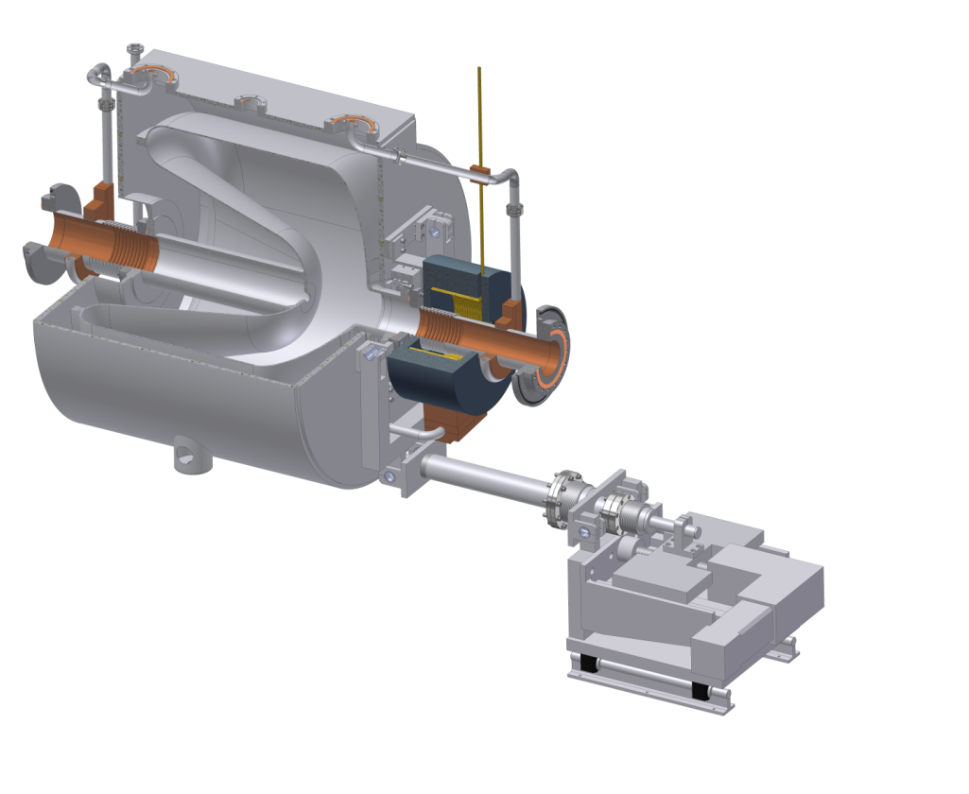
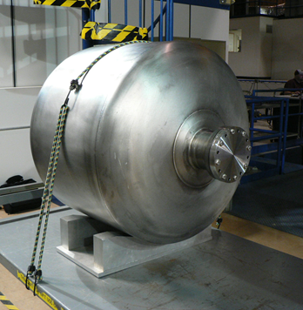
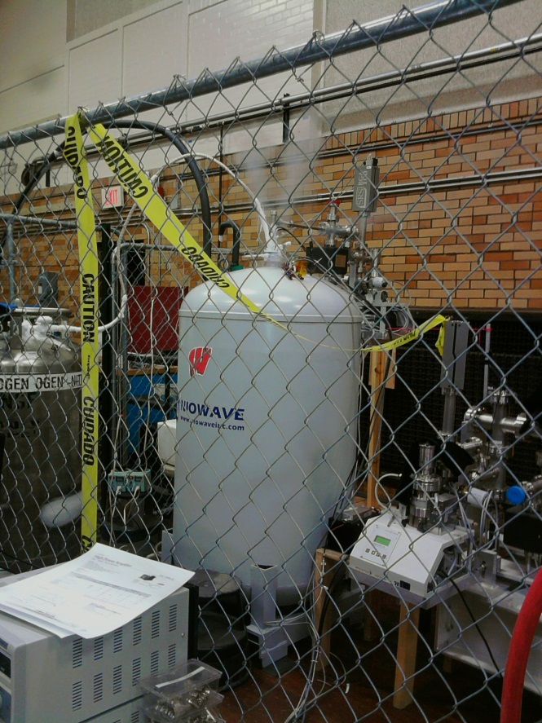
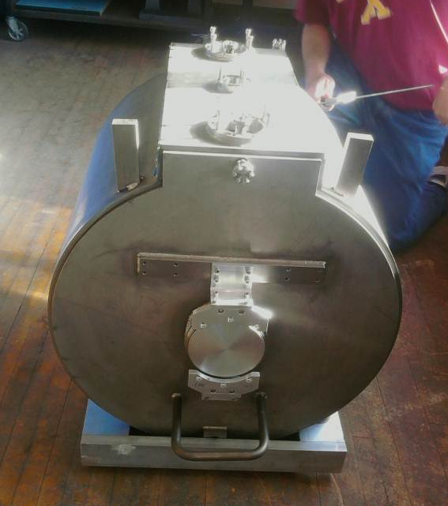
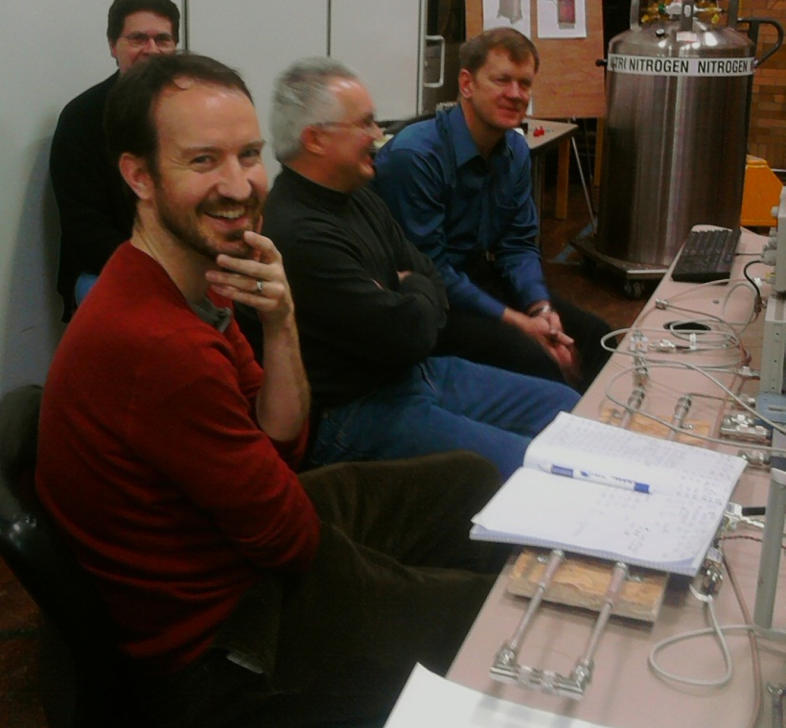
Cold Test of Cavity at Niowave Completed and Installation into He Vessel Under Way

Slide 7
February 7 Acceptance Test Successful
Cryogenic acceptance test at Niowave successfully completed
Test results
  Low field Q₀ of 3 10⁹ , as predicted by modeling
  Gradients in 10 MV/m range obtained, limited by test configuration (limited RF power, test coupler, and pumping)
  The cavity showed initial multipactor and field emission but both continued to process throughout the test
  Field is expected to substantially improve with continued processing after final assembly at Wisconsin
This test marks a major milestone in the SRF gun program, demonstrating both Q₀ and the potential for high gradients in the gun after final processing planned at Wisconsin

Slide 8
Q₀ vs E_{ACC} results
R/Q = 147 Ω
Gap in the data here shows conditioning progress from one run to the next.

Slide 9
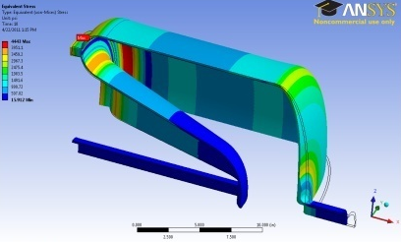
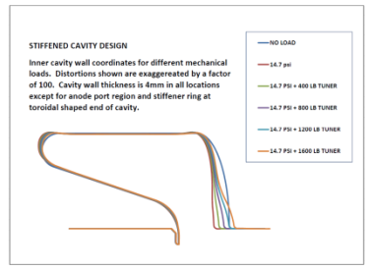
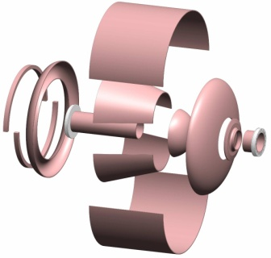
Frequency Map
Map which starts with a cold cavity at the correct frequency and moves back through the series of production steps producing an expected resonant frequency at each step
Actual cavity frequency was 199.47 MHz due to sign error in permittivity change from air to vacuum; corrected after test
FEA to Evaluate Stress and Deformation
State | Freq, MHz | D Freq, MHz | Volume, in^3 | D volume, in^3
Nominal, 4 K | 199.58953 | - | 6269.213
Remove 1600 lb preload on tuner | 199.65256 | 0.06303 | 6267.753 | -1.46
Warmed to 273 K | 199.3704 | -0.28216 | 6294.653 | 26.9
Skin depth vs temp at 200 MHz | 199.3185945 | -0.05180 | 6295.853 | 1.2
Remove vacuum load | 199.2485945 | -0.07 | 6300.243 | 4.39
Change in permitivity, fvac/fair | 199.1947645 | -0.05383 | 6300.243 | 0
Undo BCP etch | 199.3688075 | 0.174042 | 6282.793 | -17.45
Final weld shrinkage, 0.7 mm | 199.280 | -0.088 | 6294.87 | 12.08
TABLE 1. Steps from cavity blank to final frequency

Slide 10
High T_{C} Solenoid
Specification developed from early field maps
And then we simulated. A lot.
Danfysik fabricating now, delivery in April / May 2012

Slide 11
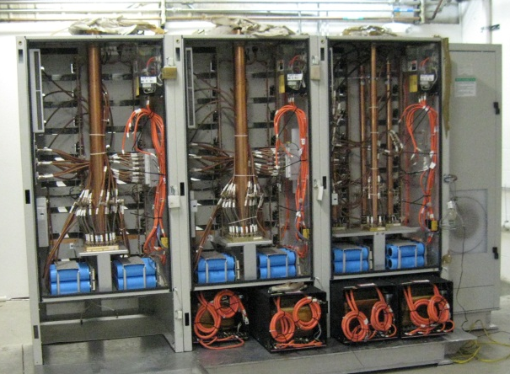
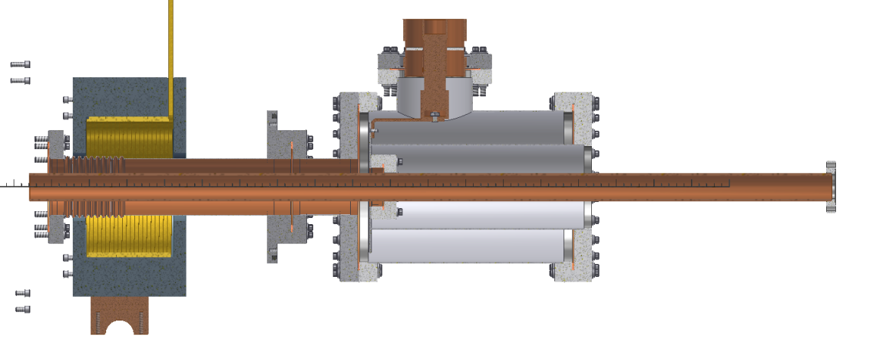
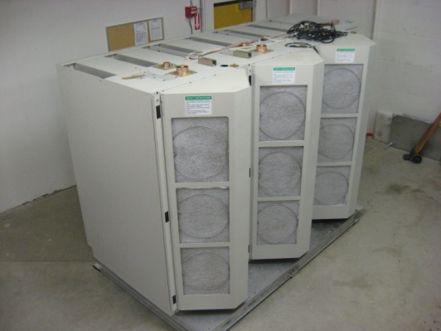
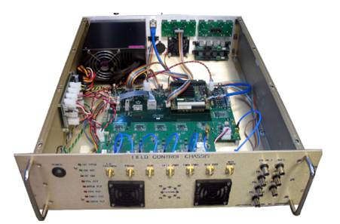
RF Coupler, HPA and LLRF
Power is introduced through a ceramic rf window and a tuned resonant structure.
Relatively low power, <10kW, at 1 mA of beam
20 kW solid state amplifier procured
Harris Corporation Broadcast Communications Division
Based on Jlab 12 GeV upgrade module

Slide 12
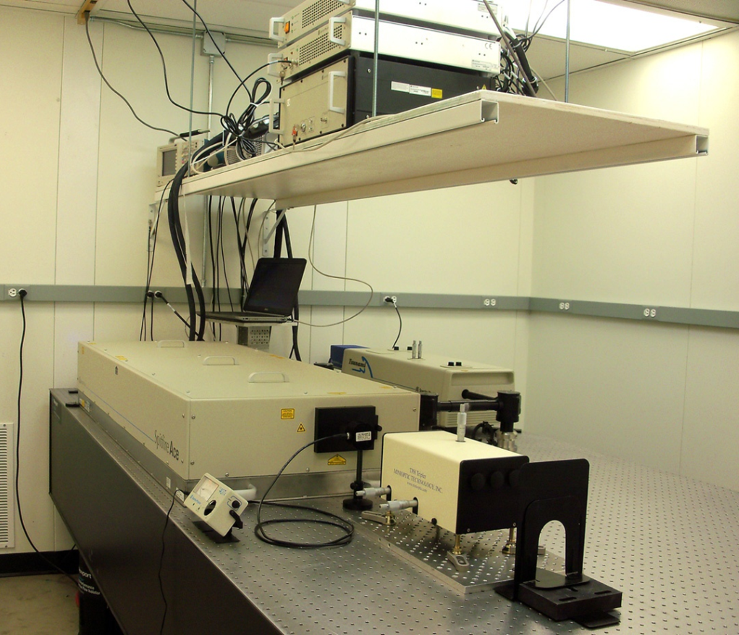
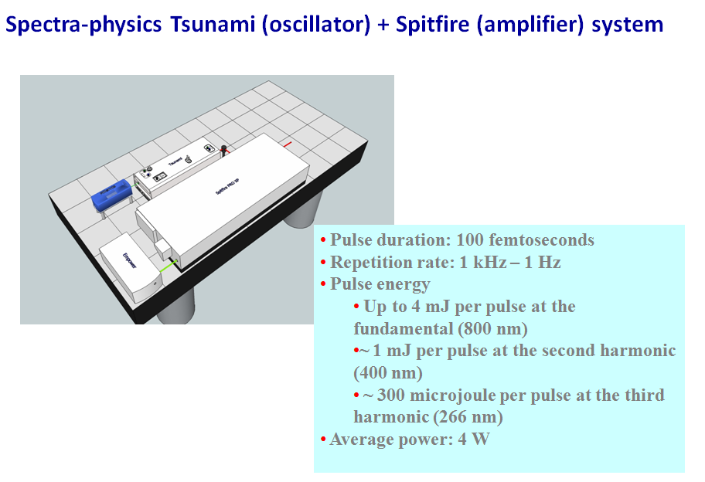
Photocathode laser installation week of February 13

Slide 13
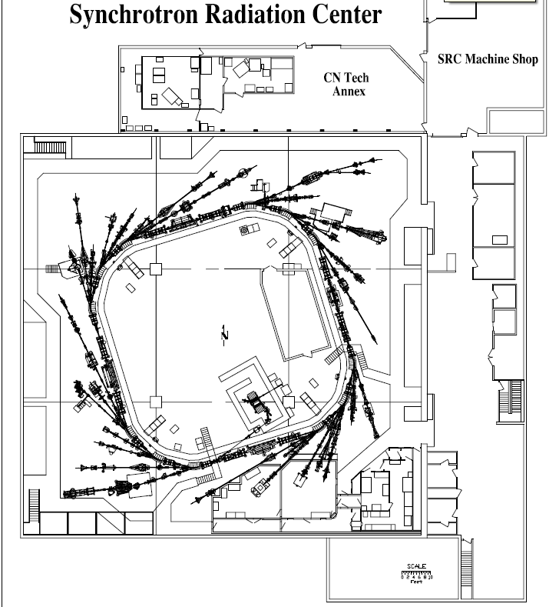
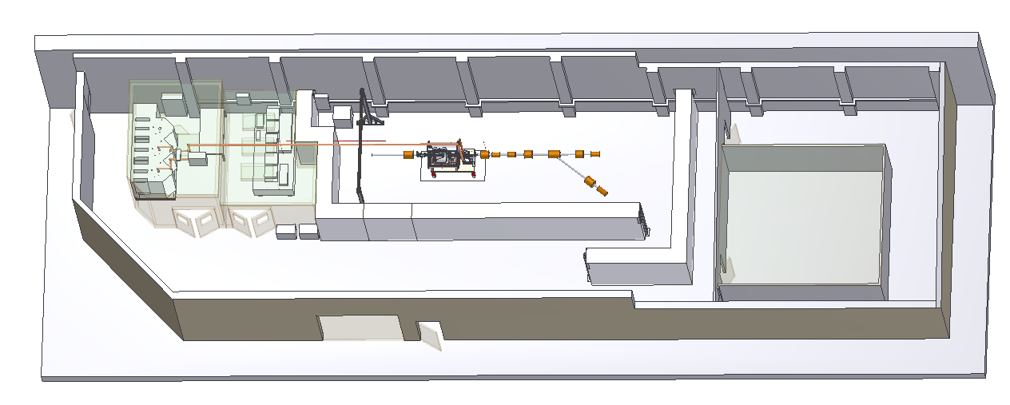
Test Vault Preparations at UW
Electron Gun and Beam Diagnostic Line
RF
Clean room for cryomodule assembly
Photocathode Laser

Slide 14
Current Scope
Demonstrate single bunch beam dynamics and operation of SRF gun
Low repetition rate drive laser
  Allows option of using doubled or tripled Ti:Sapphire laser
Cu Cathode Used for Initial Operation
  Little chance of cavity contamination from evaporated cathode material
  Cathode will not degrade over time like semiconductor
  No cathode preparation chamber needed

Slide 15
Summary
Wisconsin SRF electron gun development moving forward as planned
Offers attractive capabilities as CW electron source for FELs and other applications
In the fall, we hope to have made our first low emittance electron bunch

Slide 16
Coming Attractions
R&D on photocathode materials, including novel approaches, by Angle Resolved Photo Emission Spectroscopy (ARPES) studies on the Aladdin storage ring at SRC
Studies of the laser high harmonic generation (HHG) process for seeding, and other laser beam interactions
Bi thin film in the rombohedral phase. The surface state ~0.4 eV below the Fermi edge (blue spot) only has +2° emission angle.
This involves accessing a specific surface state without thermalization.
G. Bian, T. Miller, and T.-C. Chiang, Phys. Rev. B 80, 245407 (2009)

