Slide 1

Development of an Injector for the compact ERL
ICFA Workshop on Future Light Sources, FLS2012
Wednesday, March 7th, 2012
Thomas Jefferson National Accelerator Facility
Tsukasa Miyajima ^{A}, Yosuke Honda ^{A}, Masahiro Yamamoto ^{A},
Takashi Uchiyama ^{A}, Kotaro Satoh ^{A}, Shunya Matsuba ^{B},
Xiuguang Jin ^{C}, Makoto Kuwahara ^{C}, Yoshikazu Takeda ^{C},
Tohru Honda ^{A}, Yasunori Tanimoto ^{A}, Makoto Tobiyama ^{A}, Takashi Obina ^{A},
Ryota Takai ^{A}, Shogo Sakanaka ^{A}, Takeshi Takahashi ^{A}, Hiroshi Sakai ^{A},
Kensei Umemori ^{A}, Norio Nakamura ^{A}, Miho Shimada ^{A}, Kentaro Harada ^{A},
Toshiyuki Ozaki ^{A}, Akira Ueda ^{A}, Shinya Nagahashi ^{A}, Yukinori Kobayashi ^{A},
Nobuyuki Nishimori ^{D}, Ryoji Nagai ^{D}, Ryoichi Hajima ^{D} and Hwang Ji-Gwang ^{E}
^{A} KEK, High Energy Accelerator Research Organization
^{B} Hiroshima University
^{C} Nagoya University
^{D} JAEA, Japan Atomic Energy Agency
^{E} Kyungpook National University
Notes:
I’m tsukasa miyajima, in KEK, High energy accelerator research organization.
Today, I will be talking about Development of an Injector for the compact ERL.

Slide 2








ERL collaboration team
High Energy Accelerator Research Organization (KEK)
  M. Akemoto, T. Aoto, D. Arakawa, S. Asaoka, A. Enomoto, S. Fukuda, K. Furukawa, T. Furuya, K. Haga, K. Hara, K. Harada, T. Honda, Y. Honda, T. Honma, T. Honma, K. Hosoyama, M. Isawa, E. Kako, T. Kasuga, H. Katagiri, H. Kawata, Y. Kobayashi, Y. Kojima, T. Matsumoto, H. Matsushita, S. Michizono, T. Mitsuhashi, T. Miura, T. Miyajima, H. Miyauchi, S. Nagahashi, H. Nakai, H. Nakajima, E. Nakamura, K. Nakanishi, K. Nakao, T. Nogami, S. Noguchi, S. Nozawa, T. Obina, S. Ohsawa, T. Ozaki, C. Pak, H. Sakai, S. Sakanaka, H. Sasaki, Y. Sato, K. Satoh, M. Satoh, T. Shidara, M. Shimada, T. Shioya, T. Shishido, T. Suwada, T. Takahashi, R. Takai, T. Takenaka, Y. Tanimoto, M. Tobiyama, K. Tsuchiya, T. Uchiyama, A. Ueda, K. Umemori, K. Watanabe, M. Yamamoto, Y. Yamamoto, S. Yamamoto, Y. Yano, M. Yoshida
Japan Atomic Energy Agency (JAEA)
  R. Hajima, R. Nagai, N. Nishimori, M. Sawamura
Institute for Solid State Physics (ISSP), University of Tokyo
  N. Nakamura, I Itoh, H. Kudoh, T. Shibuya, K. Shinoe, H. Takaki
UVSOR, Institute for Molecular Science
  M. Katoh, M. Adachi
Hiroshima University
  M. Kuriki, H. Iijima, S. Matsuba
Nagoya University
  Y. Takeda, T. Nakanishi, M. Kuwahara, T. Ujihara, M. Okumi
National Institute of Advanced Industrial Science and Technology (AIST)
  D. Yoshitomi, K. Torizuka
JASRI/SPring-8
  H. Hanaki
Notes:
This slide shows ERL collaboration team in Japan.

Slide 3
Outline
Status of R&D of compact ERL (cERL) injector
Beam operation in Gun Test Beamline
Construction schedule of cERL injector
Summary
Notes:
These is outline of my talk.
Firstly, I will show you status of R&D of cERL injector.
After that, I will show beam operation in Gun Test Beam line.
Then, I will be talking about Construction schedule of cERL injector.
Finally, I summarize my talk.

Slide 4
Status of R&D of cERL injector

Slide 5
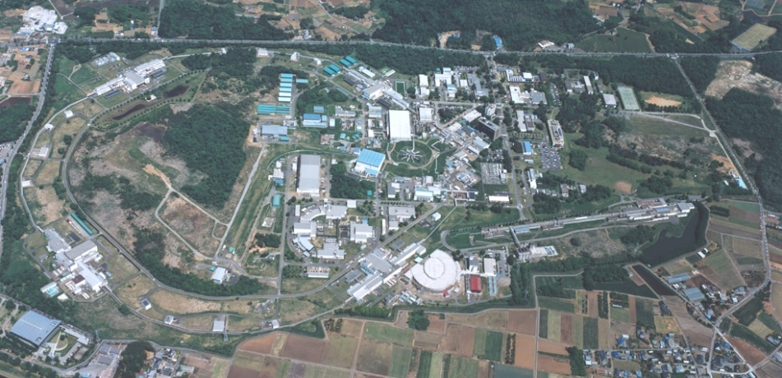
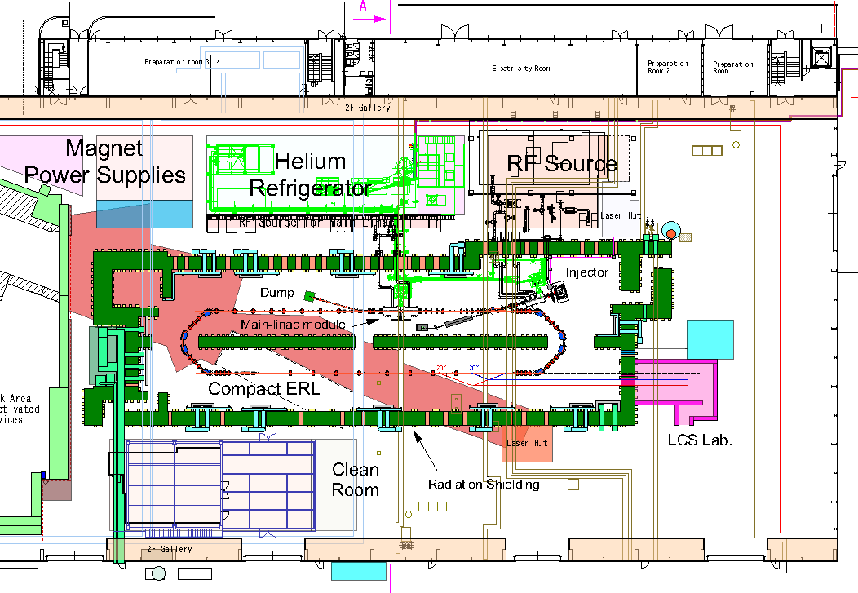
The Compact ERL for demonstrating our ERL technologies
Goals of the compact ERL
Demonstrating reliable operations of our R&D products (guns, SC-cavities, ...)
Demonstrating the generation and recirculation of ultra-low emittance beams
ERL development building
AR south experimental hall:
Gun Test Beamline
Parameters of the Compact ERL
70 m
 | Parameters
Beam energy (upgradability) | 35 MeV 125 MeV (single loop) 245 MeV (double loops)
Injection energy | 5 MeV
Average current | 10 mA (100 mA in future)
Acc. gradient (main linac) | 15 MV/m
Normalized emittance | 0.1 mm·mrad (7.7 pC) 1 mm·mrad (77 pC)
Bunch length (rms) | 1 - 3 ps (usual) ~ 100 fs (with B.C.)
RF frequency | 1.3 GHz
Notes:
The compact ERL is constructing in ERL development building in KEK, tsukuba campus.

Slide 6
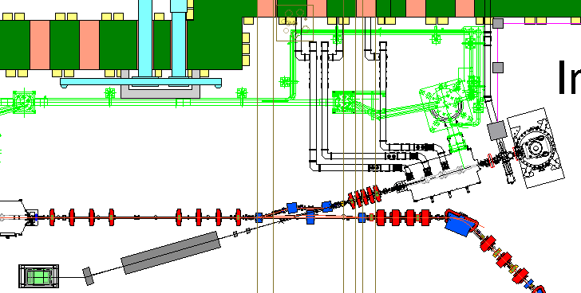
cERL injector
ERL injector:
to generate electron beam with lower emittance and shorter bunch length
Buncher
Merger
Injector Cryomodule
500kV DC gun
Diagnostic beamline
for Injector
Parameters of the Compact ERL Injector
Design layout of cERL injector.
Gun voltage | 500 kV
Beam energy | 5 – 10 MeV
Beam current | 10 – 100 mA
Normalized rms emittance ε_{n} = ε (γβ) | 1 mm·mrad (77 pC/bunch) 0.1 mm·mrad (7.7 pC/bunch)
Bunch length (rms) | 1 – 3 ps (0.3 – 0.9 mm)
R&D items
  500 kV DC gun
  Laser system
  Bunching cavity
  Injector Cryomodule (see H. Sakai’s presentation)
  Injector beamline
  Cathode materials
Before construction of a full injector, we continue R&Ds at the AR south experimental hall.
Notes:
ERL injector の目的
ERL injector の構成
After merger section, we connect to diagnostic beamline to measure emittance and temporal profile of beam.
AR 南棟でのR&D items.

Slide 7
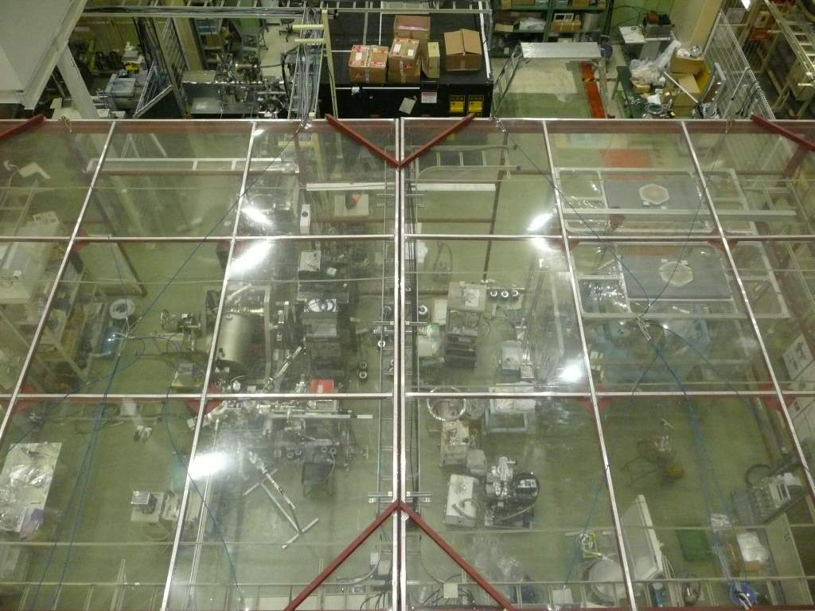
AR south experimental hall
R&Ds about DC gun and injector beamline
ERL development building
Laser Room
2nd 500 kV DC gun system
AR south experimental hall:
Gun Test Beamline
Gun Test Beamline
NPES3, DC 200 kV Gun
developed by Nagoya Univ.
Notes:
In this hall, we have two guns, NPES3 200 kV gun connected to gun test beam line, and 2nd 500 kV DC gun system.
Now we are constructing 2nd 500 kV gun system in this area.

Slide 8
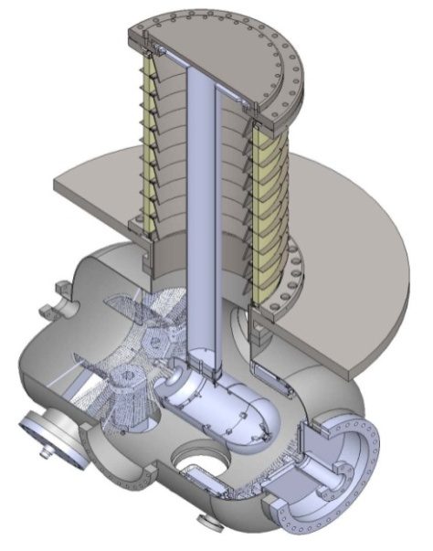
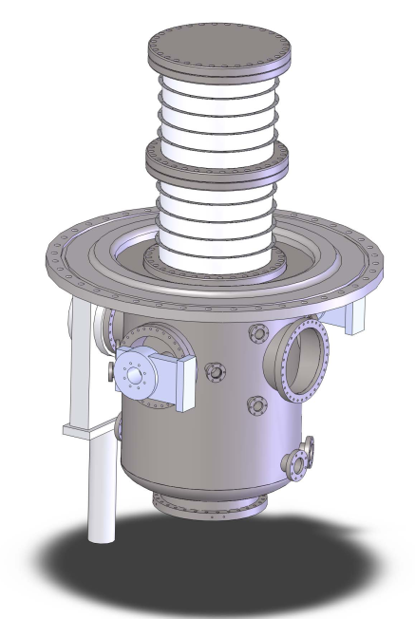
Status of DC 500 kV gun systems
JAEA 1st Gun
  HV test with a stem electrode: 500kV (510kV) for 8 hours without any discharge
  Beam generation at 300kV
  Scheduled to be installed by Oct. 2012 to cERL beamline.
KEK 2nd Gun
  Titanium chamber and ceramic tube were fabricated.
  Now modifying HV power supply.
  Out gassing rate and pumping speed of extreme high vacuum system were measured.
See N. Nishimori-san’s talk, FLS2012.
JAEA 1st Gun
KEK 2nd Gun
Notes:
JAEA 1st gun achieve 500 kV operation and beam generatin at 300 kV.
We schedule installation of this gun by Oct. 2012 to cERL beamline.
For KEK 2nd gun,

Slide 9
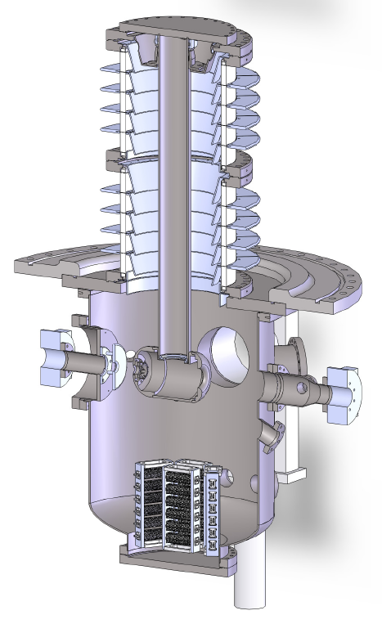
Overview of 2nd gun vacuum system
High voltage insulator
  Inner diameter of φ=360 mm
  Segmented structure
Low outgassing material
  Large titanium vacuum chamber
  (ID~φ630 mm)
  Titanium electrode, guard rings
Main vacuum pump system
  Bakeable cryopump
  NEG pump (> 1x10⁴ L/s, for hydrogen)
Large rough pumping system
  1000 L/s TMP & ICF253 Gate valve
e⁻ beam
Anode
(0V)
Cathode
(-500kV)
Goal
Ultimate pressure : 1x10⁻¹⁰ Pa
(during the gun operation)
M. Yamamoto, IPAC2011
Notes:
High voltage insulator have inner diameter of 360 mm and segmented structure.
We employed Low out gassing material.
Main vacuum pump system is bakable cryopump and NEG pump.
In the next slide, I will show you outgassing rate measurements of this system.

Slide 10
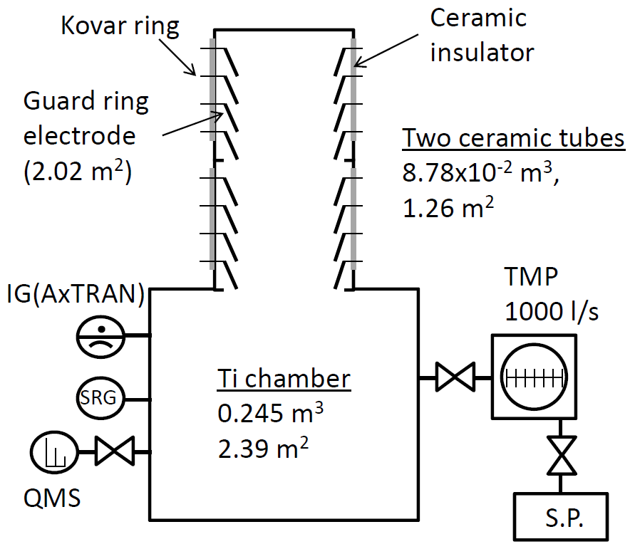
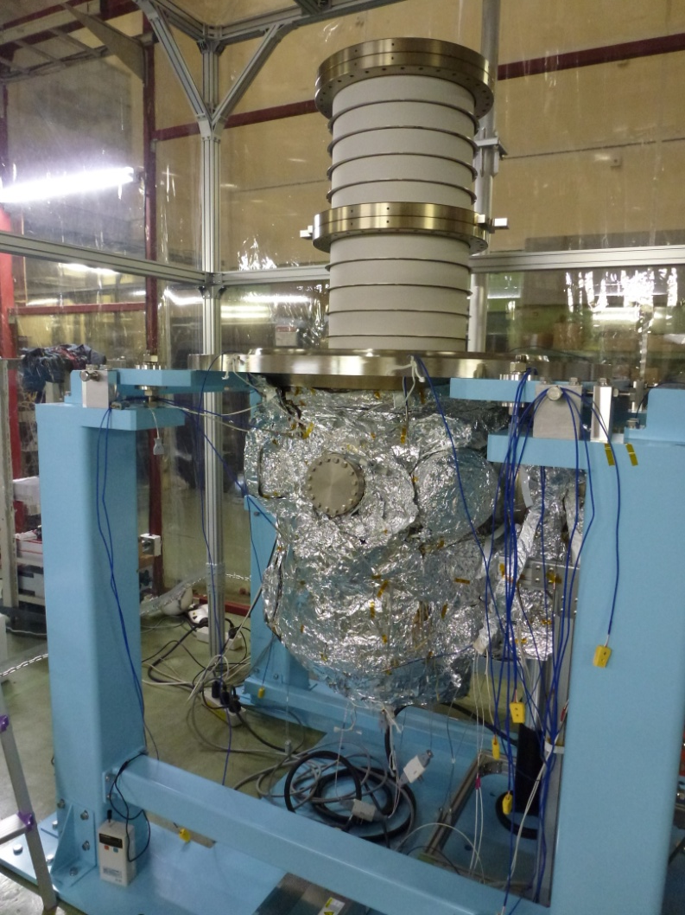
Total outgassing rate measurement
Assembled dc gun system
Spinning rotor gauge (SRG) was employed to suppress outgassing from the gauge.
M. Yamamoto, IPAC2011
Notes:
This picture shows that the assembled dc gun system to measure the outgassing rate.

Slide 11
Estimation of total outgassing rate from all system
(The values of the total outgassing rate are equivalent for hydrogen.)
Installed components | Surface area A [m²] | Total outgassing Q [Pa・m³/s] (IGs) | Total outgassing Q [Pa・m³/s] (SRG)
Gun chamber body | 2.4 | 2.7x10⁻¹⁰ | 1.1x10⁻¹⁰ (w/o viewports)
Ceramic insulator tubes | 1.6 | 1.1x10⁻⁹
Guard ring electrodes | 2 | -
Gate valves & View ports | ~0.3 | -
The total outgassing rate of the dc gun with main components was suppressed to Q~1x10⁻¹⁰ [Pa m³/s].
  Outgassing from the remaining components should be suppressed.
The possibility of generating extreme high vacuum of 1x10⁻¹⁰ Pa in the actual dc gun is still remained !
M. Yamamoto, IPAC2011
Notes:
In order to achieve goal vacuum pressure, outgassing from the remaining components should be suppressed.
Thus, this results shows that

Slide 12
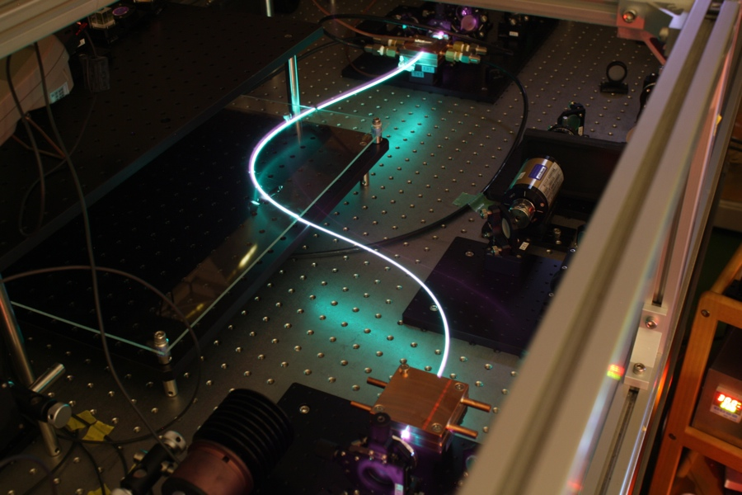
Laser System: for cERL first beam operation
Electron beam specification (first beam operation of cERL)
  Repetition rate: 1.3GHz
  Average current: 10mA(7pC/bunch)
  Normalized emittance: 1μm(at return loop) or lower
  Pulse duration: 30ps(at gun exit, this will be compressed after acceleration)
Laser specification
  Wavelength: 532nm (shorter than 700nm)
  Average power: 2.3W(2nJ/pulse)(on cathode)
    (at laser room: 5W(green), 25W(IR))
  Pulse duration: stacking 8 pulses of 8ps pulse
Achievements
  CW 1064nm, 36W output
  pulse 178.5MHz, 1064nm, 5W (peak power equivalent with 35W,1300MHz)
  SH generation
Development for first preparation of cERL is done.
Courtesy: Y. Honda
Notes:
This is the electron beam specification in first beam operation.
To achieve this specification, we decide laser specification
Y. Honda is developing laser system.
And he achieves
These values are enough for first beam operation.
Thus,

Slide 13
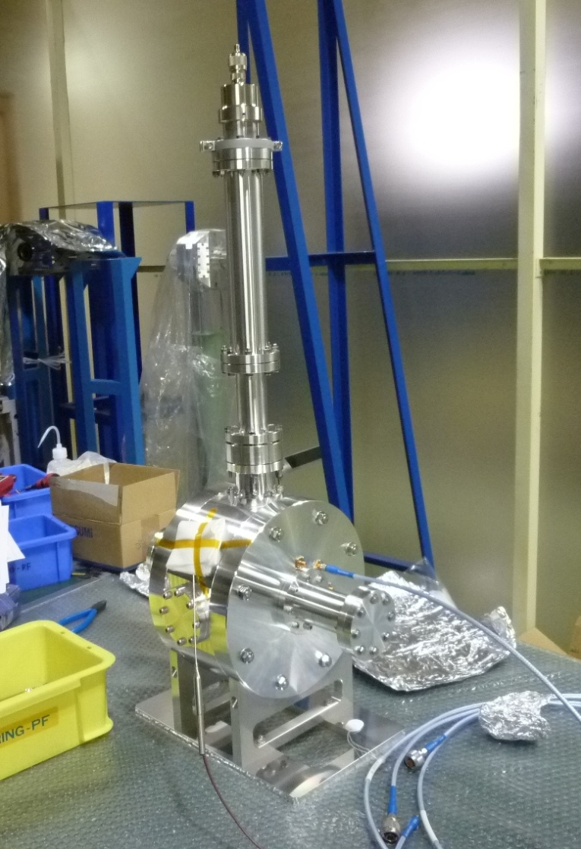
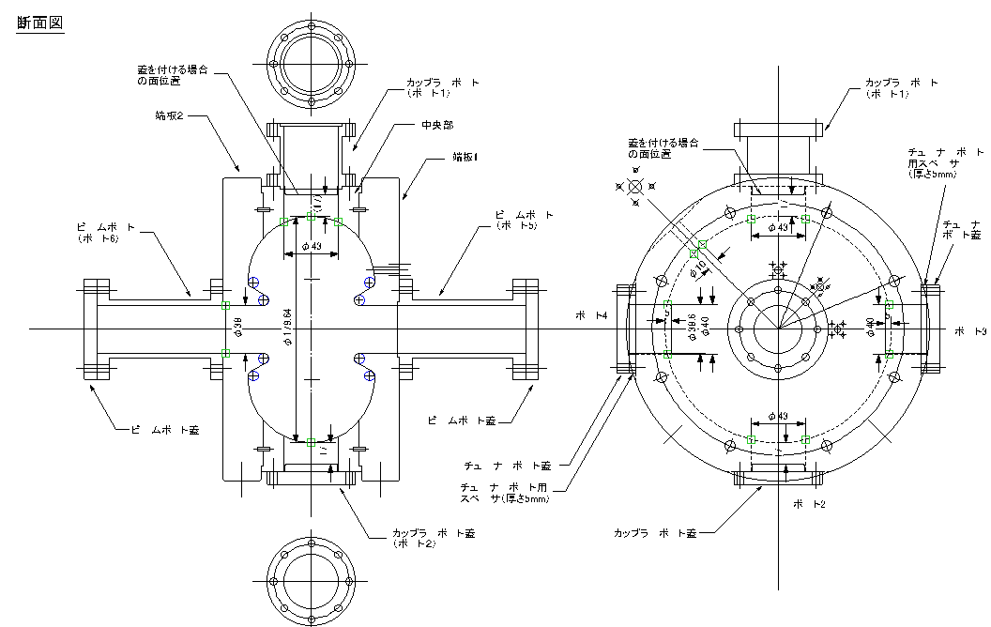
Bunching cavity
Courtesy: T. Takahashi, S. Sakanaka
A 1.3 GHz bunching cavity and a input coupler: now fabricating
Cold model: to check frequency and external Q of input coupler
Measurement results of cold model with model coupler
parameter
frequency | f_{a} = 1297.9292 MHz
Coupling of coulper | b = 0.862
Loaded Q | Q_{L} = 5,870
Unloaded Q | Q₀ = (1+b)Q_{L} = 10,940
External Q of coupler | Q_{ex} = Q₀/b = 12,700
Temperature | T = 23.9℃
Cold model of bunching cavity (Aluminum) with input coupler
Notes:
Prof. sakanaka and takahashi made Cold model of bunching cavity to check
These measurement results is fed back to design of actual cavity.
The fabrication of actual cavity will be finished this autumn.

Slide 14
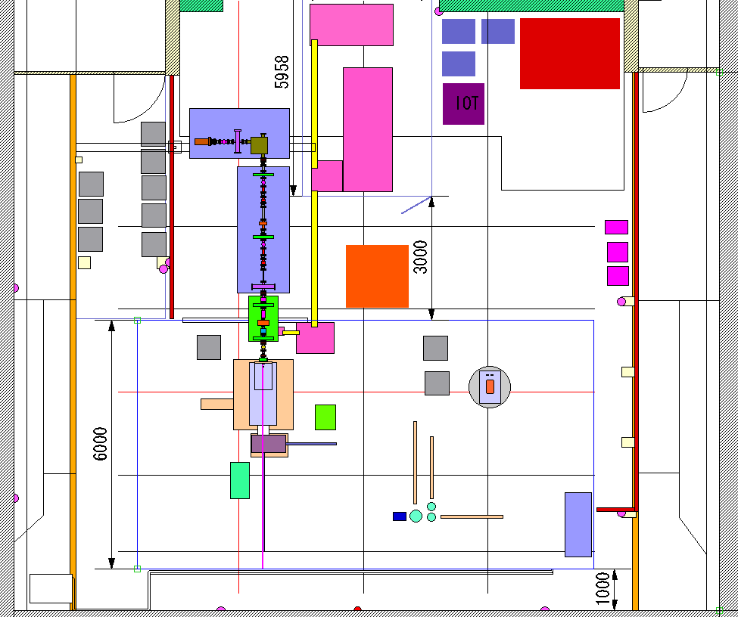
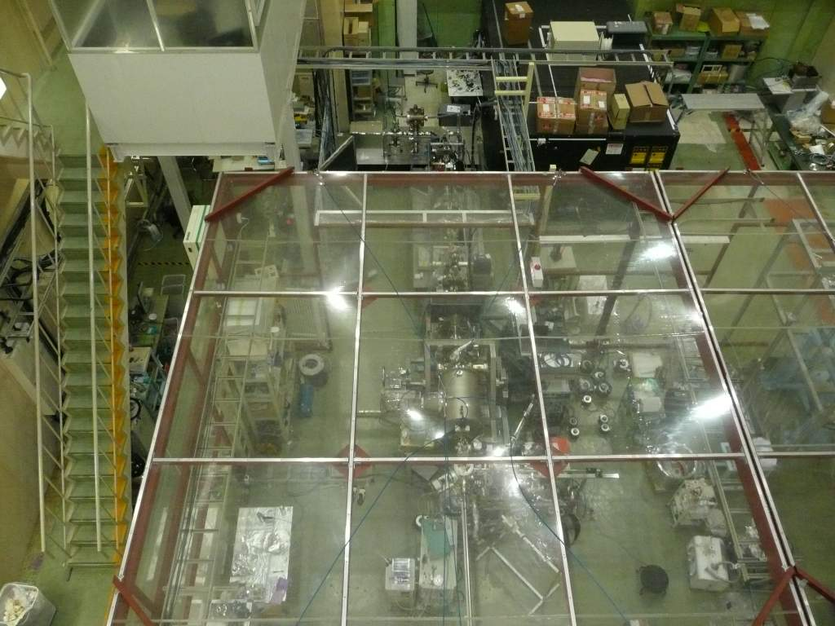
Gun test beamline for cERL injector
Purposes of test beam line
  To gain operation experience of the low energy beam.
  To evaluate performance of the DC guns and cathode materials by an additional diagnostic line to measure emittance and bunch length
  To develop a 500 kV gun and the injector line used at cERL.
NPES3, 200 kV gun
Test beamline
Laser system
Test area for 500 kV gun

Slide 15
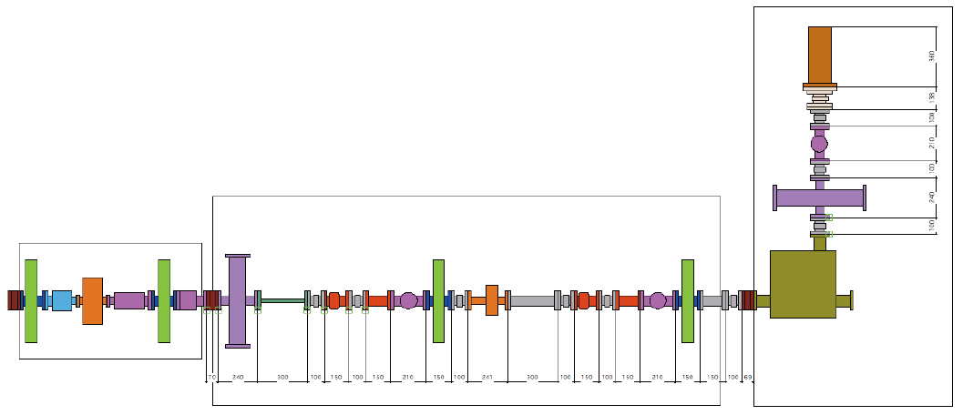
Layout of gun test beamline
5th view screen
3rd solenoid
4th solenoid
1st solenoid
2nd solenoid
1st slit
(vertical)
2nd slit
(vertical)
1st view screen
2nd view screen
3rd view screen
4th view screen
deflector
The same layout as cERL injector
Beam diagnostic line (emittance,
Bunch length measurements)
Beam dump line
Notes:
The first part is the same layout as cERL injector.

Slide 16
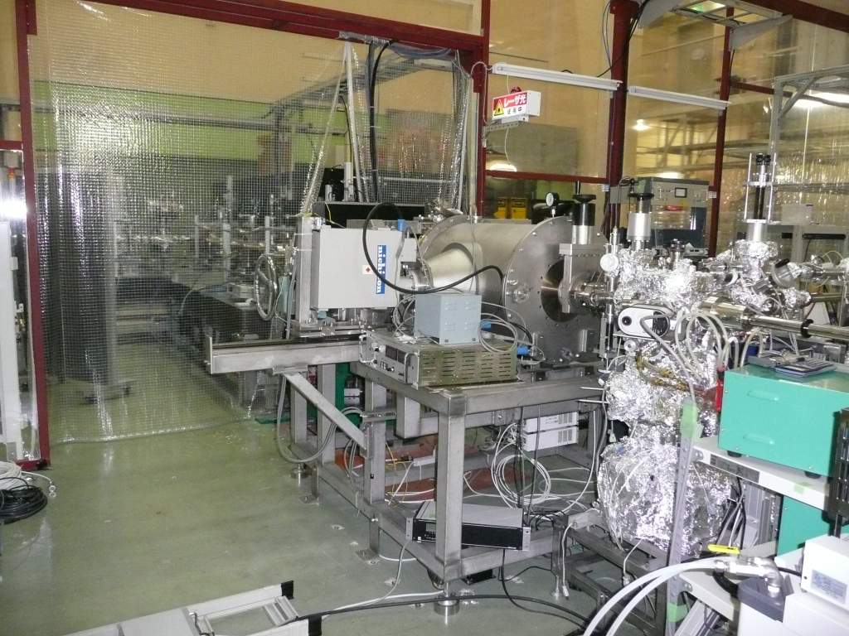
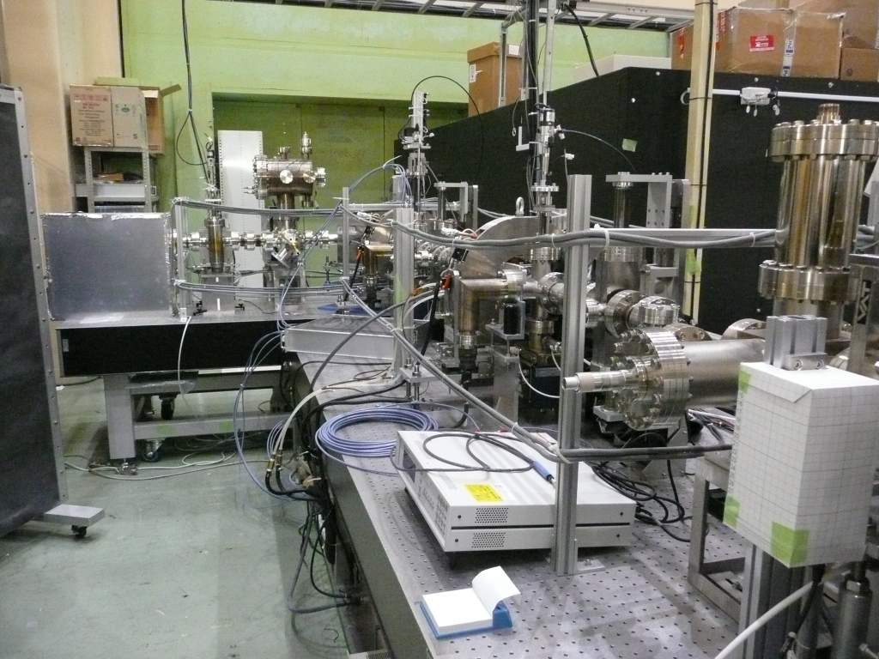
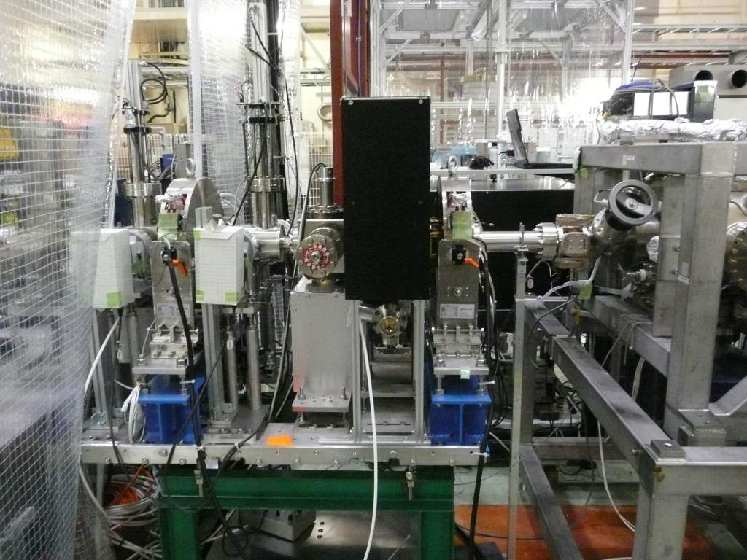
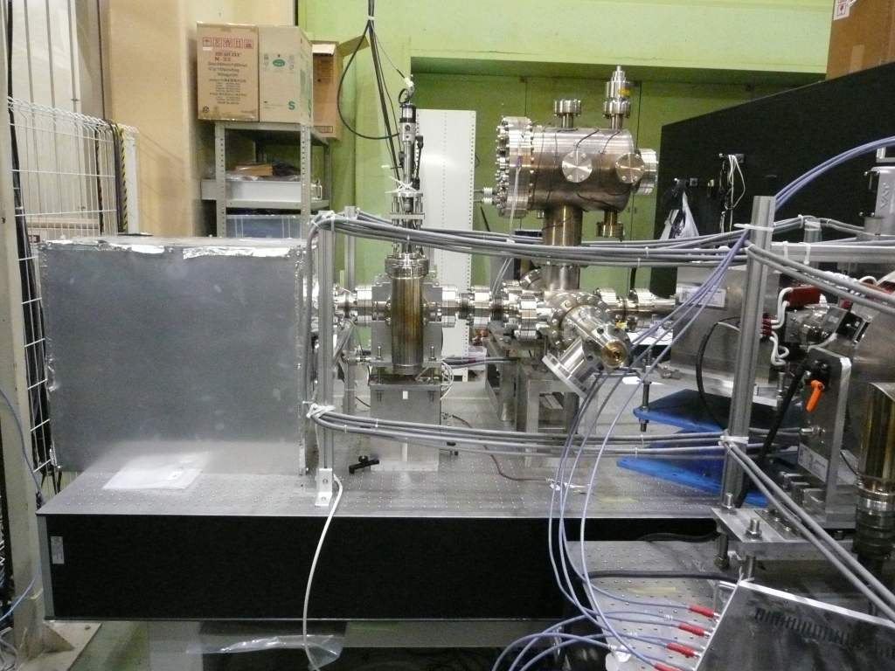
Gun test beamline
NPES3, 200 kV gun
Beam diagnostic line
Injector beamline without buncher
Beam dump line

Slide 17
Beam operation in Gun Test Beamline
Notes:
Next, I will show you beam operation in Gun Test beamline.

Slide 18
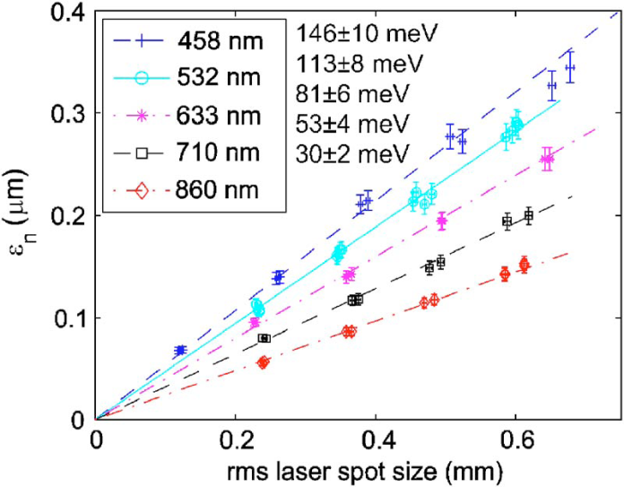
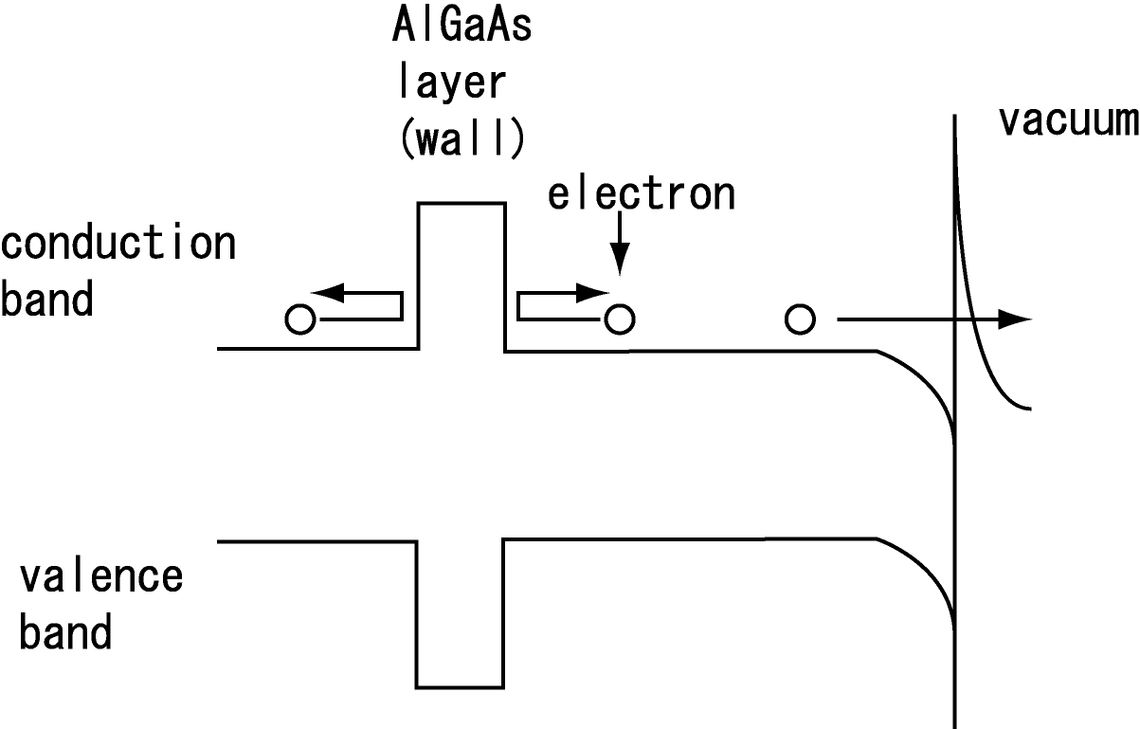
Beam operation in Gun Test Beamline
Purposes of beam operation
  To study space charge effect
  To study cathode property (initial emittance, time response)
Initial emittance of bulk GaAs cathode
  Bulk cathode was already measured.
  How is effect of thermalization in different active layer thickness of GaAs cathode?
I. V. Bazarov, et al, J. Appl. Phys. 103 (2008) 054901
Notes:
For example of beam operation, I will show you the results of the initial emittance measurement from thickness controlled GaAs cathode.

Slide 19
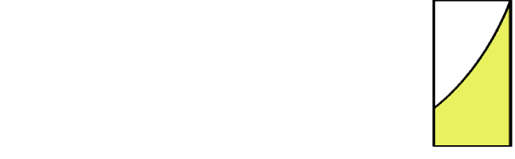
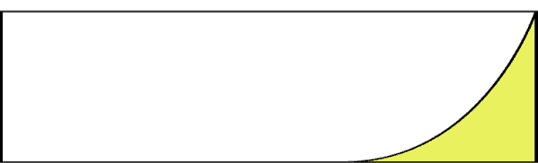
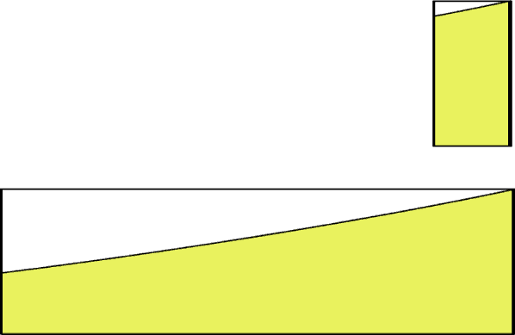
Effect of active layer thickness and wave length
Electrons around surface were not thermalized.
The emittance is determined by the ratio of the thermalized electrons to all electrons.
Effect of laser wave length
  Initial energy
  Initial electron distribution: exp(-αz)
    544 nm: absorption length, α ～ 100 nm
    785 nm: absorption length, α ～ 1000 nm
S. Matsuba, et.al., JJAP accepted
100 nm and 1000 nm
Initial longitudinal electron distribution in cathode
 | 100 nm thickness | 1000 nm thickness
Laser wave length: 544 nm
Laser wave length: 785 nm
surface
Thermalized electrons
Notes:
Electrons around surface were not thermalized.
On the other hand, the electron far from surface is extracted after thermalization.
Therefore, the emittance is determined by the ratio of thermalized electron s to all electrons.
And next, we are thinking effect of laser wave length.

Slide 20
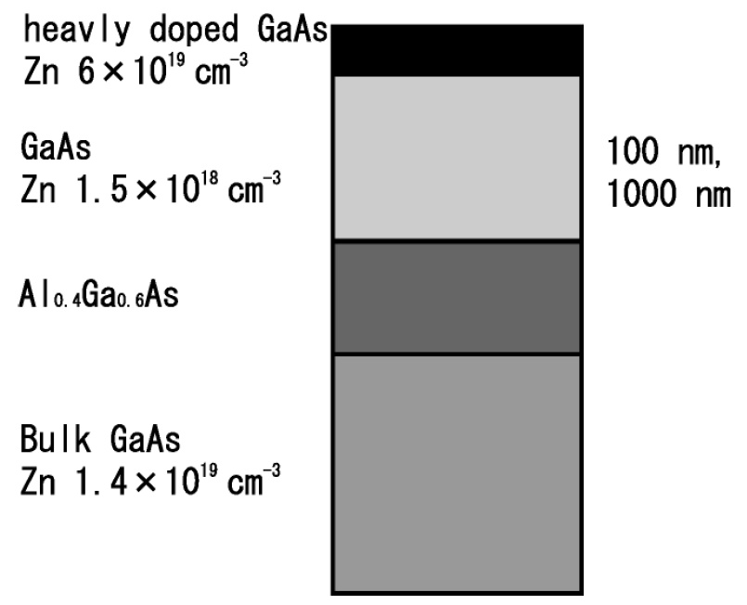
Thickness-controlled cathode
Two GaAs photocathodes with active layer thicknesses of 100 and 1000 nm fabricated by metalorganic vapor phase epitaxy (MOVPE) at Nagoya University
100 nm and 1000 nm
S. Matsuba, et.al., JJAP accepted

Slide 21
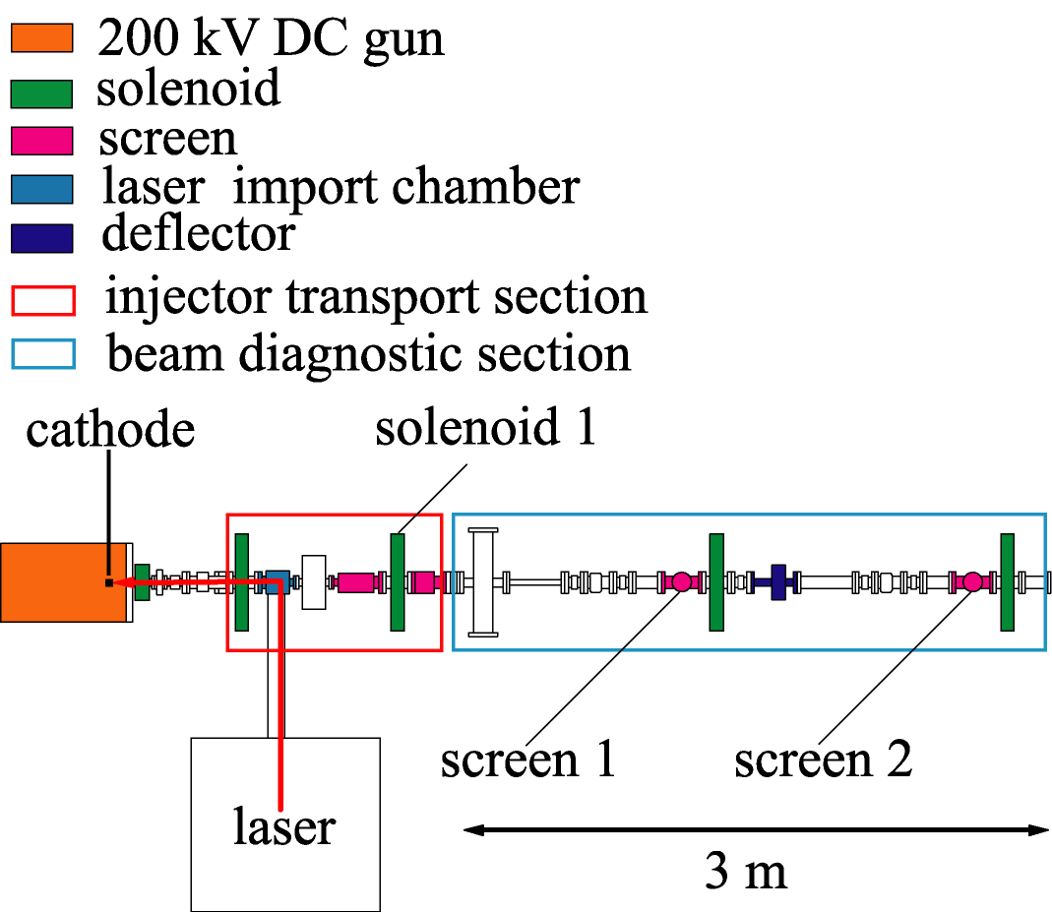
Setup of emittance measurement
Conditions
Laser
  Wave length: 544 nm and 785 nm
  Time structure: CW
Gun voltage: 100 kV
Beam current: few nA
Emittance measurement:
Waist scan method
S. Matsuba, et.al., JJAP accepted

Slide 22


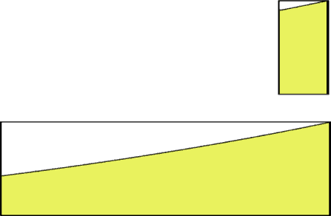

MTE measurement results
100 nm
1000 nm
544 nm
785 nm
Thermal energy of room temperature
<Ekx>: Mean Transverse Energy (MTE)
MTE depends on laser wave length.
But, MTE dose not depend on active layer thickness.
  The results indicate that any electrons must have been thermalized.
Measured MTEs are still higher than the thermal energy of room temperature.
What dose increase the emittance?
Surface roughness
S. Matsuba, et.al., JJAP accepted

Slide 23
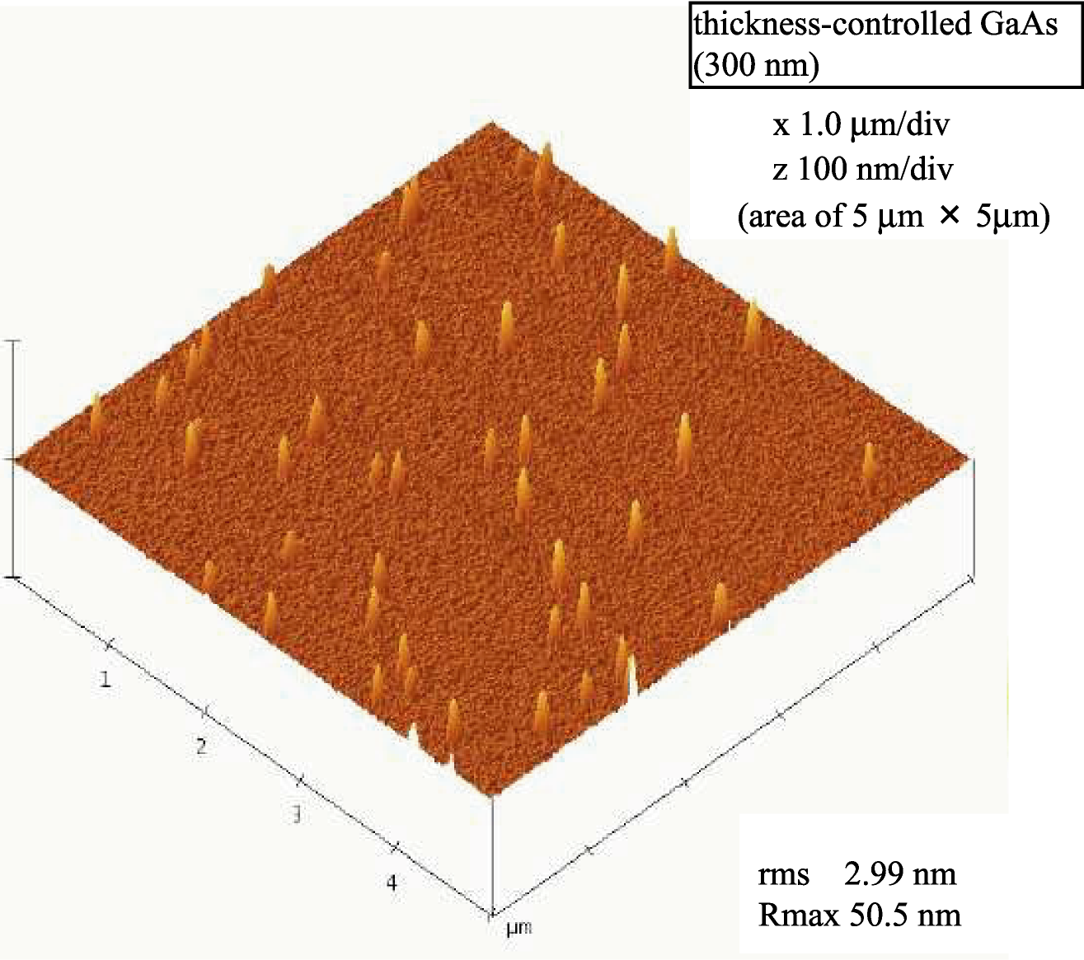
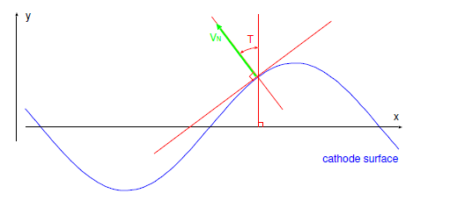
Surface roughness of cathode
The surface roughness was measured by Atomic Force Microscopy.
AFM measurement result
5μm×5μm
Calculation result of emittance growth
Rms surface roughness: 7mm
Period: 100 nm
|𝜒| = 0.2 eV
The increase in MTE is estimated to be about 20 meV.
rms 2.99 nm
Rmax 50.5 nm
AFM measurement result
90μm× 90μm rms 7nm
Rmax250 nm
S. Matsuba, et.al., JJAP accepted
Notes:
Assuming that the Rms surface roughness 7 mm, the increase in MTE is estimated to be about 20 meV.
This results may explain our measurement results.

Slide 24
Construction schedule of cERL injector
Notes:
Finally, I will show you 2 slides.

Slide 25
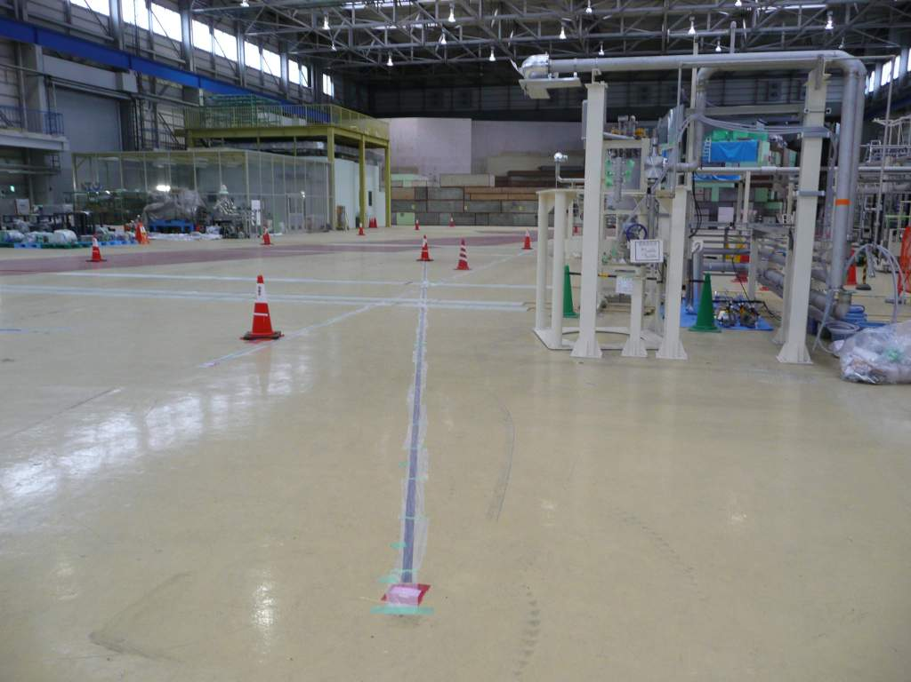
Status of ERL Development building for cERL
2 Mar, 2012
From return loop
2K cold box and end box
for injector SRF cavity
Electron beam
Place of DC 500 kV gun

Slide 26
Road Map of ERL
Japanese Fiscal Year (from April to March)
2008 | 2009 | 2010 | 2011 | 2012 | 2013 | 2014 | 2015 | 2016 | 2017 | 2018 | 2019 | 2020
R&D of ERL key elements
Prep of ERL Test Facility
cERL construction
Beam test and test experiments
Improvements towards 3GeV class ERL
Construction of
3GeV ERL
User
run
Installation of JAEA 1st Gun:
Oct. 2012
1st beam operation of cERL: Mar. 2013

Slide 27
Summary

Slide 28
Summary
Status of R&D of cERL injector
  DC photo cathode gun
    JAEA 1st Gun : HV processing and beam generation succeeded.
    KEK 2nd Gun: now developing
  Laser system: Development for first preparation of cERL is done.
  Bunching cavity: now fabricating
Beam operation in Gun Test Beamline
  Initial emittance measurements of GaAs based cathodes are done.
  Temporal response measurements
  Study of space charge effect
Construction and commissioning plan of cERL injector
  Oct. 2012: installation of JAEA 1st Gun
  Mar. 2013: 1st beam commissioning of cERL

Slide 29
Buck up slides

Slide 30
Summary & Future of DC gun vacuum system
The total outgassing rate of the dc gun with main components was suppressed to Q~1x10⁻¹⁰ [Pa m³/s].
  Outgassing from the remaining components should be suppressed.
The pumping speed of the 20 K bakeable cryopump was obtained for nitrogen, methane, argon, and hydrogen.
  The ultimate pressure of the bakeable cryopump was limited by adsorption equilibrium of adsorbent for hydrogen.
  A test about 4 K bakeable cryopump is in progress.
The possibility of generating extreme high vacuum of 1x10⁻¹⁰ Pa in the actual dc gun is still remained !
M. Yamamoto, IPAC2011

Slide 31
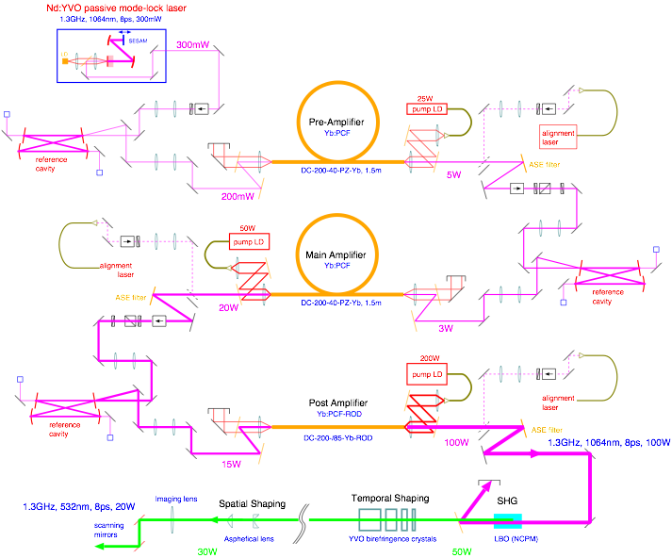
Laser system: conceptual design
Courtesy: Y. Honda

Slide 32
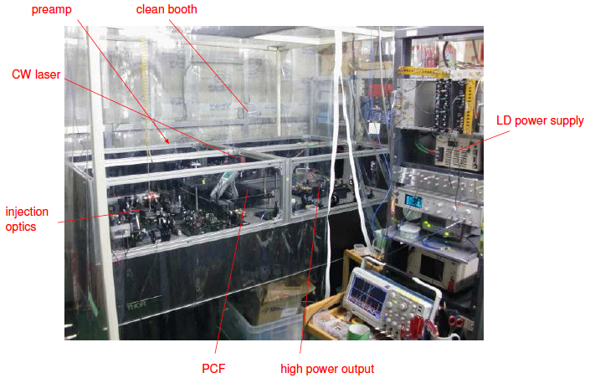
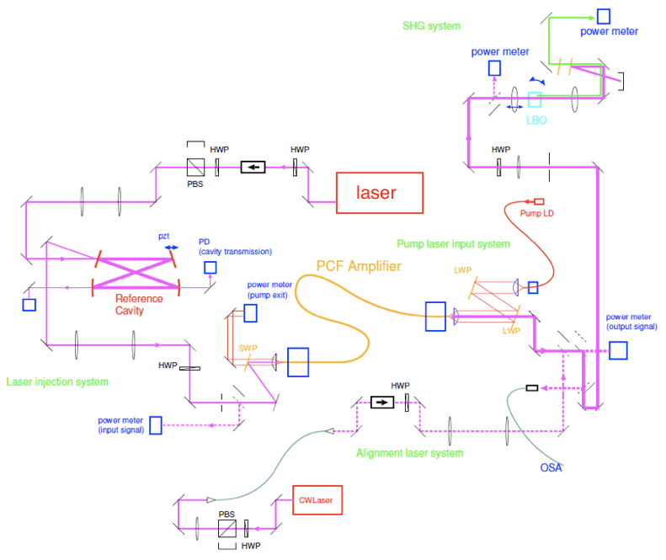
Laser system: Development work at KEK
Courtesy: Y. Honda
Since August 2011, KEK started development high power laser system by ourselves.
KEK has no experience of high power fiber amplifier system so far. Started from a basic tests with a minimal system.

Slide 33
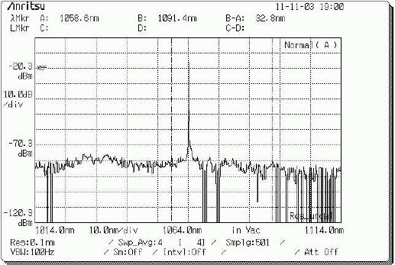
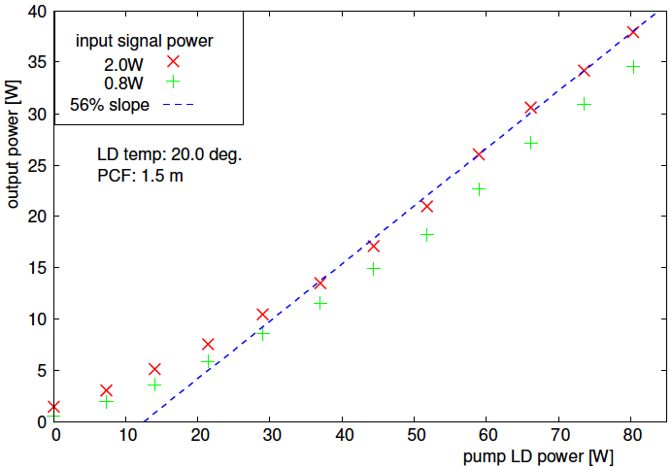
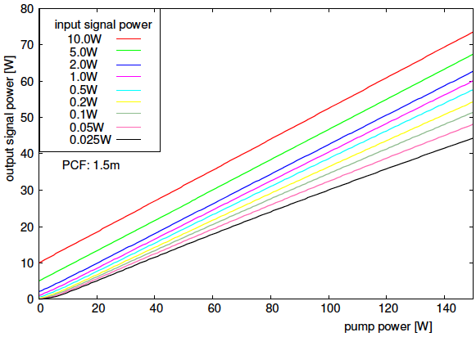
Fiber amplifier (test with a CW laser)
Courtesy: Y. Honda
PCF 1.5m (NKT photonics, DC-300-40-PZ-Yb)
Seed 1064nm, cw laser
80W pump, 37W output. Consistent with a model expectation based on low power tests.
ASE noise grows at 1035nm, but it can be suppressed at >1W input power with a suitable pre-amplifier.
spectrum
ASE
noise
1064nm
signal
calculation

Slide 34
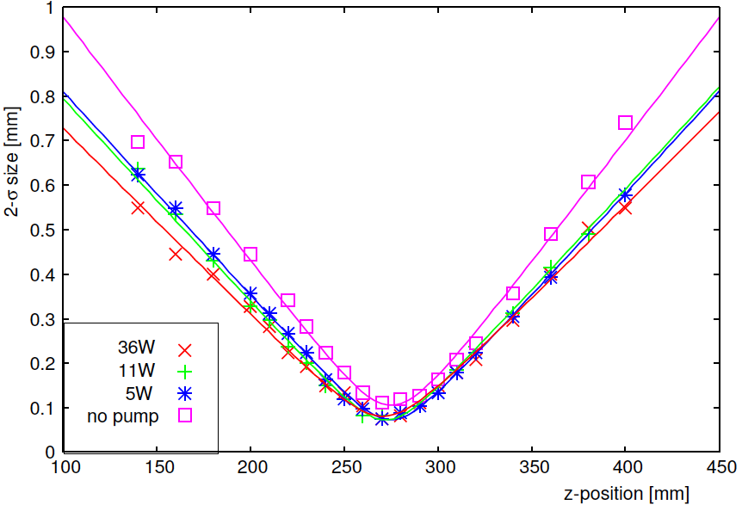
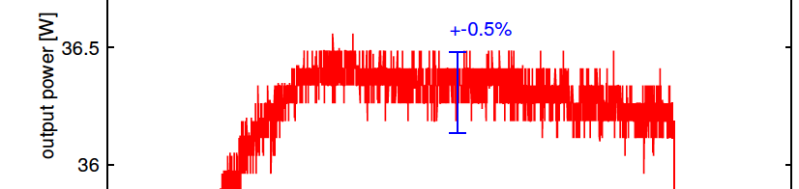
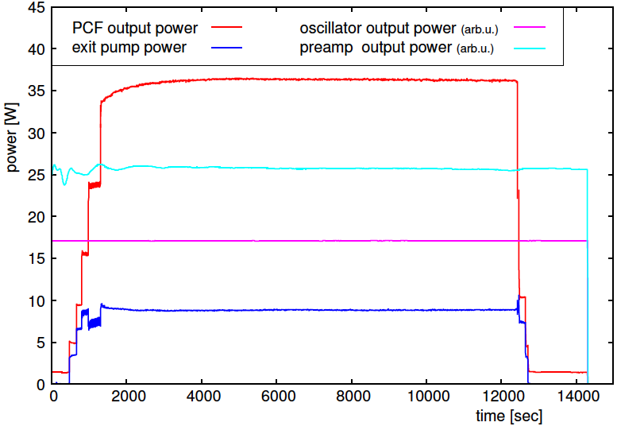
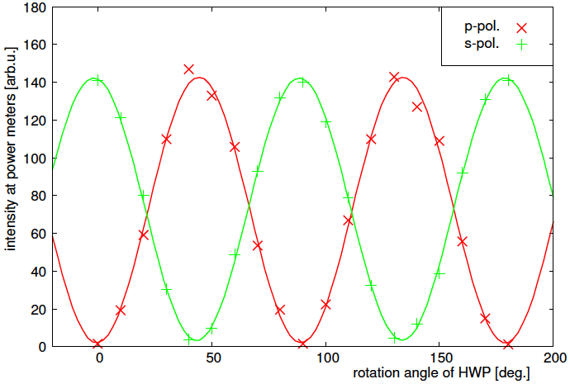
Quality of high power output
Courtesy: Y. Honda
Features of PCF are confirmed
Diffraction limited transverse mode
Polarization maintaining
Output power is stable (as long as the environment is stable). No power damages so far.
transverse mode quality
stability
polarization stability

Slide 35
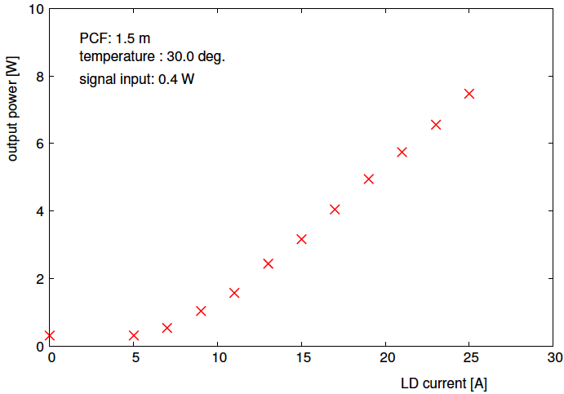
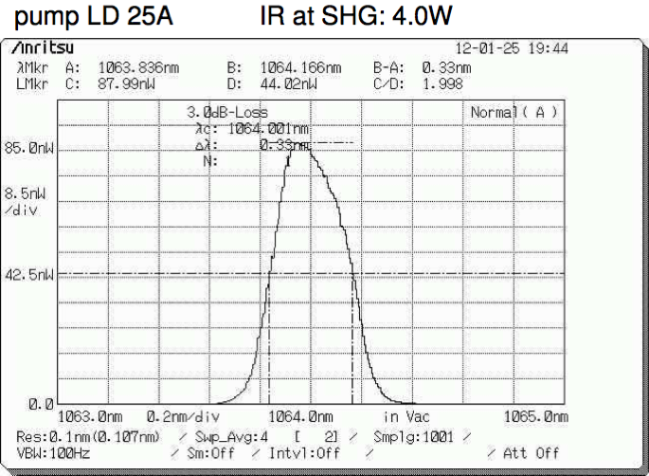
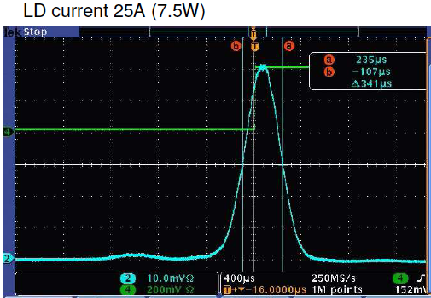
Test with a pulsed laser
Courtesy: Y. Honda
Preparing a 1.3GHz Nd:YVO passive mode-lock laser (Time-Bandwidth Product, GE-100)
Peak power tests with a same type laser of 178.5MHz.
5W at 178.5MHz is the equivalent pulse power of 35W 1300MHz
Amplification, fine.
Spectrum (0.33nm FWHM), getting a little broad due to non-linearity, seems not so significant.
Pulse width (7.5ps FWHM), looks no difference.
power amplification
spectrum
pulse width
(auto-correlator)

Slide 36
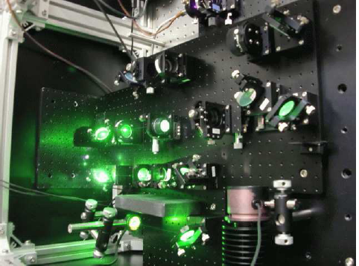
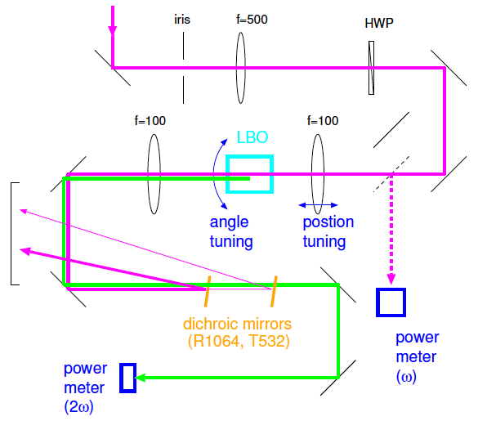
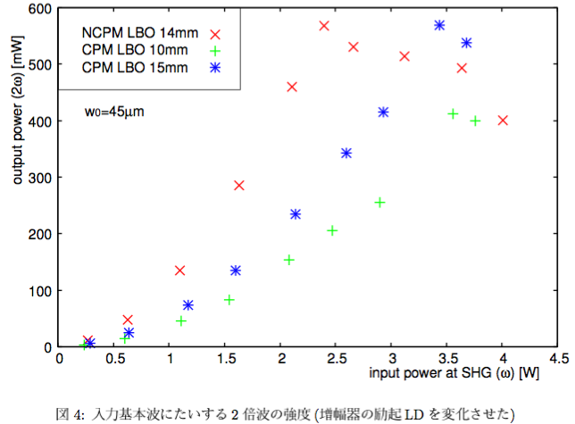
Second harmonics
Courtesy: Y. Honda
Type-1 NCPM LBO, 14mm
532nm, 0.6W could be produced by 1064nm, 178.5MHz, 3W fundamental.
Scaling this result to 1300MHz with same pulse energy
532nm, 4.3W can be expected by 1064nm, 1300MHz, 21W
Good enough for first goal of cERL

Slide 37
Laser system: summary
Laser system for cERL : Nd:YVO mode-locked laser + Yb-PCF amplifier
Method for fiber input coupling
Modeling and understanding fiber amplifier
Result
  CW 1064nm, 36W output
  pulse 178.5MHz, 1064nm, 5W (peak power equivalent with 35W,1300MHz)
  SH generation
Development for first preparation of cERL is done.
Next, actual system assembly & higher power development
Courtesy: Y. Honda

Slide 38
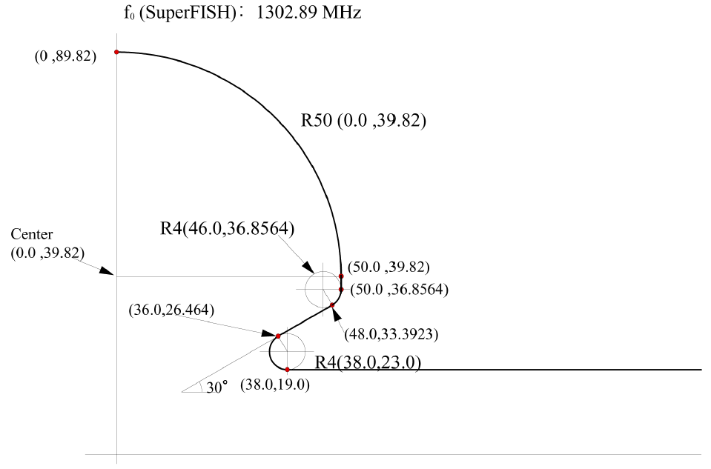
Bunching Cavity
A 1.3 GHz bunching cavity and a input coupler are fabricating.
Design parameters of buncher
parameter
Frequency (calc. without input coupler) | 1302.89MHz
Unloaded Q (calc.) | 25,000
R_{sh}/Q for β=1 | 232.8 Ω
R_{sh}/Q for β=0.863 (500 keV) | 194.7 Ω
R_{sh}/Q for β=0.8 | 173.4 Ω
Courtesy: T. Takahashi, S. Sakanaka

Slide 39
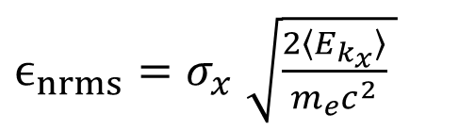
MTE and laser spot size
Mean Transverse Energy (MTE) was estimated for two different laser spot size.
Measurement results of 1000 nm cathode
S. Matsuba, et.al., JJAP accepted

Slide 40
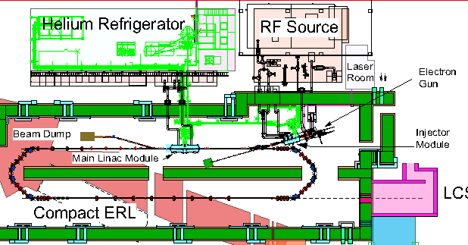

Optics Design for cERL 1st commissioning
We are designing a beam optics for the compact ERL (cERL) 1st commissioning.
The layout has a long straight section (8 m) from the exit of merger to the entrance of main linac for diagnostic system.
In the future, main SRF cavities will be installed on the long straight section.
Parameters of the Compact ERL 1st commissioning
5 MeV beam paths through the long straight section.
 | Parameters
Gun voltage | 500 kV
Injection energy | 5 MeV
Beam energy | 35 MeV
Average current | 10 mA (7.7 PC/bunch)
Acc. gradient (injector) | 7.5 MV/m
Acc. gradient (main linac) | 15 MV/m
Normalized emittance | < 1 mm·mrad
Bunch length (rms) | 1 - 3 ps (usual)
RF frequency | 1.3 GHz
Long straight for additional SRF cavities in the future.
The straight section is used for beam instrumentation to measure injected beam.

Slide 41
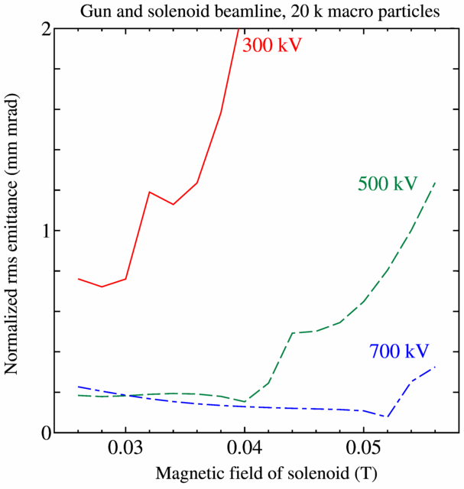

Effect of gun voltage
Preliminary results
Bunch charge: 20 pC/bunch
Gun voltage: 500 kV or 600 kV
At exit of merger
(1) 0.6 mm (2 ps) bunch length
enx = 0.14 mm mrad with 500 kV
enx = 0.13 mm mrad with 600 kV
(2) 0.9 mm (3 ps) bunch length
enx = 0.12 mm mrad with 500 kV
enx = 0.11 mm mrad with 600 kV
Results of Gun and solenoid beamline

Slide 42

Physics in ERL injector
Space charge effect （Coulomb force between electrons)
Solenoid focusing （Emittance compensetion）
RF kick in RF cavity
Higher order dispersion in merger section
Coherent Synchrotron Radiation (CSR) in merger section
Response time of photo cathode（It generates tail of emission.）
These effects combine in the ERL injector.
To obtain high quality beam at the exit of merger, optimization of beamline parameters is required.
Method to research the beam dynamics:
Macro particle tracking simulation with space charge effect is used.
The simulation code have to include
External electric and magnetic field,
Space charge effect (3D space charge).
Notes:
In the injector, we have to treat these effects.
Space charge effect, solenoid focusing, RF kick, higher order dispersion, CSR and response time of photo cathode.
Because these effects combine in the ERL injector, optimization of beamline parameters is required to obtain high quality beam.
To study beam dynamics in the injector, we use macro patciel tracking simulation with space charge effect.

Slide 43




Emittance growth in drift space with 5 MeV
The emittance growth in a drift space with 5 MeV and 7.7 pC/bunch was calculated.
A quadrupole magnet is placed at 2 m. The strength is varied from 0 to 5 m⁻¹.
Horizontal direction
We can reduce the emittance growth in the drift space due to adjust quadrupole magnet strength.
The results shows that the appropriate layout of the quadrupole magnet can reduce the emittance growth.
In three-step optimization, we used other different layout of quadrupole magnets.
Vertical direction

Slide 44


Emittance growth in drift space
Emittance growth in drift space with 7.7 pC/bunch.
The results shows that the emittance growth with 5 MeV is not negligible.

