Slide 1

polarized positive μ+↓ and negative μ-↑
muon beams @
to perform DVCS measurements
for GPD study
workshop on positrons
JLab 25 March 2009
Nicole d’Hose, CEA-Saclay
On behalf of the COMPASS collaboration

Slide 2
exclusive single-photon production
μ p → μ γ p
dσ α |T_{DVCS}|² + |T_{BH}|² + Interference Term
DVCS
BH
μ
μ
γ
γ
GPD
p
small t
slow p
p
small t
slow p

Slide 3
COMPASS : domain 10⁻² < x < 10⁻¹
ZEUS
H1
Limit due to luminosity ?
COMPASS
JLab
HERMES
Limit due
to γ acceptance

Slide 4
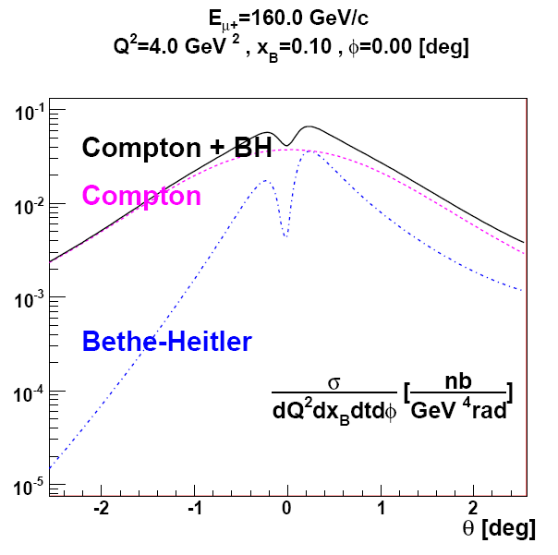
Comparison BH and DVCS at 160 GeV
x_{B}=0.05
DVCS /2
BH/10
x_{B}=0.1
DVCS /2
BH/10
x_{B}=0.2
Q²=2
Q²=2
|t |<1 GeV²
Q²=2
|t |<1 GeV²
|t |<1 GeV²
BH important
DVCS dominates
Q²=4
Q²=4
|t |<1 GeV²
Q²=4
|t |<1 GeV²
|t |<1 GeV²

Slide 5
DVCS + BH with μ+↓ and μ-↑ beam and unpolarized target
μ’
γ*
γ
μ
μ
θ
+
μ
p
p
DVCS
BH calculable
ϕ
p
dσ_{(μp→μpγ)} = dσ^{BH} + dσ^{DVCS}_{unpol} + P_{μ} dσ^{DVCS}_{pol}
+ e_{μ} a^{BH} Re A^{DVCS} + e_{μ} P_{μ} a^{BH} Im A^{DVCS}
D_{U,CS}
Beam
Charge & spin
difference
=
2P_{μ} ×
e
6
d
σ
DVCS
=
(
s
DVCS
sin
ϕ
)
pol
y
2
Q
2
1
+ 2e_{μ} ×
Twist-2 M¹¹
>>
Twist-3 M⁰¹
Twist-2 gluon M⁻¹¹
Belitsky,Müller,Kirchner

Slide 6
DVCS + BH with μ+↓ and μ-↑ beam and unpolarized target
μ’
γ*
γ
μ
μ
θ
+
μ
p
p
DVCS
BH calculable
φ
p
dσ_{(μp→μpγ)} = dσ^{BH} + dσ^{DVCS}_{unpol} + P_{μ} dσ^{DVCS}_{pol}
+ e_{μ} a^{BH} Re A^{DVCS} + e_{μ} P_{μ} a^{BH} Im A^{DVCS}
D_{U,CS}
Beam
Charge & spin
difference
=
2P_{μ} ×
e
6
d
σ
DVCS
=
(
s
DVCS
sin
ϕ
)
pol
y
2
Q
2
1
+ 2e_{μ} ×
This is the good way to get rid of the large BH contribution
if we are able to control the μ+↓ and μ-↑ fluxes and efficiencies
→ we can extract c₀^{Int} and c₁^{Int}
Twist-2 M¹¹
>>
Twist-3 M⁰¹
Twist-2 gluon M⁻¹¹
Belitsky,Müller,Kirchner

Slide 7
DVCS + BH with μ+↓ and μ-↑ beam and unpolarized target
μ’
γ*
γ
μ
μ
θ
+
μ
p
p
DVCS
BH calculable
φ
p
dσ_{(μp→μpγ)} = dσ^{BH} + dσ^{DVCS}_{unpol} + P_{μ} dσ^{DVCS}_{pol}
+ e_{μ} a^{BH} Re A^{DVCS} + e_{μ} P_{μ} a^{BH} Im A^{DVCS}
S_{U,CS}
= 2
Beam
Charge & spin
sum
+ 2
+ 2 e_{μ} P_{μ} ×
Twist-2 M¹¹
>>
Twist-3 M⁰¹
Twist-2 gluon M⁻¹¹
Belitsky,Müller,Kirchner

Slide 8
DVCS + BH with μ+↓ and μ-↑ beam and unpolarized target
μ’
γ*
γ
μ
μ
θ
+
μ
p
p
DVCS
BH calculable
φ
p
dσ_{(μp→μpγ)} = dσ^{BH} + dσ^{DVCS}_{unpol} + P_{μ} dσ^{DVCS}_{pol}
+ e_{μ} a^{BH} Re A^{DVCS} + e_{μ} P_{μ} a^{BH} Im A^{DVCS}
S_{U,CS}
= 2
Beam
Charge & spin
sum
+ 2
+ 2 e_{μ} P_{μ} ×
After integration over φ in all the acceptance and subtraction of BH contrib. contribution → we can get DVCS contribution only, C₀^{DVCS}
Twist-2 M¹¹
>>
Twist-3 M⁰¹
Twist-2 gluon M⁻¹¹
Belitsky,Müller,Kirchner

Slide 9
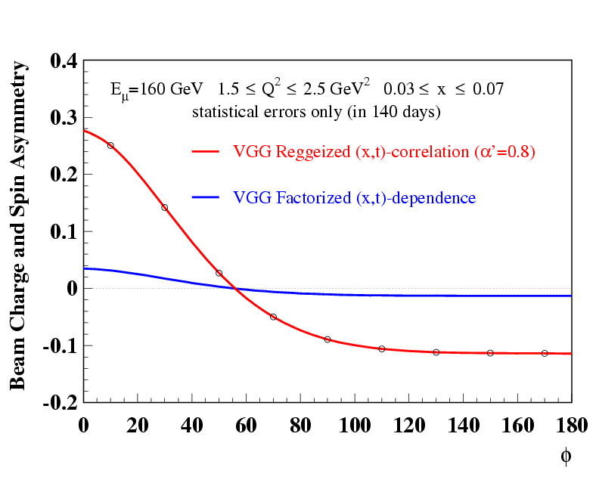
Using D_{U,CS} / S_{U,CS} : Beam Charge and Spin Asymmetry
Comparison to different models from VGG
<b²⊥> = α’ ln 1/x
H(x,0,t) = q(x) e ^{t <b}⊥^{2>*}
= q(x) / x ^{α’ t}
(α’~0.1)
H(x,ξ,t) ~ q(x) F(t)
statistical errors
still under debate

Slide 10
New predictions from Dieter Mueller
BC&SA
Dieter Mueller uses a Global Fit
on H1/ZEUS, HERMES, CLAS
and JLab Hall A
and no JLab Hall A
φ

Slide 11
Using S_{U,CS} : dσ_{DVCS} / dt ~ exp(Bt)
Projections for the t-slope measurement at COMPASS
FFS model
Adapted by Sandacz
B(x) = b₀ + 2 α’ ln(x₀/x)
α’ =0.125 GeV⁻²
b₀ =5.83 ± 0.5 GeV⁻²
x₀=0.0012 (Q²=8,W=82)
1<Q²<8
for valence quark α’ ~ 1 GeV⁻² to reproduce FF ≅ meson Regge traj.
for gluon α’ ~ 0.164 GeV⁻² (J/Ψ at Q²=0)
α’ ~ 0.02 GeV⁻² (J/Ψ at Q²=2-80 GeV²)
<< α’ ~ 0.25 GeV⁻²
for soft Pomeron

Slide 12
Still many open questions on FoM and Systematic effects:
❶Efficiency to reject background that simulates exclusive μp → μ’γp events
❷ Final accuracy of the μ+ and μ- fluxes and detection efficiencies
to combine both μ+ and μ- measurements for D_{U,CS}
❸Final accuracy on the procedure to subtract the known BH contribution
correctly renormalized to the measured yield for S_{U,CS}
Goal of a DVCS pilot run in 2009:
- do an absolute measurement of BH (dominant at small x) → FoM + ❶❷❸
- record and identify a few DVCS events → very important for ❶
- collect μp → μ’X or μ’ π+ (π-) (π°) X → ❷
μp → μ p γ (π°) (ρ)

Slide 13
In 2008 with 1.5 days of beam of low intensity
done in a rush before the shut down
(LHC accident)
we have observed ~100 Single Eclusive photons
identified to BH due to their distribution in φ
analysis to be released tomorrow

Slide 14
in 2009 absolute measurement of BH at small x
Characteristic feature of
the φ-dependence
of BH and DVCS
μ’
γ*
γ
θ_{γ*γ}
μ
p
φ
bins for BH with minimal DVCS contamination
→ to study the phi dependence
→ to determine the FoM
1<Q²<2 0.005<x<0.01 300 BH (5 DVCS + int.) → 6 %
2<Q²<4 0.01<x<0.02 121 BH (3 DVCS + int.) → 9 %
φ
in 7 days accuracy on BH

Slide 15
in 2009
→ first insight for DVCS
  Experimental determination of the DVCS yield
  to control the credibility of estimation
collect with μ+ and μ- inclusive, semi-inclusive
and exclusive events:
μp → μ’X or → μ’ π+ (π-) (π°) X or → μ’ p γ (π°) (ρ)
Perform accurate control of:
- the μ+ and μ- fluxes
- the halos flux
- the detection efficiencies
15

Slide 16
roadmap
- ’’Letter of Intent’’ CERN-SPSC-2009-003
→ a complete proposal for june 2009
Demonstrate the feasibility of
such an experiement
1rst phase in ~2011/12
DVCS with unpolarised proton target
2nd phase in ~2013/14
DVCS with polarised proton target
→ new equipments needed

Slide 17
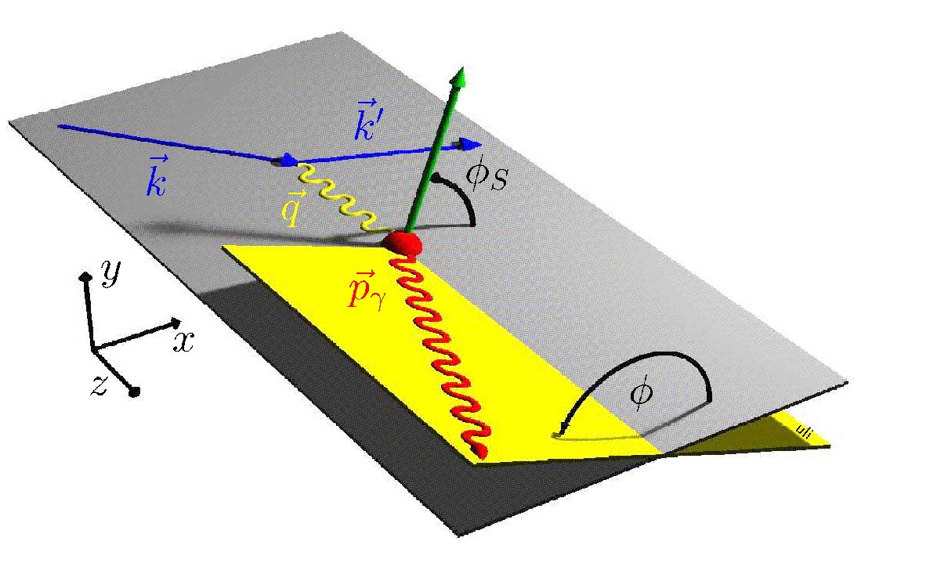
Proposal to study ‘’GPDs @ COMPASS’’ in 2 phases
Phase 1: DVCS experiment in ~2011/12 to constrain GPD H
with μ^{+↓}, μ^{-↑} beam + unpolarized long LH2 (proton) target
+ recoil detector + ECAL1,2 (possibly 0) + all COMPASS equipment
dσ /dt → impact parameter b
dσ(μ ^{+↓}, φ) + dσ(μ ^{-↑}, φ) ∝ Im(F₁ H) sin φ
dσ(μ ^{+↓}, φ) - dσ(μ ^{-↑}, φ) ∝ Re(F₁ H) cos φ
Phase 2: DVCS experiment in ~2013/14 to constrain GPD E
with μ⁺ and transversely polarized NH3 (proton) target
+ recoil detector + ECAL1,2 (possibly 0) + all COMPASS equipment
dσ(φ, φ_{S}) - dσ(φ, φ_{S}+π) ∝ Im(F₂ H – F₁ E) sin (φ- φ_{S}) cos φ

