Slide 1
U.S. Department of Energy Accelerator Safety Workshop 2017 Thomas Jefferson National Accelerator Facility
Robert May, ESH&Q Division
Harry Fanning, Accelerator Division Safety Officer
Co-Chairs
August 15-17, 2017

Slide 2
Workshop Motto
ANL Electrical Safety Lecture 08/03/2017

Slide 3
Welcome
Health and Safety
Flow of the workshop
Where to get tech support

Slide 4
Health and Safety
Life threatening situation?
Call 911, follow verbal instructions
Follow instructions of Workshop Organizers or JLab Security staff
Injury or illness?
Occupational Medicine staff available for consultation and referral
Located in Support Service Center (Building 28) in Room 22C, 757-269-7539 (7539 from lab phone)

Slide 5
Health and Safety, cont’d.
Foul Weather Events
Hurricanes (we’re fresh out of hurricanes)
Tornados (we have a tornado siren linked to the NWS) follow instructions of Workshop Organizers or JLab Security staff
All other issues such as fire, emergency evacuation, again, follow instructions of Workshop Organizers or JLab Security staff
If directed, exit building thru marked doors, gather at muster point

Slide 6
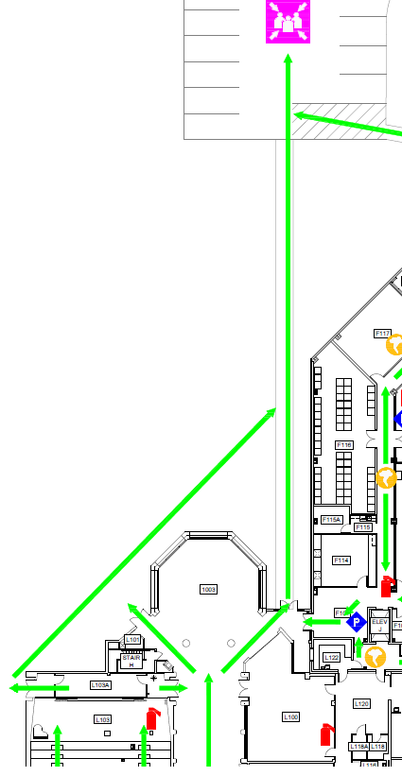
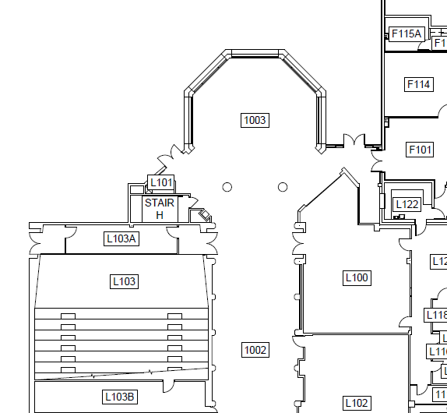
Health and Safety, cont’d.
You are here

Slide 7
Health and Safety, cont’d.
Extension cords and seating
You will find certain aisles/rows and seats blocked off to provide you with a place to plug in laptop computers and cell phones
Please be considerate of folks moving past your seat
Keep aisles clear
Unplug your device
Lift your folding desk surface

Slide 8
Flow of the Workshop
Flow of the workshop
We are doing something new this year.
Please hold your questions for any given presenter until the end of the plenary session.
Each plenary session will end with a panel discussion that will address questions
Panel consists of speakers and session chairs
Questions e-mailed in from off-site will be given to the panel
Lunch is available in the cafeteria across the lobby
Other options are listed on the website.

Slide 9
Where to get tech support
Registration desk today
see materials obtained at desk for WIFI connection
Workshop Co-chairs Wednesday and Thursday
Computer help desk can provide support for individual user issues
QUESTIONS?

