Slide 1

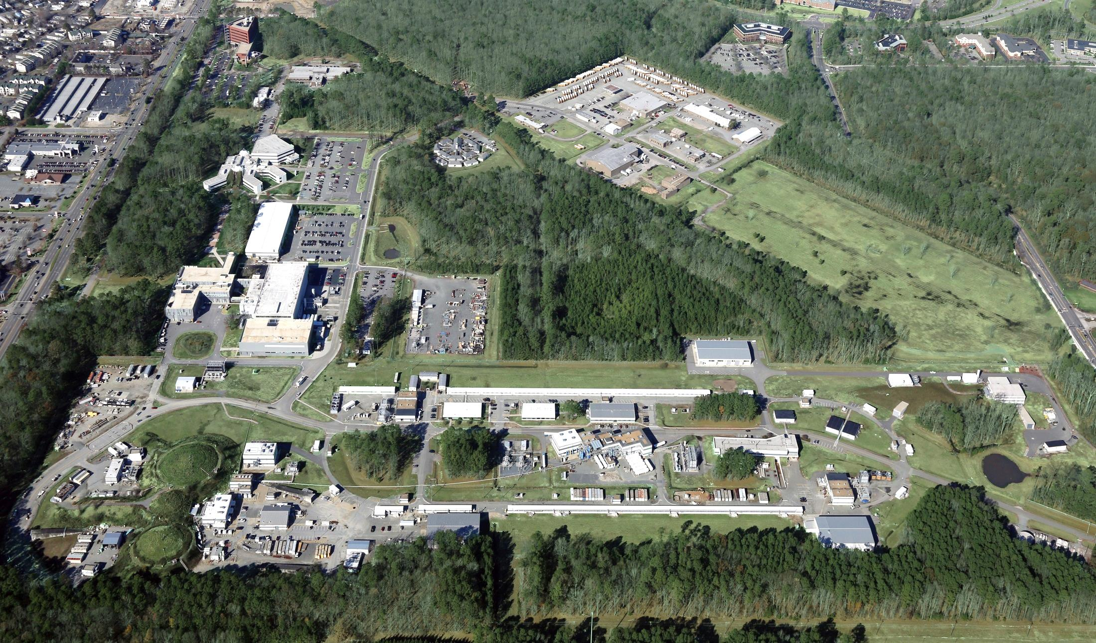
12 GeV Project Status
Allison Lung
DOE Accelerator Safety Workshop, August 15, 2017

Slide 2
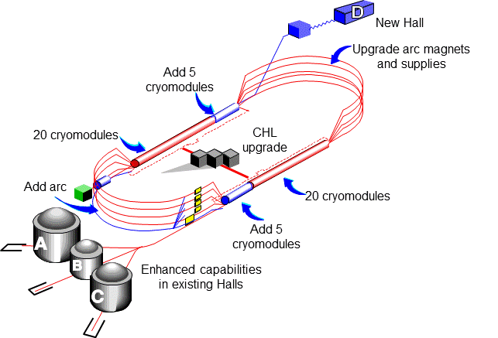
12 GeV CEBAF Upgrade
Maintain capability to deliver lower pass beam energies: 2.2, 4.4, 6.6….
Total Project Cost = $338M
ETC << $1M
2004: CD-0
2006: CD-1
2007: CD-2
2008: CD-3
2014: CD-4A
2017: CD-4B
Double maximum Accelerator energy to 12 GeV
  Ten new high gradient cryomodules
  Double Helium refrigerator plant capacity
  Civil construction and upgraded utilities
Add 10th arc of magnets for 5.5 pass machine
Add 4th experimental Hall D
New experimental equipment in Halls B, C, D

Slide 3
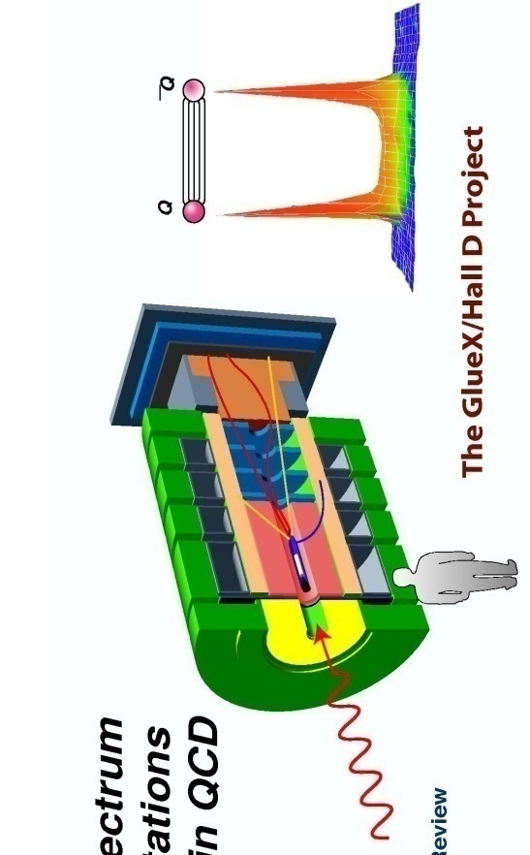
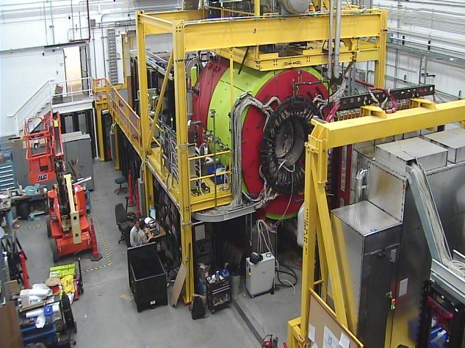
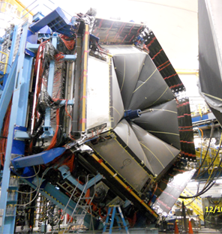
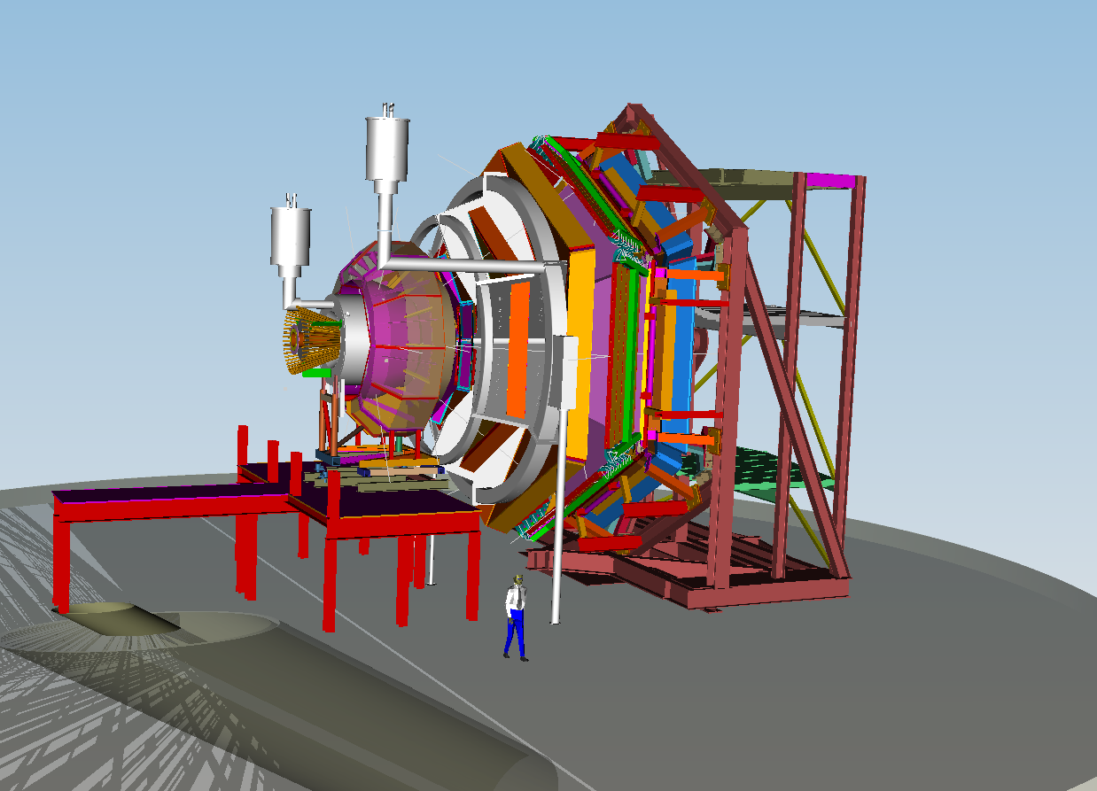
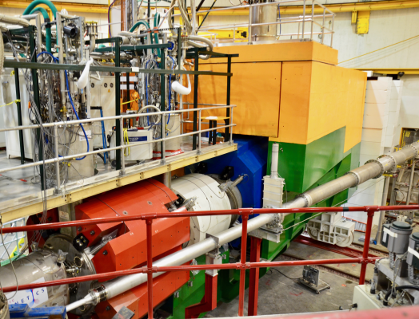
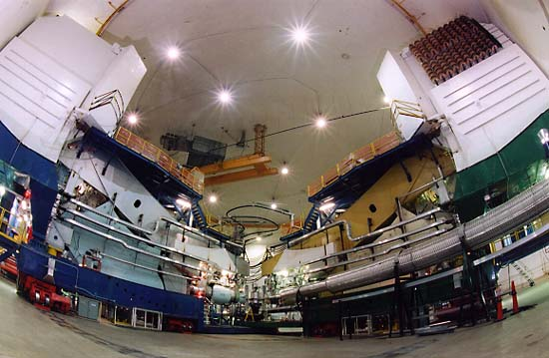

12 GeV Scientific Capabilities
Hall D – exploring origin of confinement by studying
exotic mesons
Hall B – understanding nucleon structure via generalized parton distributions and transverse momentum distributions
Hall C – precision determination of valence quark properties
in nucleons and nuclei
Hall A – short range correlations,
form factors, hyper-nuclear physics,
future new experiments (e.g., MOLLER and SoLID)
Notes:
3

Slide 4
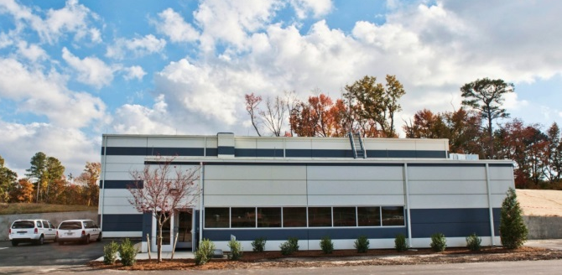

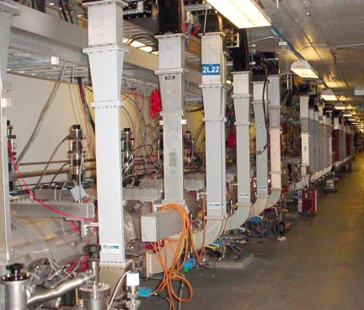
Status @ 2016 Accelerator Safety Workshop
Conventional Facilities: DONE
  Hall D Complex ~10,080 ft²
  Additions to existing facilities ~8,400 ft²
  Utilities expansion
Hall D Experimental Equipment: DONE
  GlueX spectrometer; electronics; target
  Hall infrastructure; Tagger area
  Commissioning
Accelerator: DONE
  Cryomodules ; Cryogenics ; Beam Transport
  Beam Transport ; Extraction
  Project Commissioning
Key Performance Parameters – demonstration through beam runs

Slide 5
Highlights Since Summer 2016
All about Hall B and Hall C experimental equipment: DONE
  Detectors and Electronics
  DAQ/Computing (software/firmware)
  Beamline and Infrastructure
  Magnets:
    Hall C – 3 (of 5) delivered, 5 installed and tested
    Hall B Torus – tested
    Hall B – Solenoid delivered, installed and tested
Key Performance Parameters – demonstration through beam runs

Slide 6
Readiness to Operate: Accelerator
  Accelerator Readiness Reviews (ARRs):
  Modular approach for machine and beamlines to Halls
    Phase 1a/b - CEBAF commissioning with 12 GeV tune beam (Aug/Oct 2013)
    Phase 2 - Commission Hall D Tagger with tune beam, full commission & operate Hall A (Jan 2014)
    Phase 3 - Commission & operate Hall D; Deliver beam to Hall B for HPS experiment (Aug 2014)
    Phase 4 – Commission & operate Halls B & C (Jan 2017)
      see Bob May's talk on Wed morning

Slide 7
Readiness to Operate: Exp. Equipment
Experiment Readiness Reviews (ERRS):
  Objective: safe and efficient operation of equipment (and/or an entire experiment)
  Hall C ERRs:
    Q1 magnet (Jan 2015) ; HB magnet (Mar 2015)
    Spectrometers, beamline, targets, early experiments (Aug 2016)
    Q2/Q3/D magnets (Oct 2016)
  Hall B ERRs:
    Ancillary detectors (Jun 2016)
    Torus magnet (Apr/Jun/Jul 2016)
    CLAS12 Detectors (Dec 2016)
    Solenoid magnet (Jul 2017)

Slide 8
Hall C: SHMS Magnets Delivered
HB: MAR-2015
Q1: JAN-2015
Q2: OCT-2016
Q3: DEC-2016
Dipole Rigging
NOV-2016
D: OCT-2016
Dipole CCR

Slide 9
Hall C: 12 GeV Detectors All Installed
Shower Counter
(within wall)
Pre-Shower Counter
Heavy-Gas Cerenkov (HGC)
Noble-Gas Cerenkov (NGC)
S2XY Hodoscope
Drift Chambers
S1XY Hodoscope

Slide 10
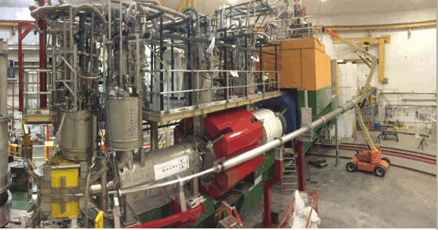
Hall C: KPP Beam Run
March 7–10, 2017
Beam ~ 5 μA CW
Target BeO, Carbon
HB
Q1
Q2
Q3
D
Installation complete Feb 2017

Slide 11
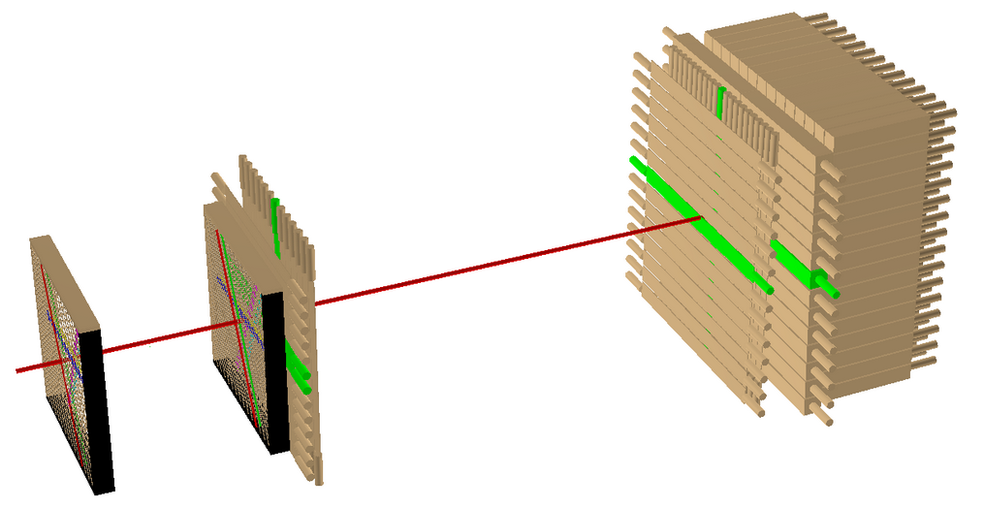
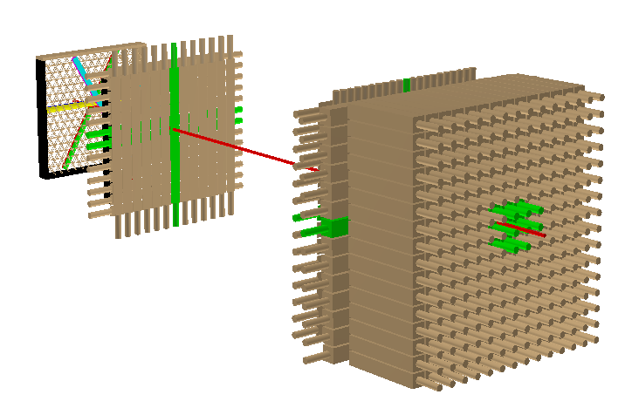
Hall C: KPP Demonstrated
Detector operational: events recorded with a > 2nA electron beam at > 6 GeV beam energy (3 pass).
Detector performance: charged-particle tracks from position-sensitive detectors.
S2y
S1y
Tracking / Event Display
Two perspectives on the same event:
  Red track generated by Wire Chamber data only
  Visual confirmation that the other detector elements along the track do indeed see the same particle
Preshower
S1x
S2x
Shower
Wire Chambers
Accepted by DOE March 14, 2017

Slide 12
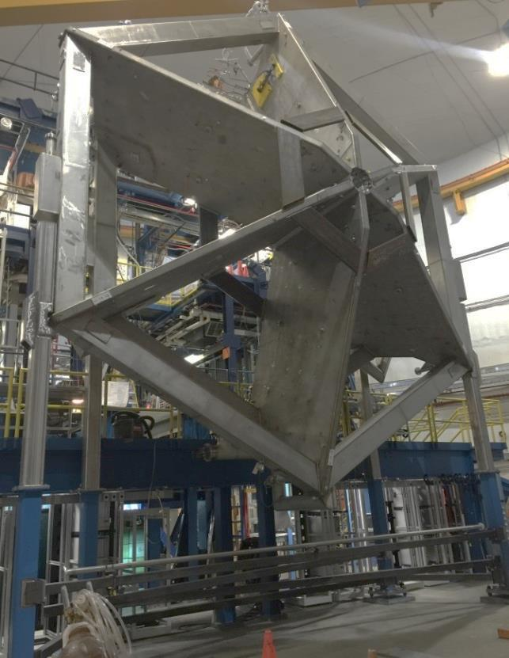
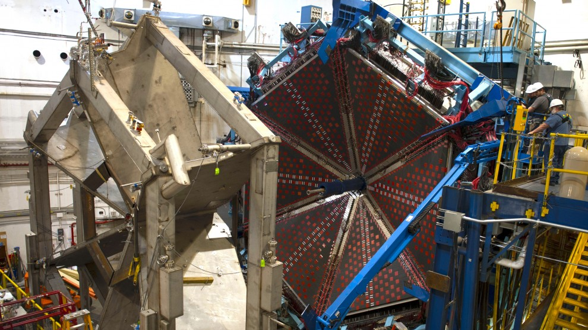
Hall B: Torus
Installation completed in May 2016
Testing completed in Nov-2016

Slide 13
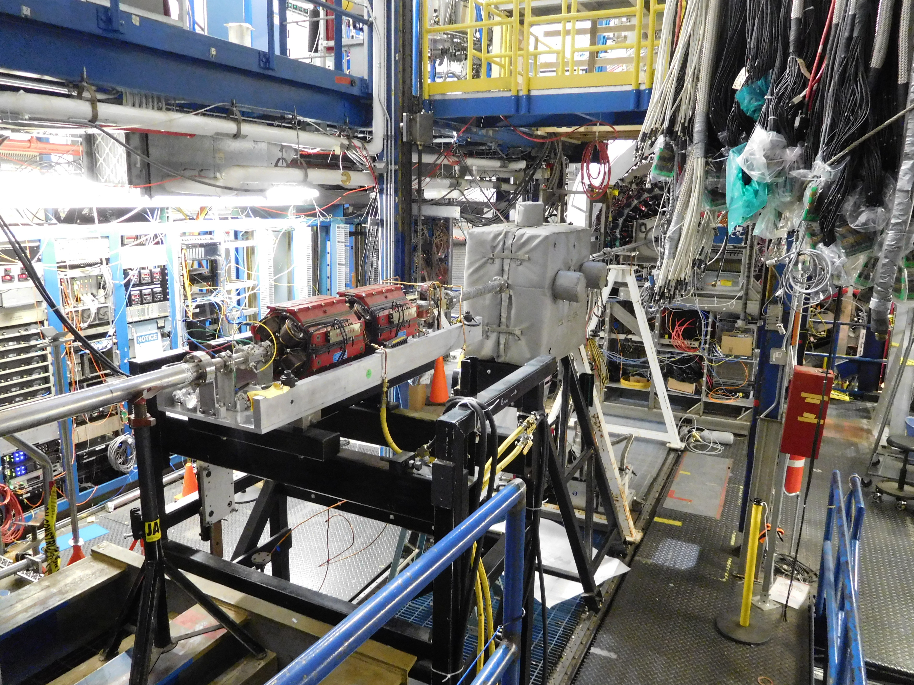
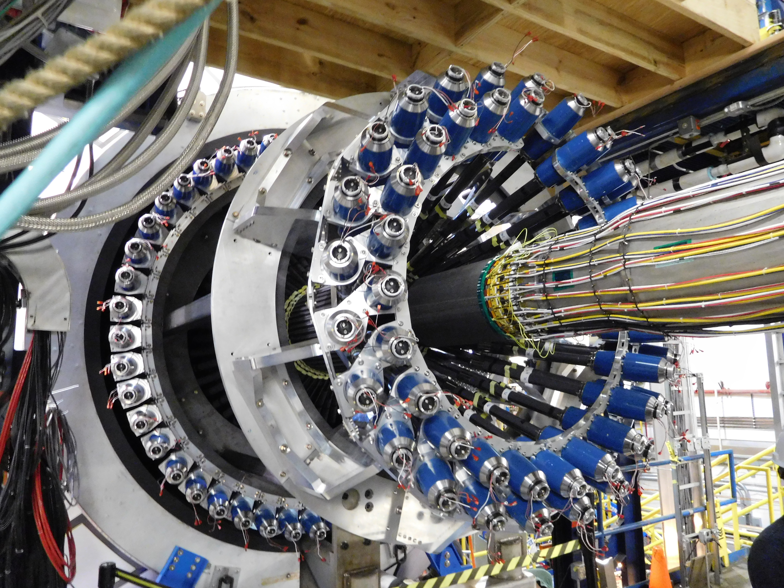
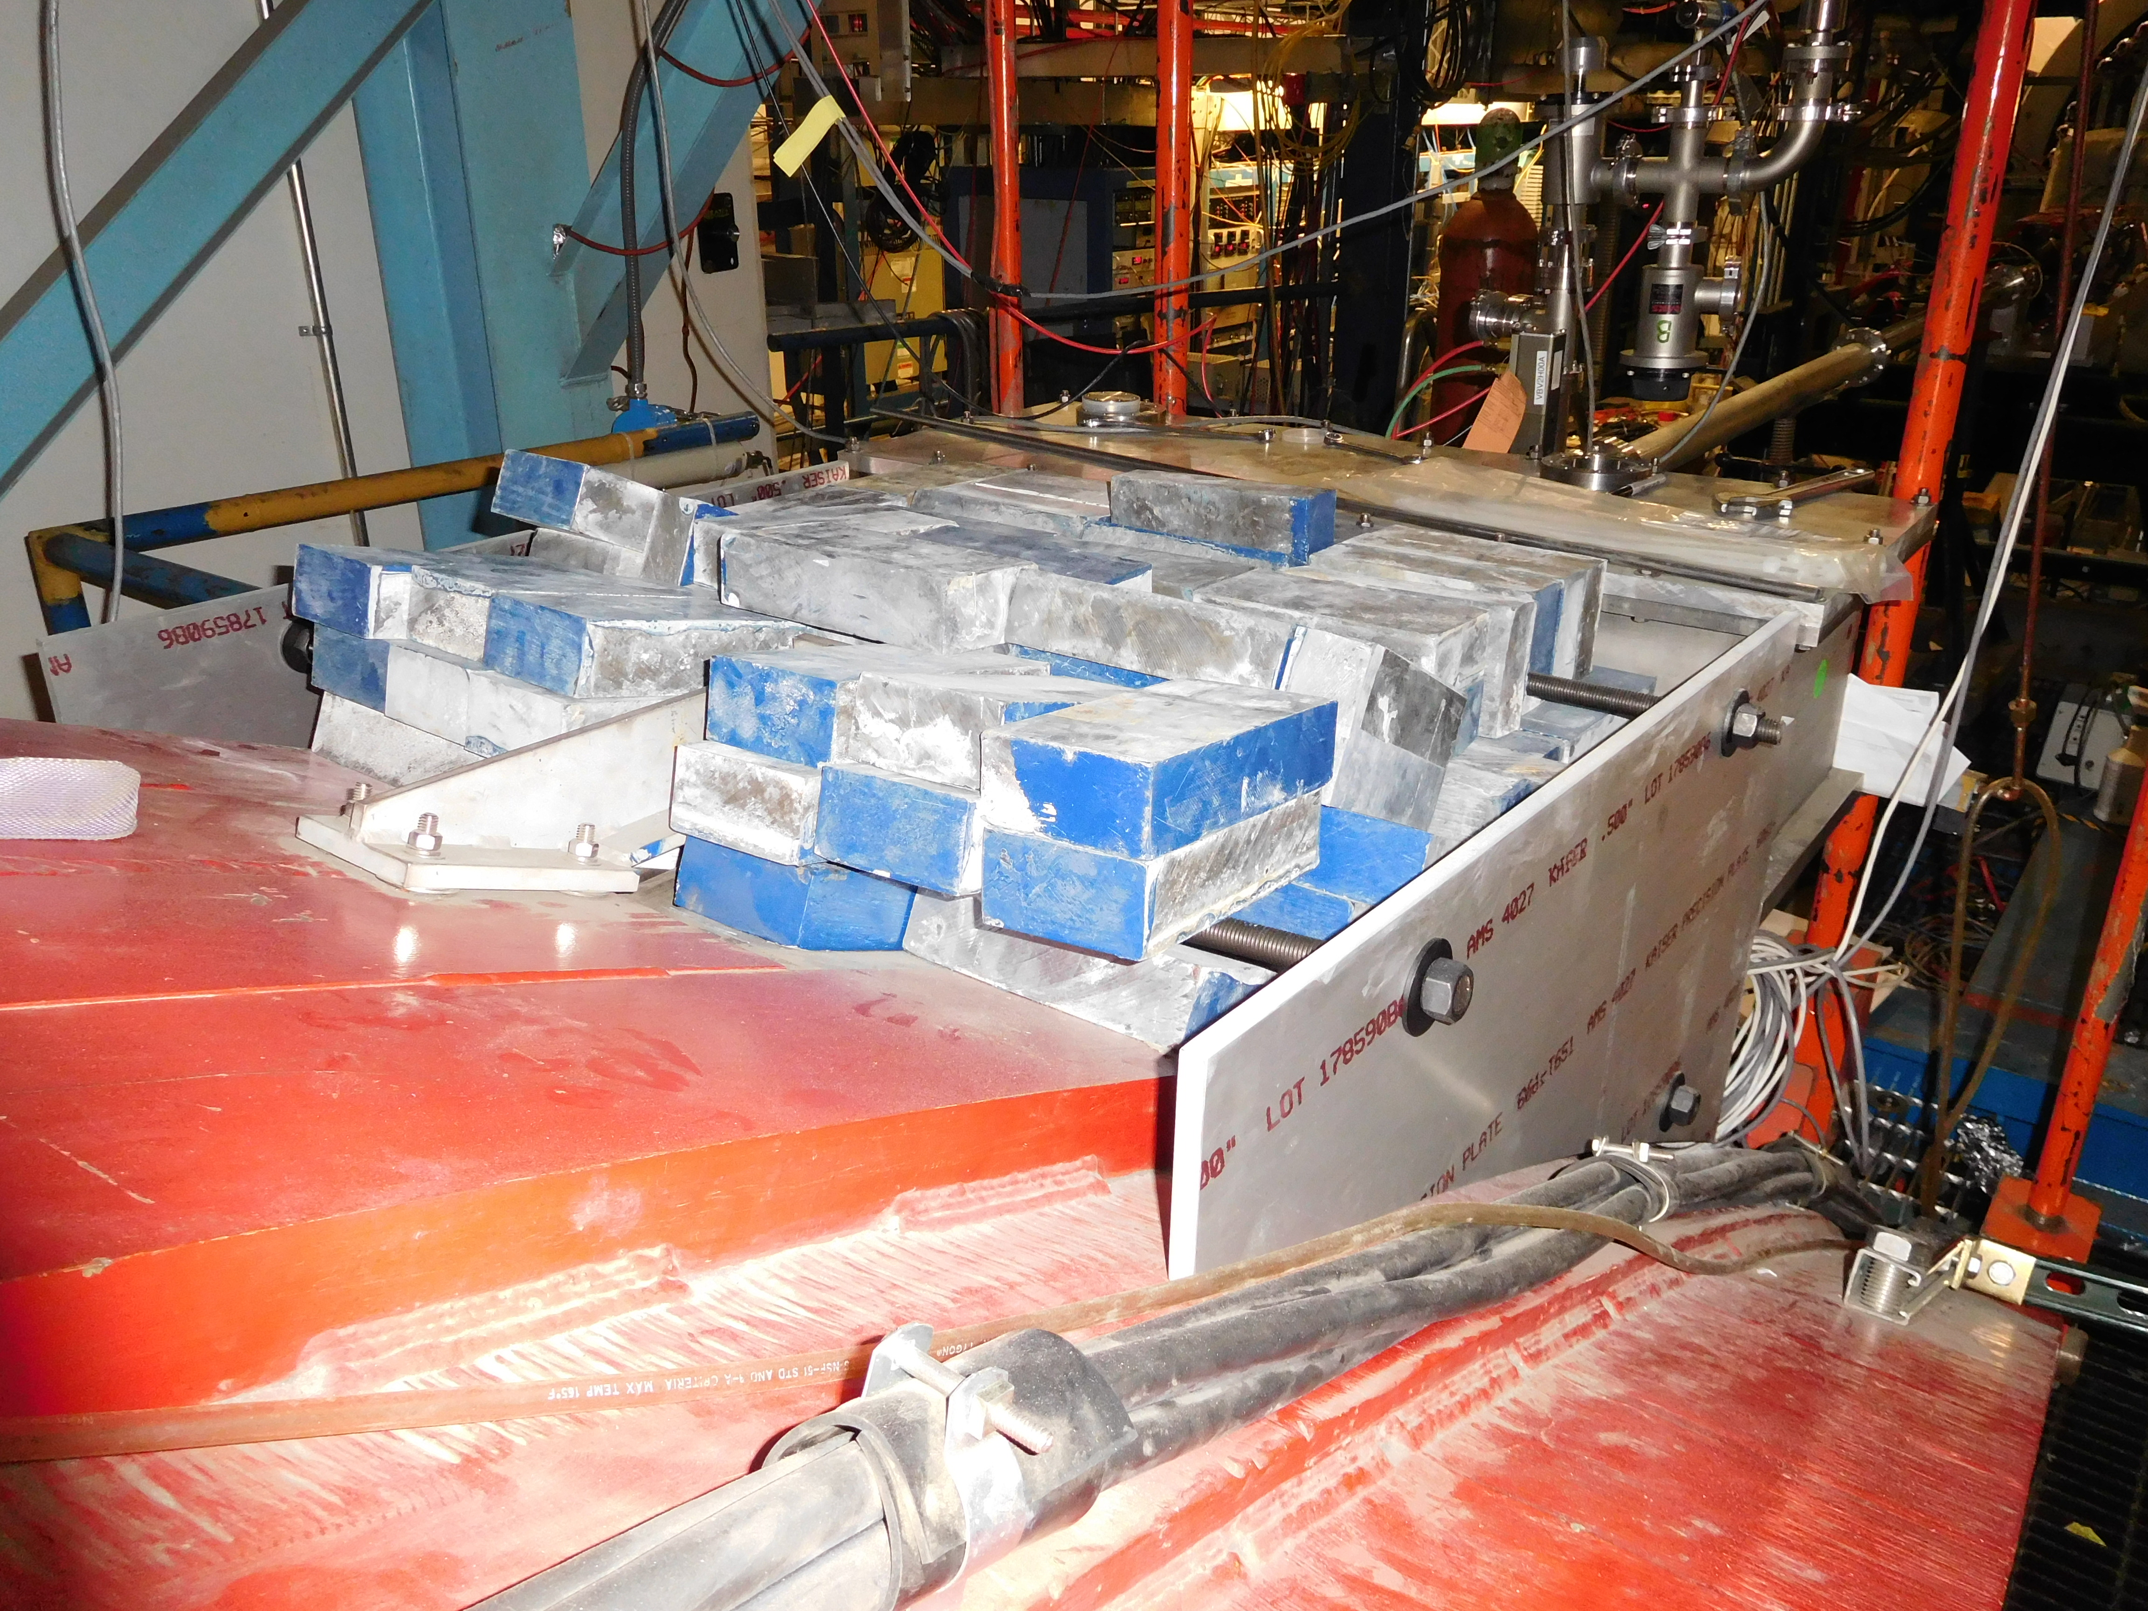
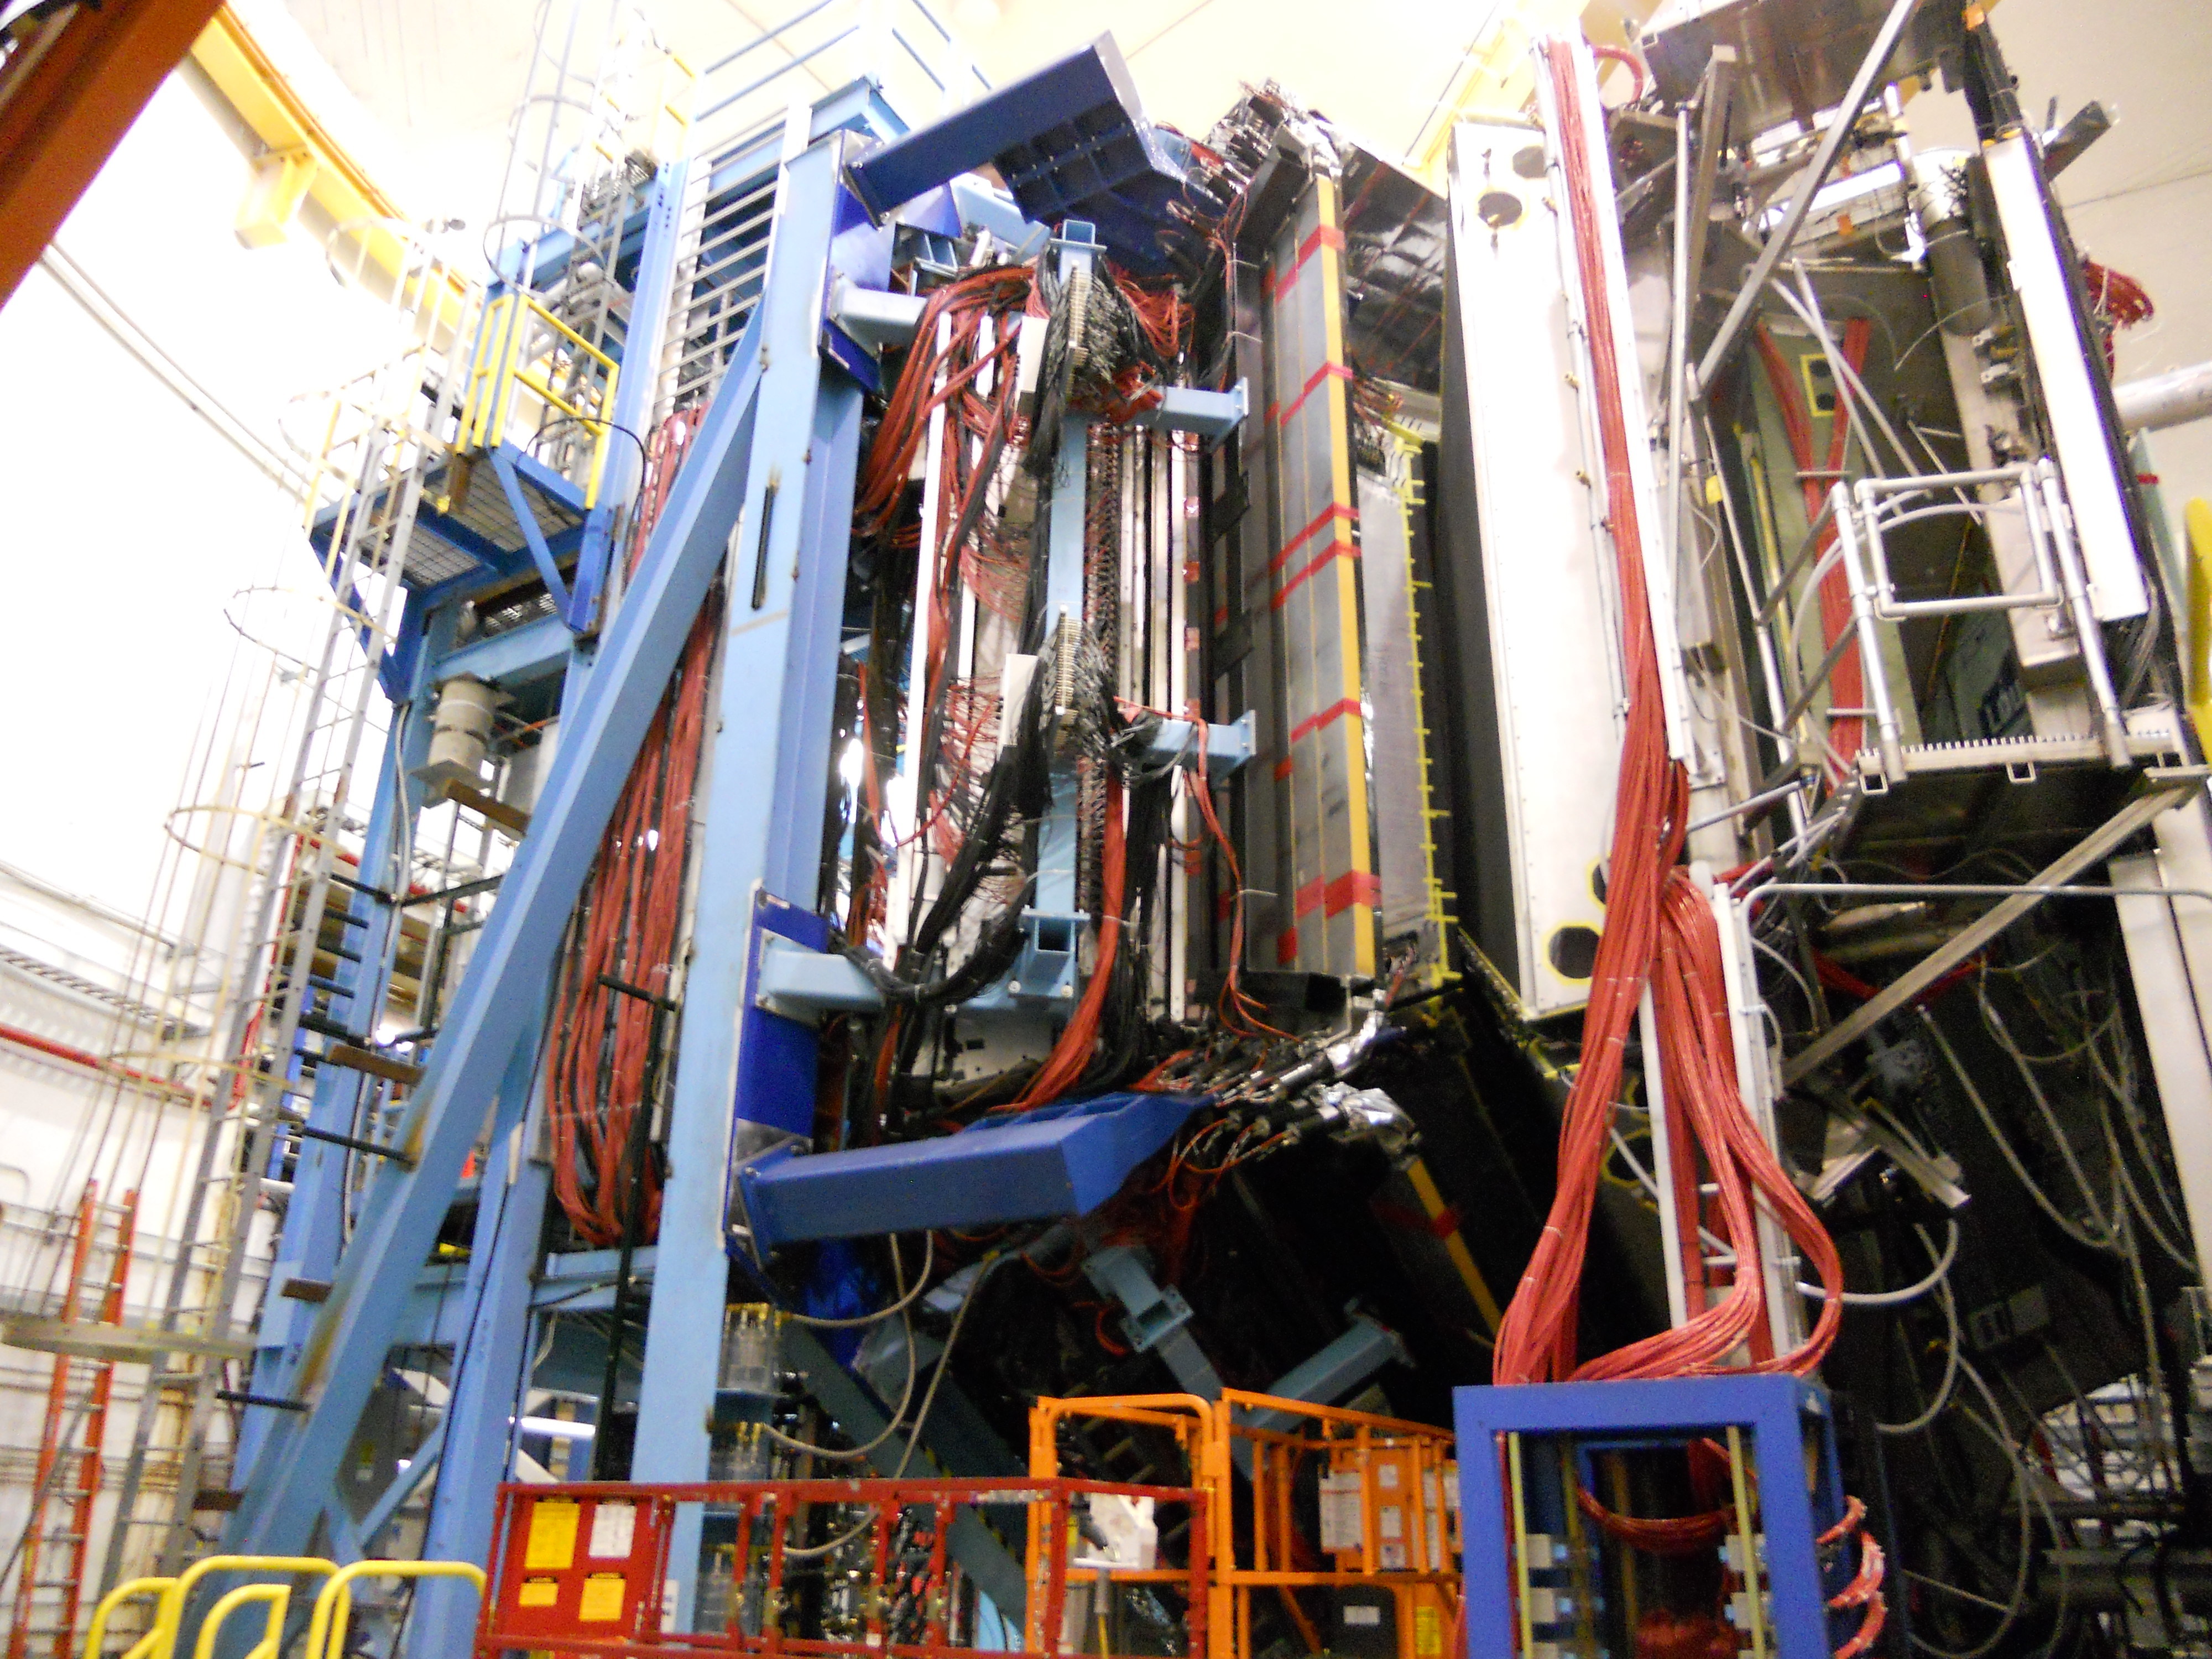
Hall B: Detector Configuration – KPP Run
Beamline
CTOF and SVT
Tagger Shielding
Forward Carriage

Slide 14
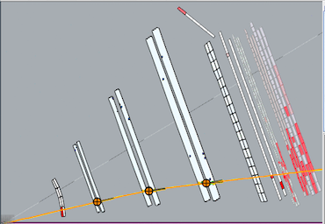
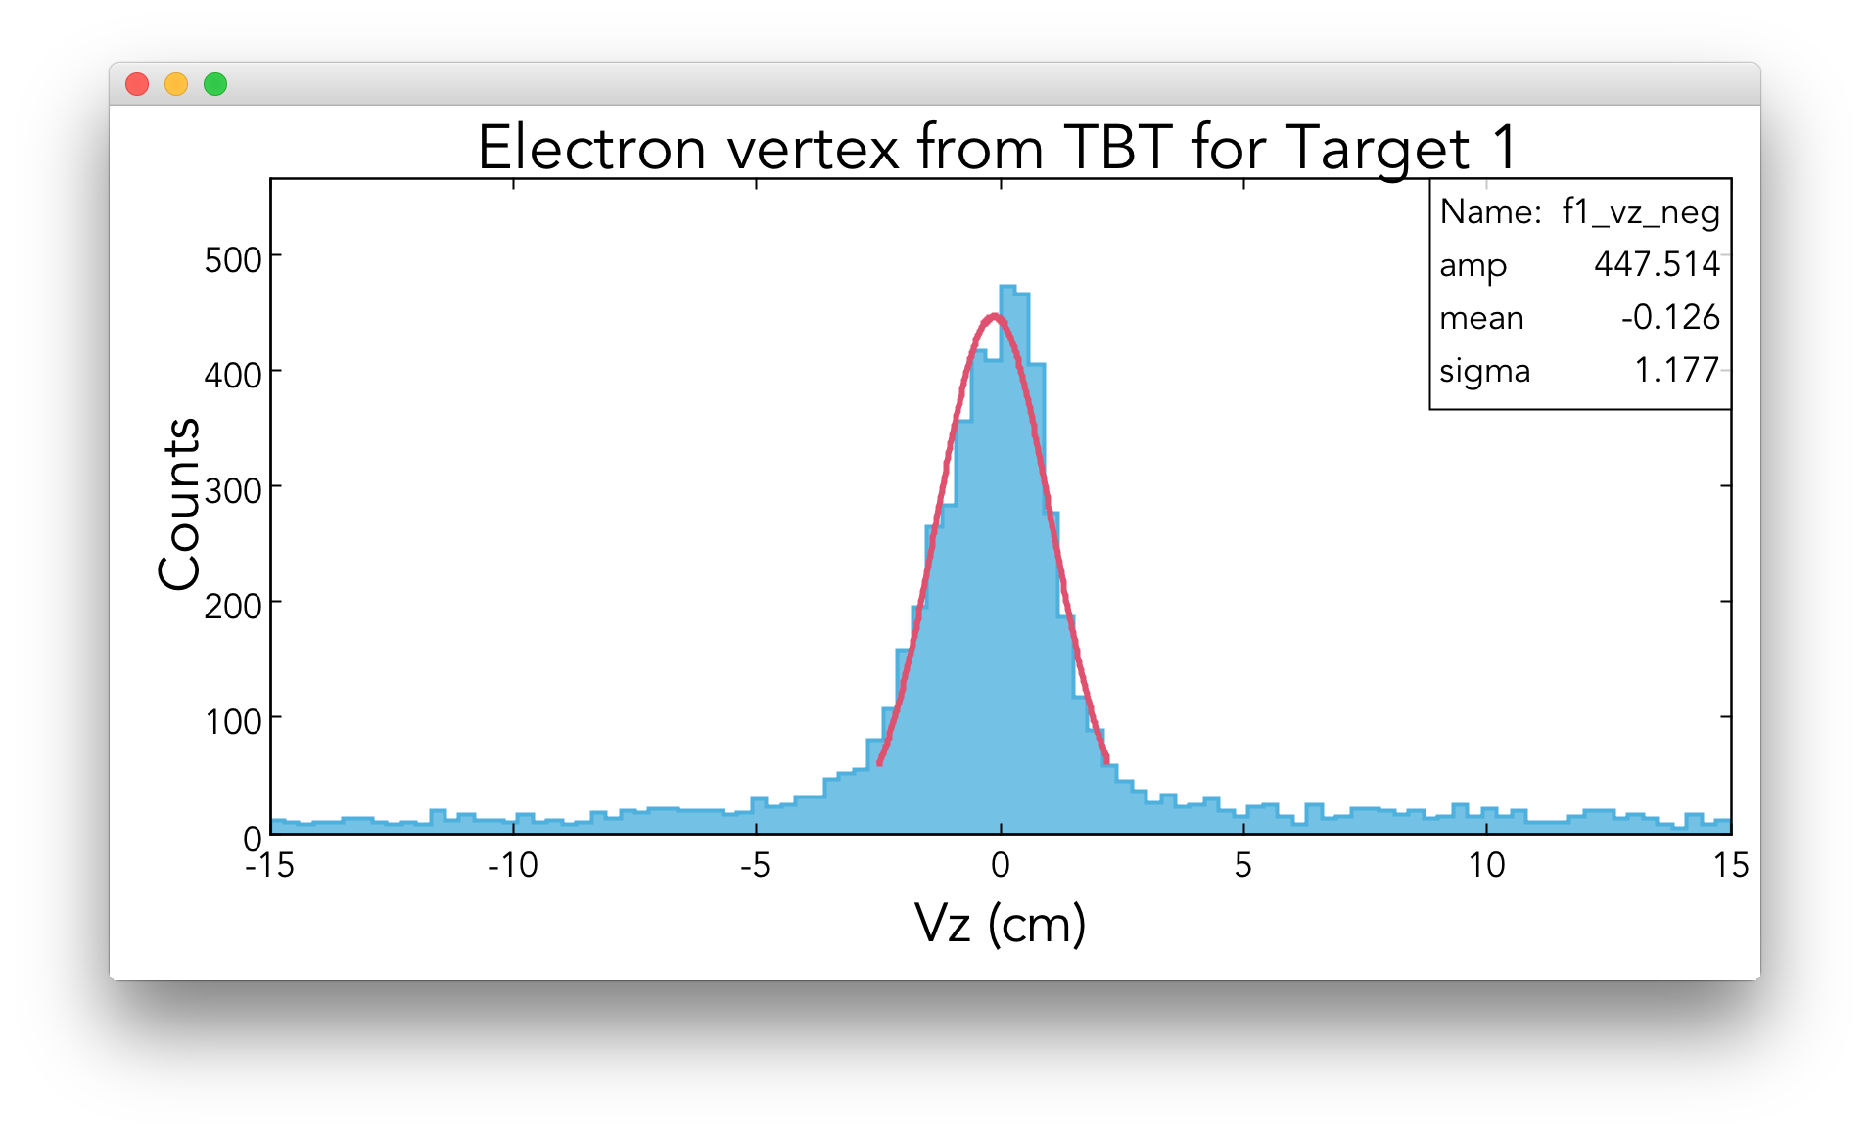
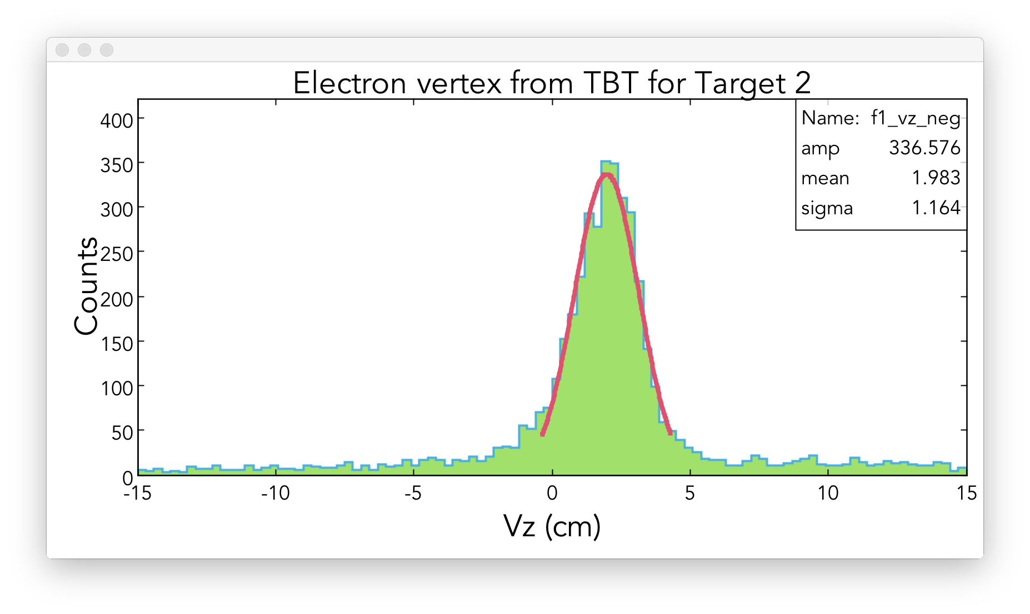
HALL B KPP Demonstrated
Detector operational: events recorded with a > 2nA electron beam at > 6 GeV beam energy (3 pass).
Detector performance:
reconstructed particle trajectories.
<σ>=1.2 cm
Accepted by DOE February 7, 2017

Slide 15
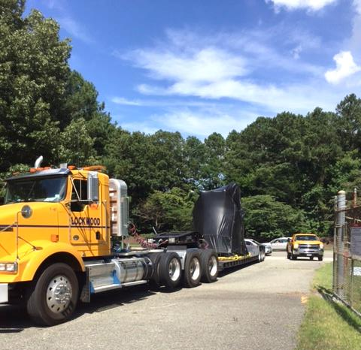
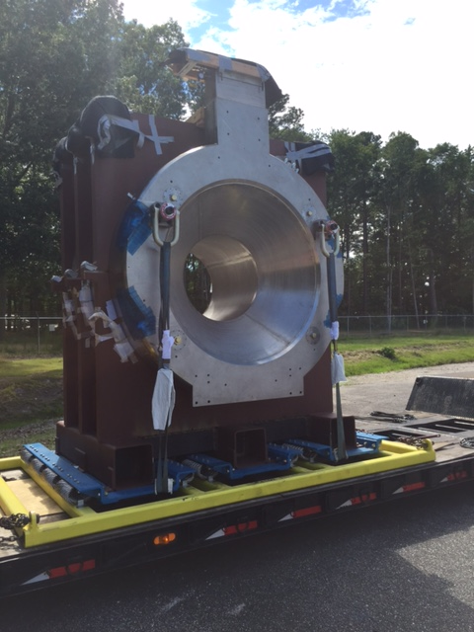
Hall B Solenoid – Arrival (27-Jun-2017)
Tarp-covered magnet on truck at JLab's back gate.
Tarp removed; Solenoid on shipping frame.

Slide 16
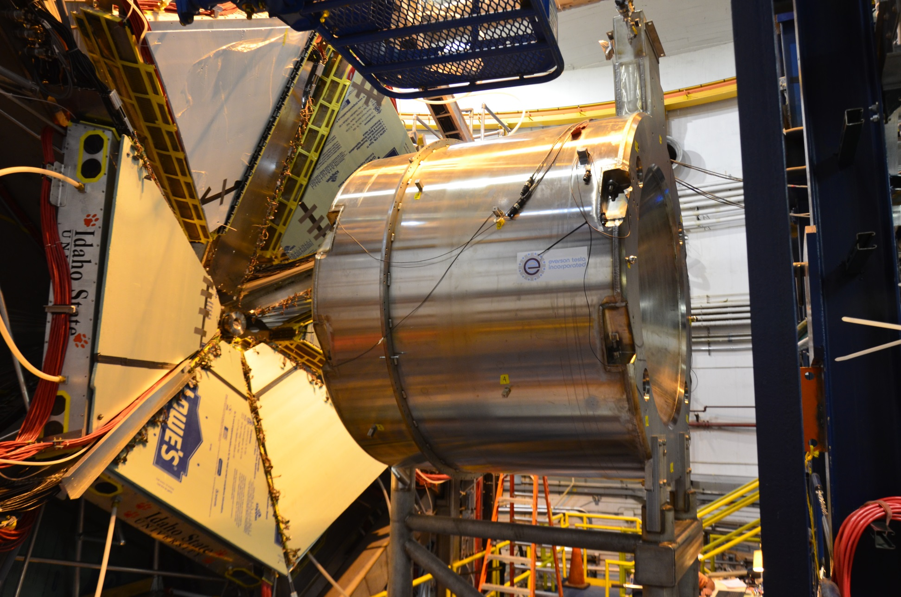
Solenoid Installation (28-Jun-2017)
Magnet on CLAS12 carriage next to Drift Chambers.

Slide 17
Solenoid Effort at JLab after Arrival
Arrival Checks
  Receiving inspection (vacuum, electrical, instrument), place on stand
  Remove shipping restraints, survey
Cryogenics SST Attachment
  Place SST, weld SST cryostat bottom plate to solenoid, add lower thermal shield plate, splice power leads, complete piping
  Radiation shield MLI, hook-up pumping system
Pump-down
Cool-down Starts Today
Energize in September

Slide 18
12 GeV Project: Summary
All superconducting magnets delivered, installed, tested
All detectors, electronics, beamline, infrastructure complete
All Key Performance Parameters demonstrated
All Level-2 Milestones Complete
All Project Scope COMPLETE
  Additional Solenoid commissioning in progress
Project Ready for CD-4B

Slide 19
APPENDIX

Slide 20
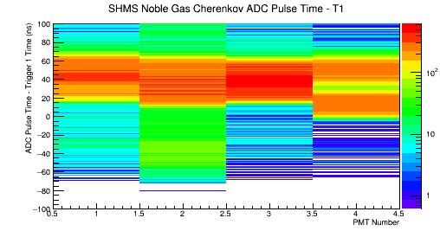
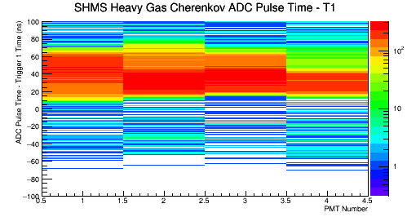
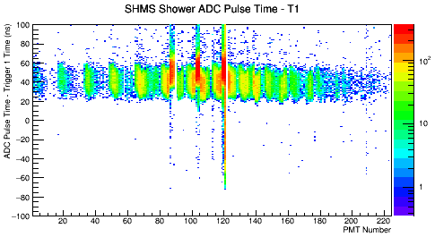
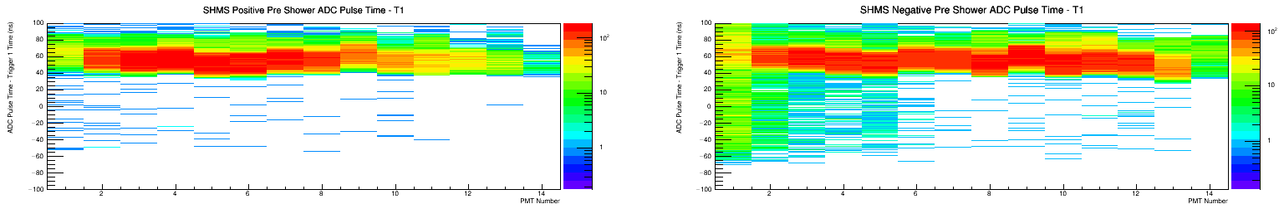
Hall C #3: Detector Performance
3. Data showing relative timing of trigger, tracking, and particle identification in detector subsystems.
HGC, NGC Timing
  Horizontal axis is PMT #
Shower Timing
  Horizontal axis is PMT #
Pre-shower Timing
  Horizontal axis is PMT #
HGC Timing
NGC Timing
Time [ns]
Time [ns]
PMT Number
PMT Number
Shower Timing
Time [ns]
PMT Number
PreShower Right Timing
PreShower Left Side Timing
Time [ns]
Time [ns]
PMT Number
PMT Number

Slide 21
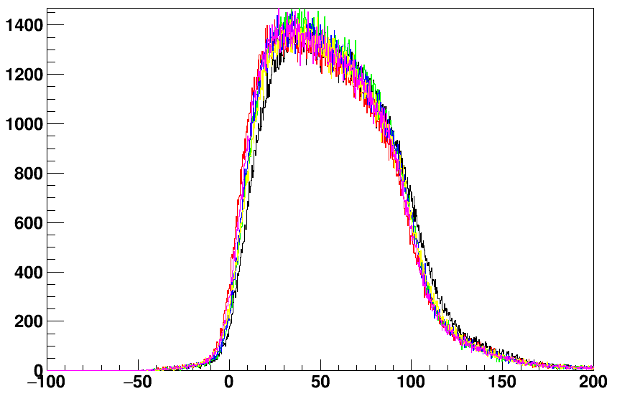
Hall C #3: Detector Performance
3. Data showing relative timing of trigger, tracking, and particle identification in detector subsystems.
Wire Drift Chambers
  2 wire drift chambers provide tracks for charged particles
    6 wire planes per chamber
Figure shows time distribution histograms of particles passing by the wires in all 6 planes
  All planes have similar timing structure, minimal background
  All planes have similar counts indicating equal detection efficiencies
Wire Drift Chamber Timing
Timing relative to Trigger [ns]

Slide 22
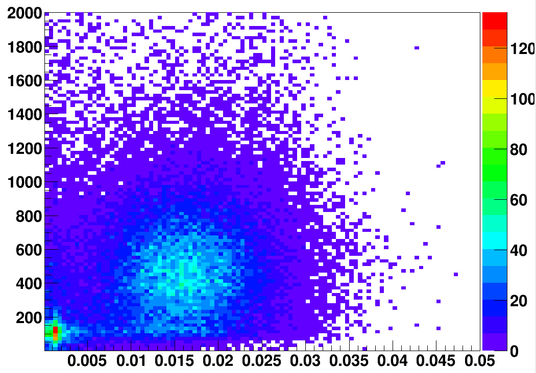
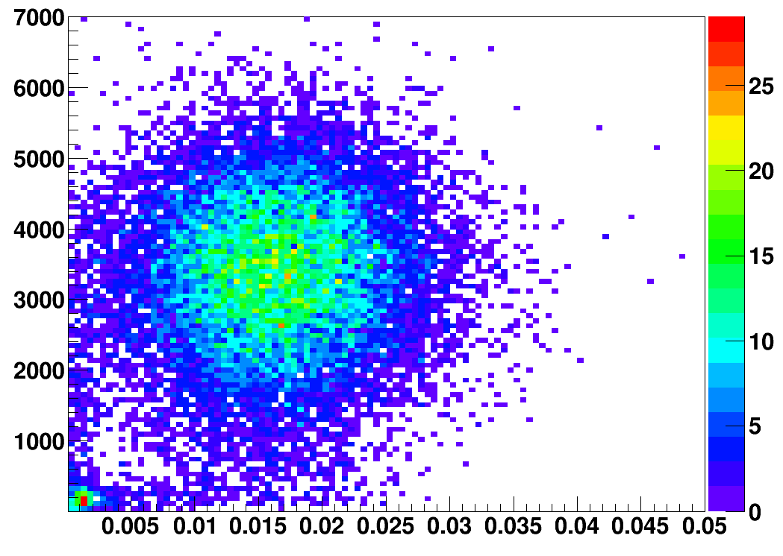
Hall C : Particle ID
5. Particle identification plots using signals from calorimetry and Cerenkov detectors.
HGC vs PSh
Electrons
HGC Signal (arb. units)
NGC vs PSh
NGC Signal (arb. units)
Preshower Energy (arb. units)
Pions
Preshower Energy (arb. units)
arb. = arbitrary

