Slide 1
Software Specification and Configuration Management
Patrick Bong
LBNL Interlock SME

Slide 2
Requirements, Specification and Configuration Management
These concepts are critical to software design and control of safety interlock software at LBNL.
    Requirements
    Provides the description of the project and the interactions of the components
    Specification
    Provides the details of implementation
    Configuration Management
    Provides the control over the deployment of new and modified software

Slide 3
Requirements Document
Requirements Document
  Introduction
    Project/Facility overview
    Assumptions and dependencies
  System Description
    Protective boundaries
    Protective devices
    Warning devices
    User interfaces
  System Requirements
    Protective functions
    Administrative functions
    Performance requirements
    RAMS (reliability, availability, maintainability)
Notes:
This is the top level document to which all others must comply
We assume there’s going to be an accelerator, depending on funding.
The accelerator is housed in a bunker with 2 doors.
Interlock switch detects the position of the door.
Emergency off buttons 2 interior locations.
Warning sign above door with redundant lights.
Warning lights inside enclosure.
Warning annunciator inside enclosure.
Telephone at each door.
The system description does not necessarily need to describe the functionality that the requirements will provide.

Slide 4
Software Specification
The software specification provides the details of how the software is going to operate.
The software specification must always conform to the details provided in the Requirements document.
The software specification may be embedded in the requirements document.

Slide 5
Types of Specification
Verbose
  Provides a detailed explanation of the interaction between inputs and outputs.
Truth tables
  Provides the logic for a single function.
Graphical
  Uses logical symbols to describe functions.

Slide 6
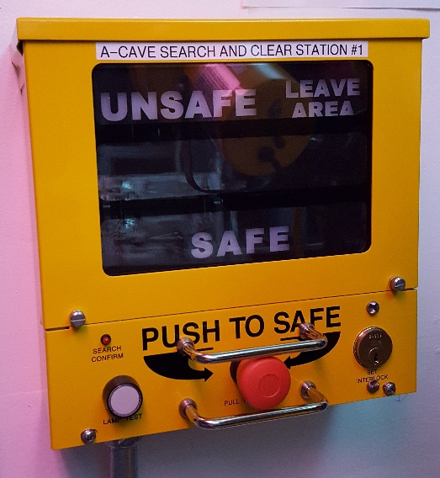
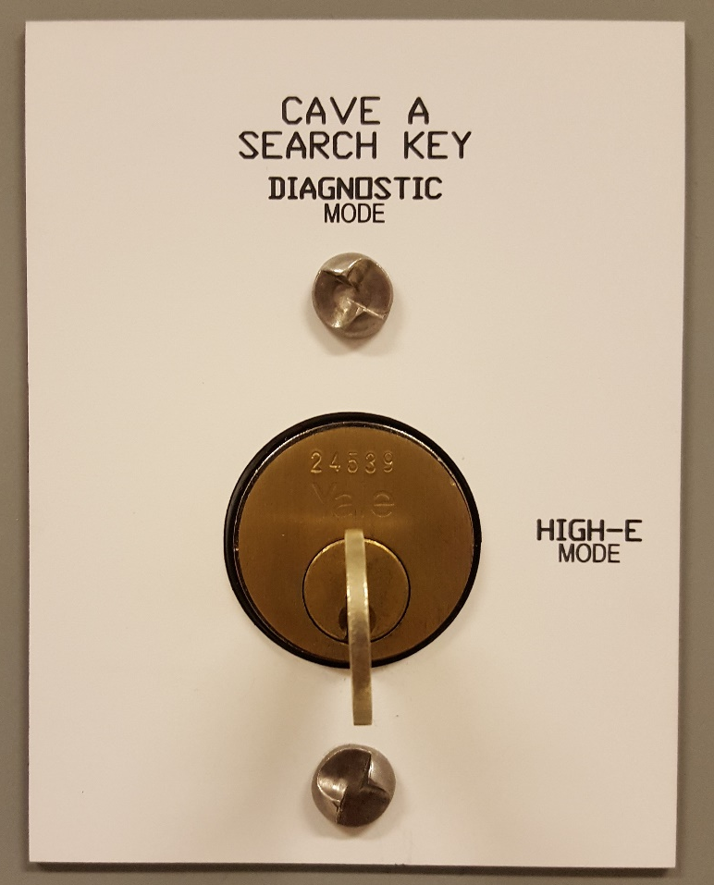
Specification of Search and Clear

Slide 7
Verbose
Search and Clear
Search and clear must be started from the HMI and completed sequentially by turning the key switch at each search and clear station. When the key is turned at the first search and clear station, Access Control must be disabled preventing access to the exclusion zone while the search is in progress.
The search and clear will be limited to a 3 minute time period, after which the circuit will reset requiring the search process to be re-started from the HMI.
The search and clear process is completed by turning the High‑Energy Mode Key Selector to High-E Mode.

Slide 8
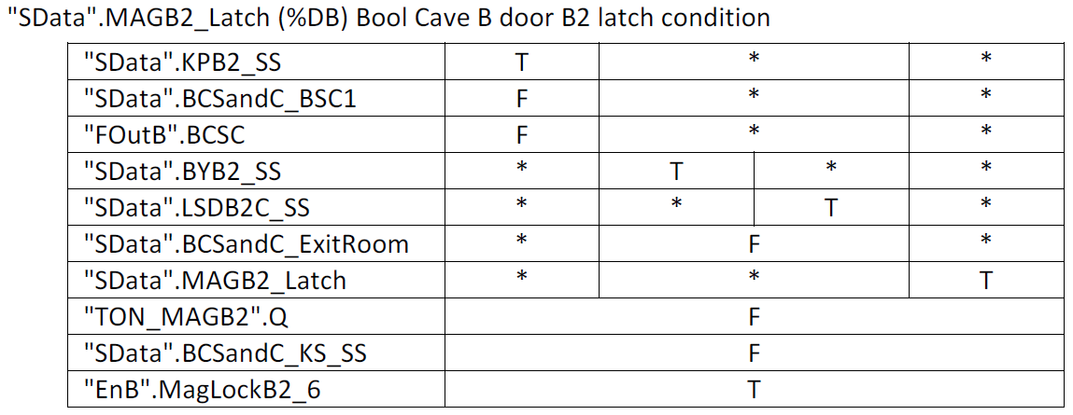
Truth Table

Slide 9
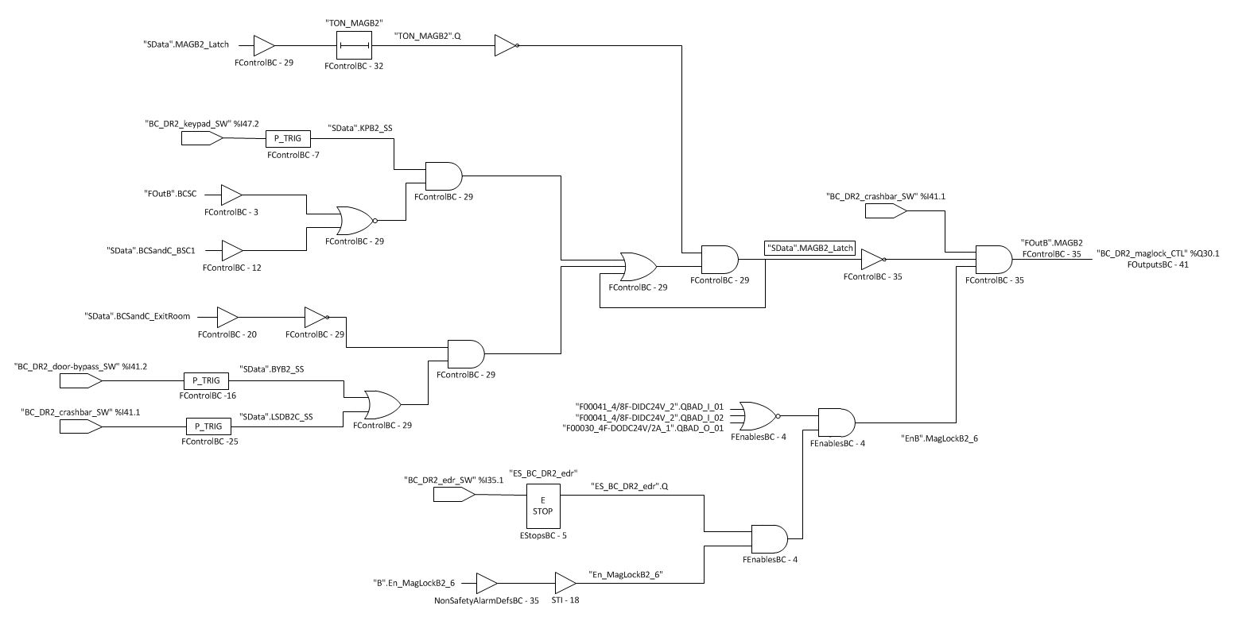
Graphical Specification

Slide 10
Comparison
A good specification uses a combination of the specification types to provide programmer guidance and help manage the software development cycle.
  Verbose
    Very similar to the description in the requirements document.
    Must be extremely detailed to guide software development.
  Truth table
    Very detailed description of the function, but difficult to follow and understand the complete impact to the overall logic.
    Software can be derived directly from tables.
  Graphical specification
    Better representation of the overall logic.
    Logic may need to be parsed during software development.

Slide 11
Software Configuration Management
The purpose of Software Configuration Management is to establish and maintain the integrity of the software throughout a project's life cycle.
Software Configuration Management involves evaluating, coordinating, approving (or disapproving) and implementing changes in hardware or software or documentation from the initial concept through design, implementation, testing, baselining, building, release, and maintenance.

Slide 12
The 3 Things
    Process document
  Provides SSQA guidance and defines;
    Reviews and testing
    Labeling
    Software version control
    Document control
    Software problem reporting
    Software version control system
  Source code management and revision control system
    Document control system
  Document management system

Slide 13
    Software Version Control Systems
Git
  Git is an open source distributed Source Control System
CVS
  Free software client-server Revision Control System.
Perforce
  Version Control System that stores all activity in a centralized database.
ClearCase
  Software Configuration Management system that also supports design-data management of electronic design documents.

Slide 14
Revision, Source and Version Control
Technically…
Revision Control is the generic term for managing versions of documents or code.
Source Control offers revision control with branching and merging which are not always available in all revision tools
Version Control is a more general term than Source Control in that it manages version of anything (sources or binaries, or any kind of documents).
Software Configuration Management includes change management up to release, including versioning

Slide 15
Conclusion
The Requirements document is the top level document to which all others must comply
Prepare the software specification to allow rapid development of the software.
  When bugs are found ask, “Is this a result of an error in the system requirements?”
Use a software Version Control System to track revisions in safety software.

