Slide 1
Safety Configuration Management Process at JLab
Harry Fanning, Accelerator Division Safety Officer
Robert May, ESH&Q Division
August, 2017

Slide 2
Contents
What’s configuration management at JLab?
What needs configuration management?
What are those configuration management requirements?
How does the USI process fit?
Results?
CM Summary

Slide 3
What’s Configuration Management at JLab?
The objectives of CM, as defined by DOE-STD-1073 “Configuration Management,” are to:
Establish consistency among design requirements, physical configuration, and documentation (including analysis, drawings, and procedures), and
Maintain this consistency throughout the life of the facility or activity, particularly as changes are being made.

Slide 4
What’s Configuration Management at JLab?
At the highest level, JLab Configuration Management is established by the Configuration Management Governance Procedure, which
Defines the levels of CM and associated performance thresholds
References the process and procedures called out in Jefferson Lab’s approved Conduct of Engineering Manual (COEM), Section 5.0, Configuration Management

Slide 5
What’s Configuration Management at JLab?
CM is accomplished through the key elements of:
System Performance Specification (SPS)¹
Document Control
Change Control
Work Control
Assessments
Item Identification
¹System Performance Specification (SPS) documents the design performance for a given system. It will capture the Design Requirements, actual tested performance limits, installation, operation, interface, and maintenance of the system.

Slide 6
System Performance Specification

Slide 7
What Needs CM at JLab?
Systems identified by a combination of mission support (Programmatic Systems), safety (Technical Systems) using a graded approach
“While it is desired to have all systems at JLab under CM, a Graded Approach is used to assess the complexity, safety risk, expense, and level of maintenance required for the system or software/firmware being designed.”

Slide 8
What Needs CM, cont’d.
The Lab’s Engineering & Technical Services Division defined four CM levels in the COEM:
Level 1 CM System - Critical to mission/operation, high safety impact, operational and maintenance information at hand.
Level 2 CM System - Highly impactful to mission/operation, not a critical safety component, operational and maintenance information available.
Level 3 CM System - Contributes to mission/operation, not tied to safety, operational and maintenance information is in basic drawings/schematics (may have to rely on availability of system expert).
No Formal CM - Outside mission/operation of JLab.

Slide 9
What Needs CM, cont’d.
For brevity, we will discuss only the Level 1 CM Systems needing CM
Technical Systems are Level 1 CM systems which are determined to be critical to protect workers, users, contractors, the public and the environment and as outlined in the lab’s Final Safety Assessment Document (FSAD). These have the tightest requirements.
Examples include:
Active and Passive Engineered Credited Controls
Administrative Credited Controls
Pressure Systems, etc.

Slide 10
What Are The CM Requirements?
Required Systems Documentation
Design Requirements Documents
Project Charters – including schedule, budget, scope of work
Drawings (Component, Assembly, Cable, Rack Layout, Experimental Definition, Beamline, Songsheets)
Wire Run Lists
Bills of Material (BOMs)
Assembly Work Instructions
Statements of Work / Procurement Specifications
DIMAD Decks
Element Control Lists
Test Procedures
Work Instructions
Equipment Manuals
User’s Guides
Troubleshooting Guides
Training Documents (all types of media)
Operations Directives and Departmental Procedures
Firmware
Software
ECOs

Slide 11
What Are The CM Requirements, cont’d?
Level 1: Systems Hardware
Change Control process broken down into four sections:
Identification and Proposal
Technical Review
Management/Operations Review (including USI [Unreviewed Safety Issue] review)
Implementation and Prove Out
Design Authority (DA) responsible for:
Reviewing Engineering Change Orders (ECOs)
ECOs affecting installed and commissioned equipment must be approved in advance

Slide 12
What Are The CM Requirements, cont’d?
Design Authority (DA) responsible for, cont’d:
Obtaining approval from the appropriate Operations group
May also need an evaluation for PSS, MPS, safety, and credited controls

Slide 13
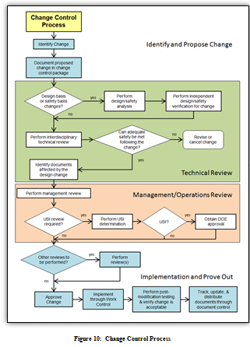
Safety Review During CM

Slide 14
How does the USI process fit?
Integrated into COEM as indicated
Also Integrated into Operations Directives for accelerators
Accelerator program is conducted using credited controls to eliminate, control, or mitigate the accelerator-specific identified hazards... specified in the ASE… essential for safe operation directly related to the protection of personnel or the environment.
Unreviewed Safety Issue (USI) Procedure is followed for proposed exception to CC - formally preapproved before implementation
If significant safety hazard is suspected, supervisor ensures immediate termination of the suspect activity; follows the notification sequence described in the Unreviewed Safety Issue (USI) Procedure.

Slide 15
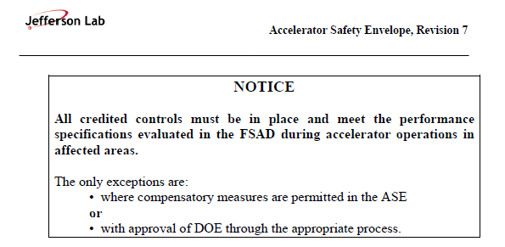
ASE

Slide 16
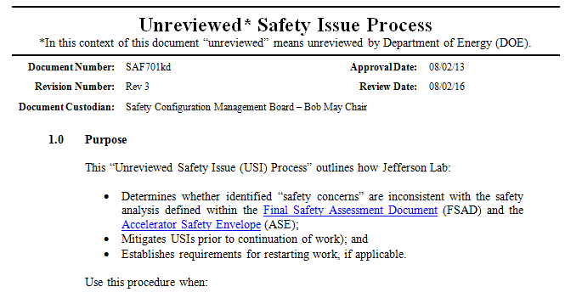
USI

Slide 17
How does the USI process fit, con’t?
Lab Director appointed oversight board
Safety Configuration Management Board (SCMB)
SMEs from different organizations (two year terms)
SCMB Chartered responsibilities
Maintain a current listing/inventory of accelerators
Provides clarification and answers questions on FSAD and ASE content; conduct periodic reviews of same
Collaborates with Accelerator Operations to ensure FSAD hazard analysis and routine practices are consistent
Manages to Jefferson Lab Beam Containment and Access Control Policy

Slide 18
How does the USI process fit, con’t?
SCMB Chartered responsibilities, cont’d:
Executes the Unreviewed Safety Issue (USI) Procedure
Accelerator Safety Envelope/Unreviewed Safety Issue (USI) Process
Screen safety concerns pertaining to accelerator operations and determine whether they are Unreviewed Safety Issues (USI), deficiencies in JLab policies or the implementation thereof, or ASE violations
Refer ASE violations, positive USI determinations and any known or suspected USI violations, to the Reporting Officer upon discovery

Slide 19
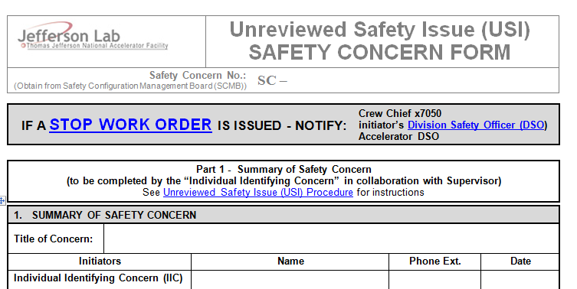
How does the USI process fit, con’t?
Procedure is required when
“New or proposed changes to accelerator equipment installation, configuration or operation activities are proposed, or
Discovered conditions are inconsistent with the FSAD or the ASE”
Documented in Safety Concern Forms managed by the SCMB

Slide 20
Results?
Any Safety Concern that is determined to be an USI or ASE violation is treated as a Notable Event in the laboratory CAS system
Most Safety Concerns are not Notable Events and are resolved by changes in practices or procedures by the affected parties
Balance of information reasonable for a mature facility
In the last three years:
Safety Concerns: 15 (inaccuracy in shield thickness, expired pre-beam checklist, inhibited defense-in-depth, etc.)
Positive USI: 4 (new CC required, physics target)
ASE Violations: 3 (unauthorized access, beam permit w/o required staff, access w/o rad survey)

Slide 21
CM Summary
The Configuration Management process at JLab provides for reliable controls identified in the safety basis for accelerator operations and the processes used to maintain and manage them
Flexible, uses a graded approach
Addresses the needs of a mature accelerator facility
Properly integrated in JLab’s CAS
It is an effective and on-going process that is fully capable of managing accelerator safety issues that arise during new or proposed changes, commissioning or operations of the accelerator

