Slide 1
Accelerator Configuration Management at Berkeley Lab
Susana Reyes
LBNL Accelerator Safety and Configuration Control Engineer
Presented at 2017 DOE Accelerator Safety Workshop
August 15, 2017

Slide 2
Outline
Accelerators at LBNL
Graded approach to CM
CM functions at LBNL
Elements of CM
Design control
Work control
Change control
Document control
Assessments
2
Accelerator Safety Workshop 2017

Slide 3
Introduction
BELLA/LOASIS
ALS/ALS-U
88” CYCLOTRON

Slide 4
Requirements and Guidance DOE O420.2C together with DOE G420.1A
2. 7 Configuration Management:
A facility configuration management (CM) program is a critical element of an accelerator safety program. This guidance focuses on accelerator-specific hazards and their corresponding credited controls as identified in the SAD and ASE. Appropriate CM is considered necessary for both the research mission and safe operation. Elements include:
Current and well-maintained safety documentation
Control and Maintenance of the credited Control system
USI determination program
Status of Accelerator CM implementation at LBNL:
Traditionally, via periodic assessment of each accelerator facility through triannual review, configuration control policy, USI determination process, corrective action tracking
In addition, new role of “Safety and Configuration Control Engineer” to improve consistency of CM framework across LBNL accelerators
4
Accelerator Safety Workshop 2017

Slide 5
Configuration Management framework common to all LBNL Facilities
Similar elements are credited in the Accelerator Safety Envelope (ASE) through-out three accelerator facilities
Safety Credited Controls (SCCs) are tailored to specific facility requirements
SCCs shall be under the highest level of CM
ALS
Electron Beam Parameter Limits
Radiation Shielding
Engineered Safety Systems (RSS)
Access Control (Search and Secure)
Beamline Review Process
88-Inch
Beam Design (Maximum energy) Beam Current and Beam Power
Radiation Shielding and Beam Path (TEA)
Personnel Protection System (RSS)
Access Control (Search and Secure)
Cave Entry and Survey
BELLA
Electron Beam Parameter Limits
Radiation Shielding Beamline Design (TEA)
Personnel Protection System (RSS, LSS)
Access Control (Search and Secure)
5
Accelerator Safety Workshop 2017

Slide 6
Configuration Management Functions at LBNL
Institutional Functions
Lab Director
DOE BSO
RSC/ARSC
Accelerator Division Functions
RPG/RCM
Accelerator Division Director
Conf. Control Engineer
Accelerator Program Head/
Facility Operations Director
System Owner
Design Authority
Accelerator Safety Workshop 2017

Slide 7
Graded Approach to CM
The following five CM levels have been defined:
Level 4 CM System – Safety Credited Control part of the ASE
Level 3 CM System - Critical to mission/operation, safety impact, operational and maintenance information at hand.
Level 2 CM System - Highly impactful to mission/operation, not a critical safety component, operational and maintenance information available.
Level 1 CM System - Contributes to mission/operation, not tied to safety, operational and maintenance information is in basic drawings/schematics (may have to rely on availability of system expert).
No Formal CM - Outside mission/operation of the accelerator
Institutional
Facility
Accelerator Safety Workshop 2017

Slide 8
LBNL Accelerator Configuration Management Program
The basic objectives of CM, as defined by DOE-STD-1073 are to:
Establish consistency among design requirements, physical configuration, and documentation (including analysis, drawings, and procedures) for the facility or activity
Maintain this consistency throughout the life of the facility or activity, particularly as changes are being made
The following five key elements for effective CM are recommended by the DOE standard:
Design Control,
Work Control,
Change Control,
Document Control, and
Assessments.
Accelerator Safety Workshop 2017

Slide 9
Design control
Objective: document and maintain system design requirements and ensure consistency with system specifications and as-built system
Design Authority develops and maintains:
design requirements documents,
system performance specifications (e.g. interlock software specifications)
related design documentation (e.g. dose calculations, shielding drawings)
System Owner is responsible for:
approving design requirements, system performance specifications and related design documentation
surveillance activities such as periodic walkdowns that ensure consistency between system requirements, system performance specifications, and as-found physical configuration
Accelerator Safety Workshop 2017

Slide 10
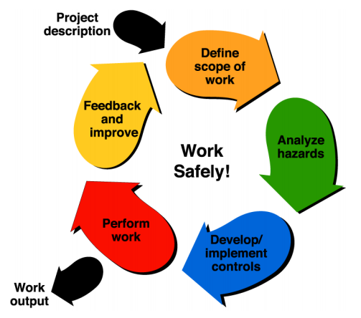
Work Control
Objective: to ensure that work is approved, does not introduce any safety risks, maintains current levels of safety, work has been performed correctly, and verifies post-work performance
Accelerator Program Head ensures that all work is performed in accordance with PUB-3140 (Integrated Environment, Safety, & Health Management Plan), EHS PUB-3000 (Work Planning and Control),
LBNL EHS Procedure 707 (Radiological
Work Authorization Program), and
facility procedures
Radiation Protection Group is responsible for
operational aspects of safety assurance
through RWA program
Facility procedures including ASE administrative
controls are maintained under configuration
control via the accelerator
Procedure Control Center
Accelerator Safety Workshop 2017

Slide 11
Change Control
Objective: to ensure changes are properly reviewed and coordinated and ensure changes are not made if they negatively impact the facility safety
Accelerator Facilities own a Configuration Control Policy and associated Procedures that covers changes to SCCs
LBNL Configuration Control Engineer approves the accelerator Configuration Control Policy and ensures compliance with institutional CM plan
Accelerator Program Head ensures implementation of Configuration Control Policy and ensures that the following steps are addressed:
Identify and propose change
Technical Review
Management/Operations Review
USI screening is part of the process
Implementation and Prove Out
Accelerator Safety Workshop 2017

Slide 12
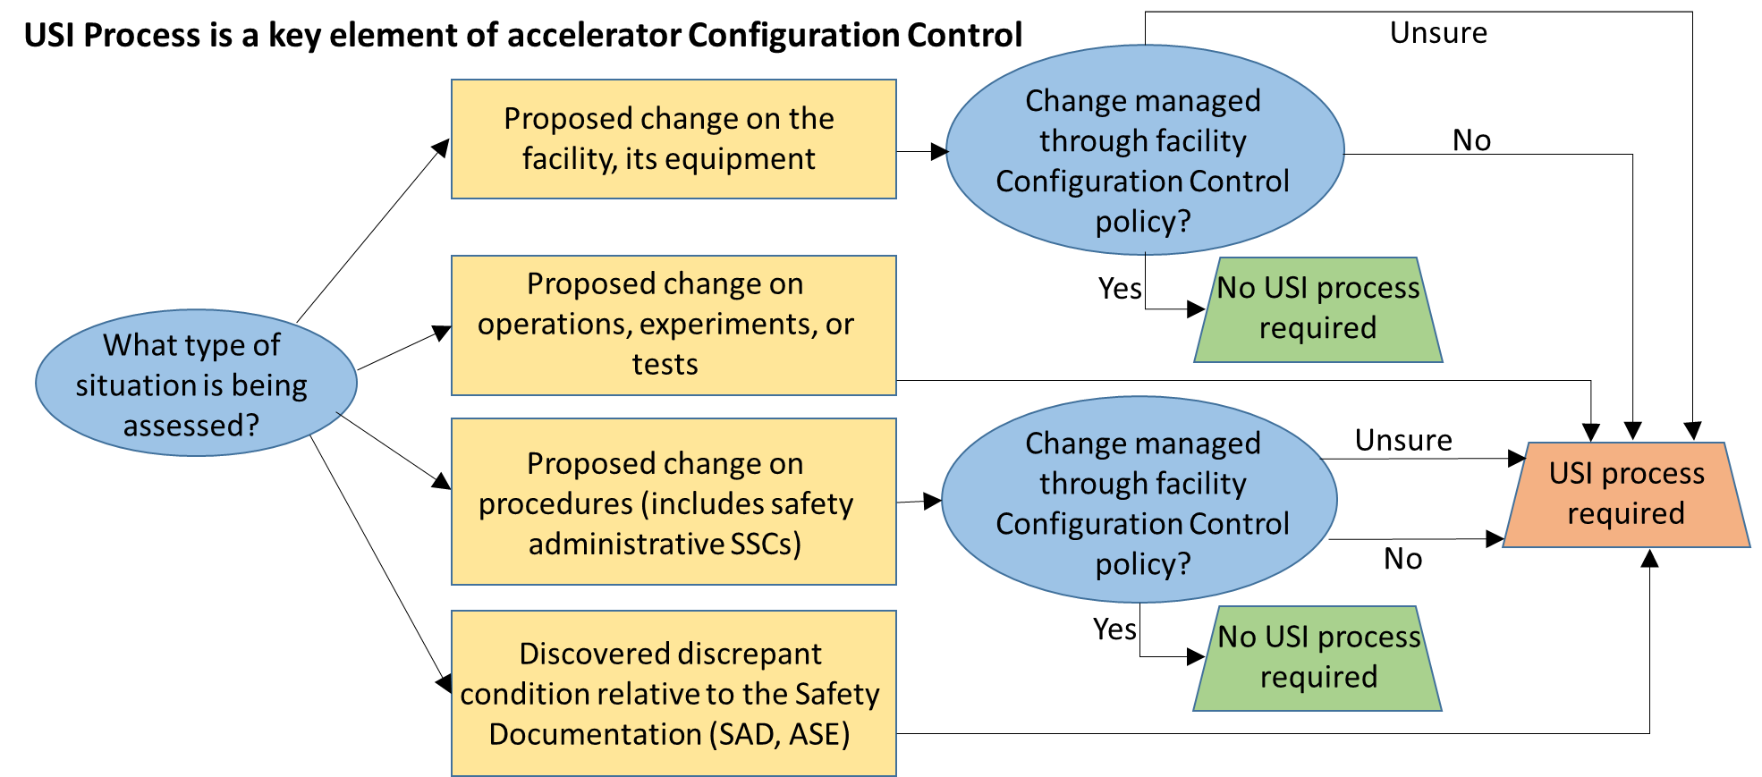
Change Control
Accelerator Safety Workshop 2017

Slide 13
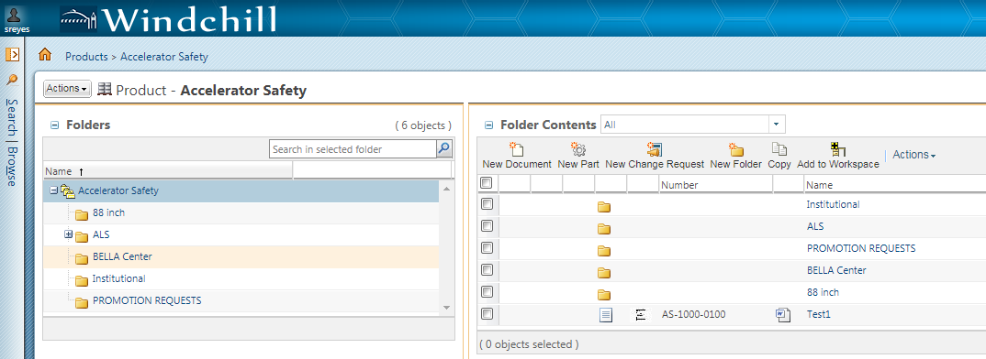
Document Control
Windchill is an online browser based PLM (Product LifeCycle Management) used as project repository to manage all types of documents like Safety Documents, USI forms, with a direct release path into LBNL’s Document Control Center (DCC)
DCC stores the current and previous released versions of documents (with revision history), electronic signatures with time-stamps and LBNL watermark.
Accelerator Safety Workshop 2017

Slide 14
Documents under CM
At a minimum, the documents to be placed under CM in LBNL’s DCC include:
SAD
ASE (and approval letter from DOE BSO)
USI determination forms
SCC administrative control procedures
SCC design documentation (SCC requirements, performance specifications and related documentation such as drawings and engineering calculations)
Facility triennial review reports
Accelerator Safety Workshop 2017

Slide 15
Triennial accelerator safety assessment
Objective: Assess accelerator safety program elements specified in CRD portion of DOE Order 420.2C Safety of Accelerator Facilities and other key areas related to accelerator safety, to ensure compliance with DOE Order 420.2C, and to focus management attention on improvements necessary for continued safe operations.
The following accelerator safety program elements are assessed:
1. ASE
2. SAD
3. USI Process
4. Configuration Management Plan
5. AAR Program
6. Roles and Responsibilities
Accelerator Safety Workshop 2017

Slide 16
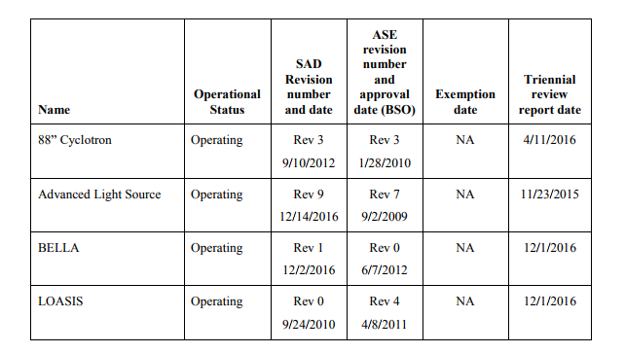
LBNL Accelerators ASO compliance summary
Accelerator Safety Workshop 2017

Slide 17
Summary
LBNL is a multidisciplinary laboratory with three very distinct accelerator programs managed by three divisions
Each accelerator has with different challenges and needs
LBNL is working towards a consistent framework that is flexible enough to address the specific needs of each facility
LBNL is strengthening the integration between engineering design and EHS with the addition of the Engineering Systems Group and the Safety and Configuration Control Engineering role
Accelerator Safety Workshop 2017

