Slide 1
Hazard Assessment Methodology Applied at the Facility for Rare Isotope Beams
DOE Accelerator Safety Workshop 2017
Bob Lowrie
AECOM N&E Technical Services Senior Technical Advisor
FRIB ES&H Deputy Manager
August 2017

Slide 2
Outline
Facility for Rare Isotope Beams (FRIB) at Michigan State University (MSU) project status
Hazard identification, postulated event scenarios, and control selection
Approach to assure that the person responsible for each system owns the safety basis and the safety controls associated with their area of responsibility

Slide 3
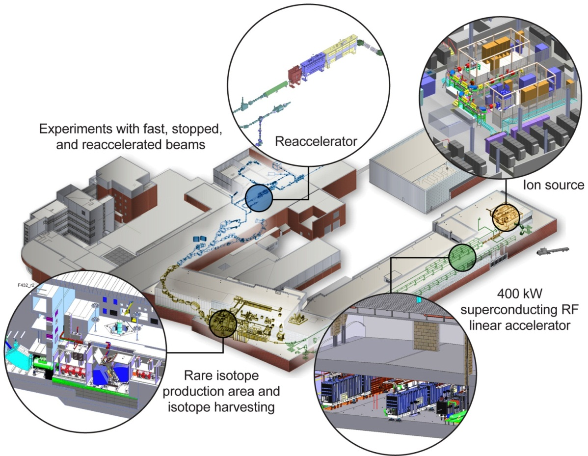
Facility for Rare Isotope Beams A DOE-SC National User Facility
Funded by DOE–SC Office of Nuclear Physics with contributions and cost share from Michigan State University
Serving nearly 1,400 users
Key feature is 400 kW beam power for all ions
Separation of isotopes in-flight provides
Fast development time for any isotope
All elements and short half-lives
Fast, stopped, and reaccelerated beams
https://frib.msu.edu/

Slide 4
FRIB Hazard Identification and Control
FRIB’s hazards and controls are not unique and are consistent with other similar facilities, but a key to success is that the evaluation is comprehensive
The approach to identifying hazards, identifying potential event scenarios, and selecting controls is based on a proven process used by AECOM N&E TS at a broad range of facilities, including nuclear facilities, accelerators, and other non-nuclear facilities
N&E TS has a number of tools and techniques available to facilitate hazard evaluation and control selection
Used an interview and feedback approach which fit the MSU and FRIB working environment
A key factor is the experience of the safety professional leading the discussion
This approach to performing and documenting the hazard and event evaluation, control selection, and control effectiveness evaluation establishes a benchmark against which project evolution could be measured and project design and operational safety could be evaluated at any time
Hazard evaluation and postulated event development was initiated early to guide design and updated as the design evolved
Recently updated to account for commissioning and operational specifics and to support the SAD

Slide 5
Hazard Analysis Organization
Facility breakdown
Conventional Facilities
Driver Linac
Target and Experimental Areas
Cryogenic Systems
All event types are addressed
E-1 Fire
E-2 Explosion
E-3 Loss of Containment/Confinement
E-4 Direct Radiological/Chemical Exposure
E-5 Cryogenic Events
E-6 External Events
E-7 Natural Phenomena
CFH Conventional Hazards (Standard Industrial Hazards)

Slide 6
Documentation for Each Event
Event number and event category
Event description
Causes
Assumptions and initial conditions
Unmitigated impact on systems
Initiating event frequency
Unmitigated consequences (Radiological, Chemical, Cryogenic ODH)
Safety function
Method of detection
Preventive features – attributes (engineered and administrative)
Mitigative features – attributes (engineered and administrative)
Credited engineered and administrative controls (CECs and CACs)
Planned analysis, assumption validations, and risks/opportunities
Mitigated consequences
Notes

Slide 7
Hazards are Documented and Controlled
Hazards and postulated event scenarios are documented in the Hazards Analysis (HA)
Current assessment includes 185 event scenarios (not all requiring controls), 24 credited engineered controls and 19 credited design features
Adequacy of the credited controls are documented in the Preliminary Safety Assessment Document (PSAD) and Safety Assessment Document (SAD)
Follows the basic format of ANSI N43.1 Radiation Safety for the Design and Operation of Particle Accelerators
Required elements for protection in Safety Basis documentation
Initial Conditions protected
Credited design features
Credited engineered controls
Credited administrative controls
The PSAD and HA provide the basis for the Safety Assessment Document (SAD), Accelerator Safety Envelope (ASE), and Operational Safety Envelope (OSE) evolution through the rolling commissioning process

Slide 8
Control Account Managers (System Owners) and Line Management Responsible for Safety
Control Account Managers (CAMs) suggest controls in accordance with requirements
ESH&Q analyzes the hazards and verifies capability of the controls to satisfy the identified safety function
CAMs document and assure their systems will perform the required safety function
ESH&Q uses Hazards Analysis (HA) and Preliminary Safety Assessment Document (PSAD) to collect, document and verify the hazards and mitigations
Highly interactive and ongoing process, hazard identification and analysis based on meetings with division directors and system owners
System owner credited safety control assurance declaration and FRIB acceptance is captured in the CAM assurance document for that system
Hazard owner either owns the credited control or agrees with control owner on the appropriate control for the hazard
CAM assurance declaration prepared by control owner
Concurrence provided by project office
Chief engineer, ESH&Q manager, ES&H deputy manager
Concurrence provided by other stakeholders
Interfacing systems and CAMs that also use the control for their hazard
Approval provided by division director
Project acceptance provided by project manager

Slide 9
CAM Assurance Document Content
Each credited engineered active and passive control (CEC)
Hazard and events affecting design
Each event from the HA is listed and the requirements for the CEC associated with that event are identified
Associated controls (CECs and CACs) required to satisfy the safety function are listed
Credited safety requirements
Succinct statement of the safety function is provided
Functional performance requirements are provided to assure that each of the identified event scenarios are addressed
System description and hazard mitigation assurance
Prepared by the system owner as their assurance to the project that their design would satisfy the identified safety function and functional performance requirements
Validated by as-built documentation following completion and testing
Open items and unmitigated hazards
Used throughout design process as a communication tool as design evolves

Slide 10
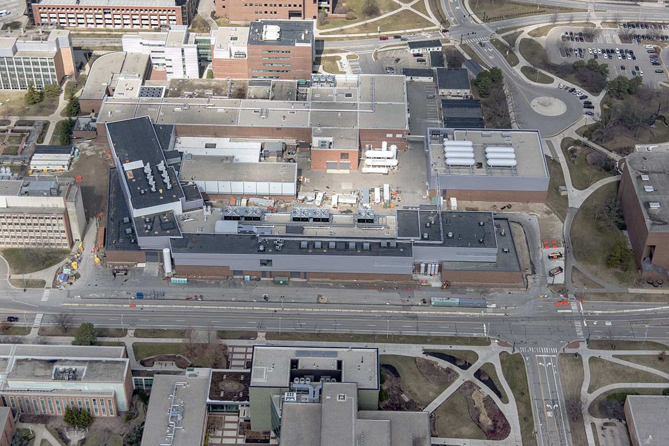
Achieved Beneficial Occupancy on 24 March 2017 Initial Oxygen and Argon non-accelerated beams transported April and May 2017

