Slide 1

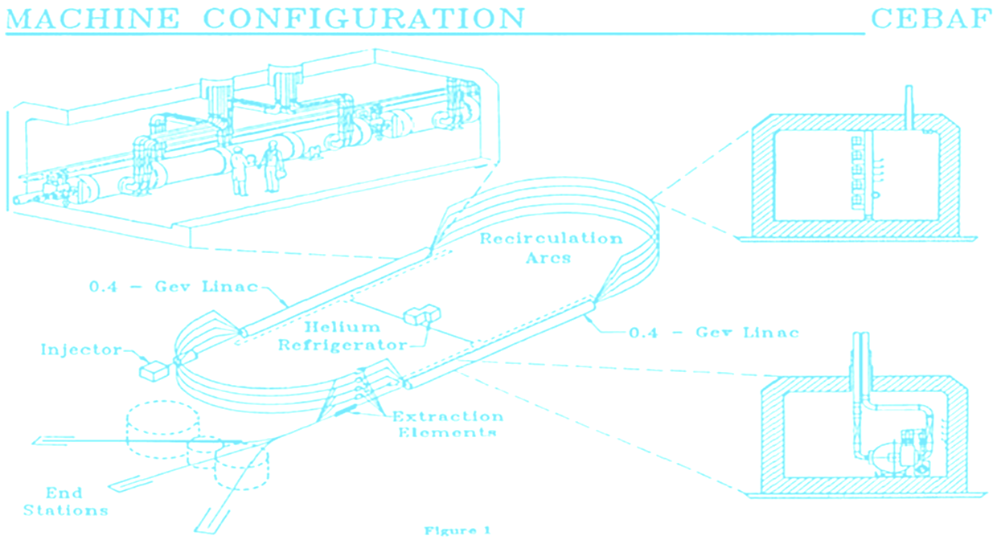
Si PiN diode detector for radiation monitoring in CEBAF accelerator service buildings
DOE Accelerator Safety Workshop
August 15-17, 2017
Penetration
Vladimir Popov
RadCon

Slide 2
Introduction
Radiation detectors for radiation monitoring in proximity of penetrations in CEBAF accelerator service building have been developed studied and tested.
The detector made with commercial BPW34 PIN diodes primarily produced as a photodiode. However, studies show that diodes applicable for x-ray and gamma detection could be used as a cost effective alternative.
The detector has to operate indoor near technological penetrations (RF and He lines) to provide a radiation safety monitoring near penetrations. In total, CEBAF accelerator service buildings have about 126 penetrations.

Slide 3
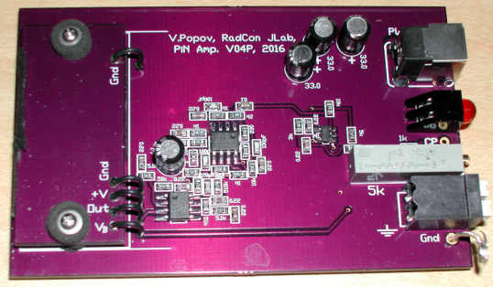
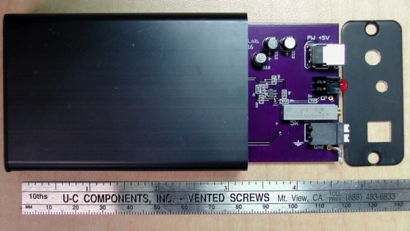
Detector specs
Sensor: 10 PIN diodes, model VBPW34FAS, sensitive area = 0.75cm² total.
Output: pulse, 5V, 10μs
Background count rate: about 2CPM at 10μrem/hr
Sensitivity: 210CPM/(mrem/hr)
Linear response limit: ~60kHz or 17.5rem/hr
Operation limit: ~65kHz
Power: +5V, (3…7V)
Size: L80xW54xH23 mm

Slide 4
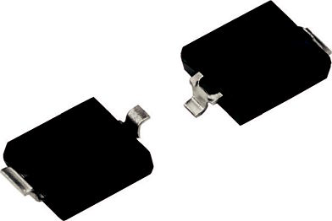
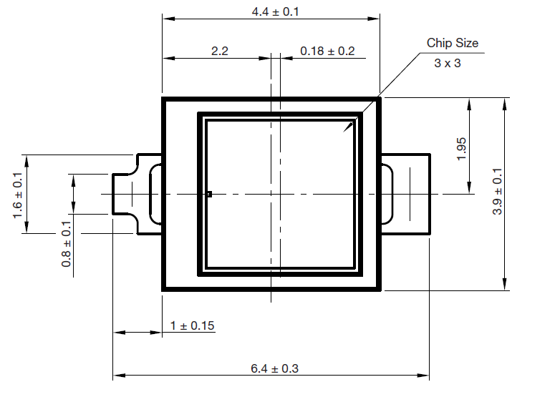
VBPW34FAS PiN Diode
FEATURES
• Package type: surface mount
• Dimensions (L x W x H in mm): 6.4 x 3.9 x 1.2
• Radiant sensitive area (in mm²): 7.5
• Daylight blocking filter matched with 870nm to 950nm emitters
• Capacitance: ≈ 70pF at V_{b}=0V,
and ≈ 10pF at V_{b}=60V
• Max V_{b}=60V

Slide 5
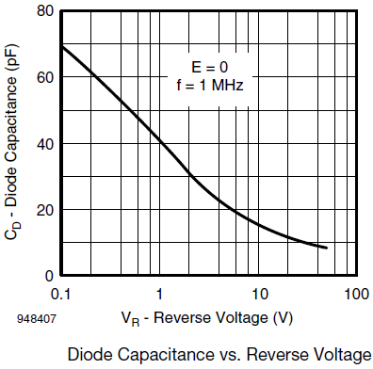
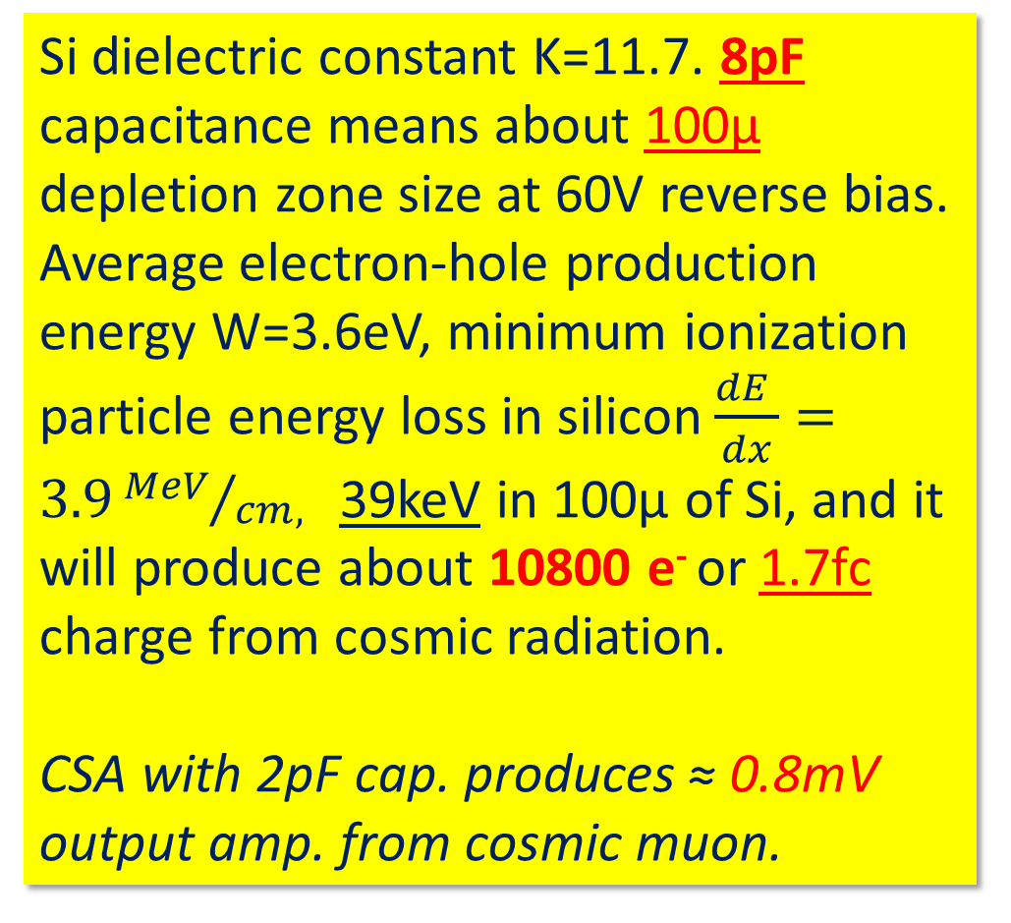
PIN diode sensitivity consideration
Si dielectric constant K=11.7. 8pF capacitance means about 100μ depletion zone size at 60V reverse bias. Average electron-hole production energy W=3.6eV, minimum ionization particle energy loss in silicon$\frac{dE }{dx}=3.9{MeV}/{cm, }$ 39keV in 100μ of Si, and it will produce about 10800 e⁻ or 1.7fc charge from cosmic radiation.
CSA with 2pF cap. produces ≈ 0.8mV output amp. from cosmic muon.

Slide 6
The PIN diode detector circuit block diagram
Ten BPW34 diodes
V_{thr} ≈ 100…200mV
0.8mV
2pF
P/Z, LPF
and amp.
TTL
Output
Discr.
10 μs, 5V
Monost. Mult.
OPA140
MCA test point
L. Reg
Pos.
+5V (digital)
+3…6V DC
V reg.
SW, +V_{cc}
L. Reg
Pos.
+5V
+V_{b}
+60V
Over Voltage Protection
PW Supply

Slide 7
Pulse Height Distributions (PHD), obtained with gamma sources and background-cosmic radiation
Suggested threshold
¹³³Ba, 81keV
¹⁰⁹Cd, 88keV
BGR, cosmic

Slide 8
Two detectors test-calibration with ¹³⁷Cs source at Radcon range
(1msv/hr)

Slide 9
Six detectors comparison

Slide 10
Linearity and response limit of the detector. Tested with LED light pulse.

Slide 11

Detectors cost estimate
OSH Park Order Details
PCBs: PIN diodes board, $8.05 per batch of three;
Main board, $33.80 per batch of three;
Set of PCB’s for one detector = $13.95;
1455C801BK, aluminum enclosure = $12.19;
Parts ≈ $10;
Component placement in EESSUP, Jlab,
about 2hr per det ≈ $63.00
Total cost of one prototype detector production ≈ $100;
The cost of one will be lower, in case of production larger series

Slide 12
THANK YOU!

Slide 13
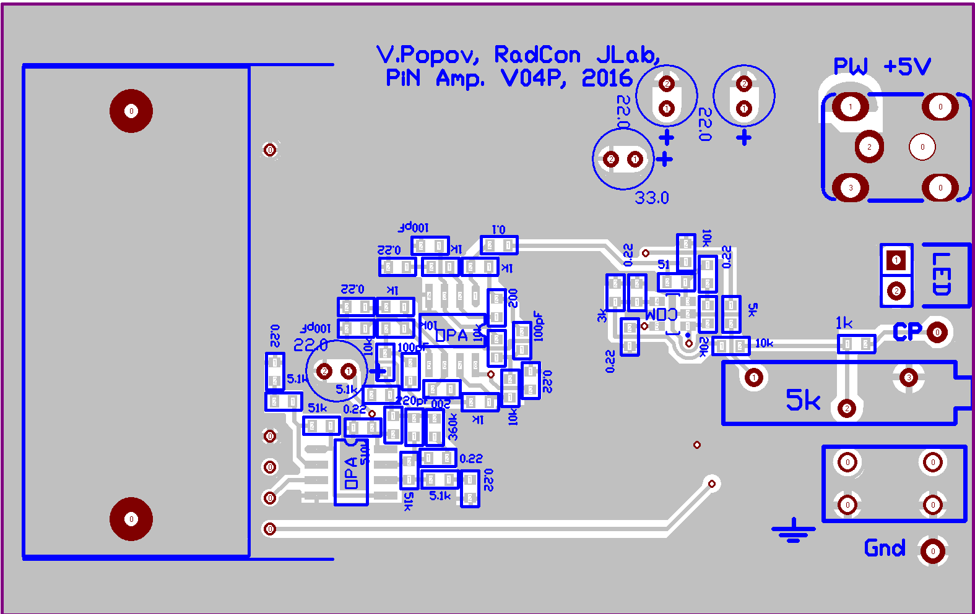
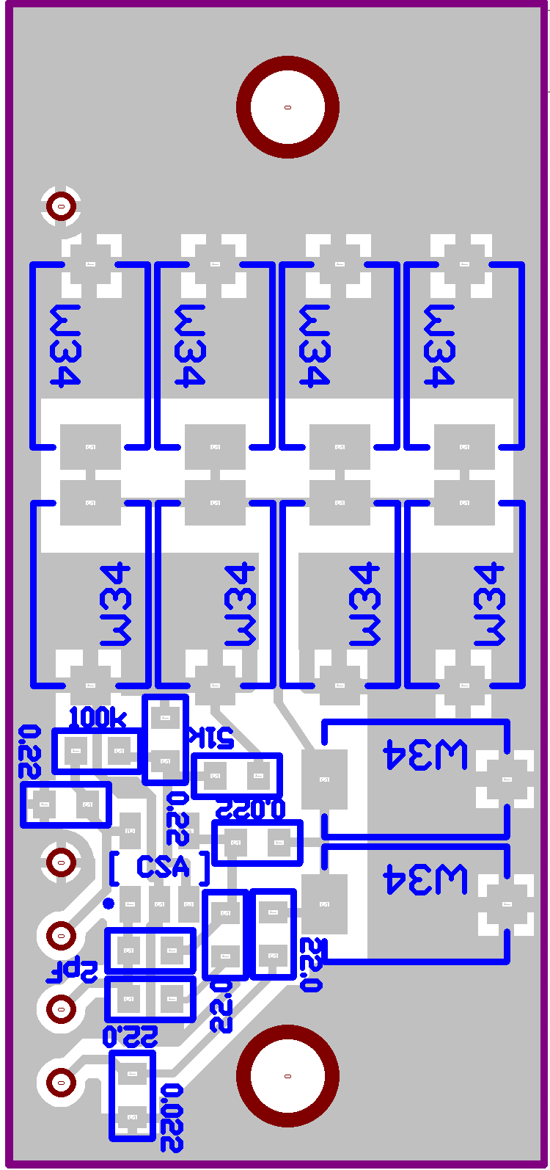
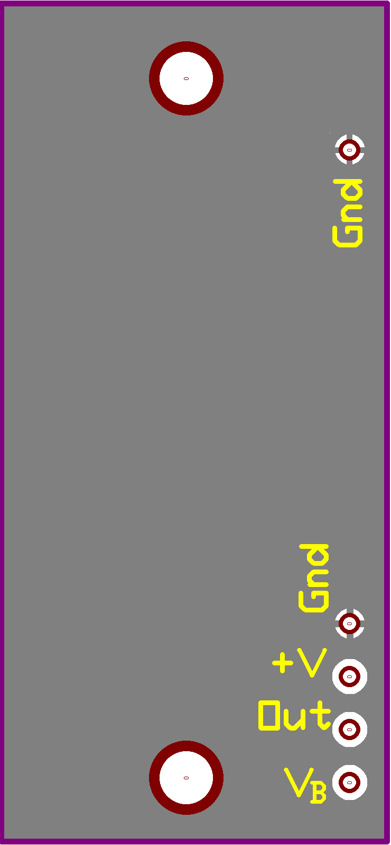
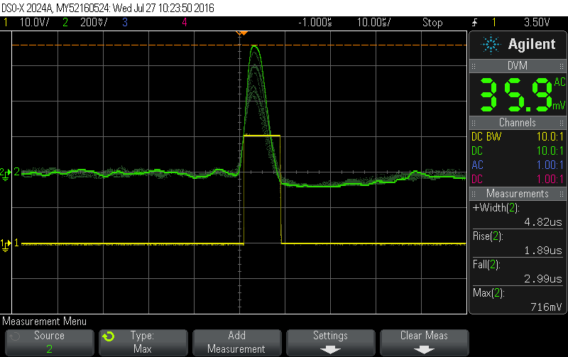

PIN diode detector layout
A
C
B
+5V
Gnd.
Gnd.
Thr.
+V
CSA
TTL Out.
V_{B}=60V

Slide 14
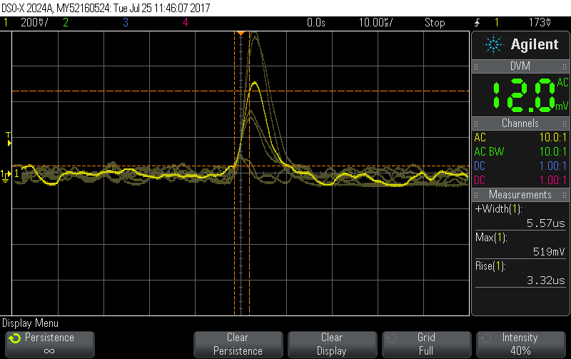
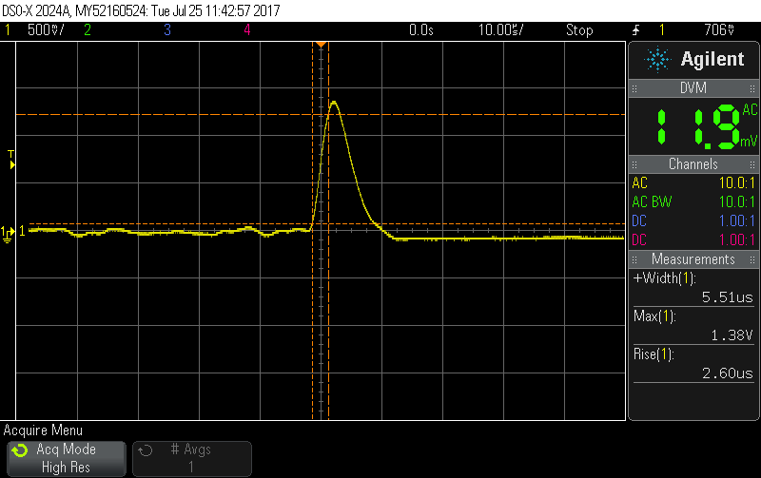
PIN detector, pulses at discriminator input
Cosmic, bgr
¹³⁷Cs

Slide 15
Gamma spectra
¹⁰⁹Cd
¹³³Ba
¹³⁷Cs
BGR
Ch.

Slide 16
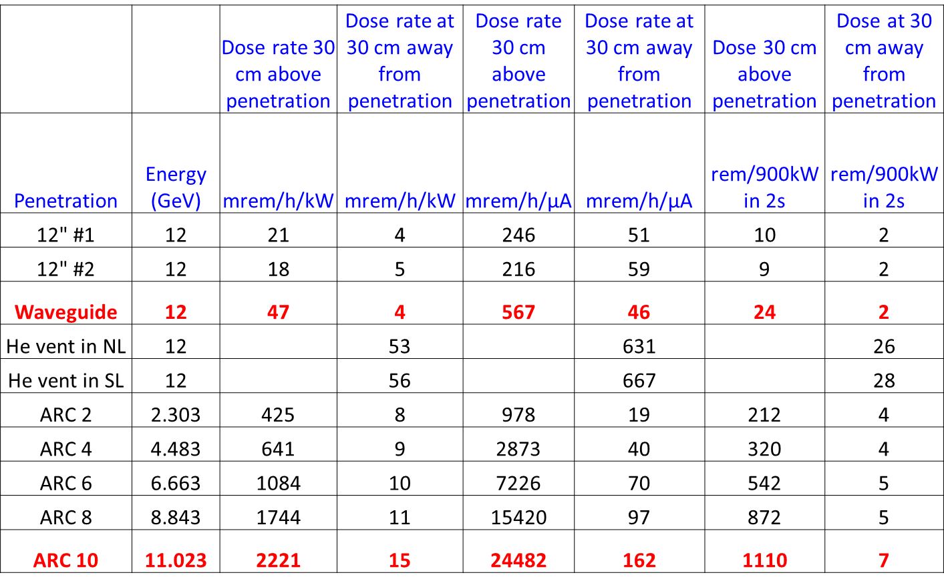
George Kharashvili, FLUKA simulation

