Slide 1
Air Activation in LCLS-II Linac from Cryomodules and Halo Collimators
Mario Santana Leitner✝, J. Blaha, L. H. Nicolas, H. Tran, J. C. Liu (SLAC / RPD)
msantana@slac.stanford.edu.

Slide 2
Outline
Introduction: Safety Design limits & Criteria, Hard X-Ray FEL, LCLS-II beam-lines; Field emission
Model for Field Emission Tracking: Method, Benchmarking, Effect of EM fields, Effect of Quad fields
Air Activation from Cryomodules – Results, Considerations
Air Activation from Halo Collimators
Total Air Activation in the Linac: Results, Considerations
Summary
ASW JLAB 2017 - Air Activation in LCLSII from Cryomodules & Collimators - MSL (SLAC)

Slide 3
Introduction - Safety Design Limits and Criteria
Member of the Public:
10 mrem/y to a Maximally Exposed Individual (MEI), from DOE/EPA (40CFR61- Subpart H)
0.1 mrem/y → no need for EPA notification and prior approval
0.1 mrem/y from each air release point → no need for continuous air monitoring. Period confirmatory measurements are still required.
SLAC Worker Air Pathway Exposure Design Criteria:
1 Derived Air Concentration DAC (2.5 mrem/h) in the workplace (10CFR835, Appendix A)
ASW JLAB 2017 - Air Activation in LCLSII from Cryomodules & Collimators - MSL (SLAC)

Slide 4
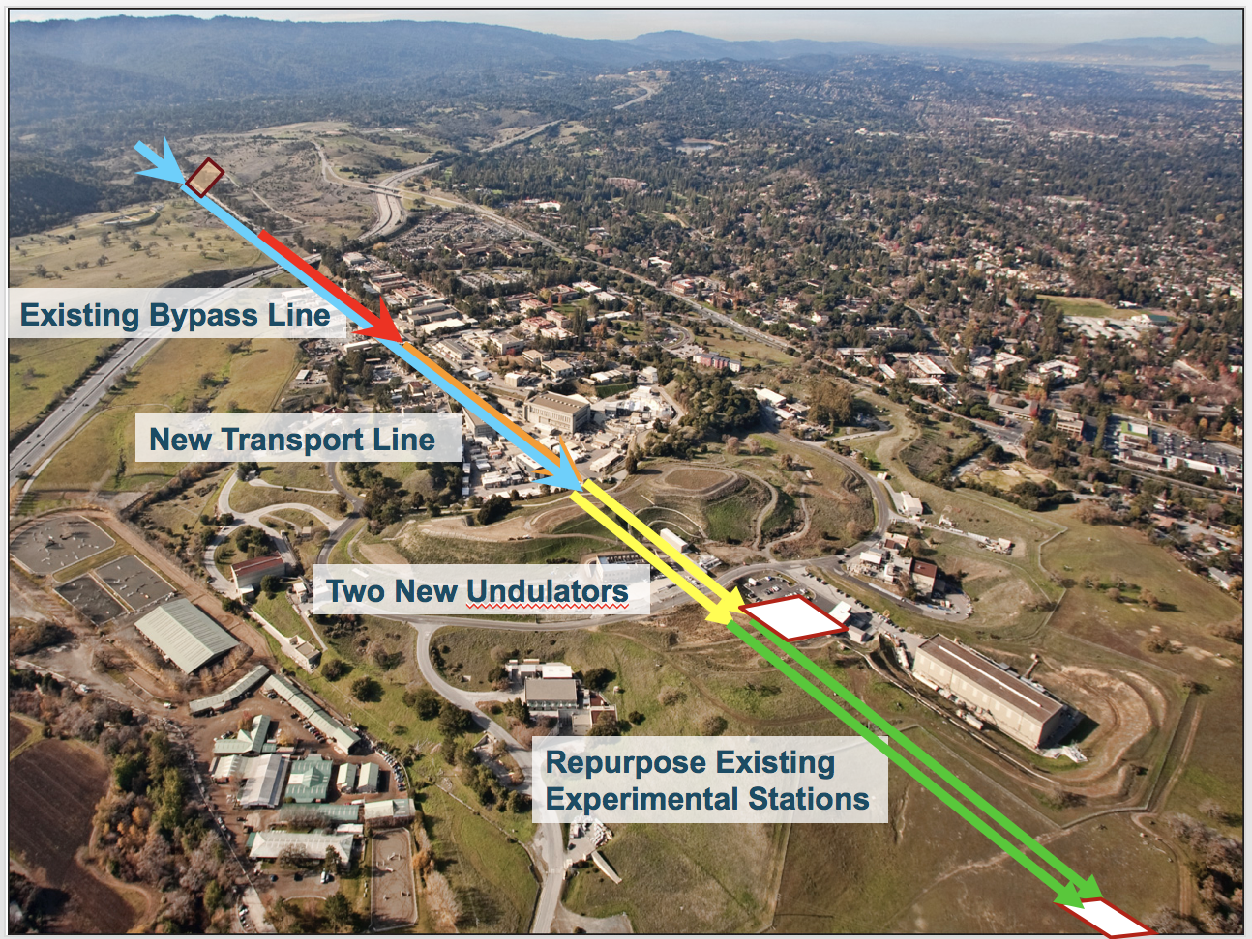
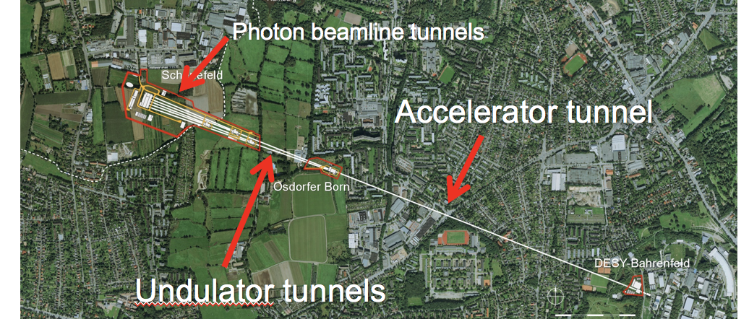
Introduction – hard X-ray facilities
35 cryomodules to be installed in LCLS-II
From W. Clement, DESY
96 cryomodules at XFEL
ASW JLAB 2017 - Air Activation in LCLSII from Cryomodules & Collimators - MSL (SLAC)

Slide 5
Introduction - LCLS-II beam-lines
L0
ϕ =varies
V₀=100 MV
I_{pk}=12 A
σ_{z}=1.02 mm
L1
ϕ = −12.7°
V₀=211 MV
I_{pk} = 12 A
σ_{z}=1.02 mm
L2
ϕ = −21°
V₀=1446 MV
I_{pk}=80 A
σ_{z}=0.15 mm
L3
ϕ =0
V₀=2206 MV
I_{pk}=1.0 kA
σ_{z}=9.0 μm
Lf
ϕ =±34
V₀=202 MV
I_{pk}=1.0 kA
σ_{z}=9.0 μm
BC3
E=4.0 GeV
R₅₆=0
σ_{δ}=0.13 %
HL
ϕ = −150°
V₀=64.7 MV
CM01
CM02,03
3.9 GHz
CM04
CM15
CM16
CM33
CM34,35
LH
E=100 MeV
R₅₆=-14.5 mm
σ_{δ}=0.05 %
BC1
E=250 MeV
R₅₆=-55 mm
σ_{δ}=1.6 %
BC2
E=1600 MeV
R₅₆=-37 mm
σ_{δ}=0.38 %
BYP/LTU
E=4.0 GeV
R₅₆≈0.2 mm
σ_{δ}≈0.014%
> 2.5-km
GUN
750 keV
100-pC machine layout: April 24, 2014; v21 ASTRA run
ASW JLAB 2017 - Air Activation in LCLSII from Cryomodules & Collimators - MSL (SLAC)

Slide 6
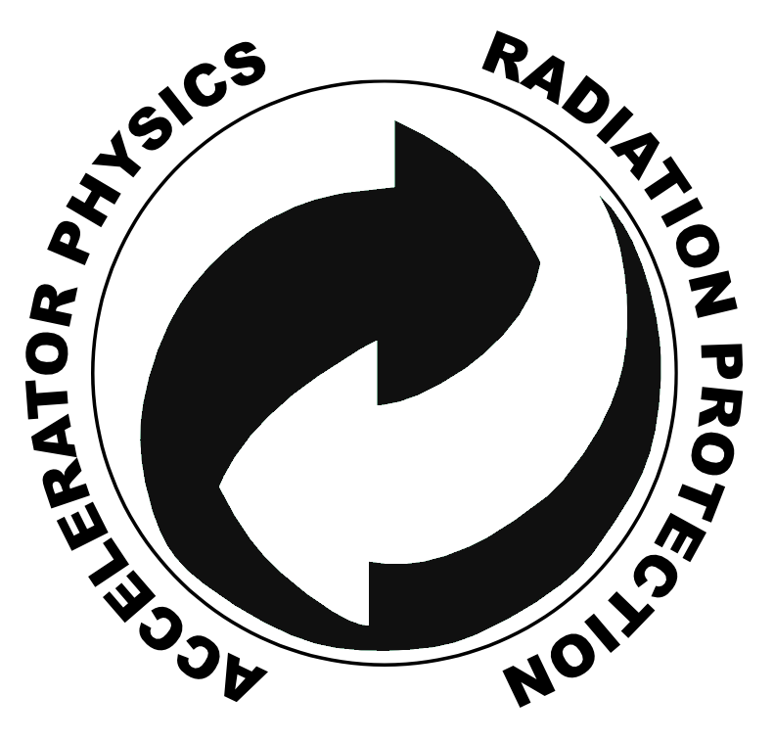
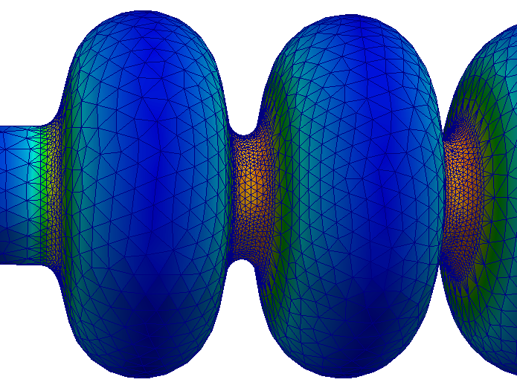
Field emission
Model for Field-emission Tracking – Method (1/3)
Santana et al, Int. J. Mod. Phys. Conf. Ser. 2016.44
Electrons are extracted from the cavity surface and accelerated by the RF fields until they are lost or intercepted
Track3P + SLAC RF fields used to simulate the emission and RF transport inside the cavities.
Track 3P uses Fowler-Nordheim law, an irregular curved mesh and SLAC RF solvers
FLUKA intra-nuclear cascade Monte Carlo Code used to transport particles between cryomodules (including quads) and in matter
Soft coupling, i.e. up to 8 x 2 data transfer between Track3P & FLUKA to simulate impact of field emitted electrons through +/- 8 cryomodules
Impact files read by FLUKA for radiation transport and activation
ASW JLAB 2017 - Air Activation in LCLSII from Cryomodules & Collimators - MSL (SLAC)

Slide 7
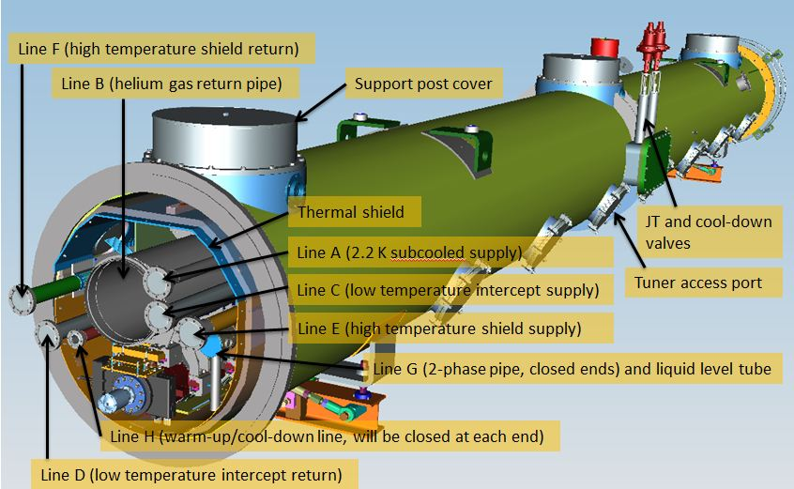
Model for Field-emission Tracking – Method (2/3)
From Mark Ross, SLAC
CM Design 1.04.05 (Fermilab)
ASW JLAB 2017 - Air Activation in LCLSII from Cryomodules & Collimators - MSL (SLAC)

Slide 8
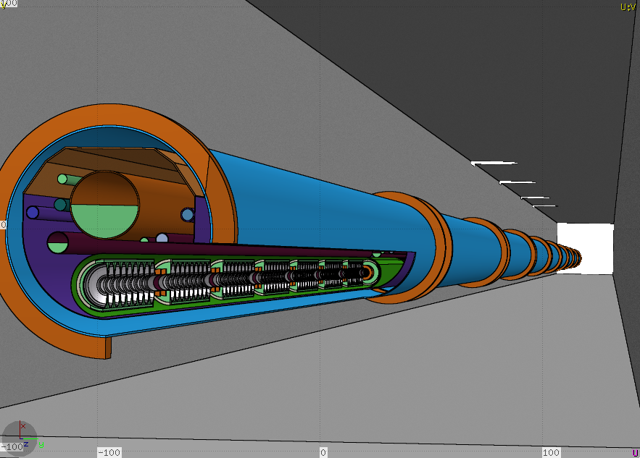
Model for Field-emission Tracking – Method (3/3)
quadrupole
8 Cavities with nine cells each
ASW JLAB 2017 - Air Activation in LCLSII from Cryomodules & Collimators - MSL (SLAC)

Slide 9
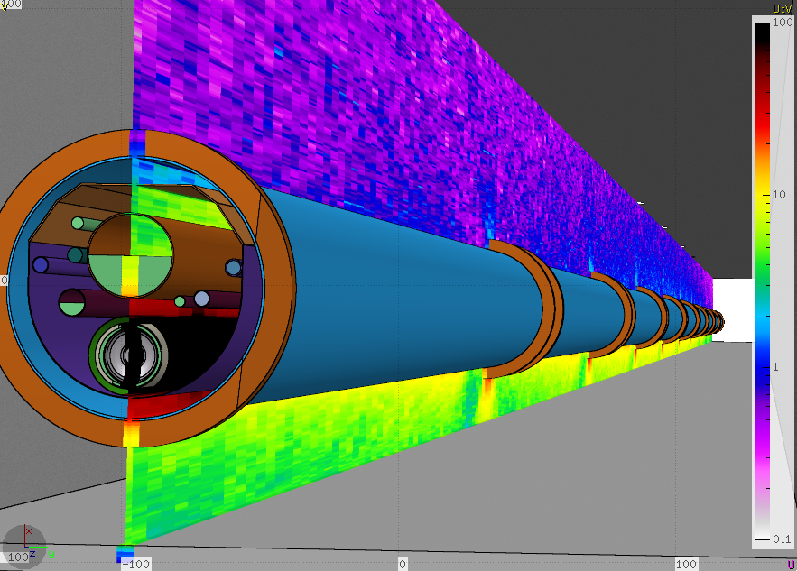
Model for Field-emission Tracking – Method (3/3)
ASW JLAB 2017 - Air Activation in LCLSII from Cryomodules & Collimators - MSL (SLAC)

Slide 10
Model for Field-emission Tracking - Benchmarking
Upgrade of the model is considered
Full coupling
Multipacting
‘Unlimited’ number of cryomodules
More flexibility in setup, i.e. quadrupoles at different fields…
However, the model has been recently successfully benchmarked with measurements for (see JLAB Staytreat’17 presentation):
Single cryomodules at FNAL: agreement within a factor 2-4
Multiple cryomodules at XFEL: agreement within a factor 1.25-2
And several phenomena can be studied and predicted…
ASW JLAB 2017 - Air Activation in LCLSII from Cryomodules & Collimators - MSL (SLAC)

Slide 11
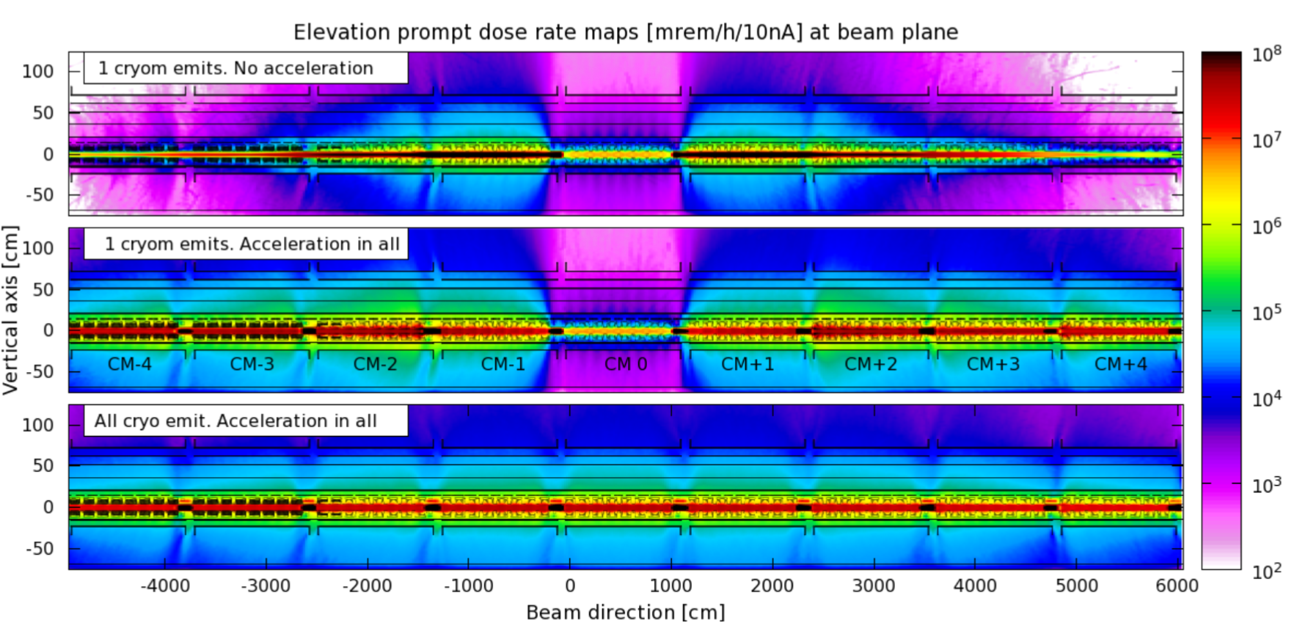
Model for … – Effect of EM fields
Now, all other cryomodules are also powered (but don’t emit): what happens to FE from the central cryomodule?
Now, if all cryomodules emit electrons (and of course, they are all powered, and synced) what is the radiation profile?
ASW JLAB 2017 - Air Activation in LCLSII from Cryomodules & Collimators - MSL (SLAC)

Slide 12
Model for … – Effect of EM fields
Now, if all other cryomodules are also powered (but don’t emit): what happens to FE from the central cryomodule?
Now, if all cryomodules emit electrons (and of course, they are all powered, and synced) what is the radiation profile?
ASW JLAB 2017 - Air Activation in LCLSII from Cryomodules & Collimators - MSL (SLAC)

Slide 13
Model for … – Effect of EM fields
Now, if all cryomodules emit electrons (and of course, they are all powered, and synced) what is the radiation profile?
ASW JLAB 2017 - Air Activation in LCLSII from Cryomodules & Collimators - MSL (SLAC)

Slide 14
Model for … – Effect of EM fields
Now, if all cryomodules emit electrons (and of course, they are all powered, and synced) what is the radiation profile?
ASW JLAB 2017 - Air Activation in LCLSII from Cryomodules & Collimators - MSL (SLAC)

Slide 15
Model for … – Effect of EM fields
ASW JLAB 2017 - Air Activation in LCLSII from Cryomodules & Collimators - MSL (SLAC)

Slide 16
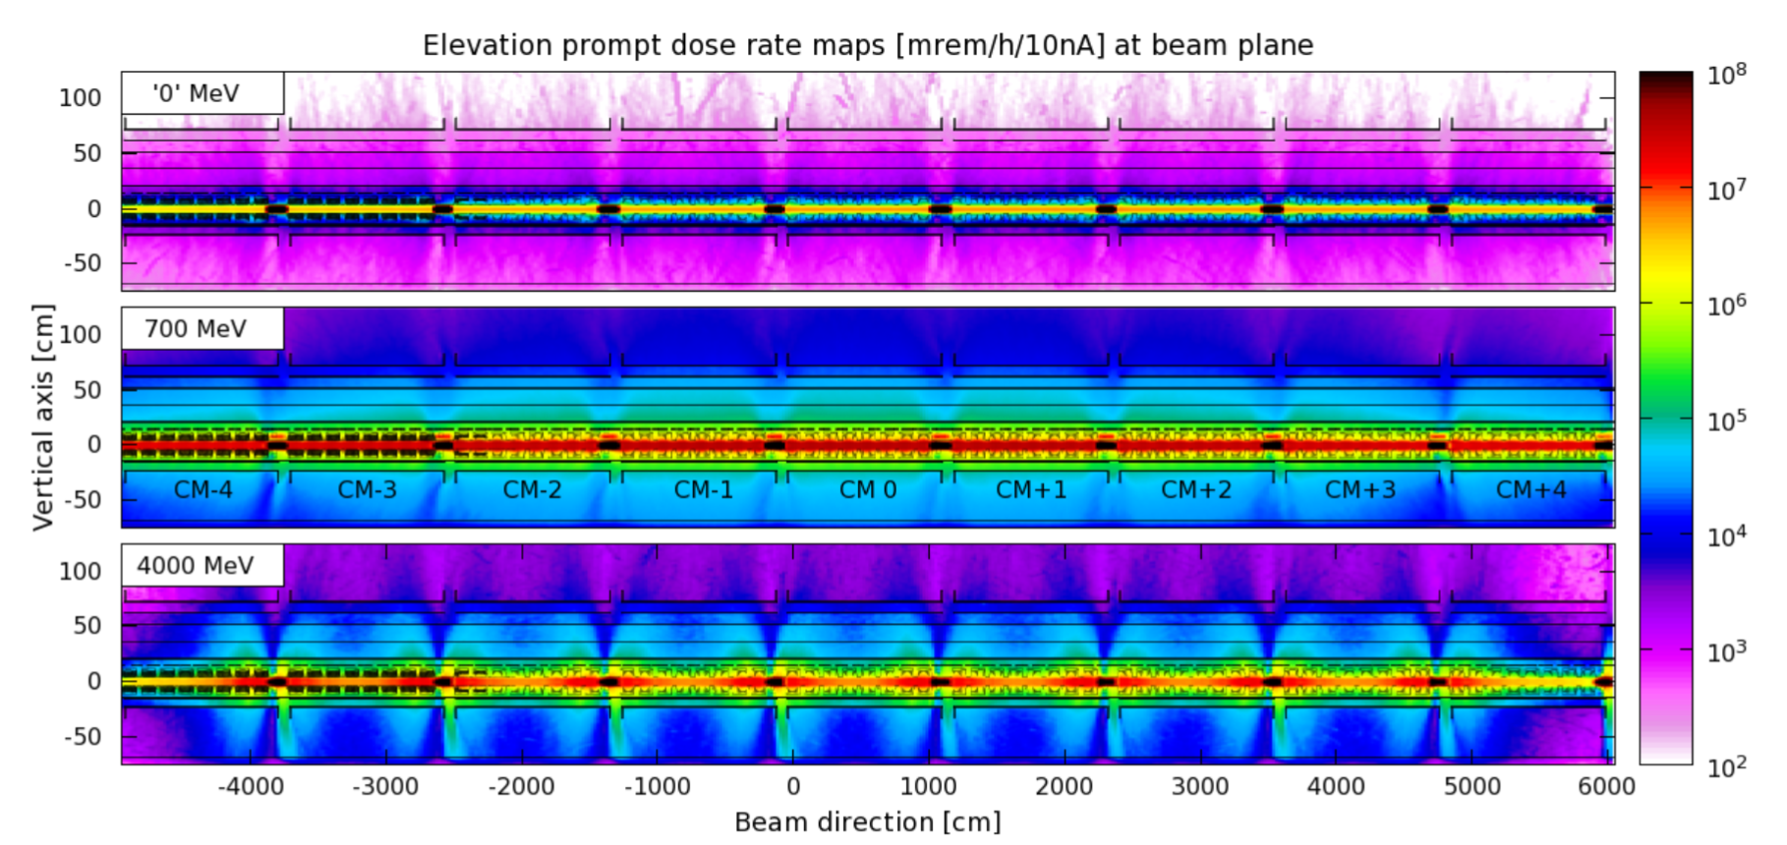
Model for … – Effect of QUAD fields
Low quad gradient increases transmission up/downstream → translates the problem to other areas
Mid quad strength maximizes radiation at the cryomodules
ASW JLAB 2017 - Air Activation in LCLSII from Cryomodules & Collimators - MSL (SLAC)

Slide 17
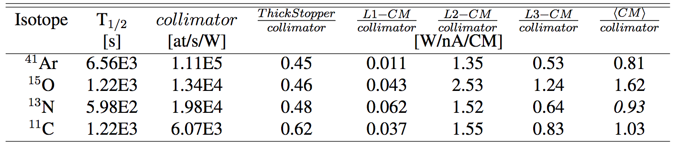
Air Activation from Cryomodules – Results (1/2)
Isotope generation in air by each cryomodule relative to that in an LCLS-II halo collimator
Thus, 35 CM @ 10 [nA]
⩸ 0.81·35·10 = 284 W on halo collimators for ⁴¹Ar production, 567 W for ¹⁵O, 325 W for ¹³N, and 360 W for ¹¹C.
These numbers are similar to the 310 W maximum integrated loss on collimators that is expected for 1.2 MW operation.
→ RP requirement of for warm linac apply also to the cold sections
ASW JLAB 2017 - Air Activation in LCLSII from Cryomodules & Collimators - MSL (SLAC)

Slide 18
Air Activation from Cryomodules – Results (2/2)
Why is this happening?
About 94% of field emission is not captured → 10 nA only represents a small fraction of all the generated field emission, the rest is lost at the cavities
The cavities are thin Nb targets, with apparent thickness as small as ~2.7 mm
A fraction of the captured field emission gets accelerated → it picks up more energy
Can this get worse…?
ASW JLAB 2017 - Air Activation in LCLSII from Cryomodules & Collimators - MSL (SLAC)

Slide 19
Air Activation from Cryomodules – Considerations
Possible Linac energy upgrades contemplate increasing…
… the number of cryomodules → more air activation,
… the beam energy → more FE power → more air activation
… the gradient of cryomodules to ~19.3 MeV/m → The higher gradient could increase FE production by an order of magnitude
Thus estimates at 10 [nA/CM] should not be looked as too conservative
ASW JLAB 2017 - Air Activation in LCLSII from Cryomodules & Collimators - MSL (SLAC)

Slide 20
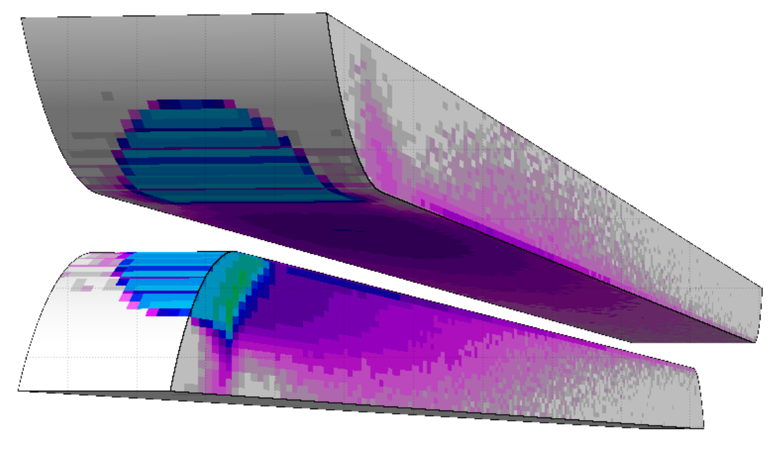
Air Activation from Halo Collimators (1/2)
Air activation was calculated for a simplified approach of beam halo losses in collimators → collapsed jaws into a single piece → cylindrical tungsten target
15 X₀
Total losses on warm linac (=collimators) = 310 W based on beam transport estimates
Collimators with > 10 W have local shielding
ASW JLAB 2017 - Air Activation in LCLSII from Cryomodules & Collimators - MSL (SLAC)

Slide 21
Air Activation from Halo Collimators (2/2)
From J. Blaha, L. Nicolas and H. Tran
 | Linac Collimators* | BSY | 2 EBDs
<Power> [kW] | 0.31 | 90 | 50
Dose [mrem/y] | ~0.8E-03 | 1.95E-03 | 2.61E-04
*) This was a 1st conservative estimate from a single release point next to closest MEI
Dose from air activation in collimators is comparable to all high power dumps combined (shielding effect)
Field emission raw data was divided by collimator data to obtain relative importance. This was done in three sections representing L1, L2 and L3…
ASW JLAB 2017 - Air Activation in LCLSII from Cryomodules & Collimators - MSL (SLAC)

Slide 22
Total Air Activation in the Linac – Results
Finally, this does not represent a major issue for the SLAC Linac (but this could be different in other machines). This is because air activation from CM and Halo collimators is spread over a long distance →
Small immersion dose for workers even without decay
Several release points to various MEI (divide & win…) → For the worst area of the linac, calculations are > 100 times below 0.1 mrem/year goal @ 1 air exchange/day (8.65E-4 mrem/y)
ASW JLAB 2017 - Air Activation in LCLSII from Cryomodules & Collimators - MSL (SLAC)

Slide 23
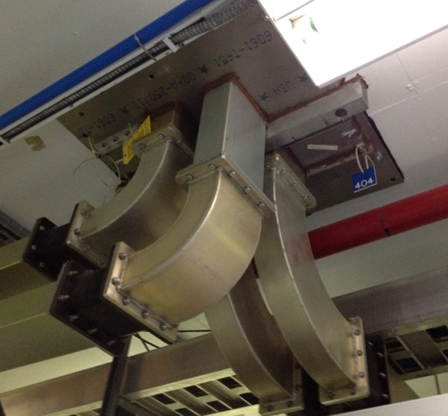
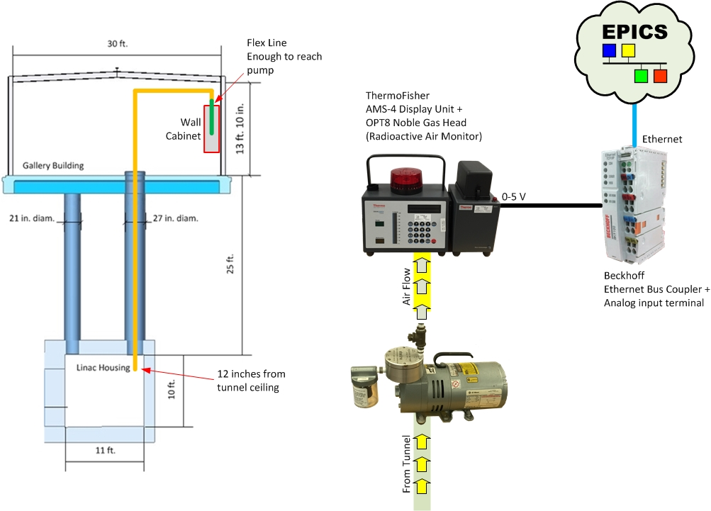
Total Air Activation in the Linac – Considerations
However, if field emission reached 100 nA, then in some areas ventilation would be limited to ~10/day with no safety factor →
Sealing penetrations
Studying ventilation
Monitoring
Sealing of penetrations like in JLAB
AMS deployment in LINAC
ASW JLAB 2017 - Air Activation in LCLSII from Cryomodules & Collimators - MSL (SLAC)

Slide 24
Summary
A model to compute air activation from SCRF field emission has been established and benchmarked
This was a successful result from a collaboration between Accelerator Physics and Radiation Protection teams with outcomes for machine protection and radiation protection
Air activation from cryomodules at 10 nA/m is equivalent to that of 310 W on halo collimators and comparable to 90 kW on a well shielding dump
In our case, consequences from air activation from cryomodules are partly ‘diluted’ due to the long span of the linac, with multiple release points. However, at higher cryomodule gradients ventilation rates need to be controlled more tightly.
ASW JLAB 2017 - Air Activation in LCLSII from Cryomodules & Collimators - MSL (SLAC)

Slide 25
End

Slide 26
BACK UP SLIDES
Independent Review of Radiological Protection for LCLS-II High Power Dumps
Feb. 28 and March 1, 2017

Slide 27
Measurements at XFEL
In collaboration with N. Tesch, A. Leuchner, J. Brahlard, N. Walker (DESY)
Measurements at XFEL – precise instrumentation – known ‘bad’ cavity – similar conditions to LCLSII – FLUKA model has been generated
ASW JLAB 2017 - Air Activation in LCLSII from Cryomodules & Collimators - MSL (SLAC)

Slide 28
‘Soft coupling’ Track3P ←→ FLUKA: impact maps (1/2)
Track3P
Generation of field-emitted electrons
Track electrons within RF field to collision with walls or extraction at either end of the 8-cavity string
2n+1 impact files: original cryomodule, ±1 cryo, …, ±n cryo
FLUKA
Read impact file & transport escaping electrons to next/previous cryomodule through quadrupoles
Auxiliary data files
Transform coordinates to original cryomodule & print position, velocity, energy, weight & RF cycle.
FLUKA
Sampling x convolution x Selection … → Radiation transport of field emitted electrons outside of cavities
ASW JLAB 2017 - Air Activation in LCLSII from Cryomodules & Collimators - MSL (SLAC)

Slide 29
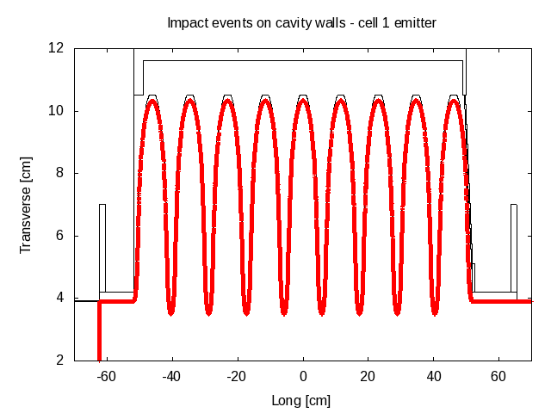
‘Soft coupling’ Track3P ←→ FLUKA: impact maps (2/2)
Select impact event randomly according to statistical weight
Randomize transverse coordinates (position & direction) to full 2π as impact data covers only 1/4th
Auto-adjust impact to boundary surface to avoid mis-match between TRACK3P and FLUKA surface of the cavities
Set detector to count current of primaries exiting its birth cryomodule. This will be used to renormalize all results
Other ’subtilities’: pre-processing, latching, convolution, suppression…
ASW JLAB 2017 - Air Activation in LCLSII from Cryomodules & Collimators - MSL (SLAC)

Slide 30
‘Soft coupling’ Track3P ←→ FLUKA: transport
Read 2n+1 files, with n determined in FLUKA input (source card)
Select file (=step number) randomly according to relative likelihood & select event within. Latch primary (FLUKA variable SPAREK(2,…))
e.g. step=-2
-1
0
+2
…
-3
-2
+1
+3
Convolute previously selected birth cryomodule with step number to obtain ‘collision’ cryomodule and discard if outside the geometry
e.g. CM5-2 = 3
…
1
2
3
4
5
6
7
Kill primary particle (not showers) if it reaches another RF zone, as such events are already included in step±1 impact file
ASW JLAB 2017 - Air Activation in LCLSII from Cryomodules & Collimators - MSL (SLAC)

