Slide 1
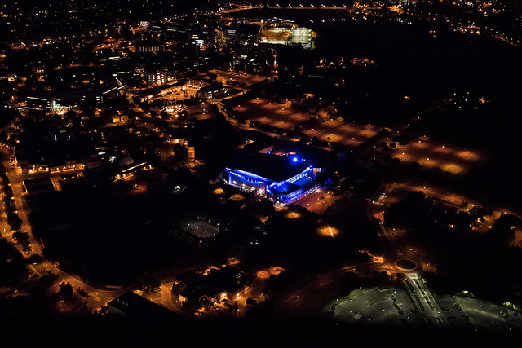
Preliminary Decommissioning Plan for the Canadian Light Source

Slide 2
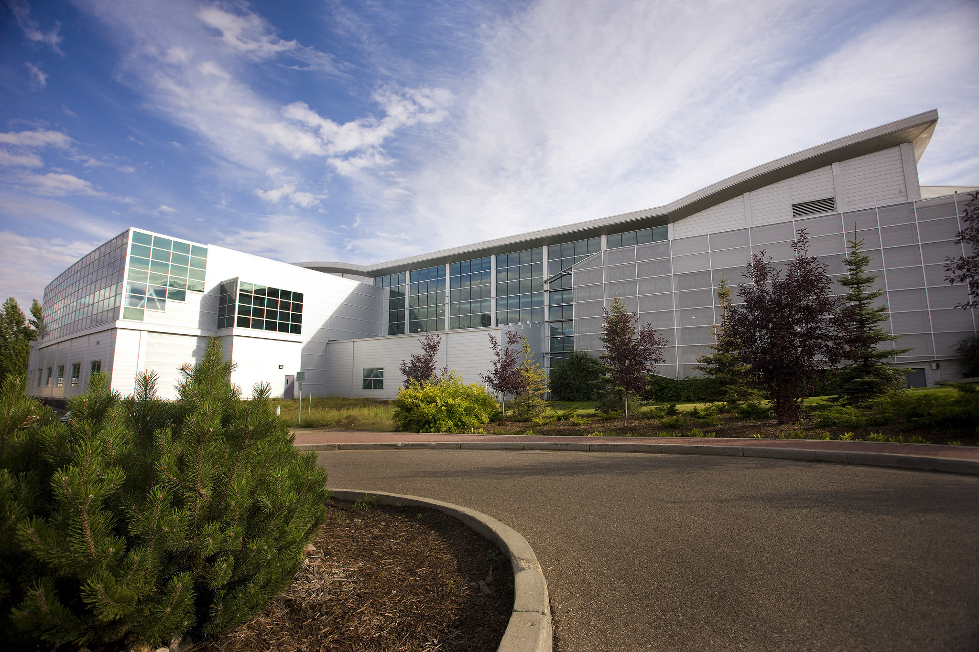
Outline
CLS Facility
  History
  Synchrotron
  Medical Isotope Project
CNSC Requirements
Preliminary Decommissioning Plan
Future

Slide 3
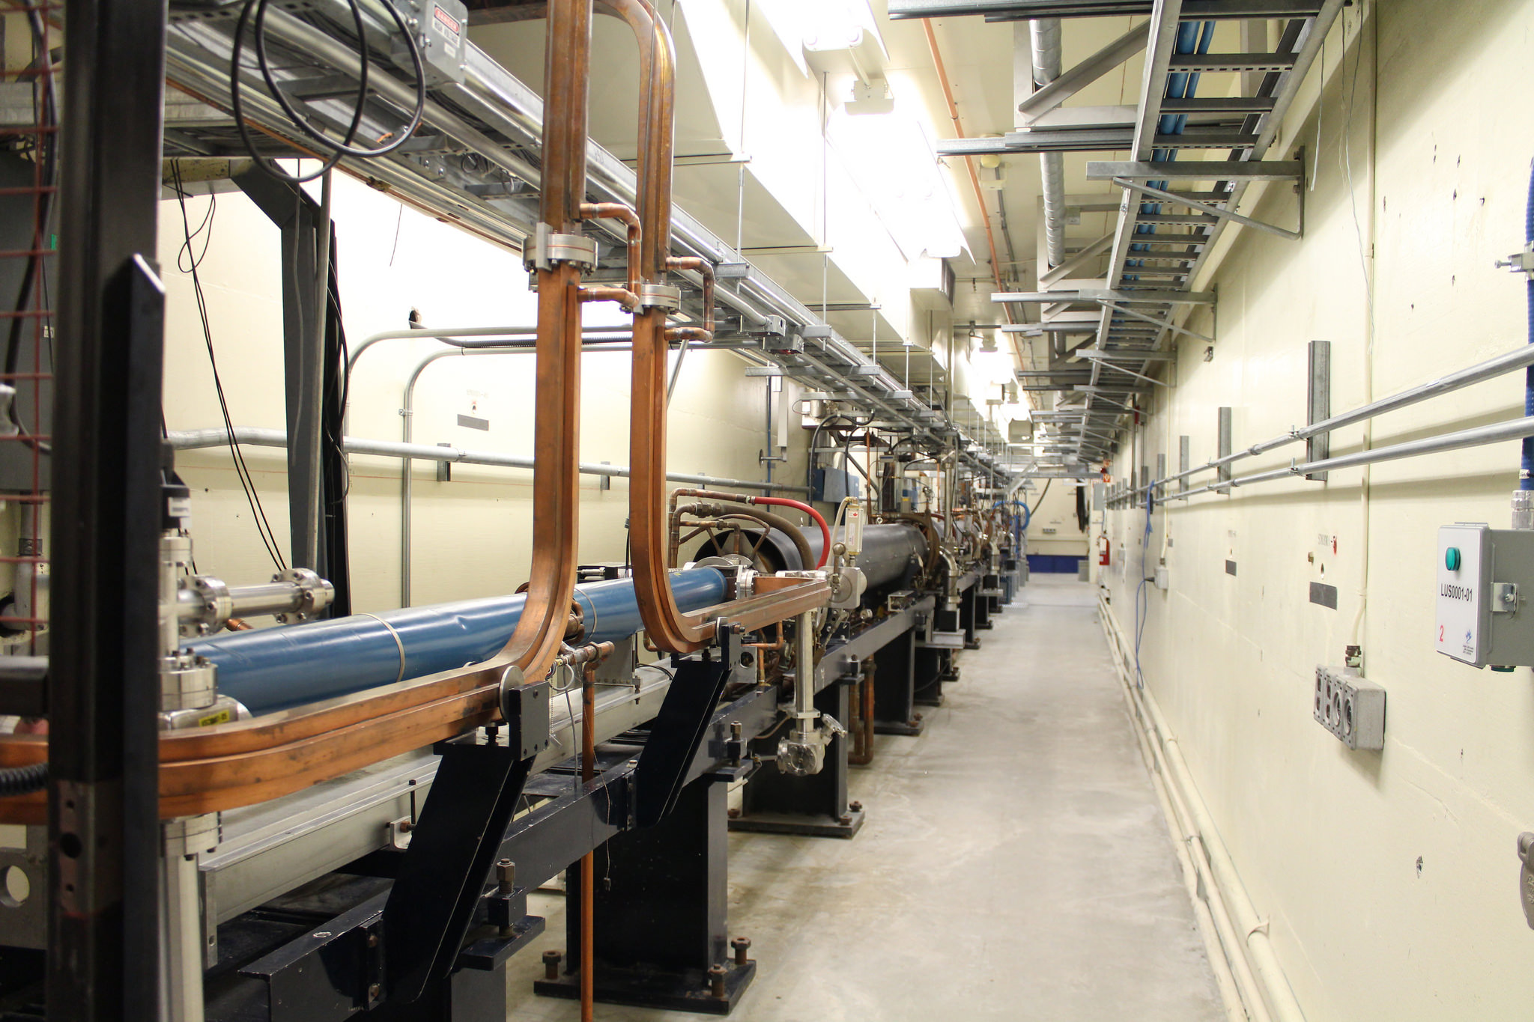
Facility Overview
Saskatchewan Accelerator Laboratory
  1964 -high energy physics research facility
  300 MeV LINAC in ‘Old’ building
    Owned by University of Saskatchewan (on Campus)
    Same LINAC but 360 Hz
      Higher power operation than CLS 1 Hz
  7.2 acre footprint
  19,820 ft² building
    Brick and mortar

Slide 4
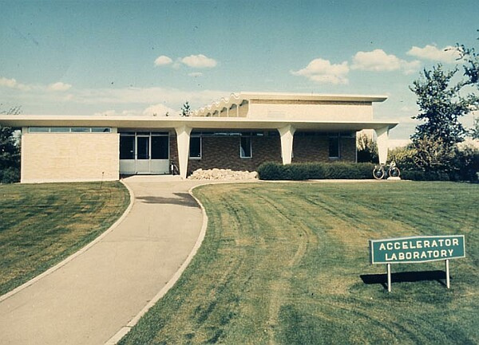
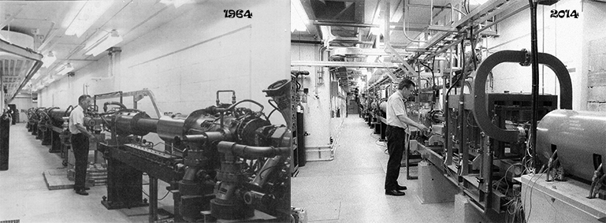
Saskatchewan Accelerator Lab (SAL)

Slide 5
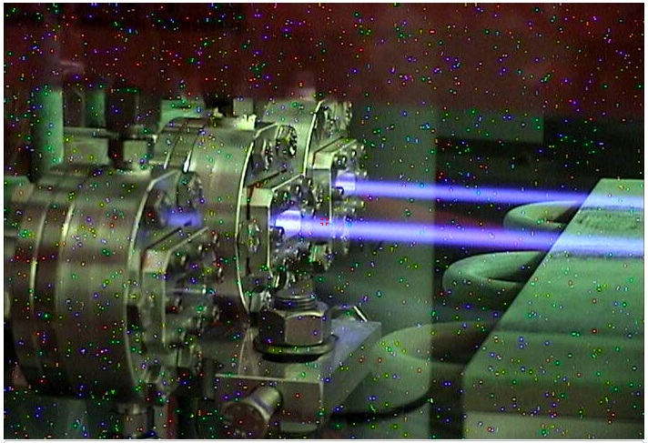
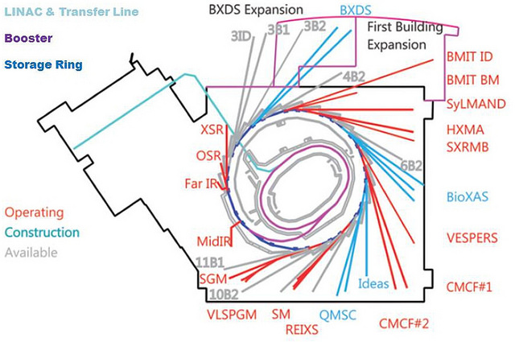
Overview of Facility
CANADIAN LIGHT SOURCE
  Synchrotron Facility
  Transfer lines to bring beam
  up two floors to Booster Ring
  Booster Ring ramps 250 MeV to 2.9 GeV
  2.9 GeV Synchrotron Storage Ring
  Beamlines in ‘new’ section of building
  ~ 110,000 ft²

Slide 6
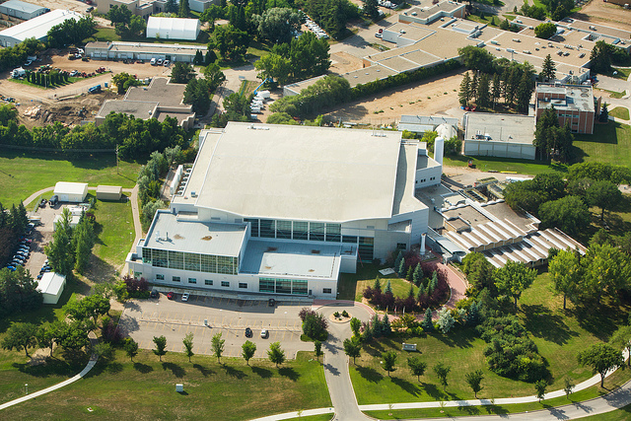
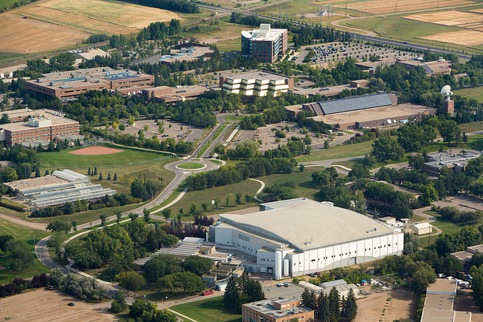
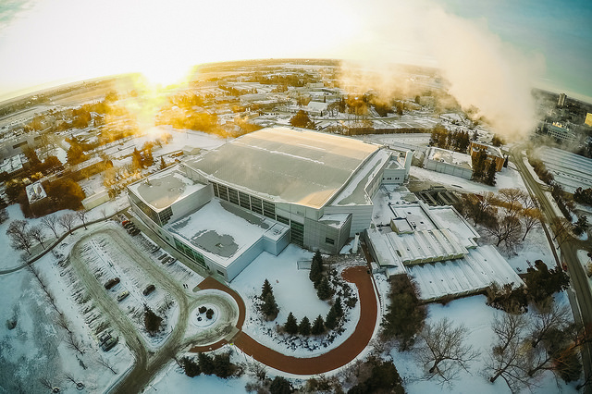
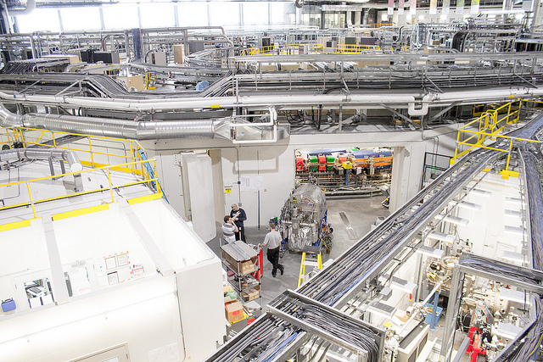

Slide 7
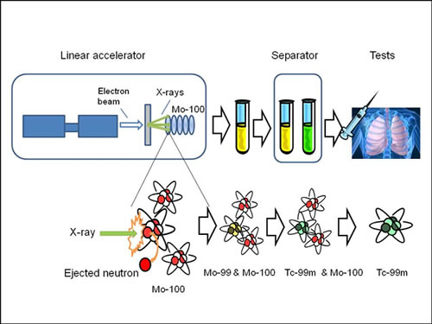
Medical Isotope Project
30 MeV, 40 kW linac
E- beam hits tantalum target
  Mo-100 produces Mo-99
  Copper beam stop
Activation + Contamination
  Small impact on overall plan
  Separate operating licence - budget

Slide 8


CNSC
Canadian Nuclear Safety Commission
  Provides licence to operate nuclear facility
  Enforces Act and Regulations
    Class 1A – Power Plants
    Class 1B
      Accelerators > 50 MeV
      U mines
      Fuel Fabrication
      Waste Management
    Class II
      Accelerators < 50 MeV
      Irradiators
      Teletherapy machines

Slide 9
CNSC
Cradle to grave approach for Class 1 licensees
  5 year PDP review cycle
  Financial Guarantee required
decommissioning (déclassement)
  Those actions taken to retire a licensed facility permanently from service and render it to a predetermined end-state condition.

Slide 10
Decommissioning
Final stage of nuclear facility life cycle
Involves
  Decontamination
  Dismantling of equipment
  Demolition of structures
  Management of resulting materials

Slide 11
Decommissioning
GOAL:
  Obtain regulatory approval for unrestricted use
Includes all areas of the facility
Accounts for regulatory requirements
  H&S of personnel, public, environment

Slide 12
Principal Hazards
Conventional
  Electrical, Magnetic
  Cryogenic
    ODH
  Mechanical, Vacuum, Asbestos
Radiological
  Activated components
  Lead
  Contamination - minimal

Slide 13
Hazard Reduction
During operations over life of facility
  Procedures to manage waste
    Waste from SAL recycled, disposed
    Some stored in sub-basement level
    Waste disposal and recycling programs
  Management structure to ensure implementation

Slide 14
Metals
AREA | WEIGHT (Fe, Cu, Al, Pb, W…) Kg | VOLUME (m³)
LINAC | 6335 | 1
TRANSFER LINE | 37526 | 5
BOOSTER RING | 225000 | 40
STORAGE RING | 500000 | 73
BEAMLINE COMPONENTS | 139000 | 18
BEAMINE ENCLOSURES | 704000 | 91
Legacy Inventory | 14000 | 2
MIP | 78000 | 10
TOTAL | 3.4 E⁶ (3500 Tons) | 240
Estimate 5% of metals are activated – very conservative!

Slide 15
CONCRETE
2080 m³ of concrete shielding
Plan is to demolish and entomb in underground parts of SAL
  3763 m³ available
  Subject to release criteria
  ~ 20% of total PDP cost estimate

Slide 16
Release Criteria
< 10 µR/h (100 nSv/h) above background
Unconditional clearance levels as defined in CNSC Nuclear Substances and Radiation Devices Regulations
Very conservative as preliminary estimates,
  radioactive material disposal < 5% of initial cost estimate

Slide 17
Preliminary Decommissioning
Plan revisited every 5 years
Management of operations and hazardous material now important to future
CLS facility expected to remain active until 2025 and beyond

Slide 18
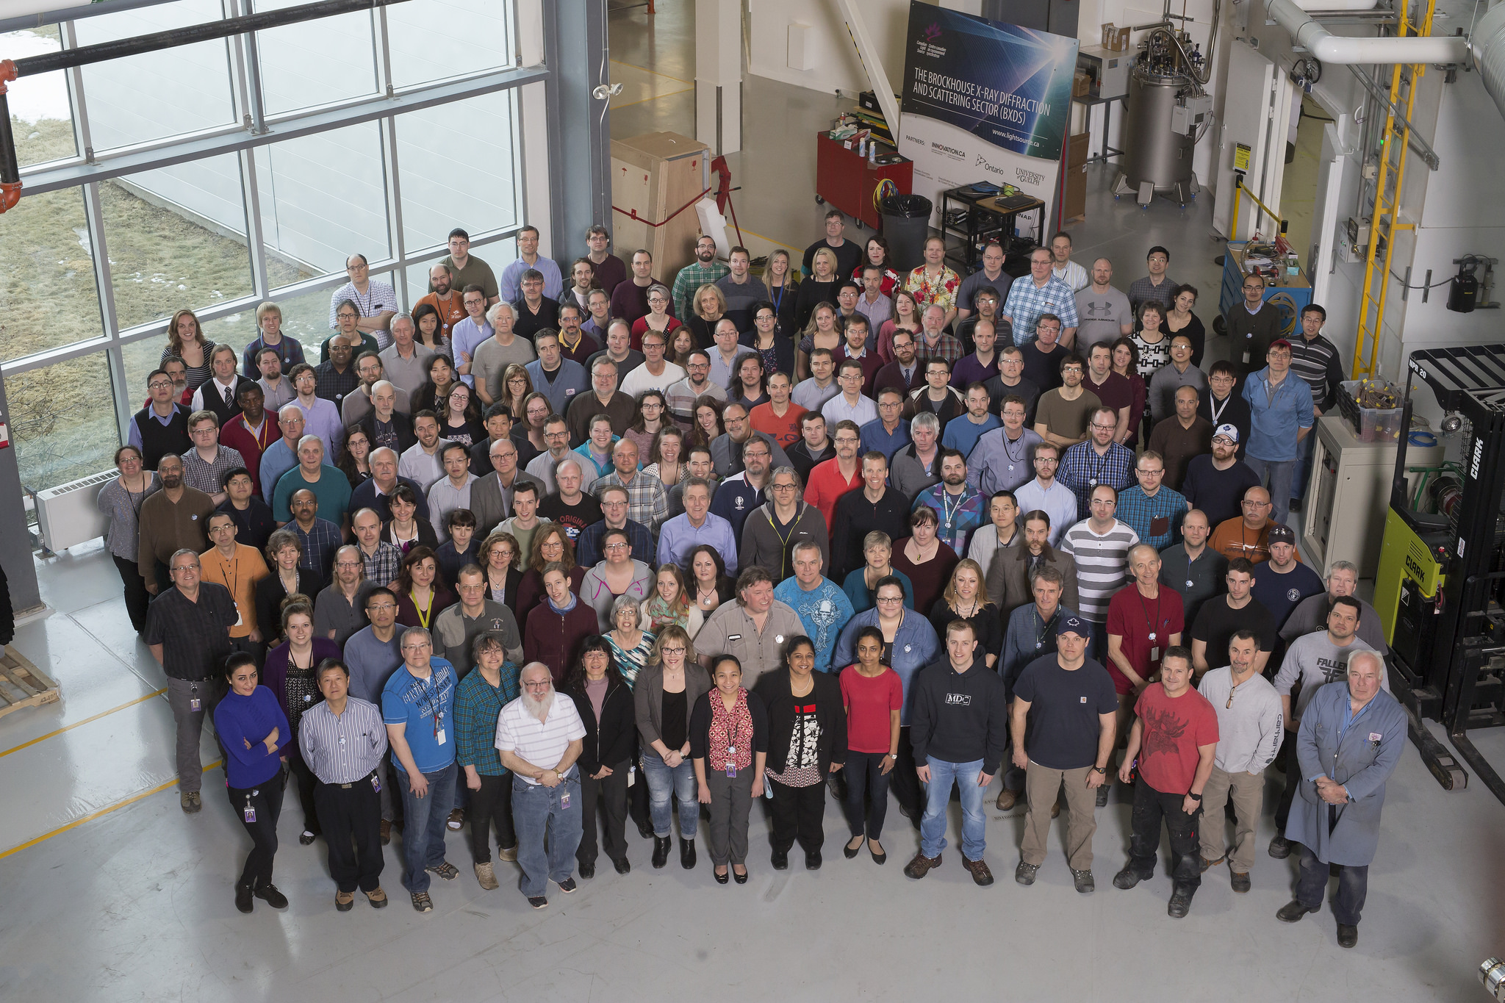
Thank you! Questions?

