Slide 1
Jefferson Lab High Power Beam Dump Refurbishment
David Hamlette, RRPT RadCon Field Operations Manager

Slide 2
Welcome to Jefferson Lab
Managed and operated for the DOE by the Jefferson Science Associates, LLC (JSA)
Continuous Electron Beam Accelerator Facility (CEBAF)
2 superconducting RF linacs, 2 arcs with four experimental halls
Low Energy Recirculation Facility (LERF)
120 MeV energy-recovery linac

Slide 3
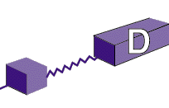
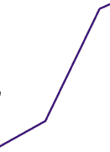
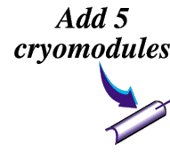
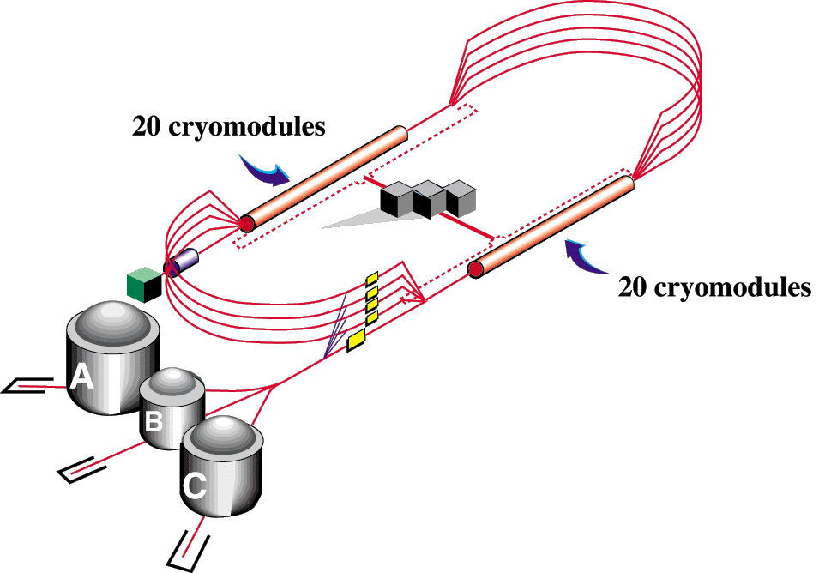
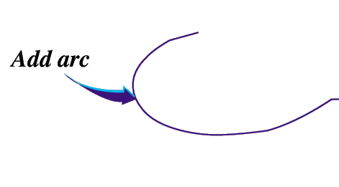
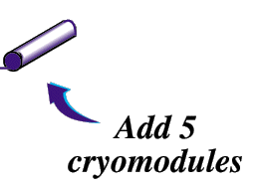
Jefferson Lab Layout
Upgrade magnets and power supplies
12
11
6 GeV CEBAF
CHL-2
Two 0.6 GeV linacs
1.1
Enhanced capabilities
in existing Halls
Lower pass beam energies
still available
Notes:
For years we supported physics experiments by providing 6GeV accelerator operations at various currents. In 2012 we began a roughly 2 year energy upgrade. Roughly 7/8 of a mile, at that time, the CEBAF linacs housed 20 cryomodules each, capable of 0.6GeV per pass. We added 5 C100 cryomodules to each linac. Upgraded 100’s of magnets, and increased our cryogenics capacity by adding CHL-2( central helium liquefier building). At the same time ground was broke for Hall D, which actually consists of two buildings; Hall Tagger and Hall D proper). Those additions enable us to deliver 11GeV beam to the high power experimental halls A & C, which were designed to take the full design power of 1MW. The dump refirb applies to these halls. To increase beam energy to 12 Gev and transport beam to Hall D an additional arc and transport line were added.
I am not sure how many how many of you have visited our campus, or how many were signed up to take the tour, so I wanted to give you a VERY brief virtual tour…
When going through this, use it to introduce power levels available to each hall – A and C can take the full design power of 1 MW (operations limit of 0.9). Dump refirb applies to these two halls.

Slide 4
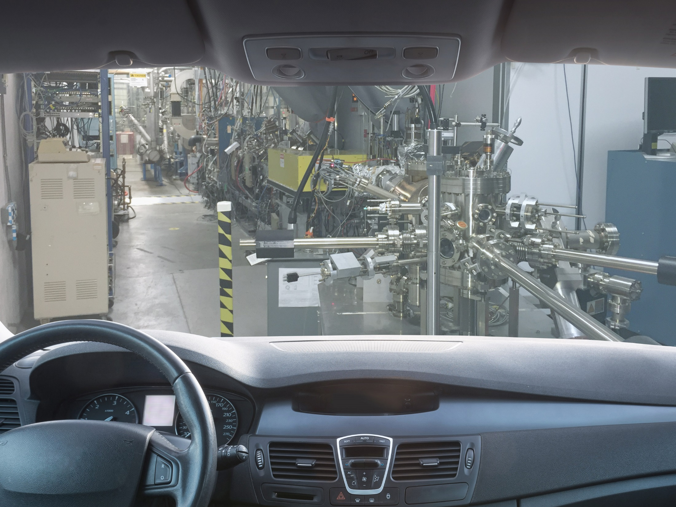
Notes:
Our first stop is the Injector. What you are looking at here is our polarized electron gun. Recent modifications, to include a 4-laser system, gives us the ability to delivery beam to all four halls simultaneously.

Slide 5
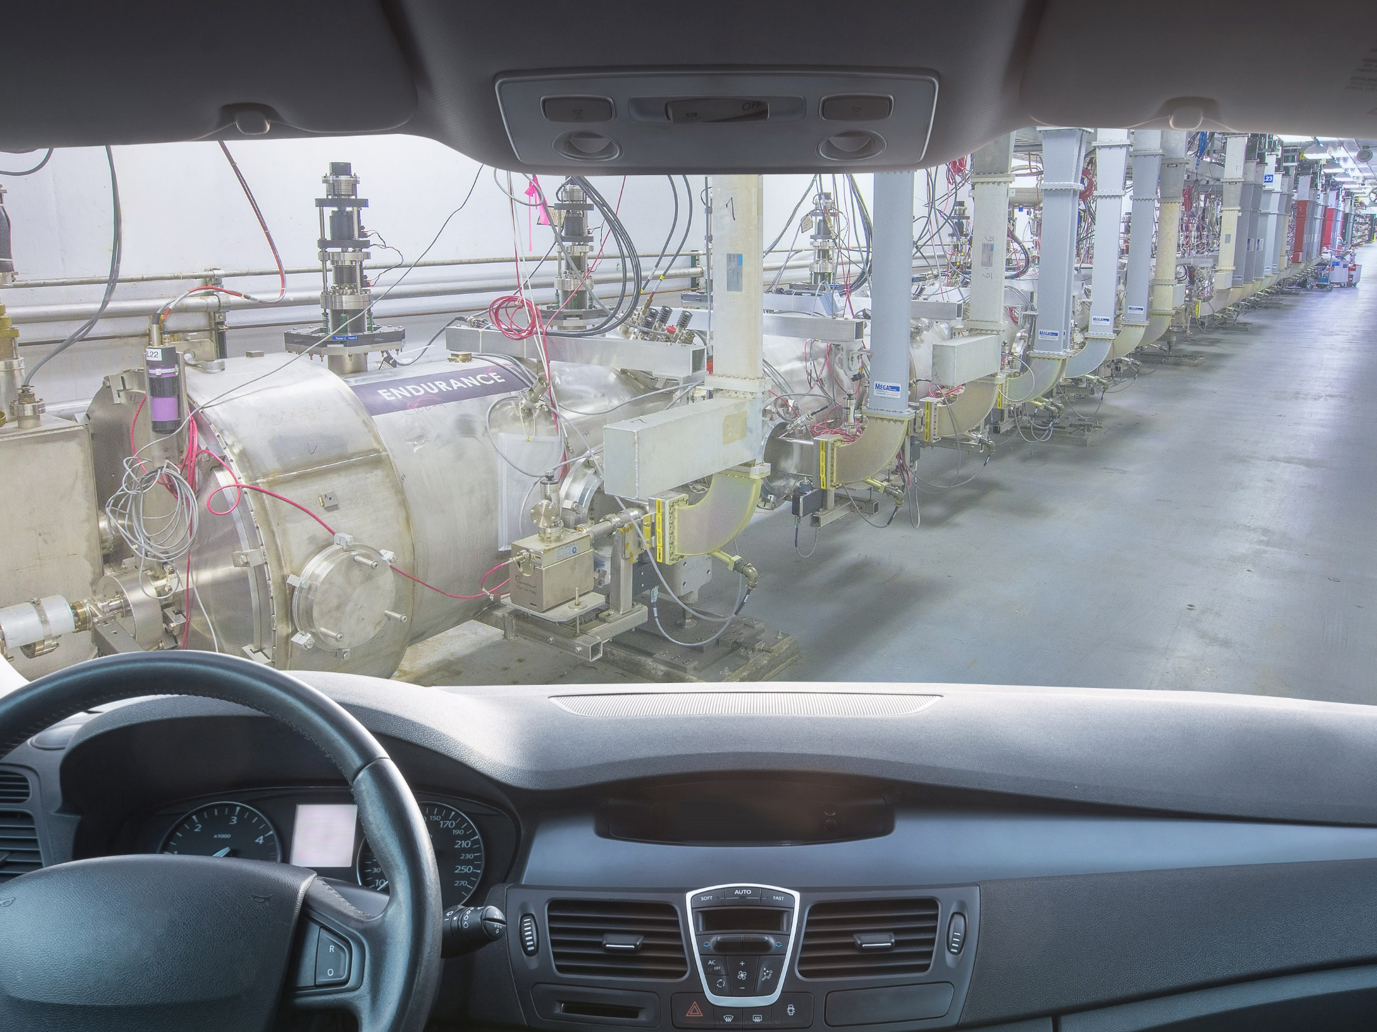

Slide 6
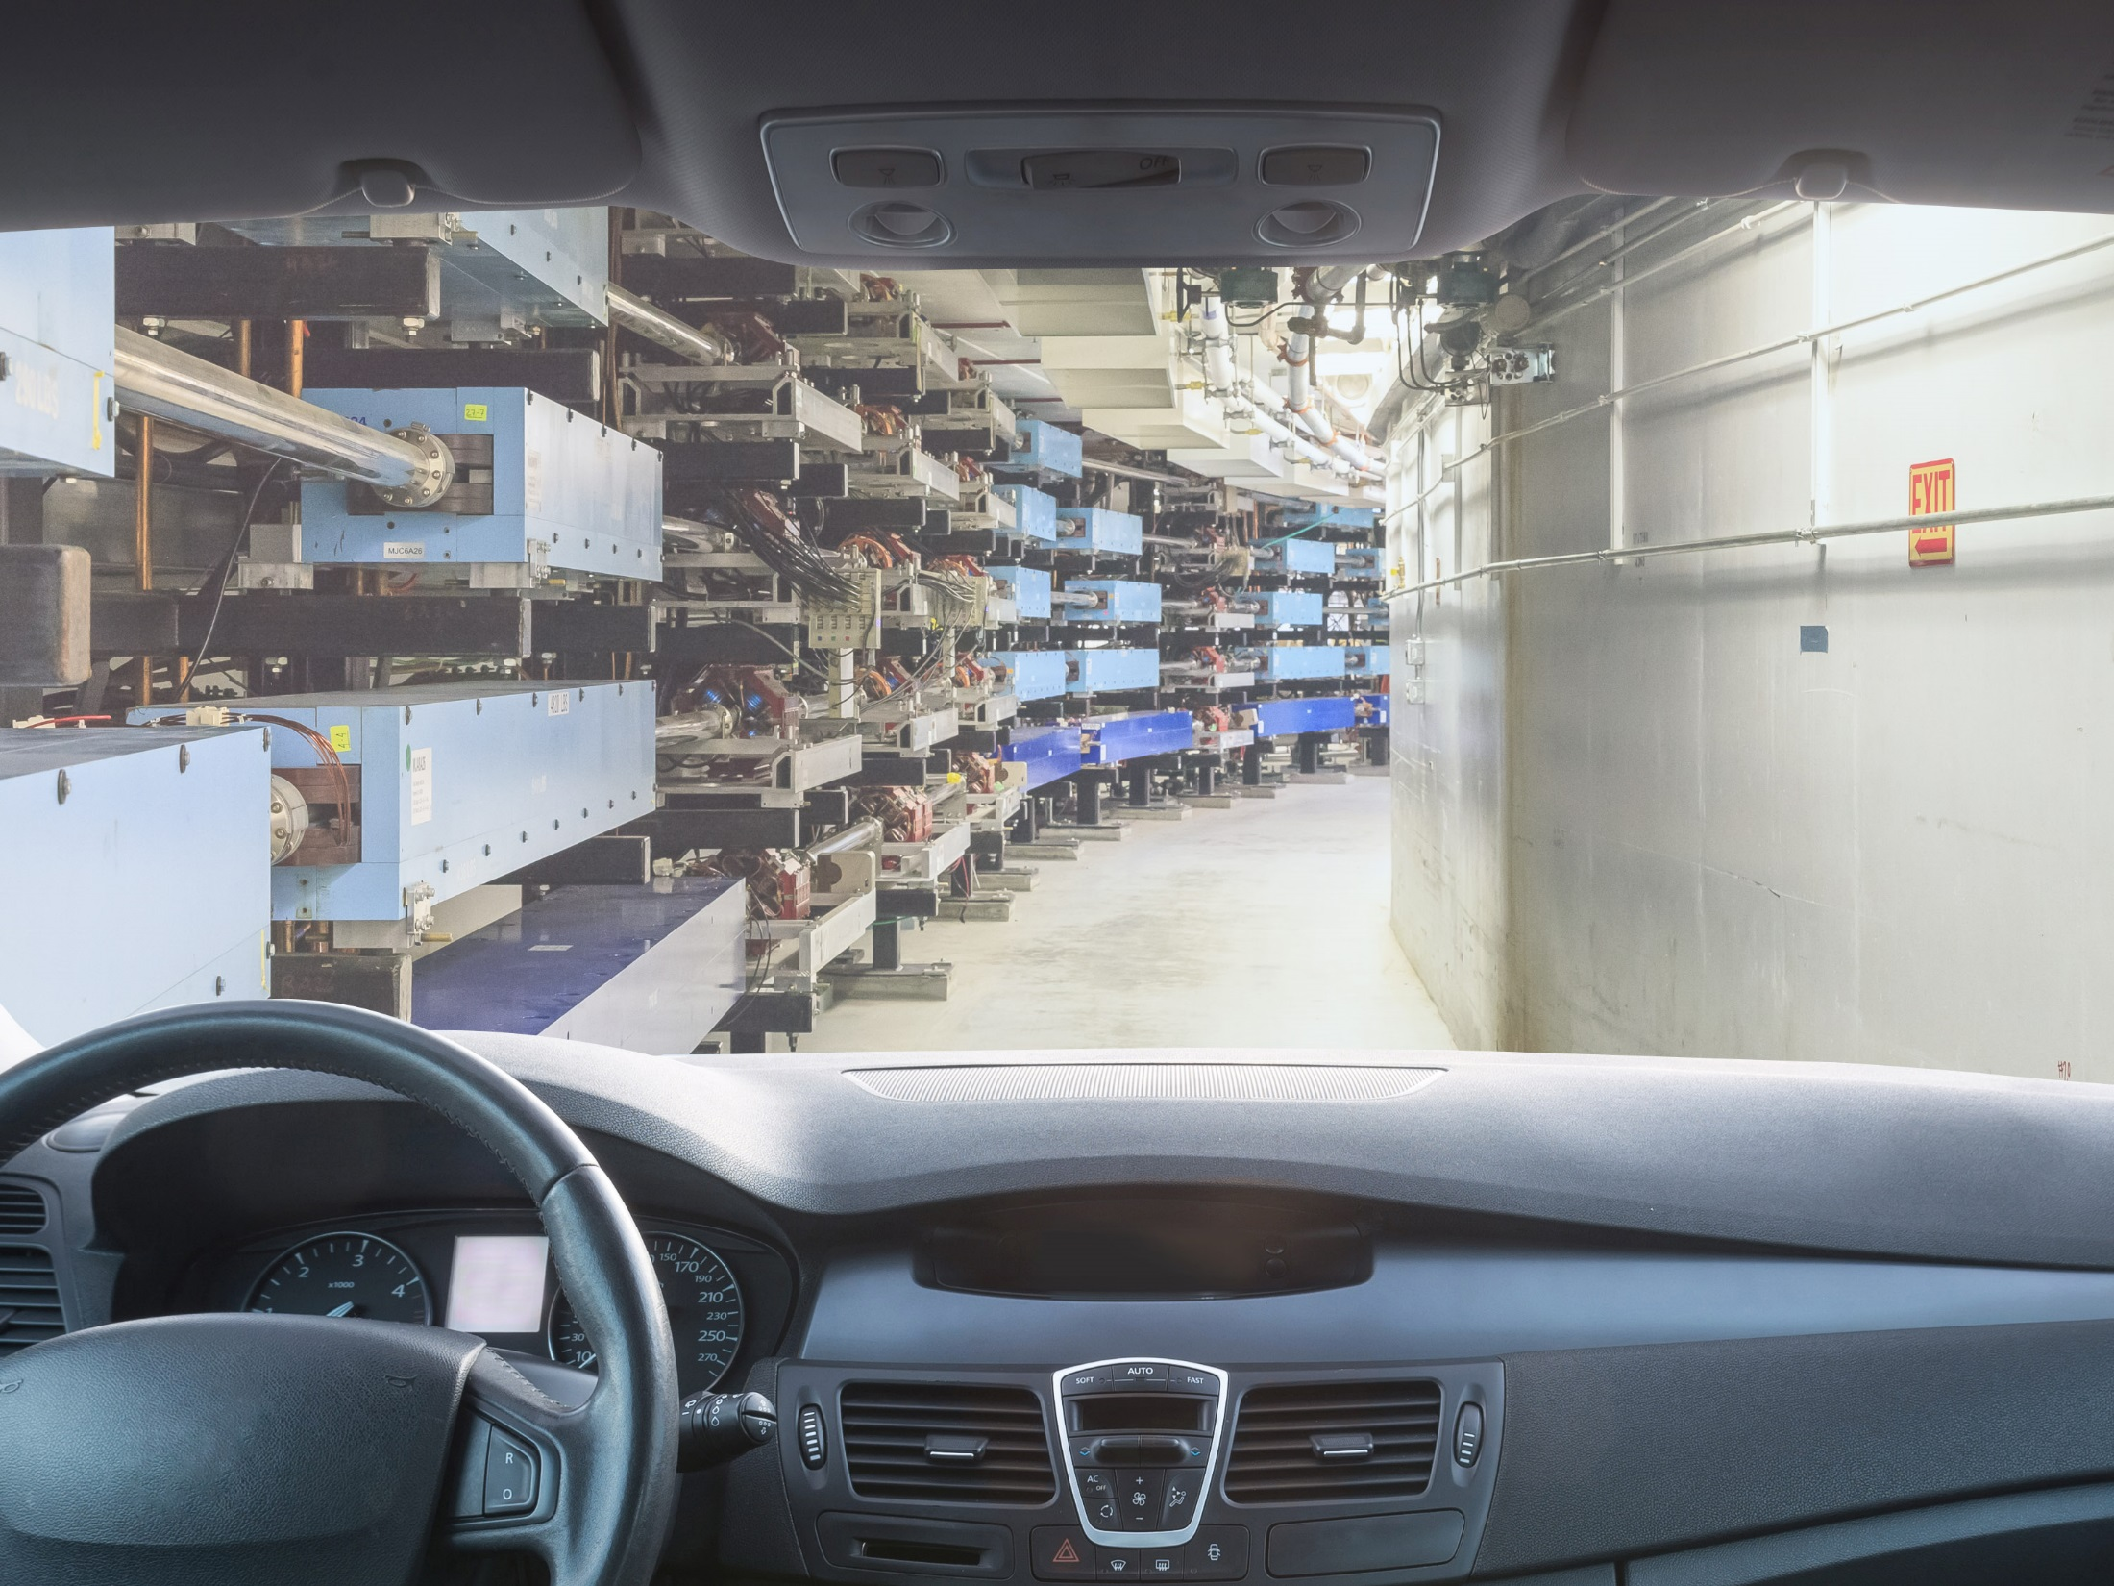

Slide 7
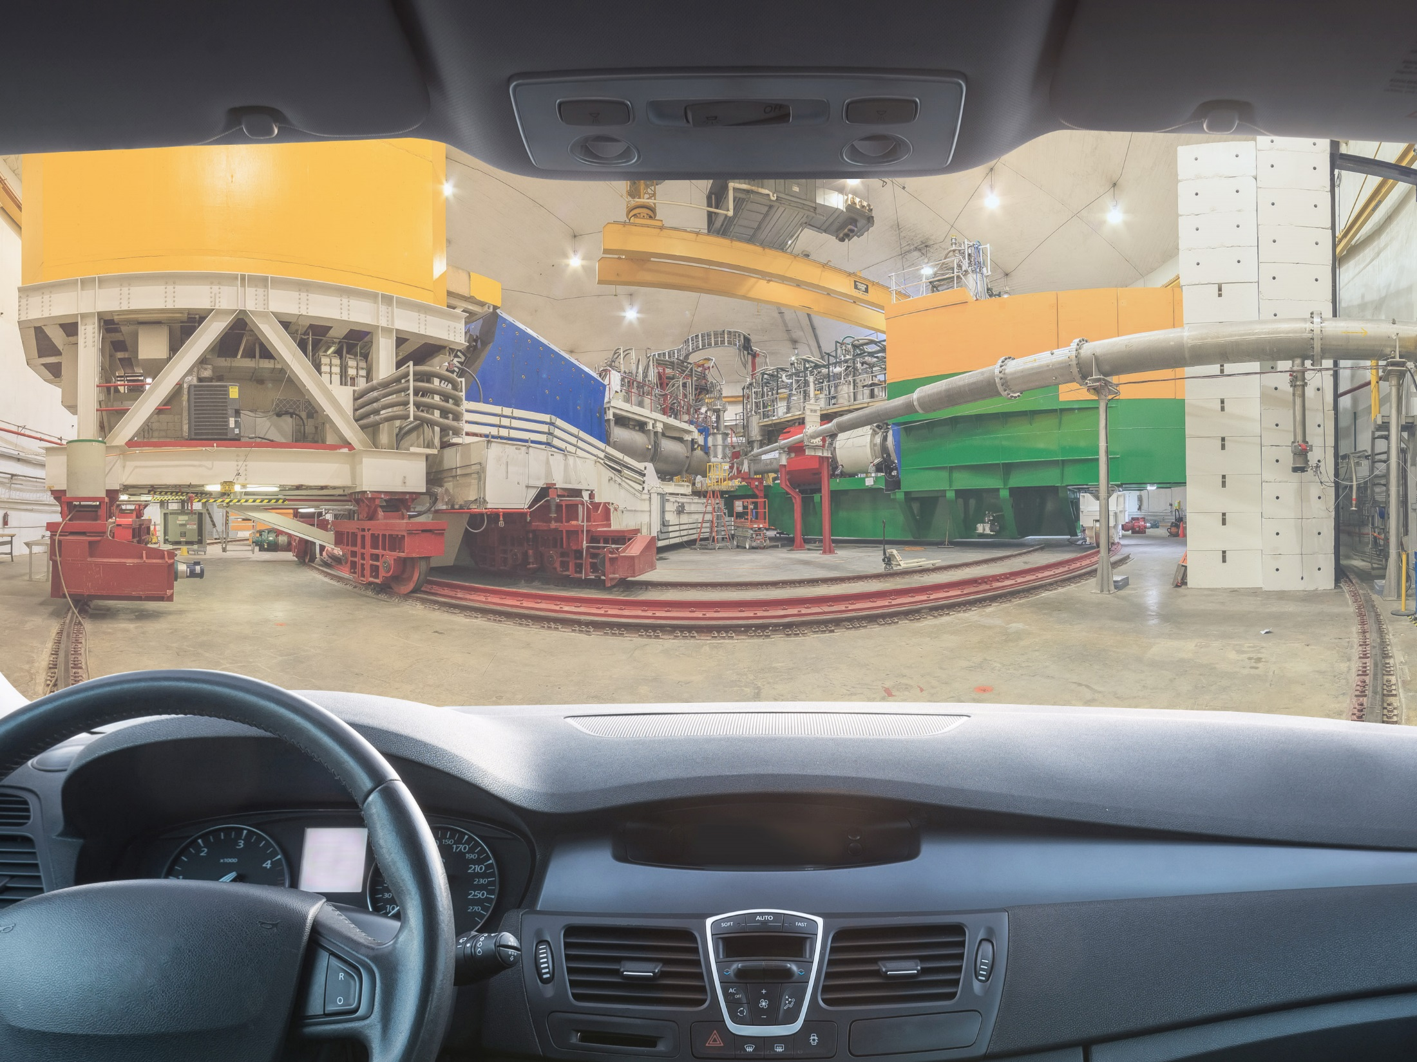

Slide 8
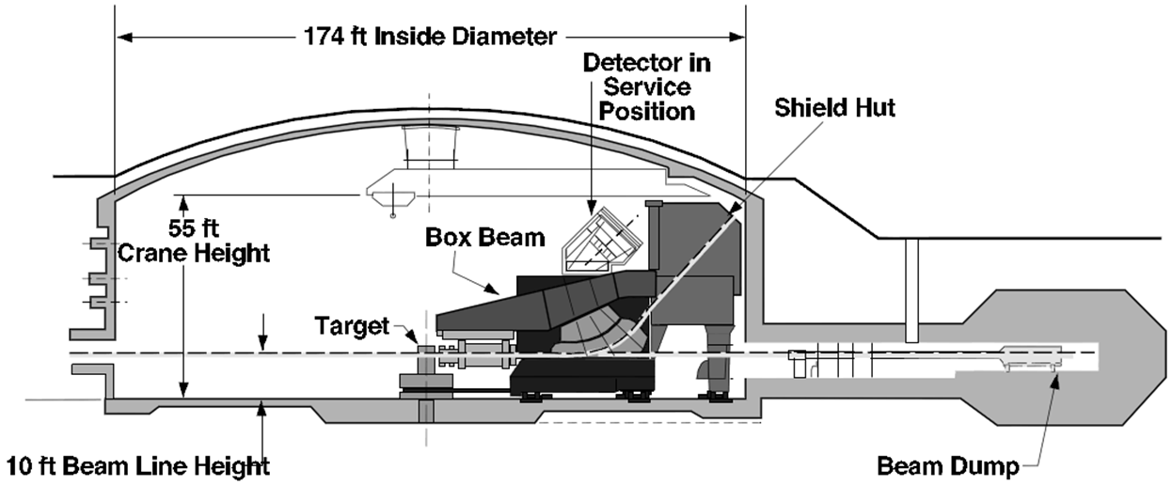
High Power Dump Overview
Vac Line
Helium Beamline
Dump

Slide 9
High Power Dump Parameters
Although engineering design assessment showed the existing Al water-cooled dump design was satisfactory for ~11 GeV beam delivered to halls A and C – provided power density design limits are not exceeded – after 15+ years of operation high power dump systems needed refurbishment and upgrade.

Slide 10
Dump Upgrade Project Scope
The $1.5M project focused on the following:
Inspection
NDT dump window and piping
Assessment of diagnostic hardware
Upgrade beam transport hardware
Replace helium tubes and upgrade helium blanket system
Vacuum-to-helium interface modification
Upgrade dump protection hardware
Beam diffuser redesign for higher energy
Ion chambers – CERN design, retrievable from outside
Replace dump cave air treatment systems with dry nitrogen inerting systems
N₂ generator(s)
Improved atmospheric isolation (wall integrity)
Add diagnostics (flow, humidity, etc.)
Upgrade beam transport diagnostics
Viewer system with tune and CW operation capability
Upgrade camera mechanical mounting and shielding package

Slide 11
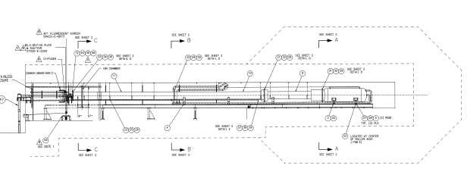
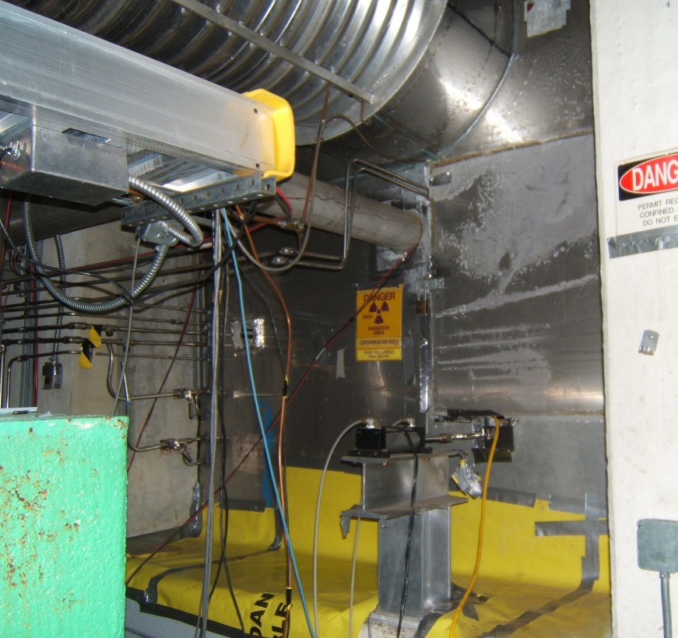
Post run conditions
300 mR/h dump proper-whole body dose rates (w/ 3R/h near dump)
Contamination ~5k dpm/100cm² general area, up to 100k dpm/100cm² (localized)
Permit required confined space

Slide 12
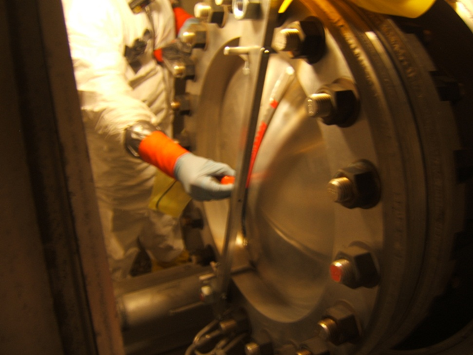
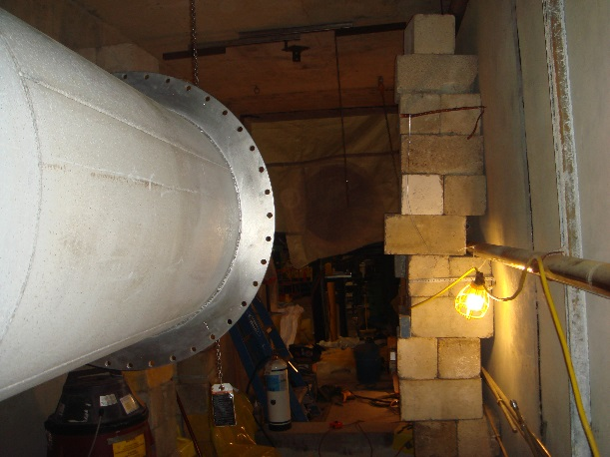
Hall A Upgrade Phases
Ultrasonic testing (UT)
Well coordinated with subcontractor
Mock-up using spare dump
Demo of hardware
Remove beam diffuser, burn-thru detector, windows
Remove old ion chambers and associated cabling
Decontamination
Machining of existing equipment
Installation of new hardware

Slide 13
Hall A
Year | Work phase | Estimated col. Dose (person-mrem) | Dose received (person-mrem)
2013 | Survey/disassembly/Inspect | 250 | 85
 | NDT | 2227 | 367
 | Totals for 2013 | 2477 | 452
2014 | Reassemble beamline(for short run) | 1137 | 673
 | Demo/Weld/leak test/Install new components and diag hardware | 3875 | 2825
 | Total | 7489 | 3950
Radwaste – 7548lbs (mostly metal)
Highest dose rates on waste 1700 mR/h contact; 100 mR/h @ 1 ft

Slide 14
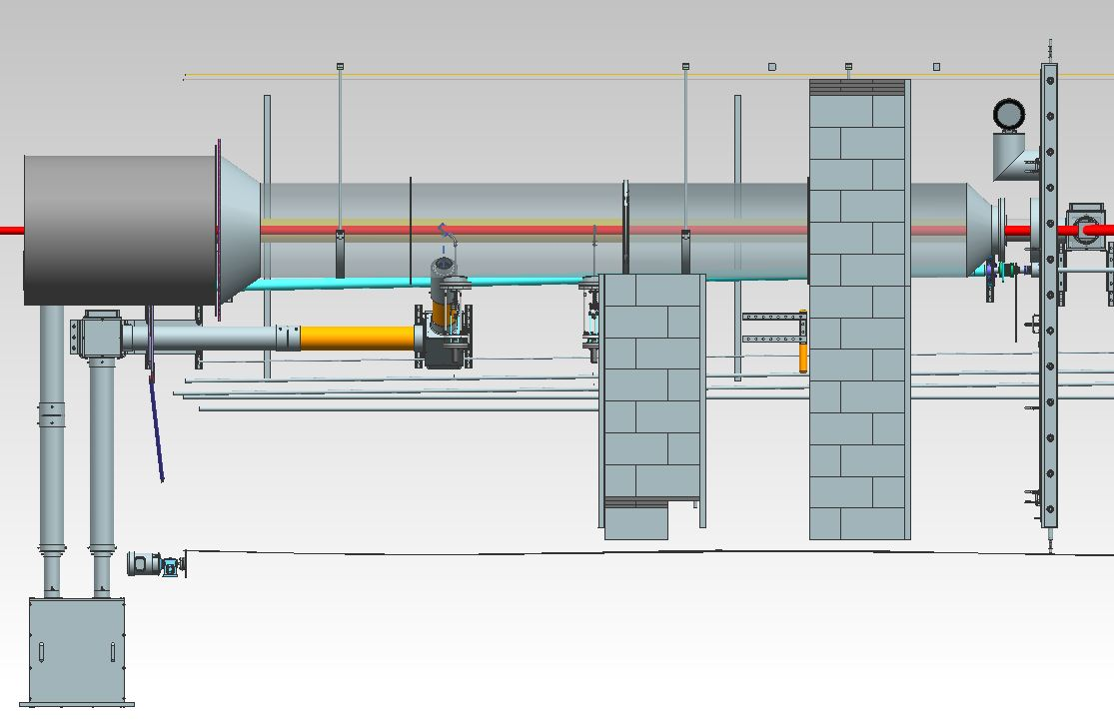
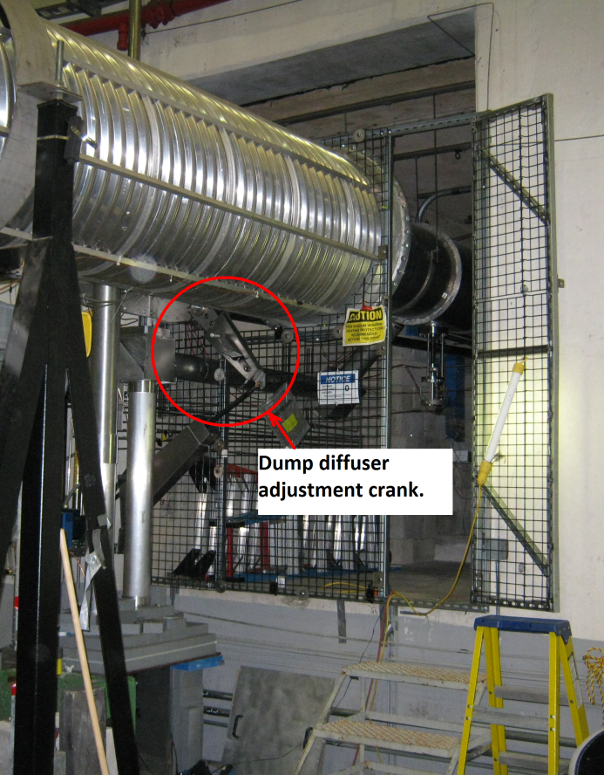
Hall A (final Configuration)
Vacuum Tube w/ internal Aperture Plate-water cooled
Vacuum Window – water
cooled
Ion Chamber
High Power Viewer
Existing Corrugated
Tube
Tune-Mode Viewer
Calibration Mechanism
Isolation
Wall
Dual Camera Box

Slide 15
Hall A “Challenges”
Although well briefed and planned between work groups, and was a great success; still some disconnects…
Legacy drawing issues
Work spaces proved to be challenging (tight)
Decontamination hitches
Unexpected material handling issues (leading to re-weld)
Steep learning curve (working in HRA/CA not routine)
Work planning
Minor non-compliance (breach of radiological area)
* These challenges addressed as “Lessons Learned” for Hall C project

Slide 16
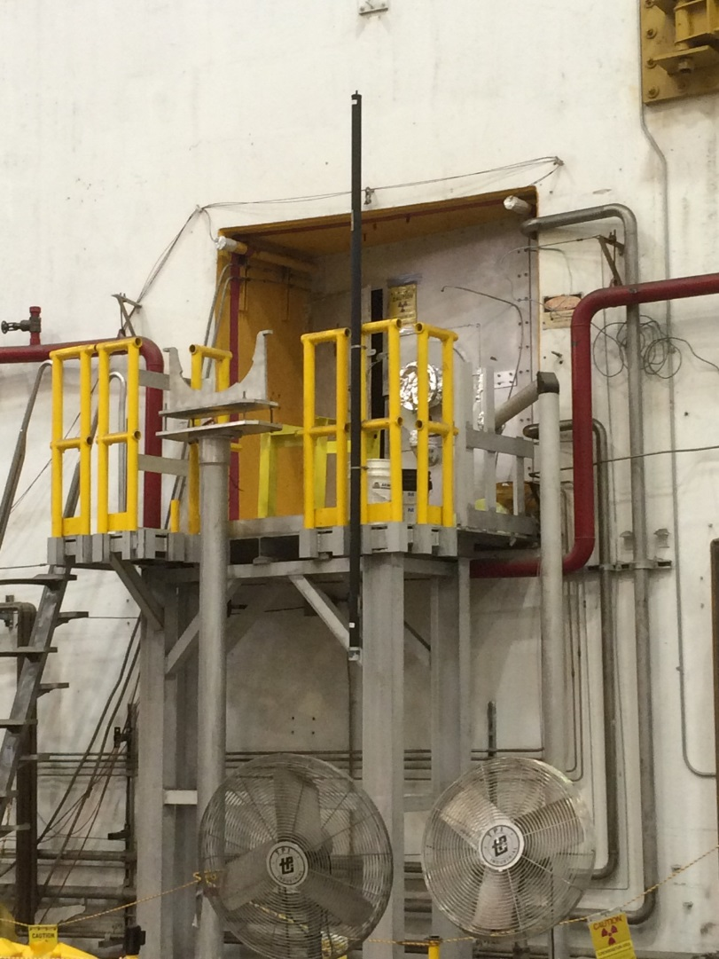
Hall C
Post run conditions
Whole body dose rates 1.1 R/h (5x Hall A), req’d physical access controls (contact max 11 R/h six months after shutdown )
Contamination 100k dpm/100cm²
general area
Permit required confined space
Elevated platform
Compact work space (7’x7’)

Slide 17
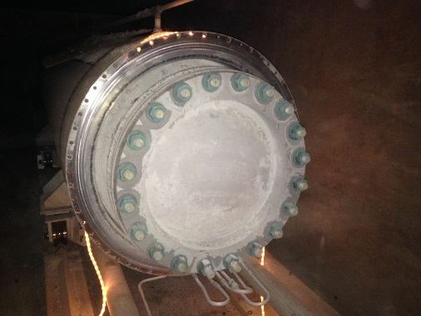
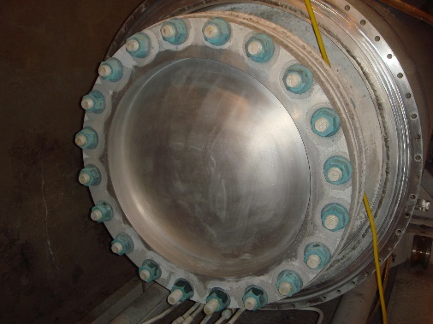
Hall C Upgrade Phases
Identical to Hall A with the exception of overall beam layout…
UT inspection
Demo of hardware
Decontamination attempts
Installation of new hardware

Slide 18
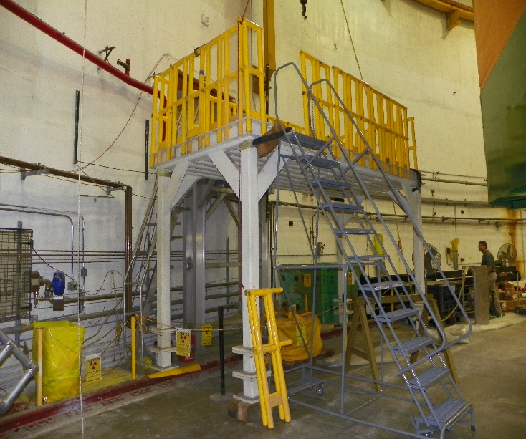
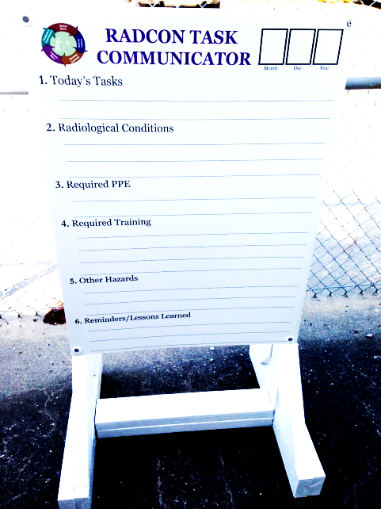
Hall A “LL” Implemented
Legacy drawings → Design review w/visual inspection
Work spaces → Installed work platform
Material handling issues → Jib cranes, intermodal in hall
Decontamination → DeconGel
Work planning → RadCon Task communicator

Slide 19
DeconGel
Hydrogel polymer
Apply-dry-peel
Encapsulates and binds to prevent spreading
Non-hazardous; OSHA /RCRA
Meets environmental and regulatory requirements
~ 100 ft
1
3
2
1 - Blue shaded area to be cut up and removed
2 - Orange areas are labyrinth shield walls (8x8x16 concrete blocks to be removed and disposed)
3 - Green shaded area of tunnel to be decontaminated if possible

Slide 20
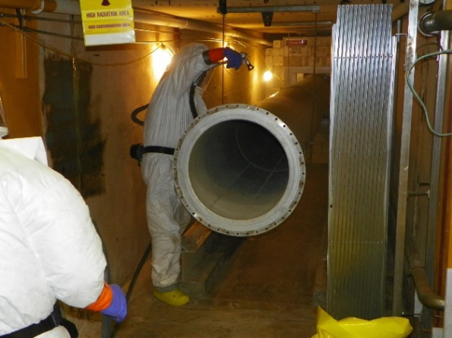
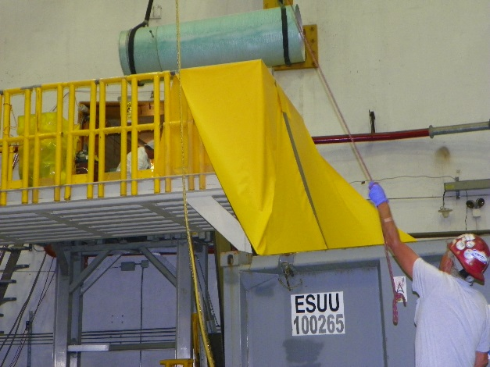
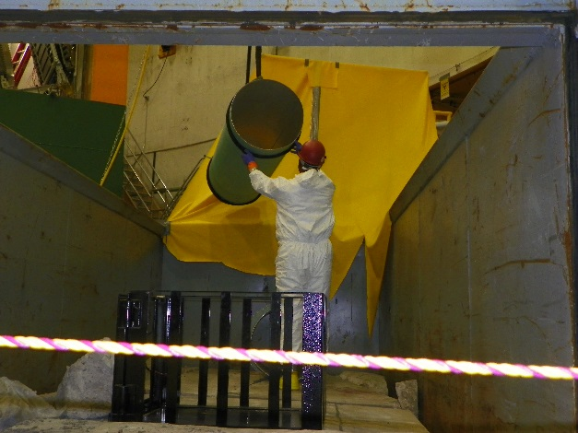
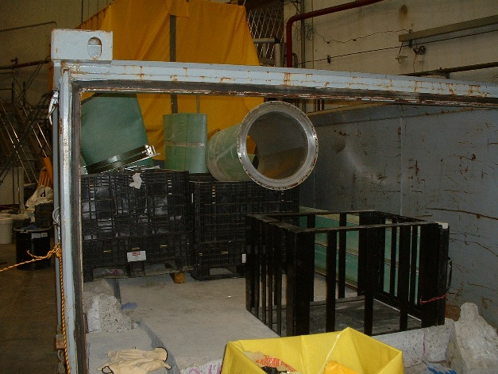
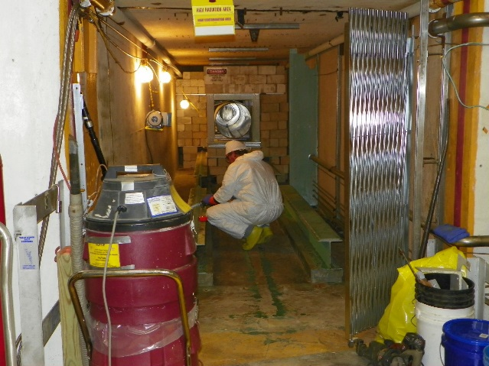
DeconGel (Hardware Removal)

Slide 21
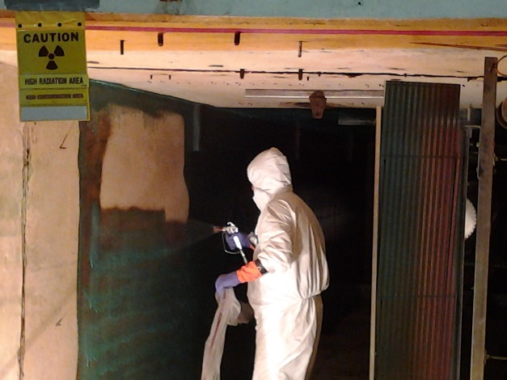
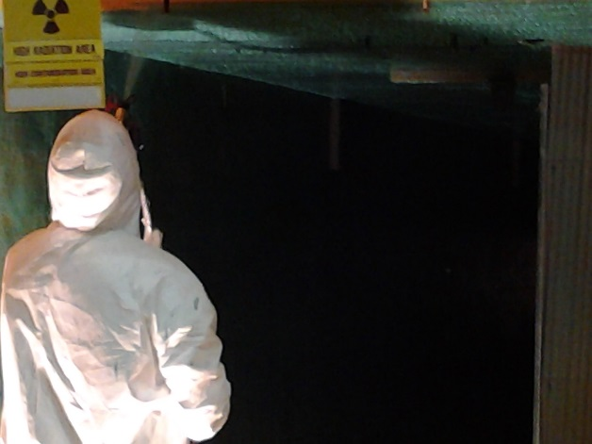
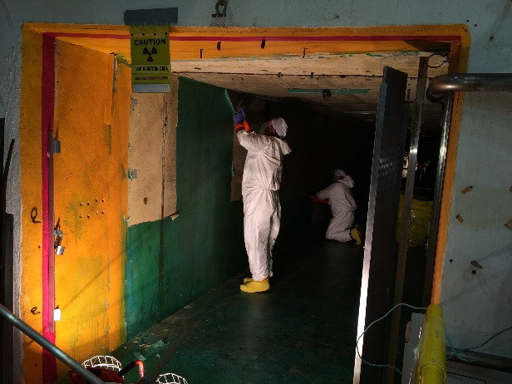
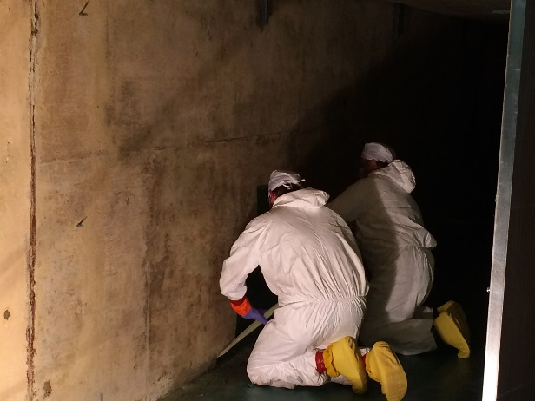
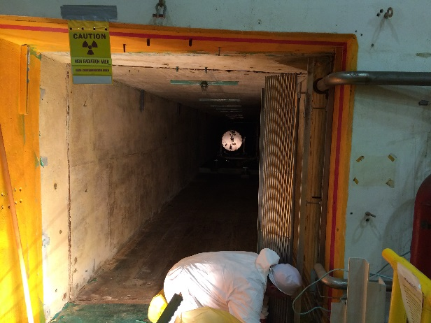
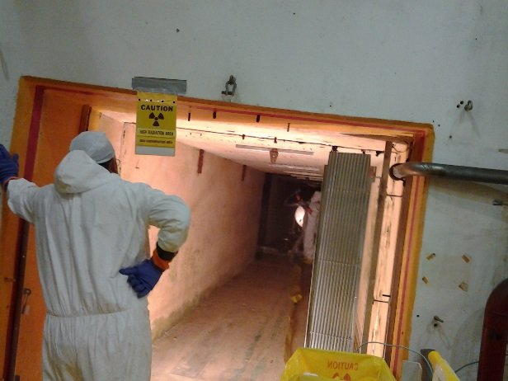
DeconGel (area decon)

Slide 22
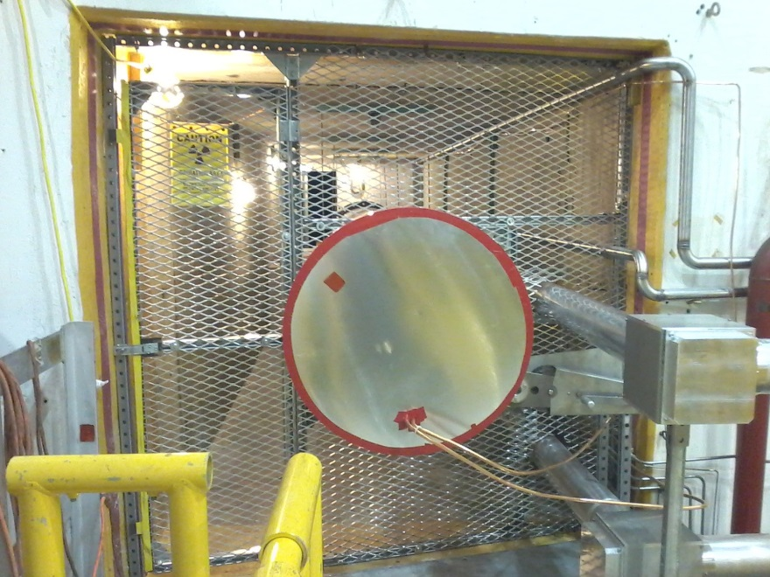
Hall C (final Configuration)
High Power Viewer Transport Line
Tune-Mode Viewer
Ion chambers
Calibration Mechanism
Isolation
Wall
Dual Camera Box
Iso-wall pushed back
Camera/viewer diagnostics
New concrete blocks

Slide 23
Hall C
Year | Work phase | Estimated col. Dose (person-mrem) | Dose received (person-mrem)
2015 | Tear-out, disassembly | 1670 | 841
 | Inspect/test dump, reassemble beamline to be reused | 2945 | 1728
 | Strip/decontaminate tunnel | 468 | 76
 | Totals for 2015 | 5083 | 2645
2016 | Install new components | 642 | 289
 | Grand Total | 5725 | 3034
This represents a significant ALARA achievement, considering the relative radiation levels in the Hall C dump (5 times higher on average than Hall A)
Radwaste – 8740 lbs of metal; ~370 lbs compactables; 19170 lbs concrete blocks; Total 28280 lbs
Highest dose rates on waste 3000 mR/h contact; 300 mR/h @ 1 ft

Slide 24
Hall C “Challenges”
Daily brief w/ Task communicator was very effective, however, there were still areas that created re-work and/or minor delays
Legacy Drawing issues cont’d
Work spaces proved to be challenging (tighter)
DeconGel learning curve
Medical emergency in radiological area

Slide 25
Summary Slide
What created the potential rad impact? Both activation and contamination
How many tons of material are affected? ~30000 lbs steel, aluminum, concrete
Evaluation approach: IFB
What organizations provided assistance? Multi-Divisional effort (Engineering, Industrial Hygiene, Installation, Physics)
What percentages or tonnage were released as scrap, landfill waste, rad waste, reuse? Essentially all materials removed from dump were radwaste

