Slide 1
JLab Phase 4 Final Results
Robert May, ESH&Q Division
Harry Fanning, Accelerator Division Safety Officer
August 16, 2017

Slide 2
Contents
JLab ARRs – Brief Review
ARR Phase 4 Planning
ARR Phase 4 Results
ARR Lessons Learned
Summary

Slide 3
JLab ARRs – Brief Review
Presented ARR results up to ARR Phase 2 of 4 at ASW 2014 at Brookhaven National Lab
Phase 3 Results:
Hall D was given permission for full operations
Internally managed Experiment Readiness Review and other configuration management programs enable safe and effective commissioning and operation of beam lines and experiments at JLab
Team recommends that these processes be used to manage remaining work with report back to ARR Chair

Slide 4
JLab ARRs – Brief Review, cont’d.
ARR Reviewers recognized maturity in JLab programs
Mature Conduct of Operations approach to operations
Mature Experiment Readiness Review process
Mature configuration management process:
Safety related systems
Extended to accelerator systems in an integrated / interdependent model allowing readiness of components, related systems, groups of interrelated systems to be assessed / upgraded / downgraded
Pointed to JLab processes to provide evidence of readiness
Use Internal Team for verification to ARR Chair

Slide 5
ARR Phase 4 Planning
Plan intentionally did not reevaluate program elements successfully reviewed in previous ARRs
ARR Reviewers are presented evidence of program maturity and continuing functionality and relevant to the review
Plan consisted of 14 presentations/walkthrough events over the next two days, 8 of which are in parallel…
ARR Team membership adjusted based on subject matter
ARR Reviewers selected from among the full team
Chair was constant even if Team makeup evolved

Slide 6
ARR Phase 4 Results
“The ARR Team endorses the observation made at the Phase 3 close-out: The ARR Team has determined that rigorous application of the internally managed Experiment Readiness Review … will enable safe and effective commissioning and operation of beam lines and experiments at Jefferson Lab.”
The Team believes JLab internal checkout / approval processes sufficient to ensure safe and effective commissioning and beam operations
The Team recommends JLab management, DOE Site Office designate representatives to verify resolution of recommendations from Experiment Readiness Review processes and report directly to laboratory management

Slide 7
ARR Phase 4 Final Results, cont’d.
Phase 4
At this point - JLab
Delivered beam energy and current required to demonstrate 12 GeV Upgrade Project Key Performance Parameters (KPPs)
All Project KPPs met
Experimental program set to resume this fall
Remaining steps
Formal request to operate Hall B and Hall C

Slide 8
ARR Lessons Learned
Scheduling an ARR (or phases of an ARR) is a balancing act
Schedule nuances and interdependencies prevent all things from being ready simultaneously
Some people or processes or hardware may nor be ready, fully operational, etc.
A more likely scenario is that key systems, processes are ready, some are not
Develop a reliance on mature internal lab processes to bring any incomplete ARR elements to full readiness

Slide 9
ARR Lessons Learned, cont’d.
Cautions regarding reliance on mature internal process
Formality of internal review process and documentation of review results and tracking needs to be compatible with formality of an ARR
If you are going to rely on internal process, then make sure that the conduct of these review and results tracking lend themselves to producing documentation suitable for an ARR
Prevents reconstituting internal review results after the fact to bring them to ARR “quality”

Slide 10
ARR Lessons Learned, cont’d.
Make sure that you have a good group of subject matter experts
Phased reviews may need ARR Team makeup tailored to technical systems, processes for each phase
Selective team makeup can be more efficient with cost and scheduling
The Chair and one or more Team members should be a core team (for continuity - particularly if you have a phased ARR)
Be flexible – three of the last five ARR events I’ve been on were affected by weather extremes

Slide 11
Summary
ARR Team made consistent movement towards internal process to validate closure
Applied the same model several times during phased commissioning activities for the accelerator (Phase 1B) to commissioning of experimental halls (Phase 2) and (Phase 3)
Team consistent movement towards internal reporting process - from reporting back to the ARR Team ultimately to reporting to Lab Management
Final Phase 4 recommendations were a validation of and reliance on the JLab’s mature process for managing operation and conducting experiments

Slide 12
EXTRA Slides

Slide 13
ARR Phase 4 Results
Phase 1B and Phase 4 were both held in snowstorms that resulted in temporary lab shutdown… ARR Team met and completed both reviews under “challenging” circumstances
Flexibility was key to success, planning was the key to flexibility
“In preparing for battle I have always found that plans are useless, but planning is indispensable.”
Dwight D. Eisenhower

Slide 14
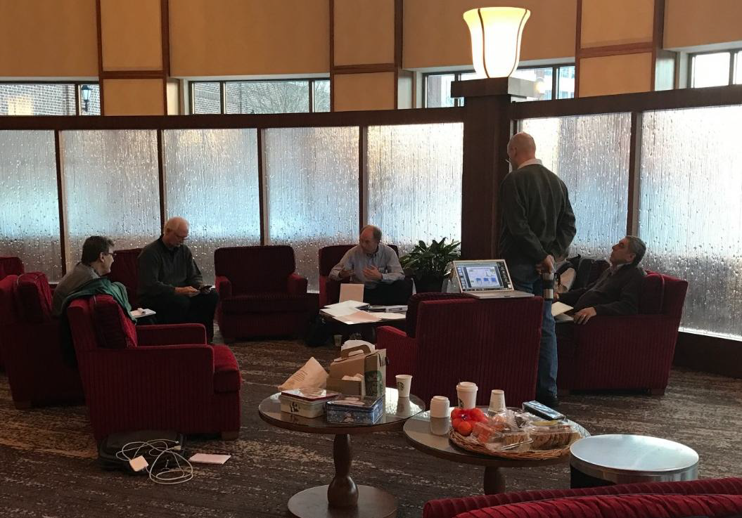
ARR Phase 4 Results, cont’d.
One of two sessions that were held in parallel at the hotel
Monday ARR session in the City Center Marriott Hotel Rotunda
Jefferson Lab was closed due to weather conditions
Reviewers gathered at Marriott Hotel Rotunda as conditions allowed including two parallel sessions

