Slide 1
Software Specification and Software Reuse - BELLA LPA experiment
Patrick Bong
LBNL Interlock SME

Slide 2
Introduction
The BELLA Terra-Watt interlock upgrade
Expanded the number of lasers used in the LPA to a primary beam and a secondary beam
Added a new laser bay
Eliminated the relay based interlock system

Slide 3
BELLA TW Layout

Slide 4
Requirements Document
Requirements Document says WHAT you are going to do
Introduction
Project/Facility overview
Assumptions and dependencies
System Description
Protective boundaries
Protective devices
Warning devices
User interfaces
System Requirements
Protective functions
Administrative functions
Performance requirements
RAMS (reliability, availability, maintainability)
Notes:
This is the top level document to which all others must comply
We assume there’s going to be an accelerator, depending on funding.
The accelerator is housed in a bunker with 2 doors.
Interlock switch detects the position of the door.
Emergency off buttons 2 interior locations.
Warning sign above door with redundant lights.
Warning lights inside enclosure.
Warning annunciator inside enclosure.
Telephone at each door.
The system description does not necessarily need to describe the functionality that the requirements will provide.

Slide 5
Software Specification
The software specification provides the details of HOW the software is going to operate.
The software specification must always conform to the details provided in the Requirements document.
The software specification may be embedded in the requirements document.

Slide 6
Types of Specification
Verbose
Provides a detailed explanation of the interaction between inputs and outputs.
Truth tables
Provides the logic for a single function.
Graphical
Uses logical symbols to describe functions.

Slide 7
Comparison of Types
A good specification uses a combination of the specification types to provide programmer guidance and help manage the software development cycle.
Verbose
Very similar to the description in the requirements document.
Must be extremely detailed to guide software development.
Truth table
Very detailed description of the function, but difficult to follow and understand the complete impact to the overall logic.
Software can be derived directly from tables.
Graphical specification
Better representation of the overall logic.
Logic may need to be parsed during software development.

Slide 8
Verbose
Search and Clear
Search and clear must be started from the HMI and completed sequentially by turning the key switch at each search and clear station. When the key is turned at the first search and clear station, Access Control must be disabled preventing access to the exclusion zone while the search is in progress.
The search and clear will be limited to a 3 minute time period, after which the circuit will reset requiring the search process to be re-started from the HMI.
The search and clear process is completed by turning the High‑Energy Mode Key Selector to High-E Mode.

Slide 9
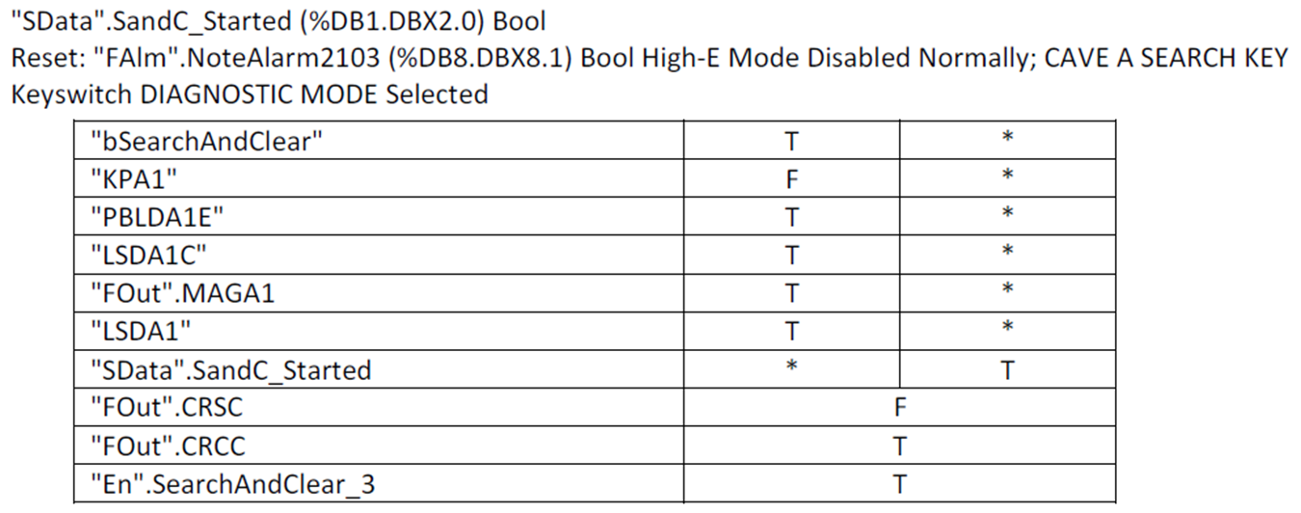
Truth Tables

Slide 11
Graphical Specification

Slide 12
Code Reuse
Code reuse can be identified in the requirement or specification when identical patterns of logic appear

Slide 13
Different Methods
Design Pattern
A segment of code that’s copied and the variables are changed.
Or a functional block is copied and the internal variables are modified.
Function reuse
The block only contains logic and the variables are assigned externally.

Slide 14
Design Pattern Reuse

Slide 15
Functional Block
Code inside function block
Function block for reuse

Slide 16
Conclusion
The software specification should be written so that the logic can be verified to comply with the system requirements
The language in the specification should not obfuscate the function of the logic
Code can be grouped into functional blocks and reused inside the project when recurring design patterns are recognized
New projects can use functional blocks from old project when design patterns are similar

