Slide 1

A view of APS ACIS from a Functional safety Assessors perspective
erhtjhtyhy
Joe Lenner
Safety Systems Engineer
Safety Interlocks Group
Advanced Photon Source

Slide 2
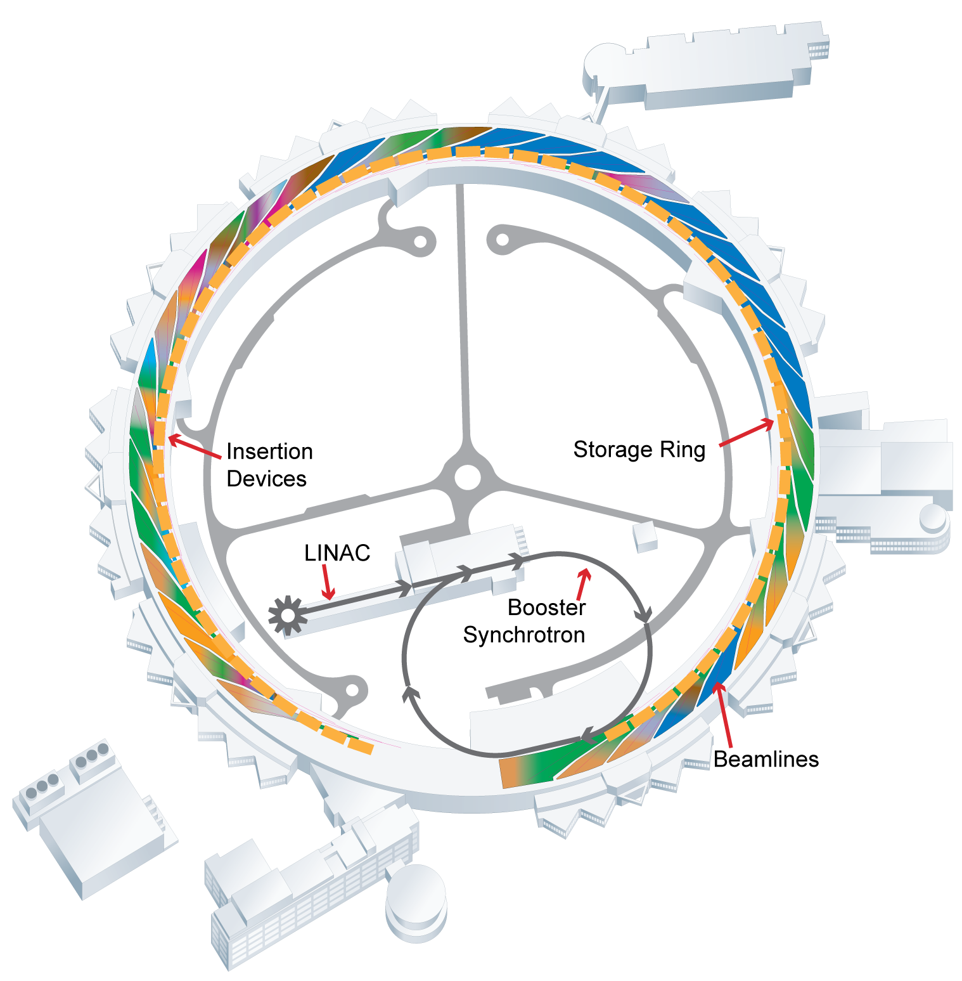
A little about me
My background
  Over 25 years of industrial control experience
    Machine design
    Control design
    Industrial communications systems
    Last 11 years – Functional Safety
      Safety communication protocols
      Safety products
  5 years auditing functional safety systems
    Wide variety of products and systems
  6 months with APS
    First task was to evaluate original ACIS and the upgraded Linac Extension Area (LEA) ACIS from a IEC Functional Safety standards perspective
LEA

Slide 3
Starting points
Examined the original ACIS designs
  Implemented since APS was started (1992)
  Designed before the first functional safety standards released on a international level
The focus of the examination is on IEC 61508
  Safety Integrity Level (SIL) identifies the level of risk reduction
  Focuses on:
    Control of random faults
    Control and avoidance of common cause faults
    Avoidance of systematic faults
  This standard provides a basis for analyzing systems.
  The examination used this standard as if I was doing a TUV assessment for certification
Also looking at upgrade of LEA ACIS to newest safety control system
  Recent design
  Captures a great deal of the IEC 61508 requirements

Slide 4
ACIS from a Standards Perspective
Very strong safety program is in place
  Hazards defined and analyzed
  Solid safety designs, dual channel architectures dominate
  Designs reviewed
  Comprehensive testing before putting into operation.
    Both hardware and software
  Periodic proof/validation testing
There are some areas that would need to be addressed …
  The suggestions are very typical of a system designed prior to the functional safety standards coming into broad use
  The upgraded LEA ACIS design addresses a great deal of these observations

Slide 5
Identify the safety functions
Clearly identify the level of risk reduction needed.
  Drives architecture selection
  Drives component selection
Understanding the level of risk reduction allows for better allocation to different sub-systems
LEA ACIS design specification clearly identifies safety function and design goal
  SIL identified
Input
Sub-system
Logic
Sub-system
Output
Sub-system

Slide 6
Address the requirements
Requirements tracking should be implemented.
  Original ACIS specifications tend to be narrative in nature
    Requirements can be hard to identify
    Parent/child requirements are even harder to determine.
  Track the requirements and tests
    Did we test all?
      Is our coverage sufficient
      Both hardware and software
    Did we test certain requirements several times?
      Over testing – get the resource back to a productive task!
  LEA ACIS tracks safety requirements – original ACIS does not
    from design specification
    to software implementation
    to validation plan

Slide 7
Extending the analysis of the safety function
Analysis of the safety function often limited to the control system
  Partially comes from the scope of the standard.
In reality the output element that removes the hazard needs to be part of the analysis
  At least the analysis needs to consider further integration to allow for reliability margins for upstream and/or down stream elements
Safety Function
Input
Sub-system
Logic
Sub-system
Output
Sub-system
35%
15%
50%

Slide 8
Safety functions and reliability
The risk reduction of a safety function is based on the reliability and the ability to control random faults
Terminology:
  PFD – Probability of Failure on Demand
  PFH – Probability of Failure per Hour
Functional safety standards define levels of risk reduction based on reliability
  Roughly an order of magnitude reduction for each Safety Integrity Level (SIL) in IEC 61508
  SIL 1-4 (from least to greatest reduction), SIL 2 is about equivalent to driving to work in the morning.
The reliability information in 61508 was developed with a large input from industry reliability engineers.

Slide 9
Fully address the reliability
We need to be consistent by doing the reliably calculations for all safety functions - find the PFD/PFH
  Do we get the level of risk reduction needed?
  Do we get the reliability we need in the time frame needed?
    Keep the components in a predictable failure mode
    Schedule maintenance and replacement
Benefits both the safety and the operational performance.
  If the system is more reliable there is less pressure to find work arounds
Plan for component life and for component wear.
  The equations for SIL estimation can be used to develop maintenance plans

Slide 10
Tying it all together
APS does very well at providing a safe system
  Limiting single points of failure
  Multiple paths that lead to a safe state
Since the original design, and implementation of the original ACIS the external standards have been improved.
  Track the requirements
    Ensure that the safety functions and their child requirements are fully tested
    Eliminate over/under testing
  Reliability is a fundamental part of the functional safety standards now.
    Does not just benefit safety, improves operations by fewer faults in the safety systems during operations!
Account for all the components in the safety function
  The component that initiates the function to the component that removes the hazard
    The final element may be mechanical, and out side of the control system!

Slide 11
Questions?

Slide 12
Backup

Slide 13
Example of safety function
Enclosure with entry gate
  Gate to provide entry
  Fencing provides protection around cell
Hazard
  Dangerous motion via some kind of motor in enclosure
Risk assessment
  Examination of exposure, ability to avoid hazard and consequence lead to a decision that the risk must be reduced.
  SIL 3 is selected as the appropriate level of risk reduction.
Safety function:
  If gate is open motion shall be inhibited
  SIL 3 is required for active controls
Notes:
The process of developing safety functions starts from the hazard identification/risk assessment. In a step wise fashion the following steps should happen:
Identify the hazards
Quantify the risk associated with the hazard
Safety functions identified for hazard/risk
Reduce the risk by applying constructive measures (guards, process change, …)
Re-quantify the risk to see if it is reduced sufficiently
Apply active controls (safety related control systems)
Re-quantify the risk to see if it is reduced sufficiently
Apply administrative controls (signage, PPE, …)
Re-quantify the risk to see if it is reduced sufficiently
This process is repeated for each safety function
In this example the safety function is simple, stop motion if gate is open.

Slide 14
Proposed controls design
From risk analysis:
SIL 3
Two channel monitoring of safety gate
Q1 & Q2 are switched off, when
  B1 not actuated
  B2 actuated
B1
CCF
L
Q1
CCF
B2
Q2
PFH_{D_Pos} =
SIL CL_{Pos} =
PFH_{D_Logic} =
SIL CL_{Logic} =
PFH_{D_Con} =
SIL CL_{Con} =
See notes view for additional explanation on the following slides
Notes:
48
48
Once the safety function is identified and a need for a control based solution is identified, the system can be proposed.
In this case we have identified a SIL reduction in risk, so the most likely way that this can be achieve is using a redundancy where appropriate. A safety related controller is used as the logic element making that part of the design simpler.
When redundancy is used, it is important to consider the common cause contribution. This will be discussed in later slides.

Slide 15
Device Information
Logic Unit:
from Manufacturer SIL CL 3, PFH_{D} = 1.2 x 10⁻⁸
Position Switch:
from Manufacturer SIL CL 3 when used with
HFT = 1, λ _{D} = 1.4 x 10⁻⁸ (C = 1/h)
Contactor: EN ISO 13849-1 (Tab. C.1) B_{10d} = 2,000,000
Application specific: 1 demand per hour (opening of safety gate): C = 1/h
Notes:
48
48
Basic information needed to continue the analysis. These numbers are either made up or derived from a standard for the purposes of the example.

Slide 16
Design of Subsystems
B1
Position switches with direct opening contacts
homogenous redundancy: λ _{D_Pos1} = λ _{D_Pos2} = λ _{D_Pos}
DC₁ = DC₂ = DC_{Pos}
CCF
B2
Q1
Contactors K3 und K4: similar contactors,
homogenous redundancy : λ_{K3} = λ_{K4} = λ_{contactor}
DC₁ = DC₂ = DC_{contactor}
CCF
Q2
Subsystem architecture D from IEC 62061 (homogenous redundancy with diagnosis):
T_{D} = 1/C = 1h
T = 20 years
Notes:
48
48
The equations from IEC 62061 will be used, they are a machinery specific version of the more general equations in IEC 61508, but will lead to a valid analysis the is complaint to either IEC 61508 or IEC 62061 from a quantitative viewpoint.
The equation considers the dangerous faults of the subsystem, testing times, overall lifetime and the common cause.
The common case is factored in by the beta factor in the equation. This is factor is determined by an analysis of the design and organizational controls effecting the resistance to common cause errors. For the example 5% is used. In practice this is a function of the organizational capabilities.

Slide 17
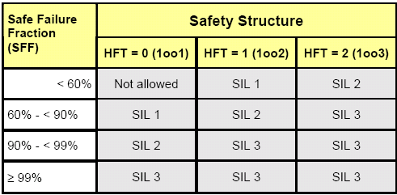
Design of Subsystems
B1
CCF
B2
DC = 99 % (fault detection with the logic unit)
Common Cause Faults CCF: β = 5 %
PFH_{D} = ?
SFF = ?
Proof of the required SFF through
  the applied DC = 99 % and/or
  the statement of SIL CL.
SIL CL 3 means, that the sensor can be used in application up to SIL 3 when used in an HFT = 1 structure, thus complies to SFF requirements.
Notes:
48
48
There are two parts to the quantitative proof of the capability of the safety faction, the PFD and the SFF. The PFD must be in the proper range for the target SIL selected and is repentant on a number of factors, and it represents the probability of a dangerous failure. The SFF is a ratio of safe and dangerous detected failures to all possible failures. The SFF typically drives the architecture of the safety function.

Slide 18
Design of Subsystems
Q1
CCF
Q2
DC = 99 % (Fault detection by monitoring of direct contacts)
Common Cause Failures CCF: β = 5 %
λ_{D} = 0.1 x C / B_{10d}
B_{10d} = 2,000,000
C = 1 / h
λ_{D_Contactor} = 0.1 x (1/ h) / 2,000,000
= 5 x 10⁻⁸ 1/h
For this calculation λ_{S_contactor,} λ_{D_ contactor} and λ _{contactor} is necessary.
Alternative: Estimation via DC..
Notes:
48
48
When the safe and dangerous faults are known the SFF can be determined by the simple formula shown above.
In this case we are only given the dangerous faults. For the purpose of estimating the SFF we can assume that the dangerous faults are equal to the safe faults (applying the 50/50% rule that is identified in IEC 61508). Using that information and a 99% DC ( contactors monitored by the PLC with force guided contacts) the SFF will 99.5 % for the output subsystem. This clearly will meet the SFF requirement for the output subsystem.
For the input the manufacture is giving the information that the SFF is sufficient in a HFT of 1 (Dual channel) for a SIL 3 usage.

Slide 19
Design of Subsystems
Subsystem-Elements
λ_{D_ Pos} = 1.4 x 10⁻⁸
λ_{D_Contactor} = 5 x 10⁻⁸ 1/h
Homogenous redundancy (similar devices)
λ ₁= λ ₂ = λ; DC₁= DC₂= DC
PFH_{D} =
DC = 99 % → SFF = 99 %
Common Cause Failures
CCF: β = 5 %
→ SIL CL 3
DC = 99 % → SFF = 99 %
CCF: β = 5 %
→ SIL CL 3
T_{D} = 1 / C
T = 20 years
B1
CCF
B2
PFH_{D} = 0.7 x 10⁻⁹
Fault detection by
comparison in PLC
C = 1 / h
Q1
CCF
PFH_{D} = 2.5 x 10⁻⁹
Q2
C = 1 / h
Fault detection by monitoring
of direct contacts
Notes:
48
48
PFD values are will within the range needed for SIL 3

Slide 20
Safety Function overall Analysis
Safety Function
Two channel monitoring of safety gate
Q1 & Q2 are switched off, when
  B1 not actuated
  B2 actuated
B1
CCF
L
Q1
CCF
B2
Q2
SIL 3
SILCL: 3
PFH_{D} = 0.7 x 10⁻⁹
SILCL: 3
PFH_{D} = 1.2 x 10⁻⁸
SILCL: 3
PFH_{D} = 2.5 x 10⁻⁹
SIL 3
1.5 x 10⁻⁸
+
+
< 10⁻⁷
Notes:
Since the subsystems are now calculated, the PFH values are added and will result in a number sufficient for SIL 3 and the all subsystems have a SIL 3 claim therefore the safety function is SIL 3.
This design has met the initial requirements!
It is important to remember that the SIL claim is related to the organizational measures applied for the design, from the identification of the safety function to the implementation in operation are applied properly. The overall lifecycle of the development and maintenance of the safety functions is in many ways more important that hardware aspects. Many faults are introduced into the system during the design by errors and omissions in specifications and implementation faults.
48
48

