Slide 1




ALS-U Radiation Safety Systems
Susana Reyes
Accelerator Safety and Configuration Control Engineer
Presented at the 2017 DOE Accelerator Safety Workshop
August 16, 2017

Slide 2
Outline
Intro
ALS-U RSS status
Conceptual design approach
Summary/discussion points

Slide 3
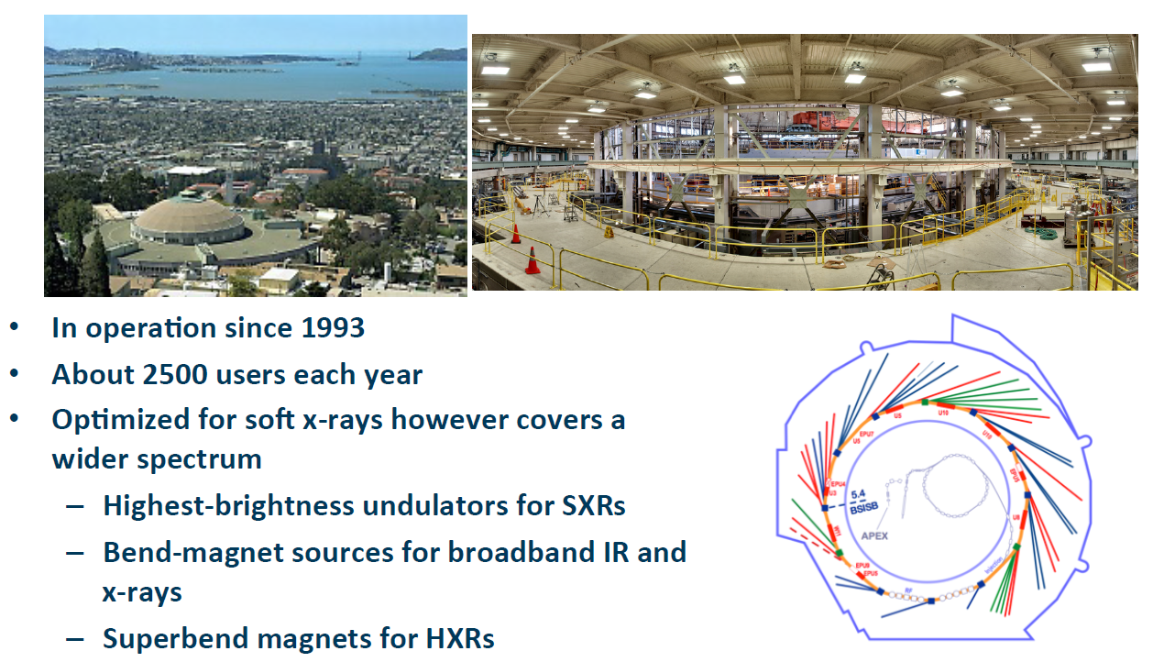
ALS National User Facility
~40 beamlines
Footer
Notes:
3rd Generation Light Source
Top-off Mode 2009

Slide 4
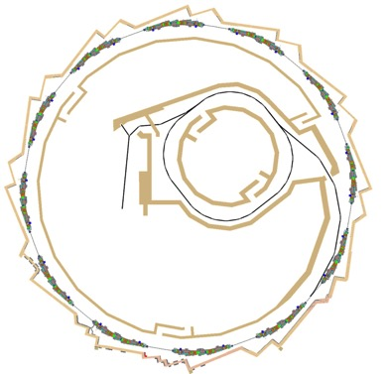
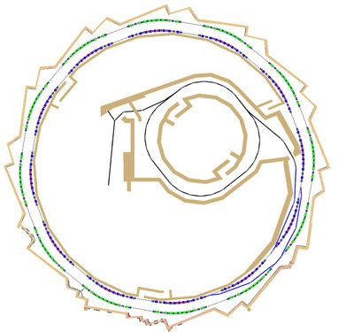
ALS-U Project
Develop the highest brightness and most capable soft x-ray synchrotron facility
  SXR brightness beyond any synchrotron (current, planned)
  up to 1000x increase in brightness over current ALS
ALS Booster Ring
Existing ALS Storage Ring
New Accumulator Ring
Radiation Shielding
New ALS Storage Ring
ALS Gun and Linac
Challenge: Operate ALS as long as possible, proposed dark time is only 1 year, installation and operation will have substantial overlap
Notes:
Scope of the upgrade:
Replacement of the existing triple-bend achromat storage ring with a new, high-performance storage ring based on a multi-bend achromat.
Addition of a low-emittance, full-energy accumulator ring in the existing storage-ring tunnel to enable on-axis, swap-out injection using fast magnets.
Upgrade of the optics on existing beamlines and realignment or relocation of beamlines where necessary.
Addition of three new undulator beamlines that are optimized for novel science made possible by the beam’s high coherent flux.

Slide 5
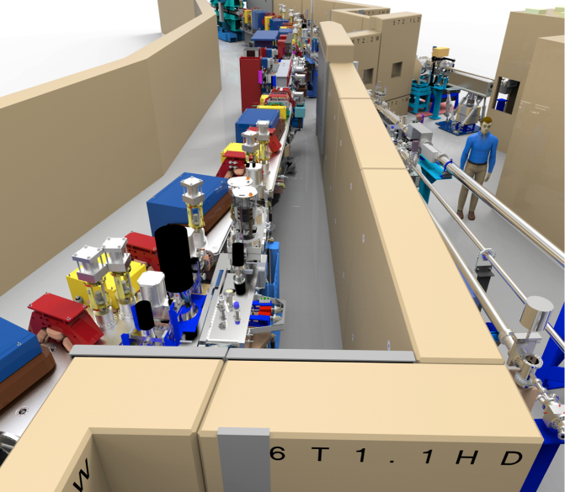
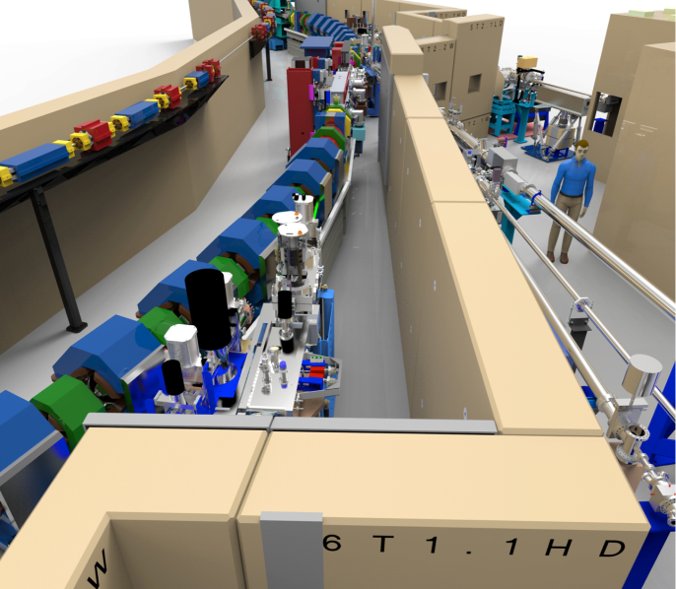
ALS-U Project
Develop the highest brightness and most capable soft x-ray synchrotron facility
  SXR brightness beyond any synchrotron (current, planned)
  up to 1000x increase in brightness over current ALS
Existing ALS ring
New ALS-U ring
New accumulator ring
Challenge: Operate ALS as long as possible, proposed dark time is only 1 year, installation and operation will have substantial overlap
Notes:
Accumulator ring can be installed during maintenance shutdowns before dark time.
Advantage of sharing same tunnel, no additional access controls.

Slide 6
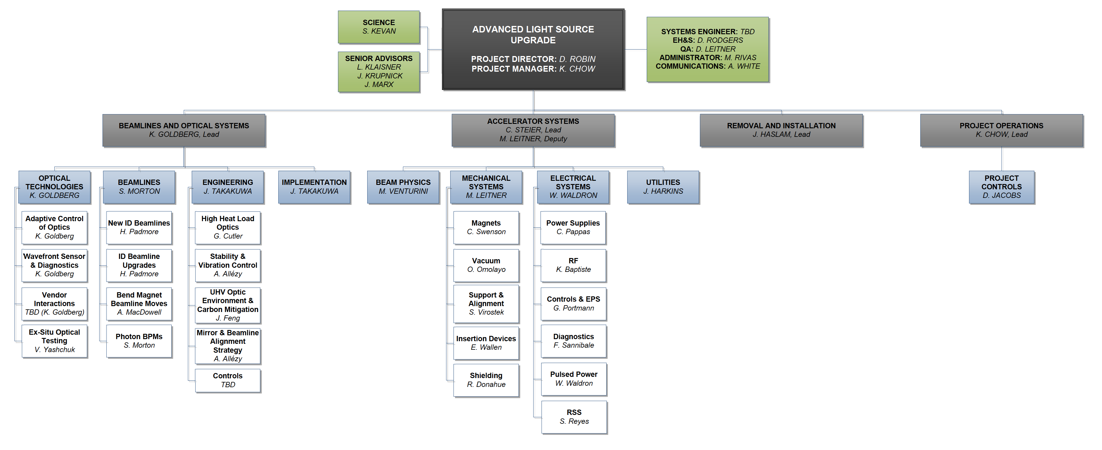
ALS-U Organization

Slide 7
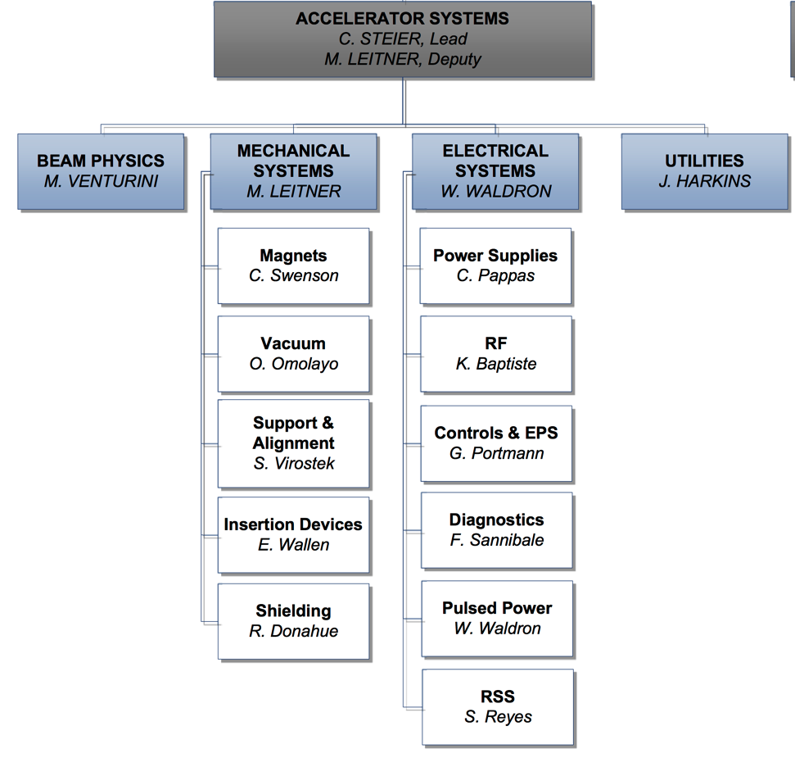
Accelerator Systems Organization
7

Slide 8
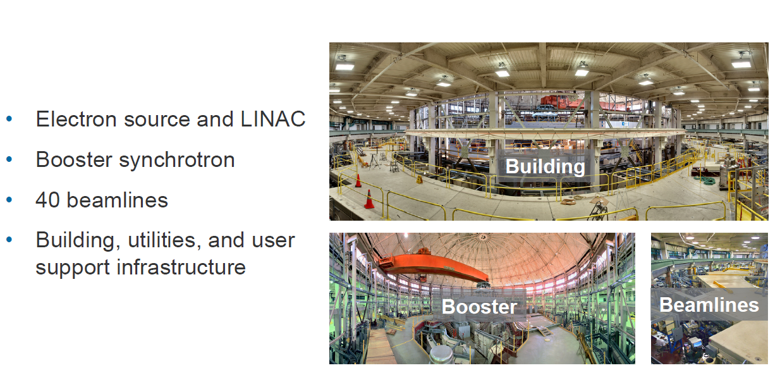
ALS-U reuses most of the ALS complex
Radiation Safety System components?

Slide 9
Current RSS at the ALS
Based majorly on electro-mechanical relays
Top-off interlock system uses PLC’s
Can be split by geographical location in the accelerator
  Accelerator RSS
    Linac RSS
    Booster RSS
    Storage Ring RSS
  Beamlines RSS
Or by function
  Access control interlock system (traditional)
  Beam containment interlock system (top-off, radiation monitors)
Notes:
The upgrade is expected to have major impact upon the sub-elements marked in red

Slide 10
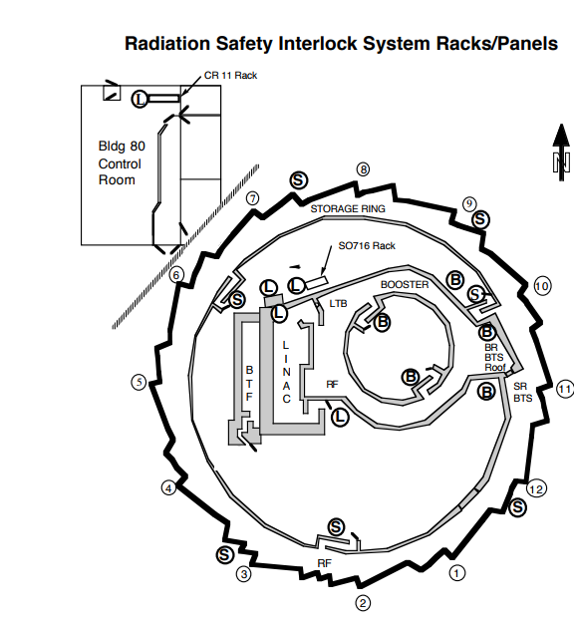
Accelerator RSS elements
Primary interlock devices
  Limit switches at access doors
  Keybank
  Emergency entry/exit device
  Emergency shut-off device (EMO switch)
Access controls
  Search and secure controls
Area monitors
  Radiation monitors
  Telemetry
Audiovisual warnings
Notes:
The elements in the booster/linac/storage ring RSS are similar and are presented here.
It main functions are access control and beam containment (interlocked radiation monitors).
Main impact expected on the Storage Ring RSS cabling.

Slide 11
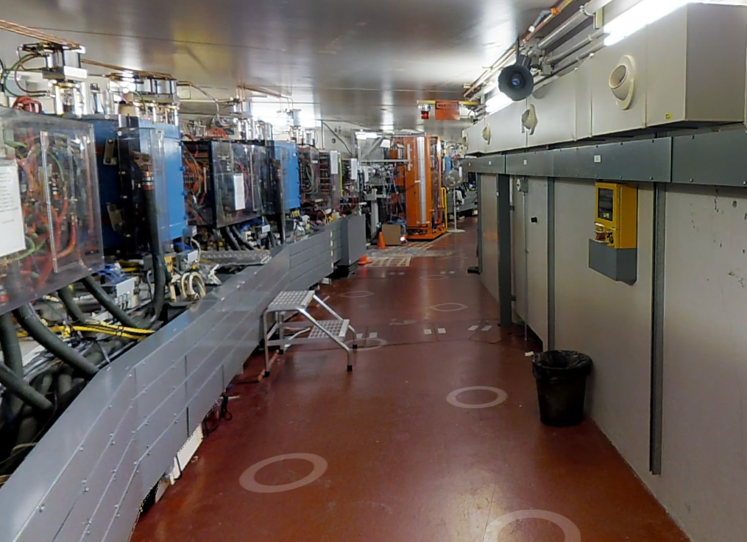
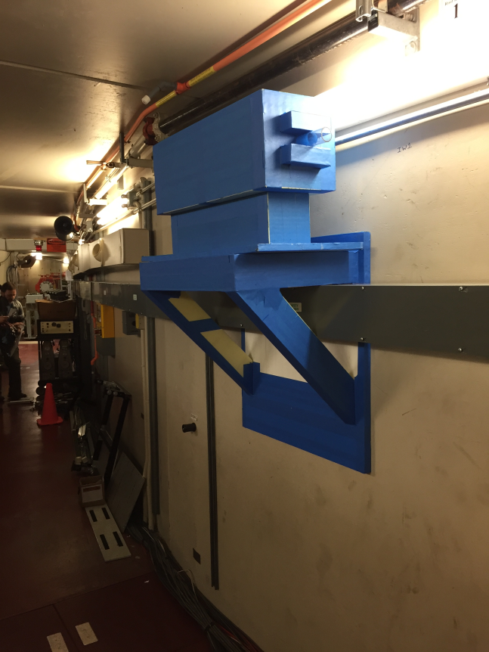
Storage ring RSS
New accumulator ring may interfere with RSS cable trays and lightening
Various options for support structures are being assessed
RSS cables
Current ALS storage ring tunnel
Example of support structure
Notes:
Storage ring RSS could be impacted by the installation of the accumulator ring
We are evaluating possible solutions, while trying to minimize downtime

Slide 12
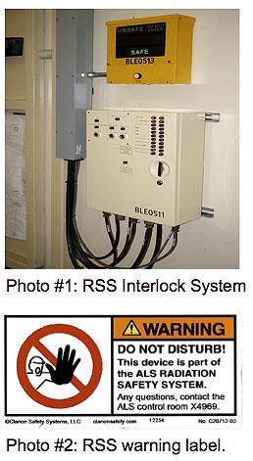
Beamline RSS elements
Branch-line Personnel Safety Shutter or PPS (inside storage ring wall)
End-station PSS
ONLINE/OFFLINE keystation
PSS controllers
Hutch
  Primary interlock devices
  Access controls
  Audiovisual warnings
Notes:
Upgrade is expected to have minimum impact of beamlines RSS

Slide 13
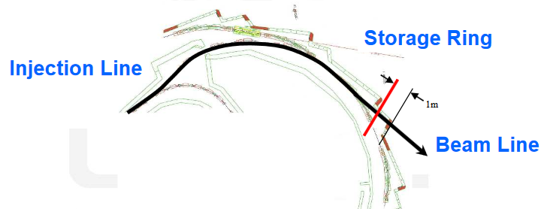
Top-off RSS
Top-off RSS required to prevent the injection of electrons down a user beam line to within 1 meter of the exit port on the storage ring concrete shielding, in top-off operation mode
ALS-U accumulator filled using top-off from the booster
  no photon beamlines mean relaxed safety challenge
Storage ring filled using swap out from accumulator
  similar safety challenges as current top-off, with 10% more charge transferred in one shot
  additional number of magnets may lead to increased complexity
Notes:
When ALS prepared for Top-off operations, the Physics Group analyzed numerous failure scenarios and combinations to determine which magnet systems needed to be interlocked and at what levels the interlocks should be set.
In order to ensure the electron path is limited as indicated above, the DC magnet current in several discrete magnets and magnet families will be monitored redundantly with dedicated precision current monitors and interlocked with solid-state electronics hardware.
Additionally the Storage Ring stored beam current will be monitored redundantly and interlocked as well in the same manner.
In ALS-U I/O counts could increase from ~42 to a couple of hundred redundant signals, we do not know the answer yet and it needs further analysis

Slide 14
RSS approach for CDR
Our approach to prioritize conceptual design activities and set a baseline for of ALS-U RSS follows these drivers:
  Required for RSS safety and regulatory compliance
  Required due to new hazards posed by future operation of ALS-U (normal ops, maintenance, search and secure etc)
  Highly recommended improvement
  Recommended improvement
Regarding safety and regulations, need to determine if existing hybrid relay-based system with minimum modifications for any new hazards can meet requirements
Top-off RSS requirements need to be updated, after better understanding of possible new hazards posed by new operation modes and increased number of magnets

Slide 15
RSS safety/regulatory compliance
Consultation with experts in LBL and other facilities has led to the belief that existing relay-based system with minimum modifications for new hazards can meet safety and regulatory requirements
We are planning a peer-review of Conceptual Design Report draft including the initial scope, assumptions, requirements and technical implementation

Slide 16
Points for discussion
We are developing the conceptual design of RSS for ALS-U under the assumption that re-use of relay-based systems will be acceptable towards future ARR
Linac/Booster RSS and Beamline RSS are in principle not impacted by upgrade, most impact on Storage Ring RSS (cabling location) and Top-off RSS (expected significant impact, TBD)
We are very interested to hear you opinion and experience feedback using relay-based systems, and identify/mitigate and possible risks
In particular experience re-using legacy radiation protection systems will be very valuable

Slide 17
Back-up

Slide 18
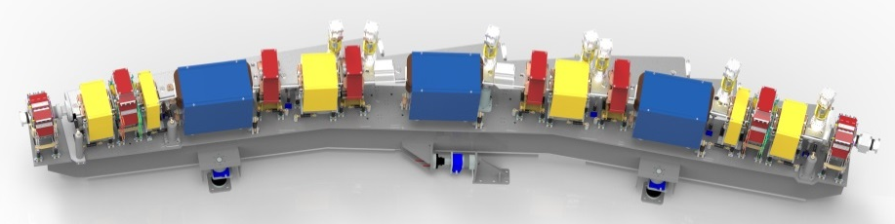
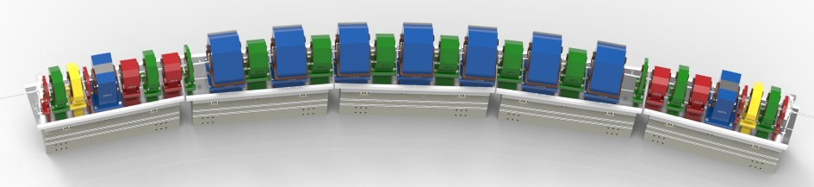
ALS and ALS-U in numbers
Parameter | Units | ALS | ALS-U
Electron energy | GeV | 1.9 | 2.0
Horiz. emittance | pm | 2000 | <70 (stretch goal 50)
Vert. emittance | pm | 30 | <70 (stretch goal 50)
Beamsize @ ID center (σ_{x}/σ_{y}) | mm | 251 / 9 | <13 / <13
Beamsize @ bend (σ_{x}/σ_{y}) | mm | 40 / 7 | <5 / <7
bunch length (FWHM) | ps | 60-70 (harmonic cavity) | 100-200 (harmonic cavity)
RF frequency | MHz | 500 | 500
Circumference | m | 196.8 | ~196.5

Slide 19
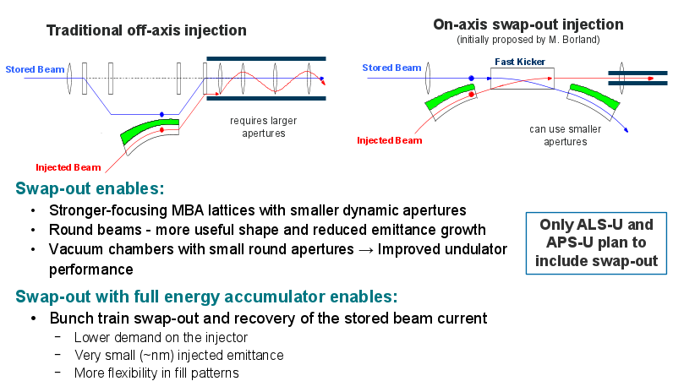
Background: Swap-out injection

