Slide 1
The National Spherical Torus Experiment Upgrade Lessons Learned on the failure of the PF1A Upper Magnetic Coil
Ray Camp
NSTX-U Chief Operating Engineer
DOE Accelerator Safety Workshop
Jefferson Lab
August, 2017

Slide 2
Outline
Reminder: Key features of the NSTX Upgrade
Summary of NSTX-U experimental results
PF1A coil failure (terminated the run)
Recovery Plan
Notable Outcomes
Extent of Condition
Corrective Action Plan (CAP)
Design Verification and Validation Reviews (DVVR’s)
Extent of Cause
Cataloging of known issues
Process Improvements
Summary

Slide 3
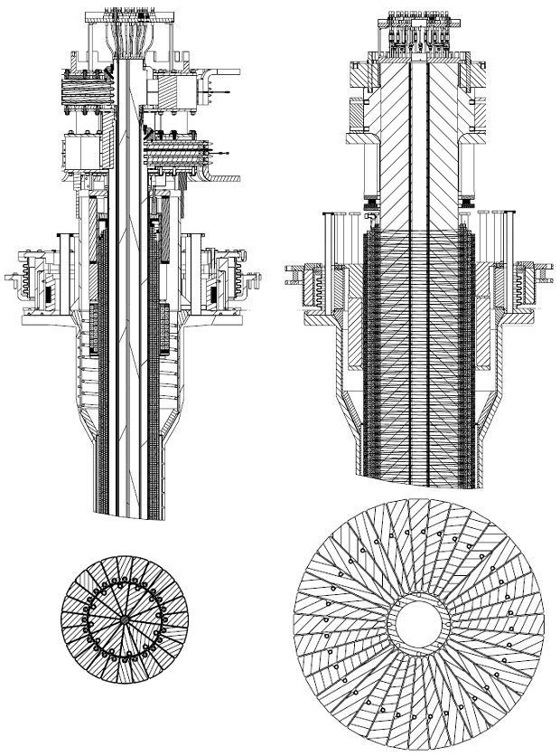
Major Upgrade #1:New CS Provides Enhanced Capabilities
TF cooling lines
TF flex-bus
New
center-stack
Previous
center-stack
TF OD = 40cm
TF OD = 20cm
TF Coil
New CS allows twice higher fields (1T), plasma current (2MA), and pulse duration (6s)
New inner divertor coils (PF1a, b, c) for enhanced plasma shaping.
PF Coil 1c
PF Coil 1b
PF Coil 1a
OH Coil

Slide 4
Major Upgrade #2: Additional Beamline Provides Additional Power and Critical Off-Axis Current Drive
Doubled power from 6 to 12 MW (at V_{accel}=90kV)
More tangential injection on NB#2 triples the NBI plasma current drive and increases current profile control capability.
Introduced many additional power supplies into the NB systems.
Significant updates to the NB control hardware and software.
NB #2
NB #1

Slide 5
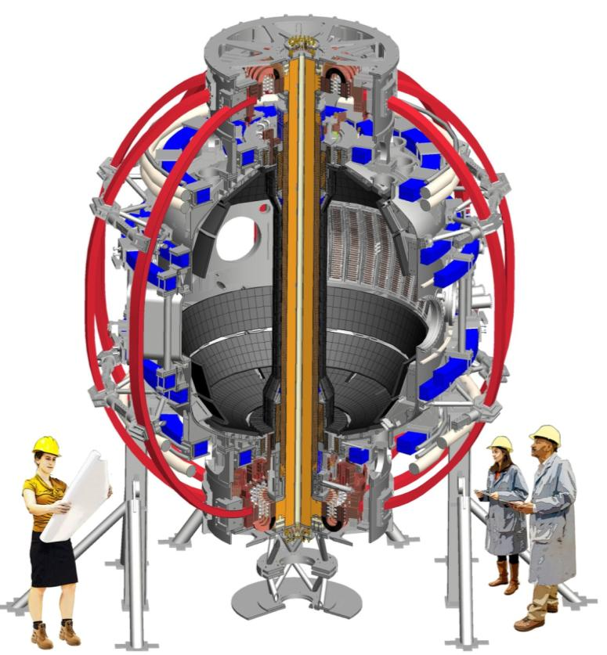
Overall NSTX-U Machine Geometry
The “outer” machine geometry (Toroidal field coils in red, Poloidal in Blue) remain the same with additional supports for higher fields
Aspect ratio (R/a) increased to 1.7 from 1.5. (Tokamak at ~2.7)

Slide 6
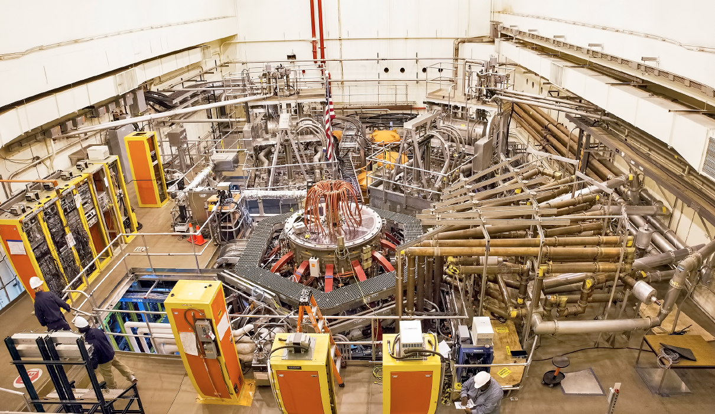
NSTX-U during the 2016 run
2nd NBI
1st NBI
All six NBI sources were fully operational, and supported NSTX-U experiments

Slide 7
Summary of FY-16 NSTX-U Operations
Completed 10 weeks of the planned 16 week run before the PF1aU coil failure.
1167 plasma attempts resulting in 1066 discharges
NSTX-U utilized new plasma control computers and code, new real-time data links for rectifier control, and a new Digital Coil protection System.
Substantial progress made in developing long pulse scenarios.
Long pulse were established to find optimal error field correction (EFC) amplitude and phase. EFC was being used on every shot by end of the run
Long pulses were also used to develop plasma rampdown/shutdown schemes upon disruption indicators. Important capability for ITER.
Real-time plasma shape control was established for plasma radius, vertical position, and X-points.
Studying fast-ion physics associated with the new beamline.
Run ended with all six ion sources reliable at 90kV, including beam modulation
Tangential injection suppresses fast ion instabilities, and is a significant tool for improving energy confinement.

Slide 8
Problems during the Initial NSTX-U Run
NSTX-U experienced a series of problems
An OH “Arc Flash” incident (OH Ground Strap)
Field induced deformation of the PF1a Bus Bar
Unable to bake inboard divertor PFCs at 350C (PF1b)
Field induced Center Stack Passive Structure Issues (Copper cooling tubes)
Fault in the PF1a U coil (terminated the 2016 run as use of the other PF coils would induce current in PF1a U)
Each event was preventable and can be attributed to a variety of Technical and Procedural Causes

Slide 9
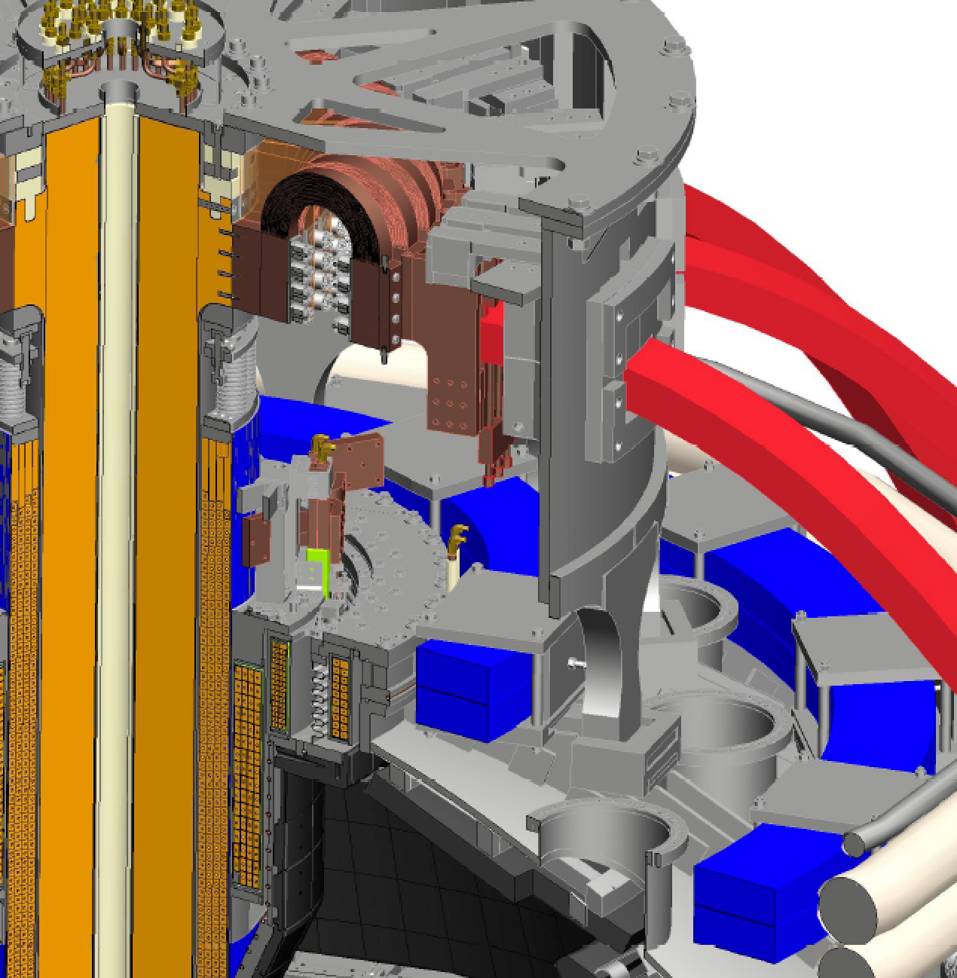
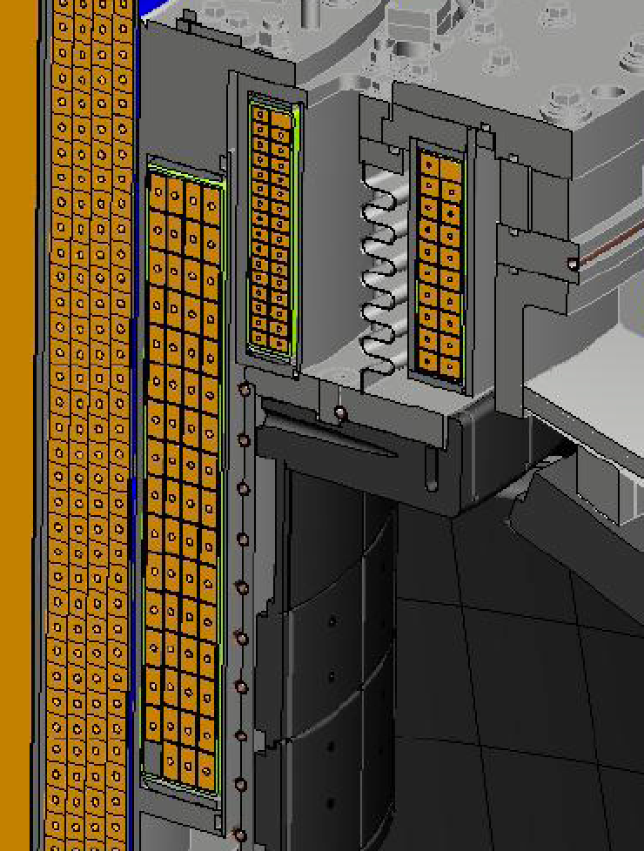
Problems were in the NSTX-U Divertor region
OH Grounding
PF1B
PF1C
PF1A
Copper Tubes
Horizontal Inboard Divertor

Slide 10
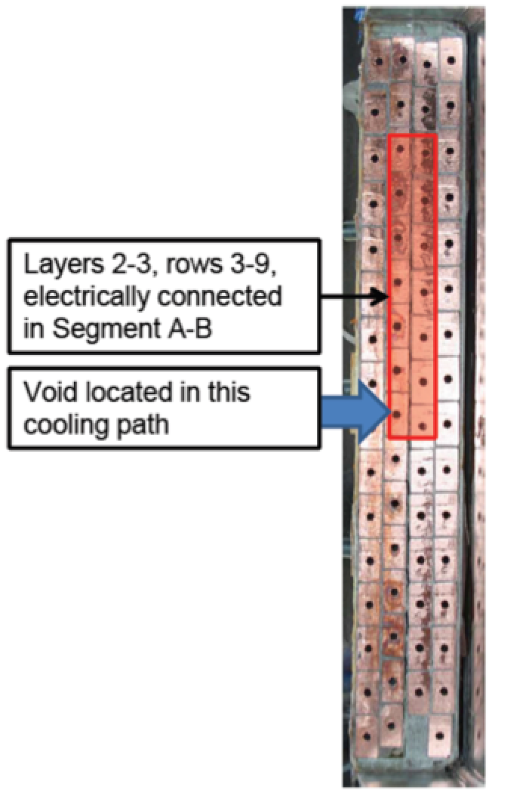
PF1a U Coil Failure Details
PF1a U forensics
X-rays of coil
Cutting of coil into 3 sectors
Boroscopic examination, vacuum testing, and pressure testing of cooling passages
Turn-to-turn electrical testing
Technical Cause
Turn-to-Turn fault, most likely due to poor Vacuum Pressure Impregnation (VPI) plus other quality factors leading to turn-to-turn insulation breakdown
Procedural Causes
Manufacturability of coil design
Lack of QA and QC surveillance of manufacturing process at factory
Based on Above, All six of the Inner PF1 Coils will be replaced.

Slide 11
Recovery Plan – Notable Outcomes
EXTENT OF CONDITION
FES: Complete an extensive extent-of-condition review of NSTX-U to identify all design, construction, and operational issues. Prepare corrective action plan (CAP) to include cost, schedule, scope, and technical specifications of actions.
EXTENT OF CAUSE
SC/PSO: Conduct a review of policies and procedures for design, construction, installation, commissioning and operations of NSTX-U and other construction activities and projects. Develop corrective actions to ensure the highest quality project management across the lab.

Slide 12
Strategy – Extent of Condition Process
Developing MOU to be approved by key stakeholders
PPPL management
Princeton University
DOE
Strategy
Initial Fact Finding
Catalog known issues
Initiate actions to correct most serious of known issues (e.g. PF1A)
Re-design and conduct Design Reviews as soon as possible
Perform long-lead procurements subject to committee approval
Perform “Design Verification & Validation Reviews” to identify other potential issues
Develop Corrective Action Plan (CAP)
Convene Extent of Condition Review. (External Committee)
Revise CAP in response to review findings and deliver to DOE

Slide 13
Strategy – Design Verification and Validation Reviews
Verification review materials
System Design Descriptions (SDDs)
SDDs to provide means for reviewers to navigate through the design-basis documetation
Prior FDR packages, design reports, calculations, drawings, etc.
Validation review materials (as applicable)
As-built documentation package
Documentation generated during manufacturing including inspection records, test reports, non-conformance reports, etc.
Documentation generated during installation at PPPL
Reviews
Design Verification & Validation Review (DVVR) committees
Composed of appropriate PPPL experts plus external reviewers

Slide 14
Preliminary + Final Design Reviews
To address re-design whenever the need is identified
Will follow format of the PPPL Engineering Procedure on “Design Verification” including
An NSTX-U QA plan to add specificity for:
Rules for review committee membership
Rules for advance distribution of review materials
Collection of questions from review committee well in advance of review
Preliminary Design Reviews (PDRs)
Review committee composed of PPPL staff members
Final Design Reviews (FDRs)
Review committee composed of PPPL staff members + external reviewers

Slide 15
Strategy – Two-Phase CAP Approach
Phase 1 of the Extent of Condition Review and Corrective Action Plan (CAP) covered high impact components:
TF inner legs, OH coil, inner PF coils, inner vacuum vessel, center stack assembly, outer vacuum vessel, passive plates, plasma facing components, outer PF coils, RWM coils, outer TF legs, all coil supporting structures, and DC bus bars, MG sets, NBI refrigerator
Phase 2 addressed systems beyond the tokamak core in the supporting infrastructure
The two-phase approach was necessary to meet the Notable Outcome date and to allow key corrective actions to begin as soon as possible on the tokamak core

Slide 16
Strategy – Corrective Action Plan (CAP)
Corrective Action Plan (CAP)
Based on results of DVVRs and re-designs
Will include a ranking scheme of a risk assessment of the issues:
Probability of occurrence
Cost, schedule, and performance risk
Mitigation cost and schedule
Post-mitigation residual cost, schedule, and performance risk
Will recommend mitigation strategy (corrective action) with prioritization
Will factor in the aspiration for NSTX-U to achieve high availability and run weeks per year commensurate with a User Facility

Slide 17
Strategy – Extent of Cause
Objective: Review and develop plan to revise/realign programmatic infrastructure as needed to deliver PPPL project outcomes that consistently meet high standards of performance
Program review is project management-centric but will necessarily extend to supporting policies, programs, procedures and work practices in areas such as engineering design, configuration management, Con Ops, etc.
Phase approach adopted to support NSTX-U recovery and restart
Phase I: Critical review of NSTX-U issues and identification/implementation of near-term actions to preclude recurrence of equipment deficiencies on time line needed to support the NSTX-U recovery schedule
Phase II: Balance of program reviews and development of corrective action plan by end of FY17
External resources, peer reviews, benchmarking etc. will be used extensively to factor best practices from across the DOE complex in PPPL’s plan to achieve the Notable Outcome 4.2 objective

Slide 18
Strategy – Process Improvements
Improvements will prevent recurrence of past problems
Provide strong engineering leadership
Assemble highly focused engineering team
Aspire to be a high-availability user facility
Sound engineering design
Quality takes priority over schedule
Disciplined configuration control
Follow root cause findings from Arc Fault and Bus Bar incident
Improve the review process (DVVRs and DRs)
Focused reviews by small teams of subject matter experts + external reviewers
Review packages distributed well in advance of meetings
Incorporate process and procedural changes as they are developed by the Extent of Cause activity

Slide 19
Status – Cataloging of Known Issues
Collecting input from all members of NSTX-U Recovery Project organization
All known issues, large and small
Un-edited list ~ 100 issues
Most serious issues
Inner PF coil design + quality issues
Inboard divertor issues
Bakeout temperaure vs. PF1B heat-sinking etc.
Ability to withstand heat loads for full 5 second pulse length
Halo current loads

Slide 20
Summary
The Upgrade involved two major components (CS and NB2), but also major changes at every other level of the facility.
Research had been making steady progress on scenarios and control for the physics mission when the PF1aU failure occurred
The NSTX-U Recovery Project was launched on September 26 soon after Notable Outcomes were issued by DOE
Excellent progress has been made toward developing a strategic plan
Recovery will be very challenging but will bring many needed improvements to design and processes

Slide 21
Backup

Slide 22
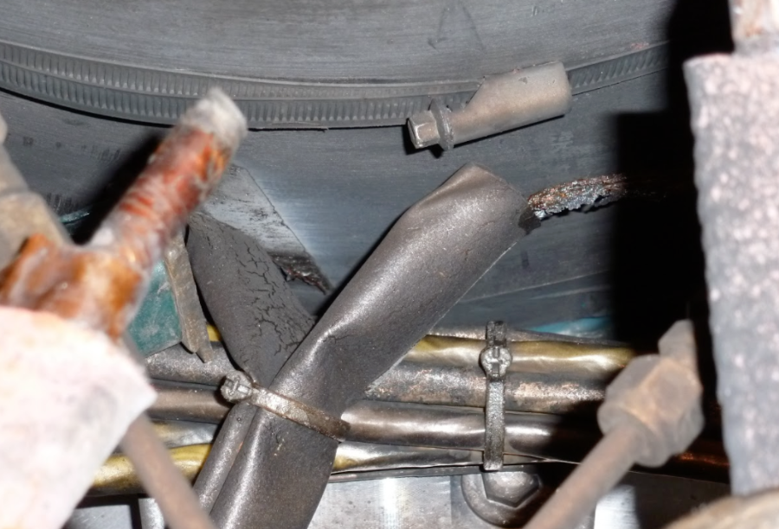
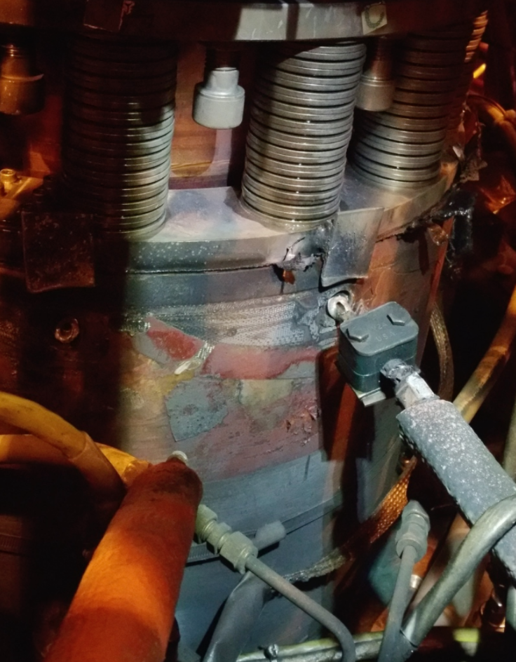
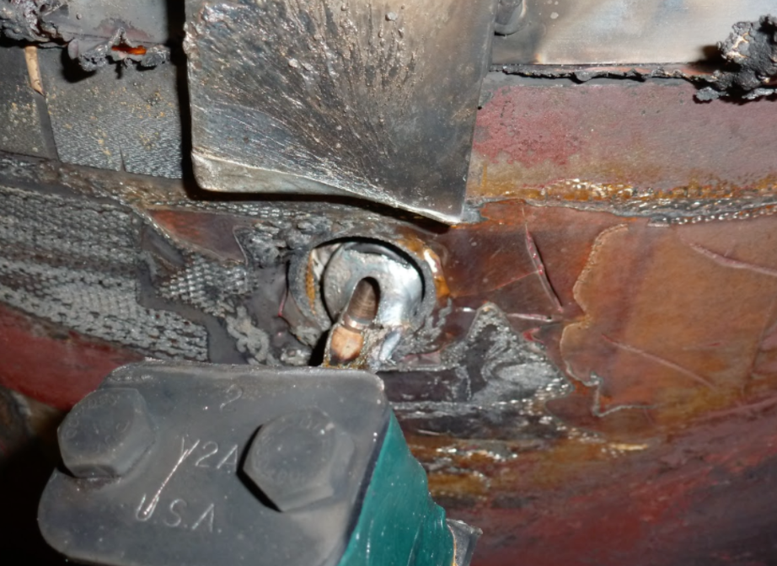
Background – Arc Flash Incident
Technical Cause
OH ground plane connections formed toroidal loops, pushed against water fittings by JxB forces, caused single ground fault, then double ground fault (turn-turn fault)
Procedural Causes (investigated by special committee)
Lack of design and configuration control of essential feature of machine
Lack of engagement of electrical engineering
Conduct of operations issue (ground fault detector was defeated)

Slide 23
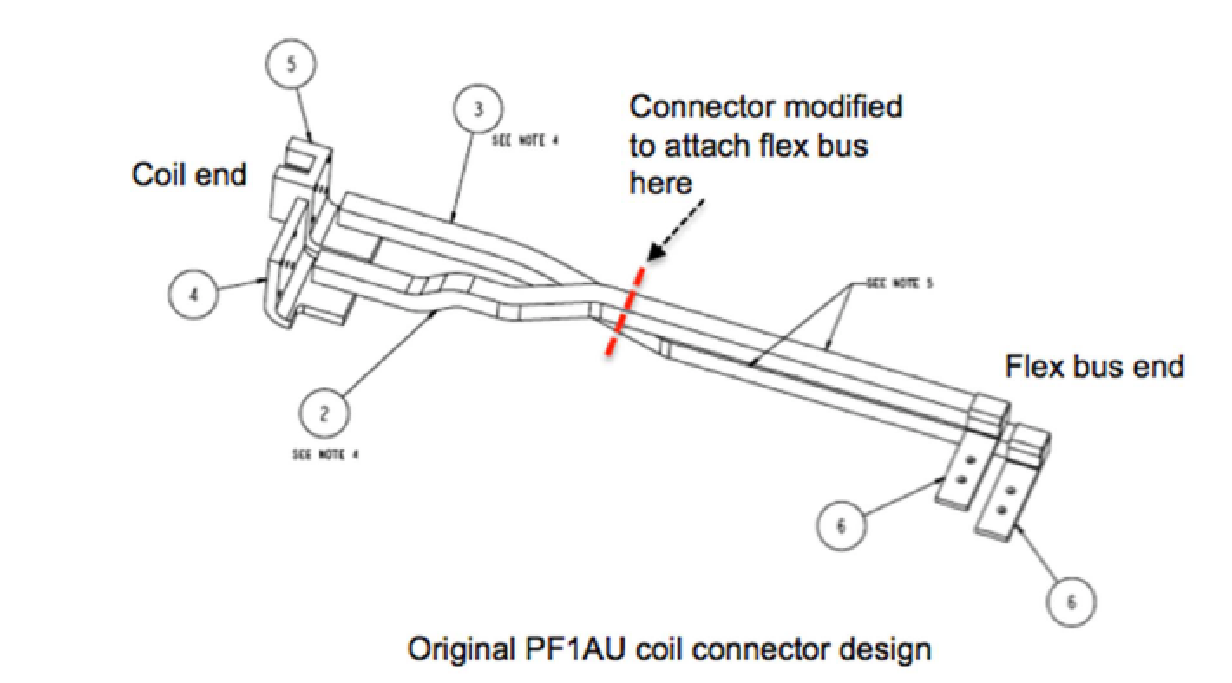
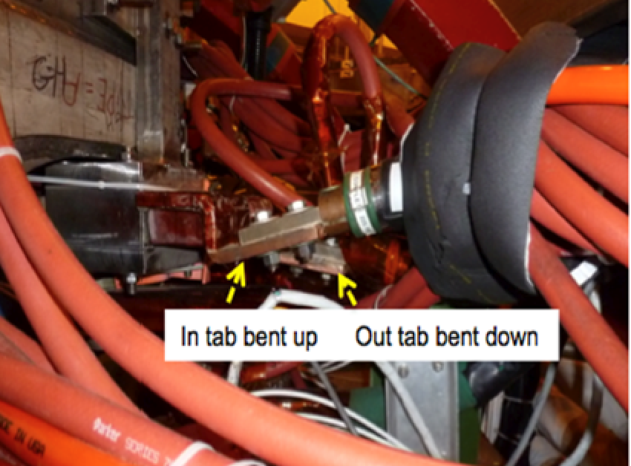
Background – PF1aU Bus Bar Incident
Technical Cause
Bus bar as designed did not fit, was modified in field
Modified configuration lacked sufficient structural support to resist JxB forces, resulting in yielding and deflection
Procedural Causes (investigated by special committee)
Field changes were reported via marked-up drawings and Engineering Change Notice (ECN) but follow-up was flawed
Change approved based on “engineering judgement” of Responsible Line Manager not qualified to understand implications
No analysis or design review was performed

Slide 24
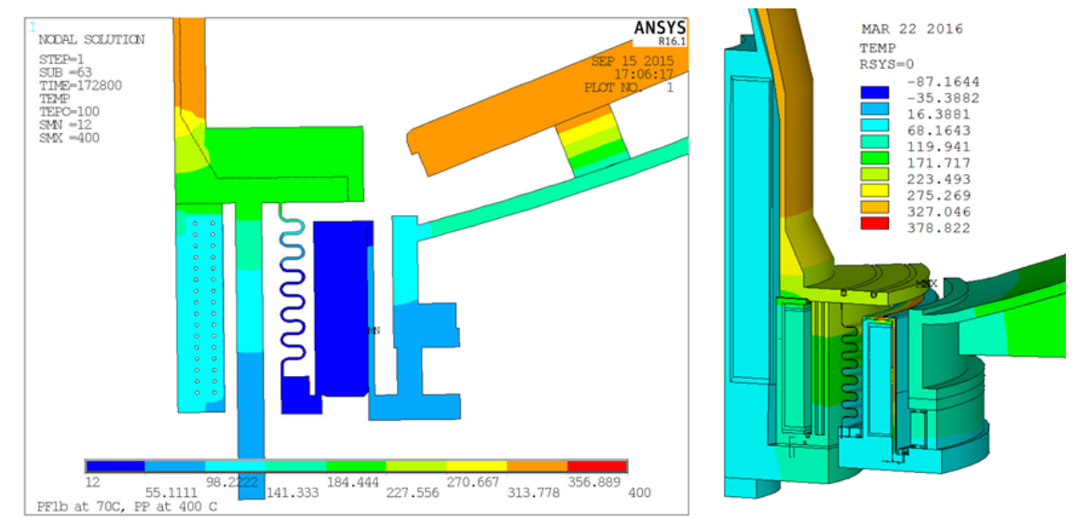
Background – Unable to Bake Inboard Divertor at 350C
Technical Cause
Horizontal Inboard Divertor PFC tile temperature limited by heat sinking to, and temperature limit, of nearby PF1B coil
Procedural Cause
Design team, and design reviews related to bakeout did not identify the issues

Slide 25
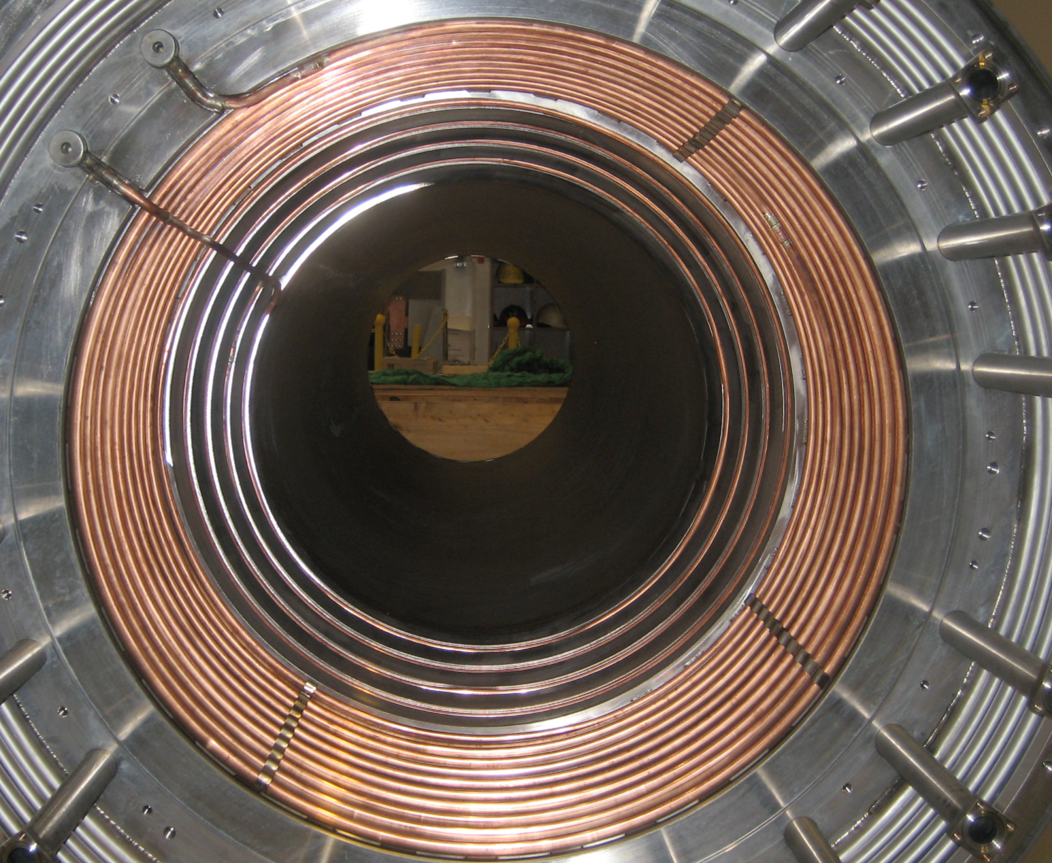
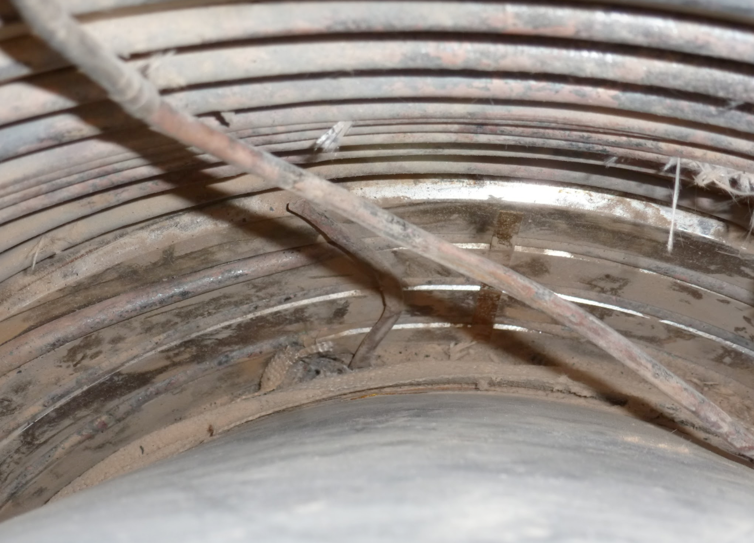
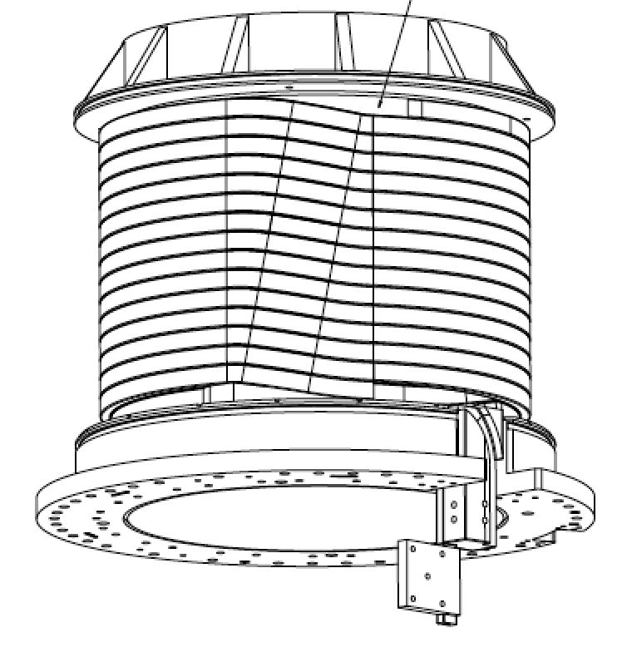
Background – Center Stack Passive Structure Issues
Technical Cause
Large induced eddy currents in passive structure leading to excess current ripple plus JxB forces and heating
Copper heating/cooling tubes inside center stack casing
Coils wound on thick steel mandrels
Procedural Cause
Design team, and design reviews related to various components did not identify the issues

Slide 26
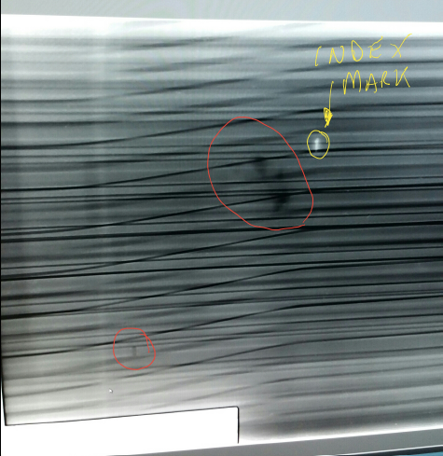
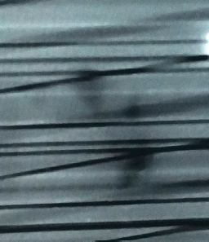
PF-1aU Coil Radiography/Forensics
• Preliminary images showed potential copper voids near the layer to layer “joggle” transitions.
• Additional coil radiography for the void area has been completed to determine radial locations, and the coil is back at the lab.
• Radiography results were used to develop the dissection and borescope inspection plan.

Slide 27
PF-1aU Fabrication Plans
• Four design improvements have been identified:
Eliminate joggles (ease winding and reduce stresses during cool down )
Double insulation thickness (increase insulation margin)
Use softer copper and control hardness (ease winding)
Use continuous conductor, eliminate in-line joints (avoid potential leaks)
• New coil mandrels are being fabricated.
• New copper conductor is on order.
• A coil shop is being set up at PPPL where the NSTX-U TF and OH coils were fabricated.

