Slide 1
Planning for Succession
Accelerator Safety Workshop
Jefferson Lab
August 15-17, 2017
E. Lessard & G. Mattson

Slide 2
Why to Plan
The Baby Boomers are in the process of retiring; we need to capture their knowledge before it walks out the door
All organizations, no matter their size, need succession planning; however, many organizations have not introduced the concept of succession planning
Others plan informally for succession of only key roles
Senior leadership teams can put forth names of employees with great potential
The advantage of a formalized system is that the organization exhibits a commitment to mentor and develop the employee
Formal succession planning allows all managers to know who the key employees are

Slide 3
Developing Employees for Succession
Train your successor(s) and work with them
You can minimally cross-train potential successors for every role
To develop the employees, use practices such as lateral moves, assignment to special projects…
Employees are motivated and engaged when they can see a career path for their continued growth and development
To effectively do succession planning, identify the organization’s long-term goals
The loss of a key employee then will not undermine your ability to accomplish important objectives

Slide 4
Succession Planning – A C-AD Example
Prepare a Job Analysis
Basic job summary
Scope of work directed
Problem solving skills and examples of difficult types of problems typically faced
Authority
Impact of results of decisions positive and negative, influence on results
Job level or who reports to who, up and down chain of command
Who must be contacted and communicated with (level, relationship, activity)
Knowhow in terms of knowledge, experience and education

Slide 5
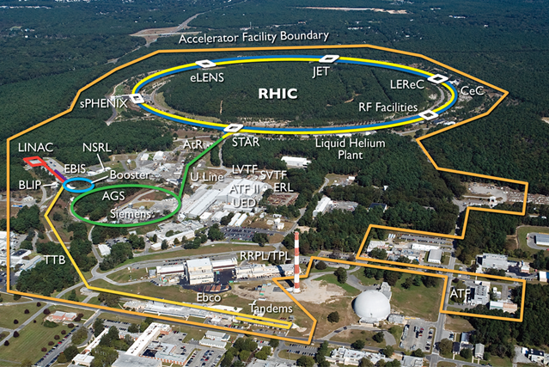
Example Job Analysis – C-AD Chief Operating Officer
Basic Job Summary
Ensure operational requirements, processes and support resources are in place to conduct work at the accelerator facilities
Help maintain research operations coordination and oversight of operational programs
Help meet operations goals safely and in an environmentally sound manner
Do same as new or modified accelerator facilities and operations are added
Coordinate, oversee and implement conduct-of-operations programs
Develop authorization bases documents (SAD and ASE)

Slide 6
Example Job Analysis – C-AD Chief Operating Officer
Authority
Make decisions regarding implementation of and changes to conduct of operations attributes, unreviewed safety issue processes, assurance programs, training programs, configuration management programs in order to operate accelerator facilities safely and efficiently
Approve policies, procedures and procedure reviewers
Approve personnel to attend training
Approve readiness for operations
Approve operator and user qualifications
Participate in decisions related to organizational structure, hiring, staff
Direct actions necessary to correct deficiencies and enforce corrective actions
Commission independent assessments, reviews and other assurance practices
SAD, ASE, USI, ARR, IRR, 10CFR851, 10CFR835, DOE Order 420.2C Safety of Accelerator Facilities, DOE Order 422.1 Conduct of Operations, ISO 14001, OHSAS 18001, Legacy Hazards Issues, FDA CGMP, ORPs, DOE Standards…

Slide 7
Qualifications & Credentials for an Accelerator Safety SME
Bachelor’s degree or higher in Physics, Health Physics or closely related field or an equivalent combination of experience and education from which comparable knowledge and skills have been achieved.
American Board of Health Physics certification (CHP) is a plus
Five to ten years’ experience showing increasing independence in responsibility and leading Accelerator Readiness Reviews (ARRs), Internal Readiness Reviews (IRRs)
Understanding of Monte Carlo shielding codes (e.g. MCNP, EGS, etc) and their application to Accelerator Operations.
Knowledge of DOE Order 420.2C, Safety of Accelerator Facilities and DOE Occupational Radiation Protection regulations (i.e. 10CFR835) and applicable radiation protection standards.

Slide 8
Example Job Analysis - Accelerator Safety SME
Review and recommend for approval all radiation protection aspects during design, operation and maintenance of the accelerators and associated systems
Provide accelerator safety subject matter expertise DOE Order 420.2C for the development of technical basis documents for radiation protection, commissioning and operation during the modifications and upgrades to accelerator facilities.
Review and analysis of Unreviewed Safety Issues (USIs).
Provide support for safe radiological operations during commissioning/operations of the accelerators and beamlines by creating procedures, reports and establishing protocols in conjunction with other cognizant safety personnel at the lab.

Slide 9
Example Job Analysis - Accelerator Safety SME
Evaluates radiological hazards associated with commissioning future projects activities and making recommendations with regard to facility, equipment, proposed operations and shielding designs
Supports the development of Safety Assessment Documents (SADs), Accelerator Safety Envelope (ASE), radiological programs and procedures as necessary to ensure the safe conduct of commissioning and operational activities.
Conducts accelerator safety surveillances and assessments of operations and recommend corrective actions as required

Slide 10
Where to find succession candidates?
In house resources should be identified during succession planning and performance evaluations
Need to be open to various candidates with different degrees and career pathways:
How many have degrees in Physics? Health Physics? Nuclear Engineering? Other engineering?
How many experience with just DOE? Academia? Nuclear Navy? Commercial Nuclear? Other industries requiring radiation protection?
Where to find external candidates:
Professional societies
Universities
Conferences
Networking within DOE
Networking within broader accelerator community

Slide 11
Implementing Succession Planning
If you have identified potential candidates in the organization, then use the job analysis to minimally cross-train potential successors
If you do not have internal candidates, then use job analysis for recruiting
Once a successor is selected, use the job analysis to help transfer knowledge, experience, working relationships, and information; and plan, if possible, an overlap period before the predecessor leaves

