Slide 1
SLAC Excess Material Disposition Various Sites
R. Ford, J. Allan, O. Ligeti, Y. Pilastro, S. Rokni

Slide 2
Outline
Scope
Strategy for material disposition
LINAC S0-10 and Beam Switchyard (BSY) Disposition
Volumes
Support of BSY reconfiguration project
Recycling of Lead (Pb)
Planned work for FY2018
Summary / Accomplishments

Slide 3
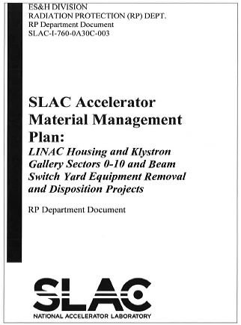
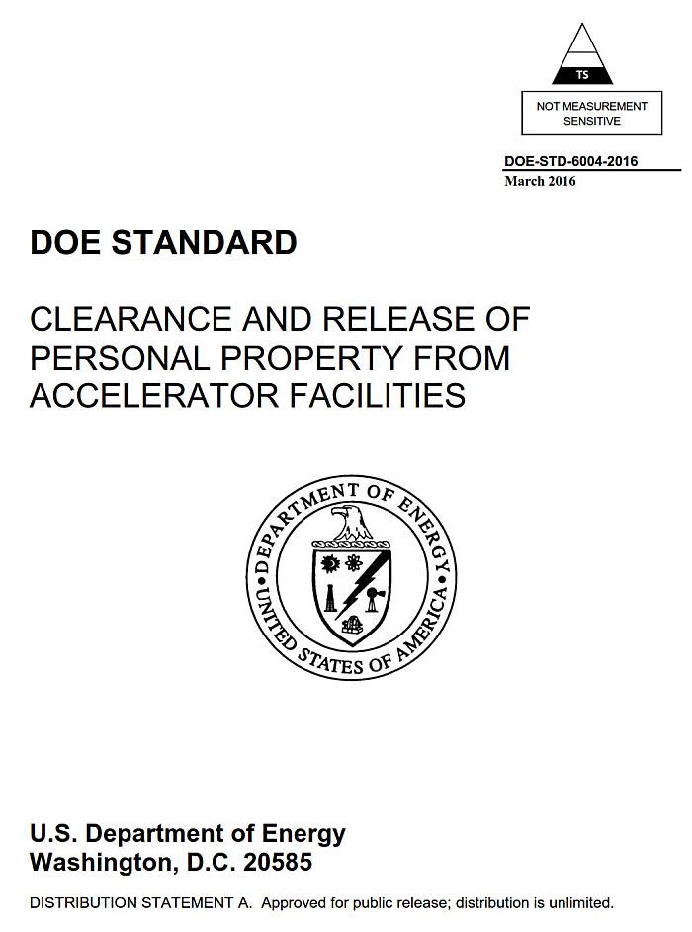
Disposition strategy: 4-prong approach
Establish clear responsibilities and requirements for managing removed materials (The AMMP)
Pre-characterize materials and equipment
Prepare appropriate space for material processing (area 1, area 2, tent, MSY)
Manage disposition of excess materials in a safe and efficient manner (radioactive waste, hazardous waste, recycling)
Notes:
Includes mgt of subcontract

Slide 4
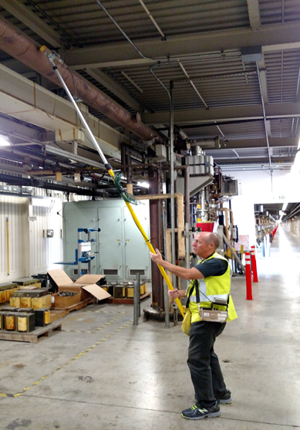
Prong 2: Radiological and hazardous characterization
S0-10
>1000 in-situ measurements
Beam switchyard
Majority radioactive – two 40 yd³ bins were recycled
Beam dump east
Mostly ESA materials, required survey and sorting and process knowledge determination
Notes:
Co-57, (270 d)
Co-60, (5.2 y)
Co-58, (72 d)
Na-22, (2.6 y)
Sc-46, (84 d)

Slide 5
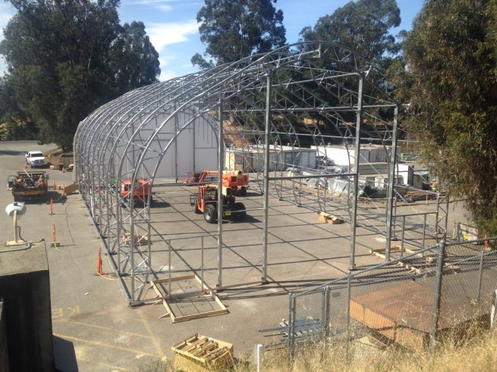
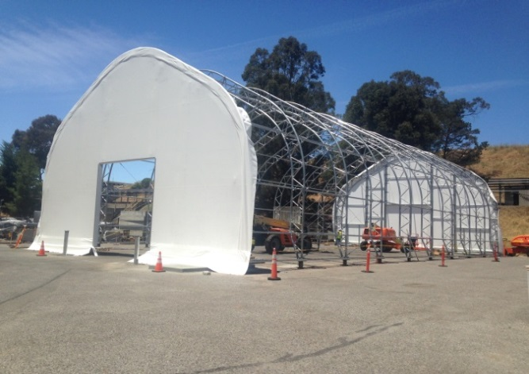
Prong 3: Tent construction, Area 1&2 Prep
This was the heaviest rainy season since 2010

Slide 6
Prong 4: Manage disposition of materials
Radioactive Waste
Recycling
Hazardous Waste
Manage subcontractor (Gilbane)

Slide 7
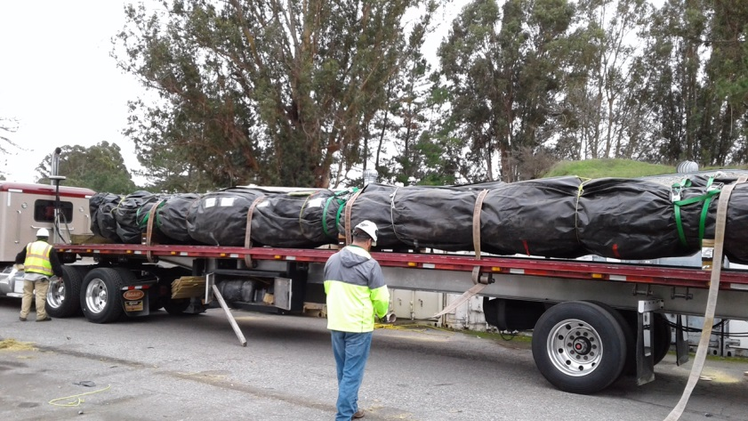
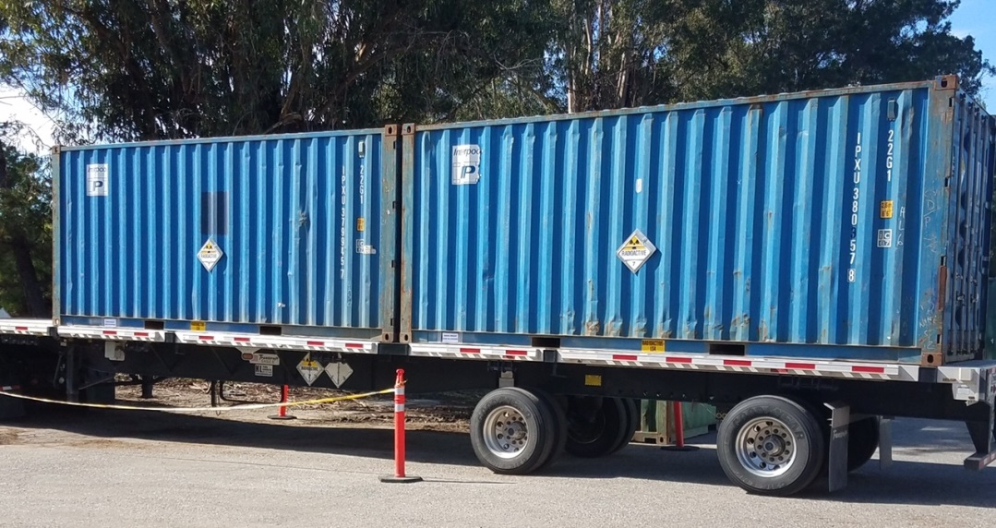
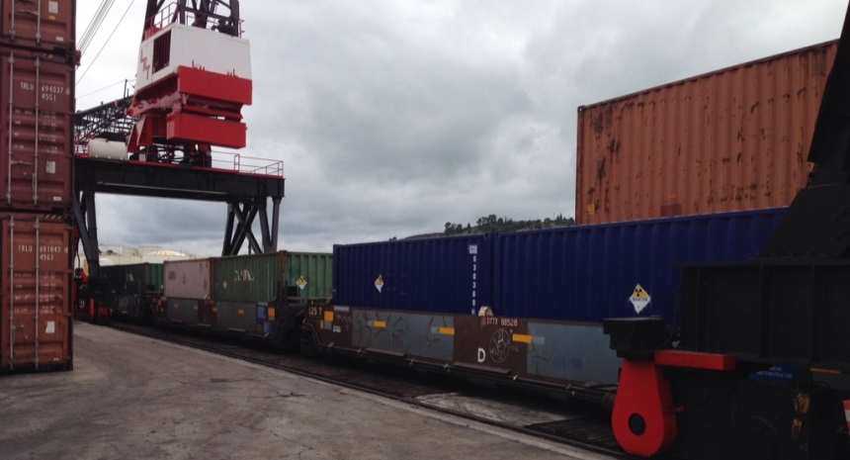
Prong 4: MSY and BDE waste shipments
First Rail Spur Shipment (10 Sea-Lands)

Slide 8
Waste disposal and recycling statistics
Prevented the accumulation of unneeded materials and prevent a future legacy problem.
DOE-STD-6004

Slide 9
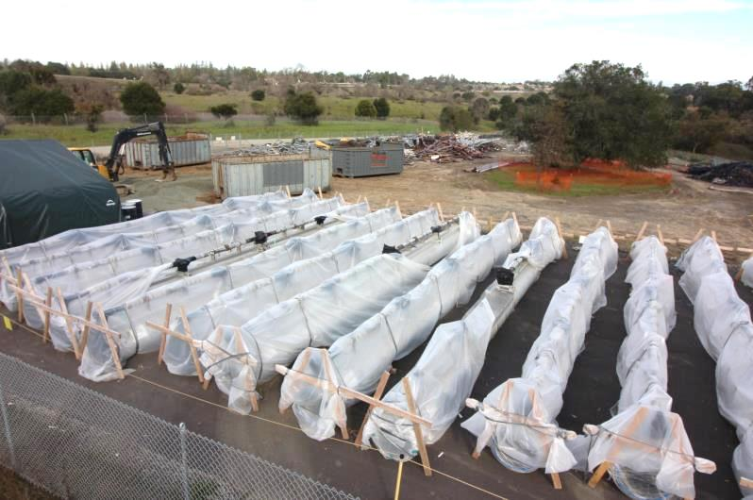
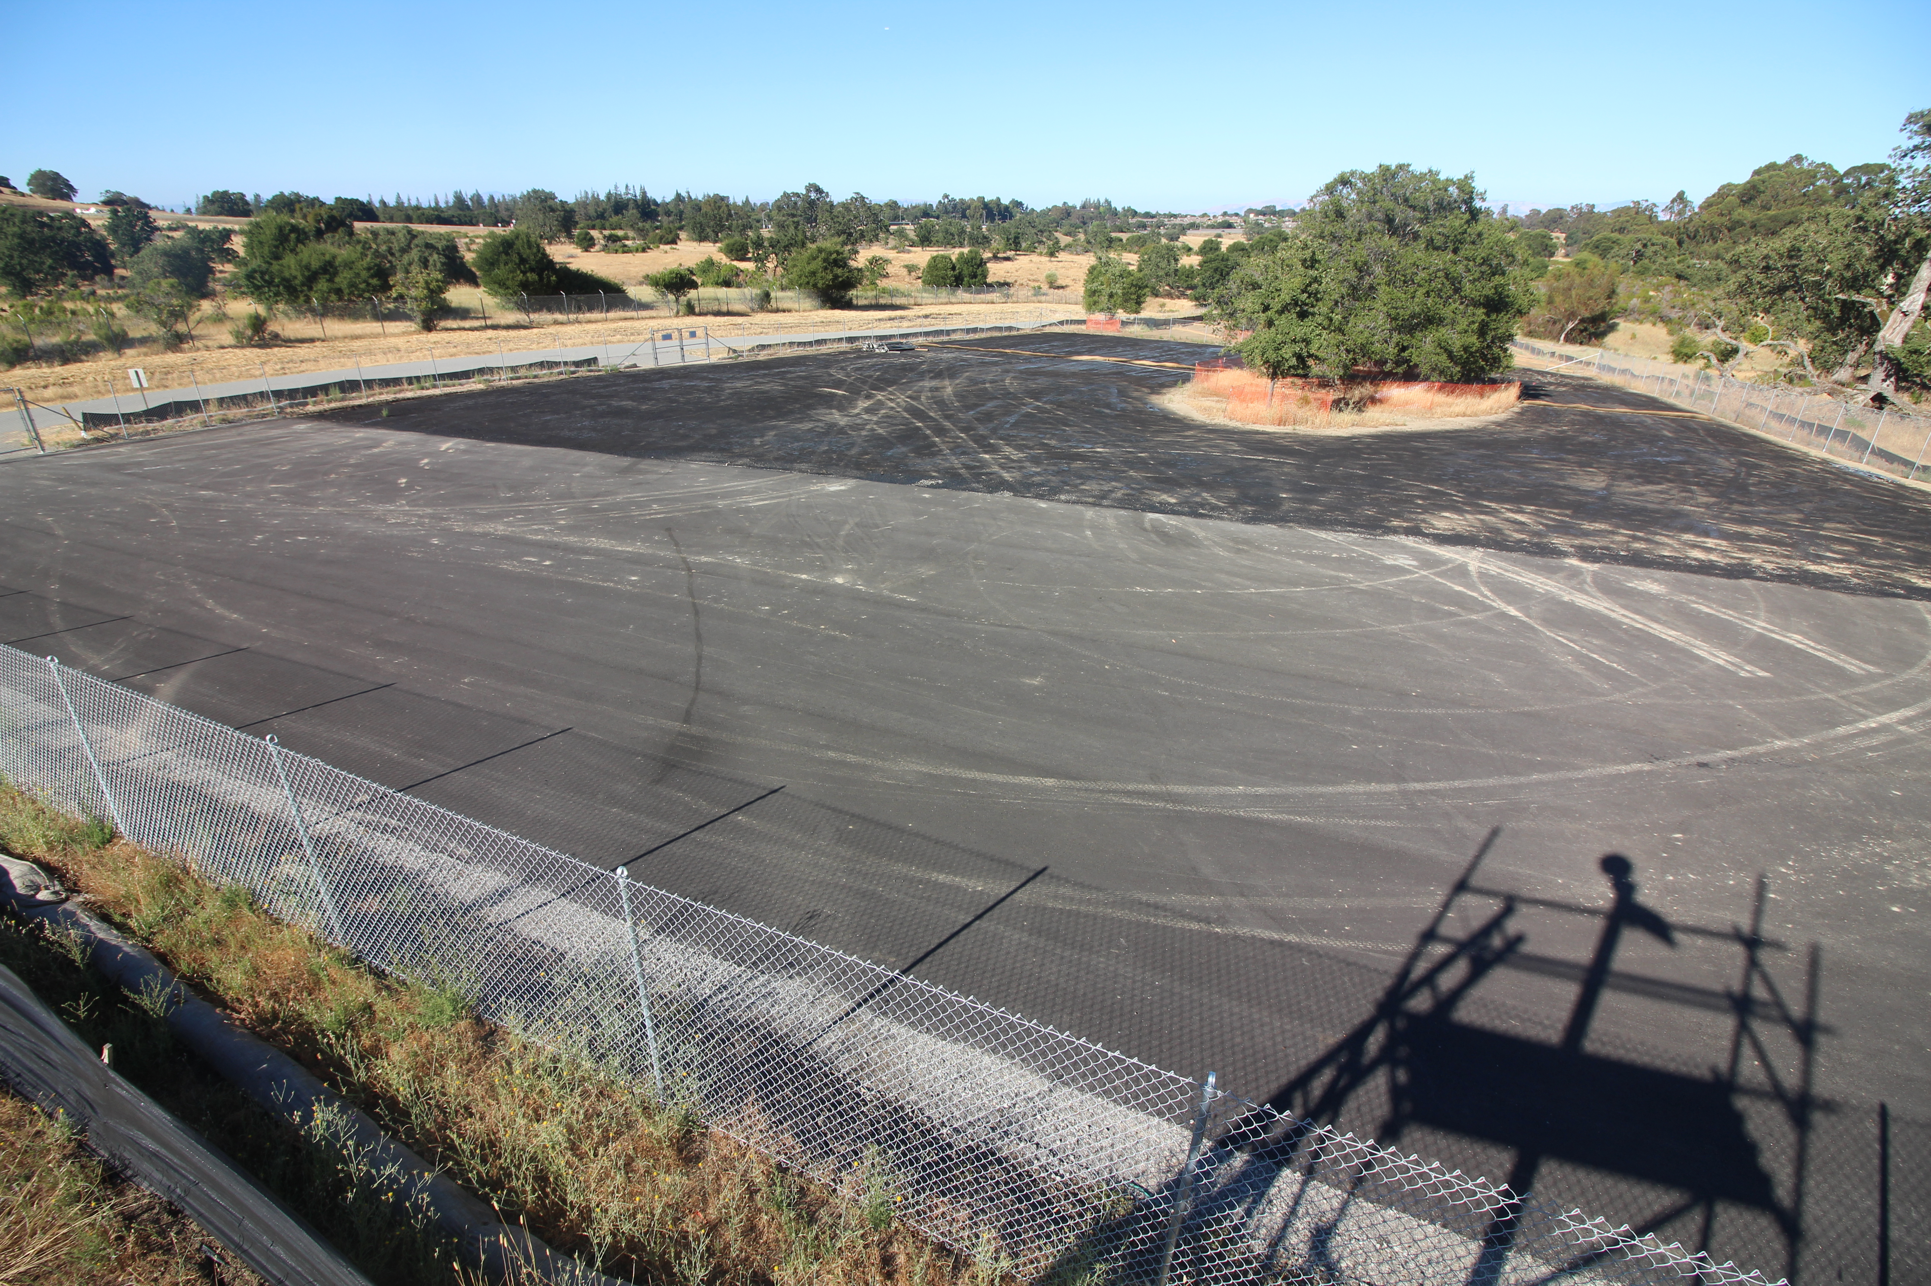
Area 1 Materials from S0-10

Slide 10
BSY reconfiguration scope statement
Remove obstructions to future LCLS-II beamlines
Remove unneeded legacy equipment
Design, fabricate, and install a new beamline
Design, fabricate, and install new collimators and Beam Containment System devices to permit continued LCLS operations through the BSY before LCLS-II is installed

Slide 11
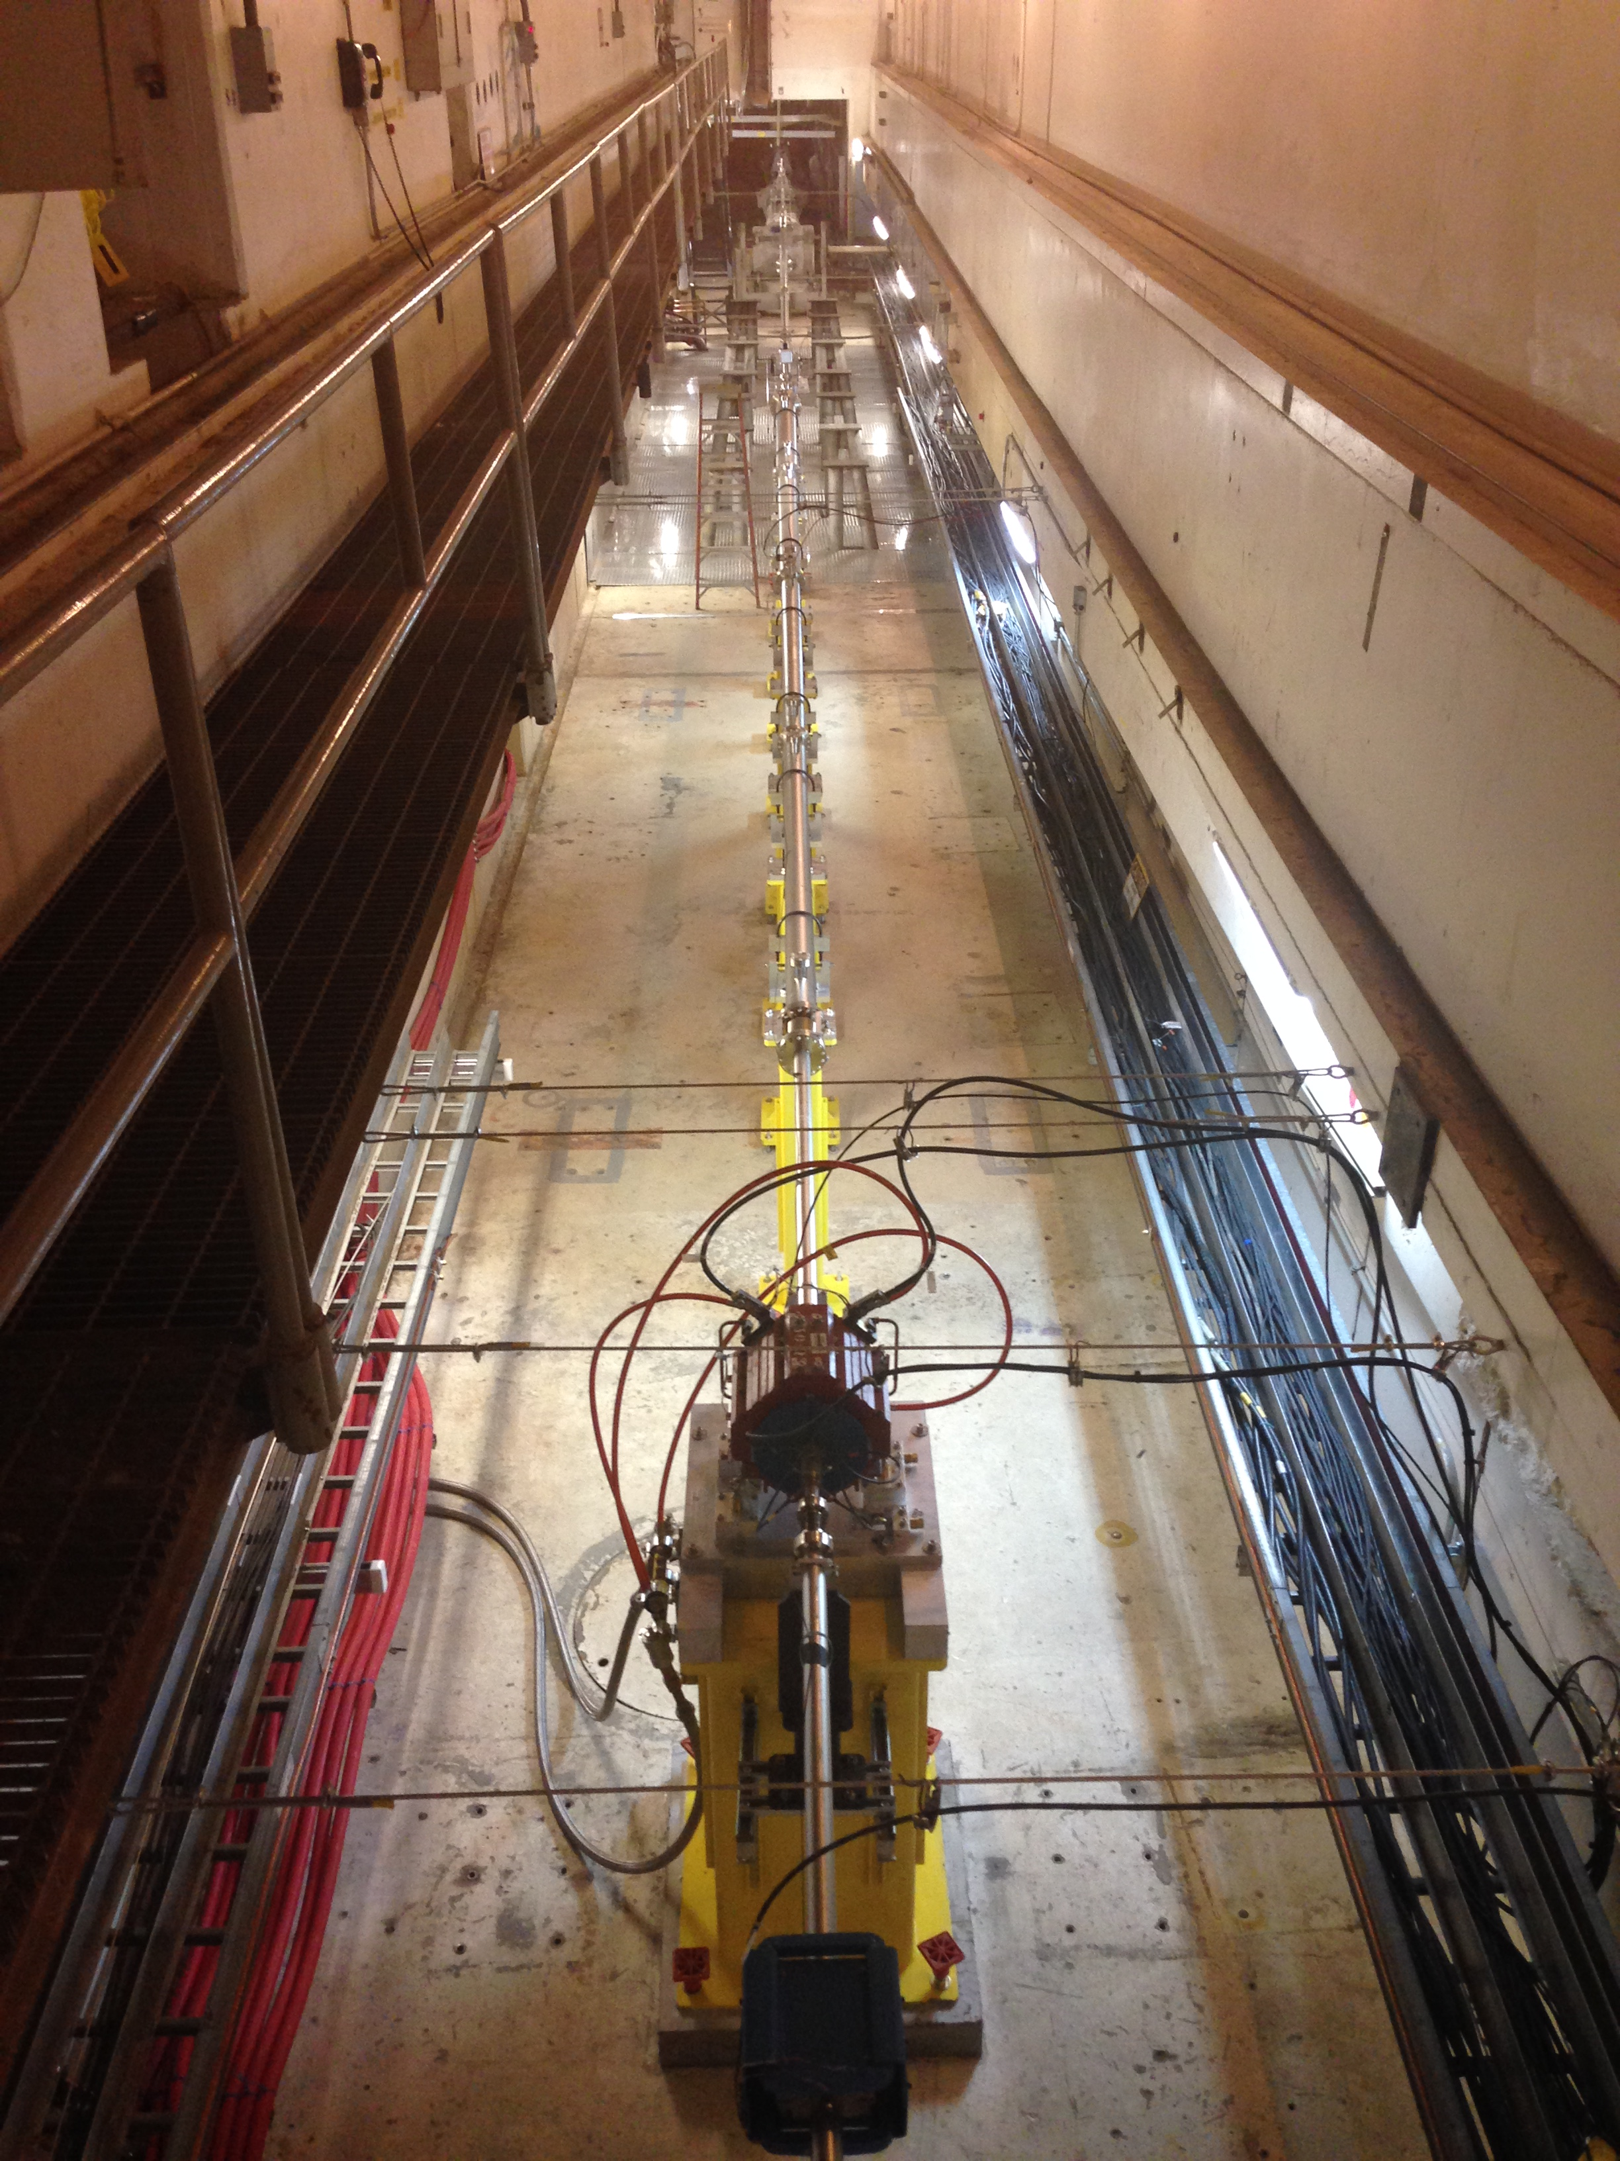
Beam switchyard: progress photos
Removal of materials from this area will prevent unnecessary exposure for future work in the BSY during high-power LCLS-II operations, by preventing their activation
ALARA practice

Slide 12
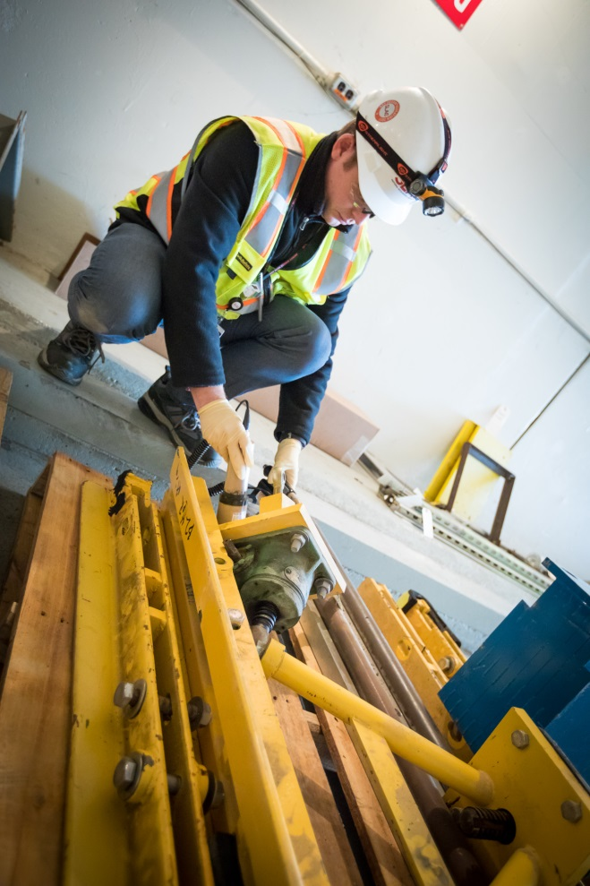
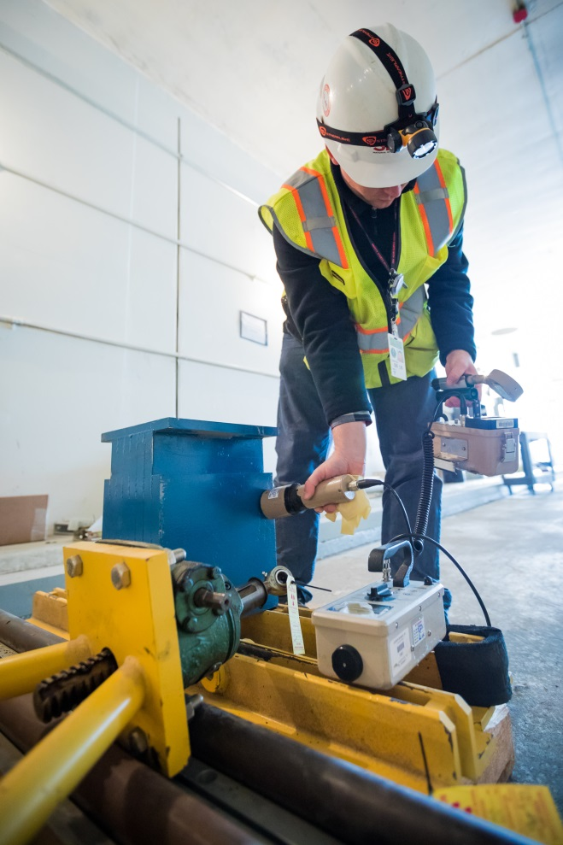
BSY: Survey of materials
Two loads were recycled using Material Release Program Procedure
Cost avoidance of ~$100K and 2 Sea-Lands
Remainder disposed as radioactive waste

Slide 13
BSY
Services Provided for S0-10 and BSY:
Contractor oversight
Staff Augmentation:
Contract RCT
Waste Shipper
Waste identification and inventory
Recycling of hold materials i.a.w. DOE-STD-6004 2016 and RPD-010

Slide 14
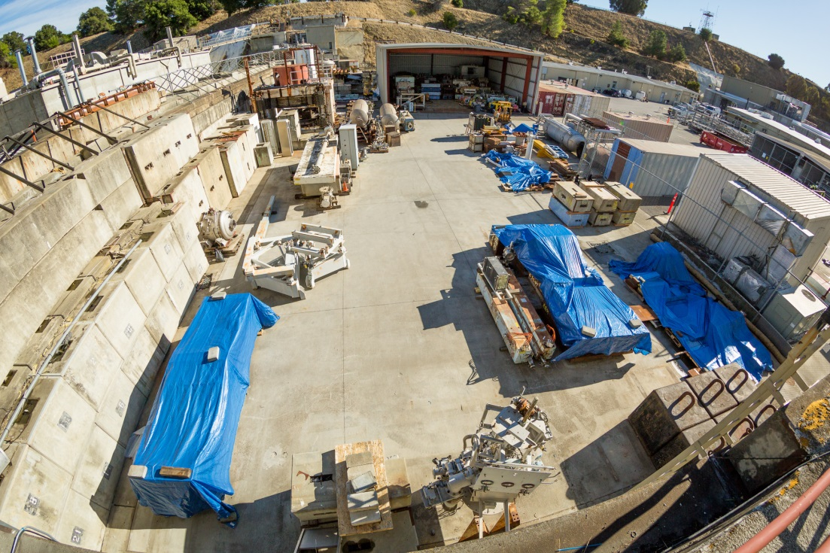
Beam dump east: Progress to date
Output: 1 Sea-Land, 1 flatbed, 7 recycling bins, 3 hazardous waste bins, several truckloads of hazardous blocks
Contractor vacuumed the area to remove hazardous debris (lead, cadmium)

Slide 15
FY2018 Excess material disposition
BTH/undulator hall radioactive waste disposal (LCLS-II)
Beam dump east waste and recycling
Legacy radioactive waste disposal
Lead recycling
Large amounts of excess lead can be cleared
Development of clearance protocols is in progress
Benefits to entire DOE complex

Slide 16
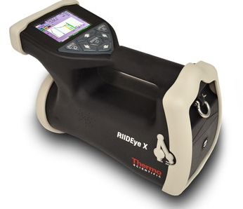
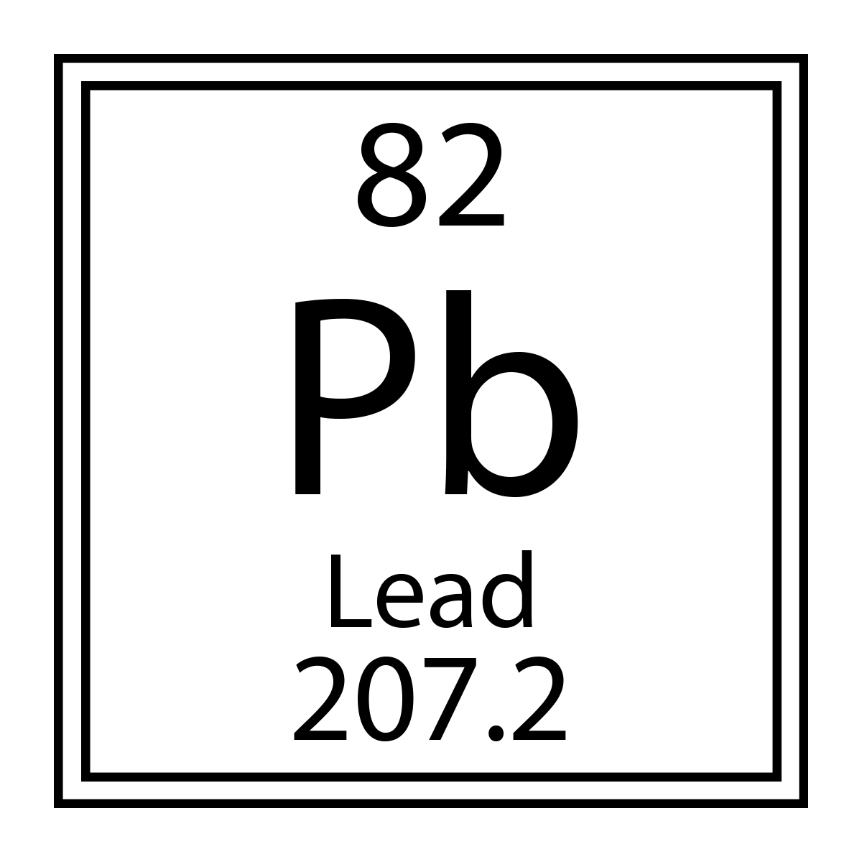
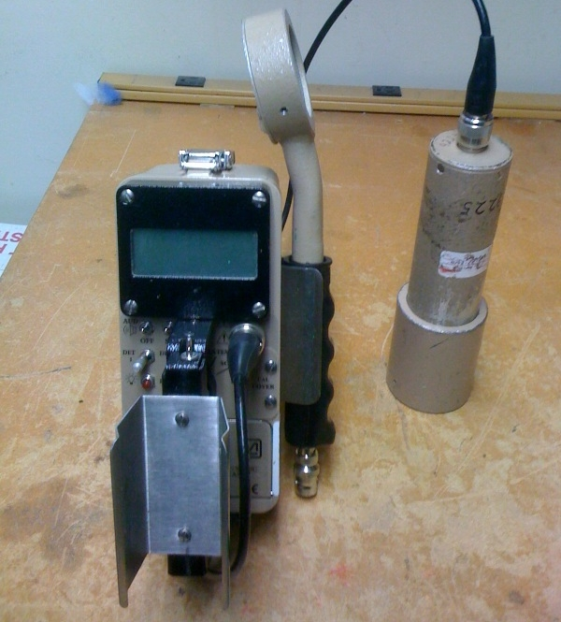
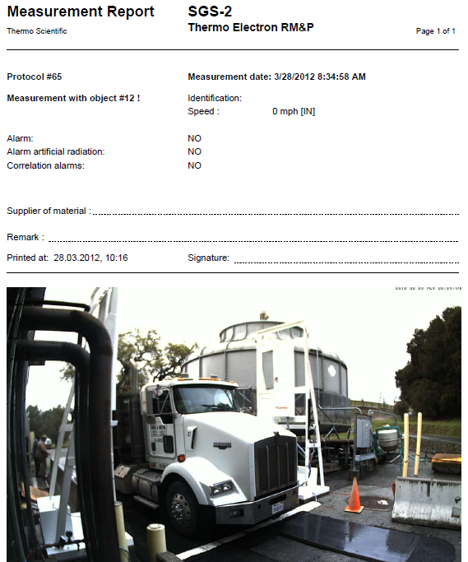
SLAC Instruments for Common Metal Clearance Measurements
Ludlum Model 2241 meter with
1”x1” NaI probe (DT ~ 0.03 Bg/g; 30 nSv/h) &
small-area GM pancake probe
Field
Gamma Spectrometer
Portal
Gate
Monitor
What about Lead?

Slide 17
Clearance of Lead (Pb)
DOE Standard DOE-STD-6004 (2016) was developed for clearance of common metals (e.g., Al, Fe and Cu) in accelerator facilities
Unlike common metals, there are no proxy radionuclides for lead clearance measurements in electron accelerators
Tl-204 (pure beta emitter, E_{max} = 764 keV, 3.78 yr) dominates activity and risk in lead in most cases
Sensitivity of a small-area (15.5 cm²) GM probe for Tl-204 in lead was calculated with FLUKA to be 8 cpm per Bq/g.
With an average background of 120 cpm, detection threshold of a large-area GM meter (4x15.5 cm²) can be 0.8 Bq/g for Tl-204 inside lead, which is lower than ANSI N13.12 SL of 1 Bq/g.
Lead clearance measurement protocol (e.g., static 1-min measurements with large-area GM probe on contact with a lead brick under maximum background of 180 cpm) is being developed to meet IFB release criterion.

Slide 18
Summary
Radioactive waste disposal campaign for BSY resulted in disposal of most of the generated BSY waste
Some waste postponed to FY18
Successful recycling campaign, large cost avoidance
Successful disposal of hazardous waste disposal from BDE yard, substantial reduction in volumes
Continuous and effective safety oversight
Project management capability enabled efficient allocation of resources and meeting of project goals

Slide 19
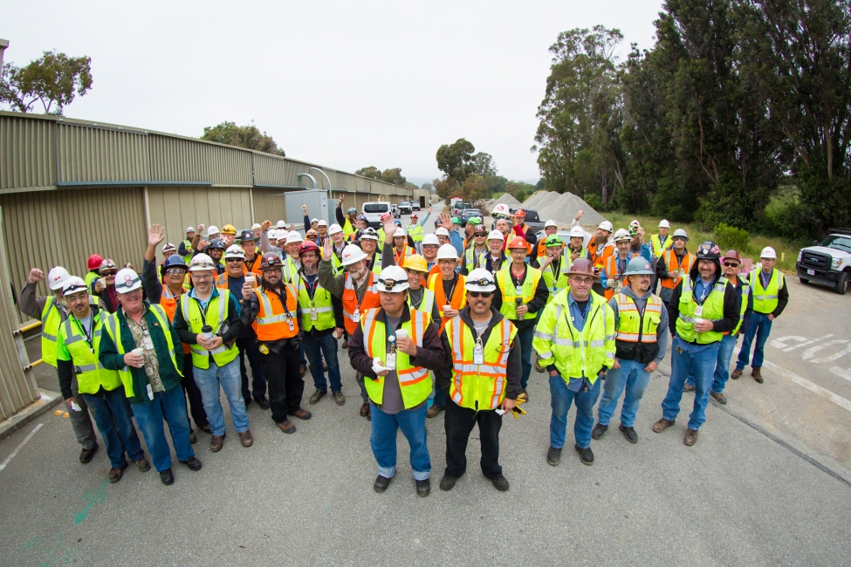
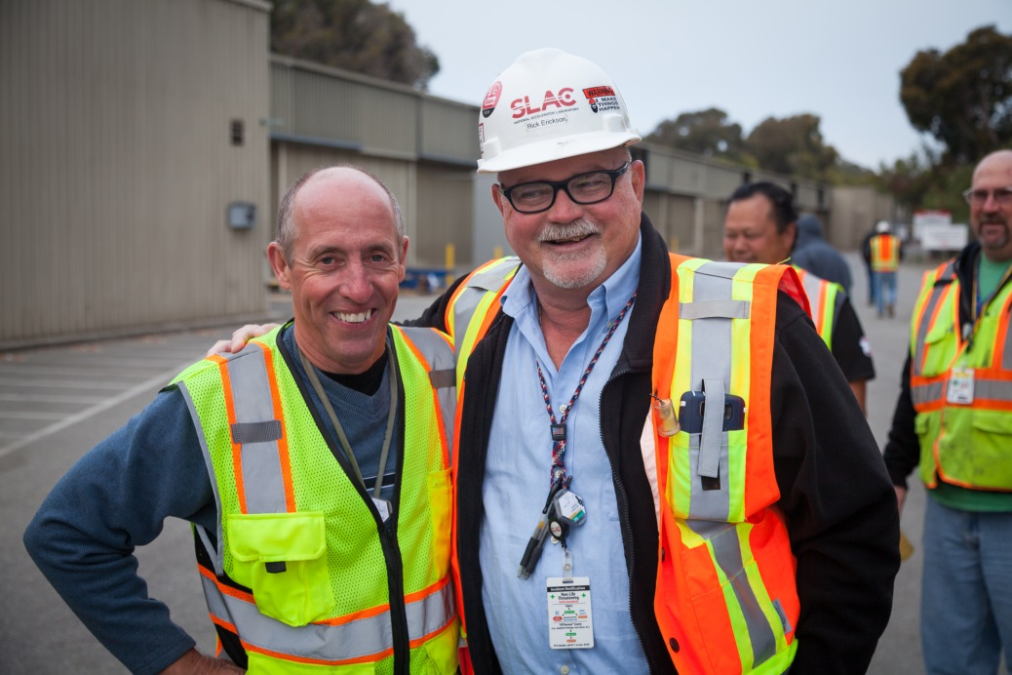
Team Work

Slide 21
Backup

Slide 22
Scope of LCLS-II material disposition support
Disposition of excess materials to approved end points from:
Sectors 0-10 linear accelerator housing (tunnel)
Klystron gallery
Beam switchyard (BSY) - Reconfiguration
Magnet storage yard (MSY)
LCLS undulator and dump halls (FY18)
Inventory, characterize, disassemble, package, transport, treat and dispose of low level and mixed radioactive waste, hazardous waste, universal waste, class II waste
Recycle excess materials impacted by DOE Metal Moratorium, as well as non-impacted materials in the klystron gallery
Site preparation to facilitate material disposition
Support for removal of materials from BSY reconfiguration

Slide 23
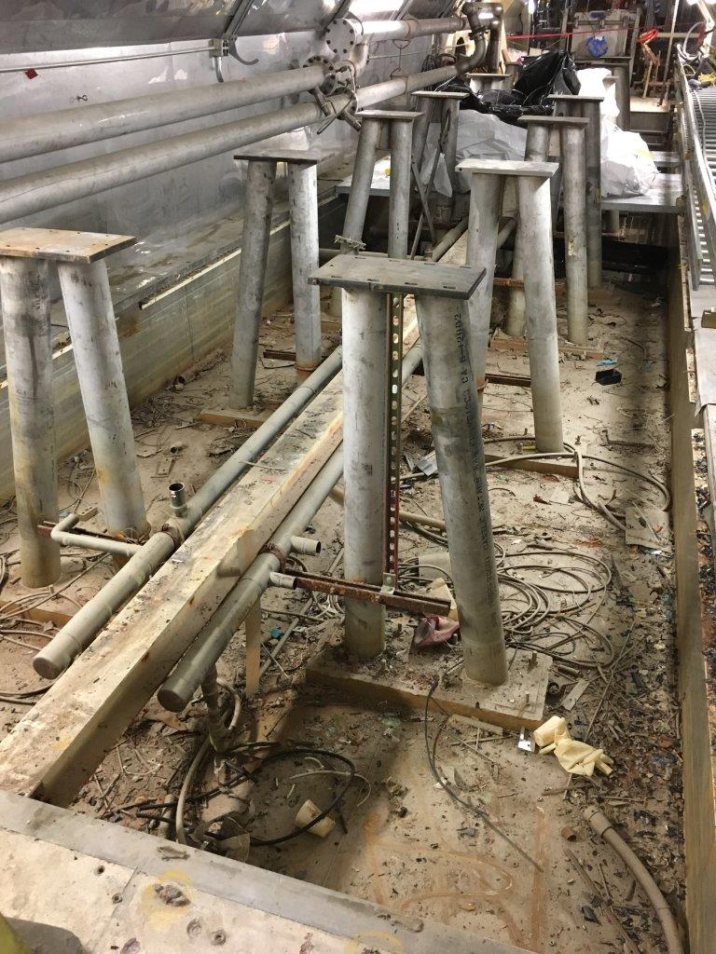
BSY sump: Before and after

Slide 24
Interrelationships and collaboration
Radiation
Protection
Gilbane
Hazardous Waste Ops
Radioactive Waste Disposal
Field Safety
Accelerator Directorate, LCLS-II
Environmental Prot.
F&O
Industrial Hygiene
Security
Procurement
Bldg Inspection Office
Property Control
Legal Dept.
Communications

Slide 25
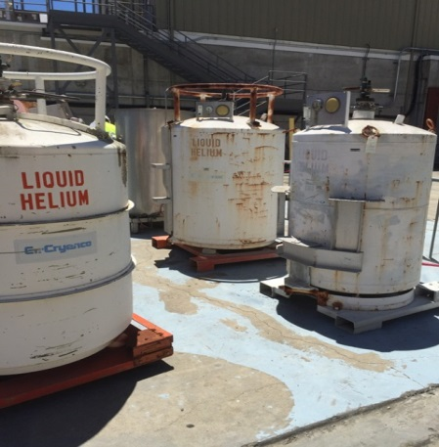
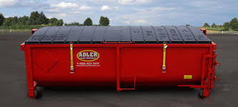
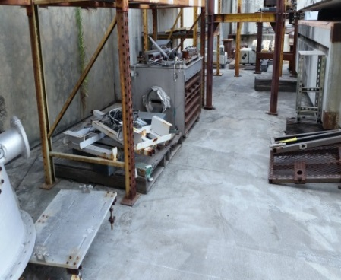
Prong 4: Hazardous waste operations
Hazardous Waste:
Concrete and debris with heavy metals (lead, cadmium)
Tanks with specialty gases
FY2016: 42 tons, 5 loads
FY2017: 5 tons, 3 loads
Total: 47 tons, 8 loads
Vacuuming operations prevented runoff into stormwater drains

Slide 26
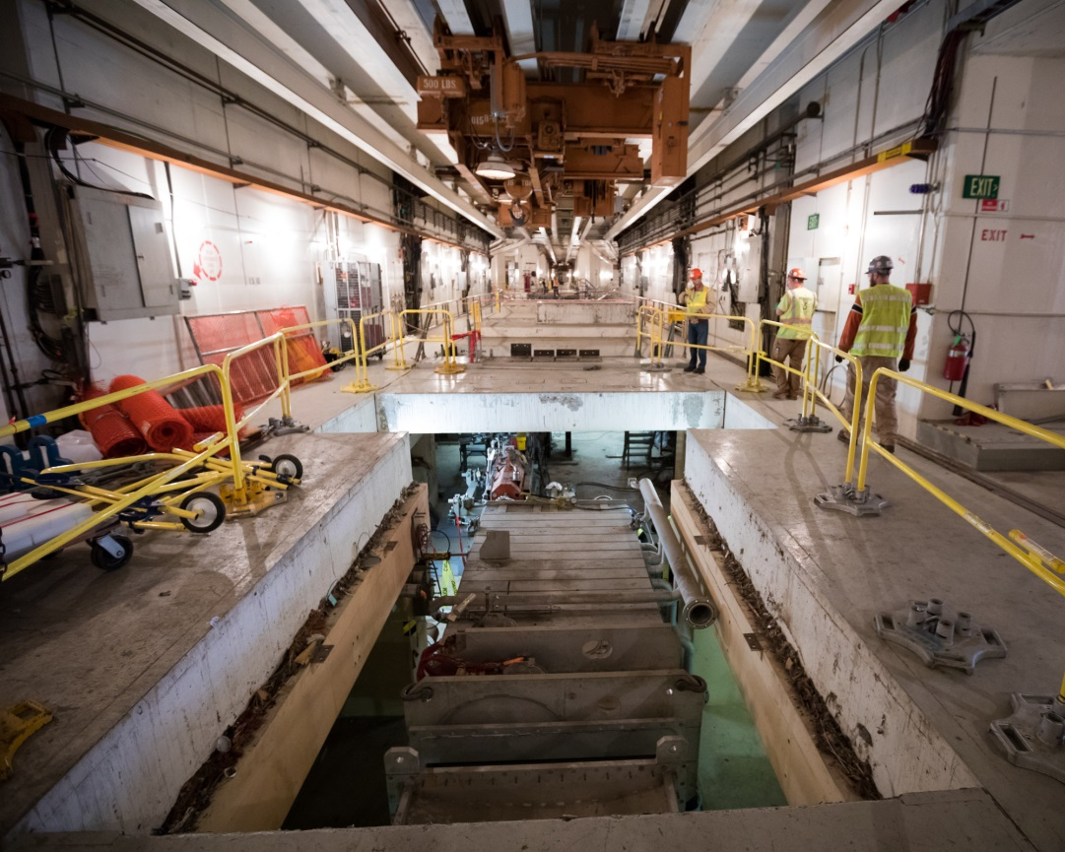
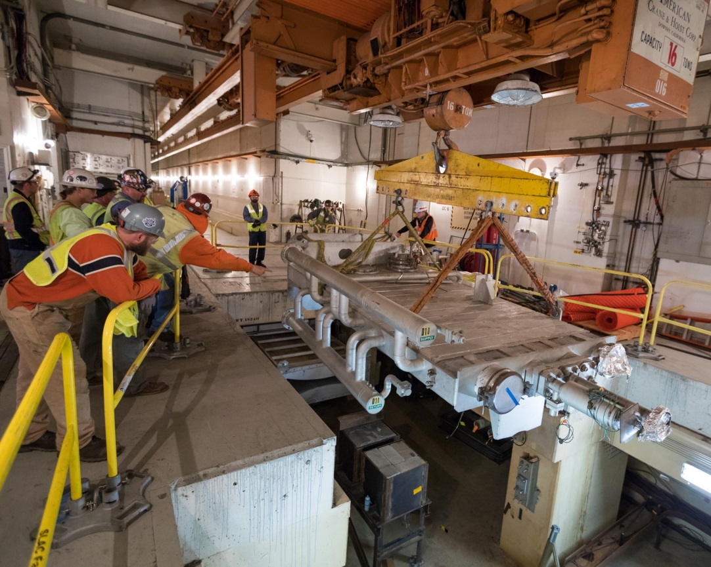
BSY: D-10 dump removal

Slide 27
Beam dump east yard clean-up
Drawing from all disciplines: IH, Field Safety, EP, Hazardous Waste and Radiation Protection
Opportunity to dispose of some of the radioactive waste within the ongoing campaigns (S0-10 and BSY)
The area will be returned to the AD
Next phases (FY18) to include tank removal and radioactive waste disposal

