Slide 1
Disciplined Operations at LANL’s Dual Axis Radiographic Hydrodynamic Test (DARHT) Facility
Terry Priestley
August 2017

Slide 2
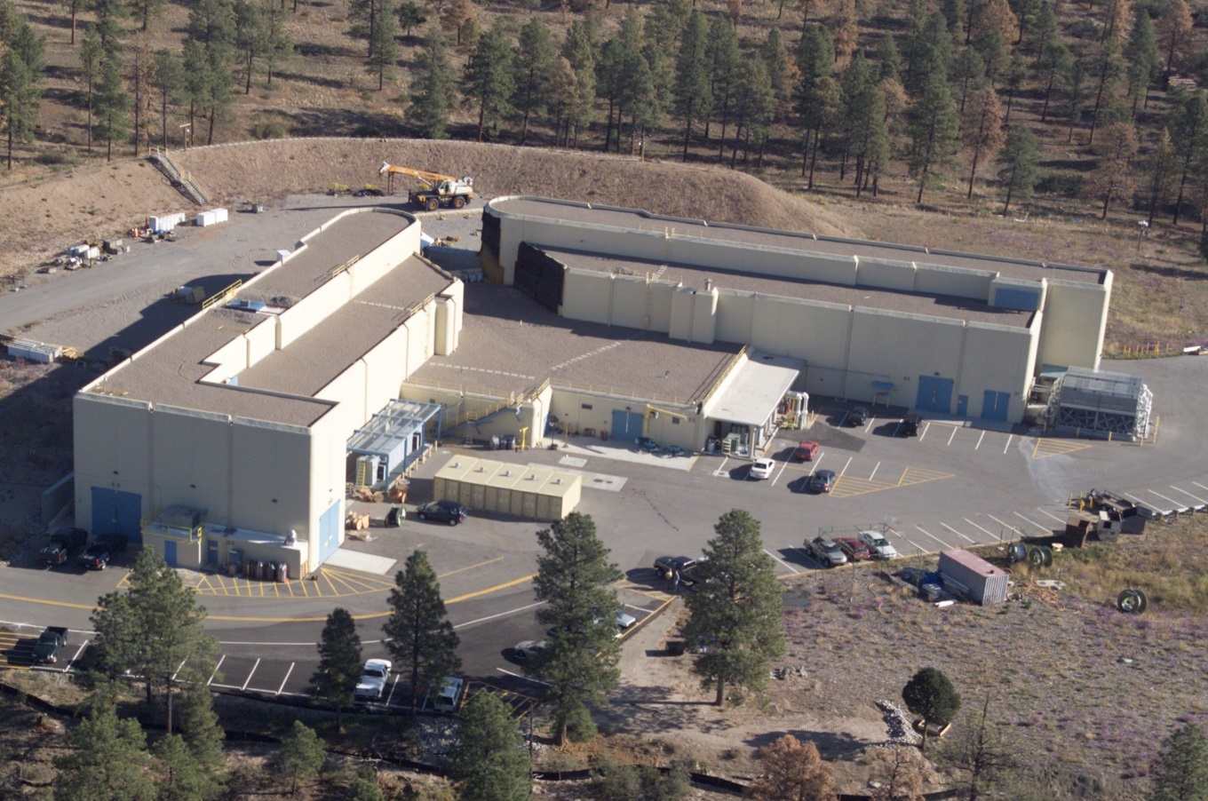
DARHT consists of 2 linear induction accelerators oriented at right angles to each other. Each electron beam is focused onto a heavy metal target that converts the beam’s kinetic energy into x-rays.
Multiple x-ray pulses produce multiple view radiographic images of a full-scale non-nuclear weapon mockup as it implodes.

Slide 4
Hazards, Risks and Concerns
High Voltages
Ionizing Radiation
Lasers
High Explosives
Weather
Physical Security
Cyber Security
Data Management
Accelerators
Experimental
Standard Industrial Hazards
Remote Location
Security Clearances
Visiting Experimentalists
Physicists
One Opportunity for Data Collection
18-24 months
~$5,000,000

Slide 5
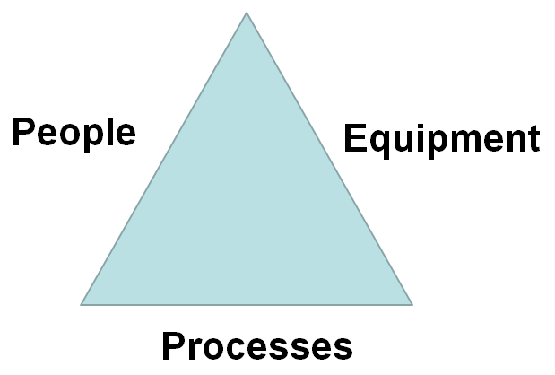
Disciplined Operations
Leadership

Slide 6
People
Staffing levels
Defined roles, responsibilities, authorities and accountability
Formal Qualification Program
Continuing training
Strong safety culture
Succession planning
Opportunities for growth
Cross-organizational relationships

Slide 7
Processes
Effective
Compliant
Formal and informal processes
Graded to match risks and resources
Built-in flexibility, as appropriate
Effective change control process
Integrated schedule
Data-driven issues management

Slide 8
Equipment
Configuration Management
Formal Maintenance Management Program
Predictive
Preventive
Corrective
Obsolescence
Effective and prioritized modifications and upgrades
Critical spare parts

Slide 9
Results
High-Quality Data
Safe Working Environment
Predictable Operations
Time for Fundamental Research and Development
Customer Confidence

