Slide 1
Some Photos and Messages
To Slava Derbenev

Slide 2
CASA Site Derbenev CV
Staff Senior Scientist, JLab, 2001-present
Visiting Research Scientist and Adjunct Professor, Physics Dept., University of Michigan, 1990 – 2001
Chief Scientist, Accelerator Physics and Laser Technology Group, Institute of Complete Electric Drive, Novosibirsk, Russia, 1986-1990
Chief Scientist, Institute of Physics, Atomic Energy Committee, Yerevan, USSR, 1985-1986
Chief Scientist, Accelerator Theory Group, Institute of Nuclear Physics, Novosibirsk, Russia, 1979-1985
Chief Scientist, Institute of Nuclear Physics, Novosibirsk, Russia, 1969-1978
Junior Scientist, Theoretical laboratory of the Institute of Nuclear Physics, Novosibirsk,Russia, 1963-1968
MS, Moscow State University, 1963

Slide 3
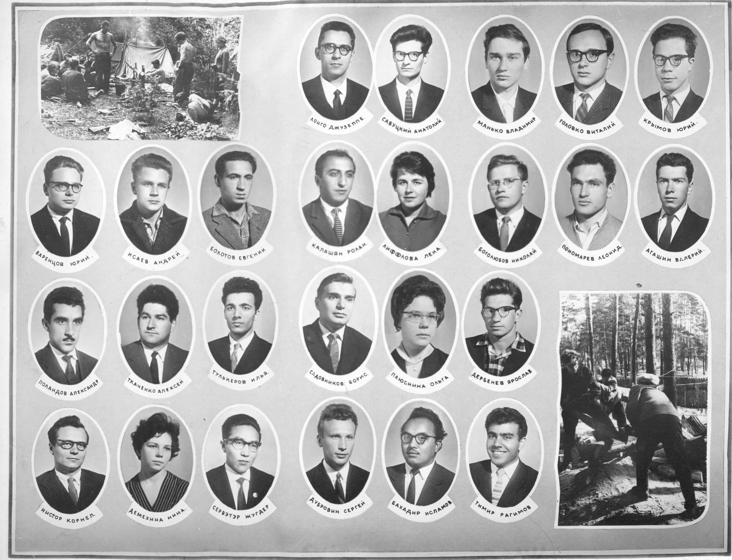

Slide 4
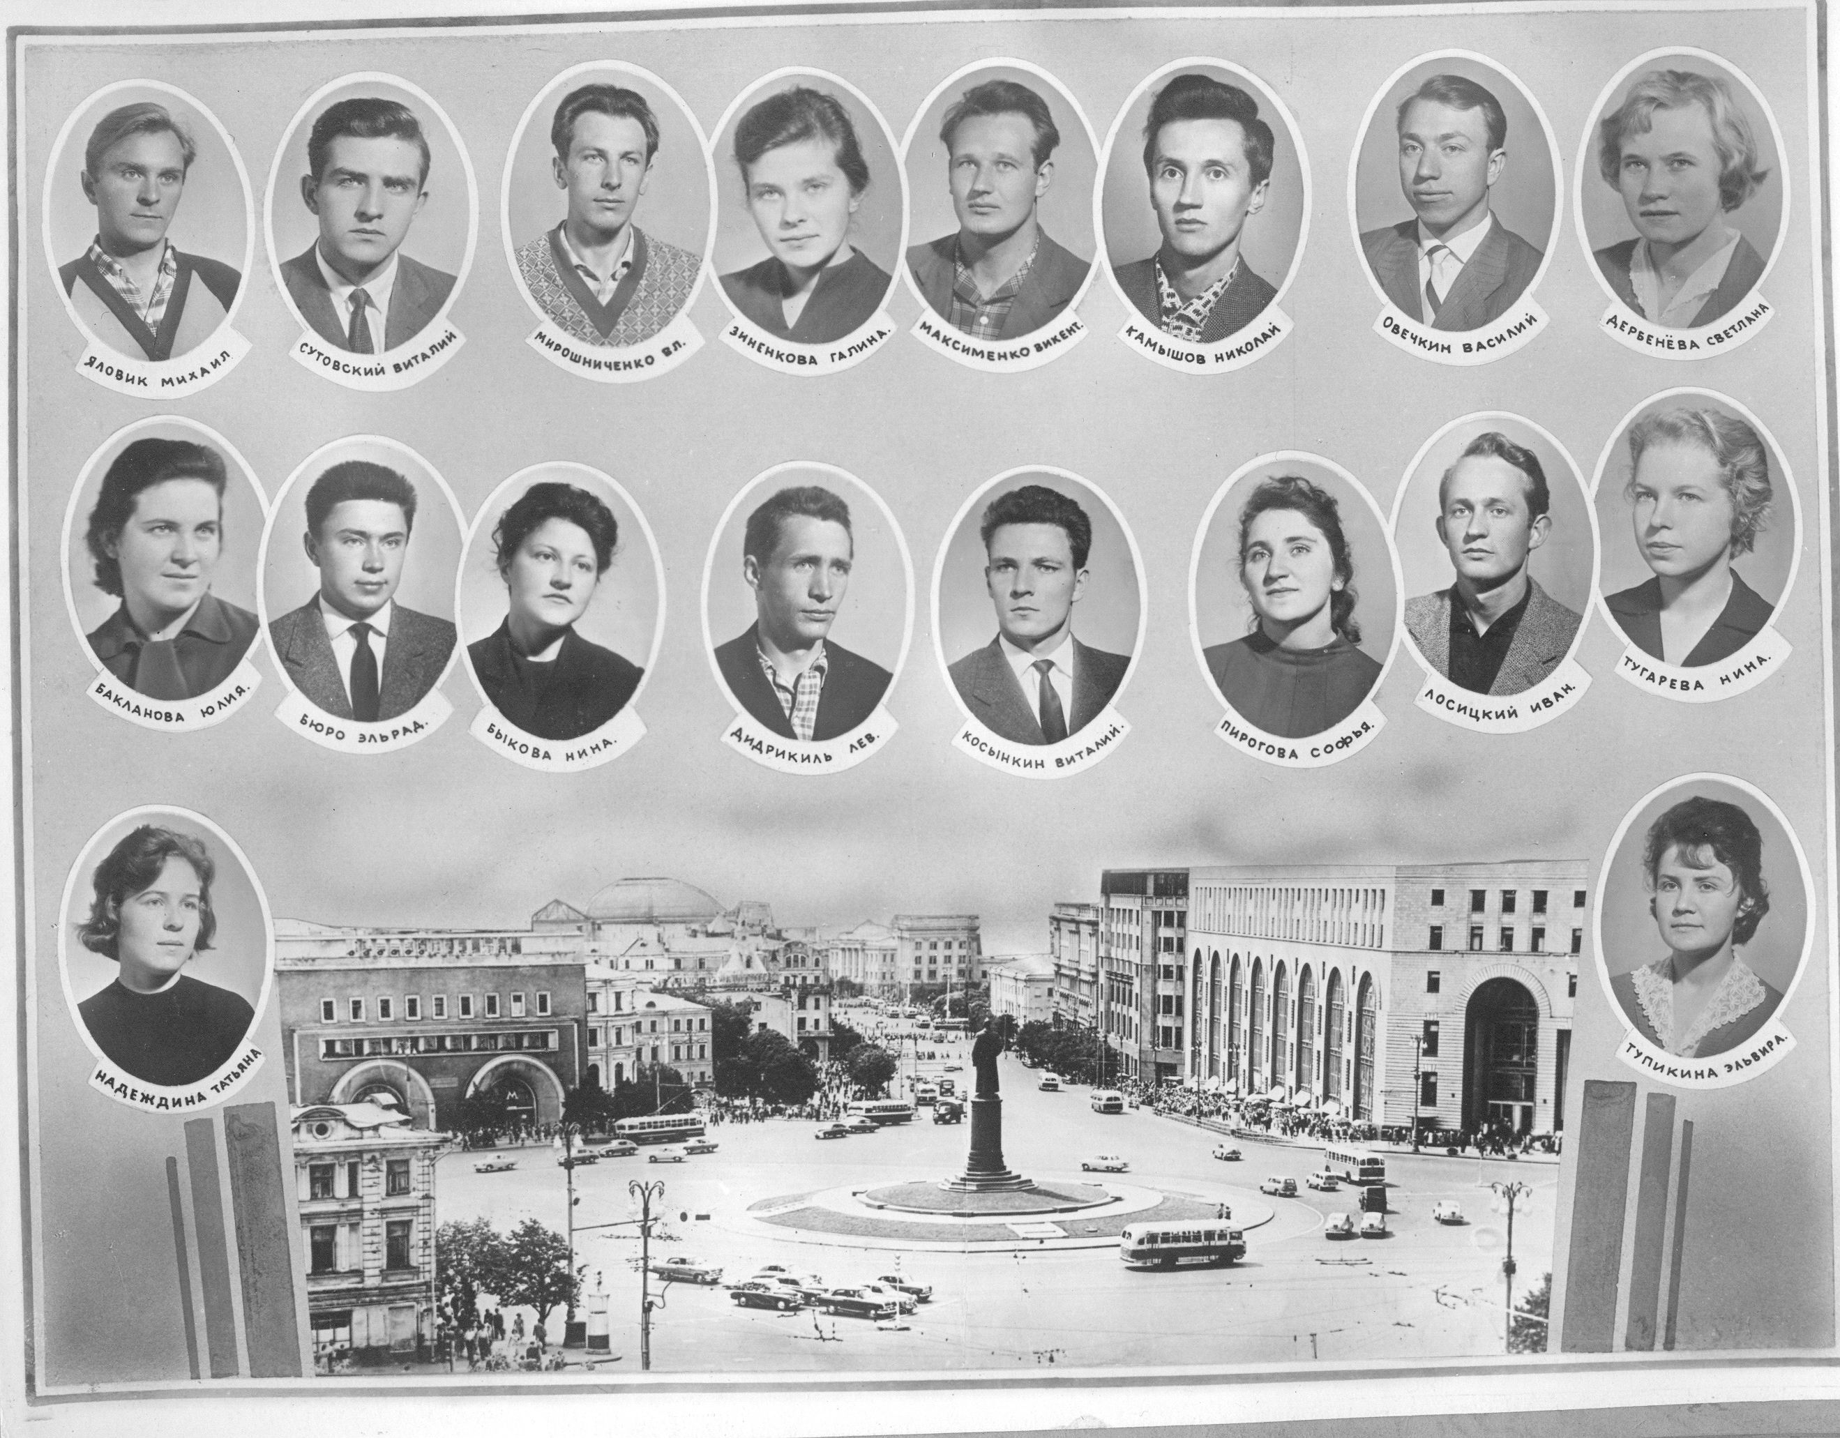

Slide 6
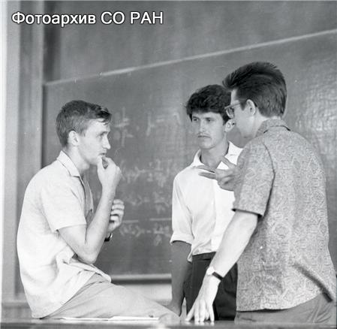

Slide 7
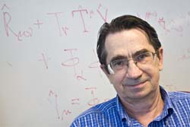

Slide 8
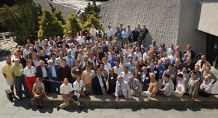
Spin2002 Conference

Slide 9
On Ya.Derbenev’s 70-year celebration
July 15, 2010
It is my pleasure and privilege to write few words to honor Ya. Derbenev in
his 70-year celebration.
It is difficult for me to believe, but I met Derbenev (Slava, the diminutive
of his first name means, unsurprisingly, GLORY in Russian) in 1963, about
50 years ago. That took place in Budker’s Institute of Nuclear Physics, in
Akademgorodok of the Siberian Branch of Academy of Sciences. We were all
very young that time: Akademgorodok had been founded only few years before
and was under construction, most of the present Institute did not yet exist,
we were all fresh from college, and our bosses were not much older. It was a
wonderful time: Russia revived after Stalin and we felt in charge of our future,
the future of the Institute, and the country. The Institute provided us with a
level of academic freedom that was incredible, even for western scientists. We
did not have to worry about grants, we were free to choose the subject of our
research, and there were no constraints on how we spent our time. We were safe
behind Budker’s broad shoulders to think and to talk about everything. We
were all good friends and equal and together.

Slide 10
Such freedom was, actually, very challenging. Many could not work productively without external control. But those who were really dedicated to science
thrived. It is little wonder that the Institute produced so many famous results
and world renown scientists, Slava included. I shared an office with Slava while
he worked on collective instabilities in accelerators. I did not realize at that
time which of the two of us developed real science and looked on as many new
results, which made Slava famous, emerged before my eyes. There is no need
to mention all of them, his results are well known in the accelerator community
around the world.
Then time changed, the Russian thaw was over, and dark cloud were hanging over the country. That was difficult for all of us. I moved west. Slava remained
but, unlike some of my colleges, took my move easy and with understanding.
However, later, with the Russian collapse, turmoil took its toll on everybody.
That was a challenging and difficult time. For a while, Slava was taken over
by the dark under-currents of pseudo-patriots. To his merit, it did not take
long time for him to understand that that was a wrong move, and, to my
knowledge, he has sincerely regretted his mistake since. He moved west into
clean waters of science and worked successfully, first, in Germany and then
in US. His contribution to science is honored today. I join the celebration to
congratulate Slava and to wish him good health and new achievements in many
years to come.
Samuel Heifets

Slide 11
In 1965, on my first visit to Novosibirsk, I was overwhelmed by the discovery that Akademgorodok was a very formidable reservoir of talent. And in particular it became clear to me - in spite of language difficulty - that Yaroslav Derbenev was one man who really understood nonlinear dynamics.
A few years later Alan Krisch began a series of (at least) biennial meetings on polarized beams. One of the major difficulties with polarized beams was - and is - that there are many depolarizing resonances, so that accelerating beams to high energy without losing polarization is at best difficult. But at one of these meetings - in 1977, I think - I came across a preprint from Novosbirsk, by Derbenev, Kondratenko and Skrinsky pointing out that by with alternating horizontal and vertical deflecting magnets the spin resonances could be canceled, making it feasible, at least in principle, to accelerate protons to high energy without depolarization. The drawback was that the orbits had to be distorted in a sinuous manner; the English version of the preprint (of which I now can't find a copy) used the word "snake", and therefore I coined the term "Siberian Snake", which has stuck.
Alan Krisch had the good sense to invite Slava to Ann Arbor, where he spent many years working with the Michigan spin physics group. My wife, Sara, and I also spent time there, and several times we found ourselves living in the same apartment building with Slava and Svetlana. Svetlana and Sara enjoyed each other on many walks together around Ann Arbor and talked about the idiosyncrasies of the English language and many other issues
Sorry I can't join the symposium in person - I'm off on a quick trip to Europe. But let me wish Slava, a youngster of 70, many more happy years!
Ernest Courant

Slide 12
Dear Slava,
On this great occasion, I wish to send my very best wishes to you and Svetlana. Regrettably, I would not be able to join you today but I feel the happiness for you.
Over the years, I have enjoyed your presence, first through your profound and amazingly creative physics, and then through your warm friendship. I want to thank you for allowing me the privilege.
Let me make one more comment on your physics. One can perhaps give a long list of topics that you have made significant contributions to. But I want to say that I consider you a physicist who can treat any physics topic with deep insight and creativity, and such a list of topics will be too limiting for you. You are at a different level from my point of view.
Happy birthday, Slava!
Alex [Chao]

Slide 13
Slava,
Many any years of excellent ideas behind you. Thanks for being the godfather of JLab's EIC, and may you add many new ideas still. Congratulations with your 70th birthday.
Rolf Ent
Dear Slava,
Congratulations for your 70th Birthday!
On behalf of the Jefferson Lab users I want to express my gratitude for your contribution to the EIC. Your creativity, innovation and the passion you've displayed in your work over the years is well appreciated.
I wish you many more years of work at Jefferson Lab and the best in your personal life.
Zein-Eddine

Slide 14
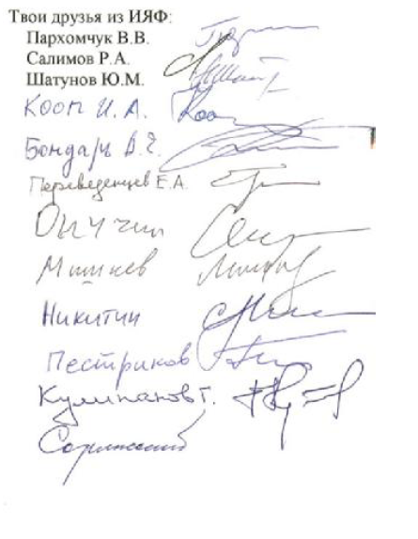
Уважаемый Ярослав Сергеевич!
В дни проведения симпозиума посвященного твоему 70 летию желаем тебе здоровья и
активной научной работы. Ускорительщики ИЯФ помнят твой выдающийся вклад во
многие разделы ускорительной науки: электронное охлаждение, поляризация пучков и
другие. Новые области развития- линейные, мюонные и др. колайдеры ждут новых твоих
идей.

Slide 15
For the minority here, who don’t read Cyrillic!!!!!!
The translation is
DEAR SLAVA, (with your permission)!
In the course of the Symposium devoted to your remarkable 70th Anniversary we wish you the strong health and long active research activity.
All the accelerator physicists of BINP remember your outstanding contribution into many fields of the accelerator science as electron cooling, polarization of beams, etc. New fields of development as the linear, muon and other collider are waiting for your brilliant ideas.
MANY HAPPY RETURNS OF THIS DAY, SLAVA.

